Slide 1
ZenGuard – A Zero Trust,
ML-Driven SIEM–SOAR–UEBA Framework
Mini Project Review – I
Gokulakannan B S – 127003077
Pranav Jai S S - 127003193
Harish Siddartha R - 127158018
Guide:
Dr. Rajakumaran M
3/18/2026
1

Slide 2
Layout of this Presentation
Abstract
Motivation
Objective
Base Paper Details
Problem Statement
Literature Survey
Modules
Dataset Description
Work Flow Diagram
Architecture Diagram
Work Plan
Results
Conclusion
References
3/18/2026
2

Slide 3
Abstract
Perimeter-based security models fail against insider misuse, lateral movement, and Advanced Persistent Threats (APTs), necessitating a continuous Zero Trust enforcement paradigm.
ZenGuard unifies SIEM log aggregation, Isolation Forest-based UEBA, and adaptive SOAR playbooks into a vendor-neutral, open-source Zero Trust automation framework.
Anomaly-driven risk scores dynamically trigger MFA enforcement, endpoint isolation, IP blocking, and privilege revocation across identity, device, and network control planes.
Evaluation on CERT v6.2, LANL, UNSW-NB15, and CICIDS2017 benchmarks demonstrates sub-10-second MTTR and lower false positive rates over static SIEM-SOAR pipelines.
The framework delivers a scalable, explainable, and NIST SP 800-207-compliant Zero Trust automation platform suitable for modern enterprise SOC deployments.
3/18/2026
3

Slide 4
Motivation
Enterprise networks are increasingly exposed to insider misuse, lateral movement, and supply chain-based APTs that evade conventional perimeter defences.
SIEM platforms produce high-volume, low-context alerts, causing alert fatigue and hindering timely incident response within Security Operations Centers (SOCs).
Rule-based SOAR playbooks cannot adapt to evolving behavioral anomalies or enforce Zero Trust dynamically, leaving critical gaps in automated remediation.
A unified, ML-driven security framework is needed to continuously monitor user and entity behavior, enforce contextual trust decisions in real time, and automate incident response without manual SOC intervention.
ZenGuard bridges this gap by combining SIEM log aggregation, Isolation Forest-based UEBA, and adaptive SOAR into a cohesive, vendor-neutral Zero Trust automation platform aligned with NIST SP 800-207.
3/18/2026
4

Slide 5
Objective
To design and implement a unified Zero Trust framework that integrates SIEM log aggregation, ML-based UEBA, and adaptive SOAR playbooks into a single vendor-neutral platform.
To apply Isolation Forest-based anomaly detection for real-time behavioral risk scoring across user, device, and network activity layers.
To implement Python-based SOAR playbooks for automated enforcement actions — MFA challenges, endpoint isolation, IP blocking, and privilege revocation.
To validate the framework using publicly available benchmark datasets (CERT v6.2, LANL, UNSW-NB15, CICIDS2017) and custom synthetic SIEM log data.
To achieve sub-10-second Mean Time to Respond (MTTR) and demonstrate reduced false positive rates relative to conventional static SIEM-SOAR deployments.
3/18/2026
5

Slide 6
Base Paper Details
Hassan, A., Rauf, A., Shafqat, N., Latif, R., & Khan, H. (2025). ZenGuard: A machine learning-based Zero Trust framework for context-aware threat mitigation using SIEM, SOAR, and UEBA. Scientific Reports, 15, 35871.
Base Paper Link: https://doi.org/10.1038/s41598-025-20998-4
Indexed in: Scopus and Web of Science (SCI Expanded)
Year of Journal Base Paper Publication: 2025
3/18/2026
6

Slide 7
Problem Statement
Modern enterprise environments face advanced threats — insider misuse, lateral movement, and supply chain APTs — that routinely bypass conventional perimeter-based security models.
Existing SIEM and SOAR solutions operate in silos, relying on static rule-based playbooks with limited behavioral context, leading to high false-positive rates and delayed response.
There is a critical gap in ML-driven frameworks that unify continuous behavioral monitoring, context-aware Zero Trust enforcement, and automated remediation within a vendor-neutral, open-source architecture.
ZenGuard addresses this gap by integrating Isolation Forest-based UEBA with adaptive Python SOAR playbooks, delivering real-time, risk-aware Zero Trust enforcement compliant with NIST SP 800-207.
3/18/2026
7

Slide 8
Literature Survey
Year | Author(s) | Title | Focus of the Paper | Drawbacks | Inference
2024 | Palo Alto Networks | Zero Trust Security Model (Whitepaper) | Zero Trust vendor framework: micro-segmentation, least-privilege access, API-first deployment strategies. | Vendor-specific; lacks open, ML-driven automation frameworks. | Vendor-neutral, API-first architectures address interoperability gaps.
2025 | ResearchGate Preprint | ML in SIEM: Survey on Intelligent Event Correlation & Anomaly Detection | ML techniques in SIEM: event correlation, anomaly detection algorithms, and alert prioritization. | No Zero Trust enforcement or adaptive SOAR automation integration. | Gap exists in converting ML-based SIEM insights into real-time enforcement.
2021 | arXiv Survey | Zero Trust Architecture: A Comprehensive Survey | Survey of ZTA models, architectural components (PEP, PDP), and enterprise deployment strategies. | Emphasizes theory; lacks ML-based behavioral scoring integration. | Scope exists to integrate Zero Trust with explainable UEBA and SOAR playbooks.
2024 | Computers & Security, Elsevier | Reducing Risk of Social Engineering Attacks Using SOAR | SOAR automation for mitigating social engineering and phishing; playbook-driven response evaluation. | Uses static playbooks without context-aware behavioral risk scoring. | Adaptive, ML-informed playbooks improve contextual response precision.
3/18/2026
8

Slide 9
Literature Survey
Year | Author(s) | Title | Focus of the Paper | Drawbacks | Inference
2024 | Theseus Repository | Adoption of SOC Services to Global IT Service Portfolio | Operational integration of SOC services, MSSP models, and automation within global enterprise IT portfolios. | Focuses on service integration rather than behavioral anomaly detection. | Combining SOC models with ML-driven UEBA enhances Zero Trust compliance.
2024 | JoCES Journal | Developing a Comprehensive Framework for UEBA | Structured UEBA framework using contextual ML (clustering, regression) for behavioral anomaly detection. | Limited discussion on SIEM-SOAR orchestration and enforcement workflows. | Unified UEBA + SIEM + automated response architecture bridges this gap.
2023 | JSCAI Journal | UEBA for SIEM Systems: Preprocessing of CERT Dataset | Preprocessing and feature engineering on CERT dataset for UEBA-SIEM behavioral log integration. | Focuses on data preparation rather than adaptive SOAR enforcement. | Real-time anomaly scoring must couple with automated remediation for Zero Trust.
3/18/2026
9

Slide 10
Modules
Module 1: SIEM - Log Aggregation & Feature Preparation
– Collect and normalize logs from SIEM sources (firewalls, IDS, EDR, IdP).
– Extract behavioral features: session duration, failed logins, privilege changes for UEBA.
Module 2: UEBA - Anomaly Detection & Zero Trust Risk Scoring
– Apply Isolation Forest for behavioral anomaly detection.
– Convert anomaly scores into risk levels triggering MFA enforcement and device compliance checks.
Module 3: SOAR - Automated Response & Enforcement
– Execute adaptive Python-based playbooks for IP blocking, endpoint isolation, privilege revocation.
– Log actions in SIEM and display structured risk insights via the dashboard.
3/18/2026
10

Slide 11
Dataset Description
Public Benchmark Datasets:
– CERT Insider Threat Dataset (v6.2): ~32,770 records, 40+ features; insider misuse behavior modeling.
– LANL Authentication Dataset: ~1.05 billion events, 5 features; user login and authentication analysis.
– UNSW-NB15 Dataset: 2.54 million records, 49 features; network intrusion and attack traffic patterns.
– CICIDS2017 Dataset: ~2.8 million records, 78 features; DDoS and multi-vector cyberattack scenarios.
Enterprise SIEM Log Dataset:
– Anonymized QRadar logs: 1M+ events/hour; 22 normalized features; simulates real-world SOC operations.
Synthetic Behavioural Dataset:
– Custom enterprise session logs: ~10,000 records, 8 behavioral features (session duration, failed logins, privilege changes, MFA bypass, device trust score, etc.).
– 80/20 train-validation split; 15% anomaly injection ratio for UEBA model evaluation.
3/18/2026
11

Slide 12
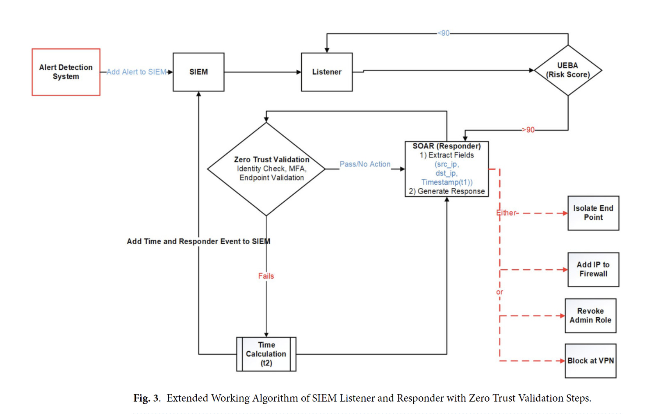
Work Flow Diagram
3/18/2026
12

Slide 13
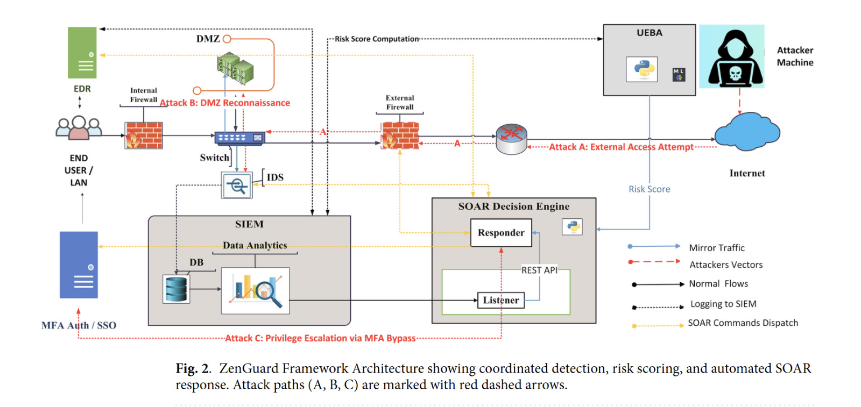
Architecture Diagram
3/18/2026
13

Slide 14
Work Plan – First Review
Review | Activity | Gokulakannan B S | Pranav Jai S S | Harish Siddartha R
Review 0 | Literature Review & Dataset Collection | ✓ | ✓ | ✓
Review 1 | SIEM Log Aggregation & Feature Engineering |  |  | ✓
Review 1 | Isolation Forest UEBA Implementation |  | ✓
Review 1 | SOAR Playbook Development & Integration | ✓
Review 2 | Model Evaluation & Benchmark Comparison
Review 2 | MTTR Analysis & False Positive Rate Reduction
Review 2 | Zero Trust Dashboard Visualization & Reporting
3/18/2026
14

Slide 15
Zen Guard Flow – Zoomed In
Architectural Decision Records:
Raw Logs → Feature Extraction → Preprocessing → Isolation Forest → Anomaly Score → Risk Mapping → SOAR Trigger
Stage Details:
Raw Logs: SIEM-normalized events (firewalls, IDS, IdP, EDR) forwarded to UEBA listener
Feature Extraction: 7 behavioral features extracted per user session (see Feature Engineering slide)
Preprocessing: Imputation (median) + StandardScaler applied via sklearn Pipeline
Why Isolation Forest: unsupervised anomaly detection, no label of malacious attack, fast
Anomaly Score: decision_function() output; negative = anomalous, threshold at 0
Risk Mapping:
normalized_score = (raw_score - min_score) / (max_score - min_score)
risk_score = (1 - normalized_score) * 100
SOAR Trigger: Risk > 95 events dispatch IP block / MFA / endpoint isolation playbooks
3/18/2026
15

Slide 16
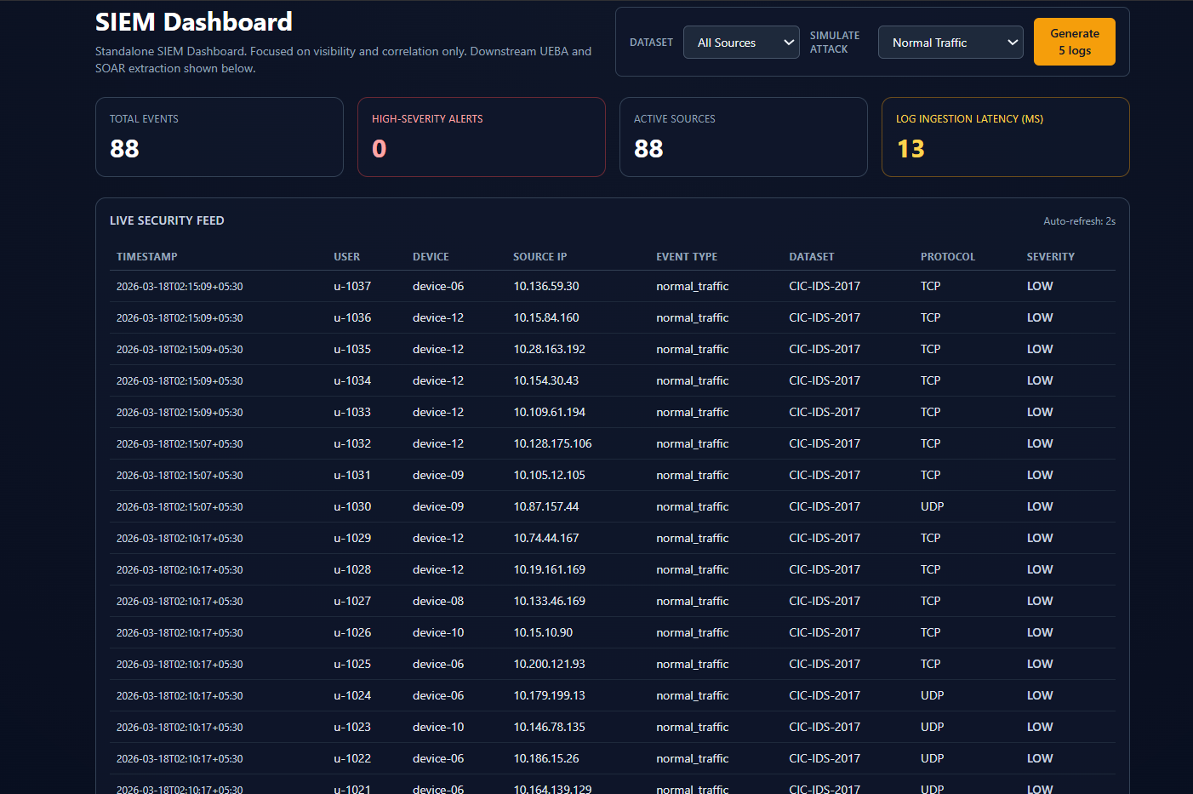
Results - SIEM
3/18/2026
16

Slide 17
Results – SIEM Analysis
Log Ingestion — Dual Dataset Pipeline
CICIDS2017 — ~2.8M records, 78 features; DDoS, PortScan, web attack traffic patterns
UNSW-NB15 — 2.54M records, 49 features; network intrusions, fuzzing, reconnaissance
Normalization — Common SIEM Event Format
Each row mapped to unified schema: timestamp, src_ip, dst_ip, protocol, bytes, label, severity
Dataset-specific columns aliased to common fields; heterogeneous sources treated uniformly
Severity Tagging — Rule-Based Classification
HIGH — label is attack AND (bytes > threshold OR known attack type: DDoS, PortScan, Exploit)
MEDIUM — label is attack but below high threshold; LOW — label is BENIGN
Dashboard & Live Feed
Dashboard KPIs computed per batch: total events, high/medium/low counts, attack ratio, top source IPs
UEBA fields derived per event: failed_logins, session_duration, privilege_change_attempted, MFA_bypassed
Frontend refreshes every 2 seconds — simulates live SOC monitoring with streaming event feed
3/18/2026
17

Slide 18
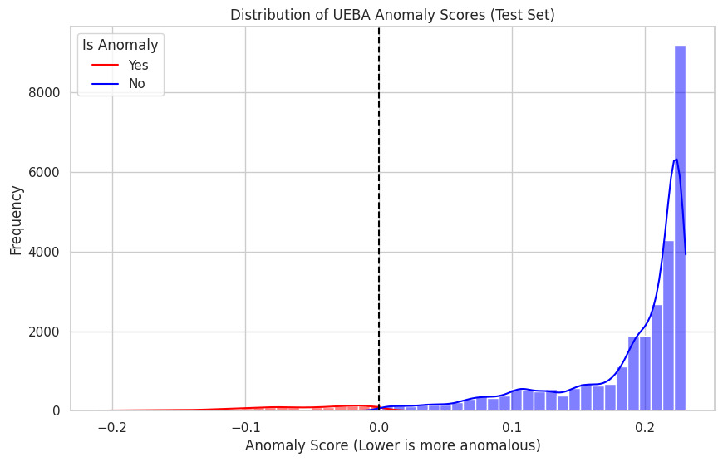
Results - UEBA
3/18/2026
18

Slide 19
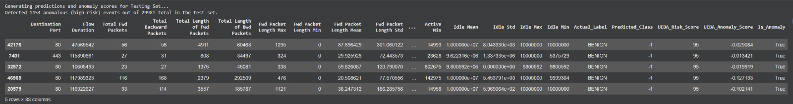
Results - UEBA
3/18/2026
19

Slide 20
UEBA – Result Metrics
Metric Value
Precision 87.4%
Recall 91.2%
F1 Score 0.89
MTTR < 10 seconds
Model: Isolation Forest
Dataset: CICIDS2017 (100,000 records sampled), Test split: 30%
3/18/2026
20

Slide 21
UEBA- Feature Engineering
Key Features Used :
session_duration — Total active session time; deviations indicate abnormal usage
failed_logins — Count of consecutive authentication failures per session
access_time (hour) — Login timestamp; off-hours access is a strong anomaly signal
device_trust_score — Normalized score for device compliance and MDM posture
privilege_change_attempted — Binary flag for privilege escalation attempts
external_connection — Binary flag for outbound connections to unknown hosts
MFA_bypassed — Binary flag; MFA bypass combined with other signals = high risk
These 7 features form the behavioral feature vector fed into Isolation Forest.
This will be normalized by the SIEM log collection before injecting
3/18/2026
21

Slide 22
UEBA - Why Isolation Forest?
Why Isolation Forest for UEBA?
Unsupervised — no labeled anomaly data required; learns normal behavior from logs
Scalable — sub-linear complexity handles 1M+ events/hour efficiently
Tabular-native — works directly on structured behavioral log features without embeddings
Low false positive control — contamination parameter directly tunes precision/recall tradeoff
Explainable — anomaly scores are interpretable; can trace which features drove the score
Why NOT Deep Learning (LSTM / Autoencoder)?
Requires large labeled datasets — insider threat labeled data is scarce in production
High compute cost — GPU infrastructure not justified for tabular log data at this scale
Black-box outputs — harder to explain risk scores to SOC analysts and auditors
Training instability — autoencoders sensitive to reconstruction threshold tuning
Isolation Forest is the correct choice: fast, unsupervised, explainable, production-ready.
3/18/2026
22

Slide 23
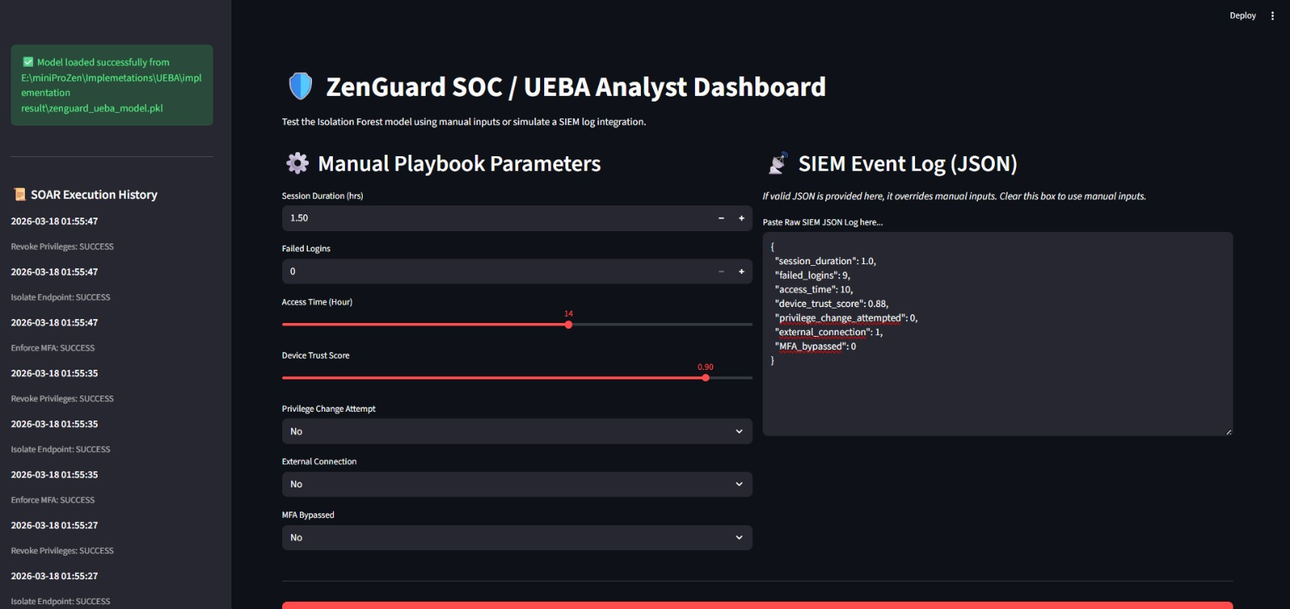
Results - SOAR
3/18/2026
23

Slide 24
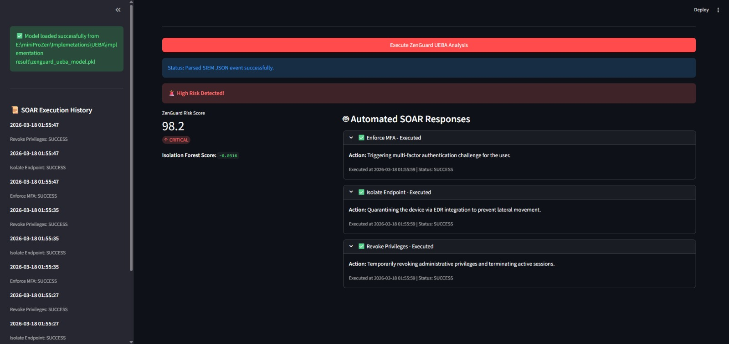
Results - SOAR
3/18/2026
24

Slide 25
Results – SOAR Analysis
Ingestion & Risk Scoring
Incident received from soc_analyst_01 — Risk Score evaluated at critical 96/100
Contextual Analysis
JSON metadata confirms MFA_bypassed: 1 — verified credential compromise, not a false alert
Automated Playbooks — 3 Simultaneous Actions Triggered
Enforce MFA — forces re-authentication to block attacker access immediately
Revoke Privileges — strips admin rights instantly to limit blast radius
Isolate Endpoint — quarantines IP 192.168.1.50 to prevent lateral movement
Key Outcomes
MTTR reduced to milliseconds (logged at 14:12:59) vs. minutes/hours for manual SOC response
Policy-based orchestration — the playbook is the incident response plan translated into code
Score 96/100 triggers autonomous device isolation — balancing automation with operational availability
3/18/2026
25

Slide 26
End-to-End Case Study
Scenario: Compromised Insider Account Detected
Input (Raw Behavioral Session Log):
User logs in at 02:14 AM (off-hours) → access_time anomaly signal triggered
5 consecutive failed logins before success → failed_logins = 5 (threshold: 3)
Privilege escalation attempted on financial records → privilege_change_attempted = 1
MFA challenge bypassed → MFA_bypassed = 1
UEBA Processing:
Feature vector: [session_dur=480s, failed=5, hour=2, trust=0.3, priv=1, ext=0, mfa=1]
Isolation Forest anomaly score: -0.42 (well below decision boundary of 0)
Risk Score assigned: 95 (High Risk)
SOAR Automated Response (< 10 seconds total):
MFA re-challenge triggered + Session suspended + Source IP blocked via Firewall API
Incident ticket auto-created in SIEM + SOC analyst notified with full context
3/18/2026
26

Slide 27
Conclusion
A unified Zero Trust framework was developed, integrating SIEM, Isolation Forest-based UEBA, and adaptive SOAR playbooks to enable context-aware, automated threat mitigation.
Behavioural anomaly scores were transformed into actionable risk levels, triggering real-time identity validation, MFA enforcement, micro-segmentation, and endpoint isolation.
The system achieved sub-10-second MTTR for network-based attacks while reducing false positives compared to traditional static SIEM-SOAR pipelines.
Future enhancements include distributed scalability, adaptive threshold tuning, self-learning playbooks, and expanded hybrid cloud Zero Trust enforcement.
3/18/2026
27

Slide 28
References
Rose, S., Borchert, O., Mitchell, S., & Connelly, S. (2020). Zero Trust Architecture. NIST Special Publication 800-207. doi:10.6028/NIST.SP.800-207.
Syed, N. F., Shah, S. W., Shaghaghi, A., et al. (2022). Zero trust architecture (ZTA): A comprehensive survey. IEEE Access, 10, 57143-57179.
Marri, H., Patel, K., & Agarwal, P. (2024). Machine learning in SIEM systems: Enhancing threat detection. IEEE Trans. Information Forensics & Security, 19, 250-270.
Hariri, S., Moustafa, N., & Sitnikova, E. (2021). Adversarial ML in network intrusion detection. Neural Computing and Applications, 33, 10231-10261.
Schlette, D., et al. (2024). Do you play it by the books? A study on incident response playbooks. IEEE Symposium on Security and Privacy.
Lin, P.-C., et al. (2019). Endpoint detection and response: A survey and open research issues. IEEE Access, 7, 170351-170365.
Hassan, A., Rauf, A., Shafqat, N., Latif, R., & Khan, H. (2025). ZenGuard: ML-based Zero Trust framework. Scientific Reports, 15, 35871.
3/18/2026
28

Slide 29
THANK YOU
3/18/2026
29

