Slide 1
ZenGuard – A Zero Trust,
ML-Driven SIEM–SOAR–UEBA Framework
Mini Project Review – I
Gokulakannan B S – 127003077
Pranav Jai S S - 127003193
Harish Siddartha R - 127158018
Guide:
Dr. Rajakumaran M
3/18/2026
1

Slide 2
Layout of this Presentation
Abstract
Motivation
Objective
Base Paper Details
Problem Statement
Literature Survey
Modules
Dataset Description
Work Flow Diagram
Architecture Diagram
Work Plan
Results
Conclusion
References
3/18/2026
2

Slide 3
Abstract
Perimeter-based security models fail against insider misuse, lateral movement, and Advanced Persistent Threats (APTs), necessitating a continuous Zero Trust enforcement paradigm.
ZenGuard unifies SIEM log aggregation, Isolation Forest-based UEBA, and adaptive SOAR playbooks into a vendor-neutral, open-source Zero Trust automation framework.
Anomaly-driven risk scores dynamically trigger MFA enforcement, endpoint isolation, IP blocking, and privilege revocation across identity, device, and network control planes.
Evaluation on CERT v6.2, LANL, UNSW-NB15, and CICIDS2017 benchmarks demonstrates sub-10-second MTTR and lower false positive rates over static SIEM-SOAR pipelines.
The framework delivers a scalable, explainable, and NIST SP 800-207-compliant Zero Trust automation platform suitable for modern enterprise SOC deployments.
3/18/2026
3

Slide 4
Motivation
Enterprise networks are increasingly exposed to insider misuse, lateral movement, and supply chain-based APTs that evade conventional perimeter defences.
SIEM platforms produce high-volume, low-context alerts, causing alert fatigue and hindering timely incident response within Security Operations Centers (SOCs).
Rule-based SOAR playbooks cannot adapt to evolving behavioral anomalies or enforce Zero Trust dynamically, leaving critical gaps in automated remediation.
A unified, ML-driven security framework is needed to continuously monitor user and entity behavior, enforce contextual trust decisions in real time, and automate incident response without manual SOC intervention.
ZenGuard bridges this gap by combining SIEM log aggregation, Isolation Forest-based UEBA, and adaptive SOAR into a cohesive, vendor-neutral Zero Trust automation platform aligned with NIST SP 800-207.
3/18/2026
4

Slide 5
Objective
To design and implement a unified Zero Trust framework that integrates SIEM log aggregation, ML-based UEBA, and adaptive SOAR playbooks into a single vendor-neutral platform.
To apply Isolation Forest-based anomaly detection for real-time behavioral risk scoring across user, device, and network activity layers.
To implement Python-based SOAR playbooks for automated enforcement actions — MFA challenges, endpoint isolation, IP blocking, and privilege revocation.
To validate the framework using publicly available benchmark datasets (CERT v6.2, LANL, UNSW-NB15, CICIDS2017) and custom synthetic SIEM log data.
To achieve sub-10-second Mean Time to Respond (MTTR) and demonstrate reduced false positive rates relative to conventional static SIEM-SOAR deployments.
3/18/2026
5

Slide 6
Base Paper Details
Hassan, A., Rauf, A., Shafqat, N., Latif, R., & Khan, H. (2025). ZenGuard: A machine learning-based Zero Trust framework for context-aware threat mitigation using SIEM, SOAR, and UEBA. Scientific Reports, 15, 35871.
Base Paper Link: https://doi.org/10.1038/s41598-025-20998-4
Indexed in: Scopus and Web of Science (SCI Expanded)
Year of Journal Base Paper Publication: 2025
3/18/2026
6

Slide 7
Problem Statement
Modern enterprise environments face advanced threats — insider misuse, lateral movement, and supply chain APTs — that routinely bypass conventional perimeter-based security models.
Existing SIEM and SOAR solutions operate in silos, relying on static rule-based playbooks with limited behavioral context, leading to high false-positive rates and delayed response.
There is a critical gap in ML-driven frameworks that unify continuous behavioral monitoring, context-aware Zero Trust enforcement, and automated remediation within a vendor-neutral, open-source architecture.
ZenGuard addresses this gap by integrating Isolation Forest-based UEBA with adaptive Python SOAR playbooks, delivering real-time, risk-aware Zero Trust enforcement compliant with NIST SP 800-207.
3/18/2026
7

Slide 8
Literature Survey
Year | Author(s) | Title | Focus of the Paper | Drawbacks | Inference
2024 | Palo Alto Networks | Zero Trust Security Model (Whitepaper) | Zero Trust vendor framework: micro-segmentation, least-privilege access, API-first deployment strategies. | Vendor-specific; lacks open, ML-driven automation frameworks. | Vendor-neutral, API-first architectures address interoperability gaps.
2025 | ResearchGate Preprint | ML in SIEM: Survey on Intelligent Event Correlation & Anomaly Detection | ML techniques in SIEM: event correlation, anomaly detection algorithms, and alert prioritization. | No Zero Trust enforcement or adaptive SOAR automation integration. | Gap exists in converting ML-based SIEM insights into real-time enforcement.
2021 | arXiv Survey | Zero Trust Architecture: A Comprehensive Survey | Survey of ZTA models, architectural components (PEP, PDP), and enterprise deployment strategies. | Emphasizes theory; lacks ML-based behavioral scoring integration. | Scope exists to integrate Zero Trust with explainable UEBA and SOAR playbooks.
2024 | Computers & Security, Elsevier | Reducing Risk of Social Engineering Attacks Using SOAR | SOAR automation for mitigating social engineering and phishing; playbook-driven response evaluation. | Uses static playbooks without context-aware behavioral risk scoring. | Adaptive, ML-informed playbooks improve contextual response precision.
3/18/2026
8

Slide 9
Literature Survey
Year | Author(s) | Title | Focus of the Paper | Drawbacks | Inference
2024 | Theseus Repository | Adoption of SOC Services to Global IT Service Portfolio | Operational integration of SOC services, MSSP models, and automation within global enterprise IT portfolios. | Focuses on service integration rather than behavioral anomaly detection. | Combining SOC models with ML-driven UEBA enhances Zero Trust compliance.
2024 | JoCES Journal | Developing a Comprehensive Framework for UEBA | Structured UEBA framework using contextual ML (clustering, regression) for behavioral anomaly detection. | Limited discussion on SIEM-SOAR orchestration and enforcement workflows. | Unified UEBA + SIEM + automated response architecture bridges this gap.
2023 | JSCAI Journal | UEBA for SIEM Systems: Preprocessing of CERT Dataset | Preprocessing and feature engineering on CERT dataset for UEBA-SIEM behavioral log integration. | Focuses on data preparation rather than adaptive SOAR enforcement. | Real-time anomaly scoring must couple with automated remediation for Zero Trust.
3/18/2026
9

Slide 10
Modules
Module 1: SIEM - Log Aggregation & Feature Preparation
– Collect and normalize logs from SIEM sources (firewalls, IDS, EDR, IdP).
– Extract behavioral features: session duration, failed logins, privilege changes for UEBA.
Module 2: UEBA - Anomaly Detection & Zero Trust Risk Scoring
– Apply Isolation Forest for behavioral anomaly detection.
– Convert anomaly scores into risk levels triggering MFA enforcement and device compliance checks.
Module 3: SOAR - Automated Response & Enforcement
– Execute adaptive Python-based playbooks for IP blocking, endpoint isolation, privilege revocation.
– Log actions in SIEM and display structured risk insights via the dashboard.
3/18/2026
10

Slide 11
Dataset Description
Public Benchmark Datasets:
– CERT Insider Threat Dataset (v6.2): ~32,770 records, 40+ features; insider misuse behavior modeling.
– LANL Authentication Dataset: ~1.05 billion events, 5 features; user login and authentication analysis.
– UNSW-NB15 Dataset: 2.54 million records, 49 features; network intrusion and attack traffic patterns.
– CICIDS2017 Dataset: ~2.8 million records, 78 features; DDoS and multi-vector cyberattack scenarios.
Enterprise SIEM Log Dataset:
– Anonymized QRadar logs: 1M+ events/hour; 22 normalized features; simulates real-world SOC operations.
Synthetic Behavioural Dataset:
– Custom enterprise session logs: ~10,000 records, 8 behavioral features (session duration, failed logins, privilege changes, MFA bypass, device trust score, etc.).
– 80/20 train-validation split; 15% anomaly injection ratio for UEBA model evaluation.
3/18/2026
11

Slide 12
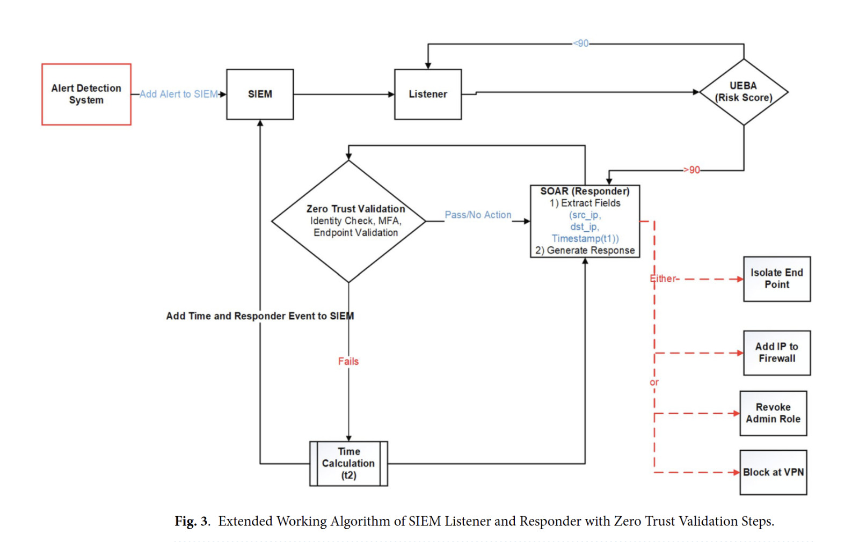
Work Flow Diagram
3/18/2026
12

Slide 13
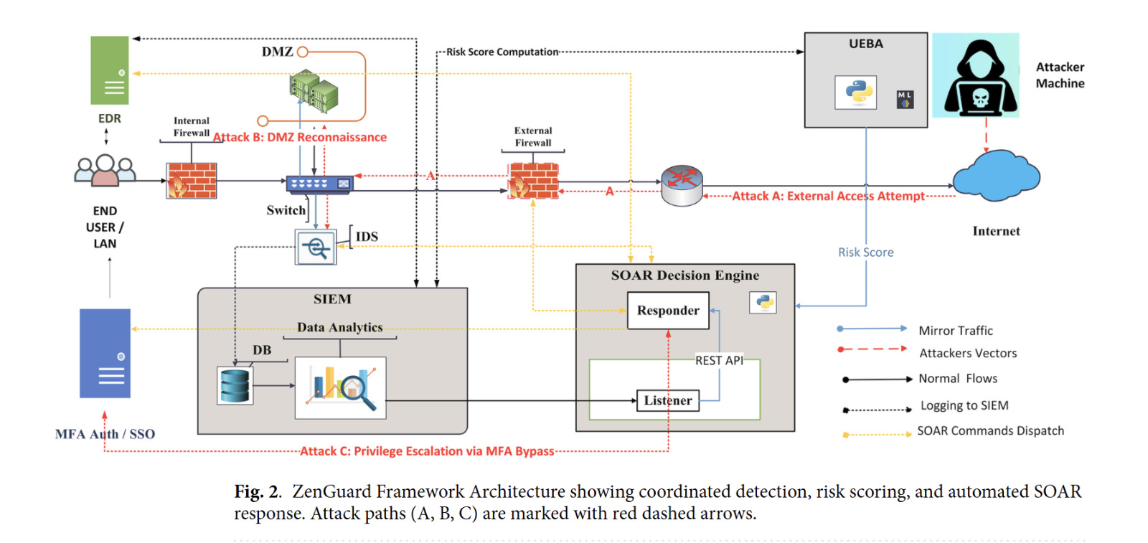
Architecture Diagram
3/18/2026
13

Slide 14
Work Plan – First Review
Review | Activity | Gokulakannan B S | Pranav Jai S S | Harish Siddartha R
Review 0 | Literature Review & Dataset Collection | ✓ | ✓ | ✓
Review 1 | SIEM Log Aggregation & Feature Engineering |  |  | ✓
Review 1 | Isolation Forest UEBA Implementation |  | ✓
Review 1 | SOAR Playbook Development & Integration | ✓
Review 2 | Model Evaluation & Benchmark Comparison
Review 2 | MTTR Analysis & False Positive Rate Reduction
Review 2 | Zero Trust Dashboard Visualization & Reporting
3/18/2026
14

Slide 15
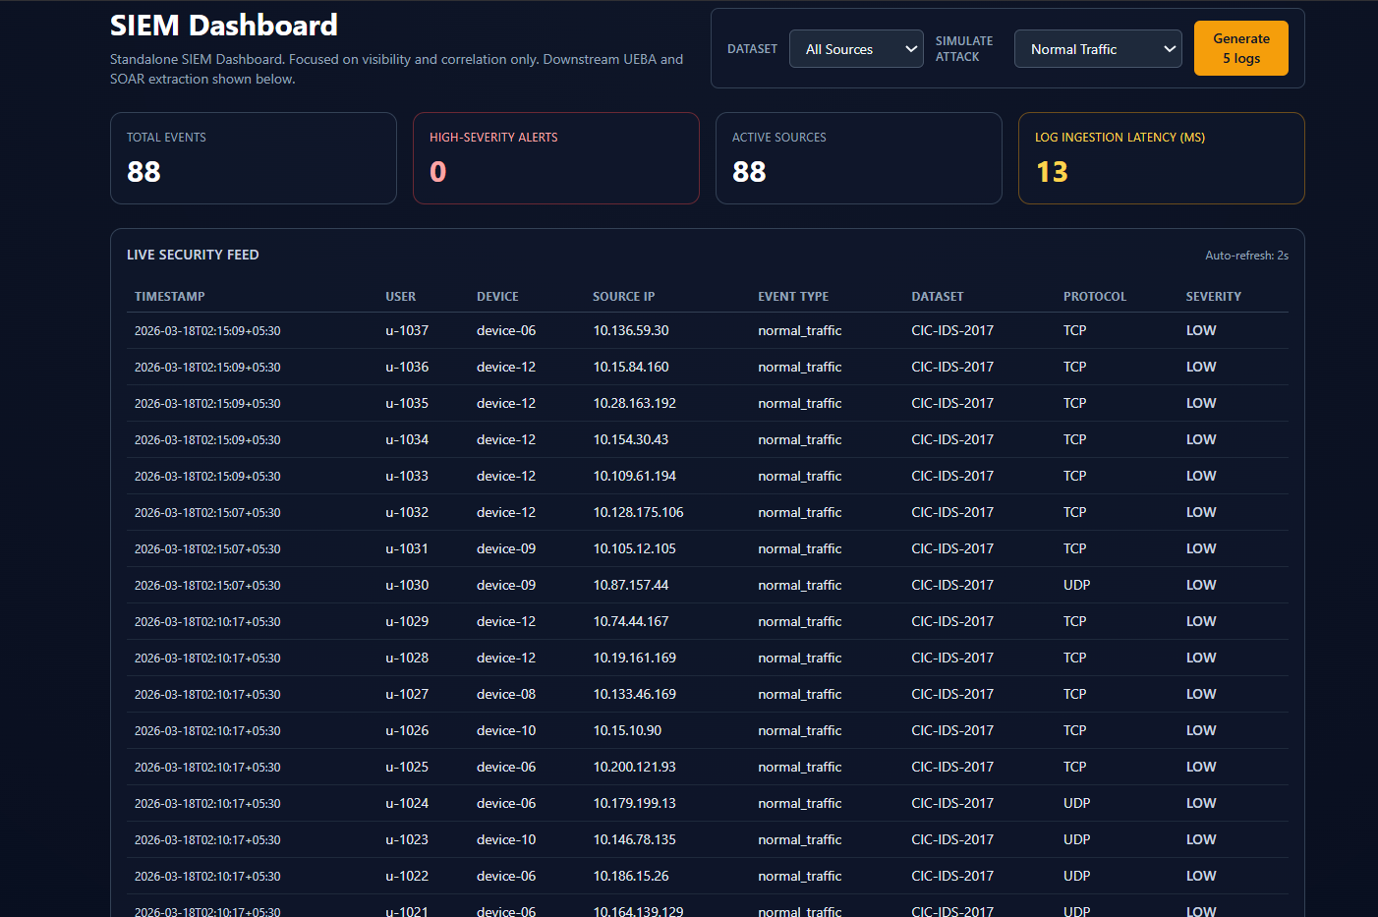
Results - SIEM
3/18/2026
15

Slide 16
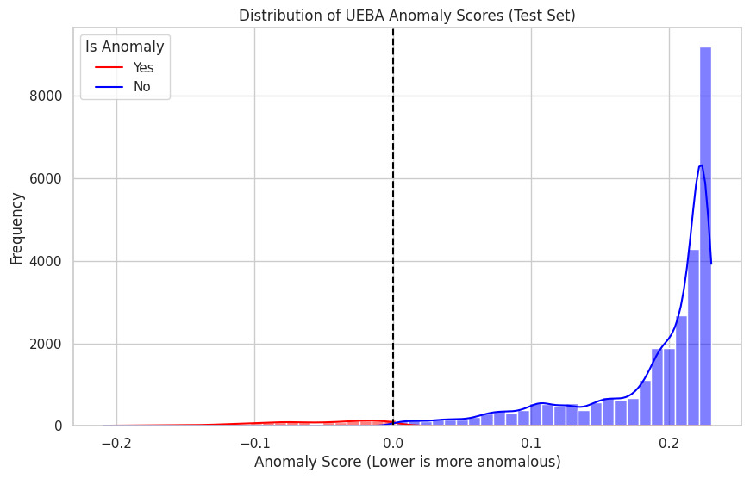
Results - UEBA
3/18/2026
16

Slide 17
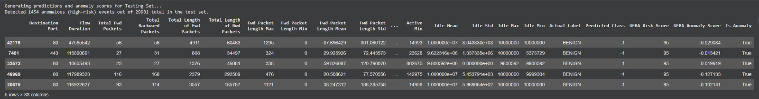
Results - UEBA
3/18/2026
17

Slide 18
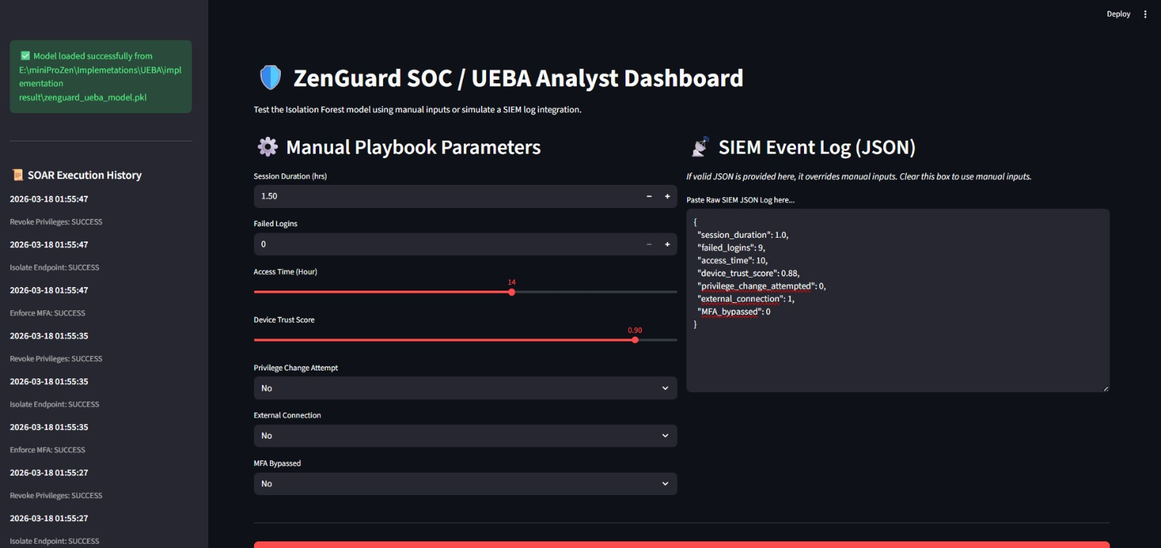
Results - SOAR
3/18/2026
18

Slide 19
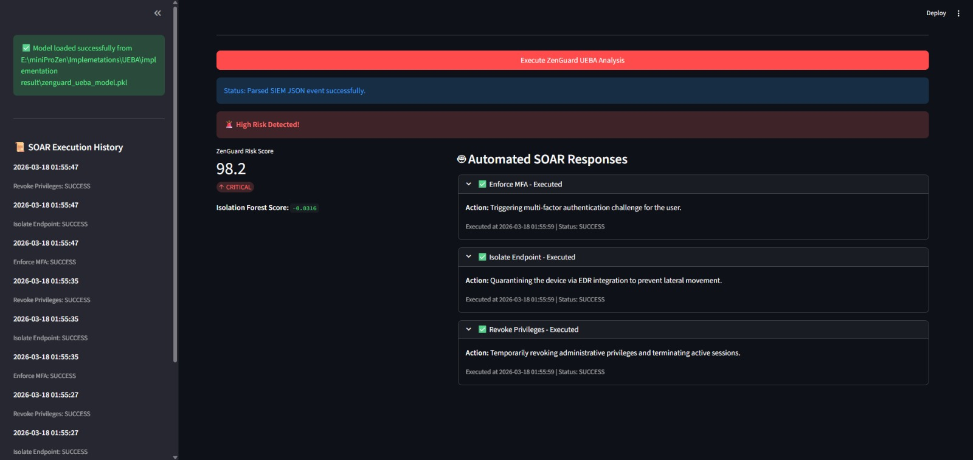
Results - SOAR
3/18/2026
19

Slide 20
Conclusion
A unified Zero Trust framework was developed, integrating SIEM, Isolation Forest-based UEBA, and adaptive SOAR playbooks to enable context-aware, automated threat mitigation.
Behavioural anomaly scores were transformed into actionable risk levels, triggering real-time identity validation, MFA enforcement, micro-segmentation, and endpoint isolation.
The system achieved sub-10-second MTTR for network-based attacks while reducing false positives compared to traditional static SIEM-SOAR pipelines.
Future enhancements include distributed scalability, adaptive threshold tuning, self-learning playbooks, and expanded hybrid cloud Zero Trust enforcement.
3/18/2026
20

Slide 21
References
Rose, S., Borchert, O., Mitchell, S., & Connelly, S. (2020). Zero Trust Architecture. NIST Special Publication 800-207. doi:10.6028/NIST.SP.800-207.
Syed, N. F., Shah, S. W., Shaghaghi, A., et al. (2022). Zero trust architecture (ZTA): A comprehensive survey. IEEE Access, 10, 57143-57179.
Marri, H., Patel, K., & Agarwal, P. (2024). Machine learning in SIEM systems: Enhancing threat detection. IEEE Trans. Information Forensics & Security, 19, 250-270.
Hariri, S., Moustafa, N., & Sitnikova, E. (2021). Adversarial ML in network intrusion detection. Neural Computing and Applications, 33, 10231-10261.
Schlette, D., et al. (2024). Do you play it by the books? A study on incident response playbooks. IEEE Symposium on Security and Privacy.
Lin, P.-C., et al. (2019). Endpoint detection and response: A survey and open research issues. IEEE Access, 7, 170351-170365.
Hassan, A., Rauf, A., Shafqat, N., Latif, R., & Khan, H. (2025). ZenGuard: ML-based Zero Trust framework. Scientific Reports, 15, 35871.
3/18/2026
21

Slide 22
THANK YOU
3/18/2026
22

