Slide 1
Module-4
Normalization

Slide 2
Introduction to Normalization using Functional and Multivalued Dependencies
So for, we learned database design using ER-DIAGRAM, SCHEMA DIAGRAM, and RELATIONSHIP MODEL but all will not measure of appropriateness or goodness to measure the QUALITY OF THE DESIGN. In this module we will learn some of the theory that has been developed with the goal of evaluating relational schema for design quality

Slide 3
Two levels at which we can discuss the goodness of relation schemas.
The logical (or Conceptual ) Level:
How users interpret the relation schemas and the meaning of their attributes.
Having good relation schemas at this level enables users to understand clearly the meaning of the data in the relations, and
Hence to formulate their queries correctly.
The implementation (or physical storage) level :
How the tuples in a base relation are stored and updated.
The RELATIONAL DATABASE DESIGN THEORY developed mainly to BASE RELATION

Slide 4
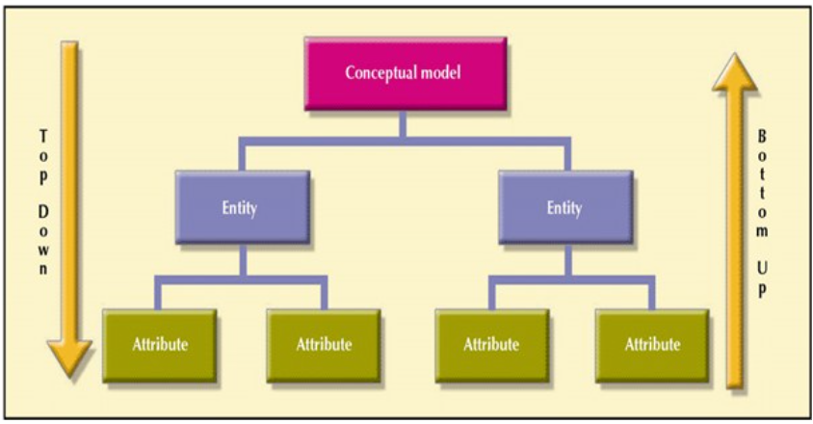
DATABASE DESIGN MAY BE PERFORMED USING TWO APPROACHES

Slide 5
Key difference between bottom up design and top down design
Sr. No. | Key | Bottom-Up Model | Top-Down Model
1 | Redundancy | Bottom-Up model is better suited as it ensures minimum data redundancy and focus is on re-usability. | Top-down model has high ratio of redundancy as the size of project increases.
2 | Interaction | Bottom-Up model have high interactivity between various modules. | Top-down model has tight coupling issues and low interactivity between various modules.
3 | Approach | Bottom-up model is based on composition approach. | Top-down model is based on decomposition approach.

Slide 6
MOTIVATION OF RELATIONAL DATABASE DESIGN
Relational database design ultimately produces a set of relations. The implicit goals of the design activity are information preservation and minimum redundancy.
Information preservation: maintaining all concepts, including
Attribute types
Entity type
Relationship types
Minimizing Redundancy: Implies minimizing redundant storage of the same information

Slide 7
EXAMPLE:
CORRECT SCHEMA:
Student
Department
RollNo | StudName | Gender | StudDept
DeptName | OfficePhone | HOD
INCORRECT SCHEMA:
RollNo | StudName | Gender | DeptName | Office Phone | HOD
Problem with bad schema
Office Phone & HOD information stored redundantly once with each student that belongs to the department
Wastage of disk space
A program that updates Office Phone of a Department
must change it at several places
More running time
Error prone

Slide 8
Informal Design Guidelines for Relation Schemas
Before discussing the formal theory of relational database design, we discuss four informal guidelines that may be used as measures to determine the quality of relation schema design:
Making sure that the semantics of the attributes is clear in the schema
Reducing the redundant information in tuples
Reducing the NULL values in tuples
Disallowing the possibility of generating spurious tuples

Slide 9
Making sure that the semantics of the attributes is clear in the schema
Imparting Clear Semantics to Attributes in Relations
Whenever we group attributes to form a relation schema, we assume that attributes belonging to one relation have certain real-world meaning and a proper interpretation associated with them
The semantics of a relation refers to its meaning resulting from the interpretation of attribute values in a tuple

Slide 10
GUIDELINE 1:
Design a relation schema so that it is easy to explain its meaning.
Do not combine attributes from multiple entity types and relationship types into a single relation.
It is straightforward to explain its meaning.
Attributes of different entities (EMPLOYEEs, DEPARTMENTs, PROJECTs)
should not be mixed in the same relation.
Only foreign keys should be used to refer to other entities
Entity and relationship attributes should be kept apart as much as possible.

Slide 11
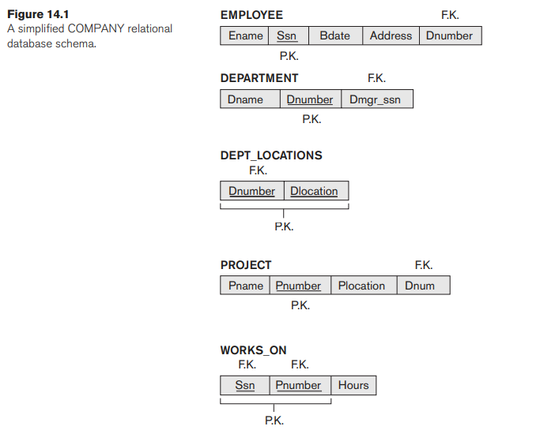
CORRECT SCHEMA DESIGN
The meaning of the EMPLOYEE relation schema is simple: Each tuple represents an employee, with values for the employee’s
name (Ename), Social Security number (Ssn), birth date Bdate), and address (Address), and the number of the department that the employee works for (Dnumber).
The Dnumber attribute is a foreign key that represents an implicit relationship between EMPLOYEE and DEPARTMENT.

Slide 12
Examples of Violating Guideline 1 or INCORRECT RELATION SCHEMA DESIGN
EMP_DEPT
SSN | ENAME | BDATE | ADDRESS | DNUMBER | DNAME | DMGR_SSN
EMP_PROJ_WORKSON
SSN | PNUMBER | HOURS | ENAME | PNAME | PLOCATION
FD1
FD2
FD3
Note
: A relation schema should always correspond to one entity type or one relationship type, for the meaning to be clear

Slide 13
2. Redundant Information in Tuples and Update Anomalies
If Redundant values are not reduced. We face the following problems.
Redundant information increases storage space.
Redundant information in Tuples introduces “UPDATE ANAMOLIES”.

Slide 14
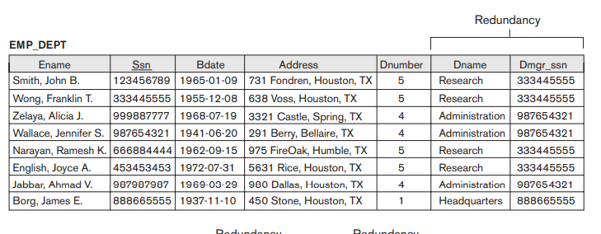
EXAMPLE: let us consider BASE TABLE EMP_DEPT (Redundancy data)

Slide 15
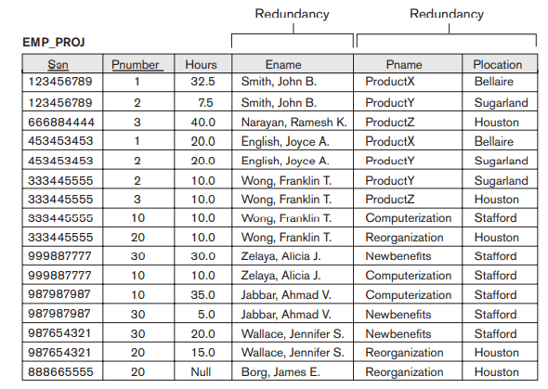
Redundancy Data

Slide 16
Storing natural joins of base relations leads to an additional problem referred to as update anomalies.
These can be classified into
insertion anomalies,
deletion anomalies, and
modification anomalies.

Slide 17
INSERTION ANOMALIES
Insertion anomalies can be differentiated into two types, illustrated by the following examples based on the EMP_DEPT relation:
CONSISTENTCY | INCONSISTENCY
IF WE HAVE TWO SEPARATE TABLE | IF WE HAVE SINGLE TABLE LIKE EMP_DEPT
we do not have to worry about this inconsistency problem because we enter only the department number in the employee tuple; all other attribute values of department 5 are recorded only once in the database, as a single tuple in the DEPARTMENT relation. | To insert a new employee tuple into EMP_DEPT, we must include either the attribute values for the department that the employee works for, or NULLs (if the employee does not work for a department as yet).
This problem does not occur in the design of SEPARATE TABLE. because a department is entered in the DEPARTMENT relation whether or not any employees work for it, and whenever an employee is assigned to that department, a corresponding tuple is inserted in EMPLOYEE | It is difficult to insert a new department that has no employees as yet in the EMP_DEPT relation. The only way to do this is to place NULL values in the attributes for employee. This violates the entity integrity for EMP_DEPT because its primary key Ssn cannot be null.

Slide 18
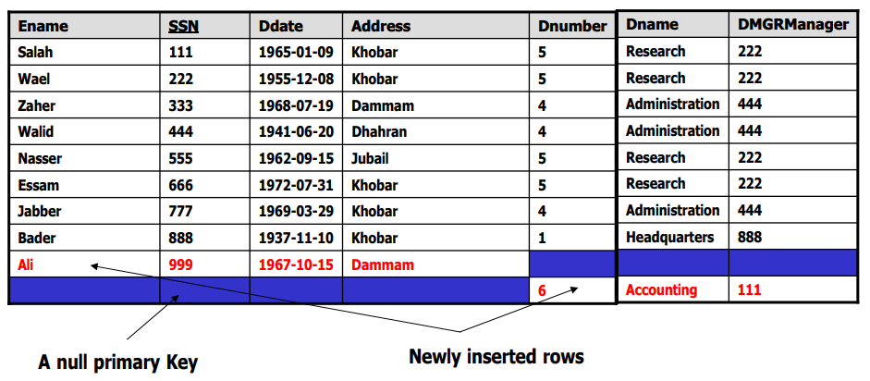

Slide 19
Deletion Anomalies
If we delete from EMP_DEPT an employee tuple that happens to represent the last employee working for a particular department, the information concerning that department is lost inadvertently from the database.

Slide 20
Modification Anomalies
In EMP_DEPT, if we change the value of one of the attributes of a particular department—say, the manager of department 5—we must update the tuples of all employees who work in that department; otherwise, the database will become inconsistent. If we fail to update some tuples, the same department will be shown to have two different values for manager in different employee tuples, which would be wrong.

Slide 21
GUIDELINE 2:Guideline for Redundant Information in Tuples and Update Anomalies
Design a schema that does not suffer from the insertion, deletion and update anomalies.
If there are any anomalies present, then note them so that applications can be made to take them into account.

Slide 22
3. NULL Values in Tuples
GUIDELINE 3: If possible avoid placing attributes in a base relation whose values may frequently be null. If nulls are unavoidable, make sure they apply in exceptional cases only and not to majority of tuples in a relation.
Problems with null values:
Waste of disk space
Problem of understanding the meaning of attributes
Problems in specifying JOIN operations
Problems in applying some aggregate functions
May have multiple interpretations (not applicable, unknown, unavailable)

Slide 23
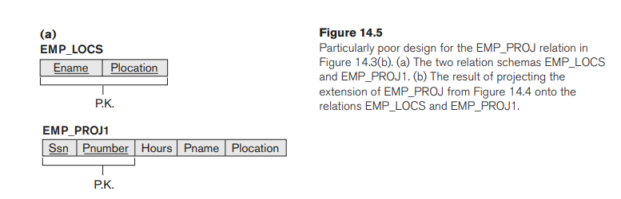

4 .Generation of Spurious Tuples – avoid at any cost
Consider the two relation schemas EMP_LOCS and EMP_PROJ1 in Figure 14.5(a), which can be used instead of the single EMP_PROJ relation in Figure 14.3(b).
Figure 14.3(b).

Slide 24
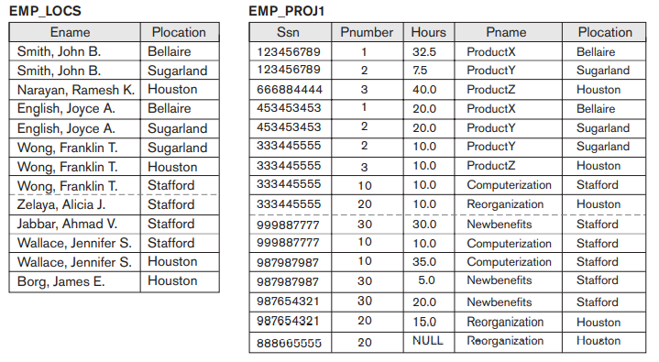
Using natural join will get spurious data

Slide 25
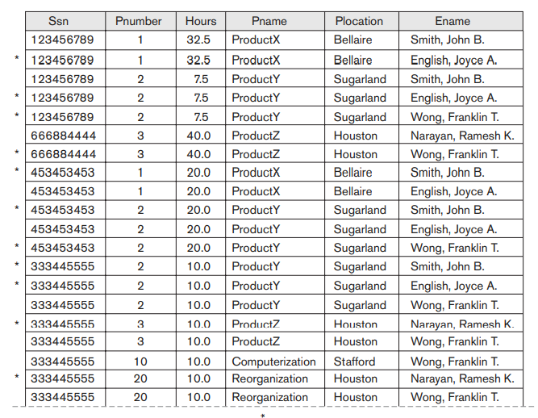

Slide 26
GUIDLINE 4:
Design relation schemas so that they can be joined with equality conditions on attributes, that are(primary key, foreign key) pairs in a way that guarantees that no spurious
Avoid table that contain matching attributes that are not (foreign key, primary key) combination because joining on such attribute may produce spurious tuples

Slide 27
Normalization of Relational schema
Normalization of a Relation schema refers to the process of:
Identifying the data dependencies in the schema; basically there are three types of data dependencies
Functional Dependencies(FDs)
Multi-valued Dependencies(MVDs)
Join Dependencies(JDs)
Identifying those data dependencies, that would cause anomalies during insert, update and delete operations on the tables created on the schema.

Slide 28
To avoid this anomalies from the table, we can follow the decomposing the schemas
Attribute Preservation: Each attribute of the schema must be represented in at least one of the sub-schemas.(mandatory requirement)
The decomposition must be a LOSS-LESS-JOIN DECOMPOSITION(also known as NON-ADDITIVE DECOMPOSITION). It implies that the decomposition must not result in SPURIOUS TUPLES.(mandatory requirement)
Preferably, the decomposition should be dependency-preserving, that is each functional dependency holding on the parent schema should be preserved in one of the sub-schemas (Desirable requirement)

Slide 29
Functional Dependencies
The functional dependency is a relationship that exists between two attributes. It typically exists between the primary key attribute and non key attributes within a relation or table.
To understand the concept thoroughly, let us consider R is a table with attribute A and B. Functional dependency is represented by →(arrow sign)
Example
A→B
Functional dependency :
B – Functionally dependent on A or A determines B
A- Determinant set
B- dependent attribute

Slide 30
social security number determines employee name
SSN -> ENAME
project number determines project name and location
PNUMBER -> {PNAME, PLOCATION}
employee ssn and project number determines the hours per week that the employee works on the project
{SSN, PNUMBER} -> HOURS

Slide 31
Mathematical notation and definition
Definition. the values of the X component of a tuple uniquely (or functionally) determine the values of the Y component.
The set of attributes X is called the left-hand side of the FD, and Y is called the right-hand side.
Note: [legal relation states (or legal extensions)]
X is a candidate key of R—this implies that X → Y for any subset of attributes Y of R (because the key constraint implies that no two tuples in any legal state r(R) will have the same value of X).
If X is a candidate key of R, then X → Y.
If X → Y in R, this does not say whether or not Y → X in R.

Slide 32
Normal Forms Based on Primary Keys
REDUNDANT DATA | NORMALIZATION
Same piece of data is held in two separate places | Aims to reduce data redundancy
Various problem if redundancy data INSERT ANOMALIES DELETE ANOMALIES UPDATE ANOMALIES

Slide 33
WHAT IS NORMALIZATION?
Normalization of Data [“filtering” or “purification]: Analyzing the given relation schemas based on their FDs and primary keys to achieve the desirable properties of
(1) minimizing redundancy and
(2) minimizing the insertion, deletion, and update anomalies

Slide 34
RECALL KEY CONCEPT
Definitions of Keys and Attributes Participating in Keys
CANDIDATE KEY: If a relation schema has more than one key, each is called a candidate key.
One of the candidate keys is arbitrarily designated to be the primary key and the others are called secondary keys but not foreign key.
EXAMPLE:
{Ssn} is the only candidate key for EMPLOYEE, so it is also the primary key.
Super key:
{Ssn}, {Ssn, Ename}, {Ssn, Ename, Bdate}, and any set of
attributes that includes Ssn are all superkeys.

Slide 35
First Normal Form (1ST NF)
It was defined to disallow multivalued attributes, composite attributes, and their combinations.
1NF (First Normal Form) Rules
Each table cell should contain a single value or atomic value.
Each record needs to be unique.
Example can be easily understood with the help of a case study. Assume, a video library maintains a database of movies rented out. Without any normalization in database, all information is stored in one table as shown below. Let’s understand Normalization database with normalization example with solution:

Slide 36
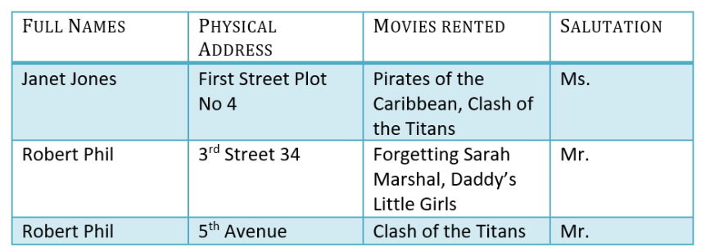
Here you see Movies Rented column has multiple values. Now let’s move into 1st Normal Forms:

Slide 37
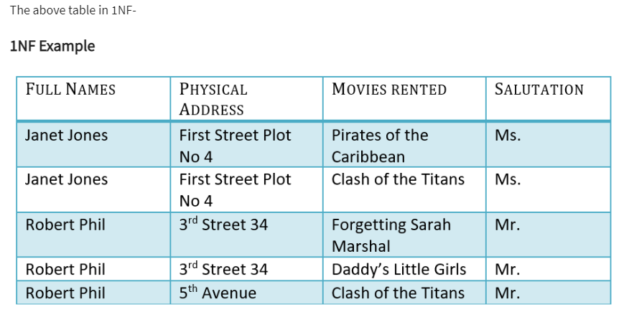

Slide 38
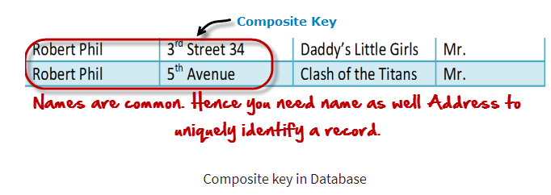
What is Composite Key?
A composite key is a primary key composed of multiple columns used to identify a record uniquely
In our database, we have two people with the same name Robert Phil, but they live in different places.
Hence, we require both Full Name and Address to identify a record uniquely. That is a composite key.

Slide 39
2NF (Second Normal Form)
Second normal form (2NF) is based on the concept of full functional dependency
or
A relation schema R is in 2NF, if every non-prime attribute A in R is fully functionally dependent an the Primary Key of R
2NF (Second Normal Form) Rules
Rule 1- Be in 1NF
Rule 2- Single Column Primary Key that does not functionally dependent on any subset of candidate key relation
Student_Project
Stud_id | Proj_id | Stud_name | Proj_name

Slide 40
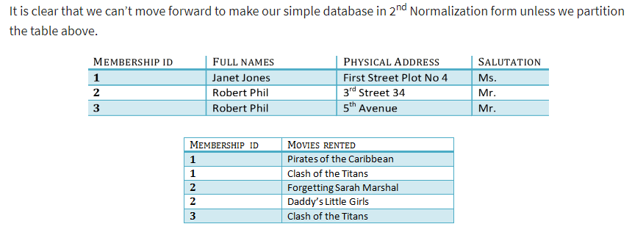
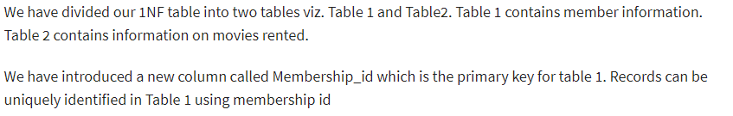
TABLE 1
TABLE 2

Slide 41
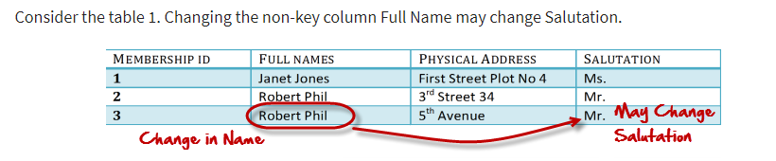
What are transitive functional dependencies?
A transitive functional dependency is when changing a non-key column, might cause any of the other non-key columns to change

Slide 42
Transitive dependency
Transitive dependency
Consider attributes A, B, and C, and where
A → B and B → C.
Functional dependencies are transitive, which means that we also have the functional dependency A → C
We say that C is transitively dependent on A through B.

Slide 43
3NF (Third Normal Form)
Relation should not have a non key attribute functionally determined by another non key attribute (or by a set of non key attributes).
3NF (Third Normal Form) Rules
Rule 1- Be in 2NF
Rule 2- Has no transitive functional dependencies

Slide 44
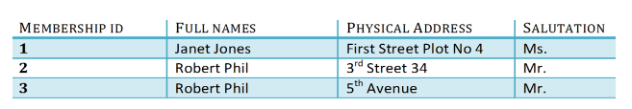
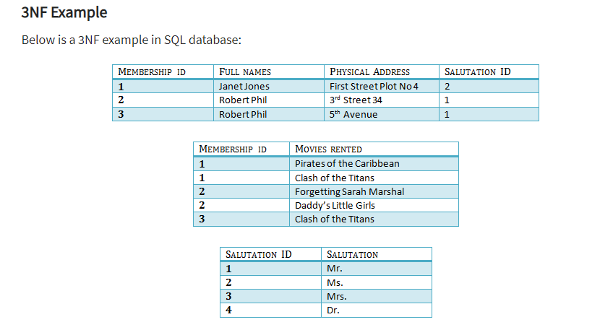
To move our 2NF table into 3NF, we again need to again divide our table.

Slide 45
BCNF (Boyce-Codd Normal Form) OR 3.5 Normal Form
Advance version of 3rd Normal form
RULE:
It is in 3NF
For every FD X→Y, X should be super key of the table.
How to know, we have to apply BCNF on table
Whenever a NON KEY prime attribute DETERMINE prime attribute, then we have to apply BCNF

Slide 46
Super key
Non key attribute or non prime attribute
EXAMPLE:
Stud-ID | SUBJECT | Professor
123 | physics | Faculty 1
123 | Music | Faculty 2
456 | Biology | Faculty 3
789 | Physics | Faculty 4
999 | Physics | Faculty 1
In this table there are two FDs in this relation
{Stud_ID,Subject} →professor
Professor → subject (non key attribute determine prime attribute)
In this case insertion anomalies , delete anomalies will be effect. Due to this we have to apply BCNF RULE. By split the mother table into two table

Slide 47
Stud_Professor
Professor_Subject
Stud_ID | Professor
123 | Faculty 1
123 | Faculty 2
456 | Faculty 3
789 | Faculty 4
999 | Faculty 1
Professor | Subject
Faculty 1 | Physics
Faculty 2 | Music
Faculty 3 | Biology
Faculty 4 | Physics
Professor →Subject
Stud_id →professor

Slide 48
4th NF(4th NORMAL FORM)
Multivalued Dependencies and fourth Normal form
Rules:
4th NF eliminate independent many-to-one relationship between columns
A relation must first been in BCNF
A given relation may not contain more than one multivalued attributes

Slide 49
EXAMPLE:
Super key
X
Y
Z
X→→ Y
X→→Z
Stud_id | Stud_Course | Stud_hobby
1 | DMBS,CN | Swimming, Tennis
2 | Java , C# | Cricket, Foot ball
Above table does not holds the conditions of 4NF because it Holds the Multivalued Dependency.
Explanation
FOR std_id =1 there are two values of Std_course (i.e. DBMS and CN) and same for Std_id =2 there are two values of Std_course (i.e. Java and C#).
Columns “Std_course” and “Std_hobby” are independent to each other but depend on “Std_id”.
Atleast three values also exist in the given table.

Slide 50
Stud_id | Stud_Course | Stud_hobby
1 | DMBS,CN | Swimming, Tennis
2 | Java , C# | Cricket, Foot ball
Student_Course table
Student_Hobby table
Stud_id | Stud_Course
1 | DBMS
1 | CN
2 | JAVA
2 | C#
Stud_id | Stud_Hobby
1 | Swimming
1 | Tennis
2 | Cricket
2 | Foot ball

Slide 51
5th Normal Form (5NF)
Join dependencies and fifth Normal form or Project Join Normal Form(PJ/NF)
A relation R is in Fifth Normal Form (5NF) if and only if the following conditions are satisfied simultaneously: 1. R is already in 4NF. 2. It cannot be further non-loss decomposed.
(R1
R2)
R3
R(mother table)
R1
(R2
R3)

Slide 52
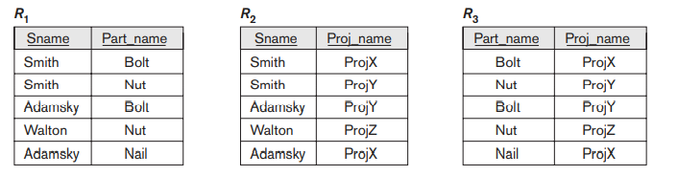
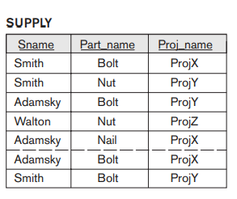
5th normal form

Slide 53
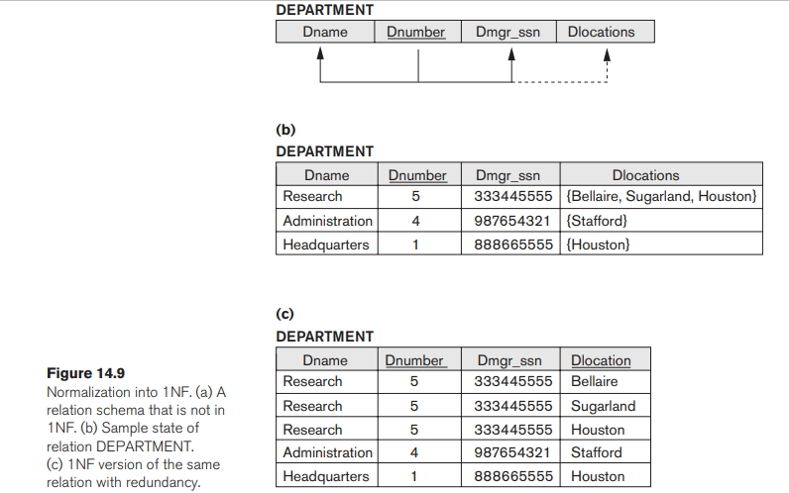
Example 2: company database

Slide 54
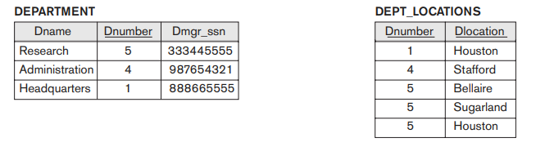
NOTE:
There are three main techniques to achieve first normal form for such a relation:
1. Remove the attribute Dlocations that violates 1NF and place it in a separate relation DEPT_LOCATIONS along with the primary key Dnumber of DEPARTMENT. The primary key of this newly formed relation is the combination {Dnumber, Dlocation}, as shown in Figure 14.2. A distinct tuple in DEPT_LOCATIONS exists for each location of a department. This decomposes the non-1NF relation into two 1NF relation

Slide 55
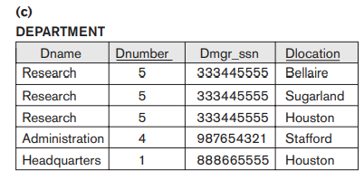
2. Expand the key so that there will be a separate tuple in the original DEPARTMENT relation for each location of a DEPARTMENT, as shown in Figure 14.9(c). In this case, the primary key becomes the combination {Dnumber, Dlocation}. This solution has the disadvantage of introducing redundancy in the relation and hence is rarely adopted.

Slide 56
3. If a maximum number of values is known for the attribute—for example, if it is known that at most three locations can exist for a department—replace the Dlocations attribute by three atomic attributes: Dlocation1, Dlocation2, and Dlocation3. This solution has the disadvantage of introducing NULL values if most departments have fewer than three locations. It further introduces spurious semantics about the ordering among the location values;
Dname | Dnumber | Dmgr_ssn | Dlocation1 | Dlocation2 | Dlocation3
Research | 5 | 333445555 | Bellaire | NULL | NULL
Research | 5 | 333445555 | NULL | Sugarland | NULL
Research | 5 | 333445555 | NULL | NULL | Houston
Administration | 4 | 987654321 | Stafford | NULL | NULL
Headquarters | 1 | 888665555 | Houston | NULL | NULL

Slide 57
COMPOSITE ATTRIBUTE
First normal form also disallows multivalued attributes that are themselves composite. These are called nested relations because each tuple can have a relation within it.
Figure 14.10 shows how the EMP_PROJ relation could appear if nesting is allowed.
EMP_PROJ(Ssn, Ename, {PROJS(Pnumber, Hours)})

Slide 58


Slide 59
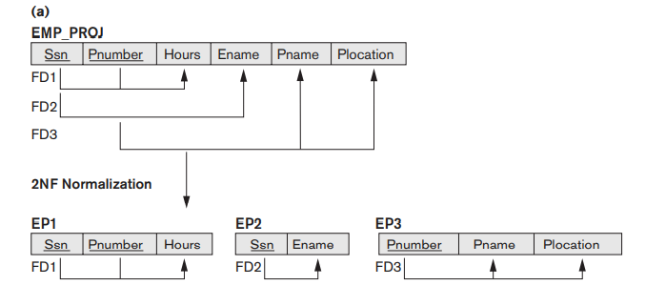
EXAMPLE: Second Normal Form

Slide 60
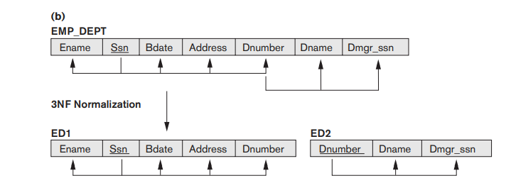
Example: Third Normal Form
NOTE: A NATURAL JOIN operation on ED1 and ED2 will recover the original relation EMP_DEPT without generating spurious tuples.

