Slide 1
College Website - Backend development using django
Presented by
Jai Keerthana G
Final Year BCA
SIGS , Tumkur
Guide
Mr. Shreenivas MCA
SIGS, Tumkur

Slide 2
Objectives
Manage faculty records.
Provide secure login system.
Store data efficiently using database.
Create scalable backend APIs
Reduce manual work in administration

Slide 3
Introduction to Django
What is Django?
Django is a high-level Python web framework.
It helps developers build secure and scalable web applications.
Follows the MVT (Model-View-Template) architecture.
Used for fast development and clean design.
Open-source and widely used in web development.

Slide 4
Why Django for College Website?
Fast backend development
Built-in admin panel
Secure authentication system
Easy database handling
Scalable for future features
Supports REST APIs and integrations

Slide 5
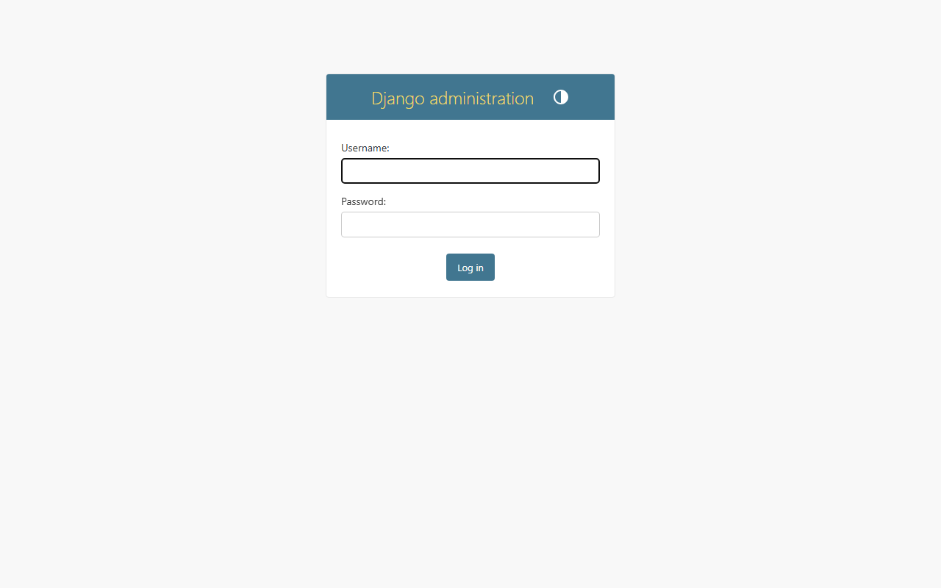
Secure Administration Login

Slide 6
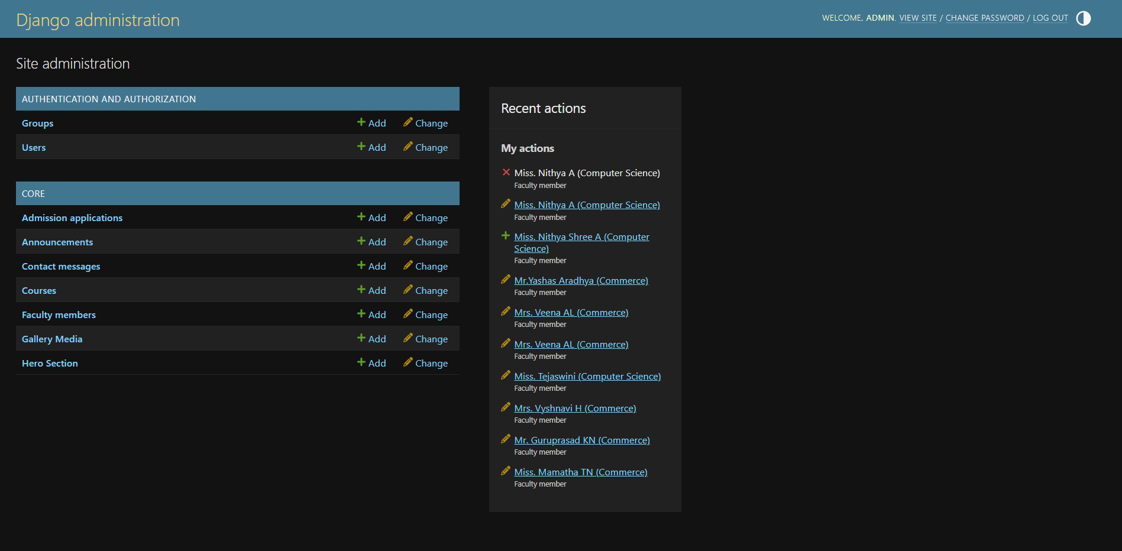
Admin Dashboard Overview

Slide 7
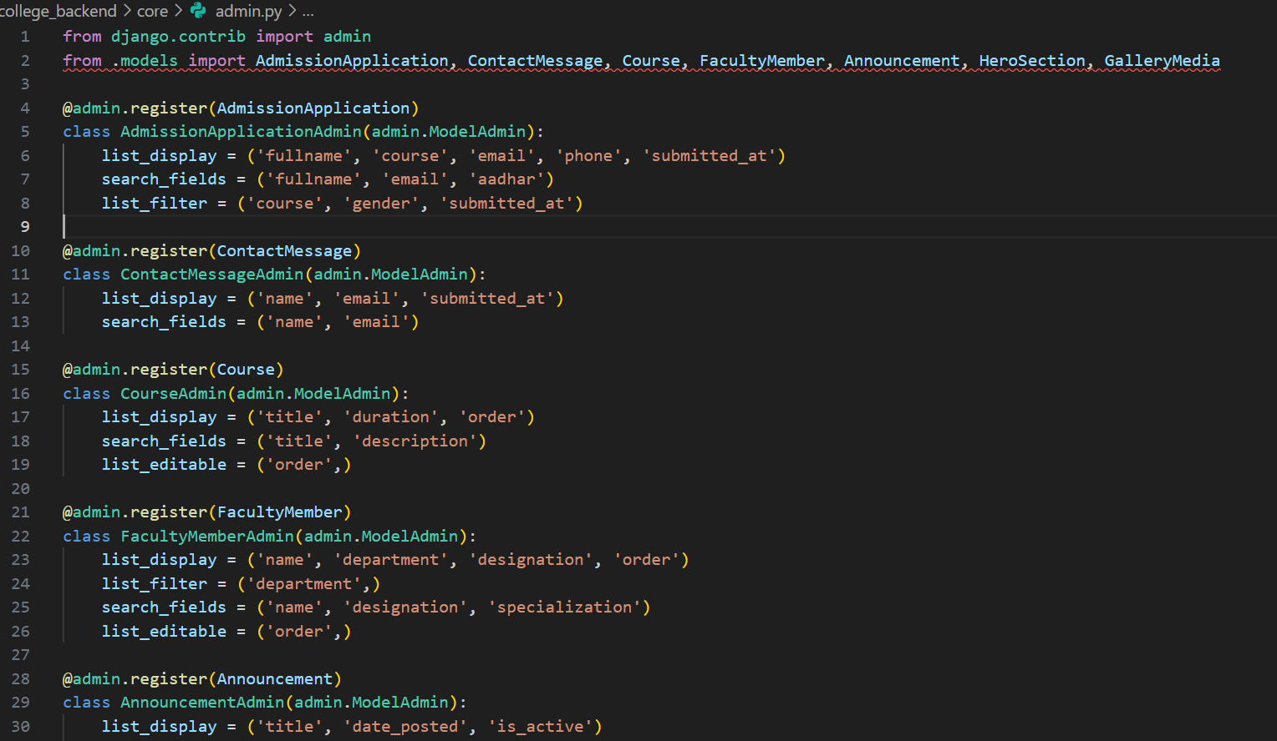
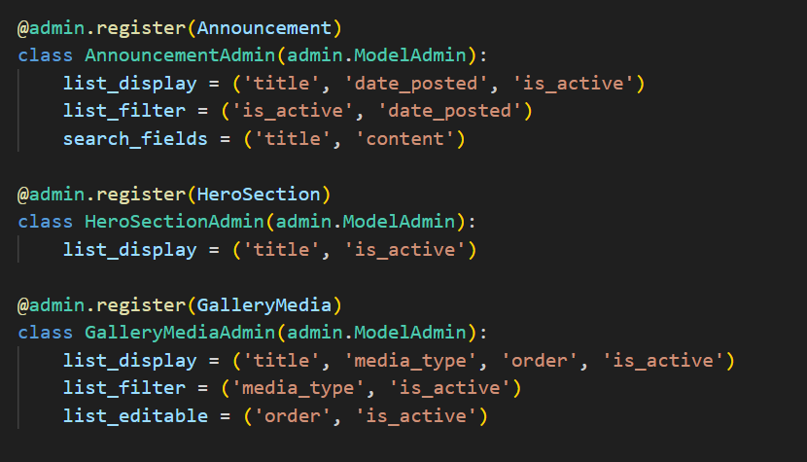
Admin Dashboard

Slide 8
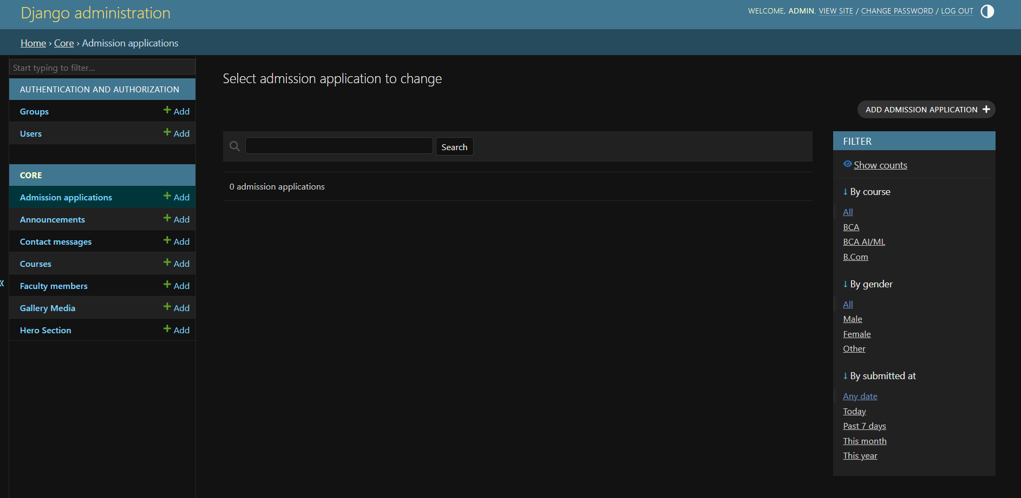
Managing Admission Applications Data

Slide 9
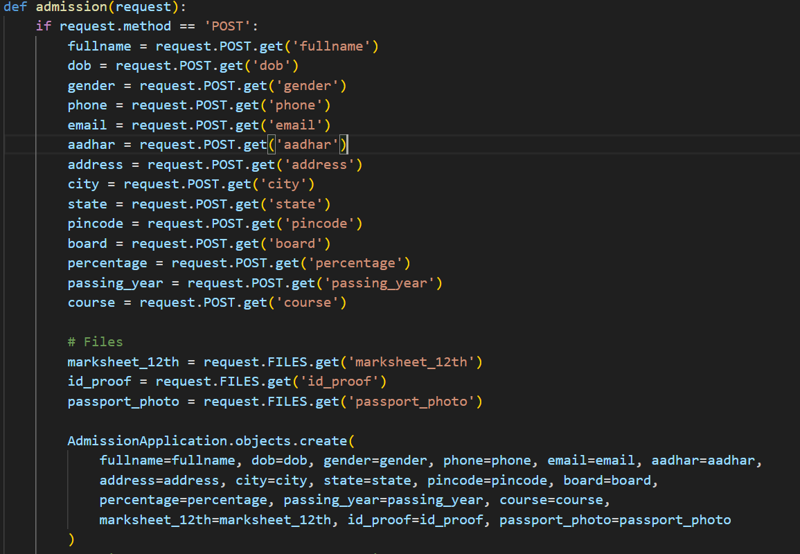

Slide 10
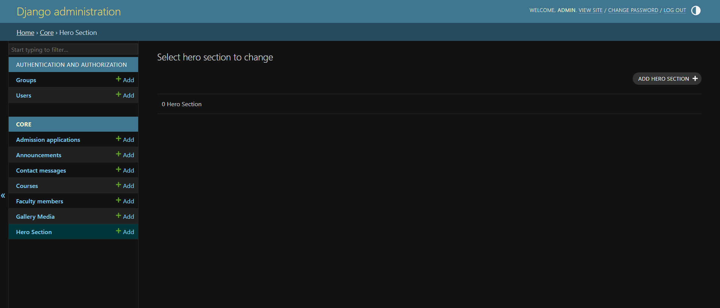
Managing Dynamic Frontend Content (Hero Section)

Slide 11
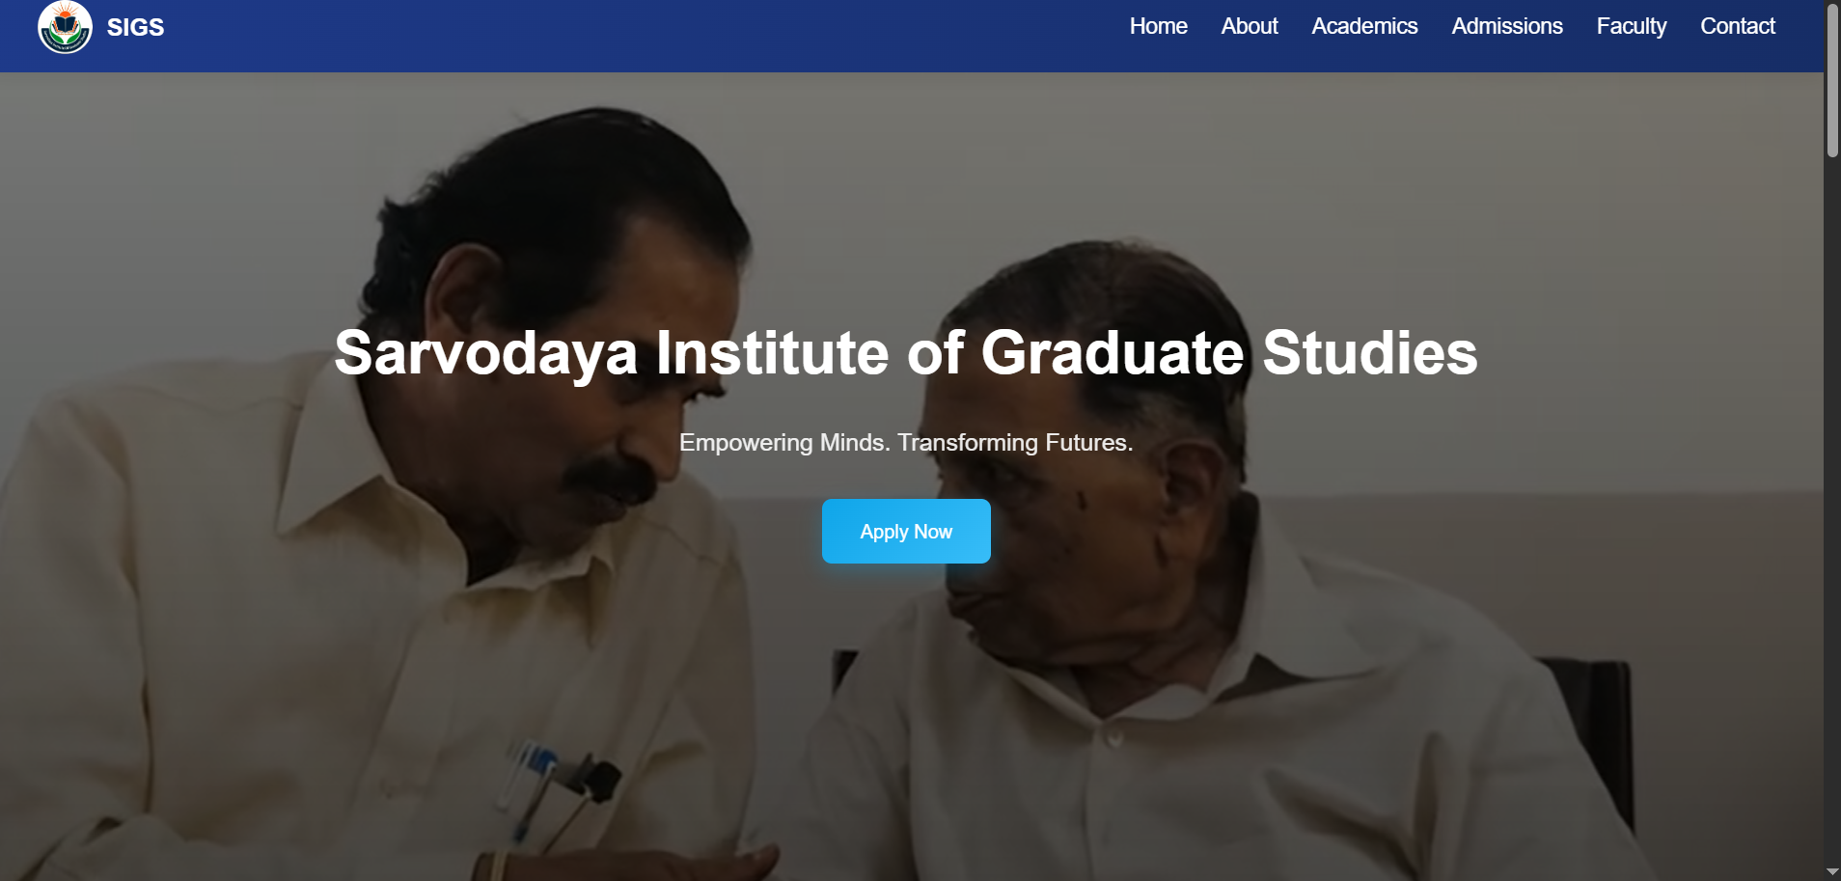

Slide 12
Database Models & Architecture
The system uses an ORM-based relational database design. Key models include
Admission Application: Handles student enrollments, docs, and academic data
Faculty Member & Course: Manages academic programs and staff profiles
Announcement & Gallery Media: Powers dynamic updates and multimedia displays
Hero Section: Controls the homepage video and text configuration
Contact Message: Stores user inquiries from the frontend

Slide 13
Backend Technologies
Our technology stack ensures security, scalability.
Framework: Django (Python)
Database: SQLite (Local) / PostgreSQL (Production)
File Storage: Cloudinary / Local Media
Deployment: Render.com

Slide 14
THANK YOU

