Slide 1
BTP: EMI Effects in Voltage-to-Time Converters
Analysis, Cadence exploration, and differential EMI-cancellation architecture
G. Jaidev | 2023EEB1200
Guide: Prof. Devarshi Mrinal Das
Department of Electrical Engineering, IIT Ropar

Slide 2
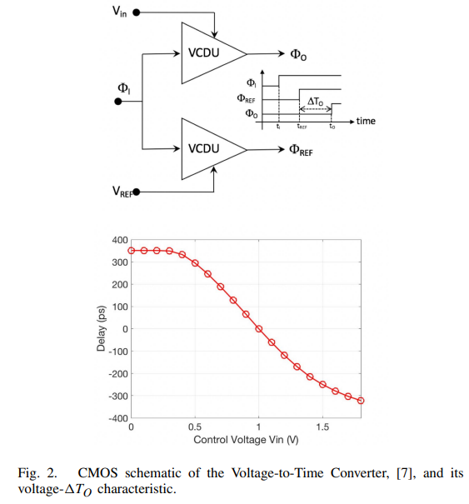
Project Story: From VTC to EMI-Robust Architecture
Before mid-semester: common VCDU/VTC foundation, PVT study, Monte Carlo and EMI base-paper analysis.
After mid-semester: BTP diverged toward EMI reduction using differential delay architectures.
Main research question: how can common-mode EMI be reduced after voltage is converted to time?
Final direction: compressed small-signal differential control around 0.9 V.
Baseline VTC from literature: two VCDU paths generate a time difference.

Slide 3
Pre-Midsemester Foundation
VCDU/VTC operation, PVT variation, and baseline EMI susceptibility

Slide 4
Baseline VCDU/VTC Principle
A VCDU delays an input edge according to a control voltage.
Two VCDUs form a VTC: one input-controlled path and one reference path.
Output is measured as a time difference, not an absolute voltage.
This structure is useful for TMSP but still sensitive to timing disturbances.
Pre-midsem baseline VTC architecture.

Slide 5
Delay Model Used Throughout BTP
Delay is the capacitor discharge time until the inverter threshold is crossed.
Any perturbation in current or threshold appears as timing jitter.
I_dis = - C_L dV_C/dt
t_d = C_L Delta V / I_ctrl
Delta I ~= g_m Delta V_ctrl
Delta t_d ~= -(C_L Delta V / I_0^2) Delta I

Slide 6
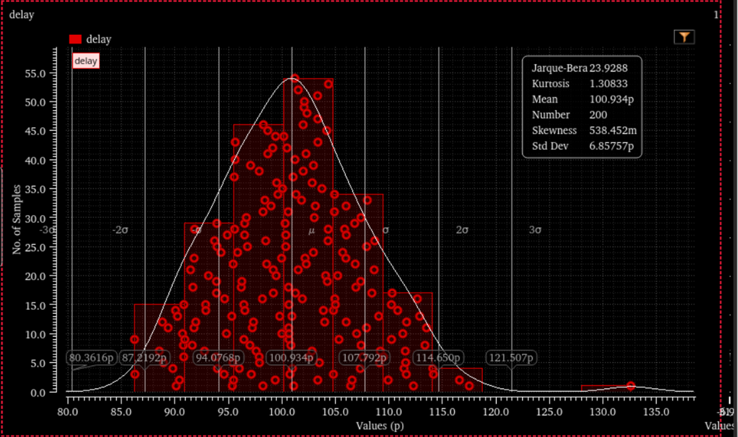
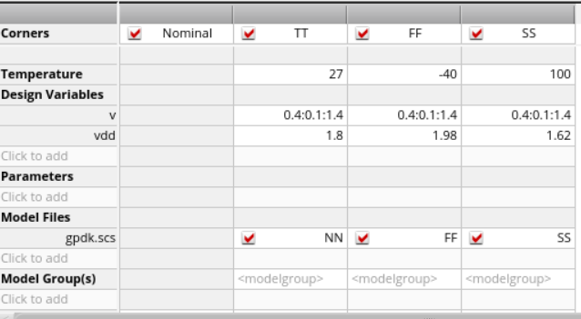
PVT and Monte Carlo: Single VCDU Sensitivity
Single VCDU delay varies strongly with process, voltage, temperature and mismatch; this was established in the mid-semester work.
Monte Carlo distribution / delay spread
Cadence summary table

Slide 7
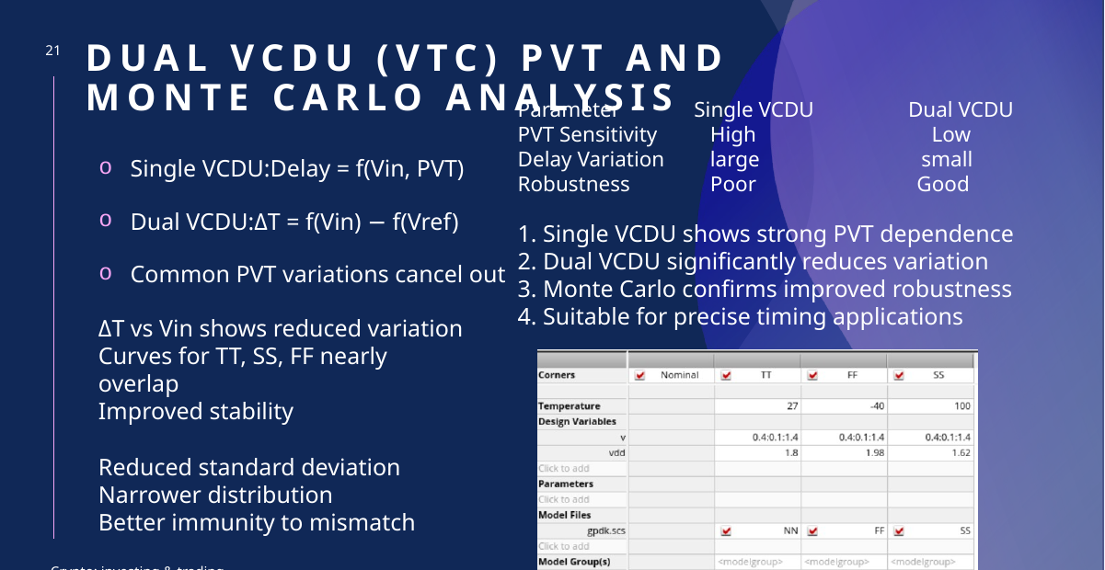
Why Dual VCDU Helps With PVT
Single VCDU: absolute delay includes PVT shift.
Dual VCDU/VTC: output is a difference of two similar paths.
Common PVT delay shifts cancel approximately in Delta T.
This improves timing stability, but does not cancel unequal EMI coupling.
Mid-sem insight: common PVT variation reduces in dual VCDU/VTC.

Slide 8
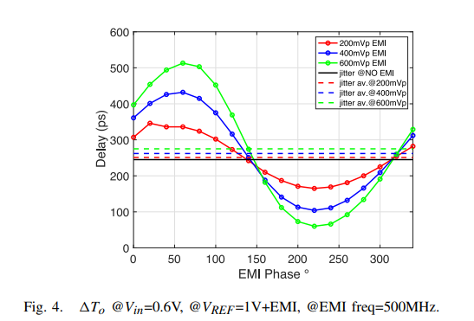
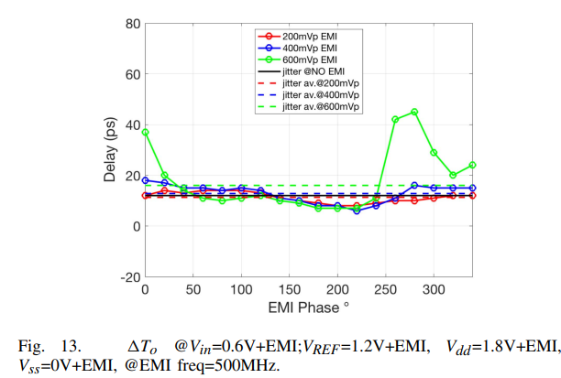
Baseline EMI Injection: Core Observation
EMI was modelled as a sinusoidal disturbance. Amplitude, phase and frequency all affect delay.
EMI injected at V_in
All-pin EMI scenario

Slide 9
Why EMI Phase Matters
A VTC makes a timing decision at one instant. The EMI value at that instant determines edge advance/delay.
v_emi(t)=A_emi sin(2*pi*f_emi*t + phi)
v_emi(t_s)=A_emi sin(2*pi*f_emi*t_s + phi)
Delta t_d proportional to v_emi(t_s)
Worst-case: max_phi |Delta t_d(phi)|

Slide 10
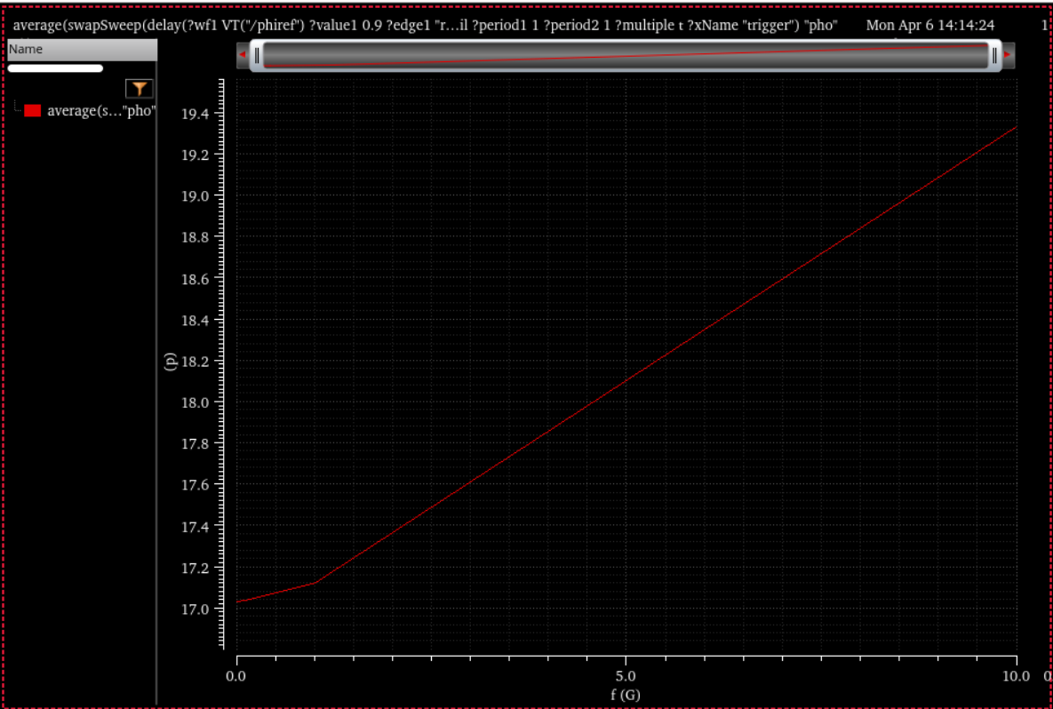
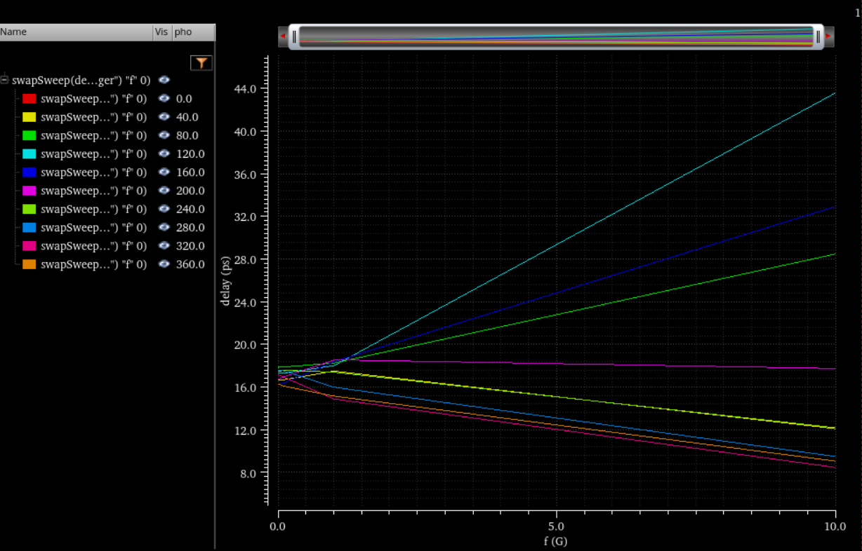
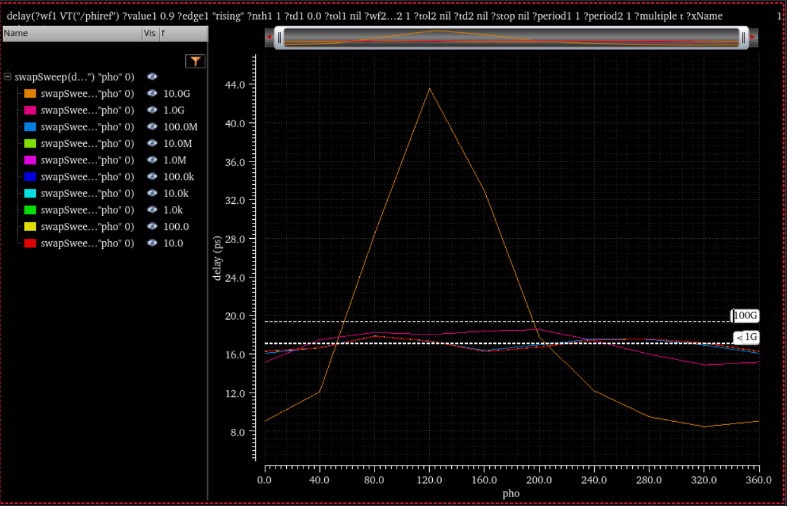
Baseline VTC Frequency/Phase Sweep
These results motivated the BTP: average delay is not enough; worst-case phase at GHz frequency can be much larger.
Average delay increases with frequency
Delay depends on phase and frequency
Worst-case phase peak at high frequency

Slide 11
Post-Midsemester Circuit Exploration
Differential delay cells tried after the scope diverged from DEP

Slide 12
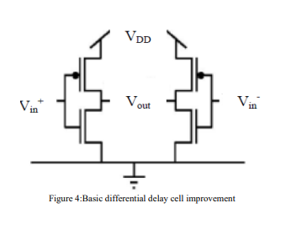
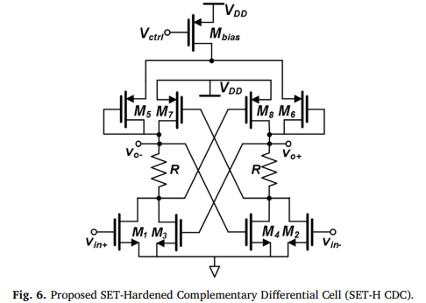
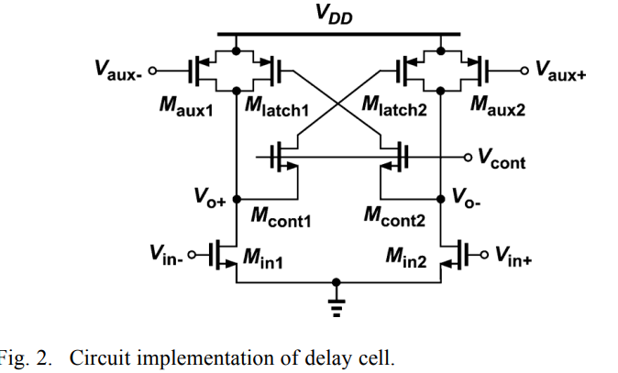
Differential Delay-Cell Literature Survey
Three topologies were reviewed and implemented/analyzed as candidates before choosing the final direction.
Basic differential delay cell
SET-hardened complementary differential cell
Input-conditioned / dual-path delay cell

Slide 13
Why Basic Differential Delay Was the Starting Point
Differential signalling can reject common-mode noise in principle.
If both branches receive the same EMI, subtraction cancels it.
But the delay cell must still give clean, monotonic voltage-to-time conversion.
This became the selection criterion for later attempts.
Basic differential delay concept.

Slide 14
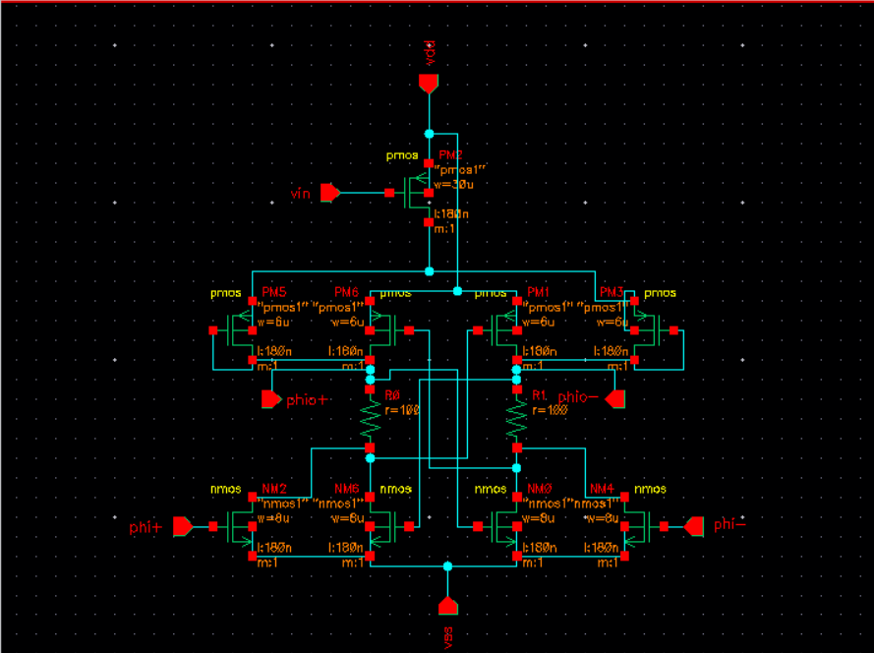
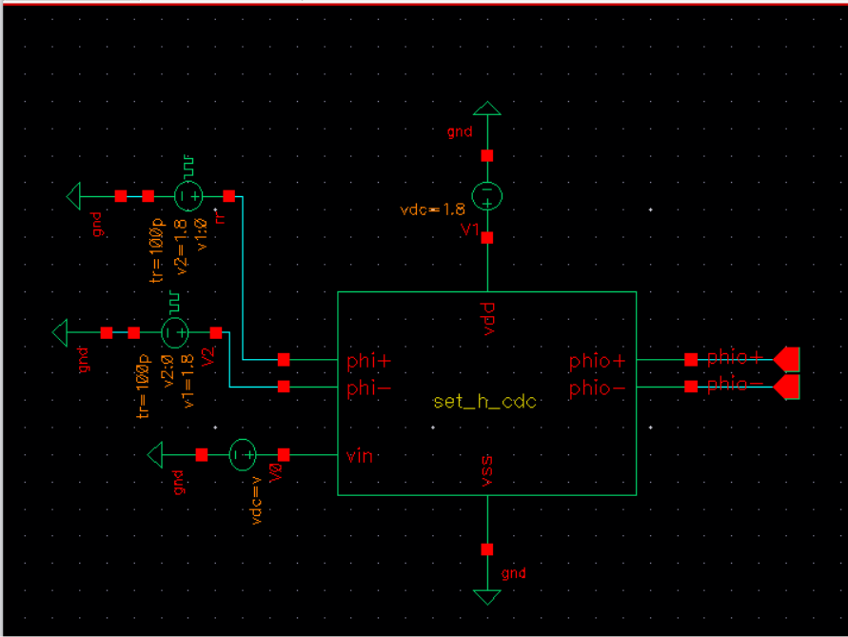
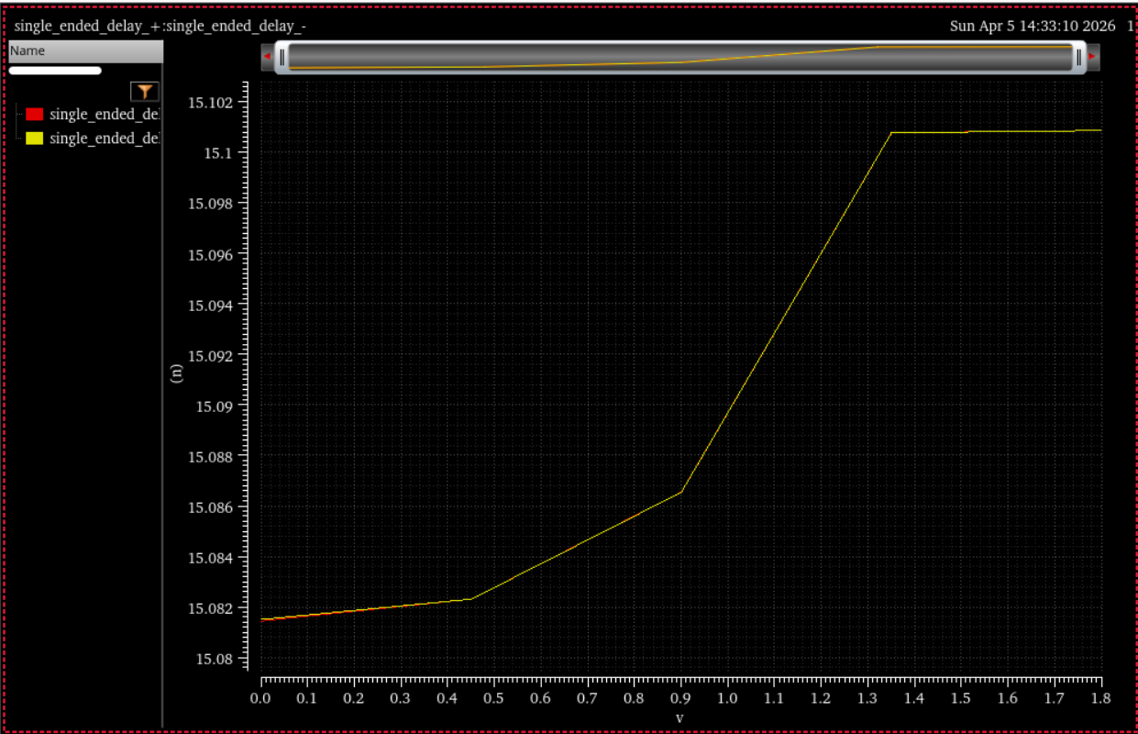
SET-Hardened CDC Implementation
This cell was studied because its cross-coupled feedback gives strong switching and robustness.
Internal Cadence schematic
Testbench
Measured delay response

Slide 15
SET-H CDC: Insight and Limitation
Good for robust/latch-like switching, not automatically good for VTC conversion.
Delay tuning was weak/nonlinear over the input sweep.
Cross-coupled feedback caused abrupt transition behaviour.
Decision: used as design-learning block, not final architecture.
Delay response was not smooth enough for final VTC.

Slide 16
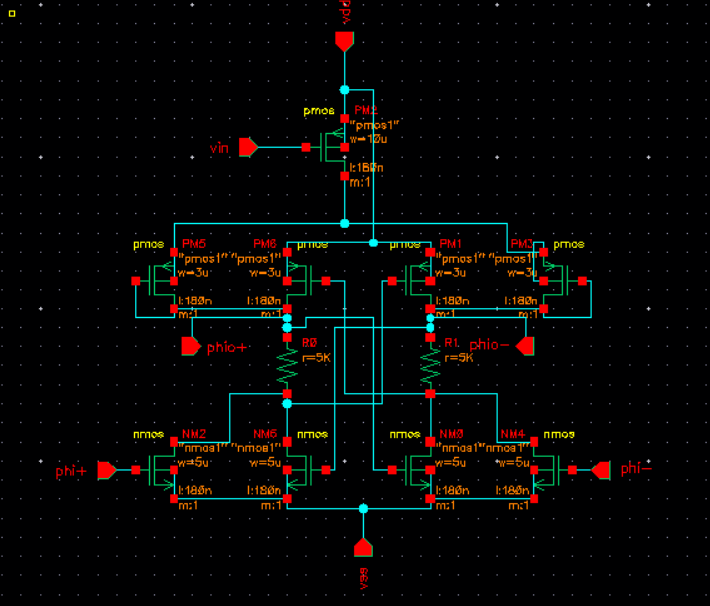
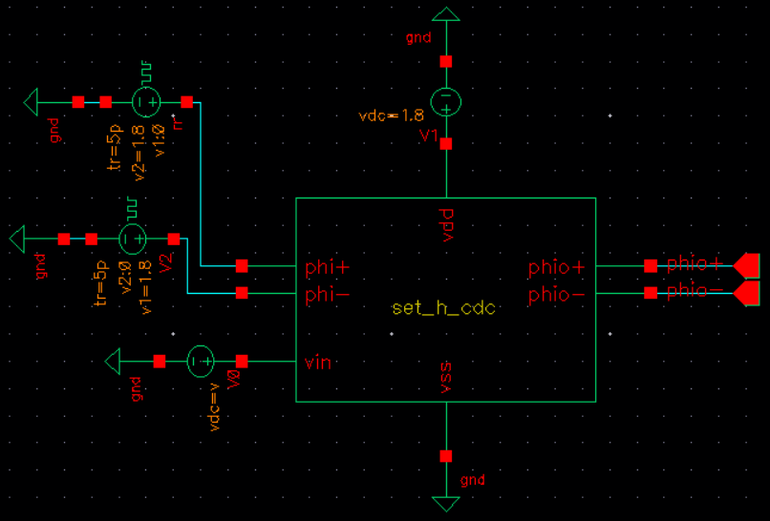
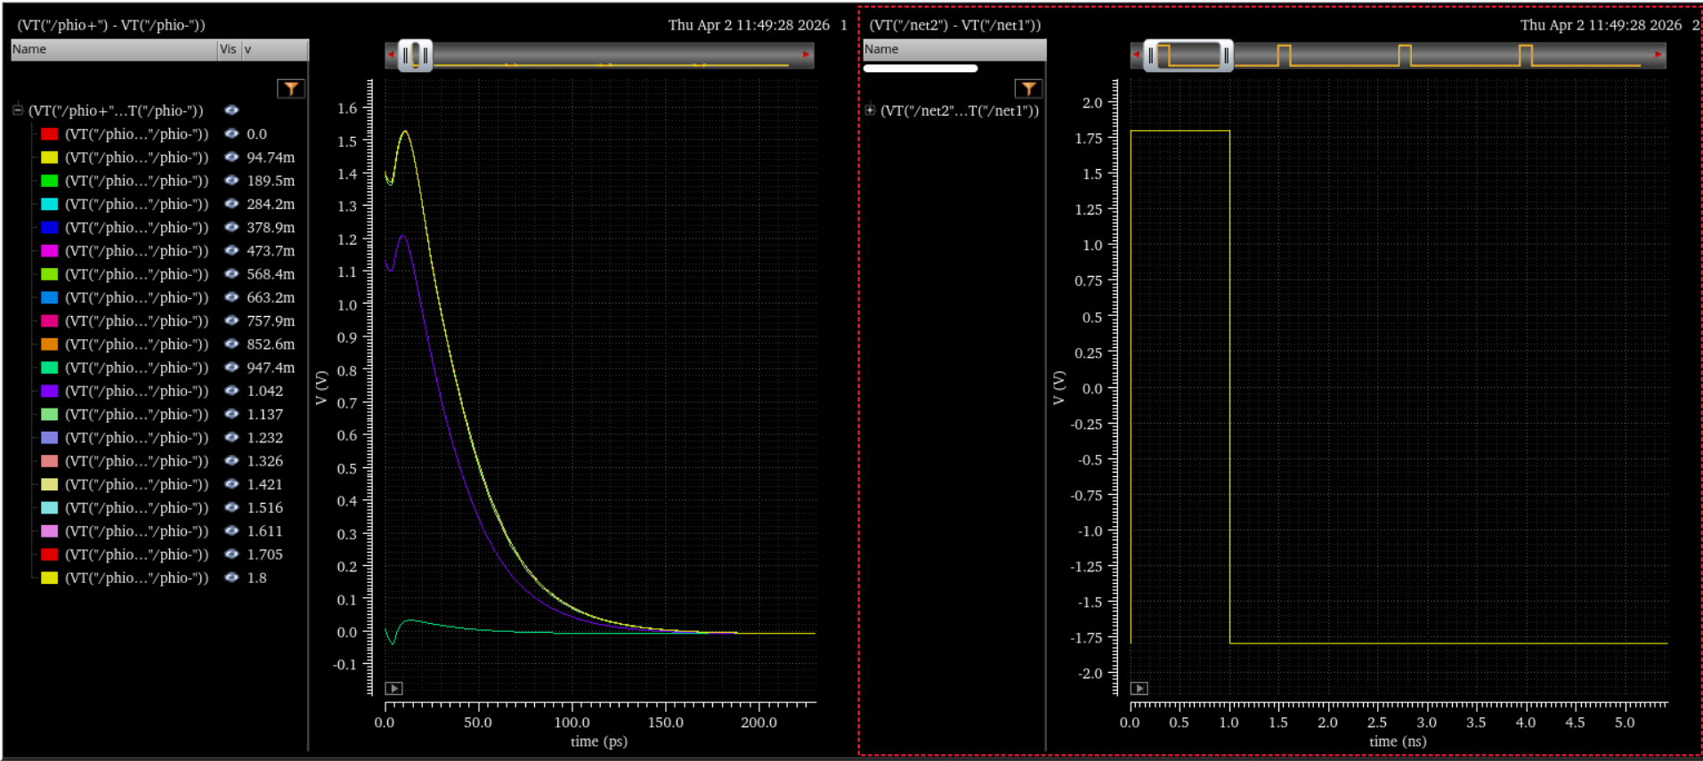
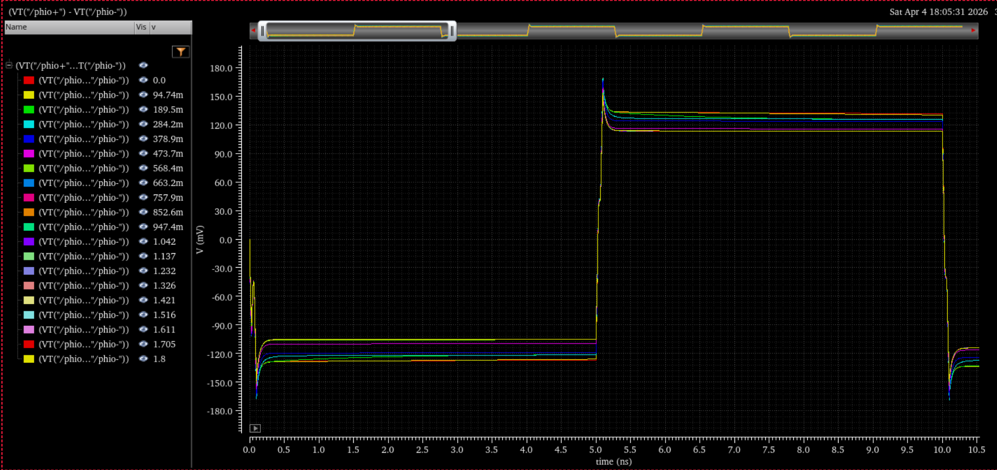
Input-Conditioned Delay Cell Implementation
This cell was a separate and important attempt; it was not the same as the SET-H CDC.
Internal schematic
Testbench
Differential transient
Delay response

Slide 17
Input-Conditioned Cell: Why Rejected
Auxiliary control paths made biasing difficult.
Transient output had overshoot/settling and limited clean swing.
Delay extraction became threshold-dependent.
Decision: not suitable as the main VTC delay core.
Irregular delay response under sweep.

Slide 18
Custom Differential Attempts
What was built in Cadence and why some versions were rejected

Slide 19
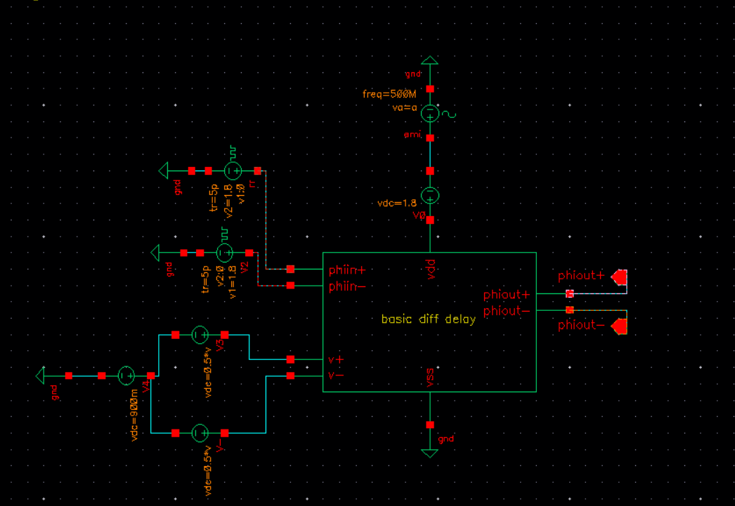
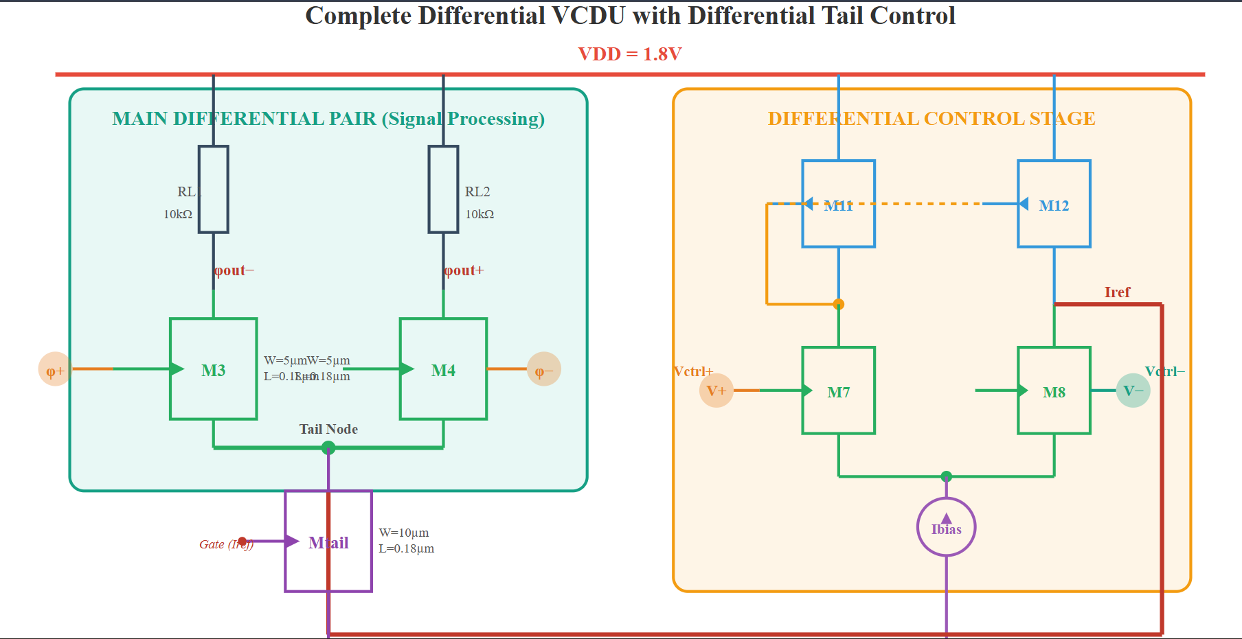
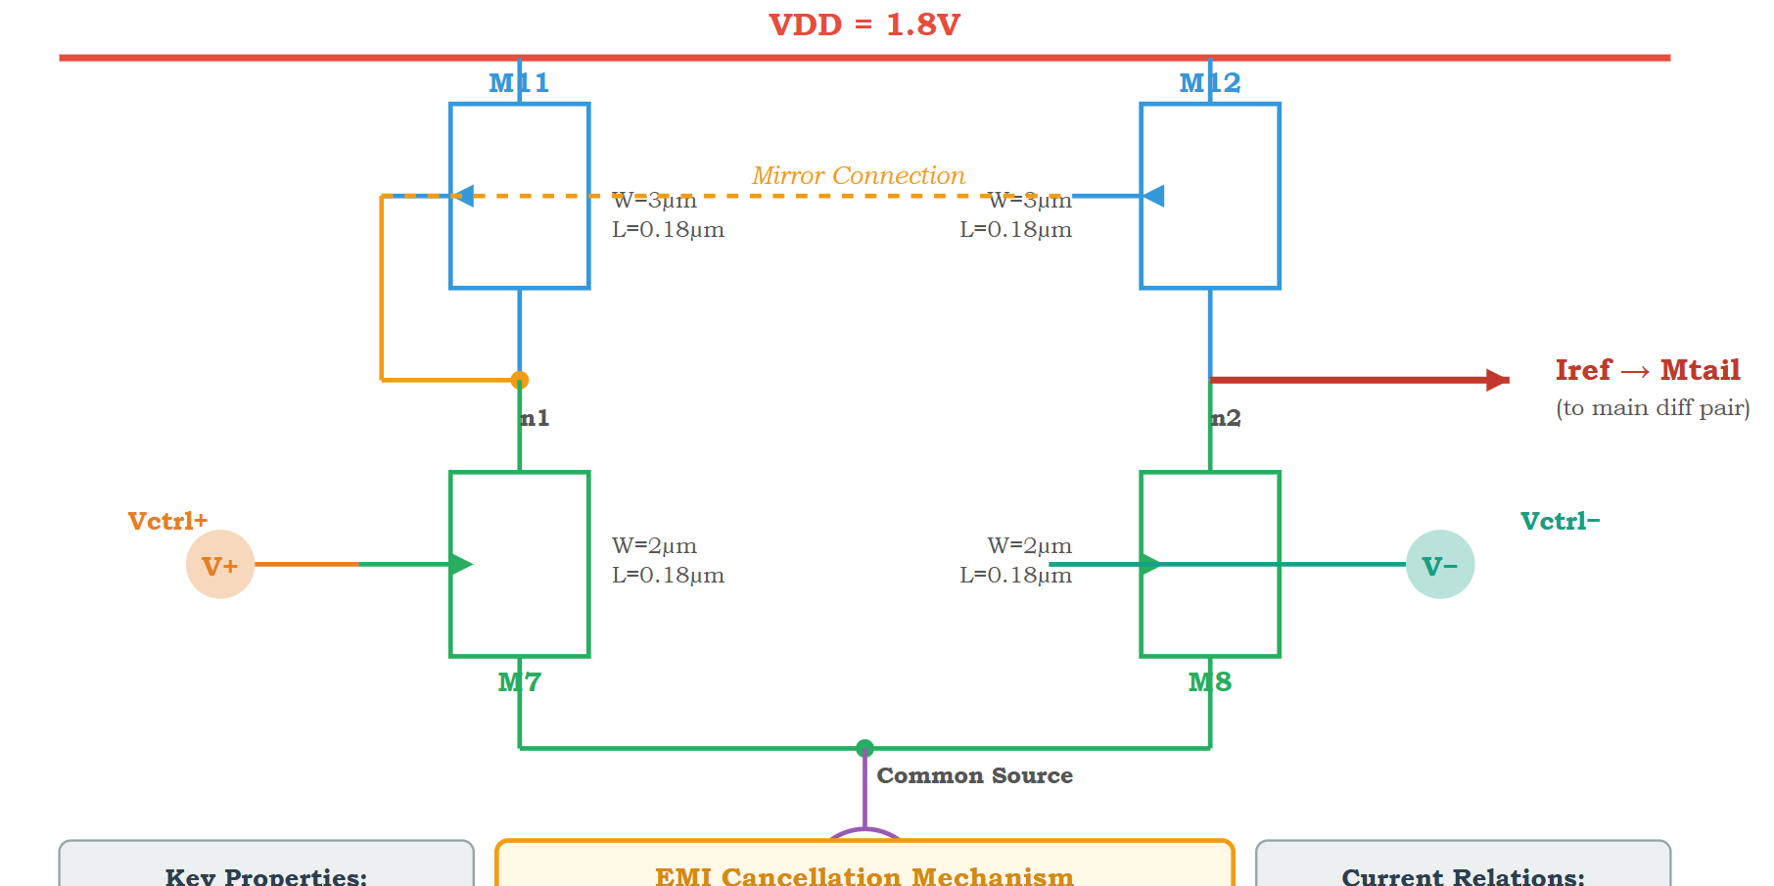
Direct Differential-Pair Controlled Delay Cell
First custom attempt: use a differential pair output to control the differential delay current.
Conceptual differential delay architecture
Expanded schematic
Cadence testbench

Slide 20
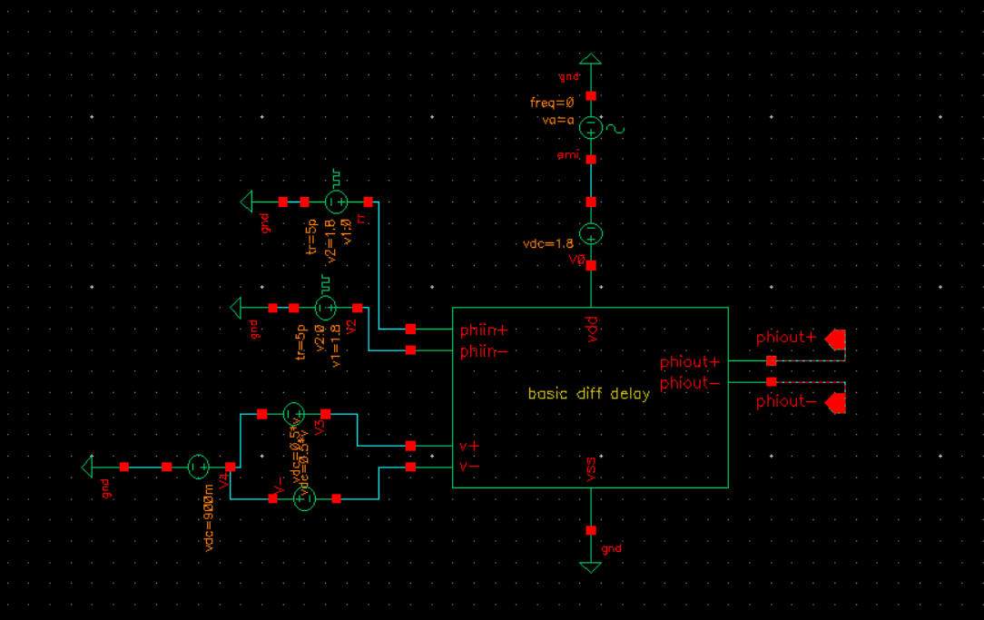
Core Problem: Differential Input Became Single-Ended Control
The front-end was differential, but later the control was effectively single-ended.
Common-mode/supply disturbance re-entered the control current.
Rising and falling delays became unbalanced.
This explained why differential structure alone was not enough.
Rising/falling delay mismatch.

Slide 21
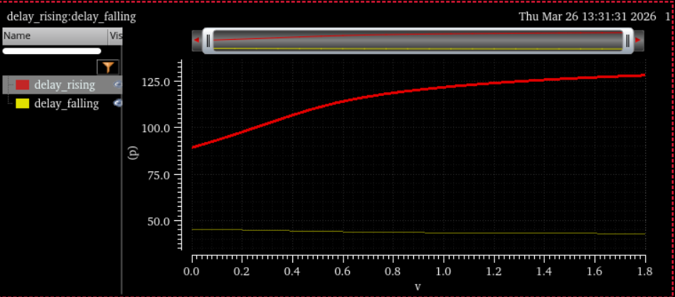
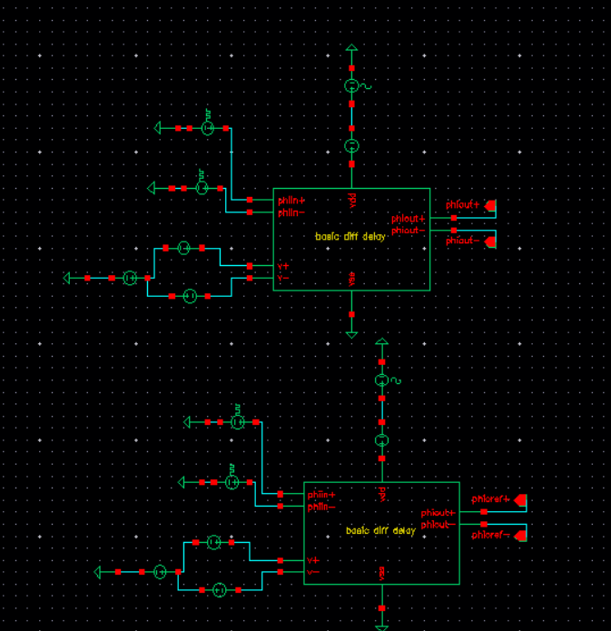
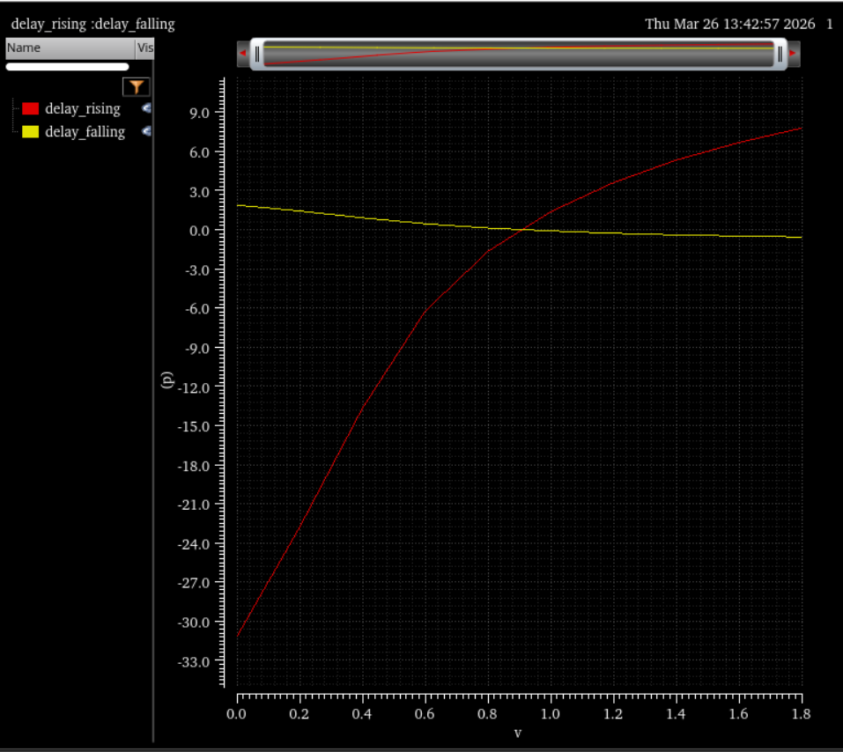
Direct Attempt: Waveforms and Delay Issues
These figures are kept because they explain the actual design challenge, not as final success claims.
Differential transient output
Two-path VTC testbench
Delay curve
Edge mismatch

Slide 22
EMI Analysis of Intermediate Architecture
Systematic sweeps across amplitude, phase, control voltage and injection ports

Slide 23
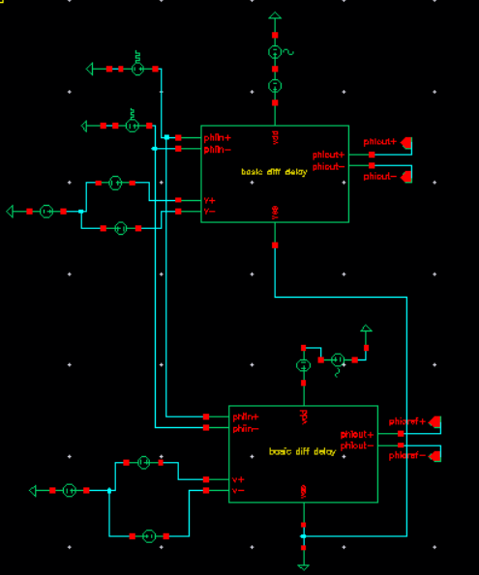
EMI Sweep Setup
Amplitude, phase and control voltage were swept; EMI was injected through different ports.
Sweep variables
All-port / multi-port EMI testbench

Slide 24
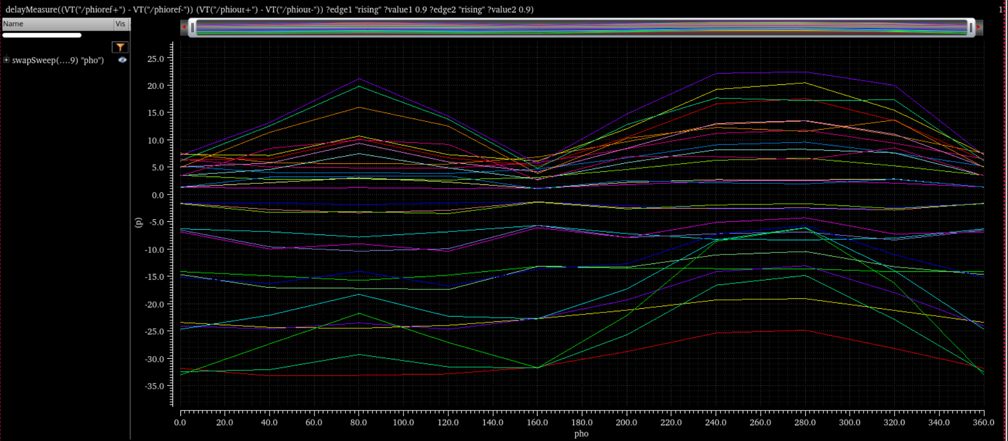
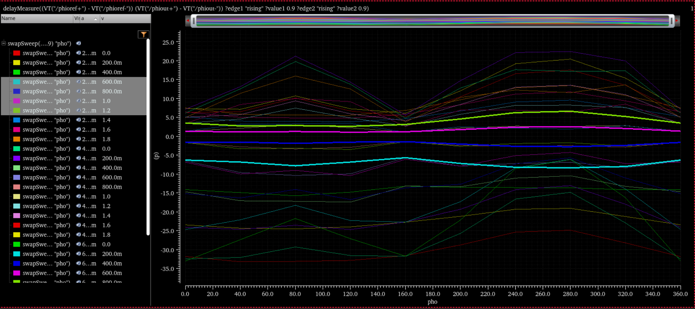
Intermediate Architecture: Phase-Dependent Delay
The response remained irregular; this confirmed incomplete common-mode rejection.
Delay vs phase
Expanded phase sweep

Slide 25
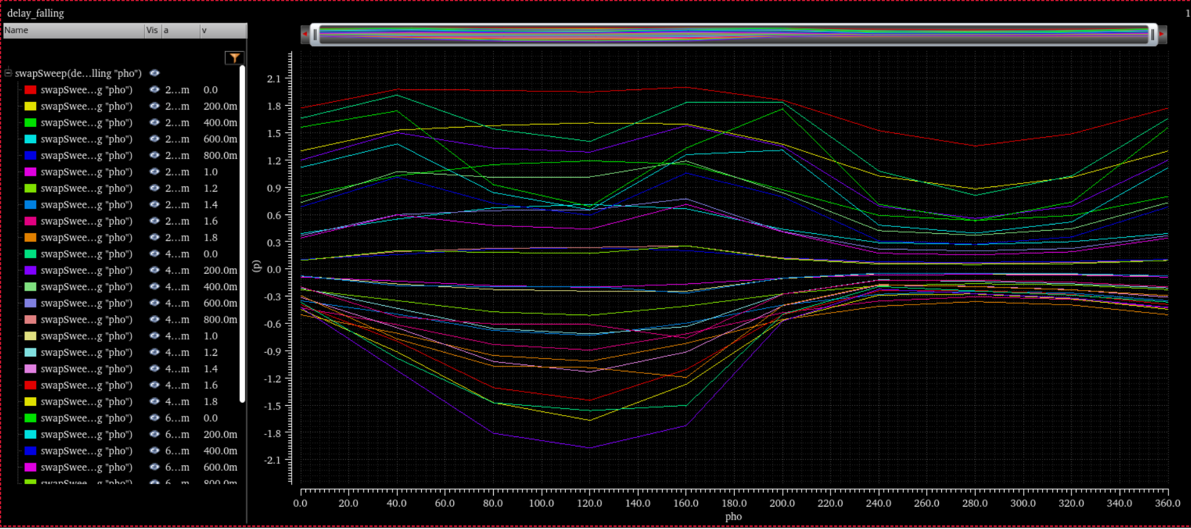
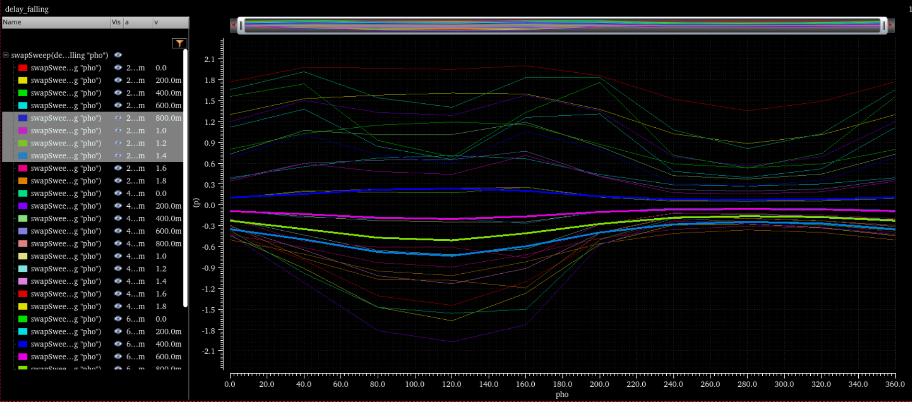
Intermediate Architecture: Falling-Edge Behaviour
Falling edge did not behave symmetrically with rising edge, making delay extraction unreliable.
Falling-edge response
Additional falling-edge result

Slide 26
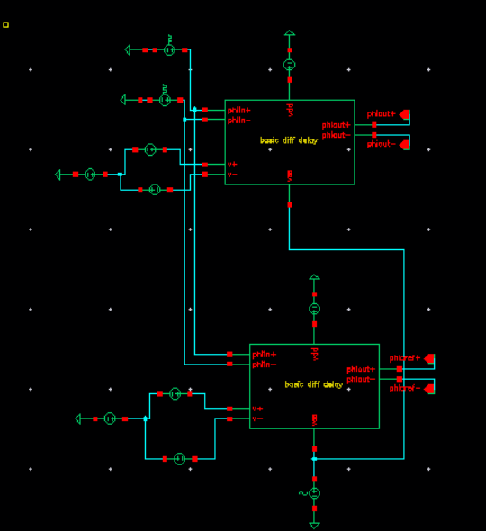
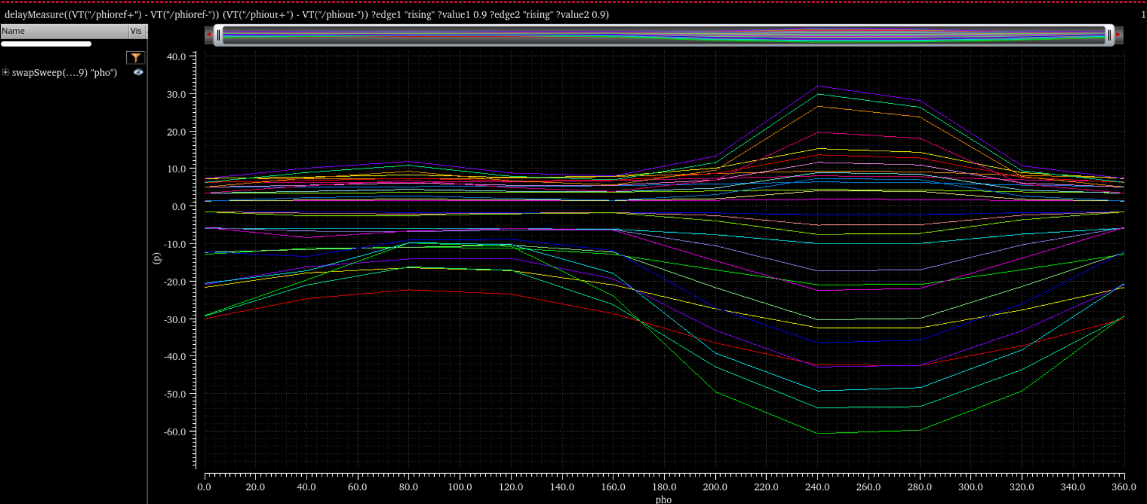
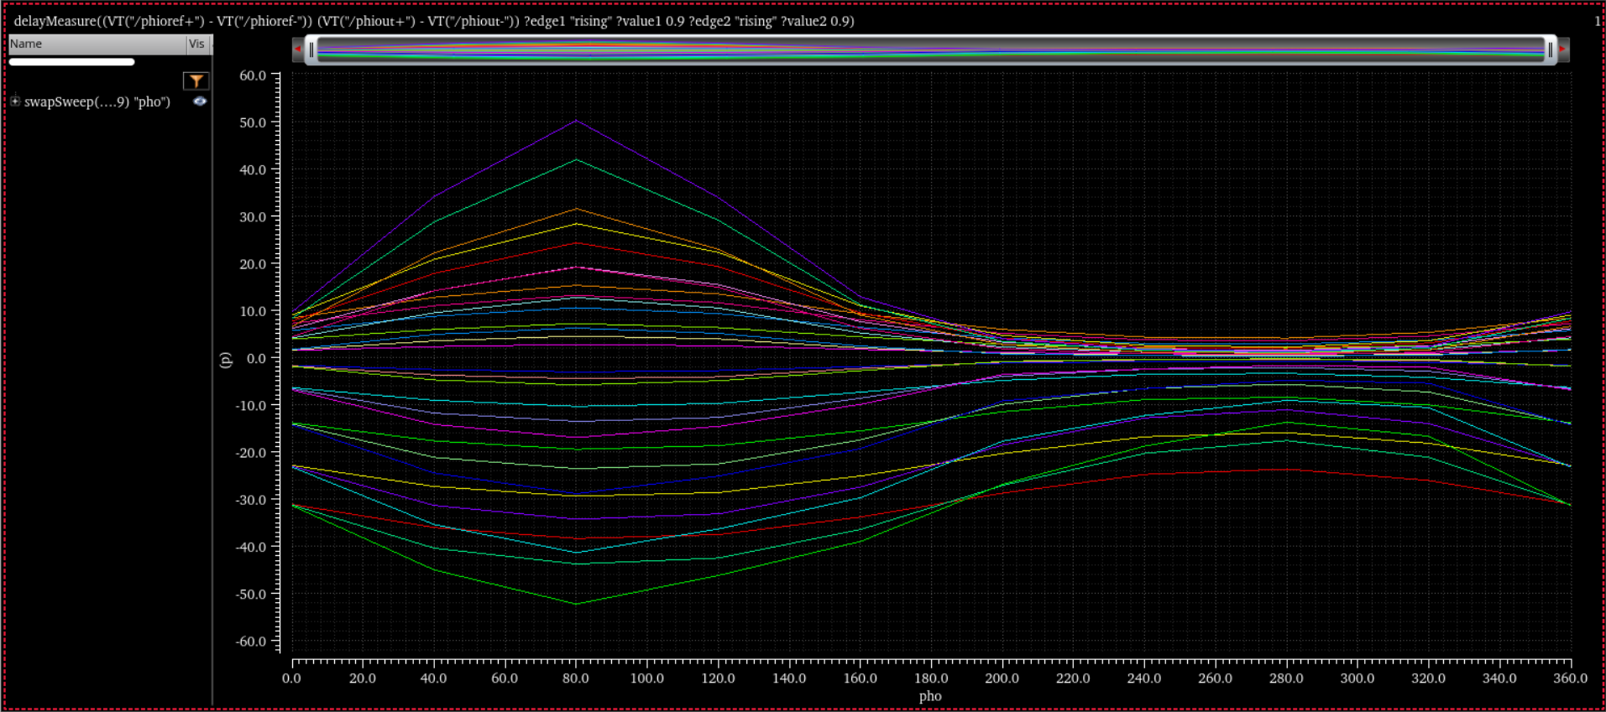
Supply and Combined EMI Paths
Supply EMI affected current and threshold; combined EMI produced residual jitter.
Supply EMI testbench
Supply EMI delay
All-port delay response

Slide 27
Intermediate Architecture: Mathematical Insight
Delay error has multiple sensitivity paths, so only cancelling input common-mode noise is insufficient.
Delta t_d = S_in Delta V_in + S_ref Delta V_ref
+ S_DD Delta V_DD + S_SS Delta V_SS
If sensitivities are unequal: residual jitter remains
Design goal: reduce common-mode terms while preserving delay gain

Slide 28
Final Design Direction
Compressed differential control around the valid operating point

Slide 29
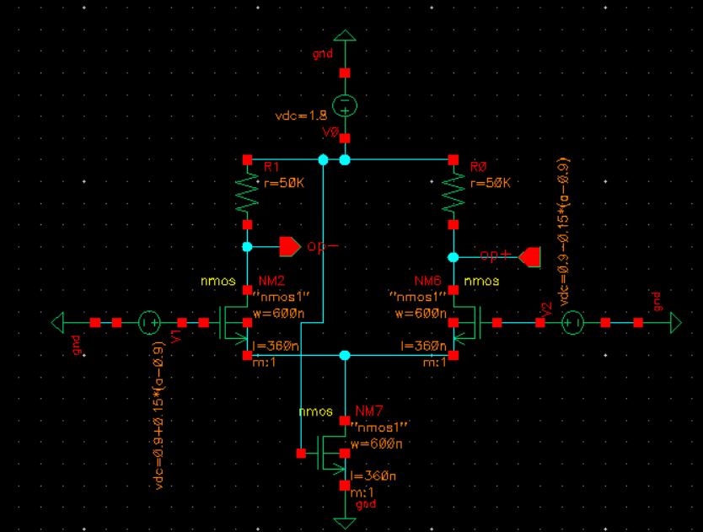
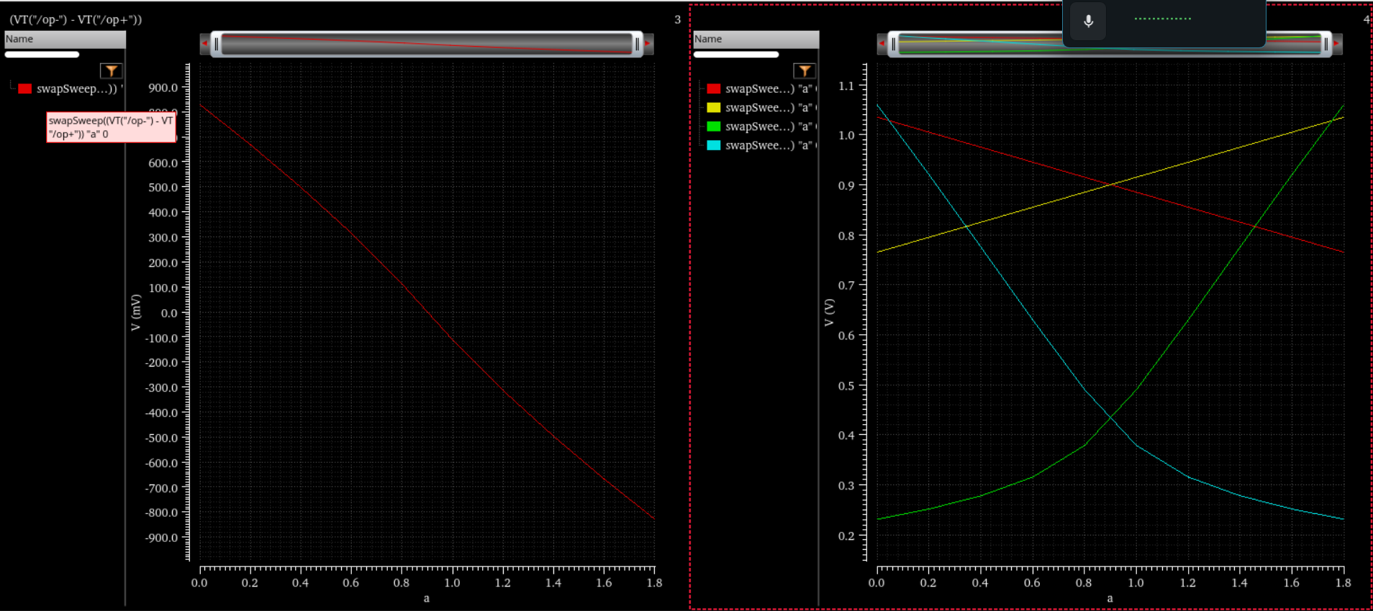
Differential Pair DC Study
Direct 0-1.8 V control pushed the pair out of its valid small-signal/saturation region.
Differential pair schematic
DC output mapping

Slide 30
Compressed Control Mapping
Full rail-to-rail control A is mapped into a small differential swing around 0.9 V.
V_CM = 0.9 V
V_plus = 0.9 + k(A - 0.9)
V_minus = 0.9 - k(A - 0.9)
k ~= 0.15
v_id = 2k(A - 0.9)

Slide 31
Why Compression Helped
Both differential-pair transistors remain closer to saturation.
Common-mode cancellation assumption becomes more valid.
Low-amplitude EMI appears similarly on both branches.
Trade-off: compressed input reduces control sensitivity.
Compressed/small-signal operation around 0.9 V.

Slide 32
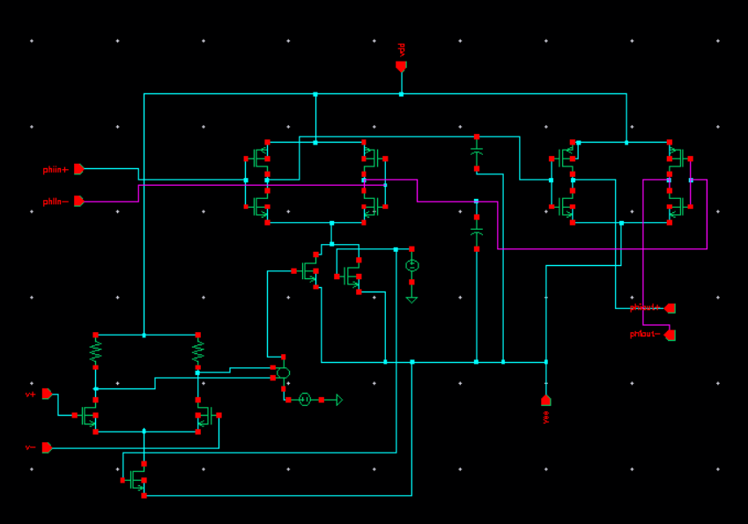
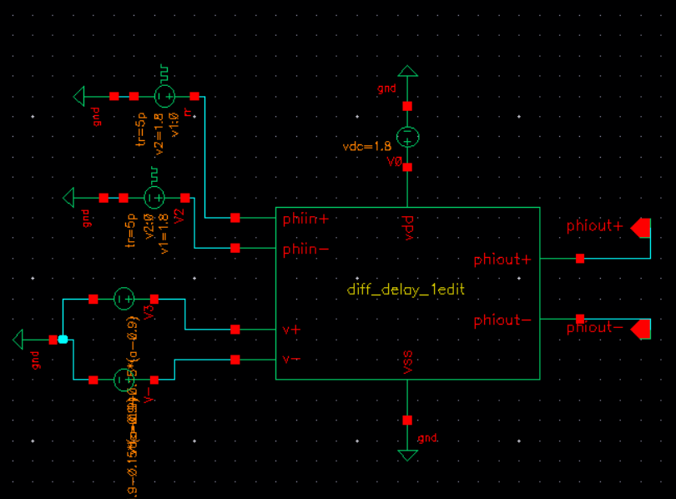
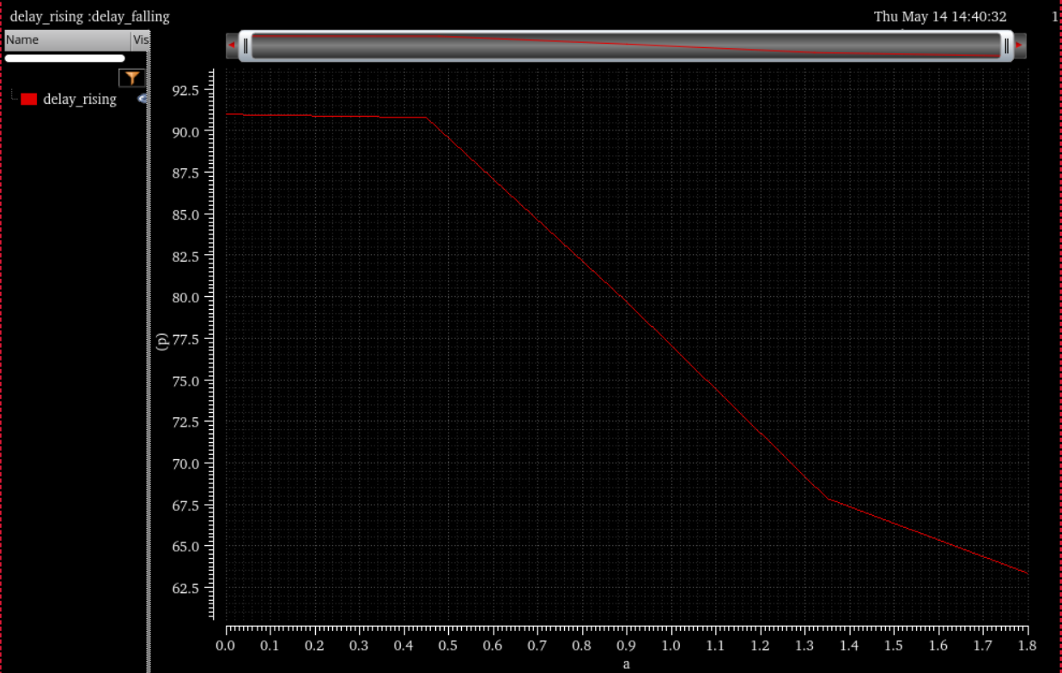
First Edit: Final Carried-Forward Cadence Direction
This is the actual Cadence-based architecture direction used in the final story. No AI-generated white diagram is used.
First edit schematic
Delay response
EMI testbench/result

Slide 33
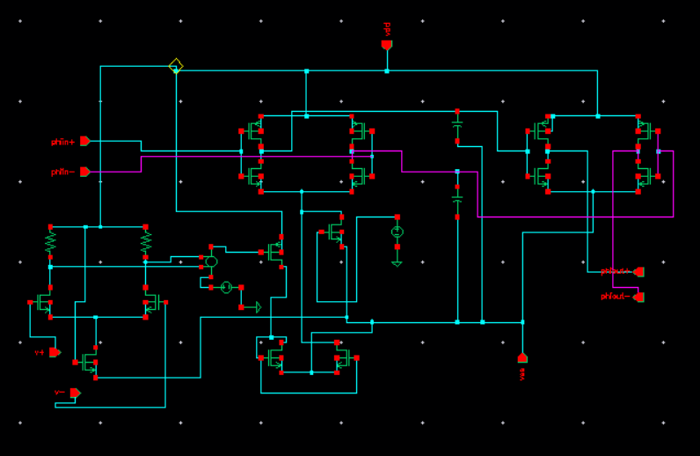
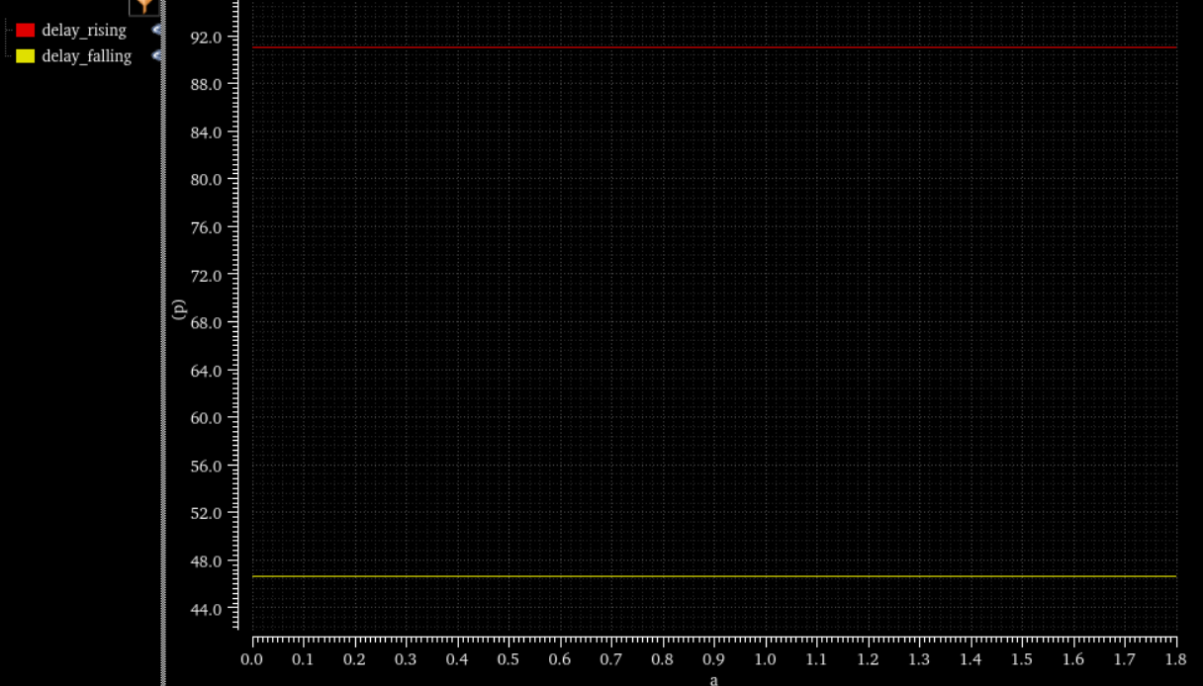
Second Edit: Ruled Out
Single-ended current mirror/tail-control attempt was rejected because delay became nearly constant.
Second edit schematic
Nearly constant delay with sweep

Slide 34
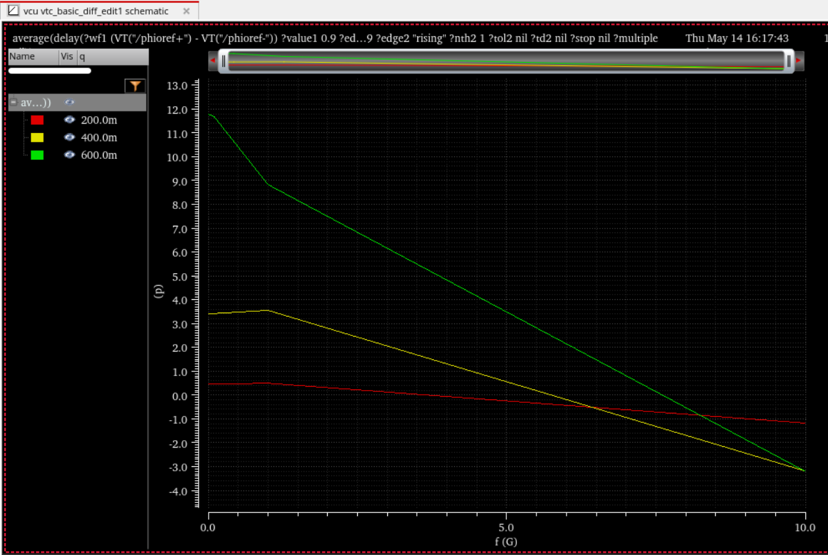
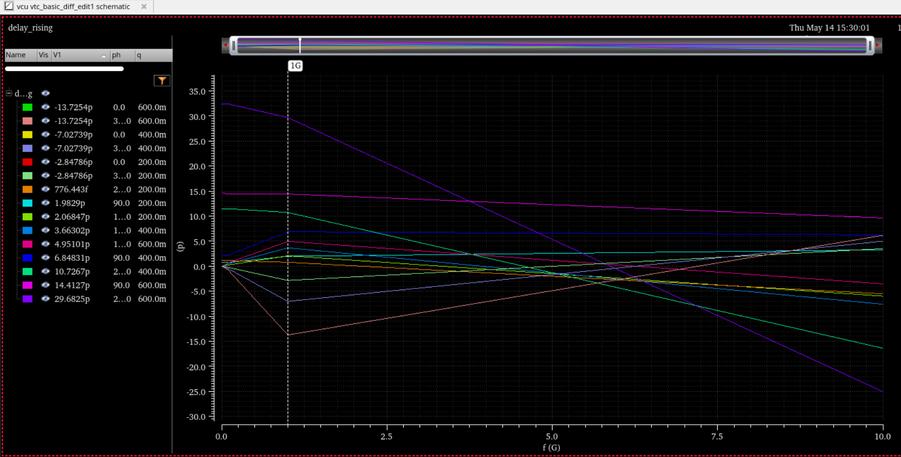
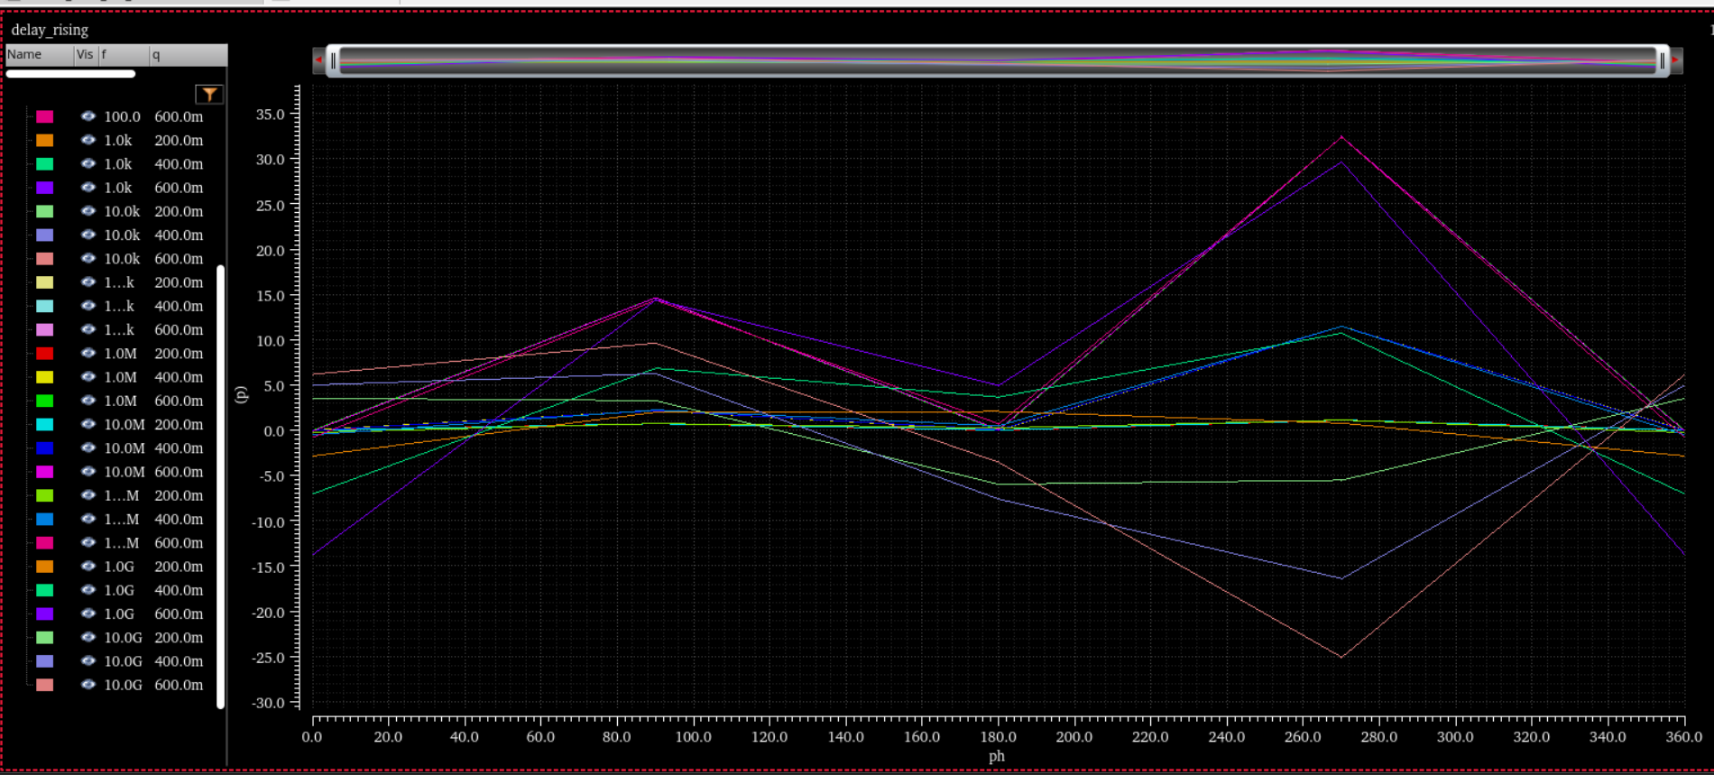
Final EMI Observations
Low frequency / low amplitude: partial cancellation. High frequency / high amplitude: residual jitter remains.
Frequency and phase sweep
Frequency-dependent jitter
Average delay trend

Slide 35
Common-Mode Cancellation: Final Equation
Differential cancellation works only if both branches are matched and equally disturbed.
V_plus = V_CM + v_id/2 + v_cm
V_minus = V_CM - v_id/2 + v_cm
V_plus - V_minus = v_id
T_plus = T(V_plus)+delta_cm
T_minus = T(V_minus)+delta_cm
Delta T = T_plus - T_minus

Slide 36
Small-Signal Delay Path
This is the final analytical link from differential input to delay modulation.
i_o = g_m v_d
v_b = A_v v_d
Delta I = g_m,tail A_v v_d
t_d = C Delta V / (I_0 + Delta I)
Delta t_d ~= -(t_d0/I_0) g_m,tail A_v v_d

Slide 37
Final BTP Contributions
Documented pre-midsem baseline VTC, PVT and EMI behaviour.
Implemented and analyzed SET-H CDC and input-conditioned cells.
Identified why direct differential architectures failed.
Developed compressed differential control for partial EMI cancellation.
Explained remaining high-frequency limitations using CMRR and parasitics.
Final frequency-dependent residual jitter.

Slide 38
Final BTP Conclusion
EMI in a VTC becomes phase-dependent timing jitter.
Dual VCDU reduces common PVT variation, but not unequal EMI coupling.
Differential architecture helps only when biasing, matching and small-signal operation are preserved.
The final proposed direction is a Cadence-based compressed differential-control architecture.
Final carried-forward Cadence schematic.

