Slide 1
MINI PROJECT 11 • GROUP 11
College Course Registration
Management System
A Modern SaaS-Inspired Desktop Application Built with Java Swing & Advanced Collections
ACADEMIC DETAILS & TEAM PROFILE
Subject: Java Programming | Cohort: Jeff Bezos | Batch: 2025-29
Team Members: Jaikishan • Omkar • Sarthak • Danish

Slide 2
PROJECT FOUNDATION
Problem Statement & Objectives
📌 Problem Statement
Modern academic institutions require an automated, conflict-free, and transparent course enrollment system to eliminate manual paperwork and over-enrollment.
Key Challenges Addressed:
• Accidental course over-enrollment beyond classroom capacity.
• Duplicate course registrations by the same student.
• Disconnected administration of faculty and course allocations.
• Lack of immediate student schedule feedback and credit visibility.
🎯 Core Syllabus Objectives
1. Manage Student, Faculty, & Course information.
2. Implement dynamic registration & cancellation workflows.
3. Real-time course capacity monitoring & seat enforcement.
4. Utilize Fixed Arrays (Course[]) for base course storage.
5. Utilize LinkedList for chronological registration audit logs.
6. Utilize HashMap for fast O(1) student/course lookups.
7. Utilize TreeMap for self-sorted course catalog display.
8. Build a dual-portal desktop GUI using Java Swing & FlatLaf.

Slide 3
DATA STRUCTURES MATRIX
Java Collections & Algorithmic Complexities
Course[] (Array)
FIXED INITIAL STORAGE
⚡ Complexity: O(1) Access
Why Used:
Stores the predefined baseline college courses; resized dynamically with System.arraycopy when expanded.
LinkedList<Registration>
CHRONOLOGICAL AUDIT LOG
⚡ Complexity: O(1) Append
Why Used:
Maintains transaction logs in order of occurrence; ideal for tracking active and cancelled records.
HashMap<String, T>
O(1) FAST LOOKUPS
⚡ Complexity: O(1) Search
Why Used:
Provides instant constant-time lookup for Students, Courses, and Faculty by unique ID strings.
TreeMap<String, Course>
SELF-SORTING CATALOG
⚡ Complexity: O(log N) Search
Why Used:
Backed by a Red-Black Binary Search Tree; automatically keeps courses in alphabetical order by ID.

Slide 4
SYSTEM DESIGN
Layered MVC Architecture & Tech Stack
Presentation Layer (GUI)
Tech: Java Swing & FlatLaf | Dual dashboards (Student/Admin), 9 specialized sub-panels, custom TableCellRenderers & Editors, live tab auto-refresh.
Business Service Layer
Tech: Service Interfaces & Logic | CourseService, StudentService, FacultyService, RegistrationService enforcing capacity limits & credit caps.
Data Persistence Layer
Tech: In-Memory DataStore | Centralized repository pattern managing Arrays, LinkedLists, HashMaps, and TreeMaps without external DB lag.
Domain Entity Layer (POJO)
Tech: Core Business Models | Student, Course, Faculty, and Registration models with strictly encapsulated fields and mutators.

Slide 5
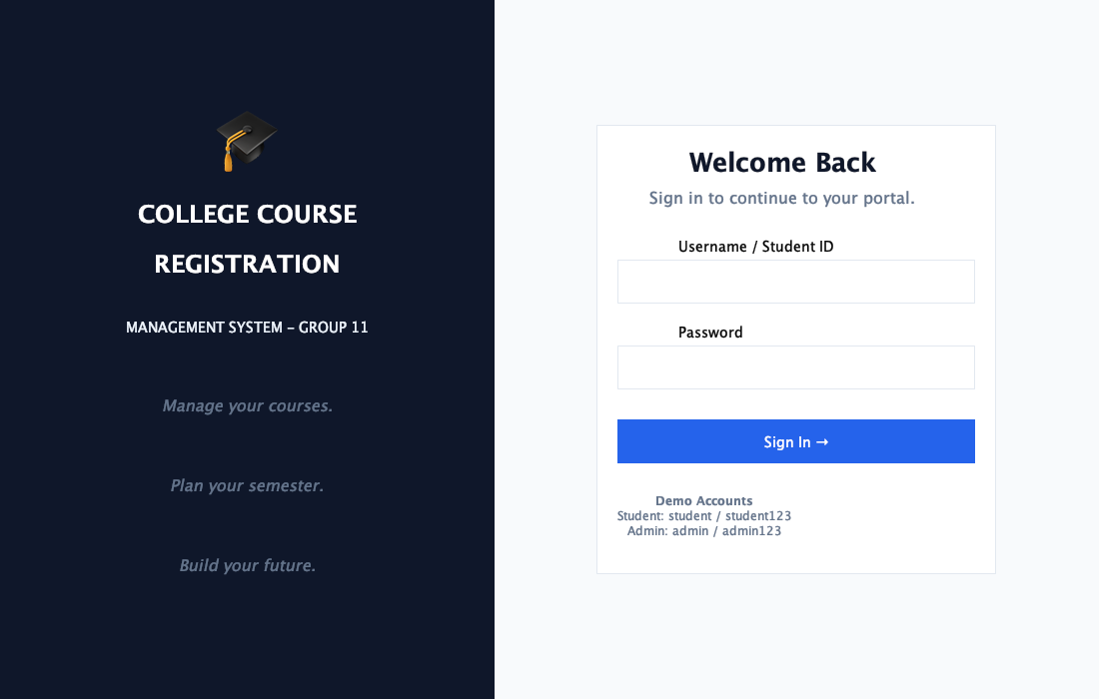
USER INTERFACE
Dual-Portal Authentication (LoginFrame)
✨ Login Highlights
• Modern SaaS Split-Screen: Dark Navy branding left panel with graduation icon.
• Dual Role Routing: Automatically redirects to Admin Portal ('admin') or Student Dashboard.
• Enter-Key Accessibility: JRootPane.setDefaultButton binds Enter key to trigger login instantly.
• Demo Credentials: Displayed directly on form for effortless evaluator testing.
• Graceful Error Handling: Modal alert dialogs on invalid username or password.

Slide 6
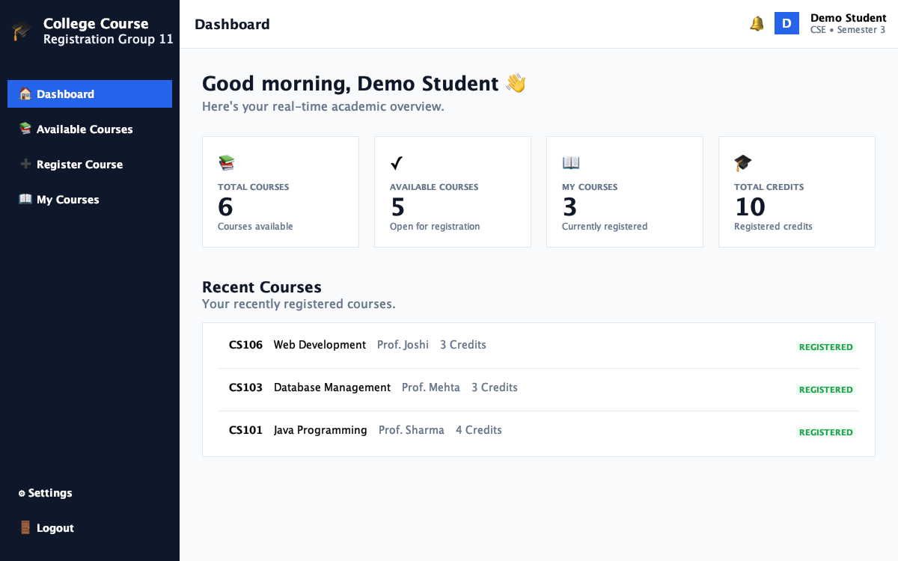
STUDENT EXPERIENCE
Student Dashboard & Live Academic Overview
📊 Dashboard Features
• 4 Live Statistic Cards: Total Courses, Available Courses, Registered Courses, and Registered Credits.
• Recent Courses Audit: Displays up to 3 most recently enrolled courses with credits and faculty.
• Active Tab Highlight: Sidebar tab turns royal blue (#2563EB) for clear navigation state.
• Dynamic Profile Pill: Top-right avatar shows initial letter badge, name, department, and semester.
• Auto-Refresh Sync: Counters recalculate dynamically whenever tab is opened.

Slide 7
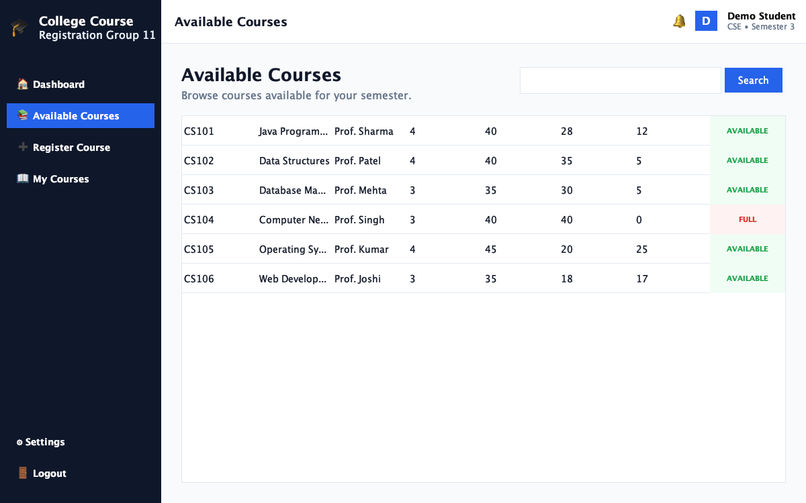
COURSE DISCOVERY
Available Courses & Capacity Enforcement
🔍 Catalog & Status Pills
• Real-Time Seat Availability: Computes Available Seats = Capacity - Registered Students.
• Status Pill CellRenderer: Green 'AVAILABLE' badge vs Red 'FULL' badge (e.g. CS104 40/40 filled).
• Live Search Bar: Filters courses instantaneously across Course ID, Course Name, and Faculty.
• Alphabetical Order: Automatically sorted by Course ID using TreeMap backing store.
• Read-Only Table: Built with DefaultTableModel.isCellEditable() = false.

Slide 8
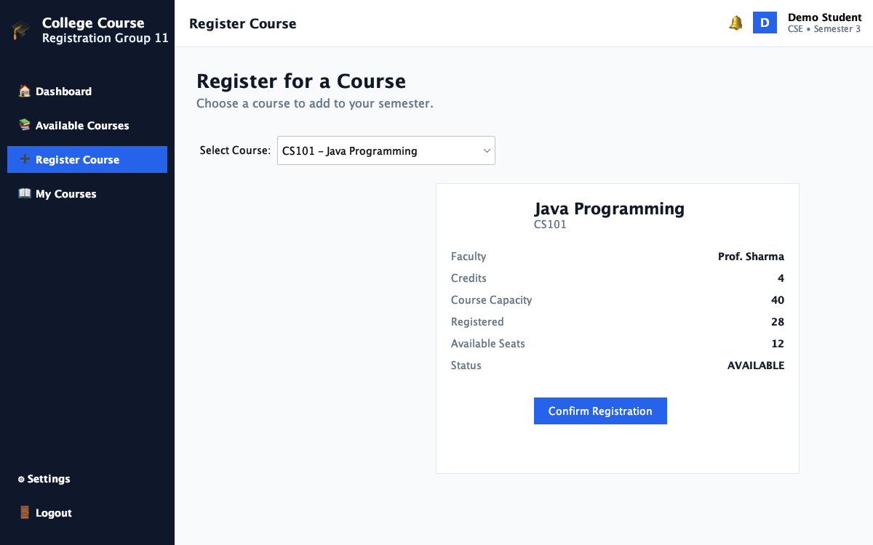
ENROLLMENT RULES
Course Registration & Academic Credit Cap
⚡ Enrollment Engine
• Dynamic Course Info Card: Selecting from JComboBox updates faculty, credits, and vacant seats.
• Over-Enrollment Guard: 'Confirm Registration' button disables automatically if course is full.
• Duplicate Prevention: Blocks repeated registration attempts with explanatory warning.
• 18-Credit Maximum Cap: Enforces university semester credit limit to prevent student overload.
• Immediate Seat Decrement: Enrolling automatically increments registered student count.

Slide 9
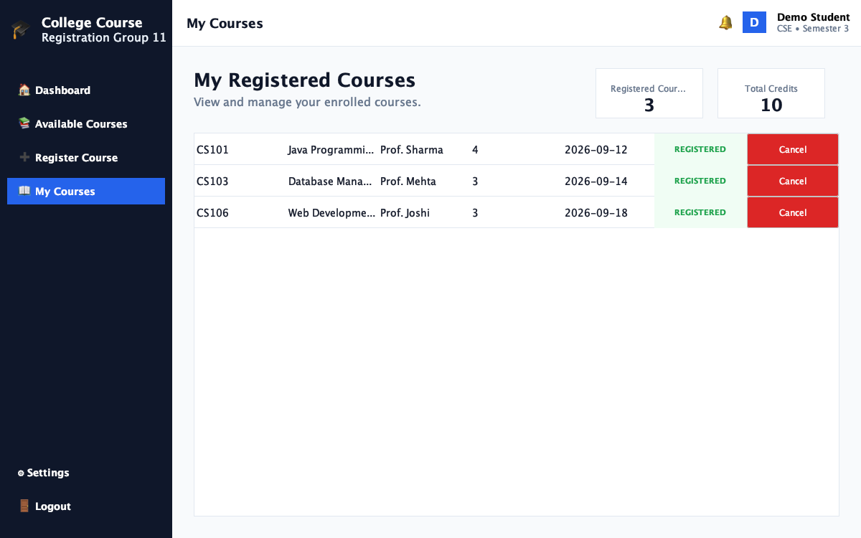
SCHEDULE MANAGEMENT
My Courses & Interactive Cancellation
🗑️ Instant Seat Release
• Schedule Overview: Shows enrolled courses with credits and registration dates.
• Live Credits Header: Real-time calculation of total enrolled credits.
• Table Row ButtonEditor: Custom TableCellEditor allows clicking red 'Cancel' button in table.
• Confirmation Guard: Prompts student before cancelling to prevent accidental deregistration.
• Restores Vacancy: Cancelling instantly decrements course enrollment count, releasing the seat.

Slide 10
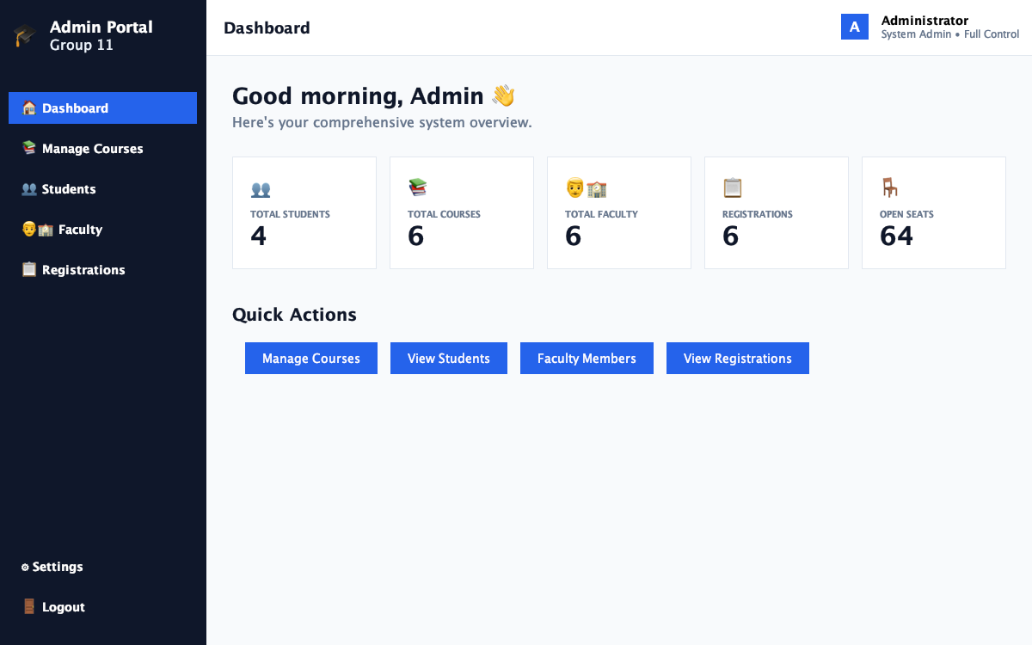
ADMINISTRATIVE PORTAL
Admin Dashboard & Institutional Metrics
🏛️ Executive Overview
• 5 Institutional Metrics: Total Students, Total Courses, Total Faculty, Total Registrations, and Open Seats.
• Real-Time Seat Aggregation: Loops through all courses to compute vacant seat capacity.
• Quick Action Buttons: One-click navigation to Manage Courses, View Students, Faculty, and Registrations.
• Auto-Refresh Synchronized: RefreshData() recalibrates counts whenever any admin tab is opened.
• Administrator Profile Badge: Highlights system administrator role in top header.

Slide 11
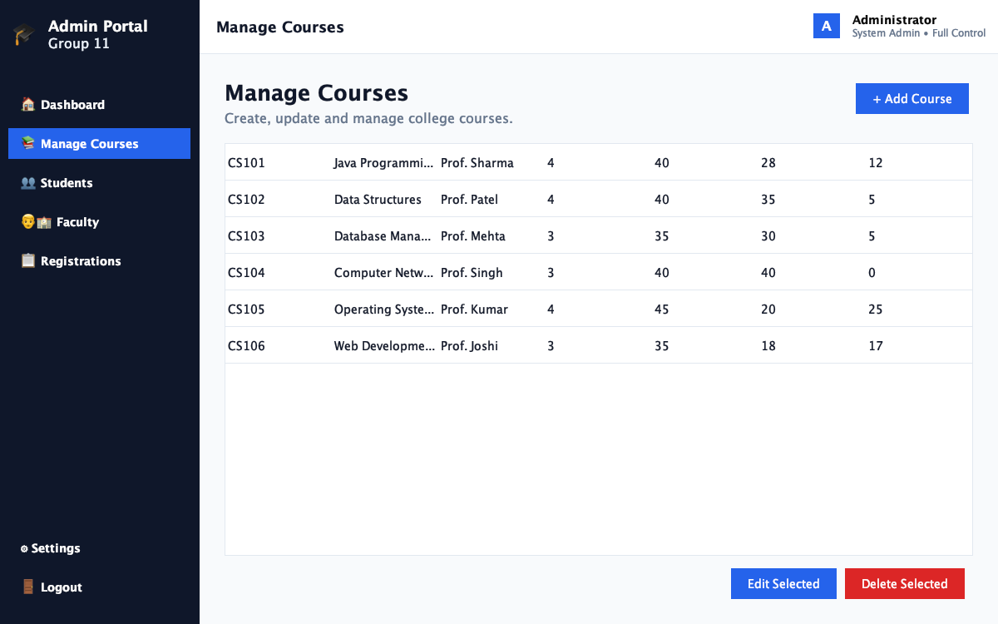
COURSE ADMINISTRATION
Course CRUD & Safe Deletion Guard
🛡️ CRUD & Data Safety
• Complete Course CRUD: Admins can create new courses, edit offerings, or remove courses.
• Modal Dialog Forms: Add & Edit modals validate non-empty fields and positive numbers.
• Capacity Constraint Rule: Cannot reduce course capacity below current enrolled student count.
• Safe Deletion Guard: Blocks deletion if registeredStudents > 0, preventing orphaned records.
• 3-Way Collection Sync: Updates Array, HashMap, and TreeMap simultaneously.

Slide 12
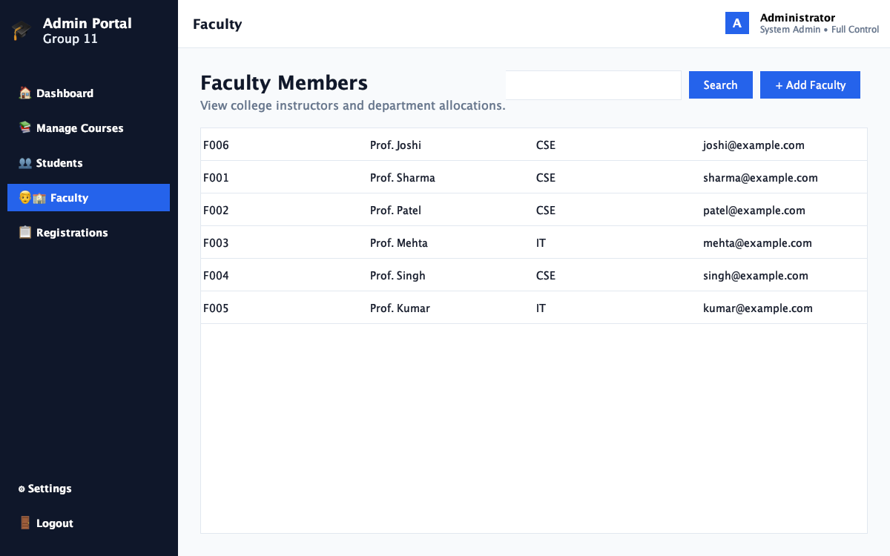
INSTRUCTOR DIRECTORY
Faculty Management System
👨‍🏫 Faculty Portal
• Fulfills Requirement: Specifically fulfills the Problem Statement directive to manage faculty.
• Faculty Directory: Displays Faculty ID, Name, Department (CSE/IT), and Email address.
• Search Bar: Instant multi-field filtering by ID, Name, Department, or Email.
• '+ Add Faculty' Modal: Validates inputs and stores into DataStore.faculties HashMap.
• Duplicate ID Check: Rejects duplicate Faculty IDs with explanatory warning dialog.

Slide 13
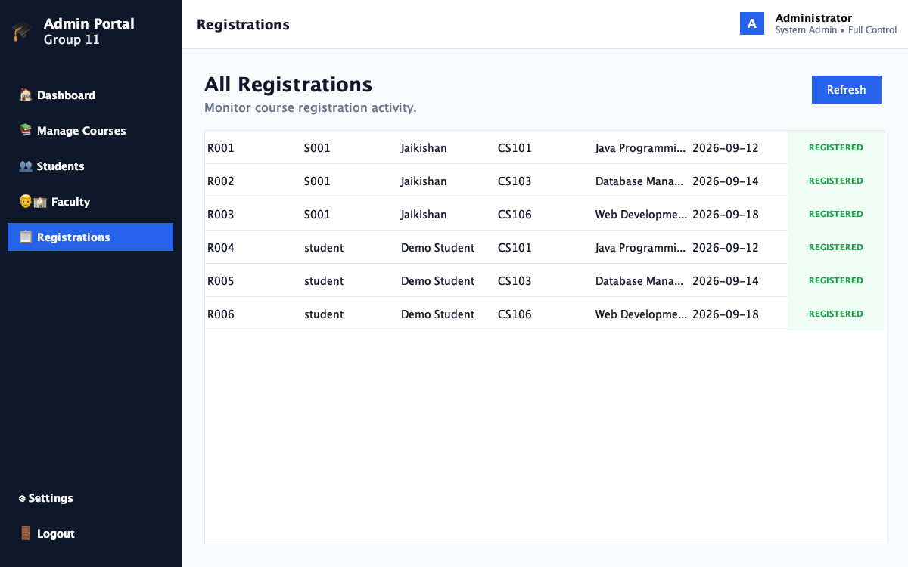
AUDIT & MONITORING
System-Wide Audit Log & Transactions
📋 Transaction History
• Complete Transaction Log: Tracks Registration ID, Student ID, Student Name, Course, and Date.
• Status Badges: Displays green 'REGISTERED' for active enrollments and red 'CANCELLED' for history.
• Preserves History: Cancelled enrollments are never hard-deleted; status transitions preserve audit integrity.
• Powered by LinkedList: Demonstrates chronological sequential traversal of LinkedList<Registration>.
• Refresh Control: Action button instantly queries latest registrations.

Slide 14
TEAM PROFILE
Team Contributions & Module Ownership
👨‍💻 Jaikishan
AUTHENTICATION & STUDENT PORTAL
Key Deliverables:
• Student.java & StudentService.java
• LoginFrame.java with Enter key support
• StudentDashboard & CardLayout
• StudentHomePanel metric cards & live sync
• Main: Authentication + Navigation Architecture
👨‍💻 Omkar
COURSE MANAGEMENT & SAFE CRUD
Key Deliverables:
• Course.java with capacity rules
• CourseService.java & array resizing
• CoursePanel.java with status badges
• AdminCoursePanel.java with Add/Edit forms
• Main: Course Service + Safe Deletion Guard
👨‍💻 Sarthak
REGISTRATION ENGINE & CREDIT CAP
Key Deliverables:
• Registration.java & RegistrationService.java
• 18-Credit Maximum Cap rule enforcement
• RegistrationPanel.java with info card
• MyCoursesPanel.java with table button editor
• Main: Enrollment Engine + Interactive Table UI
👨‍💻 Danish
ADMIN ARCHITECTURE & FACULTY SYSTEM
Key Deliverables:
• DataStore.java (Collections Architecture)
• Faculty.java & FacultyService.java
• AdminFacultyPanel.java directory & modal
• AdminDashboard & AdminHomePanel (5 stats)
• Main: DataStore Architecture + Admin & Faculty

Slide 15
PROJECT SUMMARY & CONCLUSION
A Complete, Enterprise-Grade Academic Solution
• Successfully demonstrates Object-Oriented Programming, Data Structures, and modern GUI design principles.
• Accurately fulfills all 8 Objectives and 10 Steps specified in Mini Project 11 syllabus.
• Features enterprise safeguards: Safe Course Deletion Guard, 18-Credit Maximum Cap, and live cross-panel sync.
🔮 Future Scope:
• Persistent SQL Database Integration (MySQL / PostgreSQL via JDBC).
• Automatic Waitlist Processing when enrolled students cancel their seats.
• Automated Student PDF Schedule Generation with iText.

