Slide 1

Customer Shopping Behavior Analysis
Uncovering insights from 3,900 purchases to guide strategic business decisions through data-driven analysis of spending patterns, customer segments, and product preferences.

Slide 2
DATASET OVERVIEW
The Foundation: Our Data
3.9K
18
50
Total Purchases
Data Points
Locations
Transactions analyzed
Features per customer
Geographic coverage
Key Features Tracked
Customer demographics and subscription status
Purchase details across 4 product categories
Shopping behavior and review ratings
Shipping preferences and payment methods

Slide 3

PYTHON
Data Preparation & Cleaning
01
02
Data Loading & Exploration
Missing Data Handling
Imported dataset and performed initial structure analysis using pandas
Imputed 37 missing Review Rating values using median by category
03
04
Feature Engineering
Database Integration
Created age groups and purchase frequency metrics for deeper insights
Connected to PostgreSQL for advanced SQL analysis

Slide 4
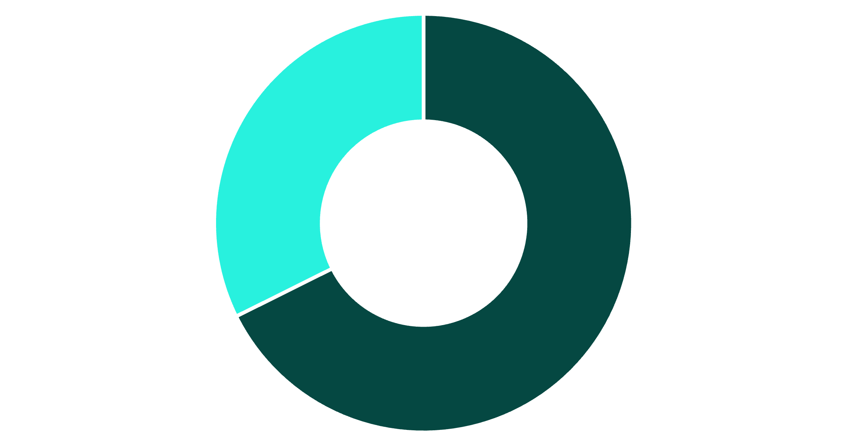
Revenue Insights by Gender
Gender Distribution
Male customers generate 68% of total revenue despite representing 68% of the customer base. This aligns with the higher frequency of male shoppers in the dataset.
Male
Female

Slide 5



SQL ANALYSIS
Key Business Insights
Smart Discount Users
Top-Rated Products
Shipping Preferences
839 customers used discounts but still spent above average ($60), showing price-conscious yet high-value shoppers.
Gloves (3.86), Sandals (3.84), and Boots (3.82) lead in customer satisfaction ratings.
Express shipping customers spend $2 more on average ($60.48 vs $58.46) than standard shipping users.

Slide 6
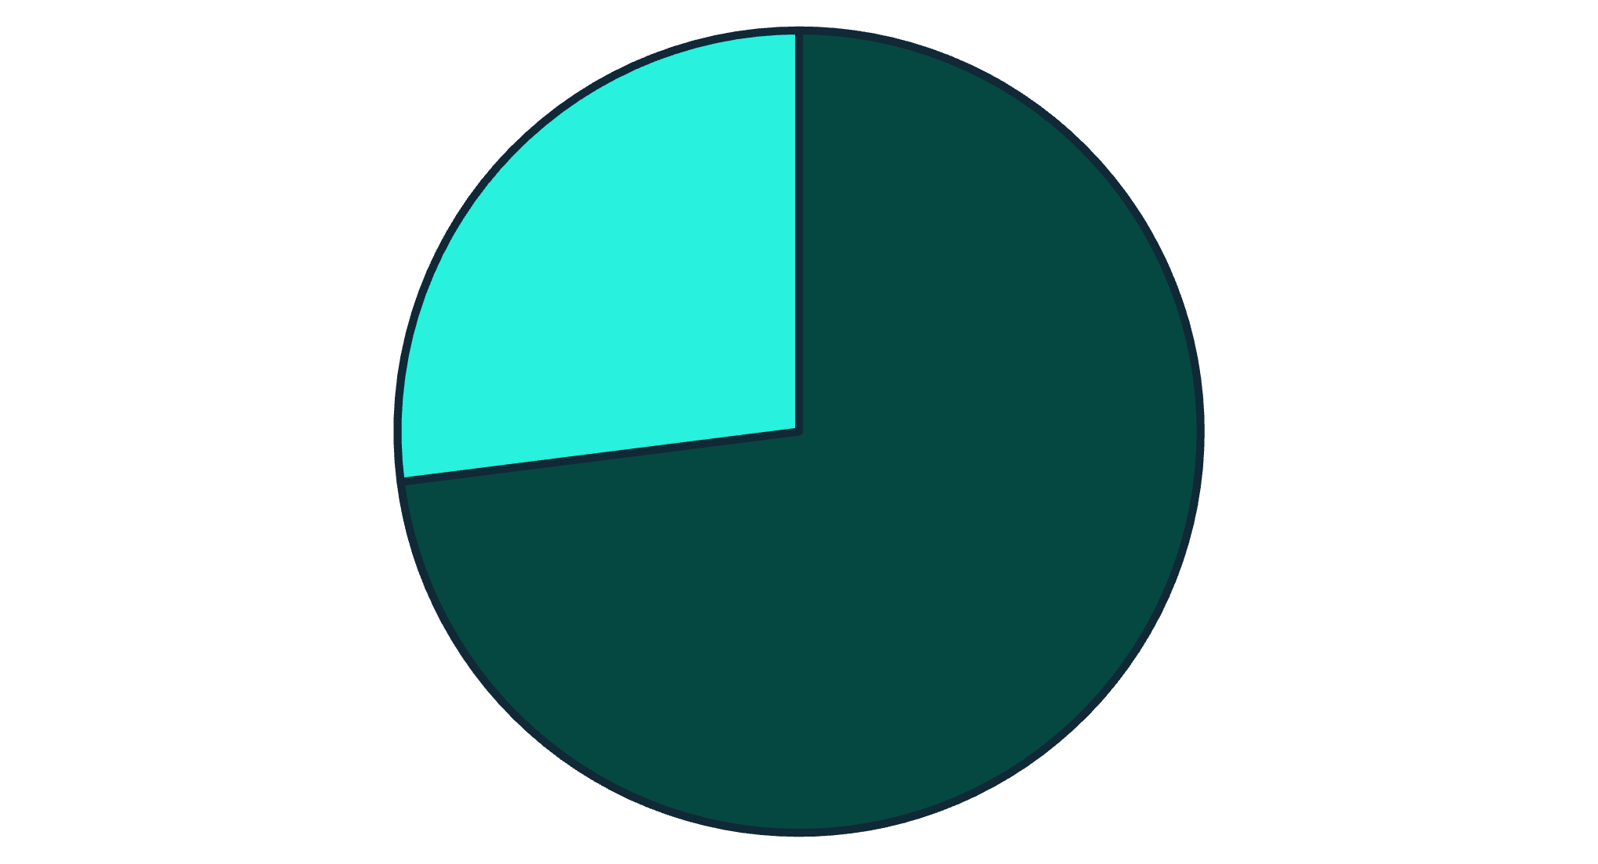


Subscription Status Analysis
Non-Subscribers
Subscribers
Subscription Opportunity
Only 27% of customers are subscribers, yet they contribute significant revenue. Both groups show similar average spend (~$60), indicating untapped potential for subscription growth.
73%
27%
Non-subscribers
Subscribers

Slide 7

Customer Segmentation
Segment Breakdown
Loyal
3,116 customers
5+ purchases
New (83)
Loyal (3,116)
Returning (701)
Returning
701 customers
2-5 purchases
New
83 customers
First purchase
The majority of customers (80%) are classified as Loyal, demonstrating strong retention. However, 958 repeat buyers with 5+ purchases remain unsubscribed—a key conversion opportunity.

Slide 8

Power BI Dashboard Highlights
Revenue by Category
Age Group Performance
Interactive Filters
Dashboard enables filtering by gender, category, shipping type, and subscription status for dynamic insights.
Clothing leads with $100K, followed by Accessories ($70K), Footwear ($30K), and Outerwear ($20K).
Young Adults generate highest revenue ($62K), with consistent performance across all age segments.

Slide 9



RECOMMENDATIONS
Strategic Business Actions
Boost Subscriptions
Loyalty Programs
Targeted Marketing
Promote exclusive benefits to convert the 73% non-subscriber base
Reward repeat buyers to accelerate movement into Loyal segment
Focus on high-revenue age groups and express-shipping users

Slide 10

Key Takeaways
Revenue Opportunity
Subscription Growth
Product Focus
27% subscription rate with 958 unsubscribed repeat buyers represents significant conversion potential.
Highlight top-rated products (Gloves, Sandals, Boots) and balance discount strategy to protect margins.
Male customers and Clothing category drive majority of revenue—optimize inventory and marketing accordingly.

