Slide 1


Slide 2
Sales Prediction for Retail Stores
By JAYAKUMAR

Slide 3
Introduction:
Retail businesses rely on accurate sales forecasting for optimization.
Machine learning offers powerful tools for predicting future sales trends.
Objective: Develop models to forecast sales for individual retail stores.

Slide 4
Objective:-
Develop robust machine learning models for accurate sales prediction.
Provide insights for store managers and decision-makers.
Inform decisions regarding inventory, marketing, and resource allocation.

Slide 5

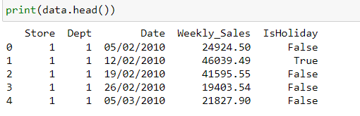



Here is our Dataset Overview .
Historical sales data for 45 stores in different regions.
421,570 instances with 5 attributes: date, weekly sales, store ID, and holiday indicator.
Represents weekly sales data for specific stores.

Slide 6

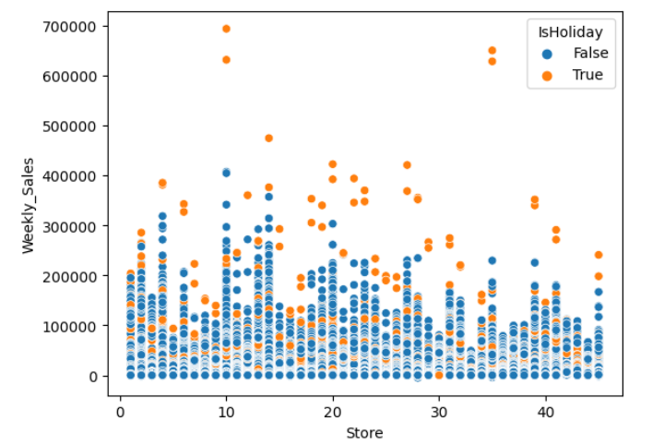



visualize the Weekly sales in each store and differentiate with IS Holiday or not

Slide 7
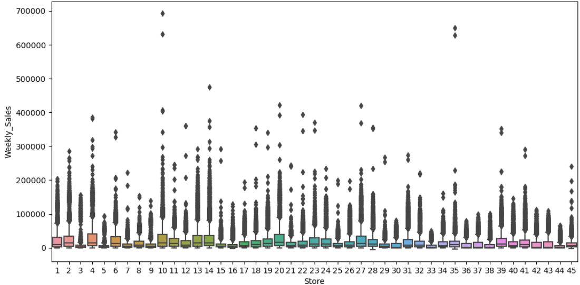
visualize the sales in each store by Box plot :

Slide 8
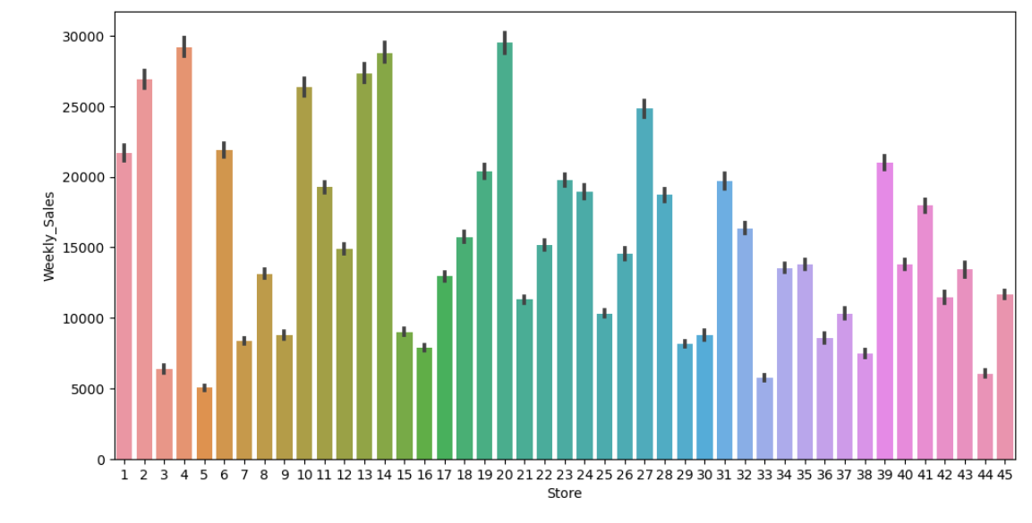
visualize the sales in each store Bar Plot:

Slide 9
ML prediction model :
We will build four ml model and test them out to check the accuracy of the model and then select the model with the most accuracy(selection is based on the R2 score which is higher the better).
The four model which we are going to use are :
Linear Regression model.
SVR model.
Decision Tree Regressor model.
Random Forest Regressor model.

Slide 10
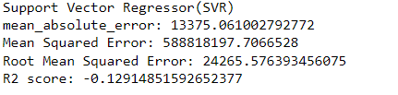
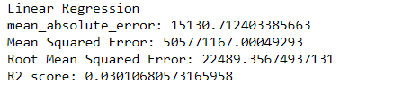
Support Vector Regressor(SVR) model is not a good fit model with a low accuracy of just -12.9%.
Linear Regressor model is not a good fit model with accuracy of 3.01%.

Slide 11
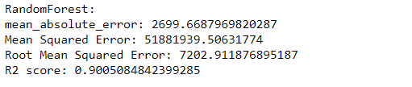
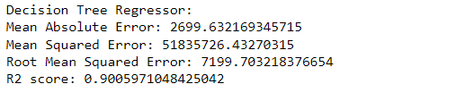
Random Forest model is a good fit model with accuracy score of 90.050%.
Decision Tree Regressor model is a best fit model with accuracy score of 90.059%.

Slide 12
Conclusion:
Summarize findings and insights.
Highlight practical implications for retail businesses.
Discuss future research and improvements.

Slide 13
Thank you !
Jayakumar

