Slide 1
What’s New In Science?
¿Qué hay de nuevo en la ciencia?

Slide 2
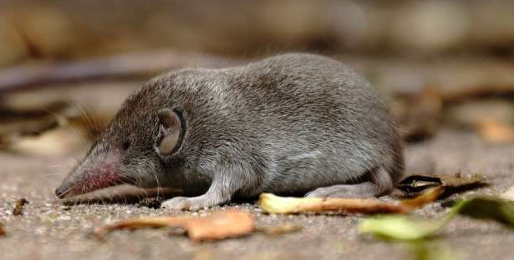
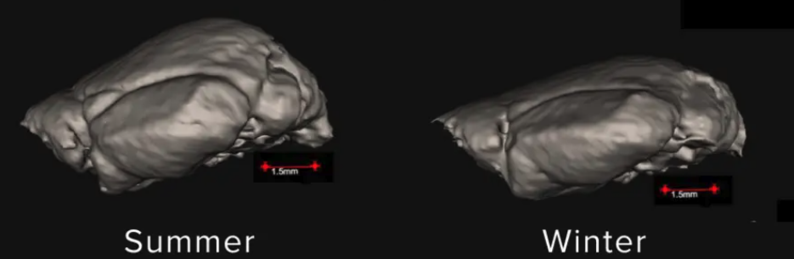
What’s new in science? ¿Qué hay de nuevo en la ciencia?
In the winter, shrews shrink their brains, skull, and other organs but elongate their noses.
En invierno, las musarañas reducen el tamaño de su cerebro, cráneo y otros órganos, pero alargan sus hocicos.
Dehnel’s phenomenon (described in 1949) is the temporary shrinkage of body and organs during winter to reduce energy needs.
El fenómeno de Dehnel (descrito en 1949) es la reducción temporal del cuerpo y los órganos durante el invierno para disminuir las necesidades energéticas.
Looking at shrews from Japan that go through harsh winters, they found the reduced skull during winter times and surprisingly also found taller and wider snouts.
Al estudiar musarañas de Japón que soportan inviernos rigurosos, observaron una reducción del cráneo durante la época invernal y, sorprendentemente, también hallaron hocicos más altos y anchos.
3D shrew brain
Cerebro de musaraña en 3D
verano
invierno
Notes:
https://www.sciencenews.org/article/shrews-winter-organ-mass-adaptation
https://www.theguardian.com/environment/2026/aug/19/shrews-bigger-snouts-winter-cold-air
https://royalsocietypublishing.org/rspb/article/293/2077/20260244/482819/Dehnel-s-phenomenon-is-not-a-simple-reduction-of
Tomakomai, Hokkaido, Japan.
summers high of 75 F, winter low of 15 F
https://phys.org/news/2026-01-small-mammals-brains-survive-cold.html

Slide 3
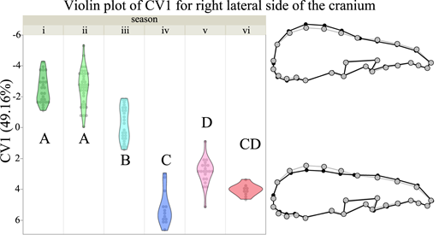
What’s new in science? ¿Qué hay de nuevo en la ciencia?
In the winter, shrews shrink their brains, skull, and other organs but elongate their noses.
En invierno, las musarañas reducen el tamaño de su cerebro, cráneo y otros órganos, pero alargan sus hocicos.
This expansion to adjust to seasonal changes is called “reverse Dehnel’s phenomenon”
Esta expansión para adaptarse a los cambios estacionales se denomina «fenómeno de Dehnel inverso».
Why does the nose expand while the other body parts shrink? Scientists don’t know.
¿Por qué se ensancha la nariz mientras las otras partes del cuerpo se encogen? Los científicos no lo saben.
Some hypotheses include: to warm the cold air or increase ability to sniff out food.
Algunas hipótesis incluyen: calentar el aire frío o aumentar la capacidad de detectar comida mediante el olfato.
Braincase (skull)
Caja craneal (cráneo)
Rostrum (snout)
Rostro (hocico)
Summer
verano
Winter
invierno

Slide 4
Last Week’s Questions
Preguntas de la semana pasada

Slide 5
Last Week’s Questions Preguntas de la semana pasada
What are the most effective ways to change habits? How does your diet affect your ability to change habits?
¿Cuáles son las formas más efectivas de cambiar hábitos? ¿Cómo afecta la alimentación a la capacidad de cambiar hábitos?
How does dopamine affect addiction?
¿Cómo afecta la dopamina a la adicción?
What is logotherapy (Victor Frankl)? Is it still practiced today? How often is it used today?
¿Qué es la logoterapia (Victor Frankl)? ¿Todavía se practica hoy en día? ¿Con qué frecuencia se usa hoy en día?
How much of our brain capacity (%) do we use when we chew gum and walk at the same time compared to taking a test?
¿Cuánta de nuestra capacidad cerebral (%) usamos cuando masticamos chicle y caminamos al mismo tiempo en comparación con hacer un examen?
What does a fish brain look like?
¿Cómo se ve un cerebro de pez?
Where was the kid from that found the cure for sickle cell and how old was he?
¿Dónde estaba el niño que encontró la cura para la célula falciforme y qué edad tenía?
What is playdoh made out of?
¿De qué está hecho el playdoh?
What differentiates dinosaurs from animals that lived together with them?
¿Qué distingue a los dinosaurios de los animales que vivían junto a ellos?
How does the sun stay over Alaska for 30 days straight?
¿Cómo permanece el sol sobre Alaska durante 30 días seguidos?
How many layers of atmosphere and ground does earth have?
¿Cuántas capas de atmósfera y de suelo tiene la Tierra?
Why has no astronaut gone to the dark side of the moon?
¿Por qué ningún astronauta ha ido al lado oscuro de la luna?
What telescope do scientists use to see planets that are light years away?
¿Qué telescopio utilizan los científicos para ver planetas que están a años luz de distancia?
Why can’t astronauts enter earth from the bottom? Why are there no pictures of earth from the bottom?
¿Por qué los astronautas no pueden llegar a la Tierra desde abajo? ¿Por qué no hay imágenes de la Tierra desde abajo?

Slide 6
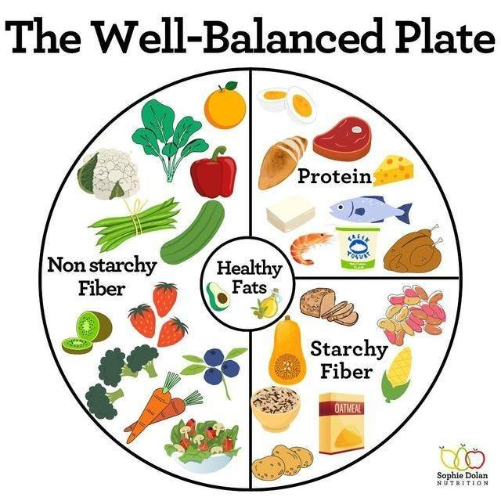
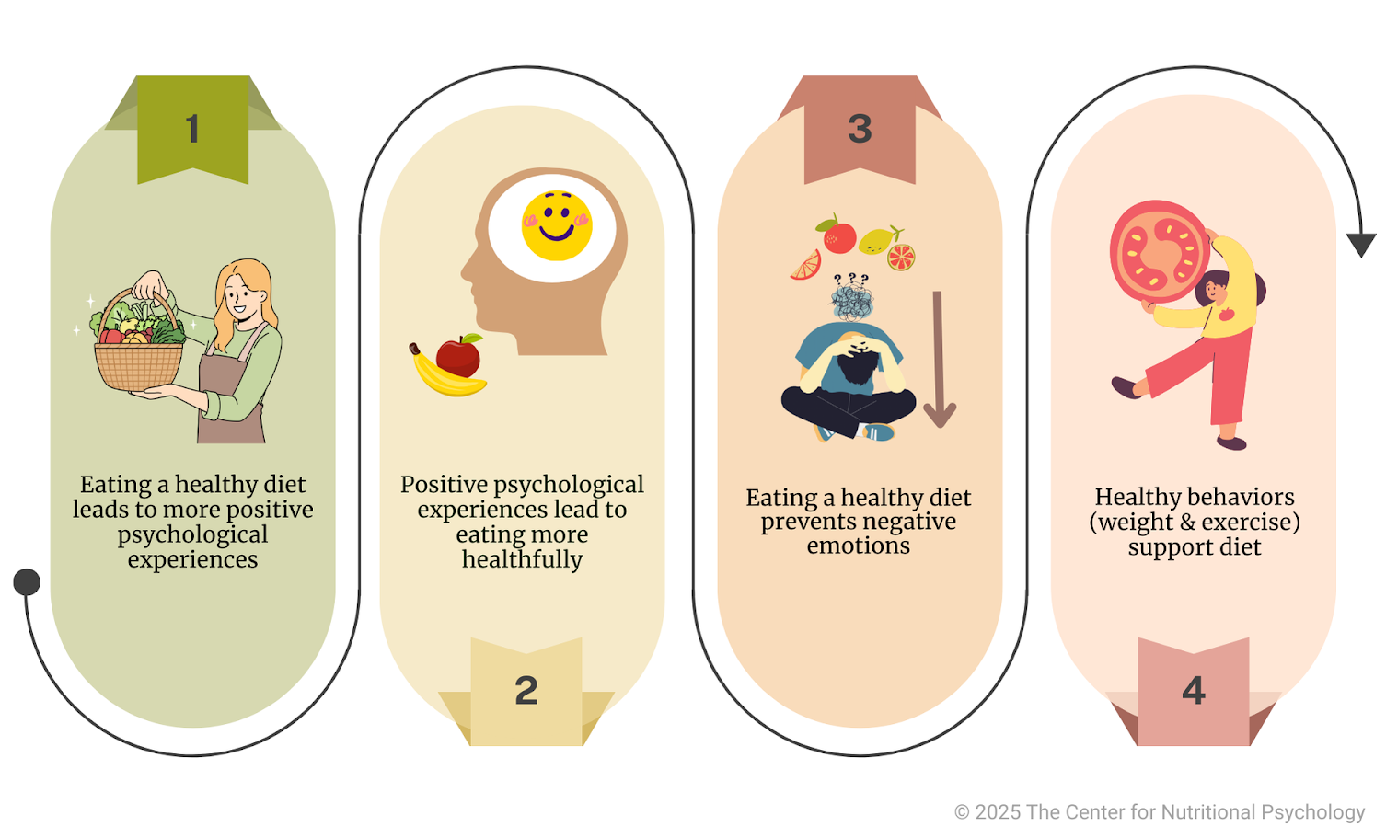
What are the most effective ways to change habits? How does your diet affect your ability to change habits?
¿Cuáles son las formas más efectivas de cambiar hábitos? ¿Cómo afecta la alimentación a la capacidad de cambiar hábitos?
Changing habits is usually most effective when you change the environment and routines surrounding the behavior.
To change a behavior, start with small changes, use specific cues to identify and modify the behavior, and track your progress.
Diet can affect your energy, mood, attention, focus, and self-control.
Eating a balanced diet that includes fruits, vegetables, proteins, and carbohydrates is important for maintaining energy and concentration.
Eating too much food can cause fatigue and discomfort, while eating too little can make it difficult to concentrate and may lead to hunger.
Cambiar los hábitos suele ser más efectivo cuando se cambia el entorno y las rutinas que rodean el comportamiento.
Para cambiar un comportamiento, comiencen con pequeños cambios, utilicen señales específicas para identificar y modificar el comportamiento, y lleven un registro de su progreso.
La alimentación puede afectar la energía, el estado de ánimo, la atención, la concentración y el autocontrol.
Llevar una dieta equilibrada que incluya frutas, verduras, proteínas y carbohidratos es importante para mantener la energía y la concentración.
Comer en exceso puede causar fatiga y malestar, mientras que comer muy poco puede dificultar la concentración y provocar hambre.

Slide 7
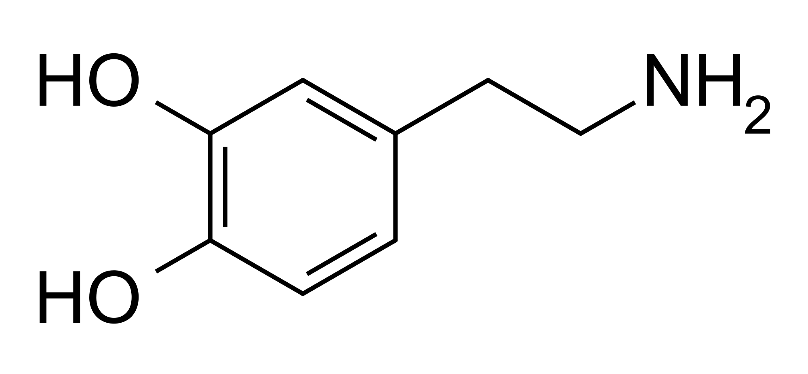
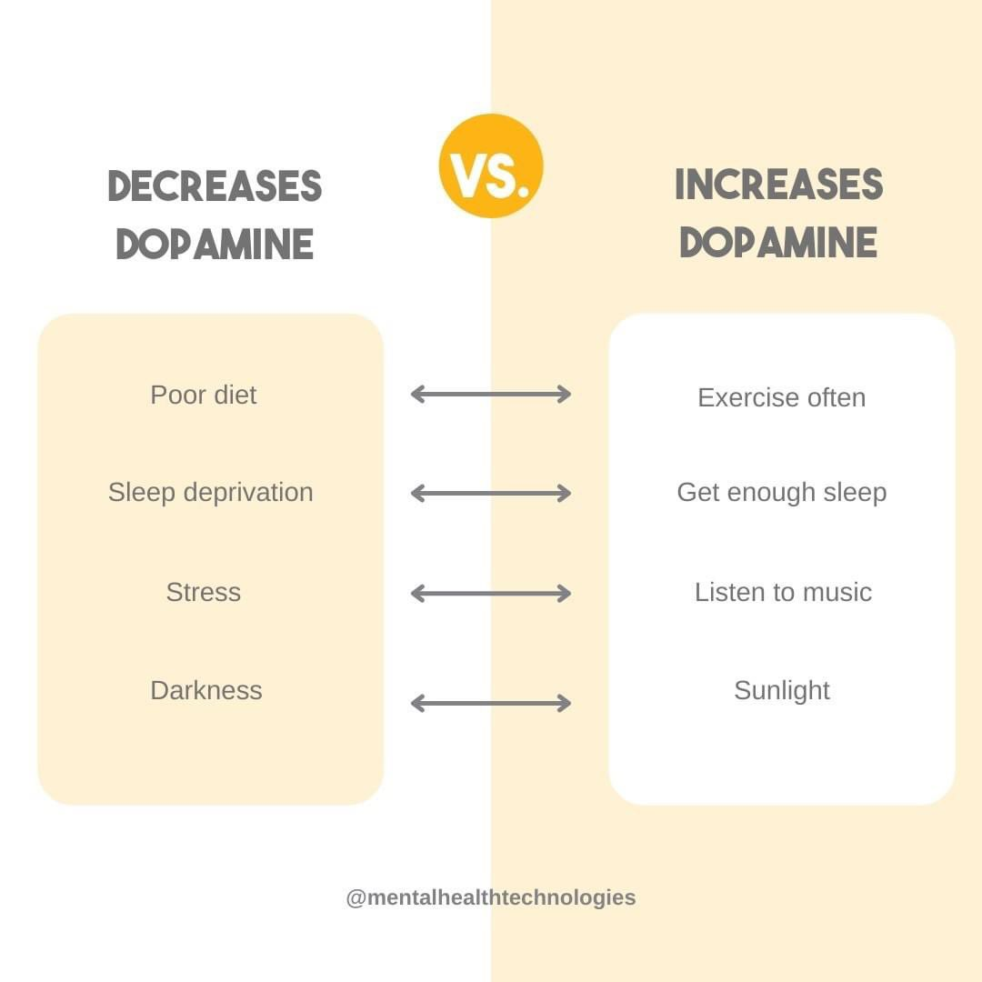
How does dopamine affect addiction?
¿Cómo afecta la dopamina a la adicción?
Dopamine is a neurotransmitter in the brain that is involved in reward, motivation, and learning.
Addictive substances and behaviors can increase dopamine activity, making the experience feel rewarding.
This rewarding feeling can create a cycle that encourages a person to continue the behavior or use the substance.
Beyond the brain’s reward system, dopamine also plays an important role in motivation, learning, and reinforcing behaviors.
La dopamina es un neurotransmisor del cerebro que participa en la recompensa, la motivación y el aprendizaje.
Las sustancias y los comportamientos adictivos pueden aumentar la actividad de la dopamina, lo que hace que la experiencia resulte gratificante.
Esta sensación de recompensa puede crear un ciclo que impulsa a una persona a continuar con el comportamiento o a consumir la sustancia.
Además del sistema de recompensa del cerebro, la dopamina también desempeña un papel importante en la motivación, el aprendizaje y el refuerzo de los comportamientos.

Slide 8
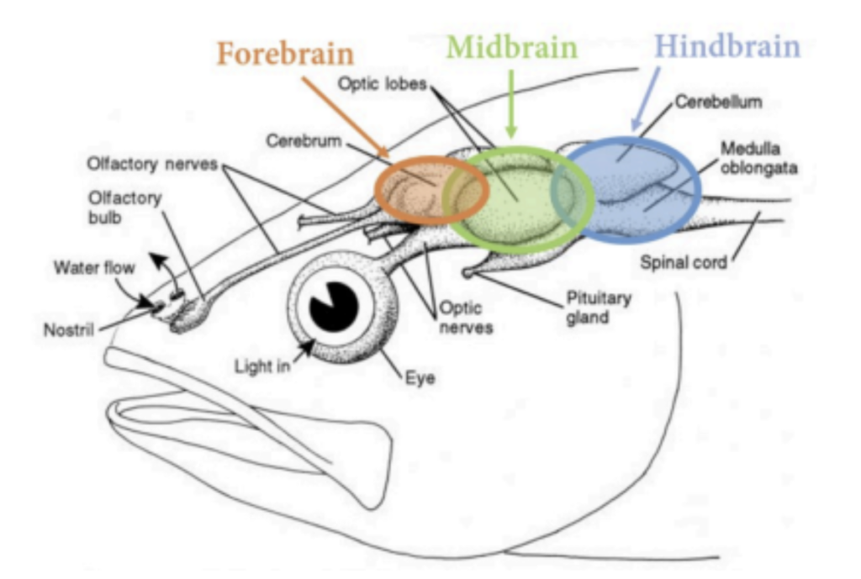
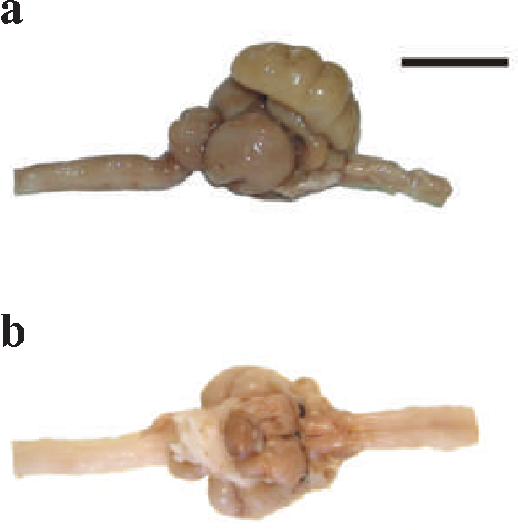
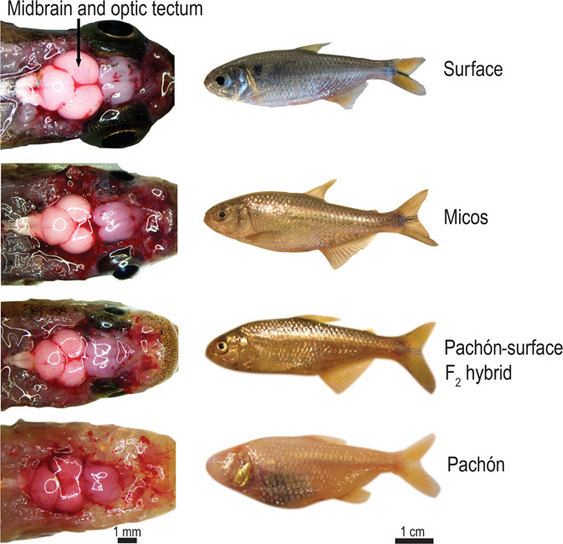
What does a fish brain look like?
¿Cómo se ve un cerebro de pez?
Fish brains can vary in size and shape depending on the species.
A fish brain is usually much smaller than a human brain.
Fish brains are generally more elongated compared to human brains.
Fish brains contain many of the same basic structures found in human brains, including the medulla, cerebellum, and optic lobes.
Los cerebros de los peces pueden variar en tamaño y forma dependiendo de la especie.
El cerebro de un pez generalmente es mucho más pequeño que el cerebro humano.
Los cerebros de los peces suelen ser más alargados en comparación con los cerebros humanos.
Los cerebros de los peces contienen muchas de las mismas estructuras básicas que se encuentran en los cerebros humanos, como el bulbo raquídeo, el cerebelo y los lóbulos ópticos.
Jen

Slide 9
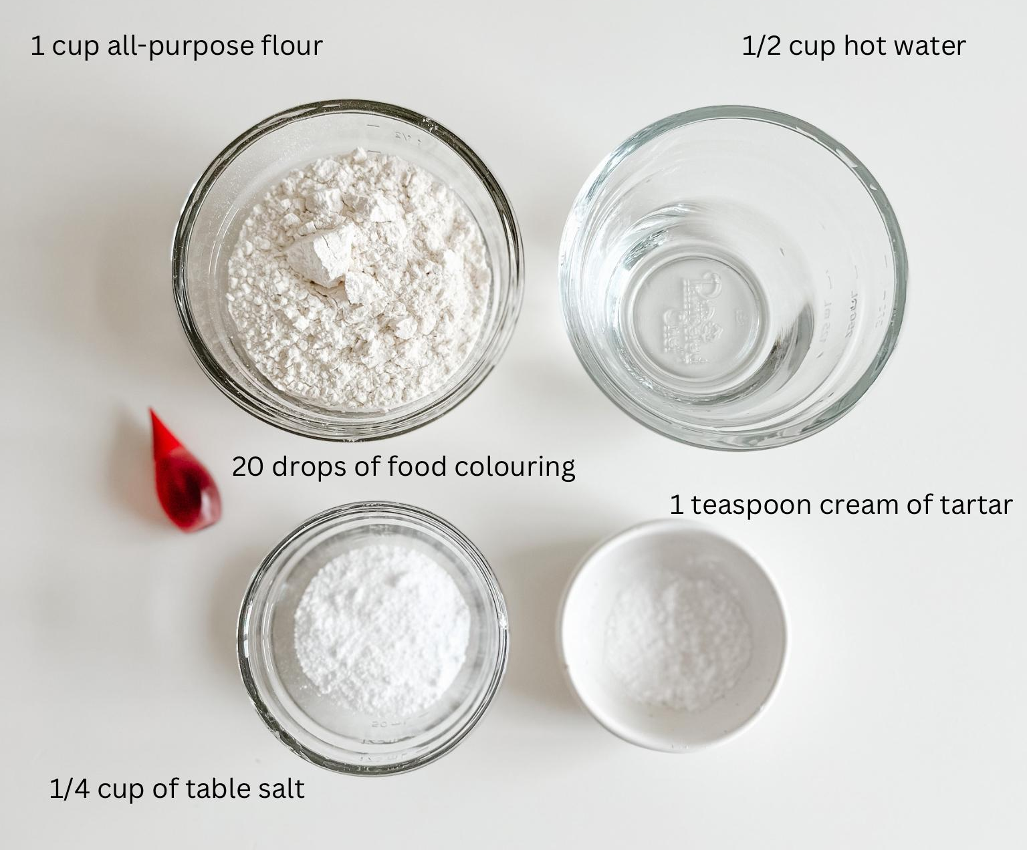
What is playdoh made out of?
¿De qué está hecho el playdoh?
Play-Doh is mainly made from water, flour, and salt.
It also contains starch, which helps give it its soft, dough-like texture.
Food coloring is added to give Play-Doh its different colors. Small amounts of preservatives and other ingredients help keep it fresh and prevent it from growing mold.
Play-Doh está hecho principalmente de agua, harina y sal.
También contiene almidón, que ayuda a darle su textura suave y parecida a la masa.
Se añade colorante alimentario para darle a Play-Doh sus diferentes colores.
Pequeñas cantidades de conservantes y otros ingredientes ayudan a mantenerlo fresco y evitan que le crezca moho.
Jen
Notes:
Core Ingredients and Their Functions
Flour (Wheat): Provides the bulk structure and starch binder. When mixed with water, the proteins in flour form gluten matrices that give the dough its solid, moldable body
Water: Hydrates the flour and dissolves the salt, turning a powdery mixture into a unified, cohesive dough.
Salt (Sodium Chloride): Acts as a powerful natural preservative to inhibit mold and bacterial growth. It also hardens the structure slightly and deters young children or pets from eating the dough due to its intense, unpleasant taste.
Cream of Tartar (Potassium Bitartrate): Acts as an acid that disrupts tight protein clumping in the flour, preventing the dough from becoming crumbly and making it stretchy, smooth, and elastic. It also enhances preservation.
Vegetable Oil: Serves as a lubricant that coats the flour and gluten strands. This retains moisture so the dough stays soft, prevents it from sticking to hands, and gives it a smooth sheen.
Food Coloring / Pigments: Added strictly for visual appeal and creative engagement.

Slide 10
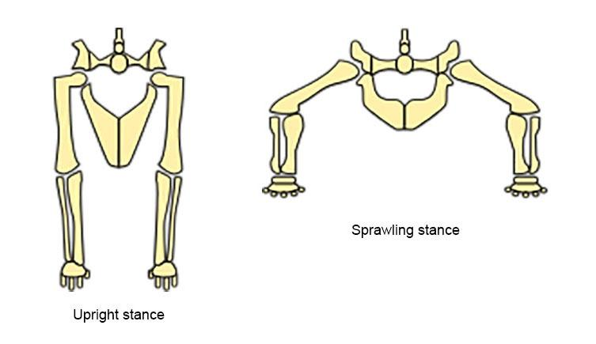
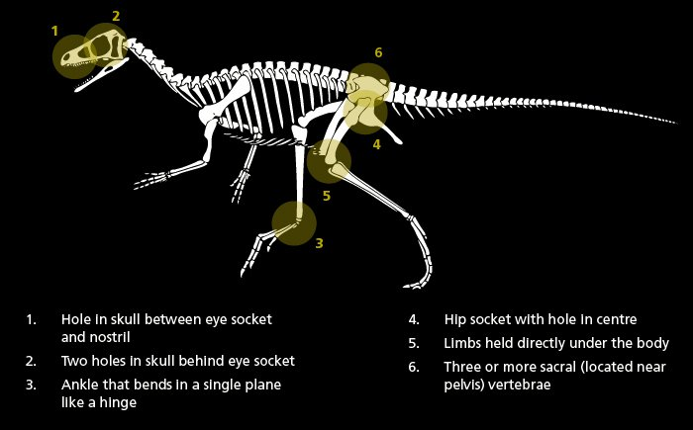
What differentiates dinosaurs from animals that lived together with them?
¿Qué distingue a los dinosaurios de los animales que vivían junto a ellos?
Dinosaurs were reptiles with a specific hip and leg structure that allowed them to stand more upright than many other reptiles.
One important feature that separates dinosaurs from other reptiles is their distinctive hip and ankle anatomy.
Dinosaurs lived on land, but they were not the only large land animals during the Mesozoic Era. Other reptiles, mammals, amphibians, and insects lived alongside them.
Los dinosaurios eran reptiles con una estructura específica de las caderas y las patas que les permitía mantenerse más erguidos que muchos otros reptiles.
Una característica importante que diferencia a los dinosaurios de otros reptiles es la anatomía distintiva de sus caderas y tobillos.
Los dinosaurios vivían en tierra, pero no eran los únicos animales terrestres grandes durante la Era Mesozoica. Otros reptiles, mamíferos, anfibios e insectos vivían junto a ellos.
Reptiles
Dinosaurs

Slide 11
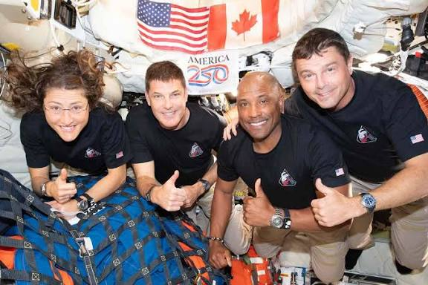
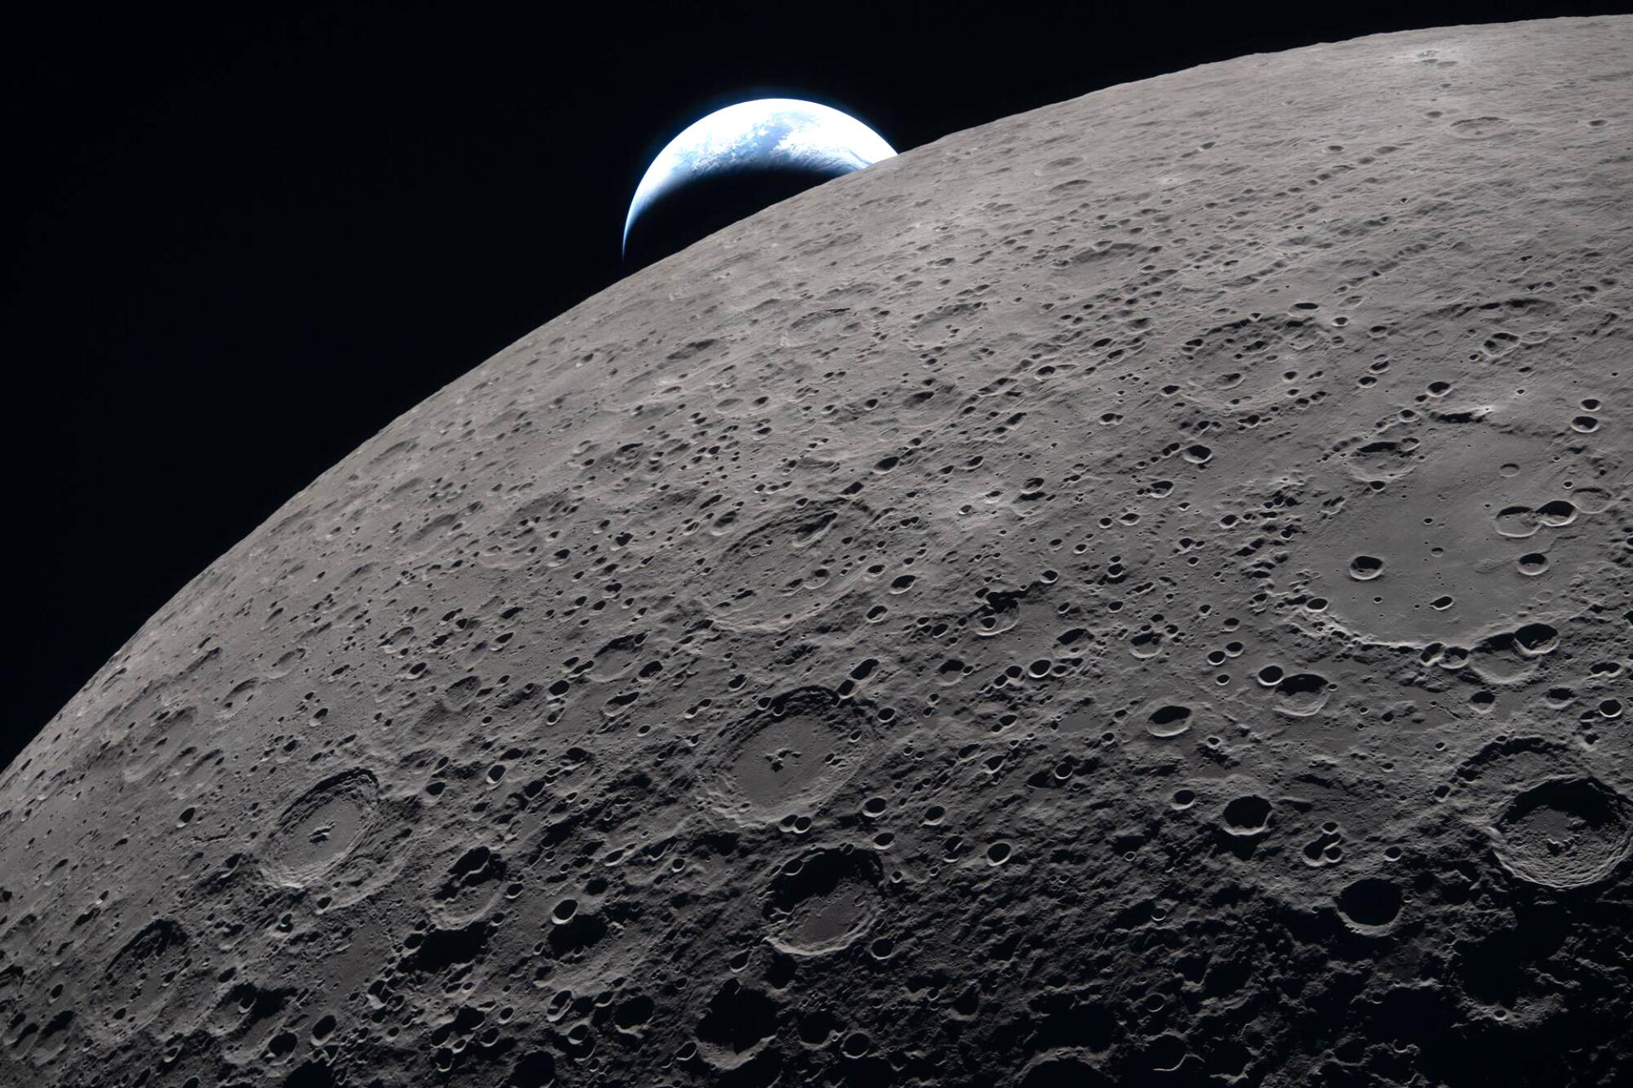
Why has no astronaut gone to the dark side of the moon?
¿Por qué ningún astronauta ha ido al lado oscuro de la luna?
The Moon is tidally locked with Earth, meaning the same side generally faces Earth while the other side faces away from us.
The far side is difficult to communicate with because the Moon blocks direct radio signals between it and Earth.
Human missions have focused on areas of the Moon that are easier to communicate with and have been more practical for earlier missions.
No human has yet landed on the far side, although future missions could potentially send astronauts there.
La Luna siempre da la misma cara a la Tierra, por lo que un lado mira hacia nosotros y el otro queda del lado opuesto.
Es difícil comunicarse con el lado lejano porque la Luna bloquea las señales de radio directas entre ese lado y la Tierra.
Las misiones tripuladas se han enfocado en zonas de la Luna con las que es más fácil comunicarse y que resultaban más prácticas para las misiones anteriores.
Ningún ser humano ha aterrizado todavía en el lado lejano de la Luna, aunque futuras misiones podrían enviar astronautas allí.
In april 2026, the artemis 2 crew flew behind the moon for 40 minutes.
En abril de 2026, la tripulación de Artemis II voló detrás de la Luna durante 40 minutos.

Slide 12
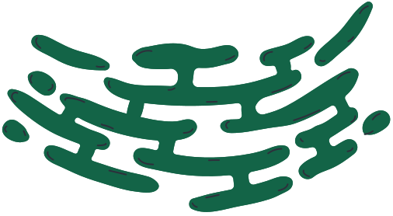
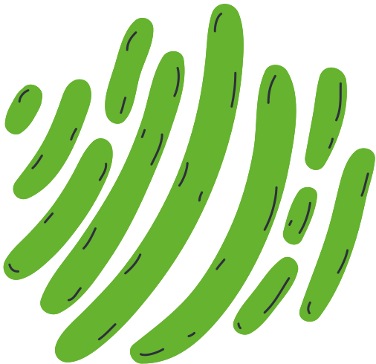
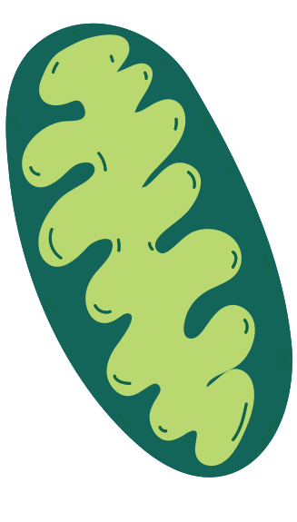
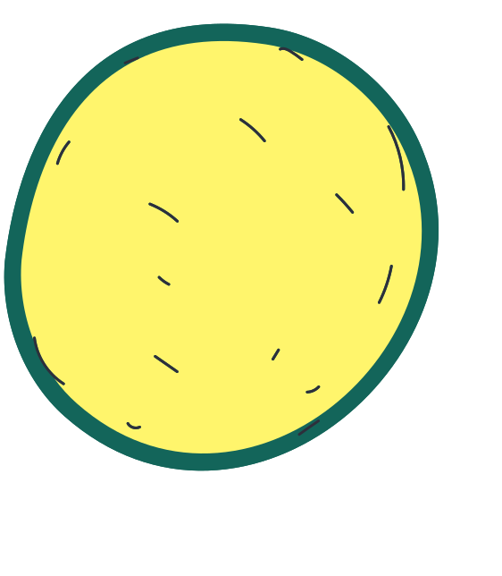
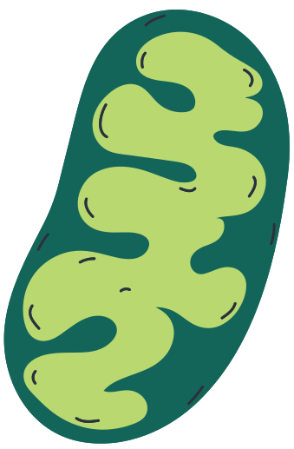
THE BIOLOGICAL BASIS OF BEHAVIOR
LA BASES BIOLÓGICAS DEL COMPORTAMIENTO

Slide 13
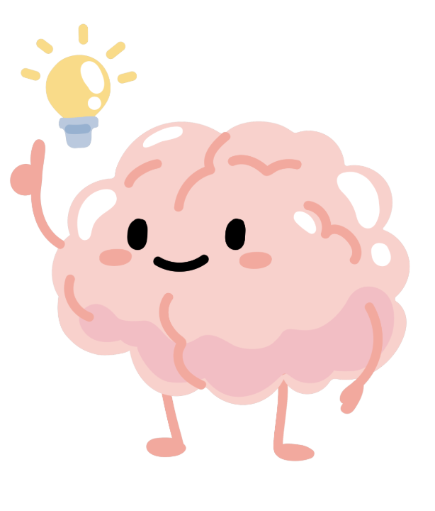
01 (10 min) | (10 minutos)
The Nervous System
El sistema nervioso
Overview | Temario
02 (15 min) | (15 minutos)
The Brain & its Parts
El cerebro y sus partes
03 (10 min) | (10 minutos)
Neurotransmitters & Hormones
Neurotransmisores y hormonas
04 (10 min) | (10 minutos)
Nature, Nurture, and the Environment
La naturaleza, la crianza y el medio ambiente

Slide 14
01 (10 min) | (10 minutos)
The Nervous System
El sistema nervioso
Overview | Temario
02 (15 min) | (15 minutos)
The Brain & its Parts
El cerebro y sus partes
03 (15 min) | (15 minutos)
Neurons and Neural Communication
Neuronas y Comunicación Neuronal
04 (10 min) | (10 minutos)
Neurotransmitters & Hormones
Neurotransmisores y Hormonas
05 (10 min) | (10 minutos)
Nature, Nurture, and the Environment
Naturaleza, Crianza y el Medio Ambiente

Slide 15
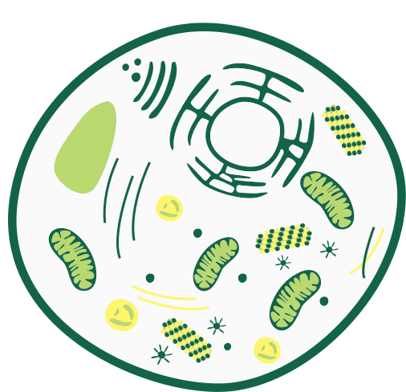
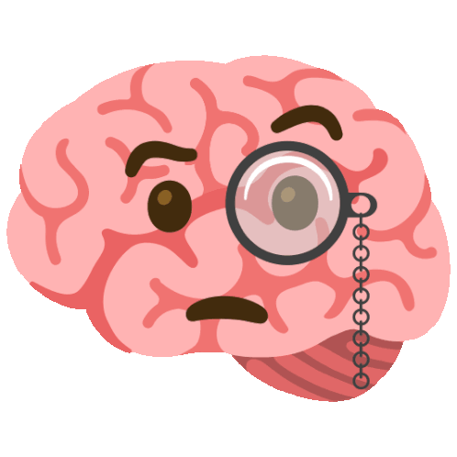
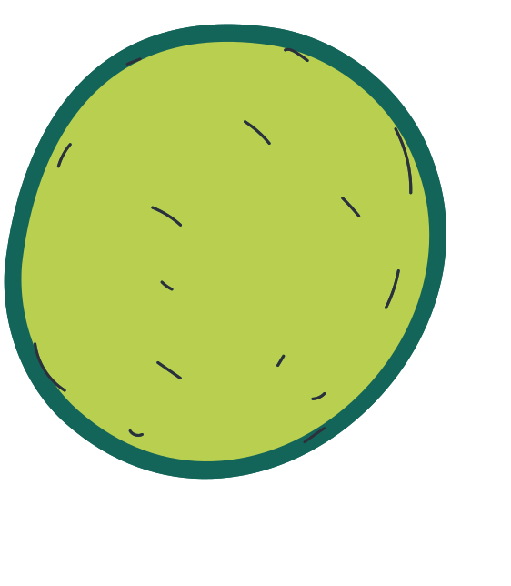

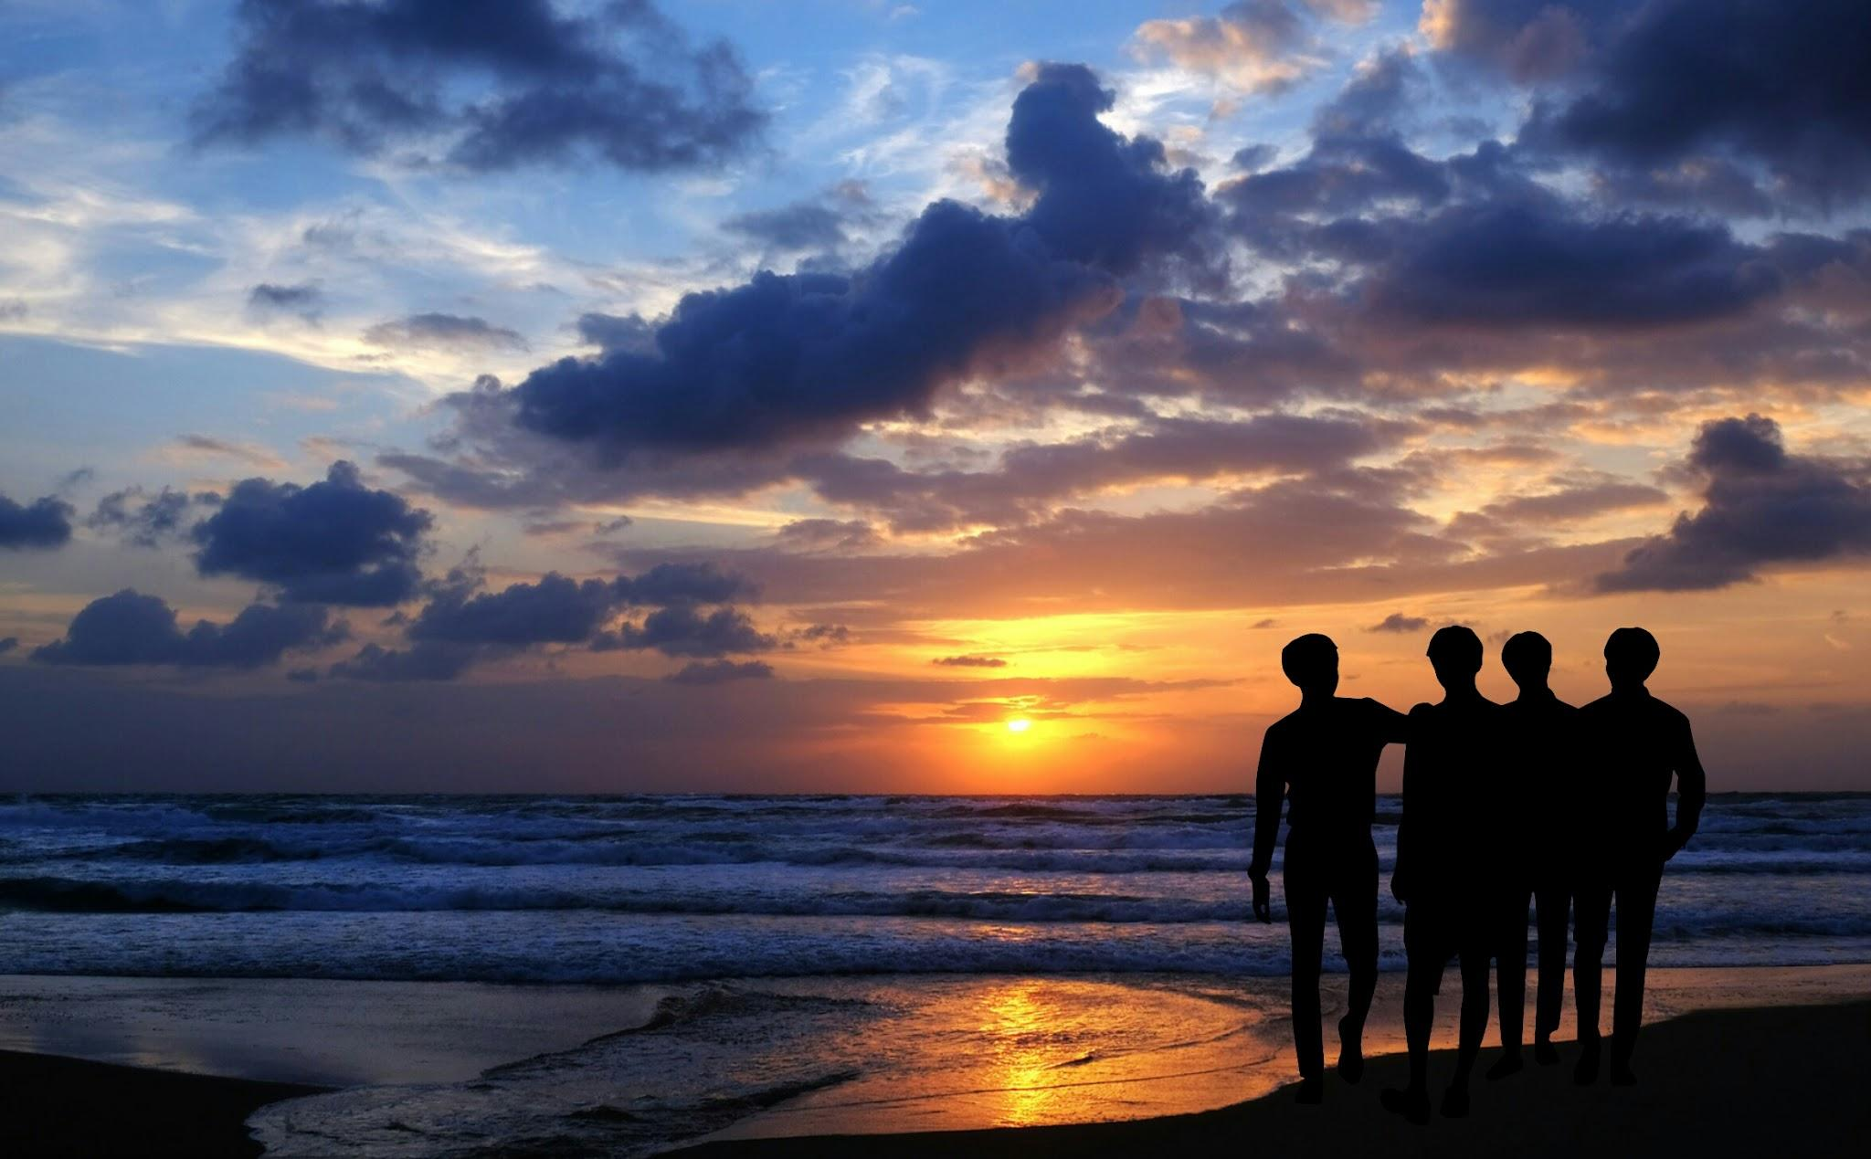
Warm Up Poll
Encuesta de inicio:
What do you think influences behavior the most?
¿Qué crees que influye más en el comportamiento?
The Brain | El Cerebro
Hormones | Hormonas
Life Experiences | Experiencias de vida
Social Environment | Entorno social
Notes:
Biology actually interacts with each option here, just in different ways.
The brain is the biological command center for all thoughts, emotions, and behaviors. Every feeling, decision, and movement comes from neural activity, which is basically electrochemical signals between these things called neurons in your brain, which we will talk more about later in the slides. For example, there is a part of your brain called the amygdala, which triggers a fear response that your body can then act on. The physical structure and function of your brain allows us to literally create the behavior you see and do every day.
Hormones are chemical messengers that can and influence and affect mood, aggression, stress, motivation, and even decision making. For example, a common hormone you might know is adrenaline, and a rush of adrenaline can cause a fight or flight response and cause behavioral changes.
Life experiences can also change the brain and behavior through a process called neuroplasticity. Things like learning, trauma, and practice/repetition can create new neural connections in your brain or strengthen old ones. Your brain is constantly changing because you are constantly gaining new experiences every day, which shapes and rewires your brain and affects how your respond.
Your social environment, which includes your culture, family, friends, and social norms also heavily influence and teach us what behaviors are acceptable and expected. Peer pressure, support systems, and cultural values also guide life choices and decisions as well. This is super influential, especially in childhood and adolescence, where we learn from others and learn how to respond emotionally and socially.

Slide 16


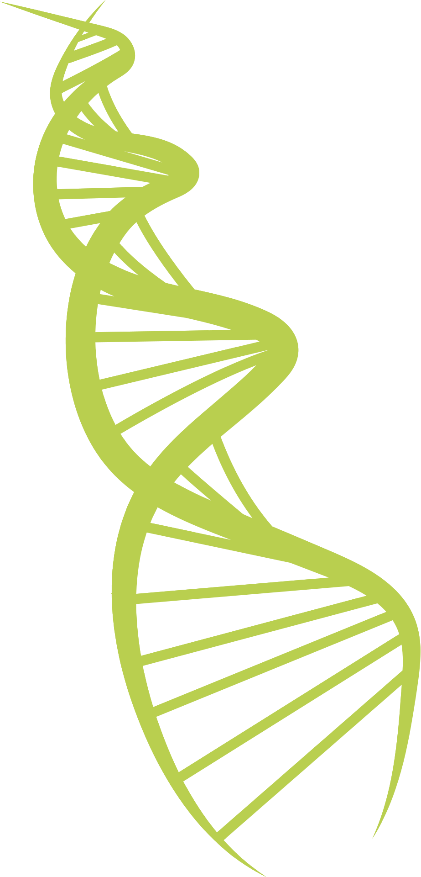
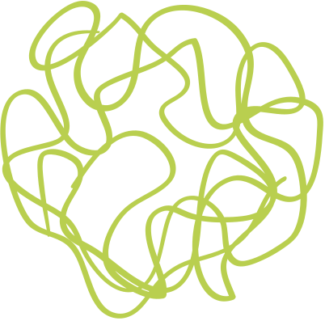
The Nervous System
El sistema nervioso
The Body’s Command Center
El centro de mando del cuerpo
Notes:
The nervous system controls everything you do, from breathing and digesting to thinking, learning, and moving.

Slide 17
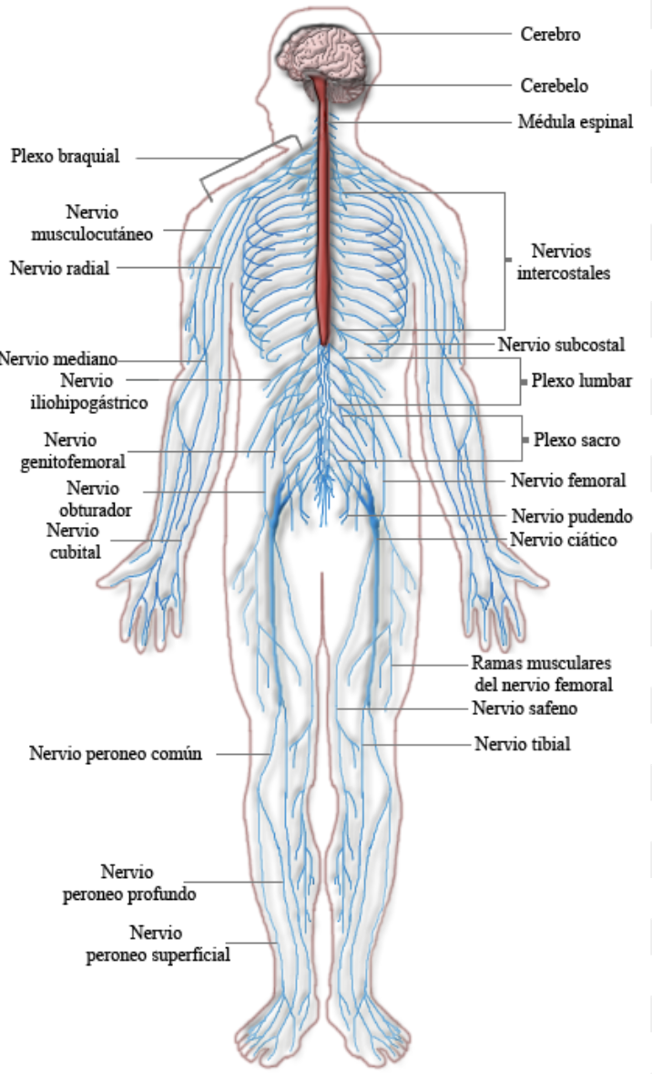
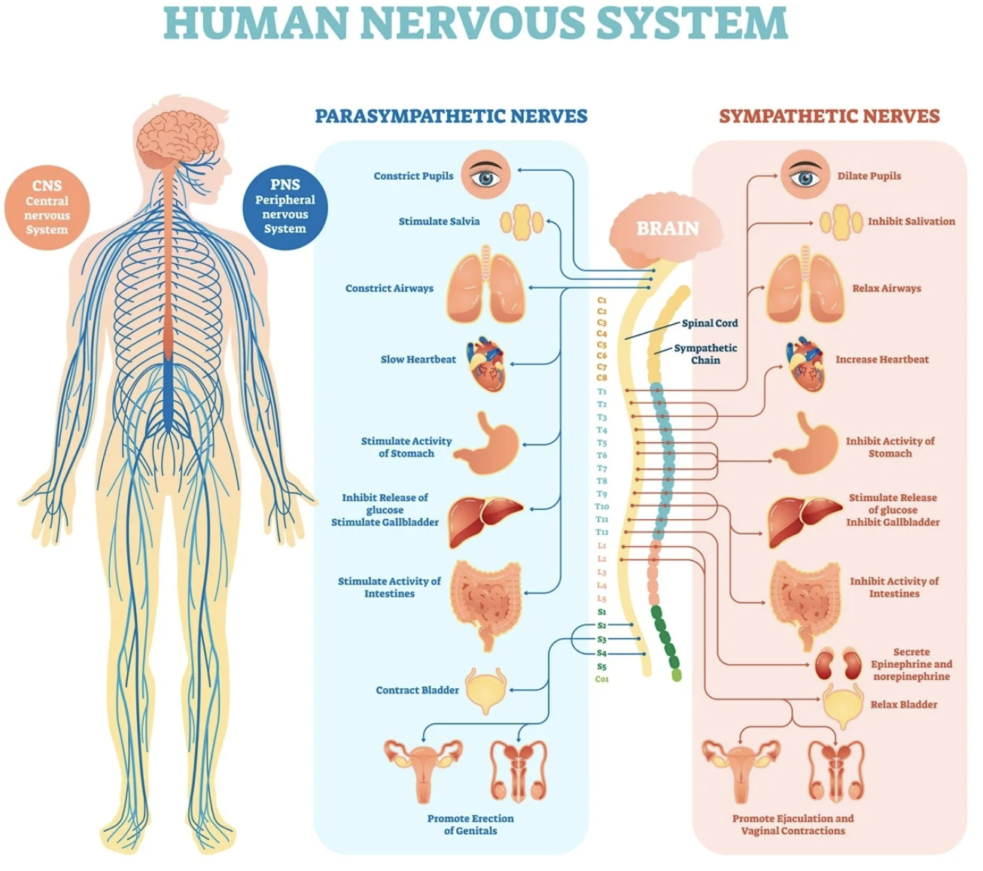
sistema nervioso humano
Notes:
As you can see, there are many different parts of the nervous system all throughout the body that are responsible for different functions.
This is because the nervous system is your body’s communication network, it sends messages back and forth between the brain, spinal cord, and body
The sympathetic system drives the "fight-or-flight" response during stress, while the parasympathetic system manages the "rest-and-digest" state to help your body recover and save energy

Slide 18
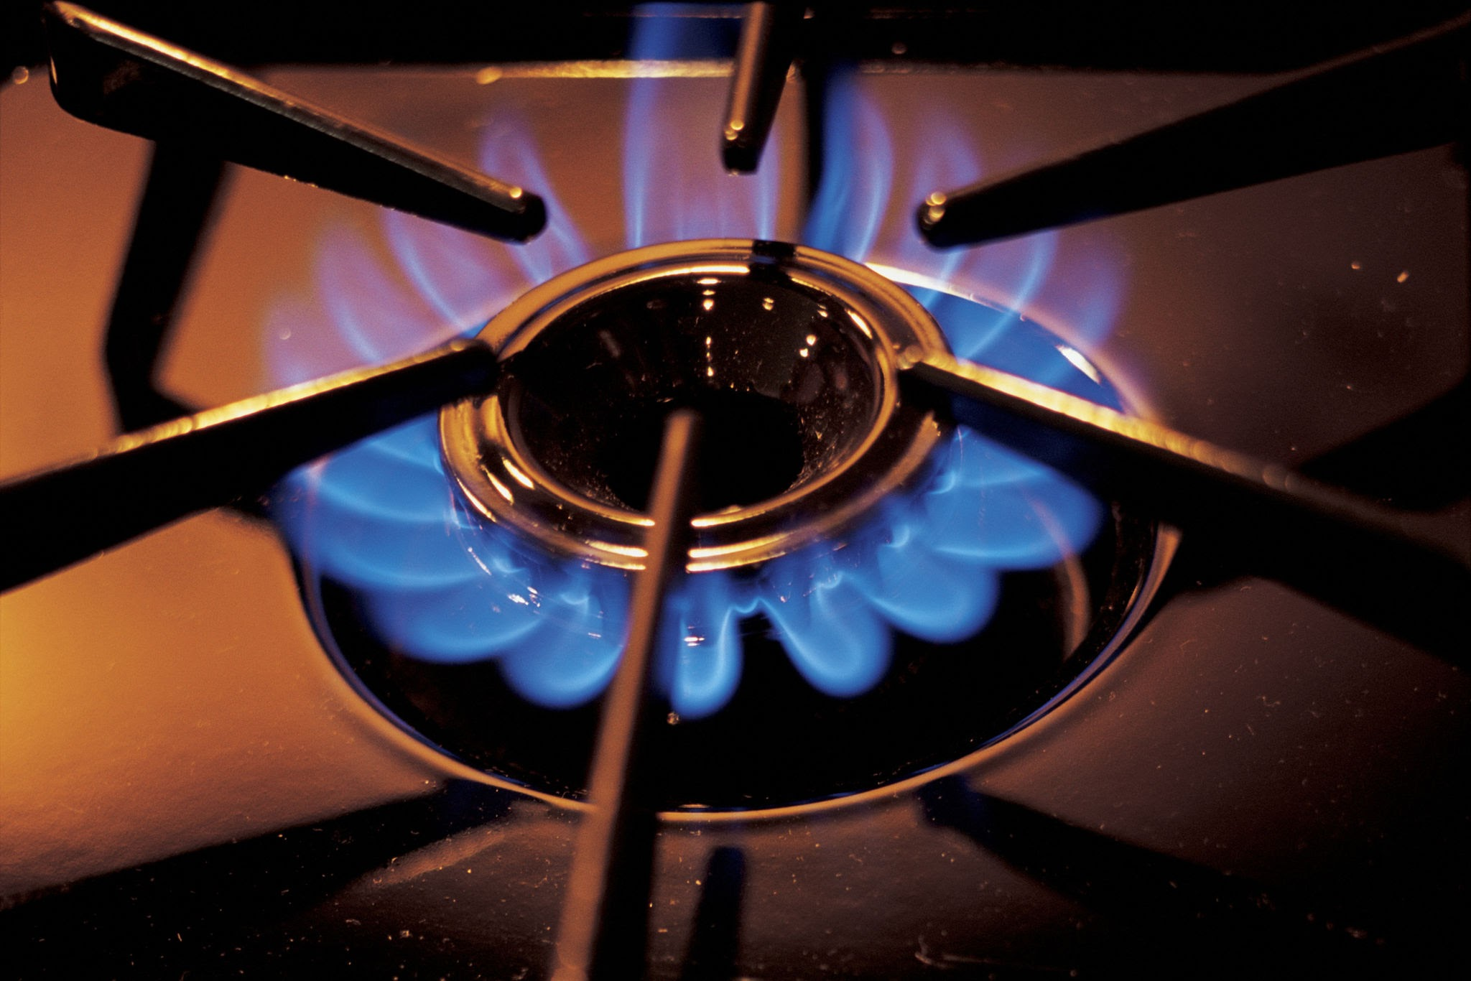
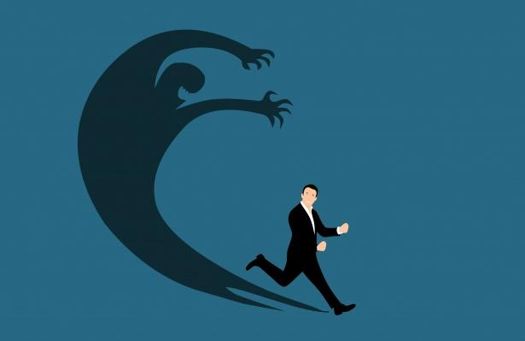
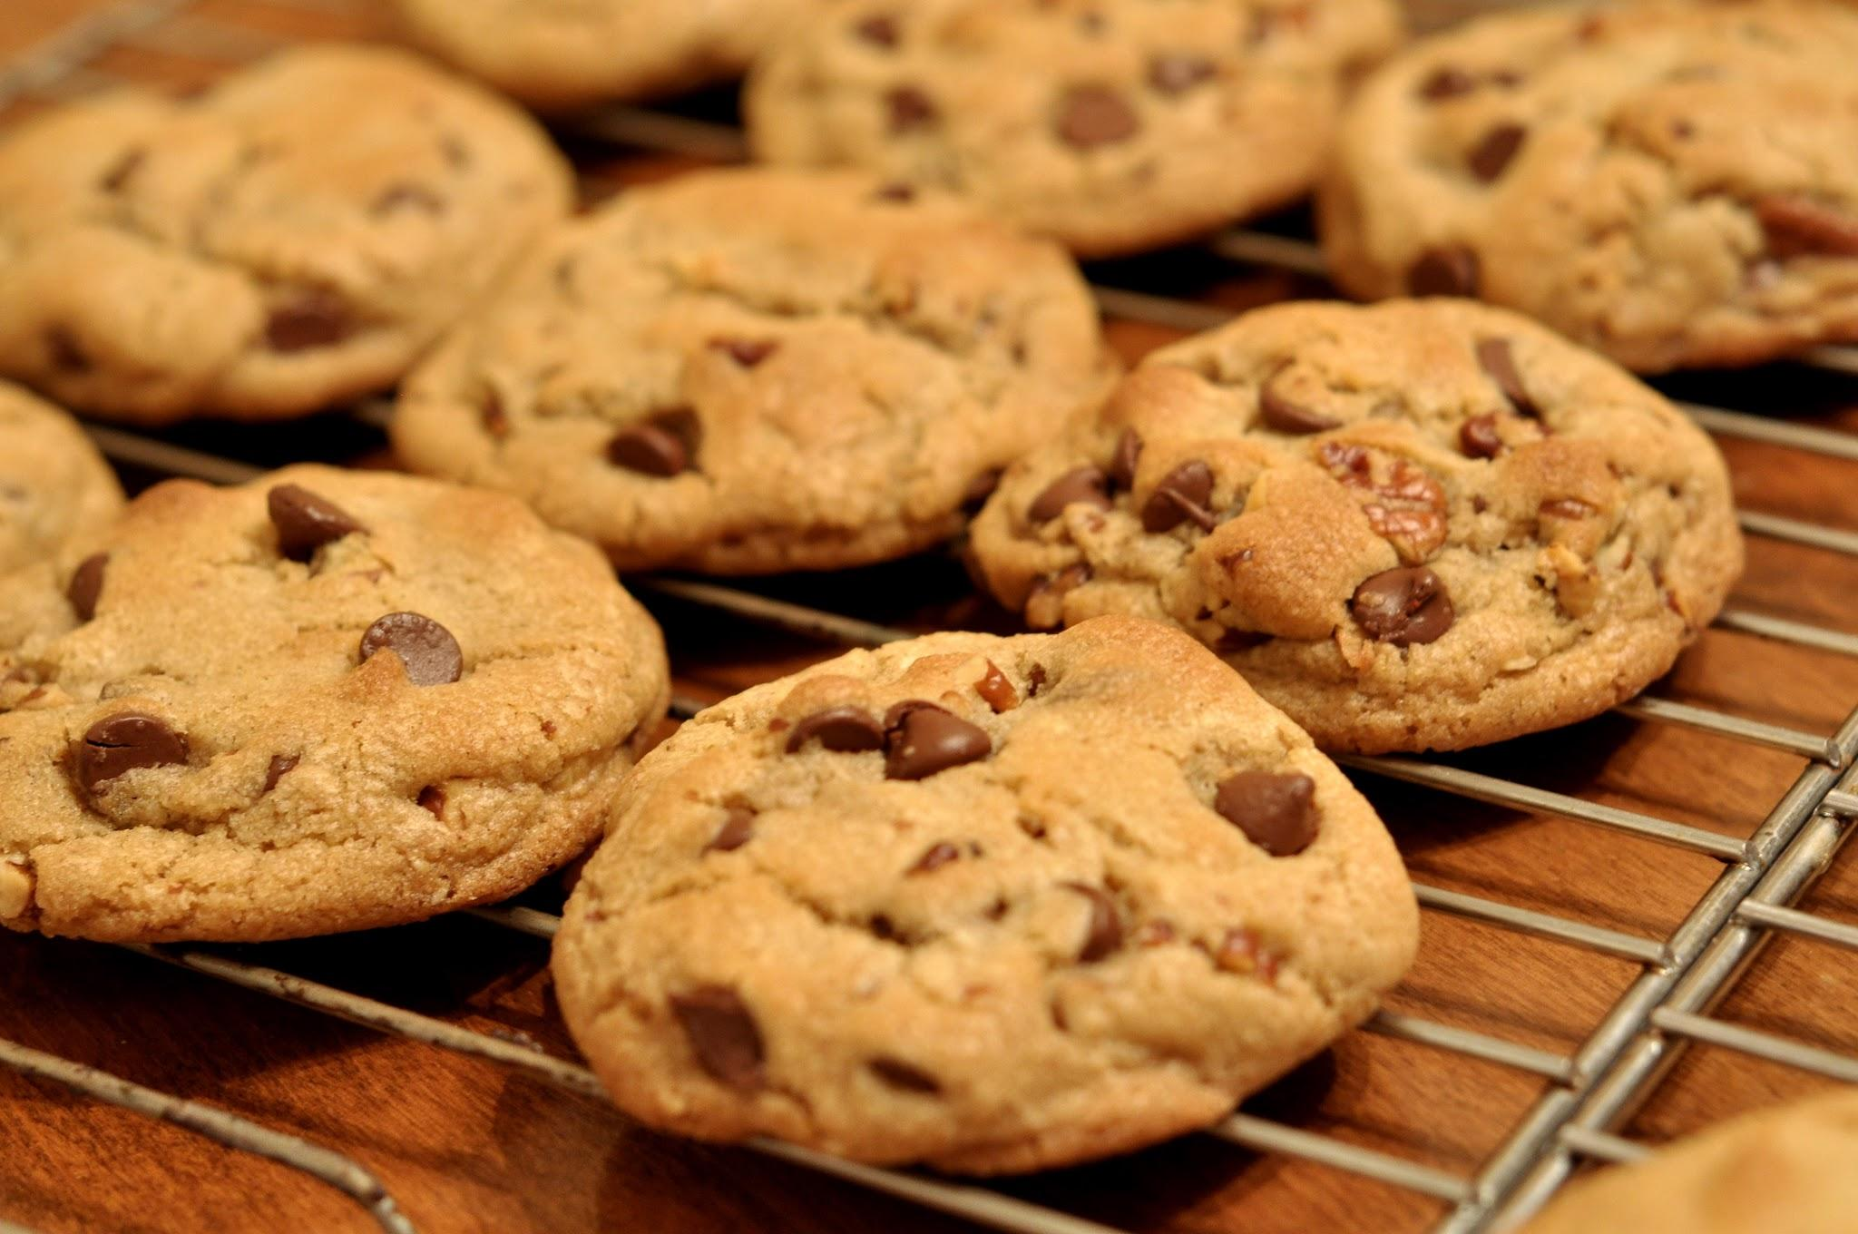
Why Do We Need It?
¿Por qué lo necesitamos?
The nervous system controls everything you do - from thinking and feeling, to moving and breathing
El sistema nervioso controla todo lo que haces: desde pensar y sentir, hasta moverse y respirar.
Ex: When you touch something hot, you pull away
Ejemplo: Cuando tocas algo caliente, te retiras.
Ex: When you get scared, your heart races
Ejemplo: Cuando te asustas, tu corazón se acelera.
Ex: When you smell cookies, you get hungry
Ejemplo: Cuando hueles galletas, te da hambre
Notes:
These functions can be voluntary, like moving our limbs and also involuntary, such as digesting food and adjusting our heart rate and body temperature. It controls everything you do, for example

Slide 19
Location | Ubicación
CNS | SNC
Prokaryotic
Dispersed genetic material
in the cytoplasm.
Within the skull (brain) and spinal column
Dentro del cráneo (cerebro) y la columna vertebral
Prokaryotic
Central Nervous System
Sistema nervioso central
Function | Función
Nervous System
Sistema nervioso
Processes and coordinates bodily functions
Procesos y coordina las funciones corporales
Location | Ubicación
Outside the brain and the spinal cord
Fuera del cerebro y la médula espinal
PNS | SNP
Function | Función
Peripheral Nervous System
Sistema nervioso periférico
Transmits info between the CNS to the rest of the body
Transmite información desde el SNC al resto del cuerpo
2 Parts | 2 partes
Somatic vs Autonomic Nervous System
Sistema nervioso somático vs. sistema nervioso autónomo
Notes:
There are 2 main parts of the nervous system, the CNS and the PNS that work together
They differ in location, function, and what they are comprised of.
CNS: made up of the brain and spinal cord - Processes information and makes decisions, Brain is the main command center, while the spinal column extends from the base of the brain down the body.
The CNS also is responsible for processing and coordinating many bodily functions such as movement, sensation, thought, and emotion
on the other hand, the PNS makes up all the nerves that are outside the CNS, such as the nerves that connect the spinal cord to the rest of the body. It transmits info between the CNS, the body’s organs, muscles, and skin.
It is also divided into 2 divisions, the somatic nervous system and the autonomic nervous system, which have different functions

Slide 20
Central Nervous System (CNS)
Sistema nervioso central (SNC)
The CNS is like the “main headquarters” of the body
El SNC es como el “cuartel general” del cuerpo
Brain | Cerebro
Spinal Cord | Médula espinal
Bones | Huesos
Decides what to do with the information received from various body parts
Decide qué hacer con la información recibida de las distintas partes del cuerpo
The skull and the spine protect the brain and spinal cord to keep it safe
El cráneo y la columna vertebral protegen el cerebro y la médula espinal para mantenerlos a salvo
Carries signals to and from the brain
Transporta señales hacia y desde el cerebro
Notes:
brains reads signals from nerves to regulate how you think, feel, and act

Slide 21
Peripheral Nervous System (PNS)
Sistema nervioso periférico (SNP)
The PNS is like the “delivery system” of the body
El SNP es como el “sistema de distribución” del cuerpo
Somatic Nervous System | Sistema nervioso somático
Autonomic Nervous System | Sistema nervioso autónomo
Controls voluntary actions
Controla las acciones voluntarias
Controls involuntary/
automatic actions
Controla las acciones involuntarias/
automáticas
Notes:
The PNS connects your brain and spinal cord to your muscles and organs, acting as the delivery system for messages in the body
There are two parts as mentioned before, the somatic nervous system, which controls voluntary movement (walking, talking, writing)
and the autonomic nervous system, which control involuntary bodily functions (digestion, heart rate, body temp, sweating)

Slide 22
Autonomic System: 2 Teams
Sistema autónomo: 2 equipos
Think of them as the gas pedal and brake for your body
Piensa en ellos como el acelerador y el freno para tu cuerpo
Sympathetic | Simpático
Parasympathetic | Parasimpático
“Fight or Flight”
“Lucha o huida”
Speeds up your body
Acelera tu cuerpo
Increased heart rate, dilated pupils
Aumento de la frecuencia cardíaca, pupilas dilatadas
“Rest and Digest”
“reposo y digestión”
Calms you down
Te calma
Increased digestion, slowing heart rate
Aumenta la digestión, disminuye el ritmo cardíaco
Notes:
The autonomic system has 2 sides that balance each other
The sympathetic system, which responds to stress and is the fight or flight response, triggers involuntary responses to prepare the body for intense activity (blood rushing to muscles)
and the parasympathetic system, which promotes calmness and preserves energy by slowing heart rate and increasing digestion

Slide 23

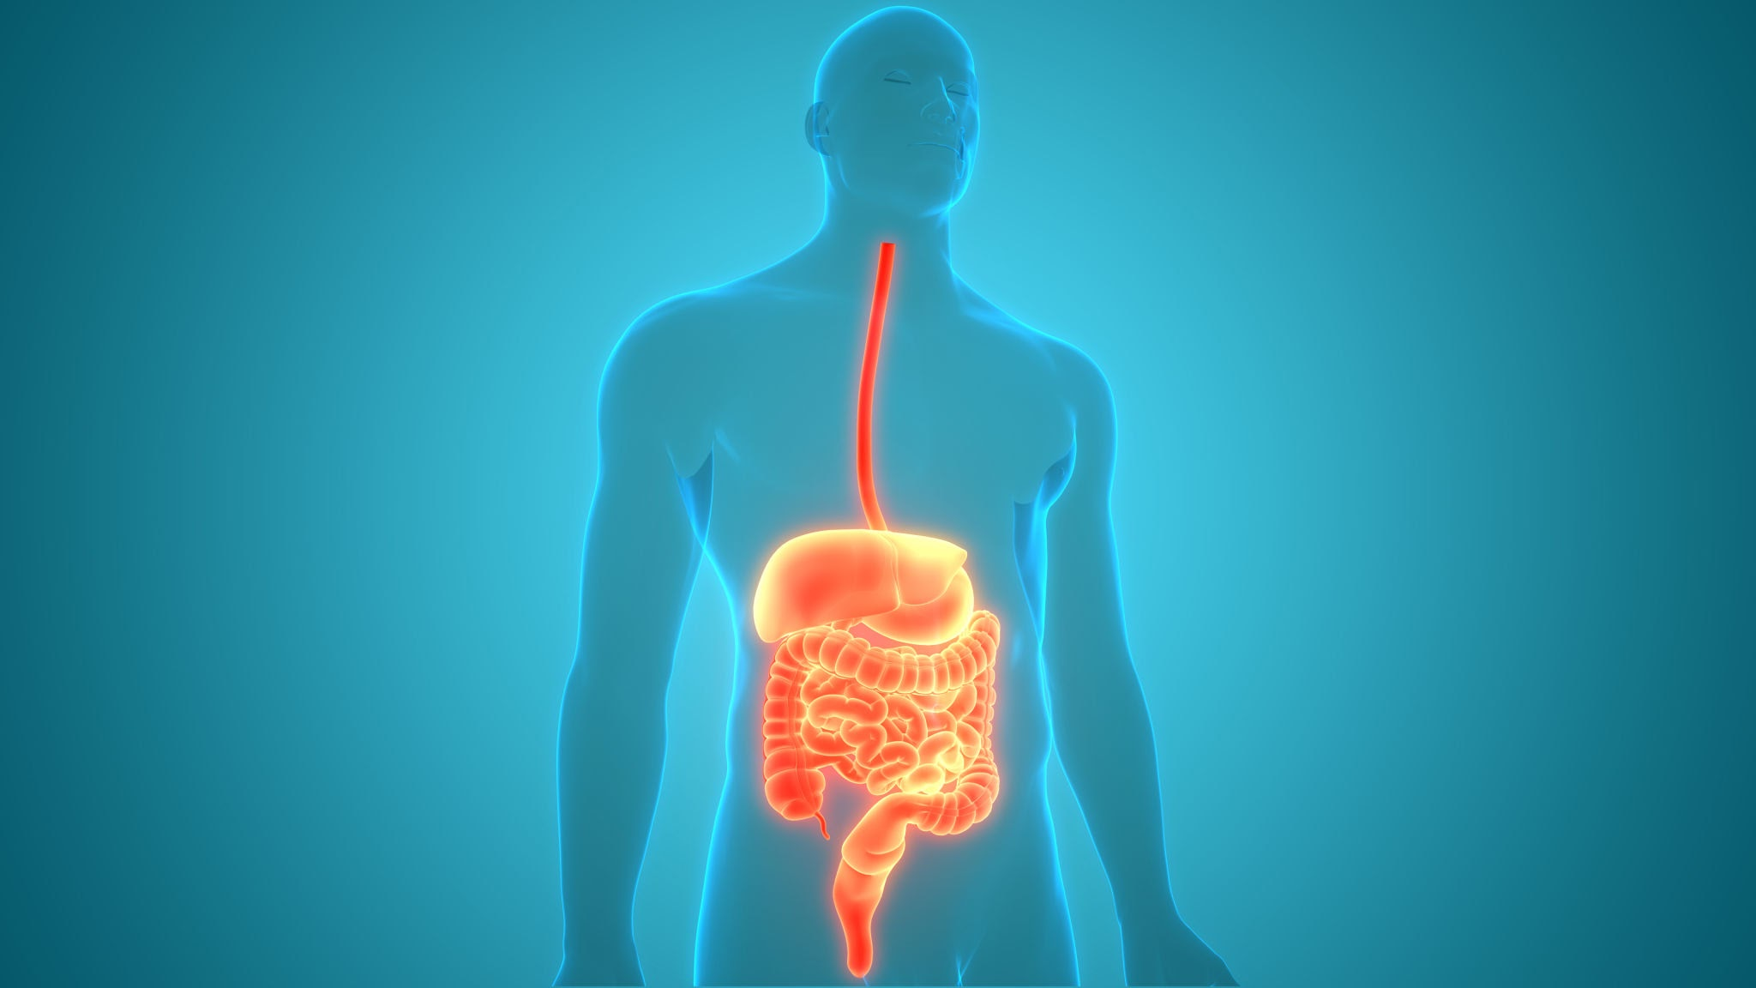
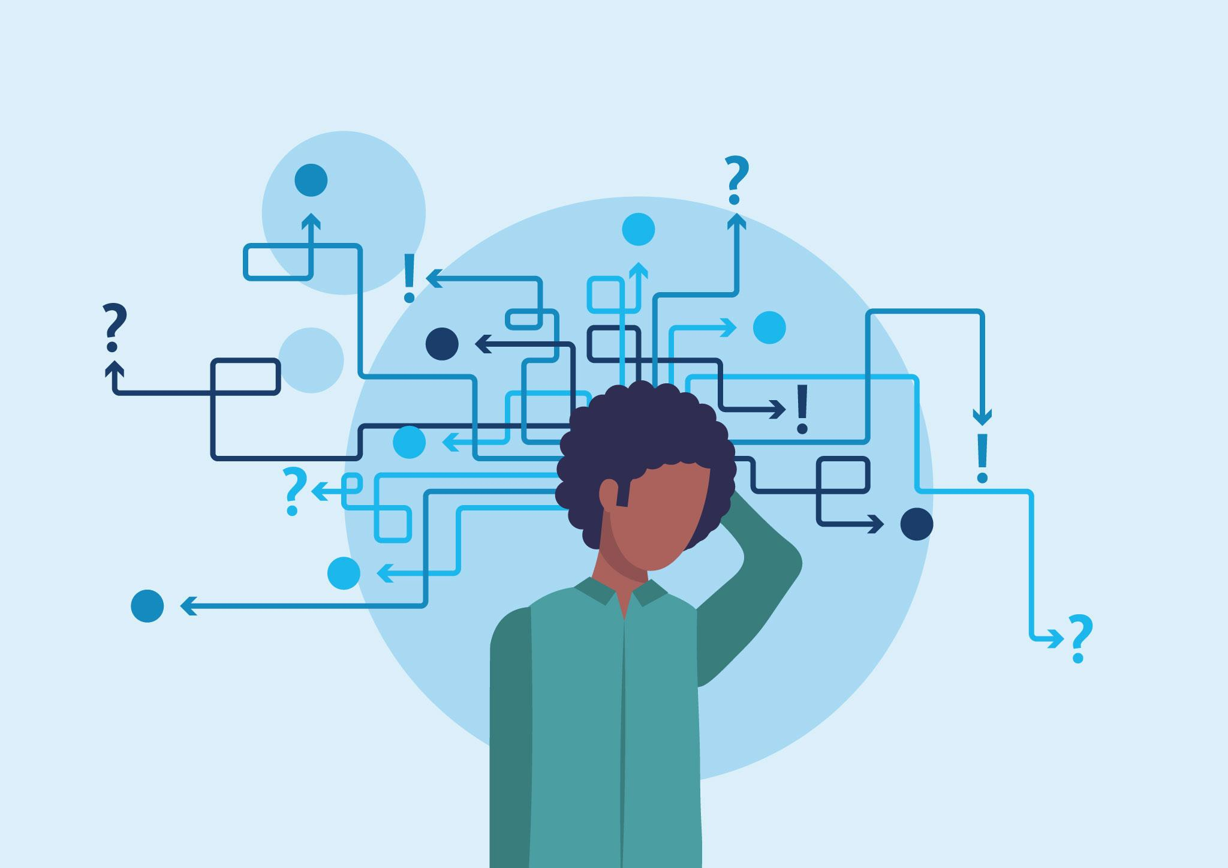
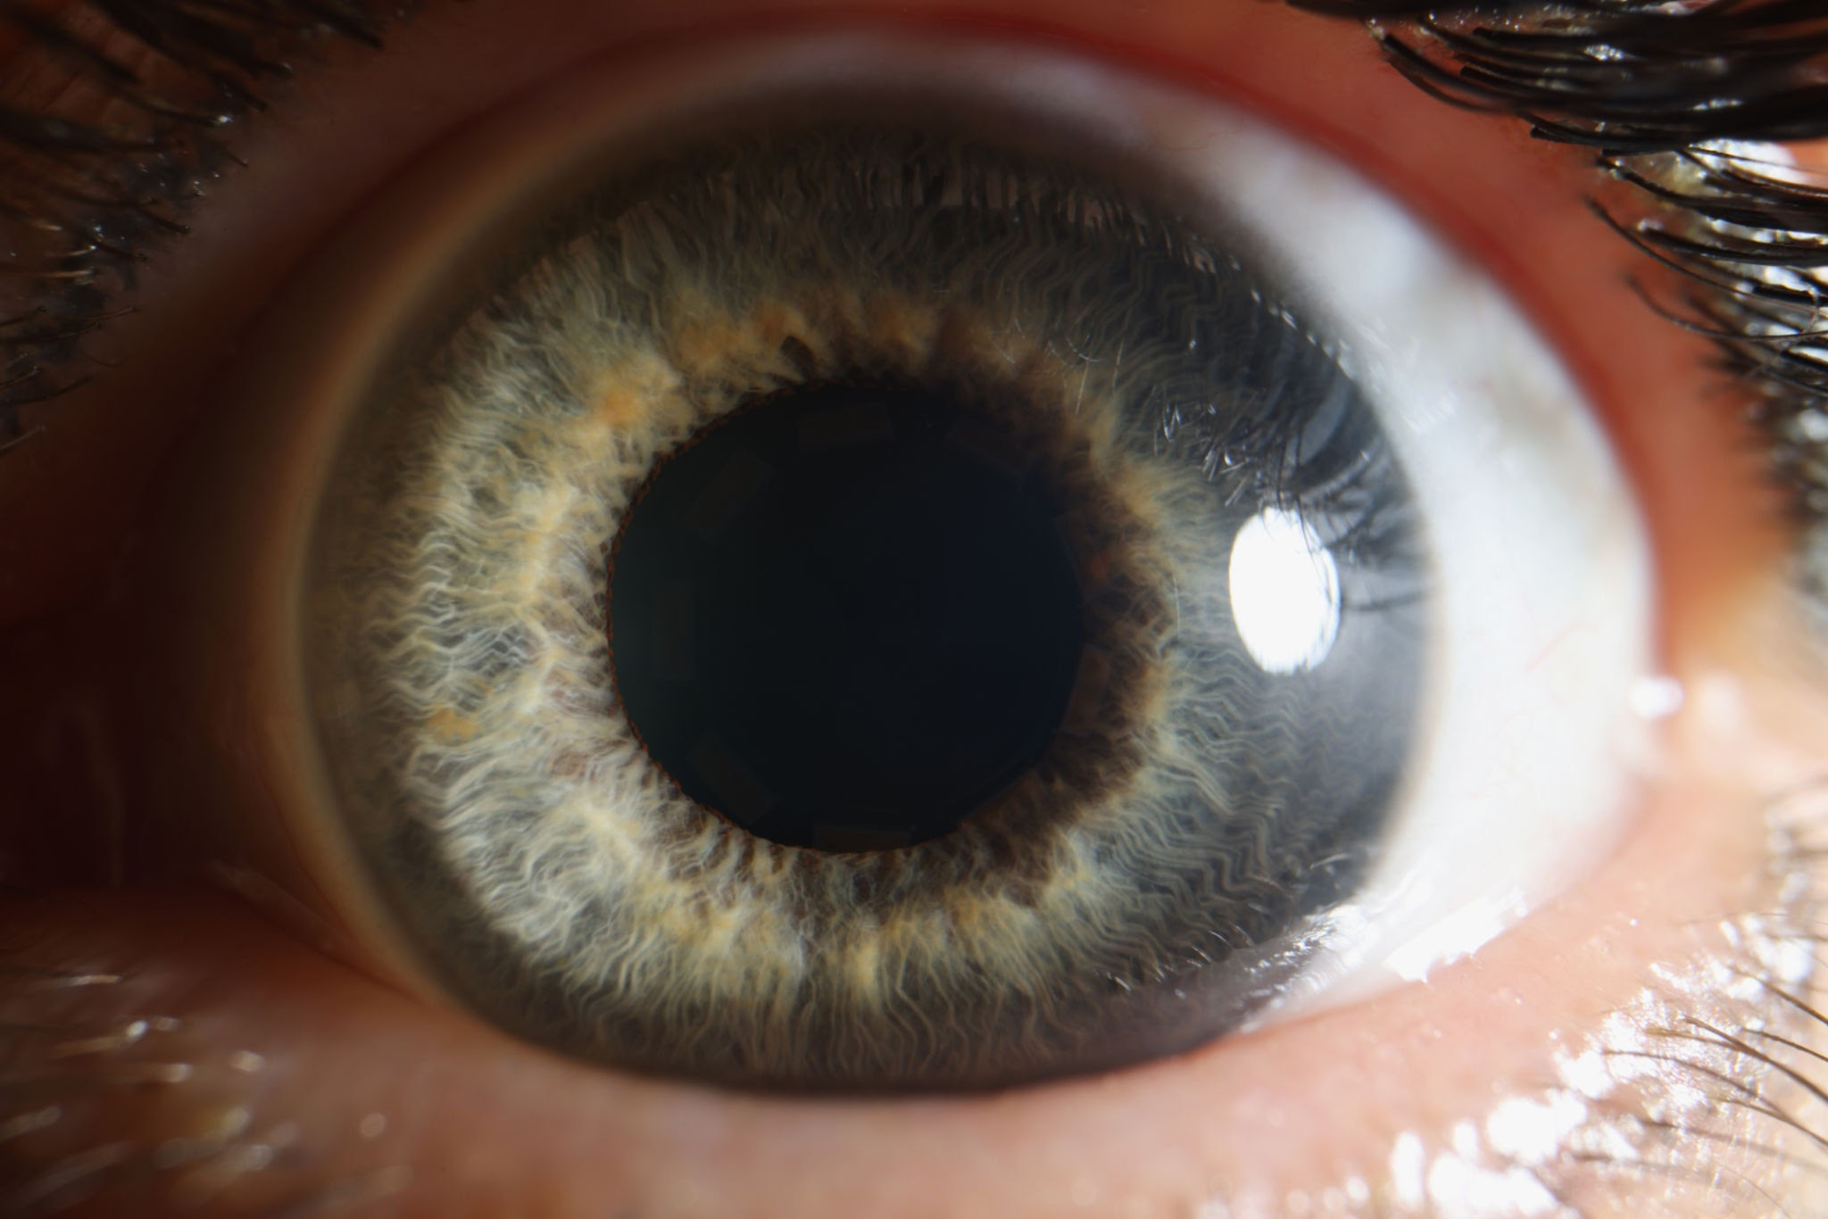
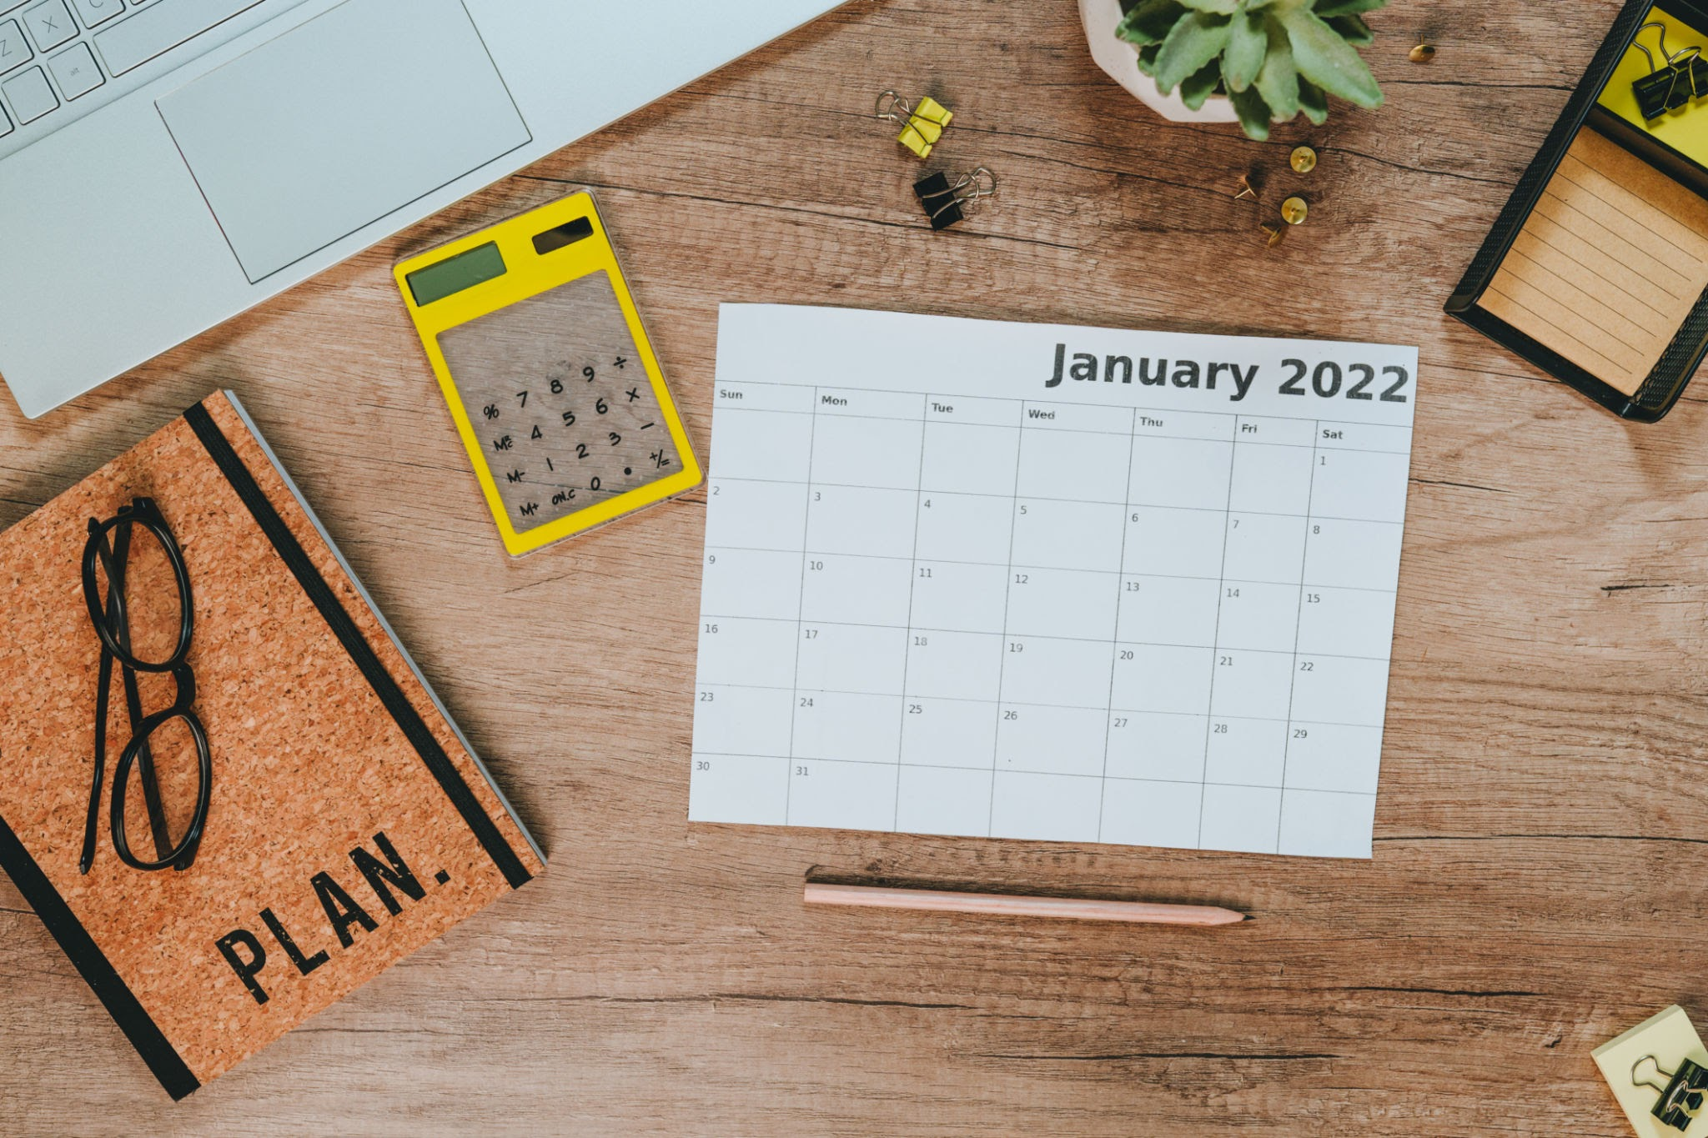
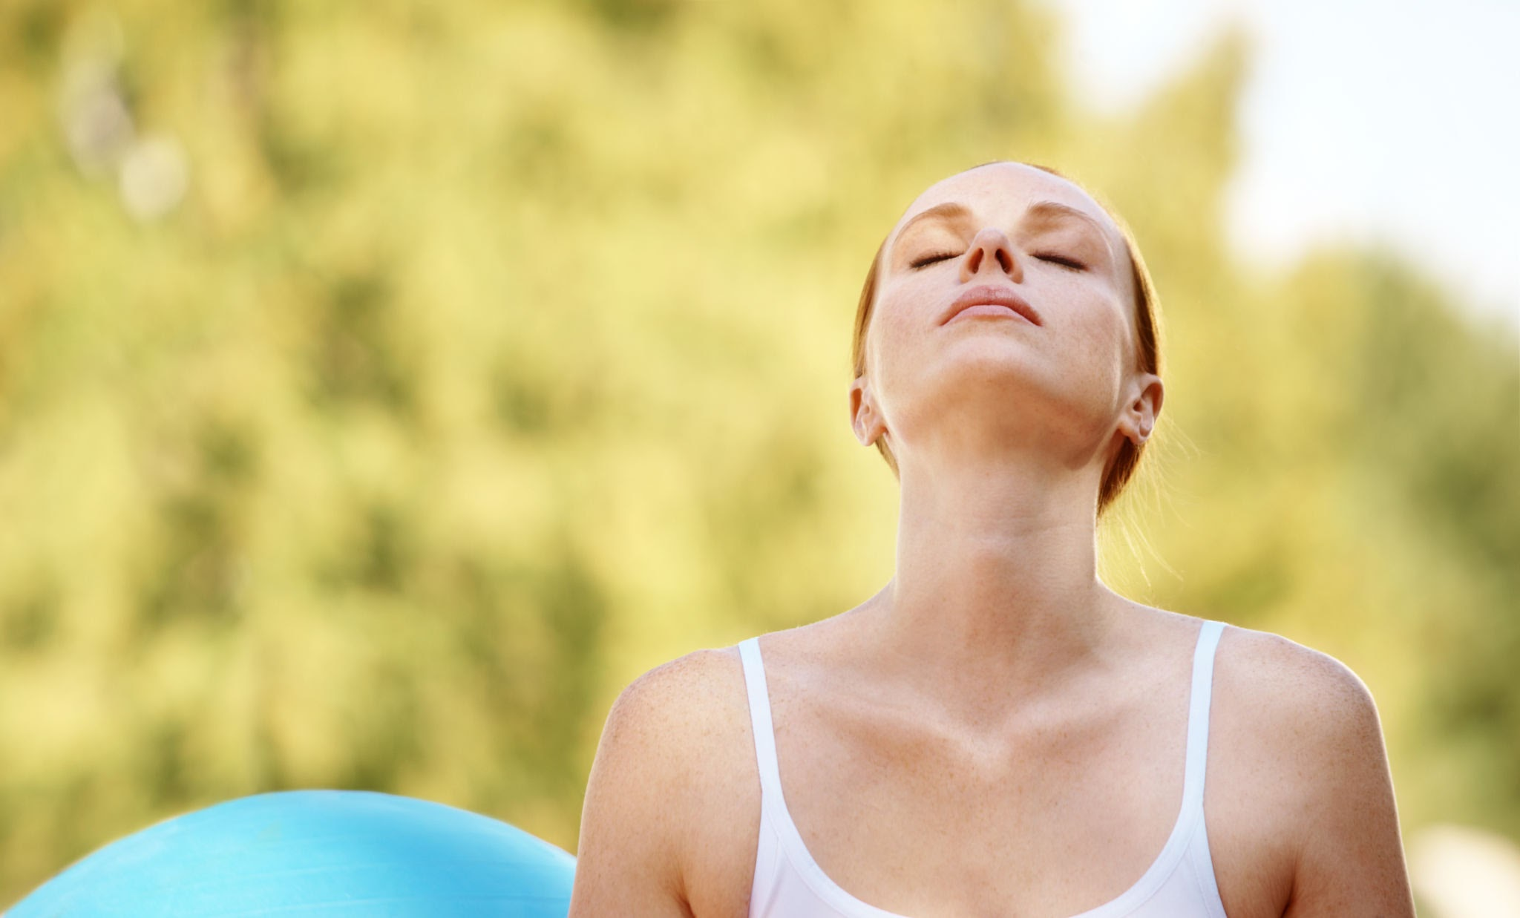
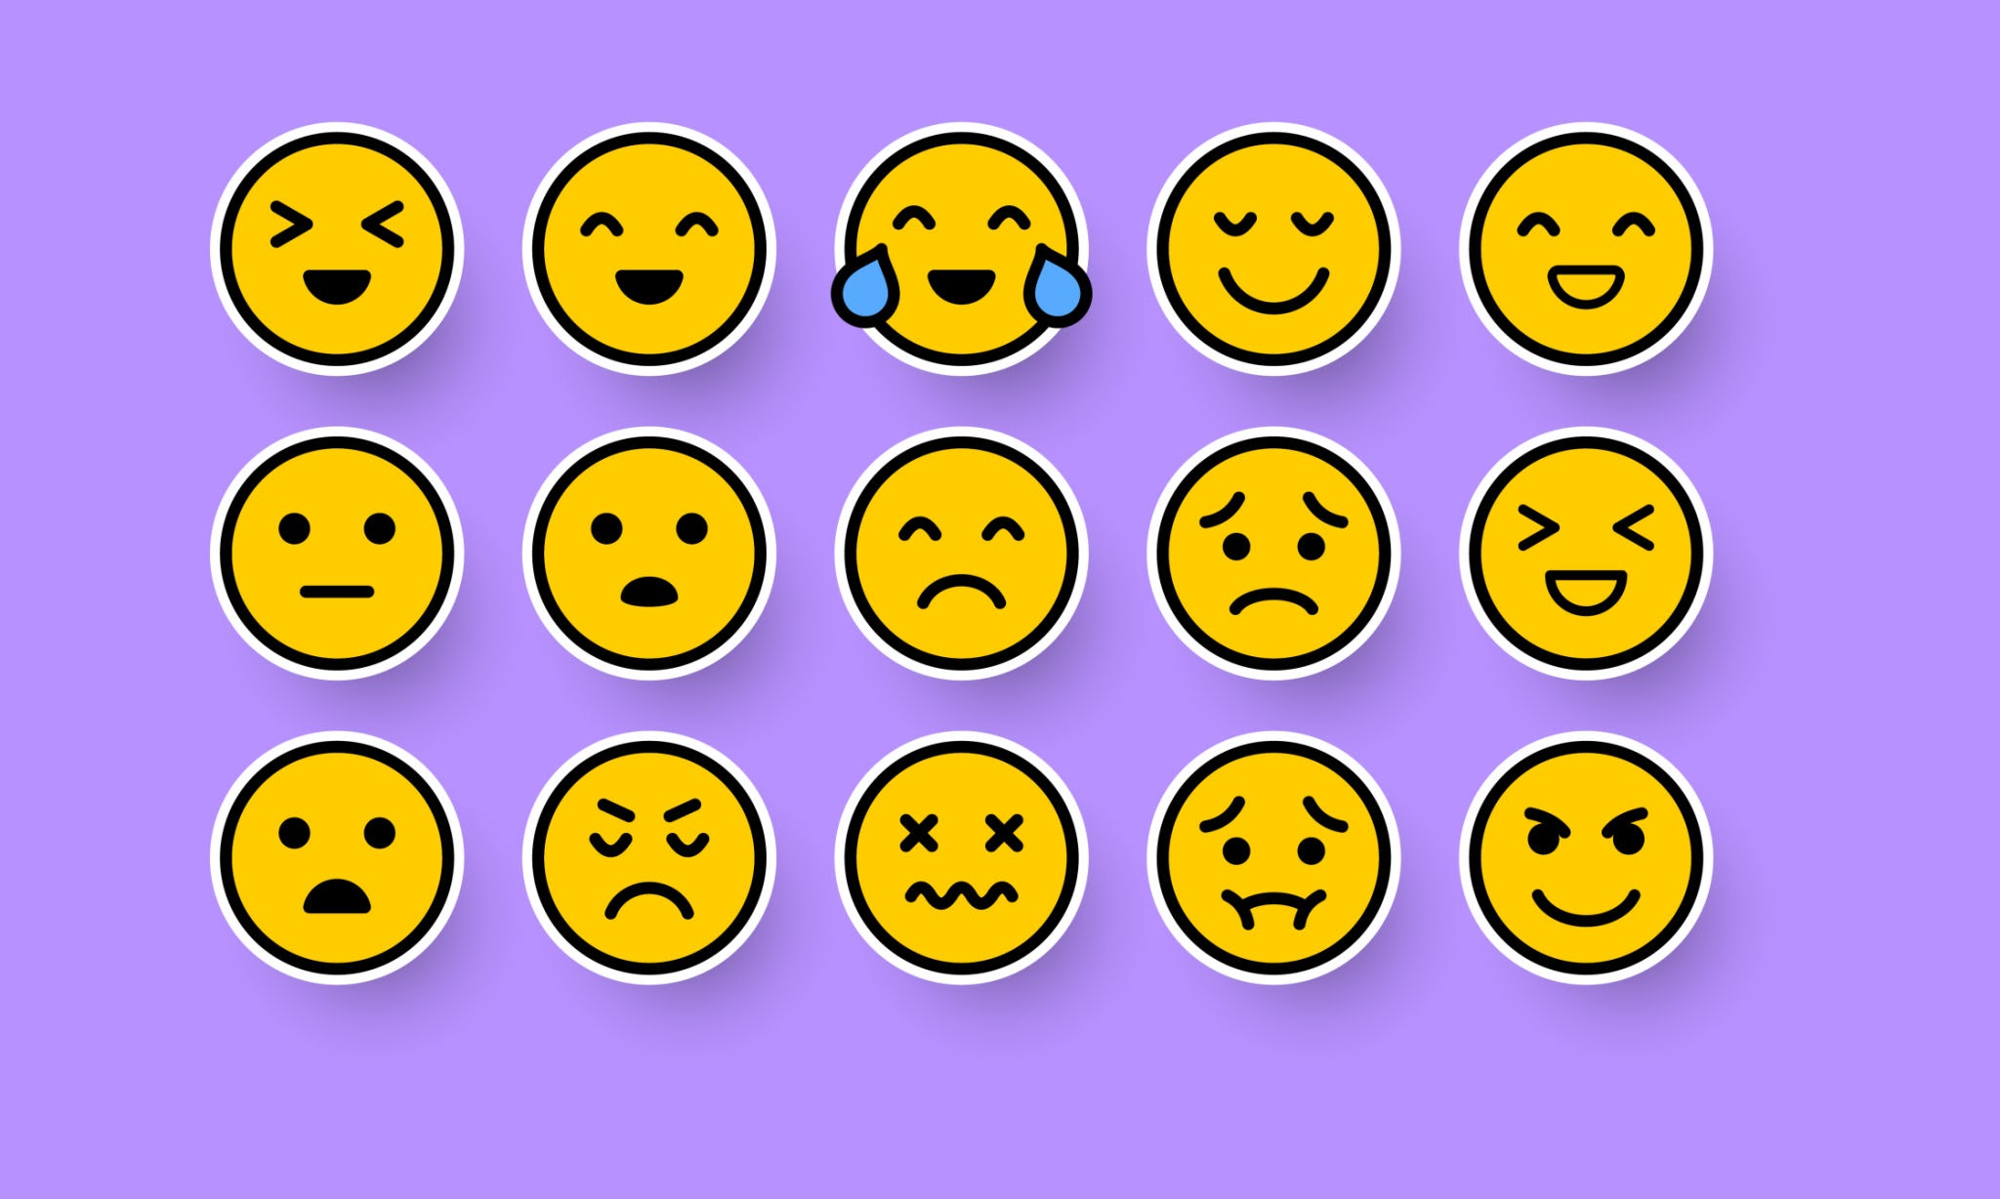
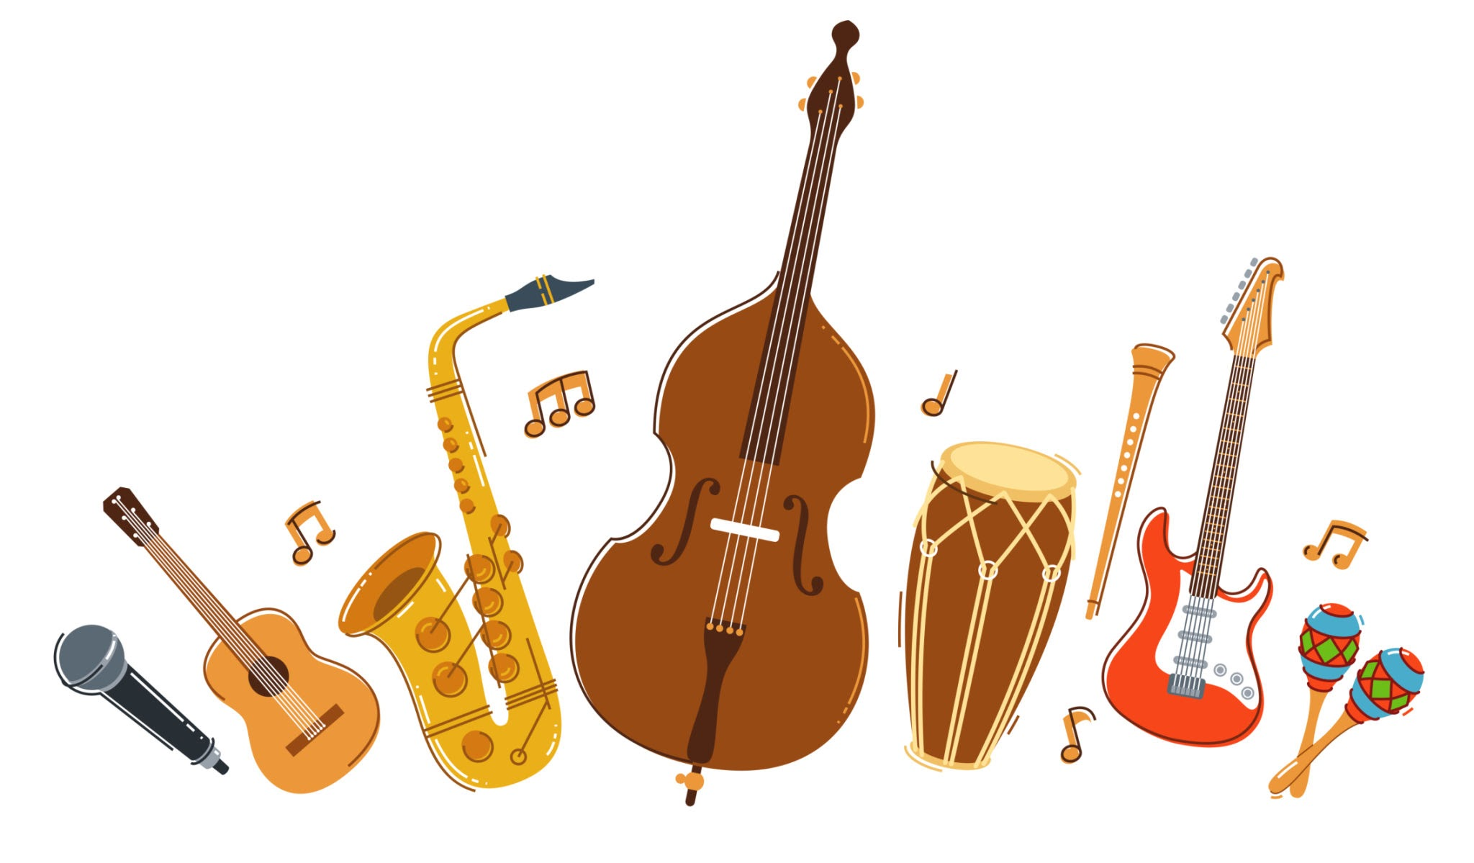
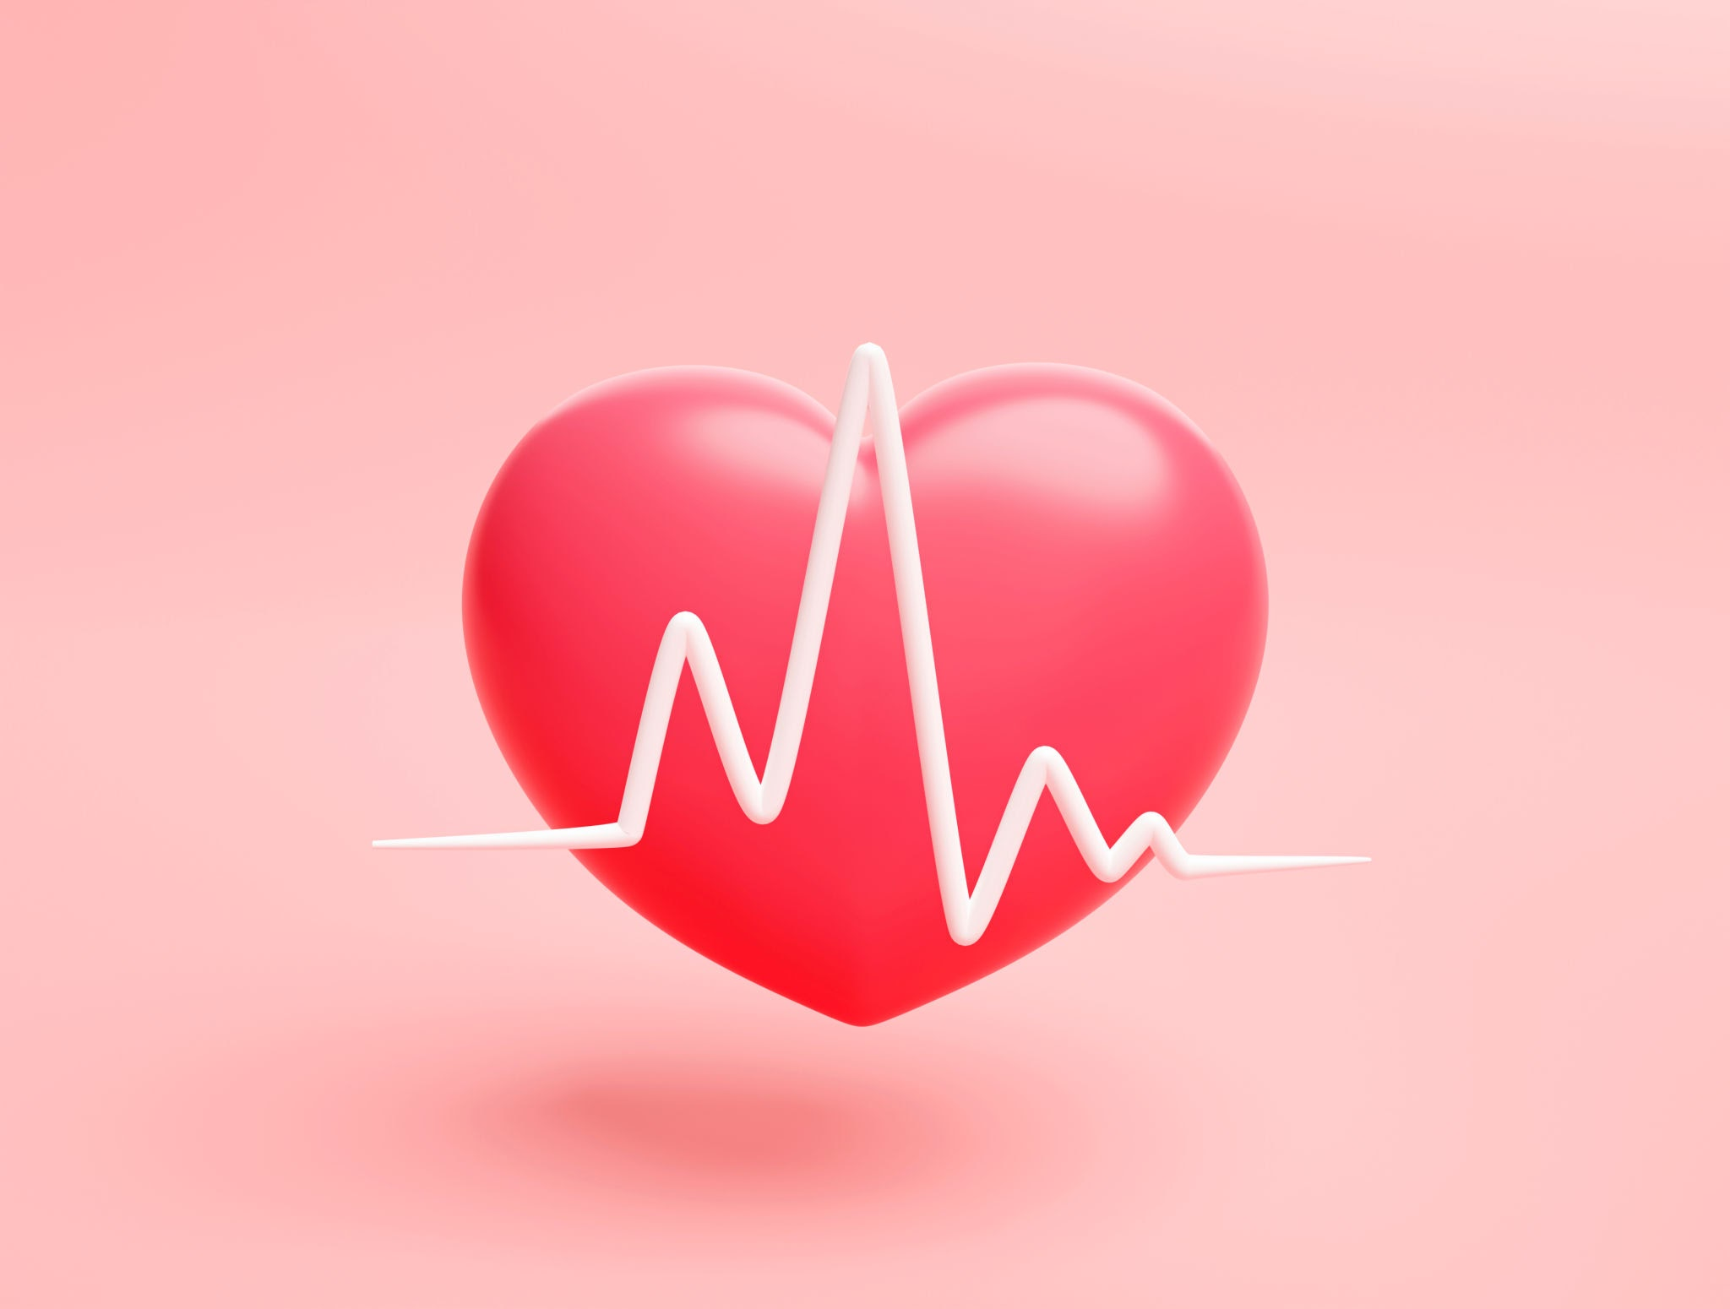
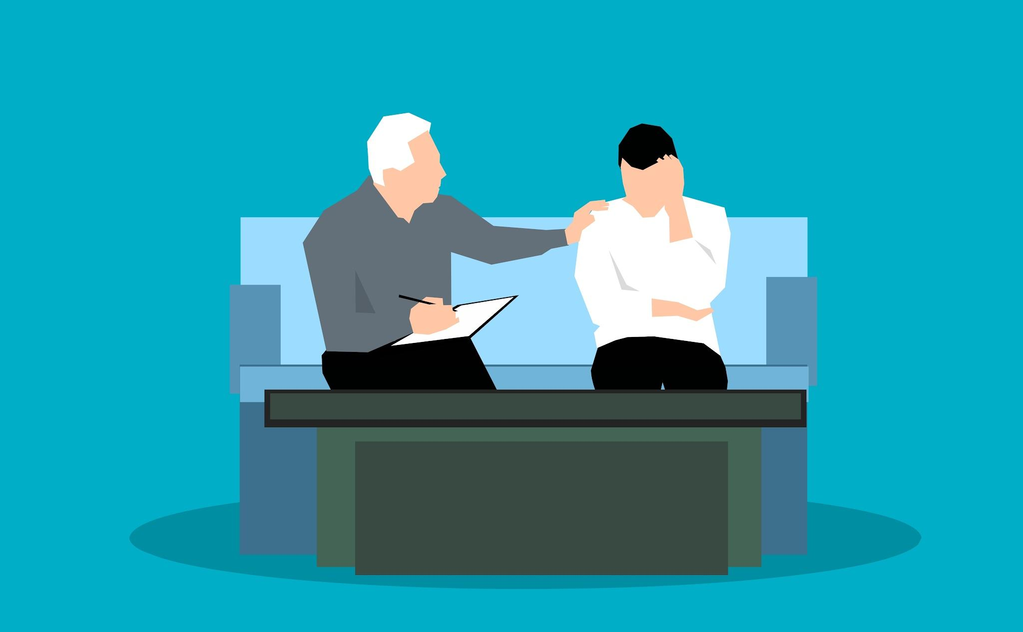
Which Nervous System Is It?
¿De qué sistema nervioso se trata?
Wiggling Fingers
Dedos que se mueven
Regulating Digestion
Regulación de la digestión
Problem Solving
Resolución de problemas
Dilating Pupils
Pupilas dilatadas
Planning
Planificación
Breathing
Respiración
Feeling Emotion
Sentimiento Emoción
Slowing Heart Rate
Disminución de la frecuencia cardíaca
Deciding to Talk
Decidir hablar
Playing an Instrument
Tocar un instrumento
Notes:
1: PNS (somatic)
2. CNS (CNS about regulation)
3. CNS
4. PNS (autonomic) (sympathetic)
5. CNS
6. PNS (autonomic) (parasympathetic)
7. CNS
8. PNS (somatic)
9. PNS (autonomic) (parasympathetic)
10. CNS (the act of deciding is a conscious and complex action that requires levels of thought)

Slide 24
Which Nervous System Is It?
¿De qué sistema nervioso se trata?
Wiggling Fingers
Dedos que se mueven
Problem Solving
Resolución de problemas
Dilating Pupils
Pupilas dilatadas
Planning
Planificación
Breathing
Respiración
Feeling Emotion
Sentimiento Emoción
Slowing Heart Rate
Disminución de la frecuencia cardíaca
Playing an Instrument
Tocar un instrumento
Notes:
1: PNS (somatic)
3. CNS
4. PNS (autonomic) (sympathetic)
5. CNS
6. PNS (autonomic) (parasympathetic)
7. CNS
8. PNS (somatic)
9. PNS (autonomic) (parasympathetic)

Slide 25
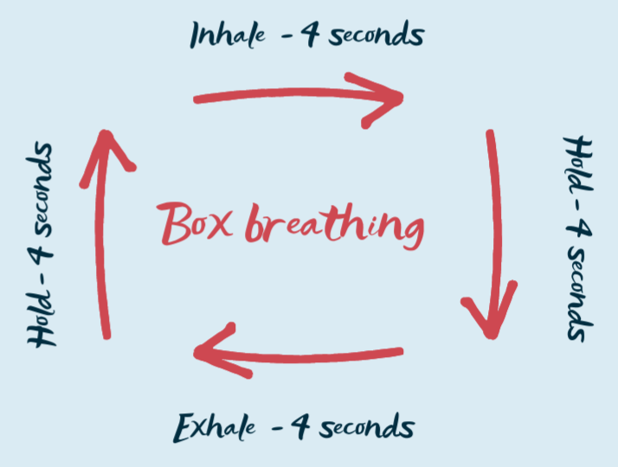
Exercise: Box Breathing
Ejercicio: Respiración en caja
Inhala durante 4 segundos.
Activates the parasympathetic nervous system (PNS).
Activa el sistema nervioso parasimpático (SNP).
Slows your heart rate, lowers blood pressure, and shifts your body away from the "fight-or-flight" sympathetic response into a state of calm.
Reduce la frecuencia cardíaca, disminuye la presión arterial y hace que el cuerpo pase de la respuesta simpática de «lucha o huida» a un estado de calma.
Mantén durante 4 segundos.
Mantén durante 4 segundos.
Exhala durante 4 segundos.

Slide 26
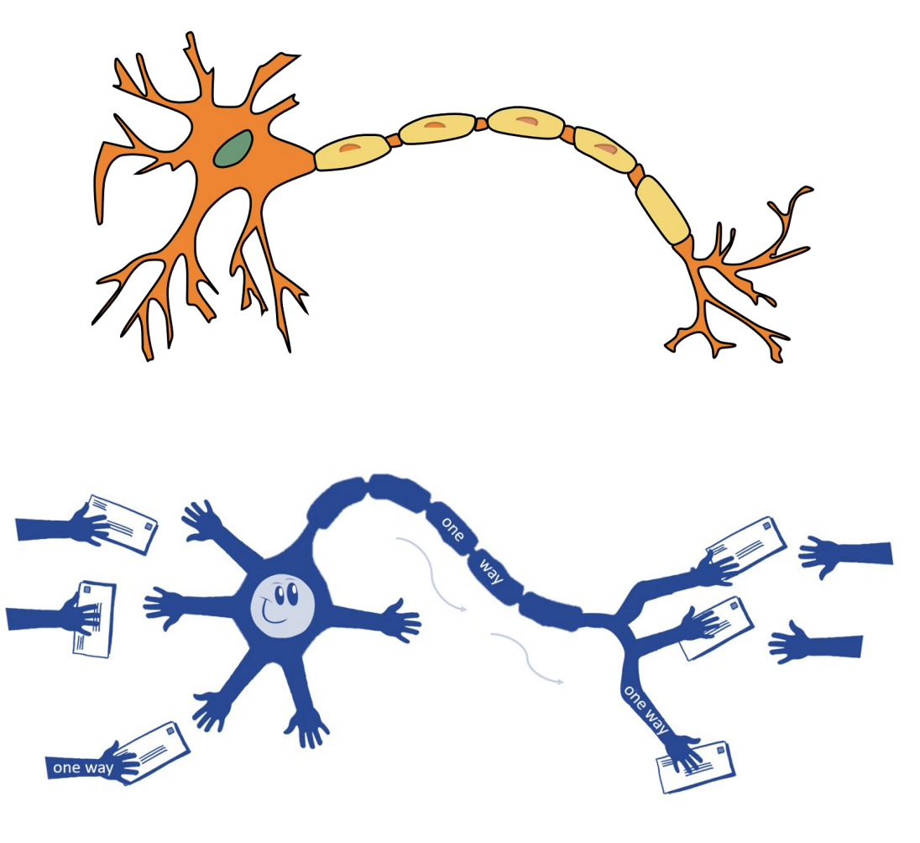
How Messages Travel | Cómo viajan los mensajes
Messages travel through the nervous system using electrical and chemical signals
Los mensajes viajan a través del sistema nervioso mediante señales eléctricas y químicas.
The body has BILLIONS of neurons - the nerve cells of the nervous system
El cuerpo tiene miles de millones de neuronas: las células nerviosas del sistema nervioso.
Neurons pass messages super fast - speeds ranging from 0.5 to 120 meters per second, or about 1.1 to 270 miles per hour!
Las neuronas transmiten mensajes muy rápidas: ¡a velocidades de entre 0,5 y 120 metros por segundo, o entre 1,1 y 270 millas por hora aproximadamente!
Notes:
will touch on neurons later in talk

Slide 27
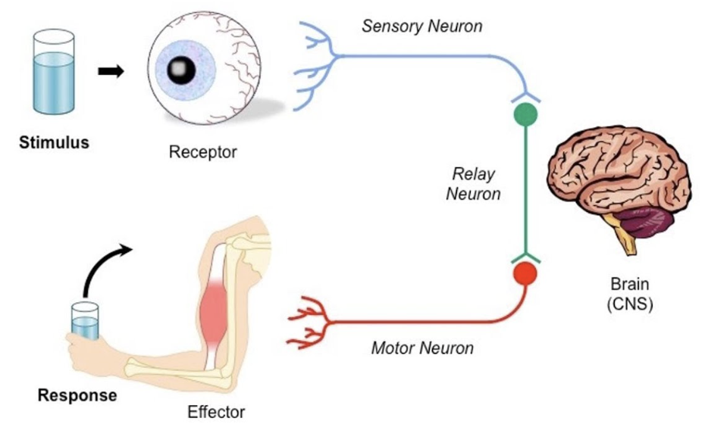
How Messages Travel | Cómo viajan los mensajes
Flow of information | Flujo de información:
SENSORY
NEURONS
NEURONAS SENSORIALES
MOTOR NEURONS
NEURONAS MOTORAS
STIMULUS
ESTÍMULO
BRAIN
CEREBRO
RESPONSE
RESPUESTA

Slide 28
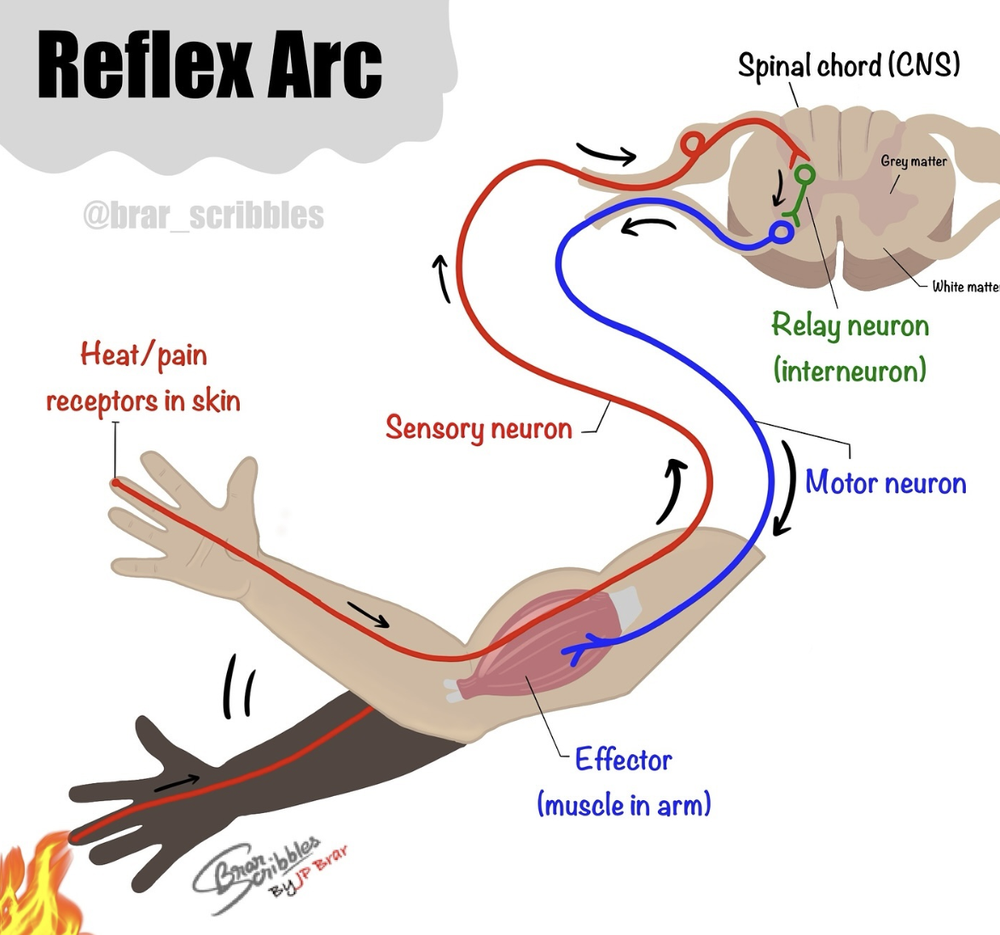

Reflexes | Reflejos
Sometimes your body skips the brain for speed - that’s called a reflex
A veces, el cuerpo prioriza la velocidad sobre la acción del cerebro; a eso se le llama reflejo
For example, if you touch something hot, your hand moves before your brain has time to process it
Por ejemplo, si tocas algo caliente, retiras la mano antes de que tu cerebro tenga tiempo de procesar la información.
WHY? ¿POR QUÉ?
Notes:
another example: the knee jerk

Slide 29
Reflexes | Reflejos
Why? The nerve signal travels to the spinal cord, which triggers an immediate response from the motor neurons
¿Por qué? La señal nerviosa viaja a la médula espinal, lo que desencadena una respuesta inmediata de las neuronas motoras.
The message is then sent to the brain for a further response
El mensaje se envía entonces al cerebro para una respuesta posterior.
Notes:
another example: the knee jerk

Slide 30
Reaction Test | Prueba de reacción
Ruler Drop Test | Prueba de caída de la regla
One person hold a ruler vertically by the top end, while another person places their hand at the bottom without touching it
Una persona sostiene una regla verticalmente por el extremo superior, mientras otra persona coloca su mano en la parte inferior sin tocarla
The first person must drop the ruler without warning, while the other person must catch it as fast as possible
La primera persona debe soltar la regla sin previo aviso, mientras que la otra persona debe atraparla lo más rápido posible

Slide 31
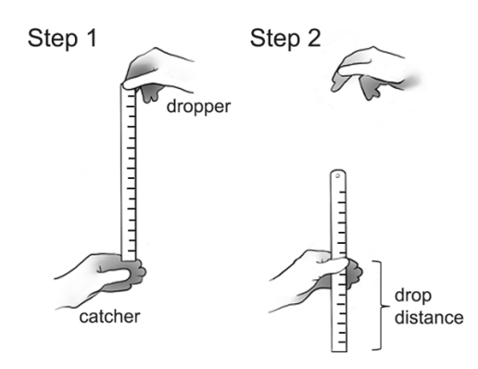
Reaction Test | Prueba de reacción
Note where the ruler was caught, and repeat 3 times and average the measurements
Anota el punto donde se detuvo la regla y repite 3 veces, luego calcula el promedio de las mediciones
A shorter drop distance = faster reaction time
Una distancia de caída más corta = un tiempo de reacción más rápido
Longer distance = slower reaction time
Una distancia de caída más larga = un tiempo de reacción más lento
Paso 1
Paso 2
persona que suelta
distancia de caída
persona que atrapa

Slide 32


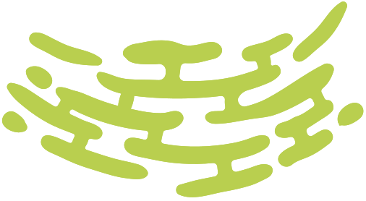
The Brain
El cerebro
The Body’s Control Center
El centro de control del cuerpo

Slide 33
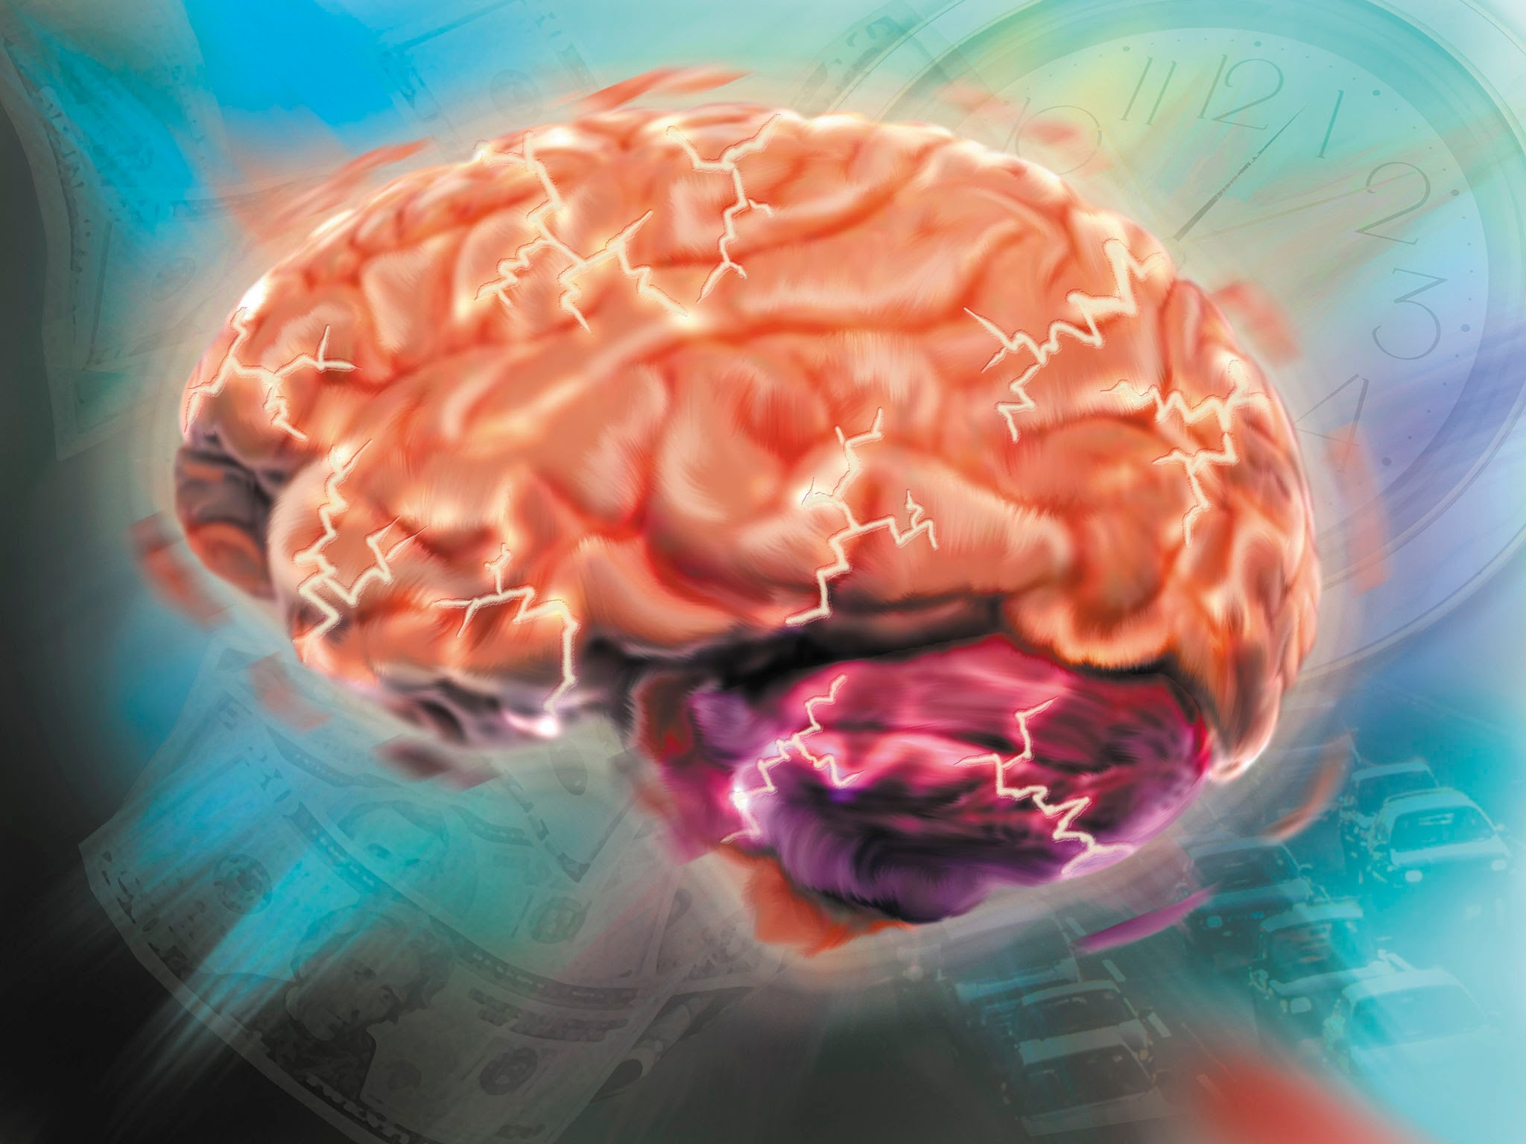
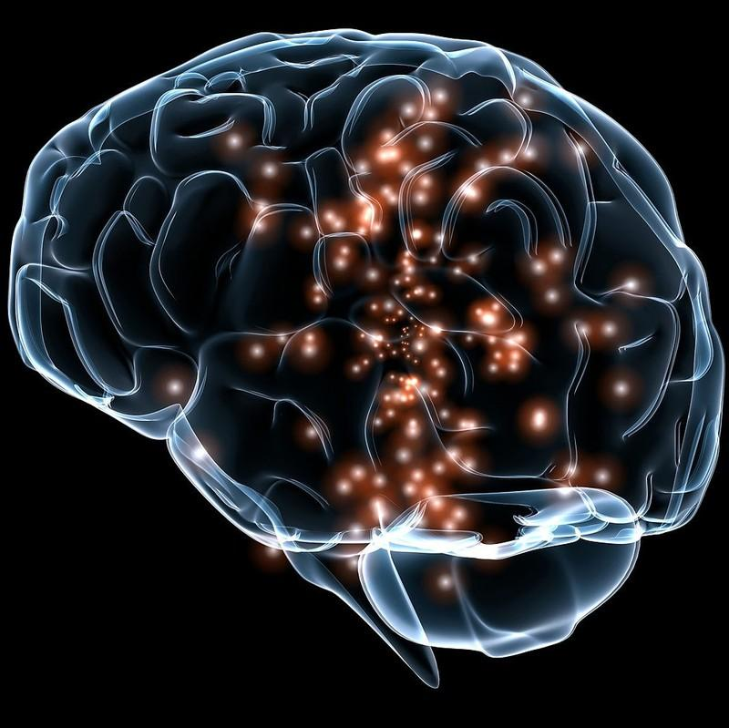
Meet Your Brain!
¡Conoce tu cerebro!
Your brain is the control center of your body, and is responsible for processing information, thoughts, memories, emotions, and movements
Tu cerebro es el centro de control de tu cuerpo y es responsable de procesar información, pensamientos, recuerdos, emociones y movimientos
Quick Facts | Datos básicos:
It weighs about 3 pounds | Pesa alrededor de 1,4 kg
Does not have any pain receptors | No tiene receptores del dolor
Uses about 20% of your body’s energy - even when you’re resting! | Consume aproximadamente el 20 % de la energía del cuerpo, ¡incluso en reposo!
It is about 75% water | Está compuesto en un 75 % de agua
Notes:
Your brain is responsible for thinking, feeling, moving, remembering, and most importantly, keeping you alive

Slide 34
The Brain’s Main Parts
Las partes principales del cerebro
Your brain has 3 main parts that work together to keep you alive and cognizant
Tu cerebro tiene 3 partes principales que trabajan juntas para mantenerte vivo y consciente
Forebrain | Cerebro anterior
Midbrain | Mesencéfalo
Hindbrain | Cerebro posterior
Hindbrain
Higher levels of thinking, emotion, language, sensory processing
Niveles superiores de pensamiento, emoción, lenguaje y procesamiento sensorial
Relay station between the forebrain and hindbrain, eye and auditory control
Estación de relevo entre el prosencéfalo y el rombencéfalo, control ocular y auditivo
Regulates vital functions such as breathing and heart rate, coordinating movement
Regula funciones vitales como la respiración y la frecuencia cardíaca, coordinando el movimiento
Notes:
Forebrain includes cerebrum ex: solving a problem or remembering a song
cerebellum ex: catching a ball
brain stem ex: staying alive and regulated at rest

Slide 35
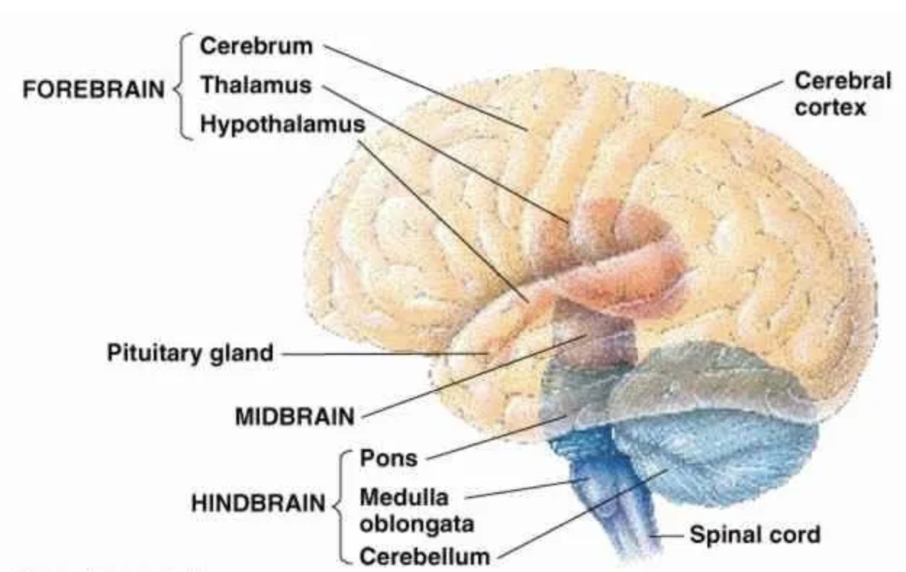
The Brain’s Main Parts
Las partes principales del cerebro
Cerebro
Tálamo
Prosencéfalo
Hipotálamo
Mesencéfalo
Puente de Varolio
Cerebro posterior
el bulbo raquídeo
Cerebelo
médula espinal

Slide 36
The Forebrain - Thinking and Emotion
El prosencéfalo: pensamiento y emoción
Components | Componentes:
Cerebrum - The largest part, responsible for higher order functions like thinking, planning, problem solving, memory, and voluntary movement, divided into 4 lobes
Cerebro: La parte más grande, responsable de funciones cognitivas superiores como el pensamiento, la planificación, la resolución de problemas, la memoria y el movimiento voluntario. Se divide en cuatro lóbulos
Hypothalamus - Regulates basic functions such as body temperature, hunger, and thirst
Hipotálamo: Regula funciones básicas como la temperatura corporal, el hambre y la sed
Thalamus - Relays sensory and motor signals to the cerebral cortex
Tálamo: Transmite señales sensoriales y motoras a la corteza cerebral
Limbic System - Emotional processing, motivation, memory
Sistema límbico: Procesamiento emocional, motivación y memoria
Notes:
limbic system involved in habits as we talked about last week

Slide 37

The 4 Lobes of the Cerebrum
Los 4 lóbulos del cerebro
Lóbulo frontal
Lóbulo parietal
Frontal
Decision making, planning, movement
Toma de decisiones, planificación, movimiento
Parietal
Touch, temperature, pain, spatial sense
Tacto, temperatura, dolor, percepción espacial
Temporal
Hearing, language comprehension, memory
Audición, comprensión del lenguaje, memoria
Occipital
Lóbulo temporal
Lóbulo occipital
Vision
Visión
Notes:
Each lobe has a special job

Slide 38


The Limbic System | El sistema límbico
Involved in emotion, memory, and motivation
Involucrado en la emoción, la memoria y la motivación
Amygdala: Fear, aggression, emotion
Amígdala: Miedo, agresión, emoción
Hippocampus: Formation of long term memories and spatial navigation
Hipocampo: Formación de la memoria a largo plazo y orientación espacial
Hypothalamus: Maintain homeostasis through drive for food, sex, and survival
Hipotálamo: Mantiene la homeostasis mediante la búsqueda de alimento, el deseo sexual y la supervivencia
What might happen when there is damage to these areas?
¿Qué podría ocurrir si estas áreas resultaran dañadas?
Hipotálamo
homeostasis
amígdala
emoción
hipocampo
conversión de memoria
Notes:
The forebrain also includes the limbic system, which is deep within the cerebrum
amygdala damage/over heightened - heightened anxiety or stress response
damage to hippocampus - memory loss (HM)
damage to hypothalamus - appetite and weight changes, hormonal imbalance, sleep dysregulation

Slide 39

The Midbrain - Relay and Regulation
El mesencéfalo: relevo y regulación
The small, upper part of the brain stem
La pequeña parte superior del tronco encefálico
Acts as a bridge between the forebrain and hindbrain to relay information
Funciona como puente entre el prosencéfalo y el rombencéfalo para transmitir información
Mesencéfalo
Controls reflexes related to vision and hearing
Controla los reflejos relacionados con la visión y la audición
Role in alertness and arousal
Papel en el estado de alerta y la excitación

Slide 40
The Hindbrain - Basic Life Support
El cerebro posterior - Soporte vital básico
Controls essential automatic bodily functions and is evolutionarily the most ancient part of the brain
Controla funciones corporales automáticas esenciales y es, evolutivamente, la parte más antigua del cerebro.
Medulla Oblongata | El bulbo raquídeo
Cerebellum | Cerebelo
Pons | Puente de Varolio
Responsible for coordinating movement, balance, and posture; procedural memory
Responsable de coordinar el movimiento, el equilibrio y la postura; memoria procedimental
Relays signals between the rest of the brain and the cerebellum; Coordinates signals between different brain regions
Transmite señales entre el resto del cerebro y el cerebelo;
Coordina las señales entre las diferentes regiones del cerebro
Controls vital autonomic functions (breathing, heartbeat, digestion)
Controla las funciones autonómicas vitales (respiración, latidos del corazón, digestión)

Slide 41


Cerebellum - “Little Brain”
Cerebelo - “cerebro pequeño”
Located at the back and base of the skull | Ubicado en la parte posterior y la base del cráneo
Responsible for balance, learning movement, coordination, and refining motor control | Responsable del equilibrio, el aprendizaje del movimiento, la coordinación y el perfeccionamiento del control motor
Contains about HALF of the neurons in the brain |
Contiene aproximadamente la mitad de las neuronas del cerebro.
New research suggests that it also plays a role cognitive functions | Nuevas investigaciones sugieren que también participa en las funciones cognitivas
Cerebelo
Notes:
talk especially about the cerebellum more
cognitive functions - the cerebellum also supports a thing called procedural memory, involves unconscious learning and allows for the automatic execution of tasks without conscious effort, includes motor and cognitive skills
for example, riding a bike or acquiring a language

Slide 42



Left Hemisphere
Hemisferio izquierdo
Right Hemisphere
Hemisferio derecho
Language | Idioma
Logic | Lógica
Analytical Thinking | Pensamiento analítico
Creativity | Creatividad
Spatial Ability | Habilidad espacial
Emotional Cognition | Cognición emocional

Slide 43

Looking at Brains - Activity
Observación de cerebros - Actividad
Brain areas are largely conserved across many species
Muchas especies comparten áreas cerebrales similares
Today, we will be looking at preserved brains and trying to identify as many major lobes as we can: frontal, parietal, temporal, occipital. Also labeling structures such as the cerebellum and brainstem if possible.
Hoy examinaremos cerebros conservados e intentaremos identificar tantos lóbulos principales como sea posible: frontal, parietal, temporal y occipital. También identificaremos estructuras como el cerebelo y el tronco encefálico, si es posible.
Also note any differences you can see between each brain!
¡Observen también cualquier diferencia que puedan apreciar entre cada cerebro!
Notes:
talk especially about the cerebellum more
cognitive functions - the cerebellum also supports a thing called procedural memory, involves unconscious learning and allows for the automatic execution of tasks without conscious effort, includes motor and cognitive skills
for example, riding a bike or acquiring a language

