Slide 1
PhonePe Insurance Data Analysis
Name: Jailakshmi Ramesh
Course: Data Science (DS-C-WE-E-B113)

Slide 2
Introduction
Analyzing insurance transaction data from PhonePe Pulse dataset.

Slide 3
Objectives
Extract data
Transform data
Analyze trends
Build dashboard

Slide 4
Technologies Used
Python
Pandas
Streamlit
SQL
GitHub

Slide 5
Data Source
PhonePe Pulse GitHub dataset

Slide 6
Workflow
JSON → DataFrame → Analysis → Dashboard

Slide 7
Data Processing
Year
Quarter
Count
Amount

Slide 8
SQL Analysis
Year-wise
Quarter-wise
Total
Average

Slide 9
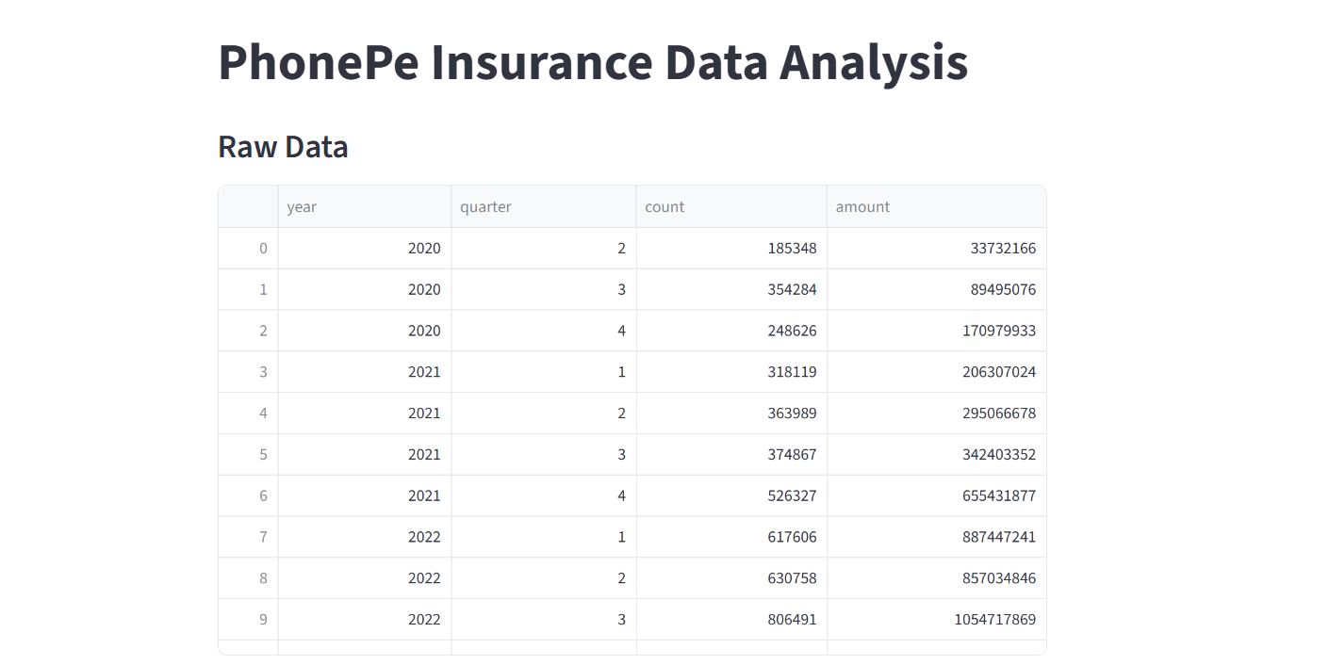
Dashboard
Displays raw data and charts

Slide 10
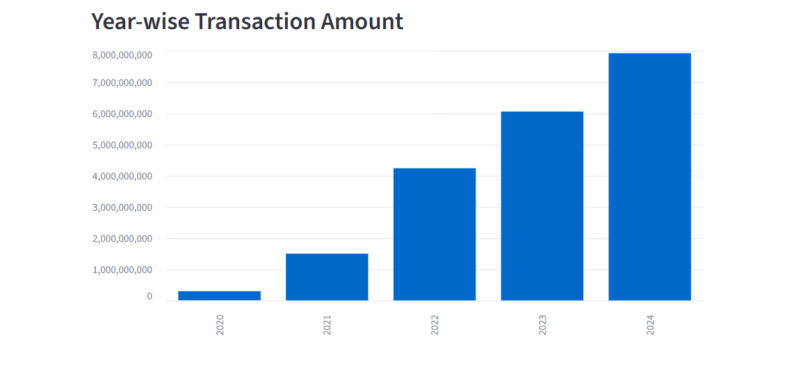
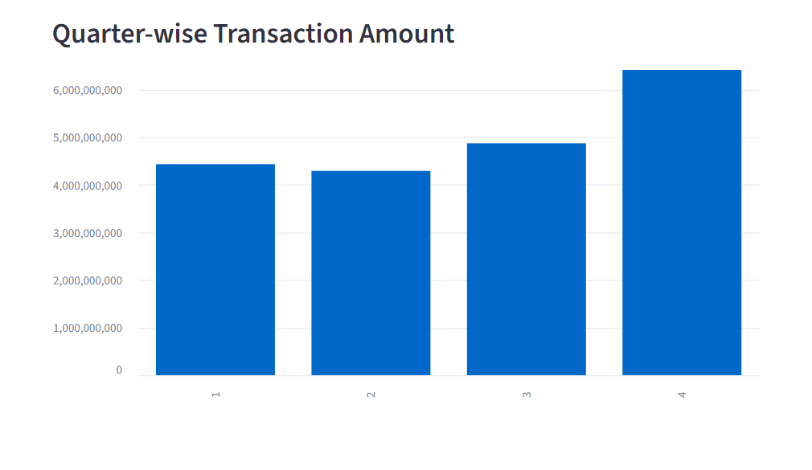
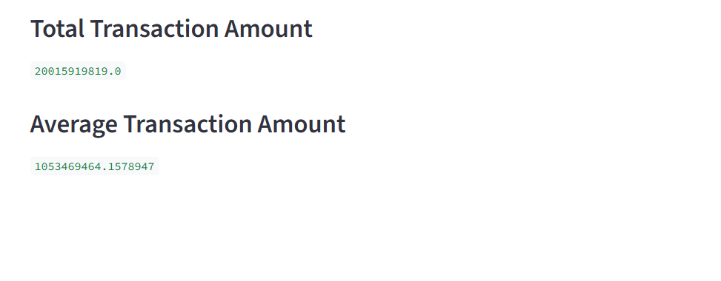
Dashboard

Slide 11
Key Insights
Growth in transactions
Digital adoption rising

Slide 12
Challenges
JSON handling
Setup issues

Slide 13
Conclusion
End-to-end data analysis project

Slide 14
Thank You

