Slide 1
Abaqus CAE
Manual .par script
Build Geometry
Optimization Module
.par file
Create Optimization Task
Mesh
Tosca
Optimization Process “Job”
Submit Optimization “Job”
Define Material + Section
Submit Optimization “Job”
.par file + optimization files
Assembly, step, BCs, loads
“Tosca” .par file + optimization files
writeInput from Job
The optimization module and the tosca workflows are separate methods for TO.
.inp file

Slide 2
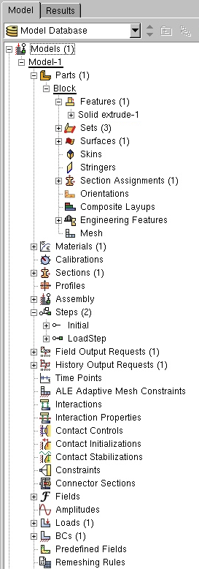
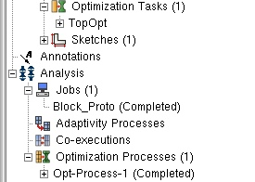
Build geometry
Mesh
Define material + section
Assembly, step, BCs, loads
Create job and writeInput()
Define optimization
Create optimization job and submit
Interchangeable
Interchangeable

Slide 3
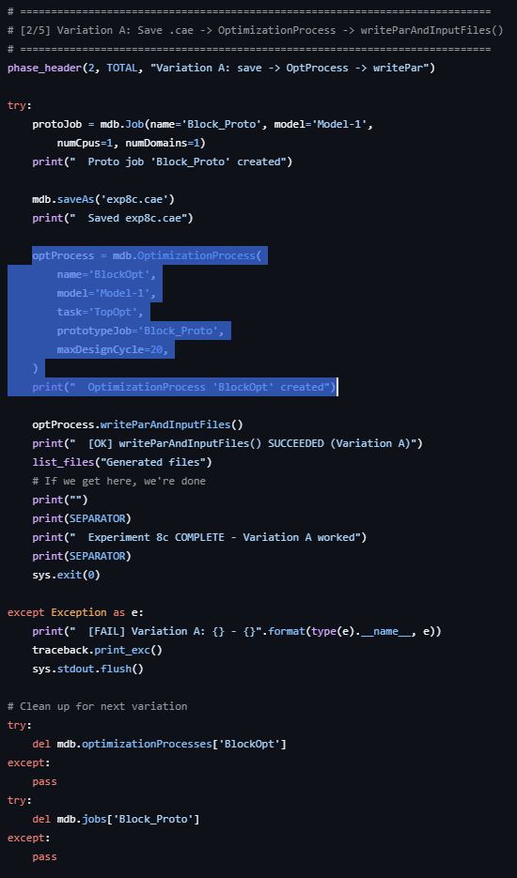
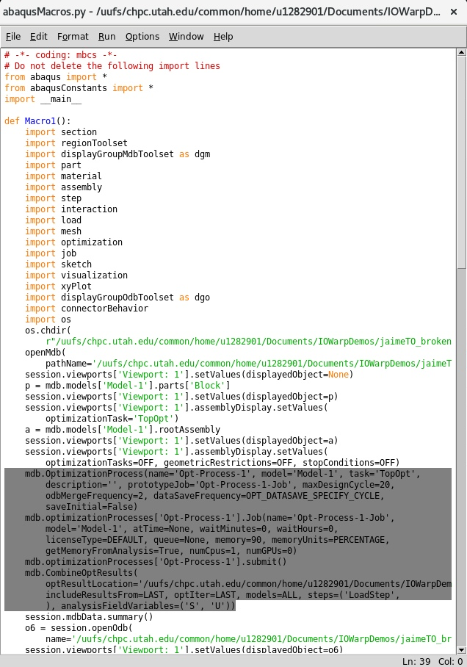
Exp8c_write_par.py (Variation A)
abaqusMacros.py
IMPORTANT: mdb.OptimizationProcess(...) and mdb.optimizationProcesses[‘X’].Job(…) are different and must be called out separately to run the optimization module in Abaqus.
mdb.OptimizationProcess(...) defines how optimization will run.
mdb.optimizationProcesses[‘X’].Job(…) defines how each analysis iteration will be executed.
Other Notes:
mdb.optimizationProcesses[‘X’].submit() should now work after correct the par/inp setup.
mdb.CombineOptResults(…) is optional, but it is typically done to view the iterations of optimization better.

