Slide 1
Clock Synchronization - Improve total order

Slide 2
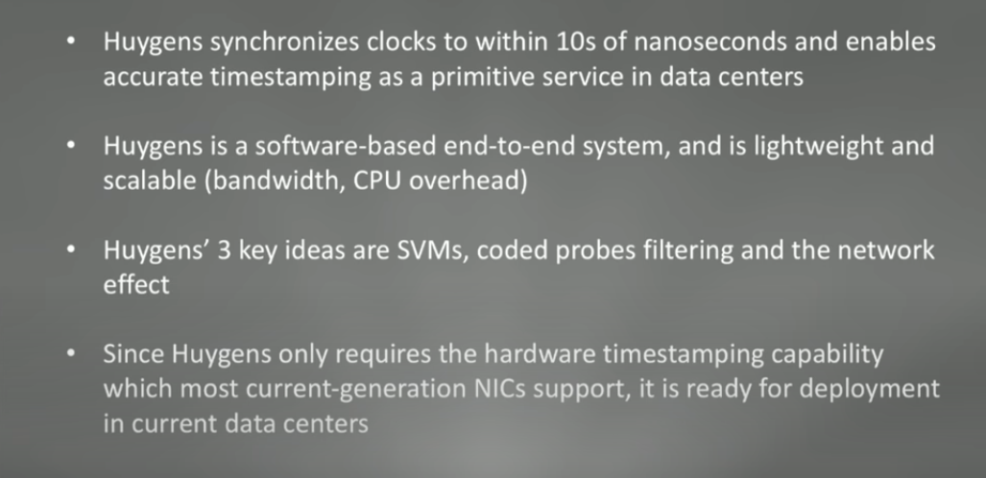

Slide 3
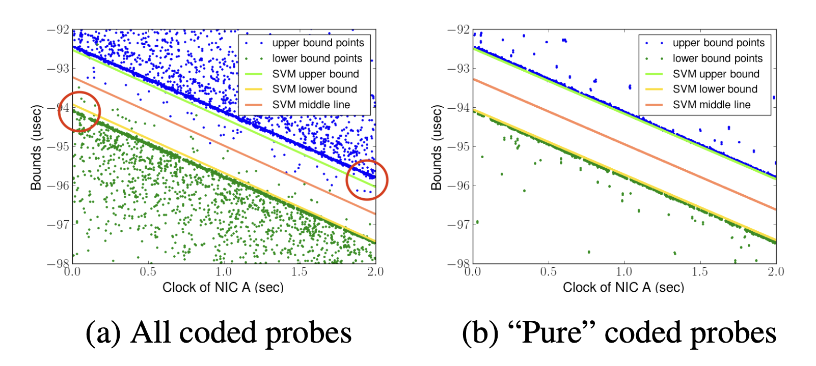
Huygens linear SVM Model
Cleaning: Coded probes filter out invalid probes.
Model: Run linear SVM with filtered probes to get the slope and intercept.
Test & performance: In a 40 Gbps data center testbed, HUYGENS only takes around 0.05% of the link bandwidth and less than 0.44% of a server’s CPU time.

Slide 4
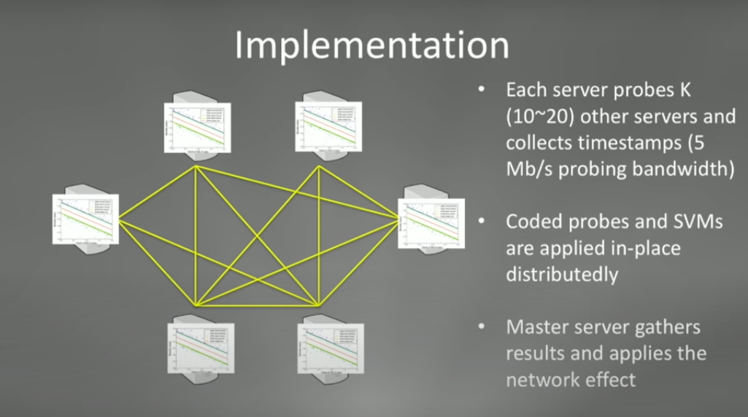

Slide 5
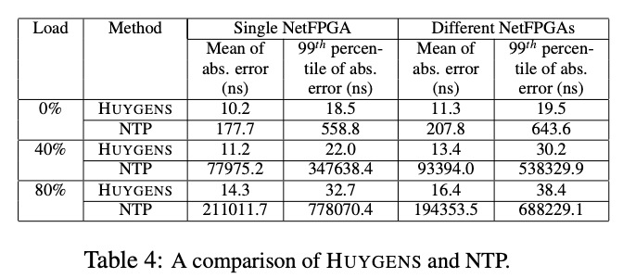
Comparison

Slide 6
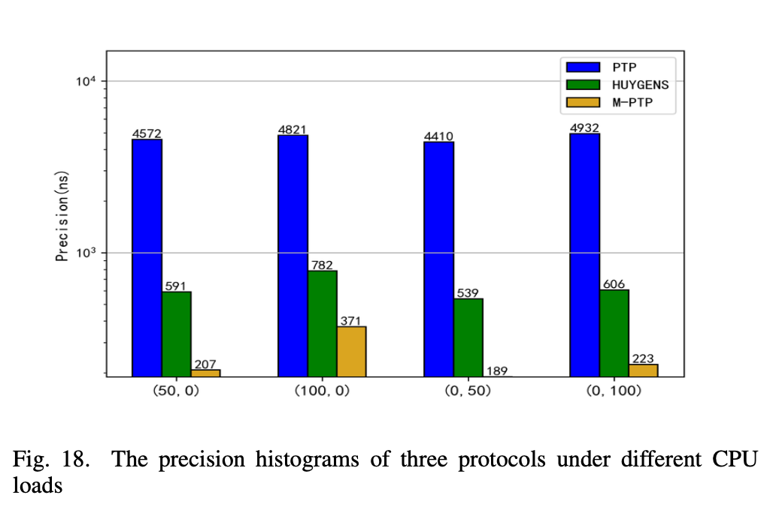
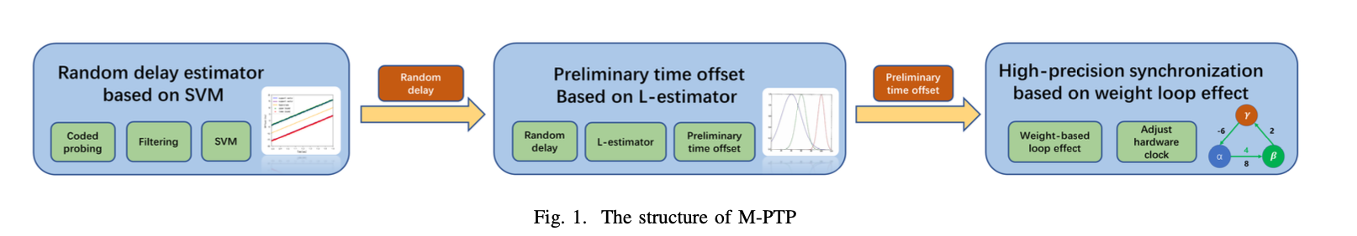
Multi-hop Precision Time Protocol: an Internet Applicable Time Synchronization Scheme
Paper claims: Approximately 3 times the precision of HUYGENS
and approximately 30 times the precision of PTP
HUYGENS’s synchronization is only applicable to symmetrical
structure of the data center.
Multi-hop Precision Time Protocol (M-PTP) is
especially suitable for Internet-scale high-precision
time-synchronized scenes and with low cost.

Slide 7
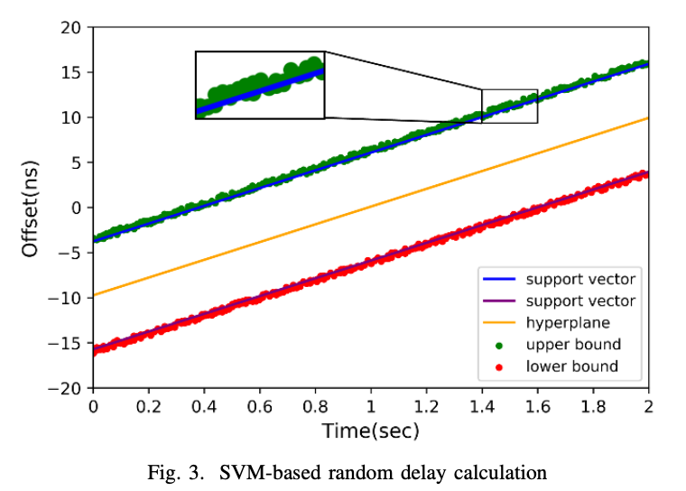
Step 1: Get random delay distribution based on SVM:
M-PTP encodes and filters the packets to obtain packets that are less affected by the delay of network equipment, obtains the upper and lower bounds, and estimates the random.
The longitudinal distance between the data point
above the upper support vector and the upper
support vector is its forward random queuing delay.
The longitudinal distance between the data point
below the lower support vector and the lower
support vector is its reverse random queuing delay.

Slide 8
Step 2: Calculate preliminary time offset based on L-estimator:
In each period of the L-estimator, we can obtain the distribution of positive and negative random queuing delay through SVM based random delay estimation, and then calculate its expectation and covariance.
k is the number of historical periods of the extended model of the L-estimator.
If k periods are met, calculate the parameters of the L-estimator for the current period and the previous k periods, and then calculate the time offset estimate based on the parameters, that is, the preliminary time offset.

Slide 9
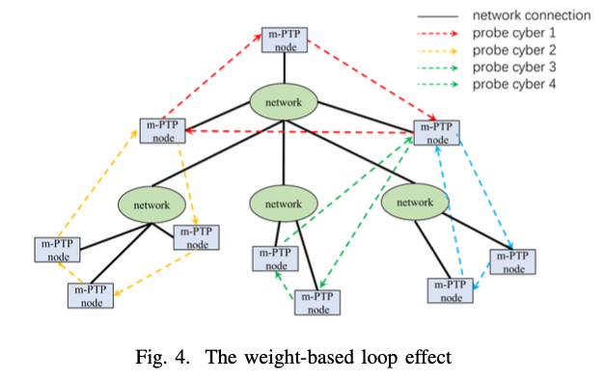
Correction based on weight loop effect
Perform a loop correction based
on the weight to obtain the final
time offset.
Loop correction means that a
group of synchronized clocks
must be transfer synchronized.
Based on the preliminary time
offset of each edge calculated
at the previous step, M-PTP would
perform a loop correction based on the weight.

Slide 10
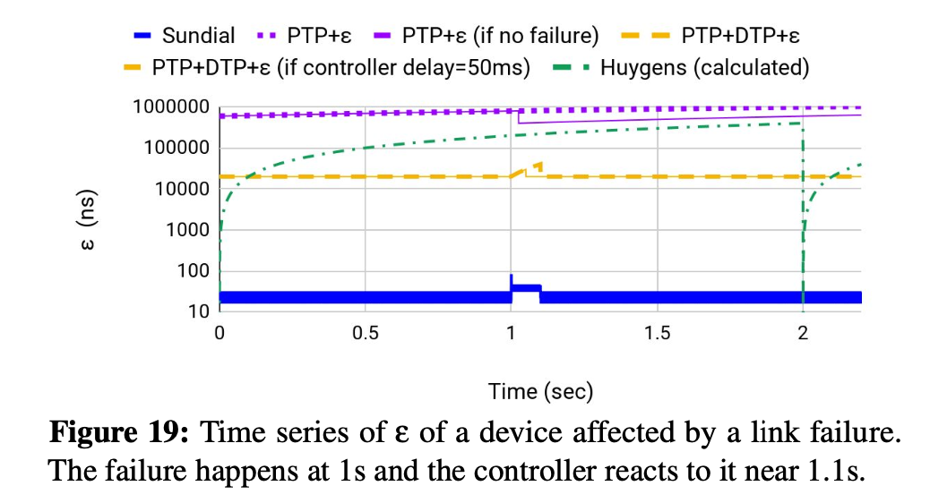
Sundial: Fault-tolerant Clock Synchronization for Datacenters
Unlike Huygens which uses only software to improve
clock synchronization, sundial is a hardware-software
based solution.
Sundia is a submicrosecond-level clock synchronization
system that is resilient to failures, provides fast failure
detection based on frequent synchronization messages in
hardware.
Sundial enables fast failure recovery using a novel graph
based algorithm to precompute a backup plan that is
generic to failures.
It uses hardware-software codesign to quickly detect
failures and recover from them.
FRANCIS: Fast Reaction Algorithms for Network Coordination In Switches - Claims that it quickly recovers from multiple failures, reduces the time uncertainty bound by up to 5x, and lowers the clock drift when compared to sundial.

Slide 11
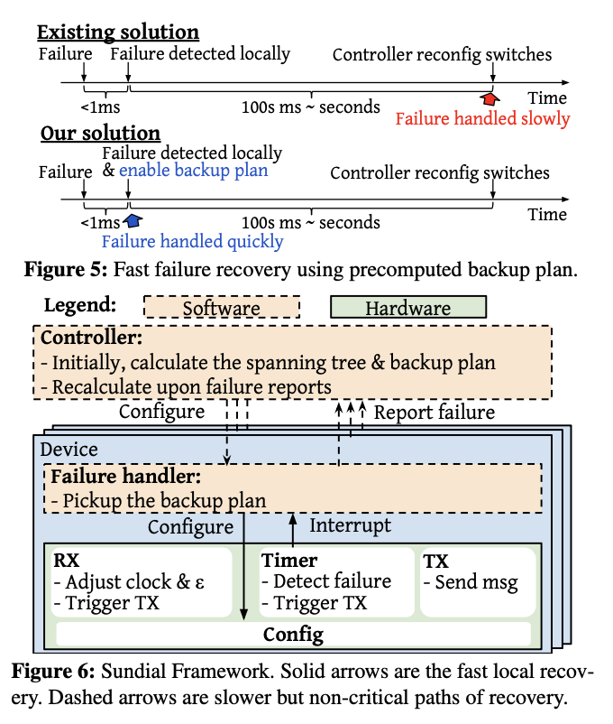

Slide 12
Graham: Synchronizing Clocks by Leveraging Local Clock Properties
Graham leverages the fact that the local clock still keeps time even when connectivity is lost and builds a failure model using the characteristics of the local clock and the desired synchronization accuracy.
Reduces the clock drift of a commodity server by up to 2000x, reducing the maximum assumed drift in most situations from 200ppm to 100ppb.
Graham works in synergy with other synchronization mechanisms, such as Huygens, PTP and FaRMv2 to maintain synchronization.
Establish “ground truth”, or the temperature-clock error response curve. If we can determine the clock error given a certain temperature, then we can correct the clock even in the absence of the accurate timing signal.

Slide 13
Communication-efficient Clock Synchronization
This paper is an enhancement to the HUYGENS clock synchronization. It claims to reduce the communication time between the master node and the server node.

