Slide 1
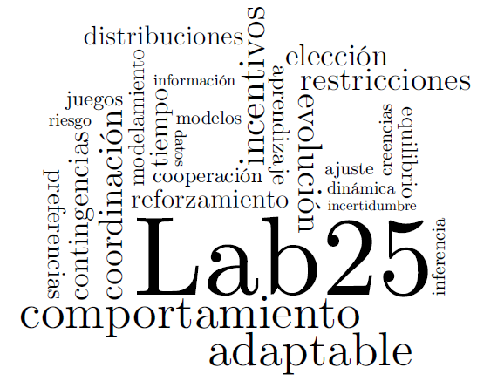
Cognitive Levels and Beliefs in Games
Jaime O. Islas Farias
National Autonomous University of Mexico
Faculty of Psychology
Supported by PAPIIT Project IN307214

Slide 2
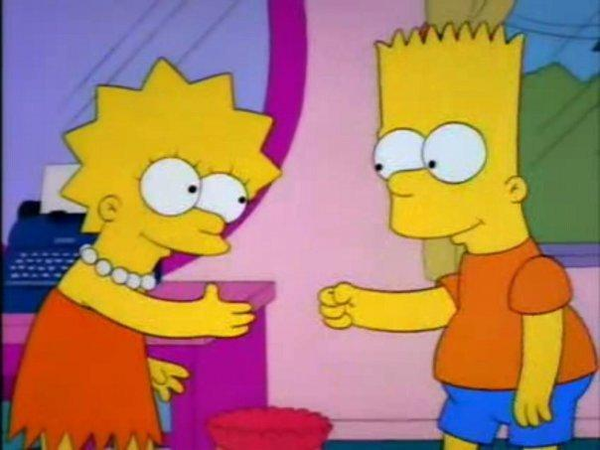
Iterated Reasoning
Lisa’s brain: Poor predictable Bart. Always takes ‘rock’. Bart’s brain: Good ol’ ‘rock’. Nuthin’ beats that! Bart: Rock! Lisa: Paper. Bart: D’oh!

Slide 3
p-Beauty Contest
First used by Nagel (1995) for studying iterated reasoning.
A group of players simultaneously choose a number within the range [0,100].
The player that chooses the closest number to the average of all chosen numbers multiplied by a parameter p (usually ⅔) wins the game.

Slide 4
Level k and Cognitive Hierarchy Models
The number chosen by a player depends on the number of steps of reasoning he/she is capable of doing and the expectations he/she has about the cognitive levels of other players (Agranov, 2012).
Level 0 players choose their number randomly.
Level k players choose a number that is the best response to the choices of level k-1 players, or a distribution of level 0 to level k-1players (Camerer et al., 2004).

Slide 5
Previous Research
Previous studies considered the chosen number to be an estimator of beliefs in average choices and in the choices of others. (Lahav, 2015).
However, there is no information about the relationship between choices and beliefs.
Are choices of participants consistent with their beliefs about others?

Slide 6
Previous Research
Lahav (2015) studied this by using belief elicitation. He concludes that choices do not reflect actual beliefs.
Period | Belief * 2/3 | Belief
1 | -3.81 (0.00)* | 3.22 (0.00)*
2 | -2.52 (0.01)* | 3.87 (0.00)*
3 | -2.42 (0.02)* | 2.54 (0.01)*
4 | -1.98 (0.05)* | 2.12 (0.04)*
5 | -1.38 (0.17) | 2.44 (0.02)*

Slide 7
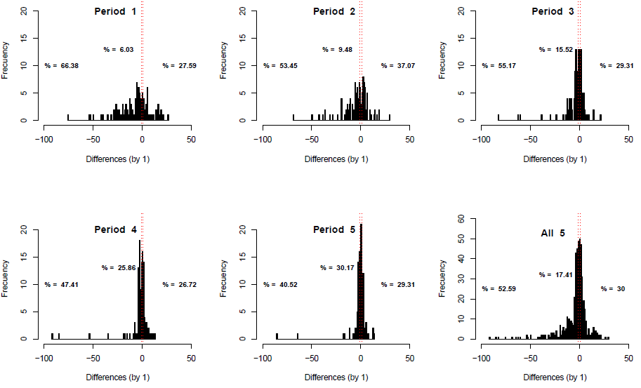

Slide 8
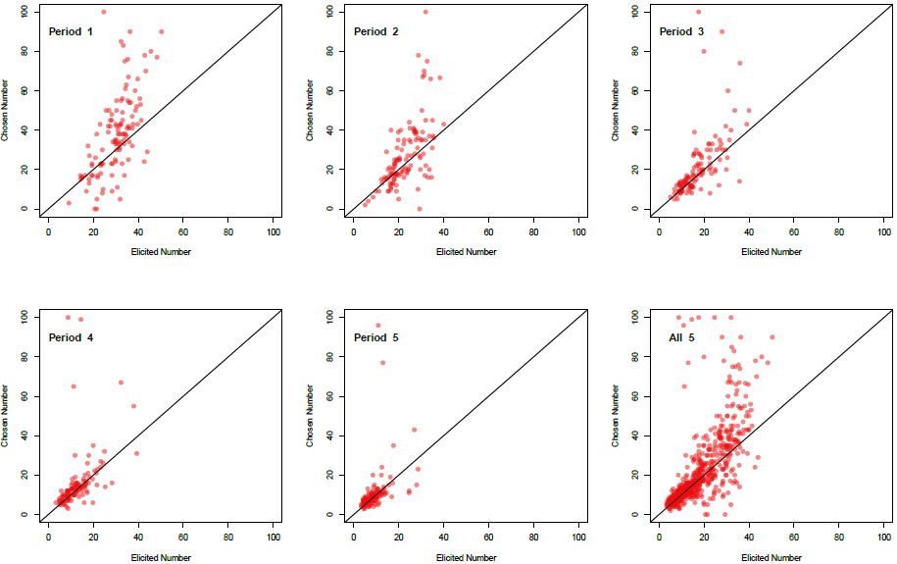

Slide 9
Do inconsistencies diminish with experience?
Or is it just an effect of the tendency towards the equilibrium and the lower limit of the range of eligible numbers?
Slonim (2005) studied the effect of experience, by pairing experienced and inexperienced players in a Beauty contest game.

Slide 10
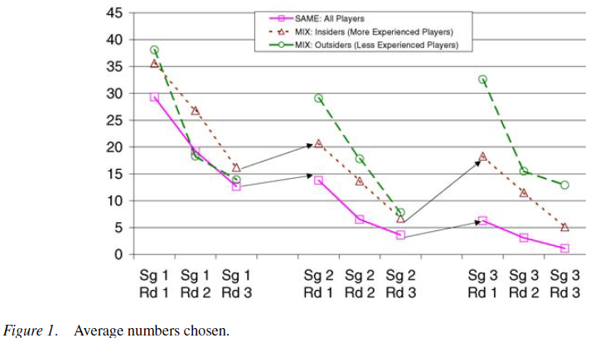
Slonim found a ‘reset’ effect when new players enter a game.

Slide 11
Research Questions
Differences between choices and beliefs diminish with experience?
Inconsistencies between choices and beliefs will decrease for an experienced player, even when a reset effect is elicited?
How do beliefs differ between experienced and inexperienced players?

Slide 12
Experimental Design
10 Sessions
Participant A |  | SubGame 1 |  | SubGame 2
Participant B |  | 4 Periods |  | 4 Periods
Participant C |  | Participant A |  | Participant A
Participant D |  | Participant B |  | Participant D
Participant E |  | Participant C |  | Participant E
ID: S3PB | My Chosen Number: ___________ | Numbers of Other Players: _____ & _____
Period 1

Slide 13
Preliminary
Results
...

Slide 14
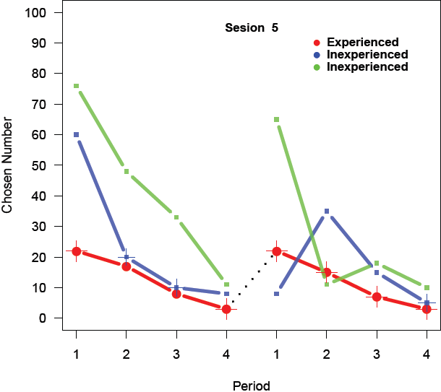
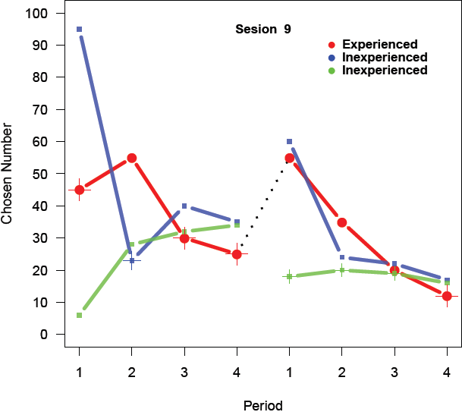
Reset effect examples

Slide 15
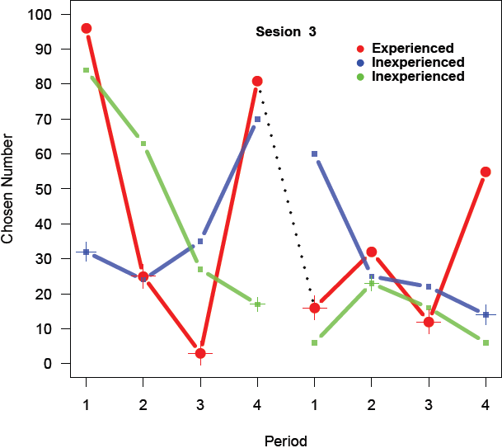
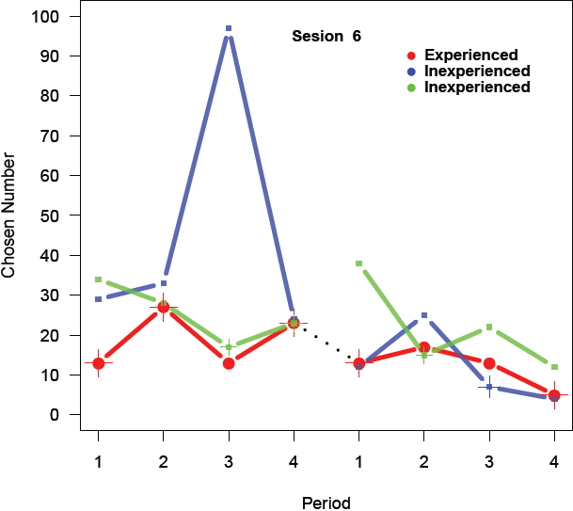
Reset effect not found

Slide 16
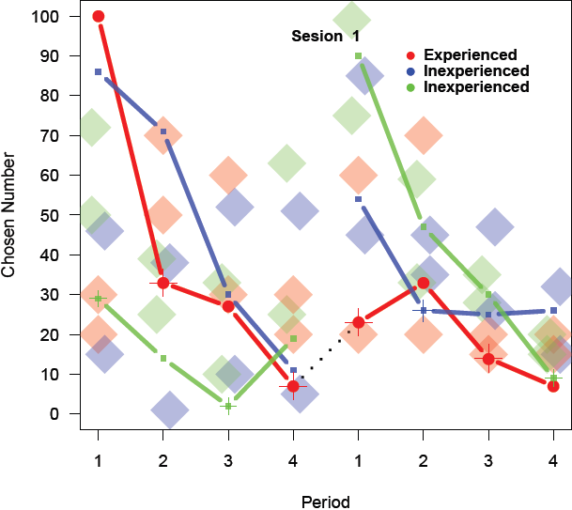
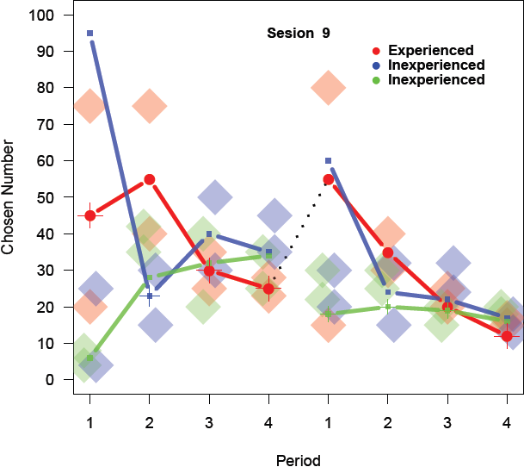
Beliefs follow Choices

Slide 17
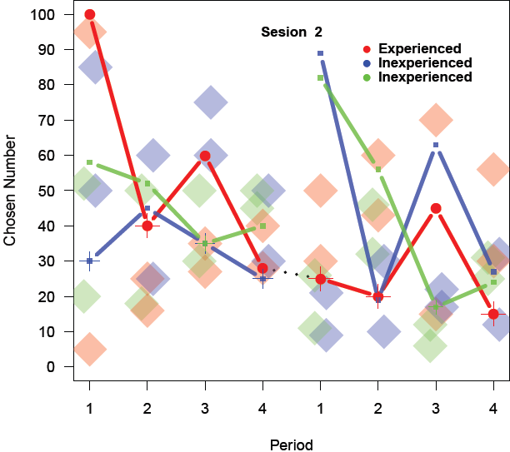
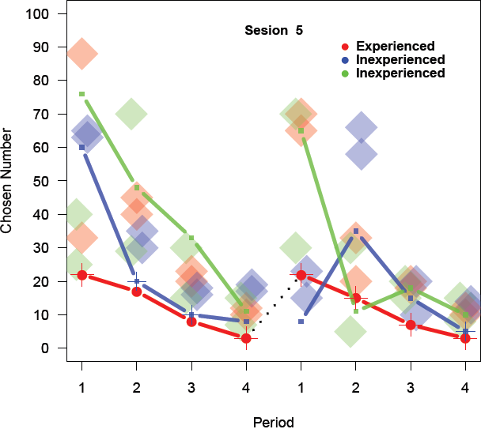
Choices in Period 1 SubGame 1 seem to affect Choices in Period 1 SubGame 2 for Experienced Players

Slide 18
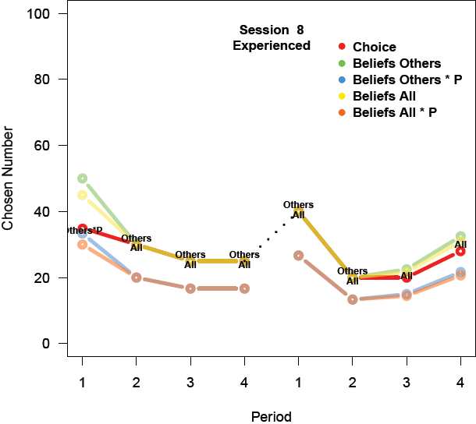
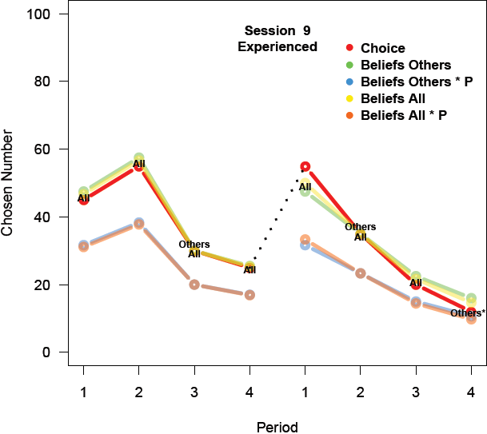
Some Players don’t consider the *P

Slide 19
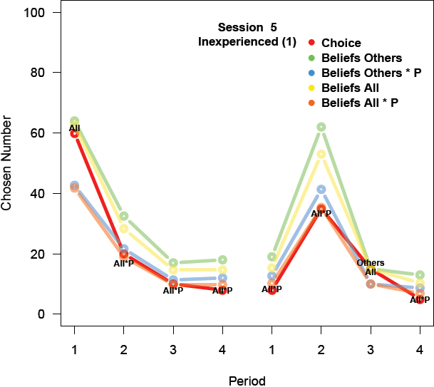
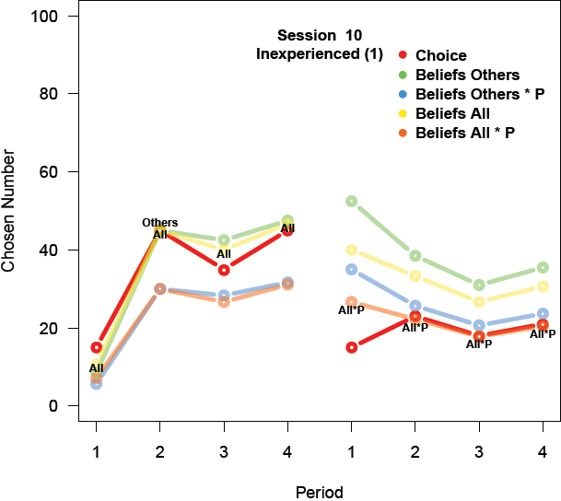
Some Players are both consistent and sophisticated

Slide 20
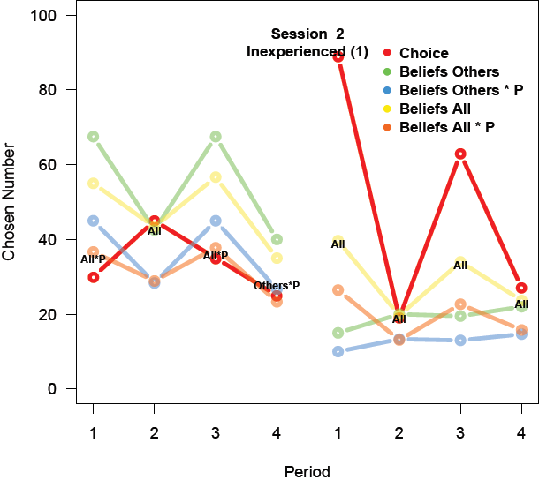
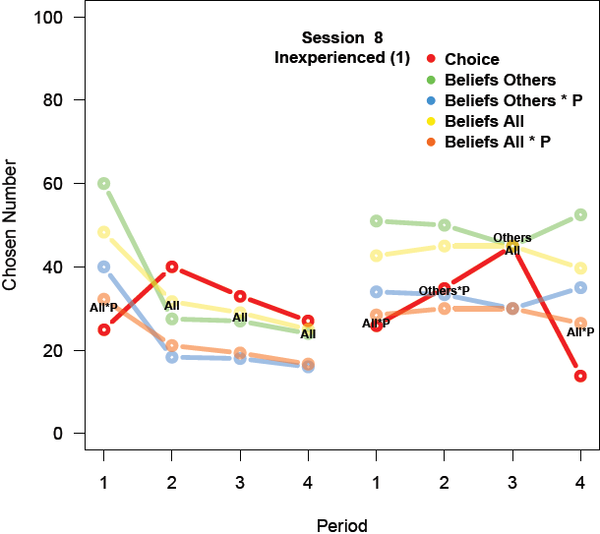
Some Players are not consistent

Slide 21
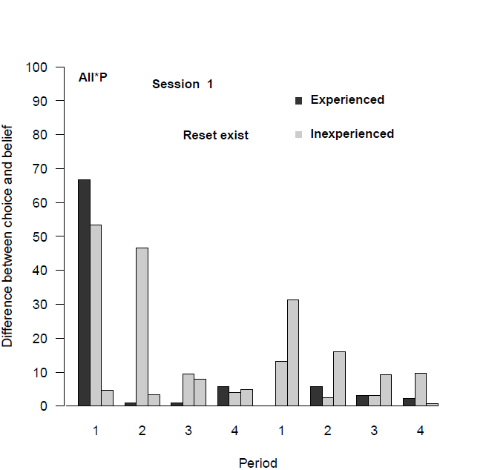
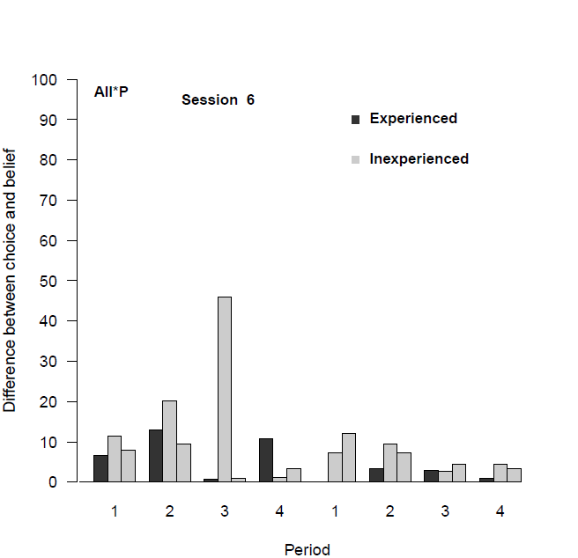
Most experienced players show reduced differences between choices and beliefs in SubGame 2.

Slide 22
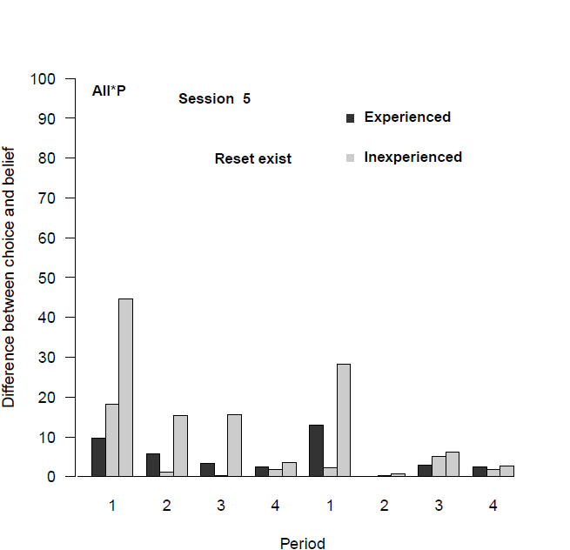
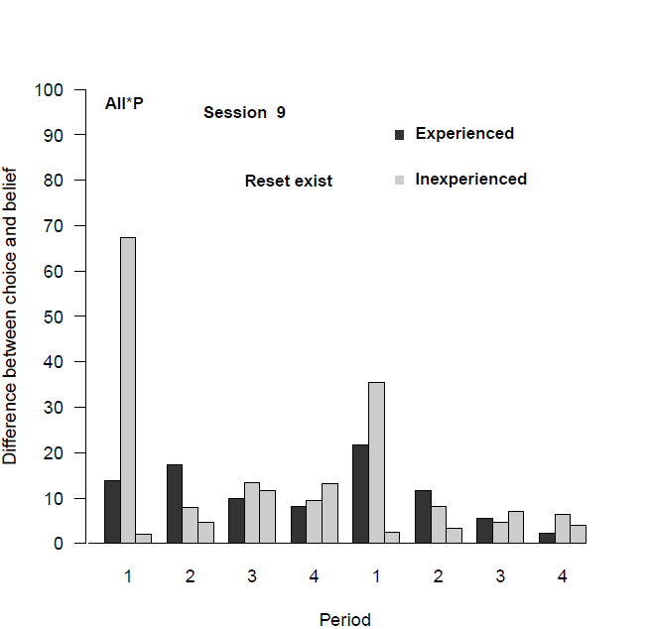
Some experienced players don’t show reduced differences between choices and beliefs in SubGame 2.

Slide 23
Next one is a PDF

Slide 24
References
Agranov, M., Potamites, E., Schotter, A., & Tergiman, C. (2012). Beliefs and endogenous cognitive levels: An experimental study. Games and Economic Behavior, 75(2), 449-463.
Camerer, C. F., Ho, T. H., & Chong, J. K. (2004). A cognitive hierarchy model of games. The Quarterly Journal of Economics, 861-898.
Lahav, Y. (2015). Eliciting beliefs in beauty contest experiments. Economics Letters, 137, 45-49.
Nagel, R. (1995). Unraveling in guessing games: An experimental study. The American Economic Review, 1313-1326.
Slonim, R. L. (2005). Competing against experienced and inexperienced players. Experimental Economics, 8(1), 55-75.

Slide 25
That’s it… for now
THANK YOU

