Slide 1
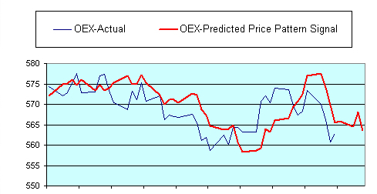
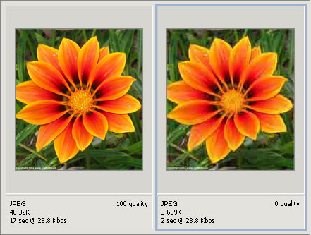
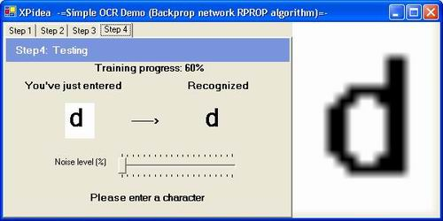
Applications
Stock market prediction
Image compression
Optical character recognition

Slide 2
Application Types
Classification
Assigning objects to a predetermined group
Uses a training set to create classifiers
Clustering
Grouping objects similar to each other
Like classification but without knowing the class
Commonly uses a distance relationship
Pattern Association
Can be used to reduce noise or corruption
Can be split into auto/hetero-association
Vector Quantization
Associates each input with the nearest vector
Process is similar to clustering
Can compress large amounts of input data
Not lossless
Notes:
For each one talk about how it can be used in a neural network (or perhaps do this all at once at the end).

Slide 3
Optical Character Recognition (OCR)
Algorithms used to be processor intensive
Caused significant delay in recognition time
Neural networks seen as efficient without extensive processing
Can be learnt with back propagation algorithm
Initial learning time is one time only
Notes:
Optical character recognition – algorithms for this usually did a whole bunch of stuff before being able to recognise a character, including smoothing, curve analysis etc. This took a lot of processing power for the time, and could cause delays in recognition time, which wasn't very good for commercial environments, since speed is crucial there.
So, neural networks were seen as an alternative since they could do without so much processing. They could actually be used with the back propagation algorithm, which does have the downside of being quite fiddly to get the right environment, since you need to to adjust the learning rate, number of layers, number of nodes and so forth, but this is one time only and once this is done it's an effective to recognise characters

Slide 4
Image Compression
Can decompose an image into a set of vectors
This can be based off brightness, colour etc
Vector quantisation can then be used in a neural network
Has several learning algorithms that can be used
There are other ways of compressing images with neural networks
Notes:
Image compression – this can be done with neural networks because you can decompose an image into vectors, using brightness or colour perhaps. Once this is done, the vector quantisation method can be used, and that has some different algorithms such as competitive learning or using self-organising feature map.
There are actually other ways aside from vector quantisation that can be used with a neural network, such as Hebbian learning, predictive coding or once again back-propagation, which can adapt to each given image with a specially designed network, so you can optimise specifically for each image.

Slide 5
Stock Market Prediction
Why use neural networks?
Good at finding patterns in data
Can find non-linear patterns with multiple layers
The network
Have to decide how many inputs to use – complex
Which learning algorithm is most ideal?
Notes:
So first of all, why do we need neural networks for stock market prediction. Well, current methods involve a lot of analysis to find patters in the data, which neural networks are quite good at in the first place. They're also pretty adept at finding non-linear patterns which are quite hard to spot.
When designing the network you have to look at how many input neurons to use, since stock markets are quite complex and have many factors affecting them. You also have to look at which learning algorithm is most ideal; back propagation can once again be used since its fairly easy to implement and is effective, but there are other methods such as recurrence and self-organising networks.

