Slide 1
Neural Networks and their Applications
By Mateusz Dyda, Ashley Hemingway, Jaime Lennox and Christophe Steininger

Slide 2
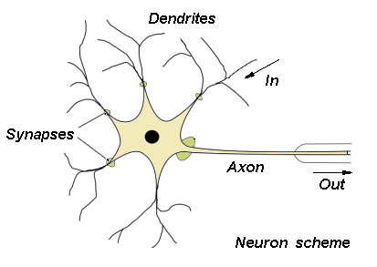
Introduction
Logical structures
Nodes communicating through synapses
Self-adjusting behaviour

Slide 3
Artificial Neural Networks (ANNs)
Target applications that are hard to formulate explicitly
Comparable to the biological nervous system but not perfectly equivalent
Exhibit particular brain characteristics:
Learning from experience
Deriving from previous data to the new one
Extracting valuable data from input containing irrelevant data
Generalise as a result of their structure, contrary to the classical idea of programs

Slide 4
How do ANNs work?
Compute output neurons using the input and weights (synapses)
Need to be trained to produce consistent and desired output
Analogous to human brain memorising relevant information
Training methods:
Supervised learning
Unsupervised learning
Neural Network
Nodes
Weights
Input
Output

Slide 5
Supervised Learning
Requires pairing of each input with corresponding target output (training pairs)
Large number of such training pairs
For each training pair:
Output is calculated with the current weights
Error between the target and calculated output is fed back to the network
Weights are adjusted to minimise the error
Overall error should drop to an acceptable level
Not the best representation of learning in biological systems

Slide 6
Unsupervised Learning
Closer representation of learning in biological systems
Does not require target output and error calculation
Training set consists only of input
Modifies behaviour to produce outputs consistent with each other
Grouping similar inputs together by extraction of statistical properties
Can be difficult to identify those properties without bias

Slide 7
Possible Drawbacks
Awareness of their limitations
Not quite duplicating the functions of the human brain (yet)
The actual 'intelligence' is below the level of a tapeworm
However:
Brain-like performance in certain situations
Should not be underestimated (again)
Help to develop deep understanding of human intelligence

Slide 8
Perceptron – A Brief History
1940’s – Warren McCulloch and Walter Pitts introduced the first neural network model – The MP Neuron
1949 – Donald Hebb introduced Hebb’s Rule which explains a model for learning within the brain
1957 – Perceptron, the first artificial neural network is invented by Frank Rosenblatt

Slide 9
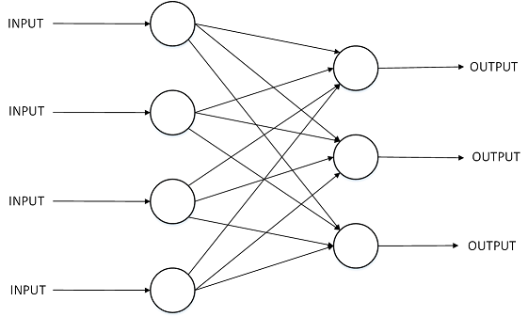
Single-Layer Perceptron

Slide 10
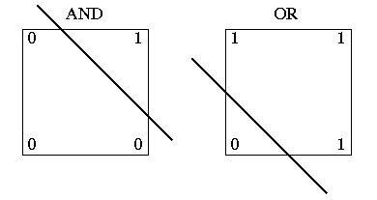
Limitations
Output can only be a definite true or false with no in-between
Can only recognize linearly separable patterns

Slide 11
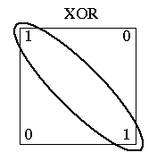
Limitations – XOR Problem

Slide 12
Limitations – XOR Problem
Solution
Use a 3D plane in order to make the values separable by 1 line
Multi – Layer Perceptron

Slide 13
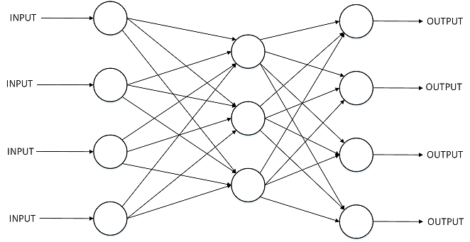
Multi-Layer Perceptron

Slide 14

Multi-Layer Perceptron
Activation function –
Needed to gain an advantage from the hidden layers
Advantage – Can learn more complex patterns
Disadvantage – Too many layers can make network slow and see irrelevant patterns

Slide 15
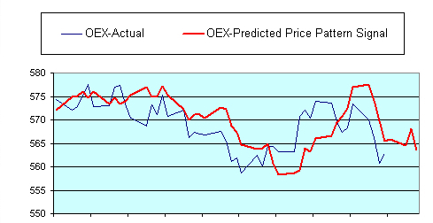
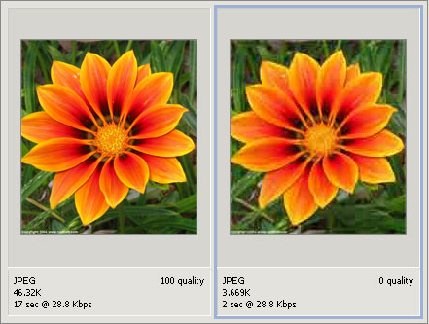
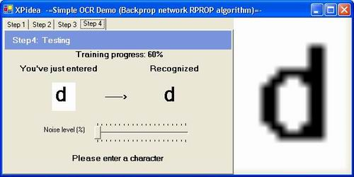
Applications
Stock market prediction
Image compression
Optical character recognition
Image Sources
http://www.image-restore.co.uk/blog/saving-your-images-correctly/
http://www.codeproject.com/Articles/3907/Creating-Optical-Character-Recognition-OCR-applica
http://www.pricepatternprediction.com/
Notes:
Hi, I’m here to talk about the applications of neural networks. There are many places where neural networks can be used, and some examples are displayed here, which I will talk about in a bit, but first of all I’d like to talk about some of the types of applications.

Slide 16
Application Types
Classification
Assigning objects to a predetermined group
Uses a training set to create classifiers
Clustering
Grouping objects similar to each other
Like classification but without knowing the class
Commonly uses a distance relationship
Notes:
For each one talk about how it can be used in a neural network (or perhaps do this all at once at the end).

Slide 17
Application Types
Pattern Association
Can be used to reduce noise or corruption
Can be split into auto/hetero-association
Vector Quantization
Associates each input with the nearest vector
Process is similar to clustering
Can compress large amounts of input data
Not lossless
Notes:
For each one talk about how it can be used in a neural network (or perhaps do this all at once at the end).

Slide 18
Optical Character Recognition (OCR)
Algorithms used to be processor intensive
Caused significant delay in recognition time
Neural networks seen as efficient without extensive processing
Can be learnt with back propagation algorithm
Initial learning time is one time only
Notes:
Optical character recognition – algorithms for this usually did a whole bunch of stuff before being able to recognise a character, including smoothing, curve analysis etc. This took a lot of processing power for the time, and could cause delays in recognition time, which wasn't very good for commercial environments, since speed is crucial there.
So, neural networks were seen as an alternative since they could do without so much processing. They could actually be used with the back propagation algorithm, which does have the downside of being quite fiddly to get the right environment, since you need to adjust the learning rate, number of layers, number of nodes and so forth, but this is one time only and once this is done it's an effective to recognise characters

Slide 19
Image Compression
Can decompose an image into a set of vectors
This can be based off brightness, colour etc.
Vector quantisation can then be used in a neural network
Has several learning algorithms that can be used
There are other ways of compressing images with neural networks
Notes:
Image compression – this can be done with neural networks because you can decompose an image into vectors, using brightness or colour perhaps. Once this is done, the vector quantisation method can be used, and that has some different algorithms such as competitive learning or using self-organising feature map.
There are actually other ways aside from vector quantisation that can be used with a neural network, such as Hebbian learning, predictive coding or once again back-propagation, which can adapt to each given image with a specially designed network, so you can optimise specifically for each image.

Slide 20
Stock Market Prediction
Why use neural networks?
Good at finding patterns in data
Can find non-linear patterns with multiple layers
The network
Have to decide how many inputs to use – complex
Which learning algorithm is most ideal?
Notes:
So first of all, why do we need neural networks for stock market prediction. Well, current methods involve a lot of analysis to find patters in the data, which neural networks are quite good at in the first place. They're also pretty adept at finding non-linear patterns which are quite hard to spot.
When designing the network you have to look at how many input neurons to use, since stock markets are quite complex and have many factors affecting them. You also have to look at which learning algorithm is most ideal; back propagation can once again be used since its fairly easy to implement and is effective, but there are other methods such as recurrence and self-organising networks.

Slide 21
Back Propagation
Only the weights of simple neural networks can be found without training, but complex networks must be trained
Back propagation is a common supervised learning algorithm for training neural networks
Notes:
The weights of a simple network, such as one to solve the XOR problem, can be found without an training. However, the weights of a network created for tasks such as character recognition are too complex to find manually.
Instead, the designer creates the structure of the network – with the number of input, outputs, hidden layers and neurons; and a set inputs paired with the expected output, called the training set. This training set can then be used by back propagation to train the network.

Slide 22
Algorithm Outline
Randomise all synaptic weights
Create a training set
Choose a input – expected output pair from the set
Run the network with the input and measure the error of each output
Adjust each weight in the network using these errors
Repeat 2i - iii until the training set is empty
Notes:
To begin, each synapse in the network is initialised to a small random number, usually between -1 and 1. The actual range is not important; what is important is that not all weights are equal, in this case back propagation will adjust each weight by the same amount, and the network will never behave in a useful way.
Next, a training set is created which contains valid inputs to the network and the desired output for the input. If it is possible to compute the expected output from the input alone, for example when training a network to approximate the sine or any other function, the training set is not needed. The training set is needed when the network will be trained for a task like character recognition where the expected output is not known; in this case, training set will have to be created manually.
Once the training set is finished, the algorithm begins a train and test loop which starts by choosing any pair in the training set and runs the selected input through the network. Then, the errors between the output of the network and the expected output are measured and each synaptic weight is adjusted with this error. This loop is repeated for a set number of iterations, or until the total error of the network becomes acceptable.

Slide 23
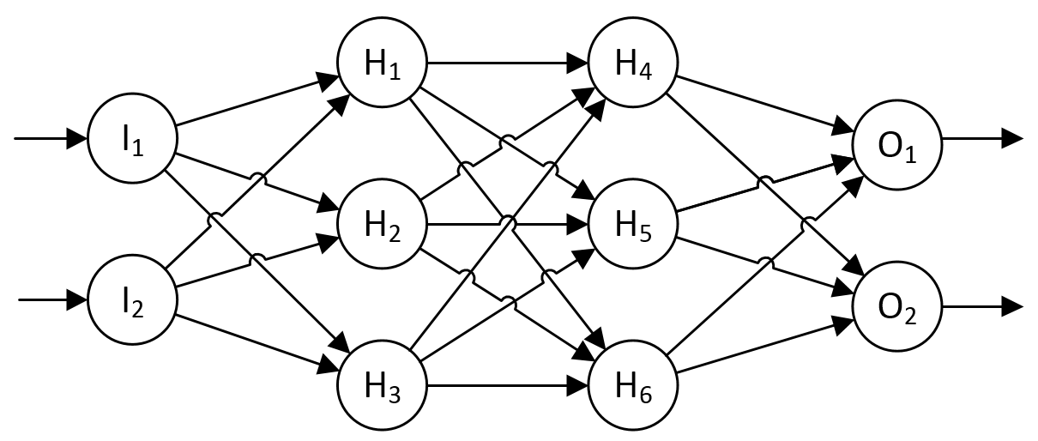
Algorithm 2ii: Forward pass
Notes:
This is the network I will use to demonstrate an iteration of the train and test loop.
First, an input from the training set is feed through the network as before. Next the error of each output is calculated which is the output of the network minus the expected output.

Slide 24
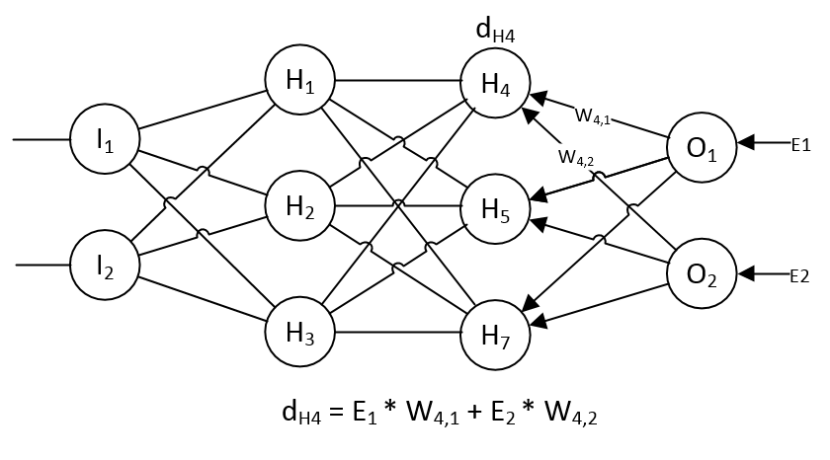
Algorithm Step 2iii: Backward pass
Notes:
The previous step calculates the error of the output neurons, but the internal error of each hidden neuron is also needed to adjust the synaptic weights. The error of a hidden neuron is known as its delta value.
The delta value of a neuron in the last hidden layer is the sum of every error in the output layer weighted by the synapse connecting to it. The delta value of each neuron in the last hidden layer is calculated in this way.

Slide 25
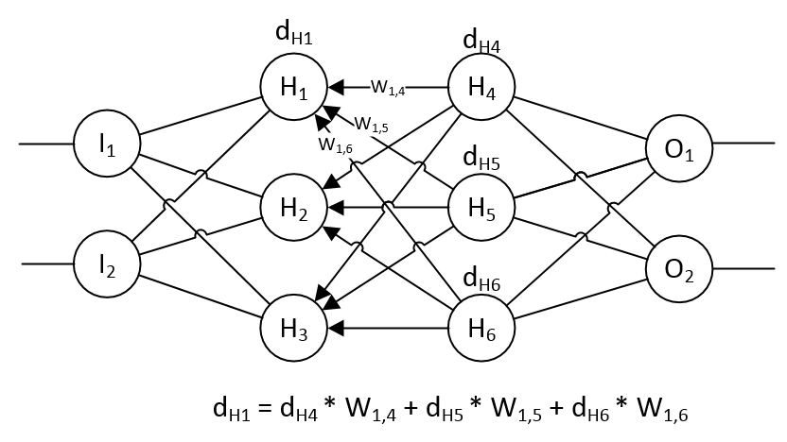
Algorithm Step 2iii: Backward pass
Notes:
This network contains two hidden layers, so the delta values of the first hidden layer must also be calculated. This is done similarly to the previous delta calculation, however, the delta values of the last hidden layer is used instead of the error values of the output neurons.
This process is continued until the delta values for every hidden neuron is calculated. So for example, if the network contained another hidden layer, the delta values of that layer would be calculated in the same manner using the delta values calculated here.
This process is very similar to running the network in reverse – the error value is presented to the output neurons and is feed through the network ignoring the activation function and the value of each neuron.

Slide 26
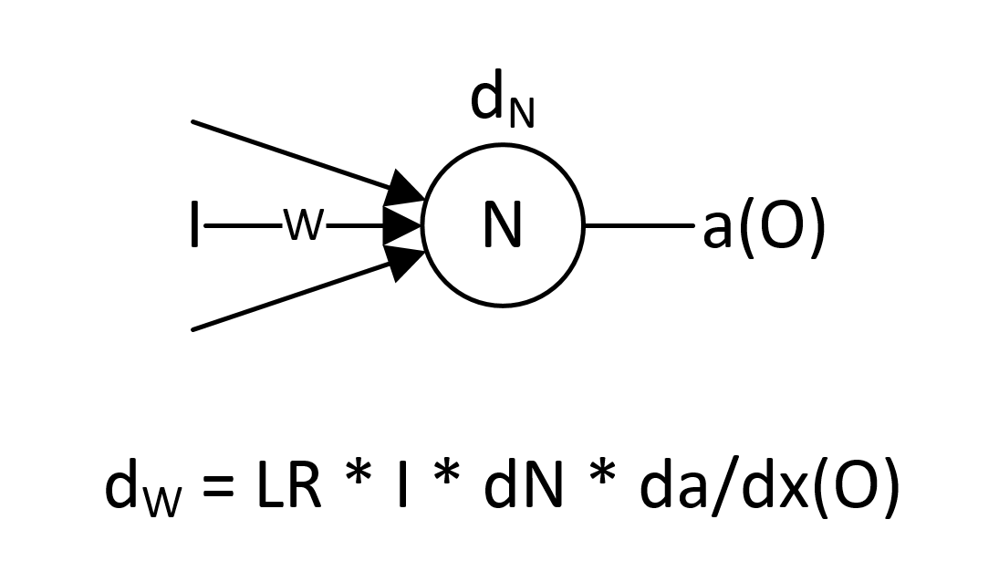
Algorithm Step 2iii: Weight adjustment
d_{W} is the weight adjustment
LR is the learning rate
I is the input to the synapse
d_{N} is the delta (or error) value of the neuron which the synapse connects to
da(O)/dx is the gradient of the activation function at output of the neuron
Notes:
Now, a delta value has been calculated for each hidden neuron and an error value for each output neuron, so the weight of each synapse can be adjusted by this formula.
Here, I is the input to the synapse, W is the weight of the synapse, dn is the delta value of the neuron which the synapse connects to, the function a is the activation function and O is the weighted sum of the inputs to the neuron.
The constant LR is the learning rate. This is a small value, usually around 0.1, which prevents from adjusting the weights too much which causes the network to overcompensate.

Slide 27
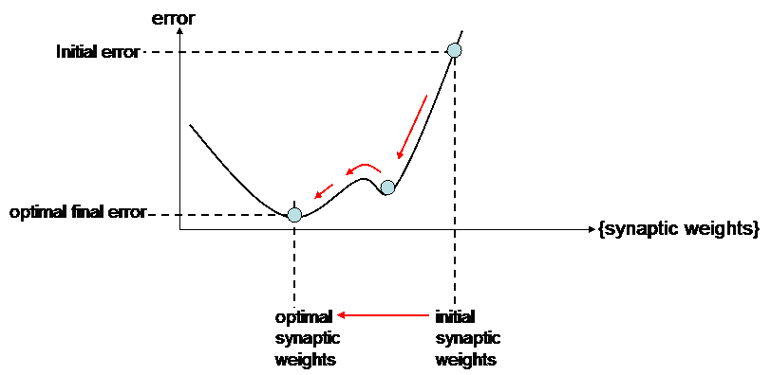
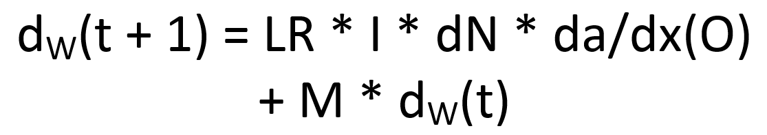
Momentum
Image source: http://www.nexyad.net/HTML/e-book-Tutorial-Neural-Networks.html
Notes:
An important limitation of back propagation is that it will settle in any error minimum it finds, regardless if this a local or global minimum. This is similar to a small ball placed on the error graph which will roll down the graph and settle in the nearest minimum. Generally, the number of local minimums increases with the number layers.
This is countered by introducing a momentum term which allows the network to move up the error slope for a few iterations in the hopes that a better minimum is found. In the case shown by the diagram, momentum will allow the weights to move towards the optimal position instead of remaining in the local minimum.
A weight adjustment using momentum is the adjustment from the slide before, plus the product of the previous weight adjustment and the momentum constant, usually around 0.05.

Slide 28

The Healthcare prize

