Slide 1
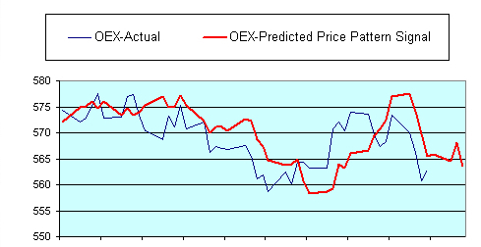
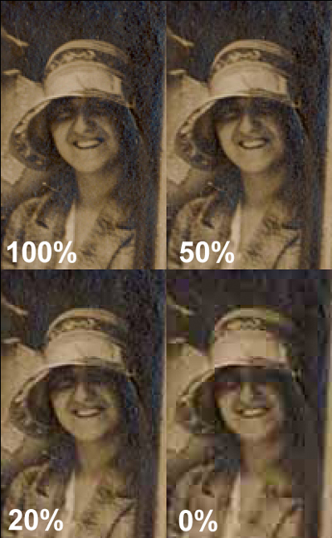
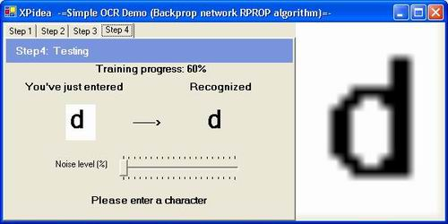
Applications
Stock market prediction
Optical character recognition
Image compression

Slide 2
Application Types
Classification
Assigning objects to a predetermined group
Uses a training set to create classifiers
Clustering
Grouping objects similar to each other
Like classification but without knowing the class
Commonly uses a distance relationship
Pattern Association
Can be used to reduce noise or corruption
Can be split into auto/hetero-association
Vector Quantization
Associates each input with the nearest vector
Process is similar to clustering
Can compress large amounts of input data
Not lossless
Notes:
For each one talk about how it can be used in a neural network (or perhaps do this all at once at the end).

Slide 3
Optical Character Recognition (OCR)
Algorithms used to be processor intensive
Caused significant delay in recognition time
Neural networks seen as efficient without extensive processing
Can be learnt with back propagation algorithm
Initial learning time is one time only
Notes:
Speed crucial in a commercial environment

Slide 4
Image Compression
Can decompose an image into a set of vectors
This can be based off brightness, colour etc
Vector quantisation can then be used in a neural network
Has several learning algorithms that can be used
Competitive learning
Kohonen self-organising feature map
Frequency sensitive competitive learning

Slide 5
Stock Market Prediction
Why use neural networks?
Good at finding patterns in data
Can find non-linear patterns with multiple layers
The network
Have to decide how many inputs to use – complex
Which learning algorithm is most ideal?
Notes:
Why
Stock market is complex, so needs to be modelled, which neural networks do a good job of
Learning algorithm
Backpropagation popular since they are good at generalizing and easy to implement, however the optimal network configuration is hard to work out
Recurrence/self-organising networks also used

