Slide 1
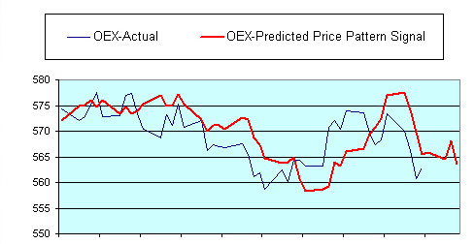
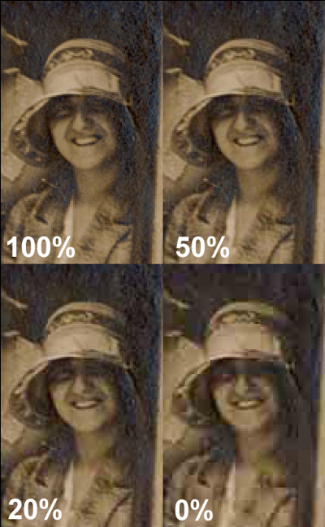
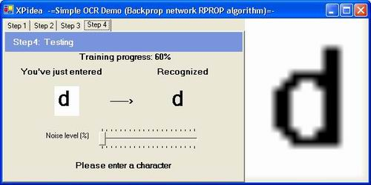
Applications
Stock market prediction
Optical character recognition
Image compression

Slide 2
Application Types
Classification
  Assigning objects to a predetermined group
  Uses a training set to create classifiers
Clustering
  Grouping objects similar to each other
  Like classification but without knowing the class
  Commonly uses a distance relationship
Pattern Association
  Can be used to reduce noise or corruption
  Can be split into auto/hetero-association
Vector Quantization
  Associates each input with the nearest vector
  Process is similar to clustering
  Can compress large amounts of input data
  Not lossless
Notes:
For each one talk about how it can be used in a neural network (or perhaps do this all at once at the end).

Slide 3
Optical Character Recognition (OCR)

Slide 4
Image Compression

Slide 5
Stock Market Prediction
Why use neural networks?
  Good at finding patterns in data
  Can find non-linear patterns with multiple layers
The network
  Have to decide how many inputs to use – complex
  Which learning algorithm is most ideal?
Notes:
Why
Stock market is complex, so needs to be modelled, which neural networks do a good job of
Learning algorithm
Backpropagation popular since they are good at generalizing and easy to implement, however the optimal network configuration is hard to work out
Recurrence/self-organising networks also used

