Slide 1


Block Buster
Jaime Leoz sql proyect - Ironhack

Slide 2
intro
Which actors are in more movies
Top 5 longest movies
Top 10 scary movies by rating
Stock of movies by rating
Top 10 most expensives movies to rent

Slide 3
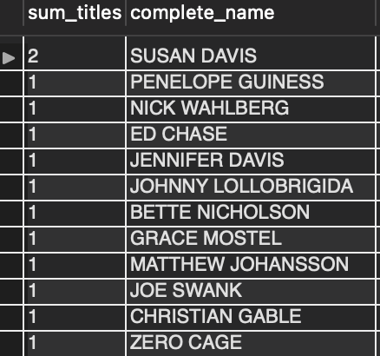

Which actors are in more movies
Susan Davis wins ! top actress.
Also because she is a duplicate!
She is just too good to be forgiven by the Academy.

Slide 4
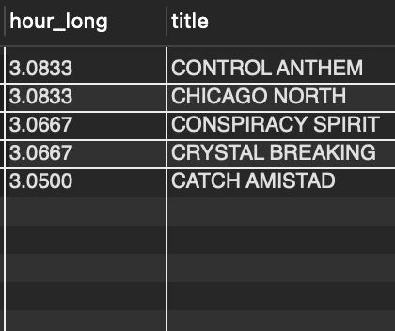
Top 5 longest movies
They have almost hit Titanic’s record
Titanic lasts 3.15 hours

Slide 5
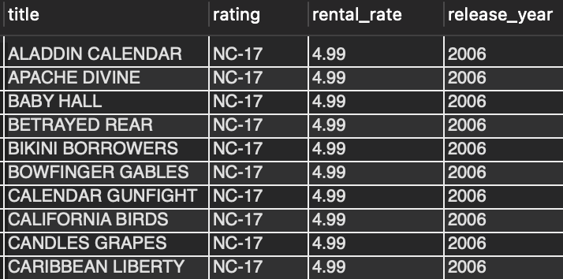

Top 10 scary movies by rating
Aladdin Calendar gave me the creeps. Mostly when Aladdin decided to eat a monkey
Our customers love scary movies! the weirdest is their Title the better.

Slide 6
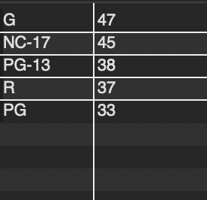

Stock of movies by rating
We are clearly covering everyones needs, from babies to very old adults.

Slide 7

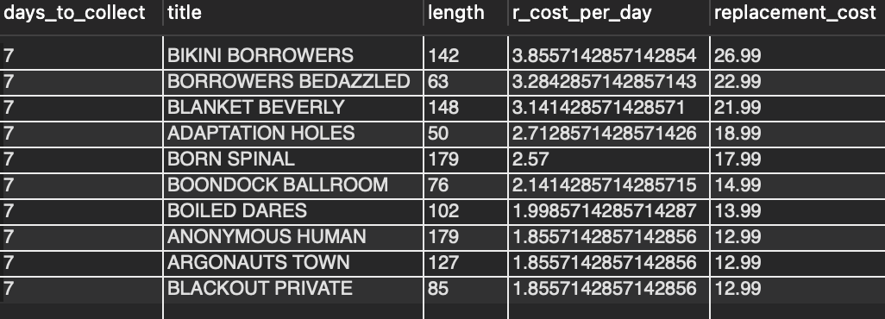
Top 10 most expensives movies to rent
Bikini Borrowers, the scary movie
With almost 4 $ per day
Possible advertisement opportunity, like a poster of a borrowers of bikinis….

Slide 8
C’EST FINI
MERCI

