Slide 1
Introduction To R
Tassie Gniady
Grace Thomas
CyberDH
Research Technologies, UITS, Indiana University
cyberdh@iu.edu

Slide 2
The basics
R is an open source language
It uses <- instead of = to assign variables
It begins counting vector positions at 1, not 0 like many other languages
Notes:
Very high powered for statistics, but we are using it for text analysis

Slide 3
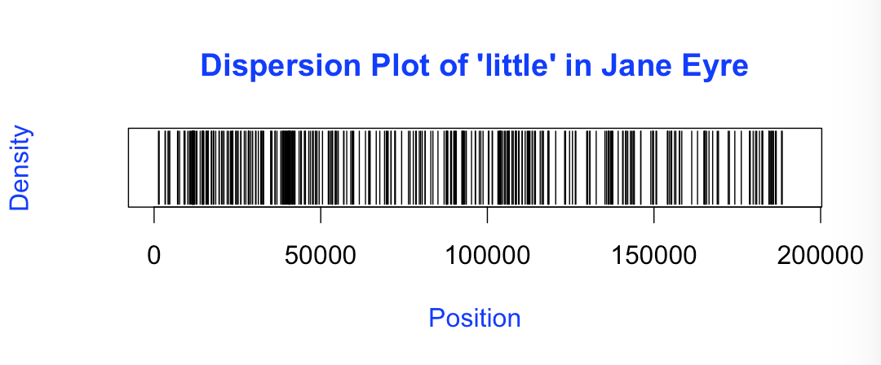
What is it good for?
Developed for statisticians, R is very powerful. While we won’t get to these examples today, here are some of the outputs that you can generate:
Dispersion plots

Slide 4
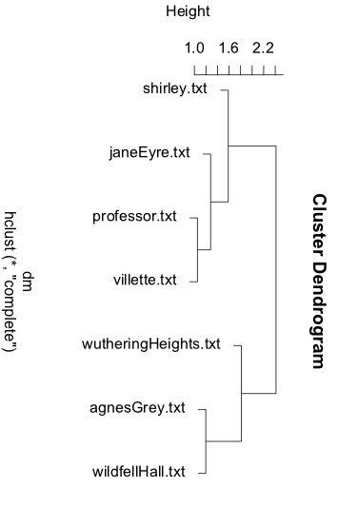
MORE Uses
Dendograms

Slide 5
r, Me Matey!
Let’s get started!
http://tryr.codeschool.com/levels/1/challenges/1

Slide 6
GiTHUB
Go to https://github.com/cyberdh/Text_Analysis
If you are unfamiliar or don’t have an account with Github, just click “Download Zip,” otherwise fork this repository.

Slide 7
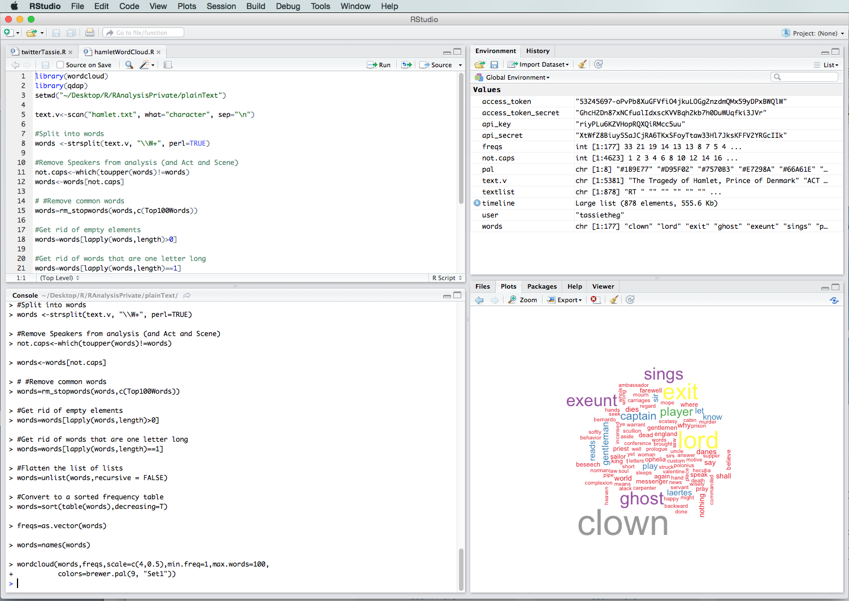
RStudio
If you’ve never used R before, you also want to download Rstudio: https://www.rstudio.com/ or if you have a Karst account, you can go to https://rstudio.iu.edu/

Slide 8
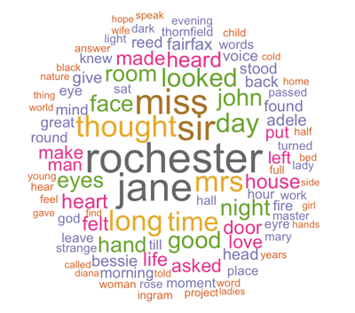
wordclouds
Top 75 Words in Jane Eyre

Slide 9
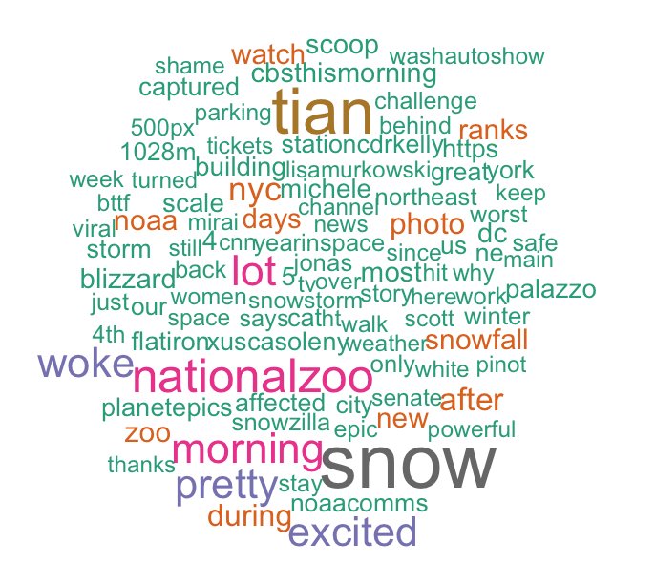
Hashtags

Slide 10
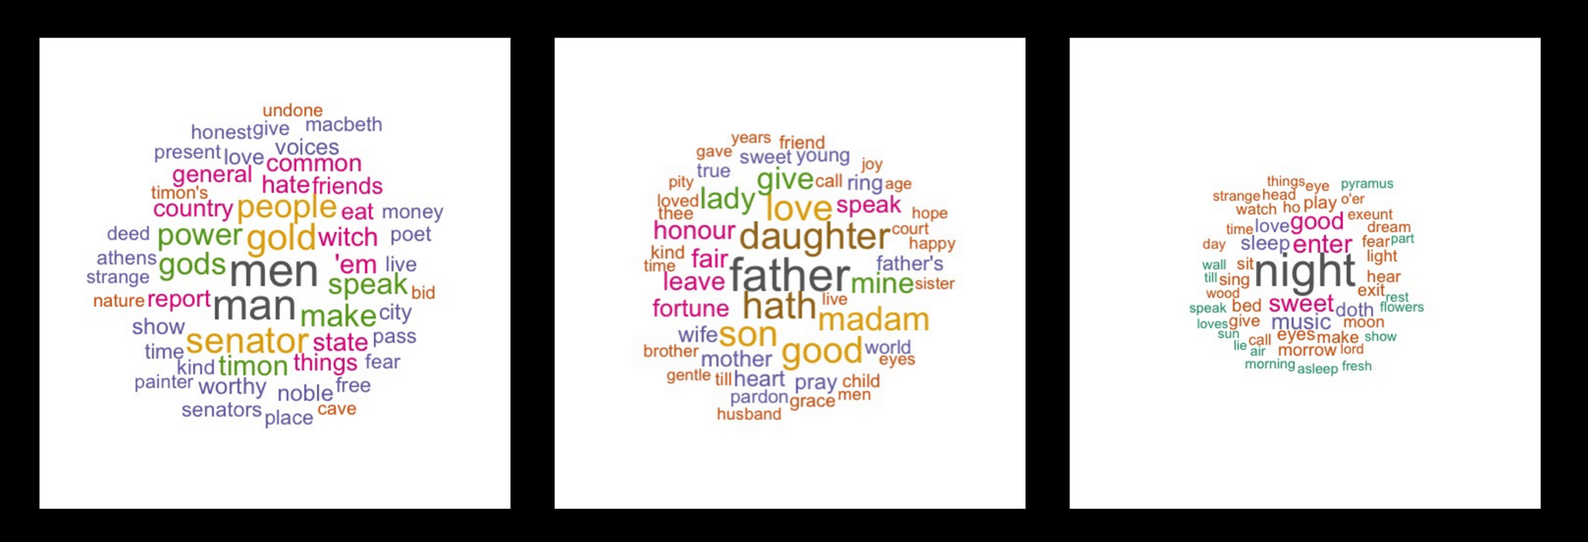
Why use wordclouds?
LDA

Slide 11
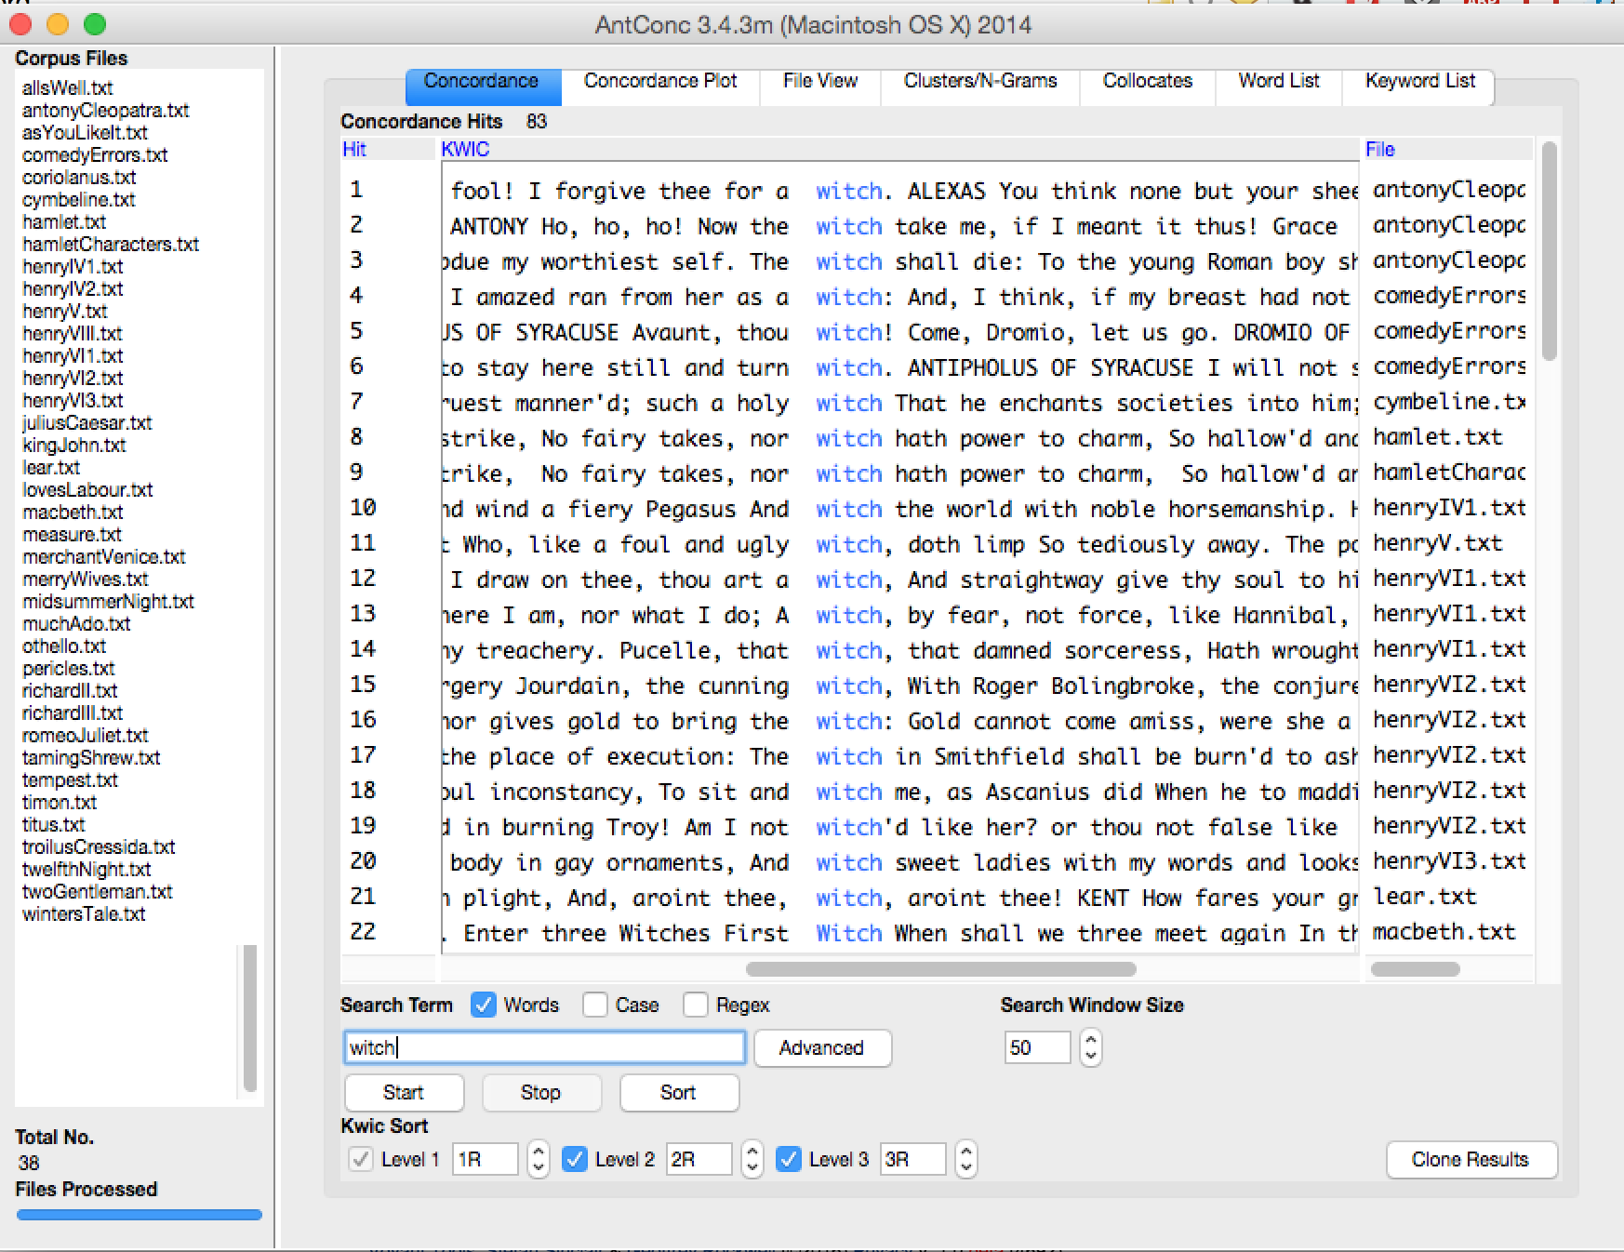
Which witch?

Slide 12
Contact US!
If you’d like to make an appointment, please email cyberdh@iu.edu.
Also, check out our website: https://www.indiana.edu/~cyberdh/ for interesting blog posts and written tutorials about R.
Thank you!
Tassie, Grace, and Adam
The CyberDH Team

