Slide 1





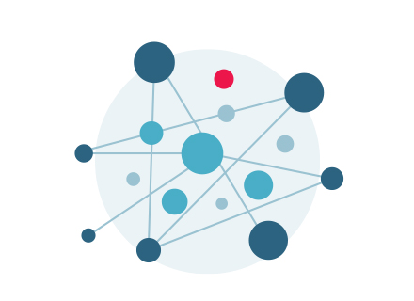




R: Basics for Humanists
Tassie Gniady
UITS Research Technology, Digital Humanities Coordinator for Cyberinfrastructure
Indiana University Pervasive Technology Institute
Science Storage Computation Analysis/ Bio/Health Visualization Campus Education/ Grant CyberDH Gateways Software Bridging Outreach Support
January 29, 2016
© Trustees Indiana University 2015
Notes:
This slide-deck uses IU fonts downloaded from: http://brand.iu.edu
If the footer does not look right, than you do not have the right fonts installed. Benton SansRegular and Georgia Pro and Salvo Serif
Updated April 2015
Change PRESENTER’s NAMES and DATE - EVENT
Welcome

Slide 2
The basics
R is an open source language
It uses <- instead of = to assign variables unless they are inside functions
It begins counting vector positions at 1, not 0 like many other languages
Notes:
Very high powered for statistics, but we are using it for text analysis

Slide 3
Tutorial Structure
Web App → RNotebook → RScript
the web app provides a lightweight introduction to each method with some adjustable parameters
the RNotebook is fully annotated code that explains how each line works and why it is included
the RScript provides a lightly commented scripted for ease of manipulation

Slide 4
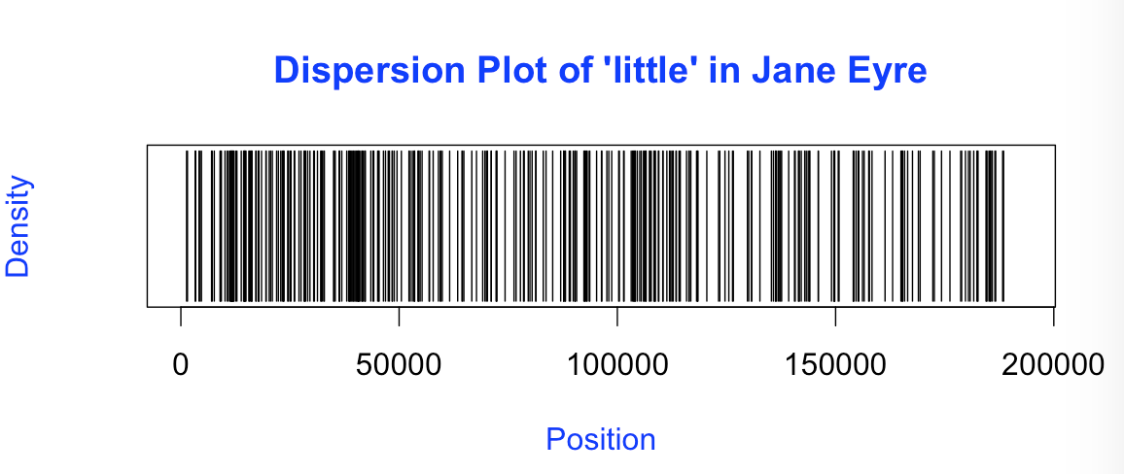
What is it good for?
Developed for statisticians, R is very powerful. While we won’t get to these examples today, here are some of the outputs that you can generate:
Dispersion plots

Slide 5
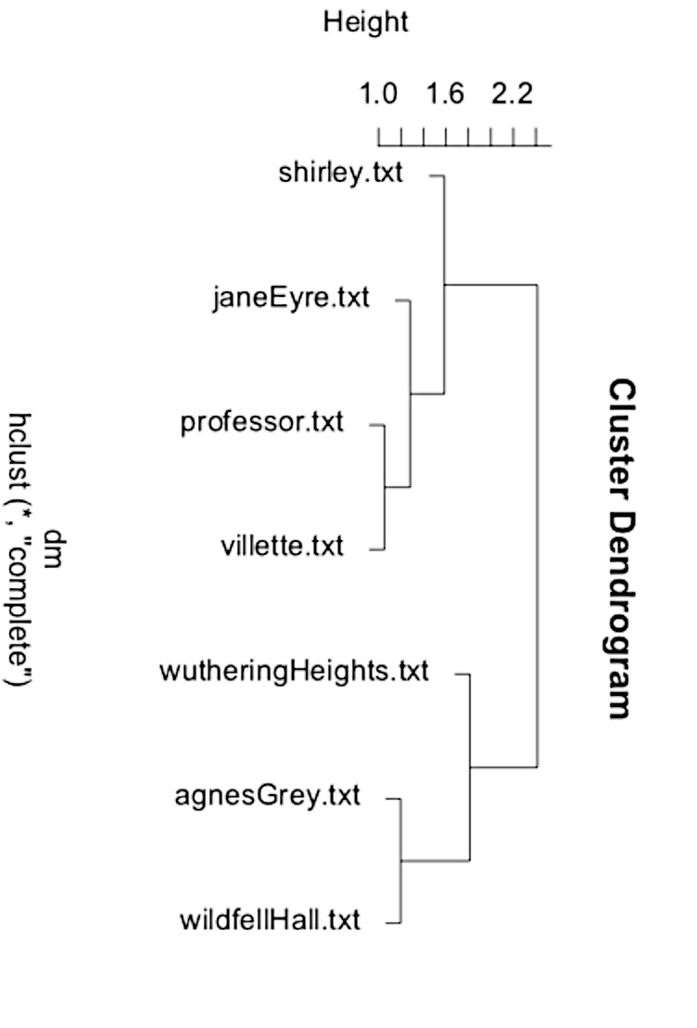
More Uses
Dendrograms

Slide 6
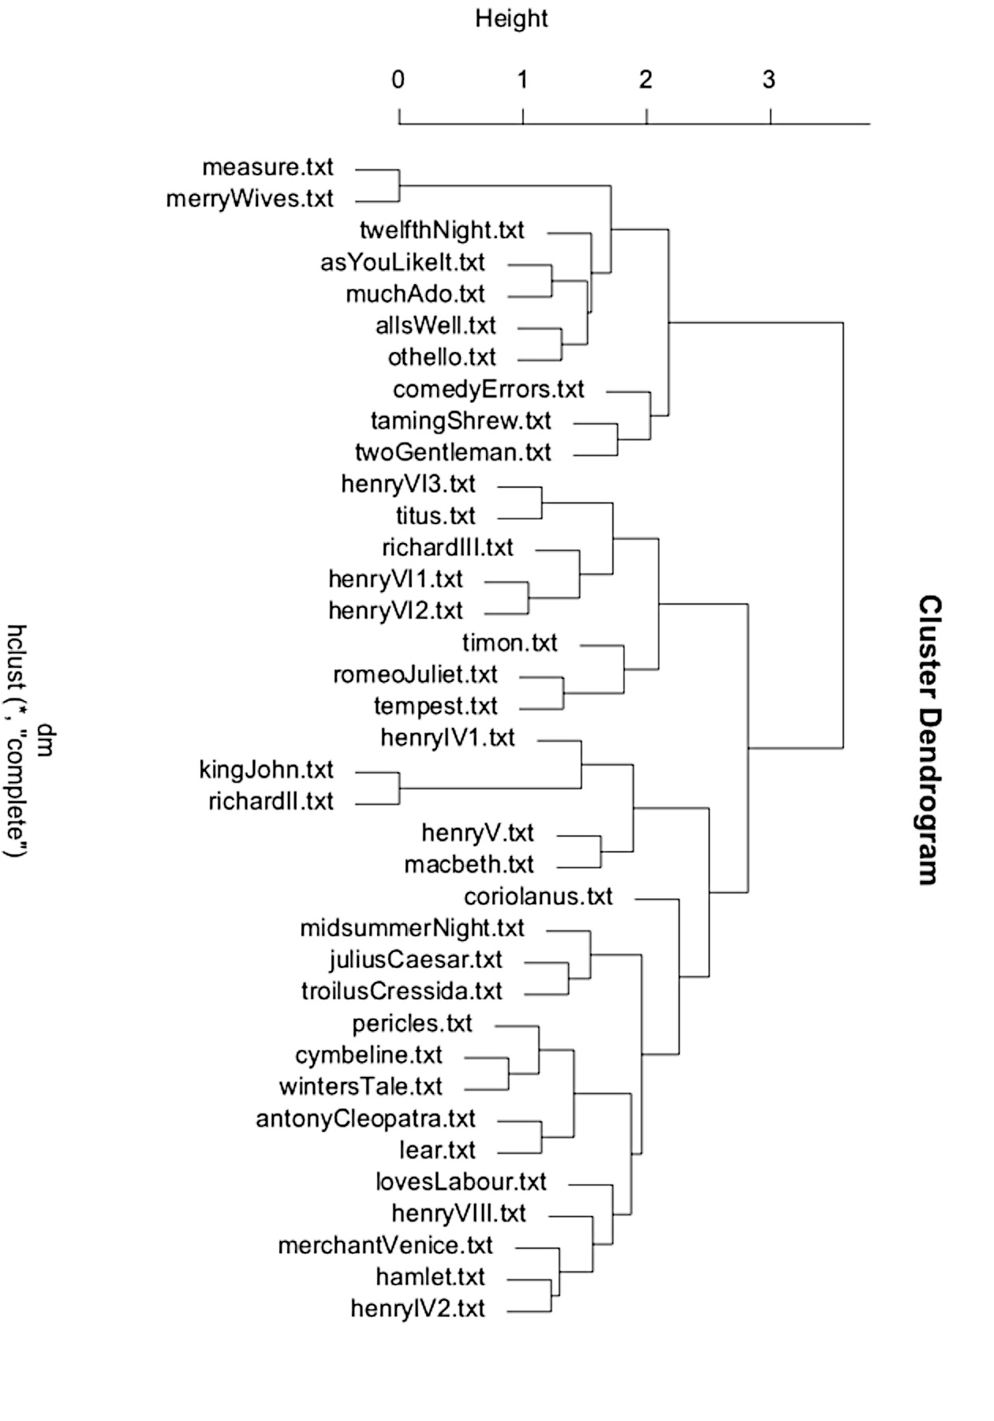
Shakespeare Dendrogram

Slide 7
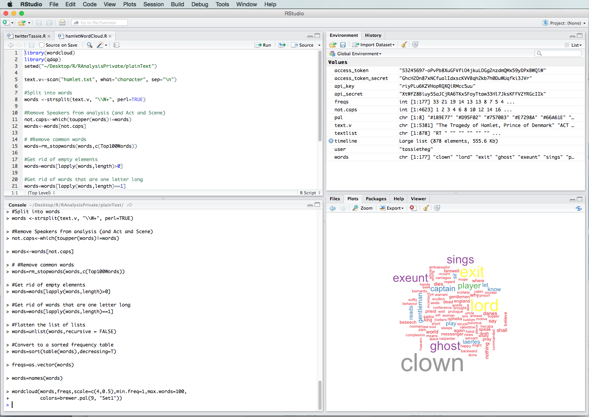
RStudio
If you’ve never used R before, you also want to download Rstudio: https://www.rstudio.com/ or if you have a Karst account, you can go to https://rstudio.iu.edu/

Slide 8
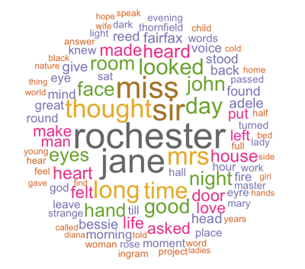
wordclouds
Top 75 Words in Jane Eyre

Slide 9
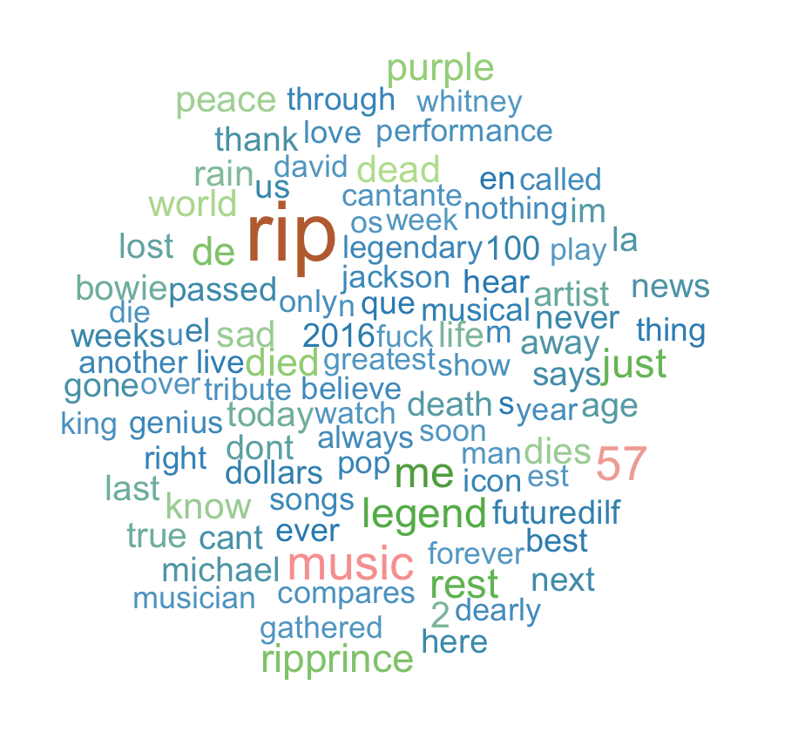
Twitter: “prince” on 4/29/16

Slide 10
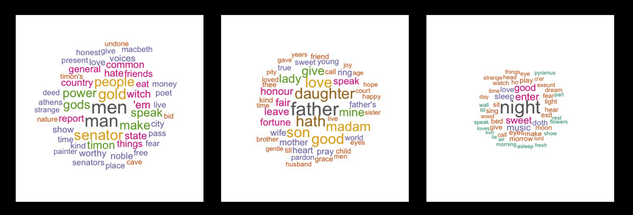
Why use wordclouds?
Topic Modeling (LDA)

Slide 11
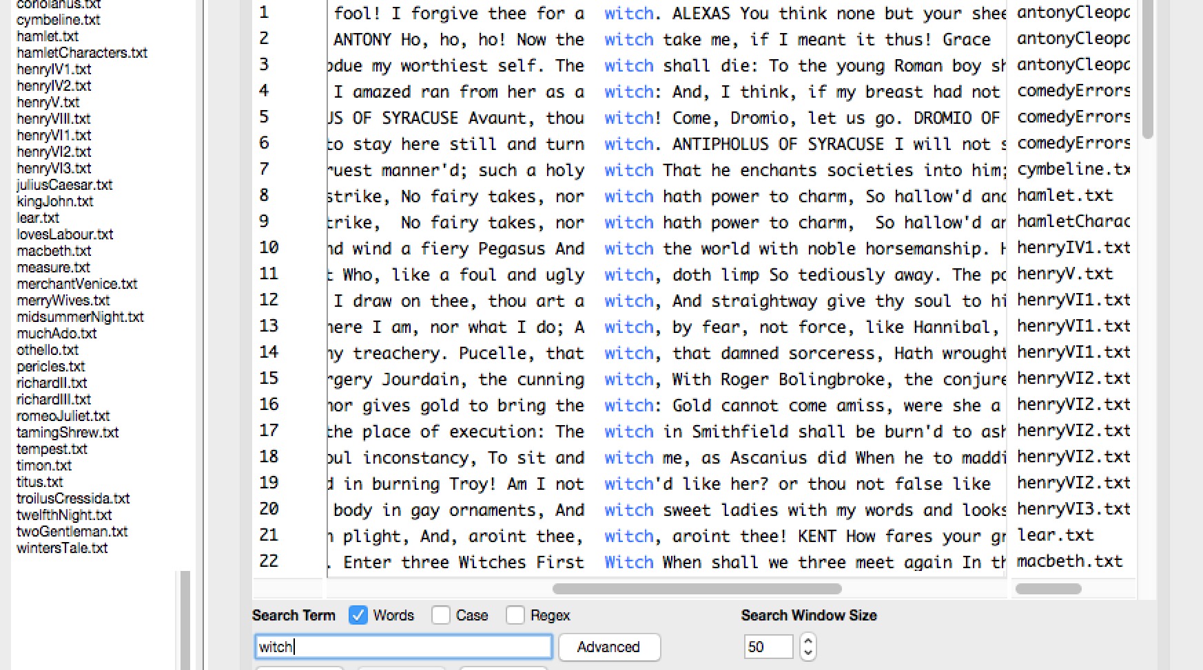
Which witch?

Slide 12
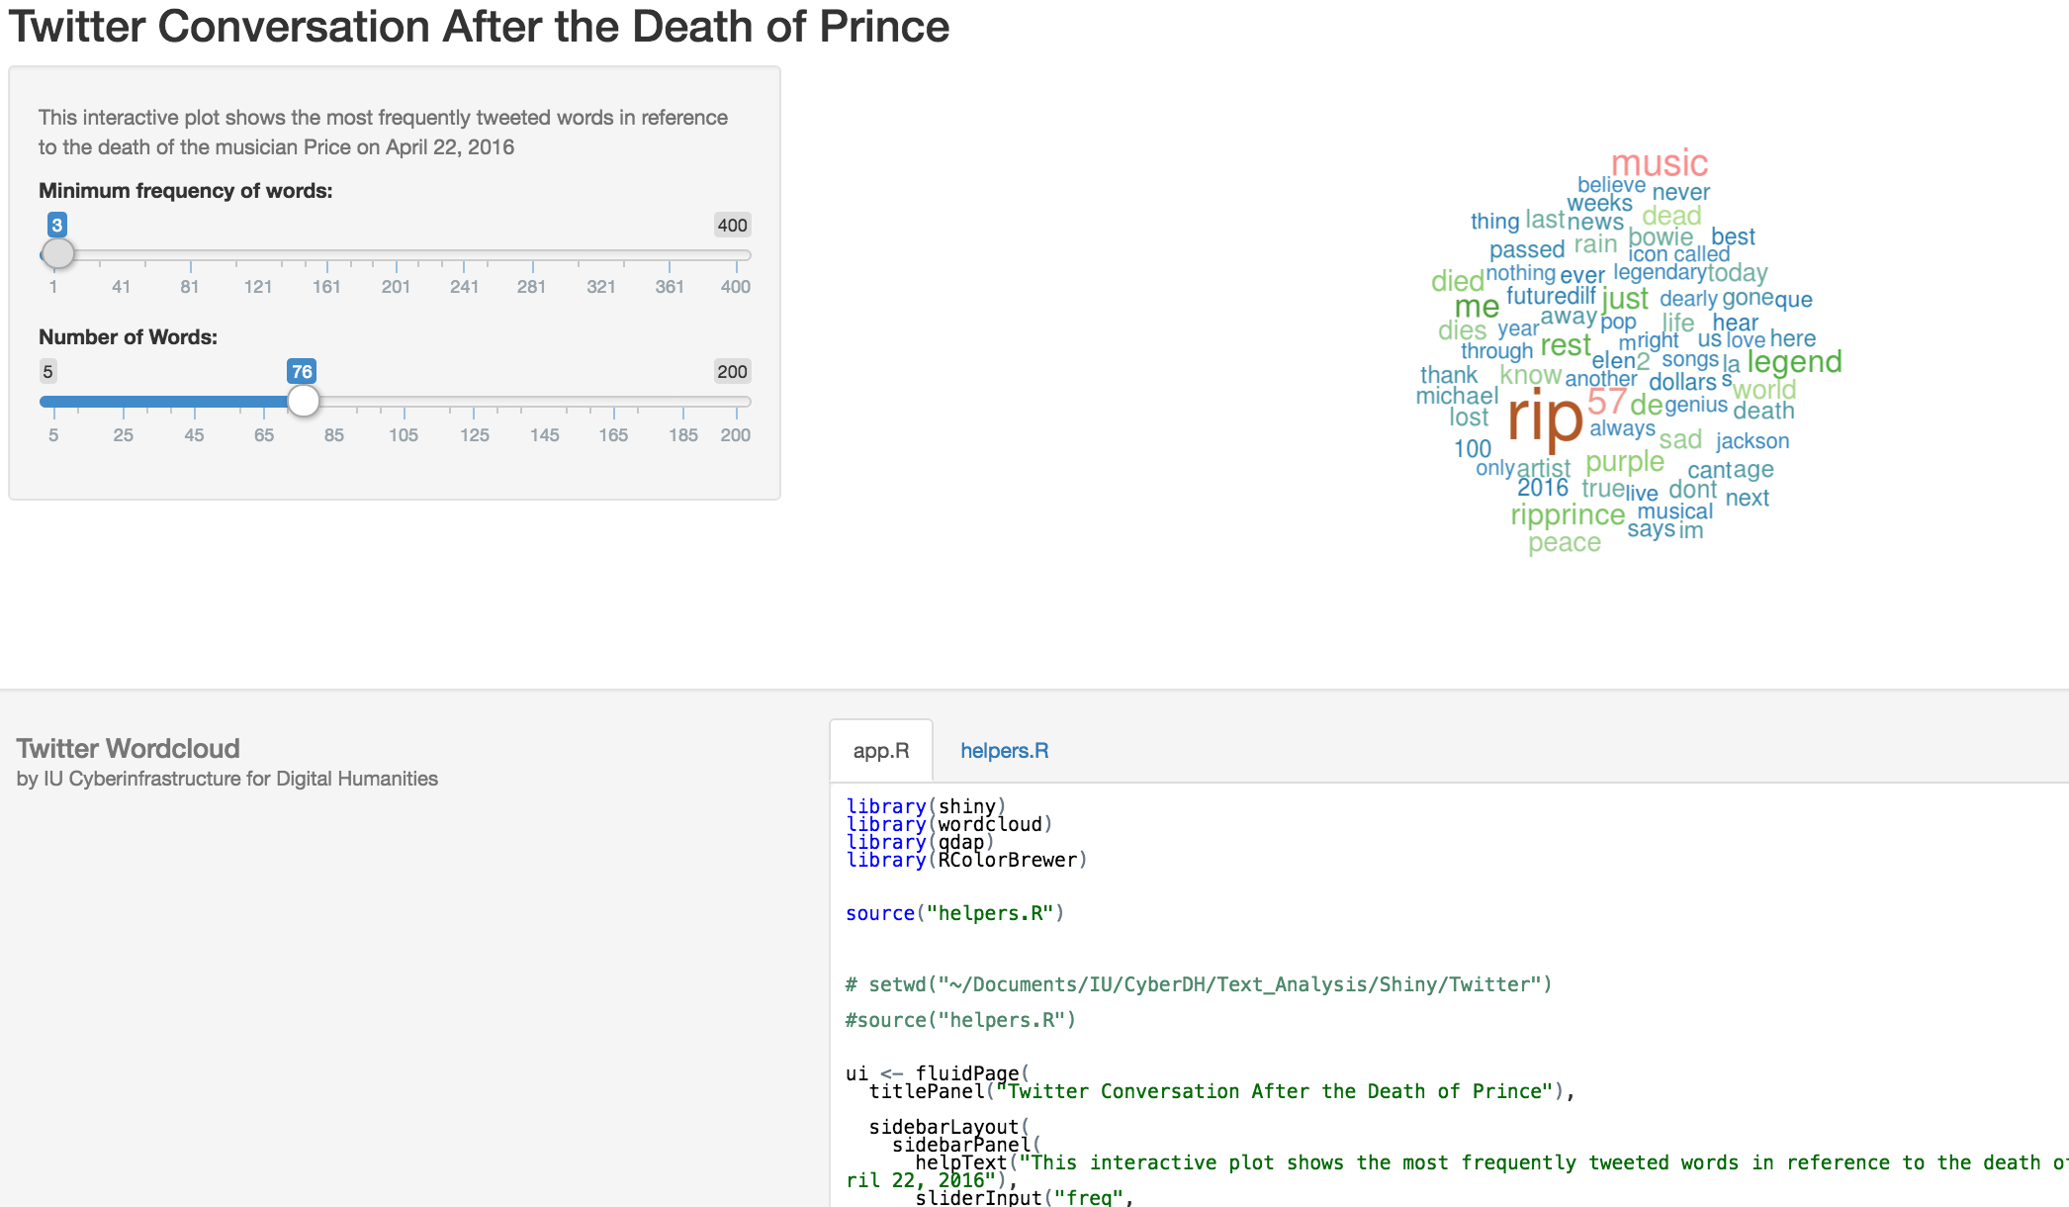
Shiny!
https://beta.rstudioconnect.com/ghthomas/Twitter/

Slide 13
GiTHUB
Go to https://github.com/cyberdh/Text_Analysis
If you are unfamiliar or don’t have an account with Github, just click “Download Zip,” otherwise fork this repository.

Slide 14
Contact US!
If you’d like to make an appointment, please email cyberdh@iu.edu.
Also, check out our website: https://www.indiana.edu/~cyberdh/ for interesting blog posts and written tutorials about R.
Thank you!
Tassie, Grace, and Adam
The CyberDH Team

