Slide 1
Sentiment Analysis with R
Tassie Gniady
Grace Thomas
CyberDH
Research Technologies, UITS, Indiana University
cyberdh@iu.edu

Slide 2
What is Sentiment Analysis?
Sentiment analysis is also known as opinion mining—it is used to extract subjective information from text.
The word “subjective” is exactly why sentiment analysis can be difficult, though.
“I love chocolate ice cream as much as I love the sound of nails on a chalkboard.”
“I hated nothing about that movie! Nothing!”
Let’s not even get started with emojis.

Slide 3
Source Material
This script was adapted from Jeffrey Breen’s tutorial “Mining Twitter for Airline Consumer Sentiment.” Breen developed this is simple algorithm to show how data can be easily extracted and quickly synthesized. http://www.inside-r.org/howto/mining-twitter-airline-consumer-sentiment

Slide 4
Overview of process
Get data (in this case twitter has been mined for you and saved into .Rdata files)
Load and inspect data
Extract text
Load opinion lexicons
Implement algorithm
Test algorithm with sample data first
Score twitter data using algorithm
Graph the result of scoring

Slide 5
Get data
We used TwitteR
cruz.tweets = searchTwitter('@tedcruz', n=4000, since="2016-02-02", until="2016-02-03")
trump.tweets = searchTwitter('@realDonaldTrump', n=4000, since="2016-02-02", until="2016-02-03")
clinton.tweets = searchTwitter('@HillaryClinton', n=4000, since="2016-02-02", until="2016-02-03")
sanders.tweets = searchTwitter('@BernieSanders', n=4000, since="2016-02-02", until="2016-02-03”)
First tweets were gathered at 2016-02-02 at 11:59pm GMT going back 4,000 from that time

Slide 6
Load Opinion Lexicons
We need lists of positive and negative words to use as a guide for scoring:
Liu, Minqing Hu and Junsheng Cheng. "Opinion Observer: Analyzing and Comparing Opinions on the Web." Proceedings of the 14th International World Wide Web conference (WWW-2005), May 10-14, 2005, Chiba, Japan. http://www.cs.uic.edu/~liub/FBS/sentiment-analysis.html
Can add words using the combine c() function to ensure the lists have words relevant to your corpus

Slide 7
Test the Algorithm with Sample Data
We have written a function to compile and analyze the tweets (more on that in a minute).
Before running the algorithm on all 4,000 tweets, lets test it first with these sentences:
“This ice cream is the best! I love this flavor!”
“I am so angry at the terrible weather!”
“Impressed and amazed: you are peerless in your achievement of unparalleled mediocrity.”

Slide 8
Implement Scoring Algorithm
Let’s write a function!
One of the great strengths of R is the user's ability to add functions. In fact, many of the functions in R are actually functions of functions.
Let’s look again at the RNotebook

Slide 9
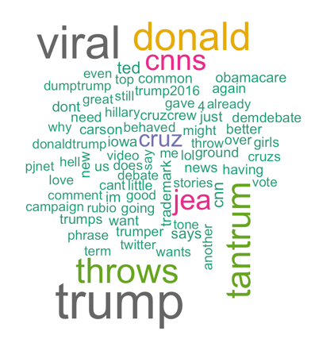
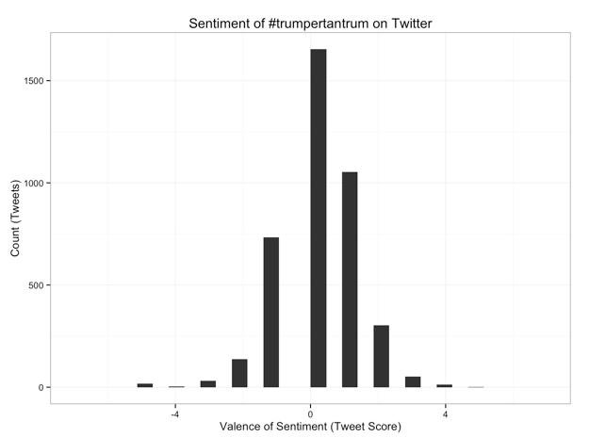
Going Further #trumpertantrum!
Now that you have a basic sentiment graph, you can use the wordcloud script from last week to look at the top words used to get more insight.

Slide 10
Contact US!
If you would like to discuss further options with R, such as clustering, LDA, or need more help with the scripts we’ve gone over, please make an appointment!
Email cyberdh@iu.edu

