Slide 1


Chapter 11
Trees

Slide 2

Terminology
Definition of a general tree
  A general tree T is a set of one or more nodes such that T is partitioned into disjoint subsets:
    A single node r, the root
    Sets that are general trees, called subtrees of r
Definition of a binary tree
  A binary tree is a set T of nodes such that either
    T is empty, or
    T is partitioned into three disjoint subsets:
      A single node r, the root
      Two possibly empty sets that are binary trees, called left and right subtrees of r

Slide 3
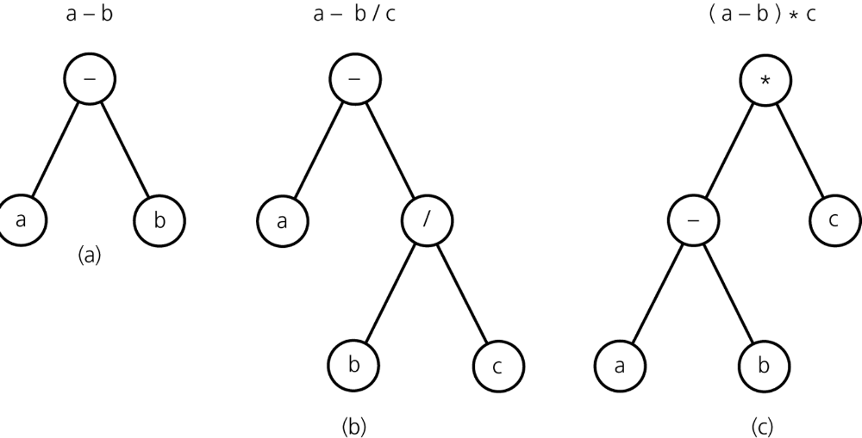
Terminology
Figure 11-4
Binary trees that represent algebraic expressions

Slide 4
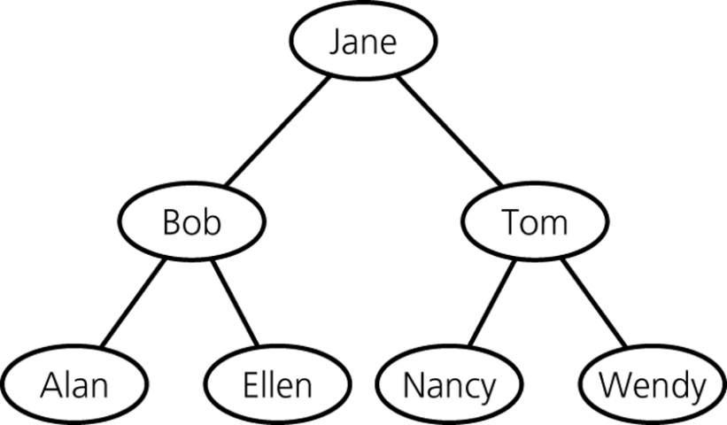
Terminology
A binary search tree
  A binary tree that has the following properties for each node n
    n’s value is greater than all values in its left subtree T_{L}
    n’s value is less than all values in its right subtree T_{R}
    Both T_{L} and T_{R} are binary search trees
Figure 11-5
A binary search tree of names

Slide 5
Terminology
The height of trees
  Level of a node n in a tree T
    If n is the root of T, it is at level 1
    If n is not the root of T, its level is 1 greater than the level of its parent
  Height of a tree T defined in terms of the levels of its nodes
    If T is empty, its height is 0
    If T is not empty, its height is equal to the maximum level of its nodes

Slide 6
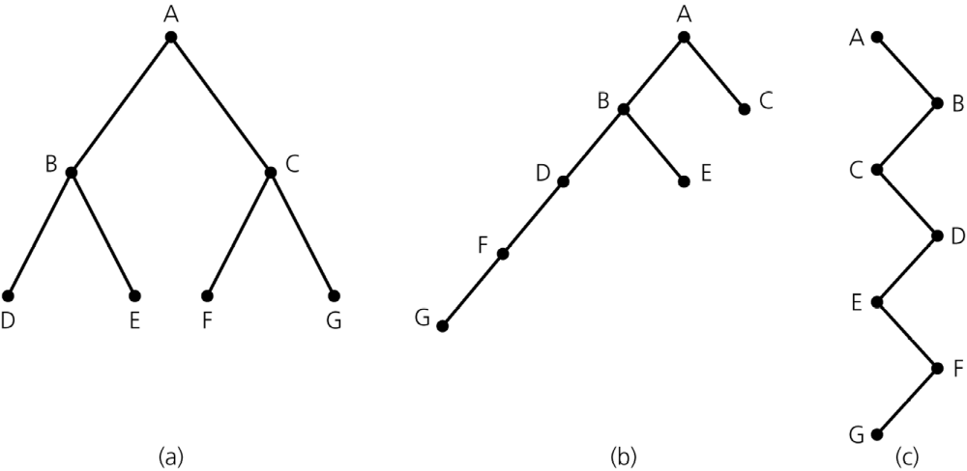
Terminology
Figure 11-6
Binary trees with the same nodes but different heights

Slide 7
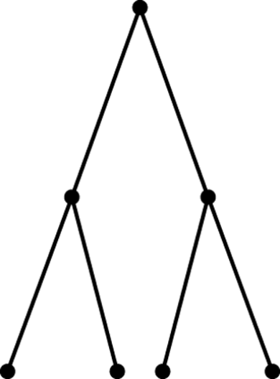
Terminology
Full, complete, and balanced binary trees
  Recursive definition of a full binary tree
    If T is empty, T is a full binary tree of height 0
    If T is not empty and has height h > 0, T is a full binary tree if its root’s subtrees are both full binary trees of height h – 1
Figure 11-7
A full binary tree of height 3

Slide 8
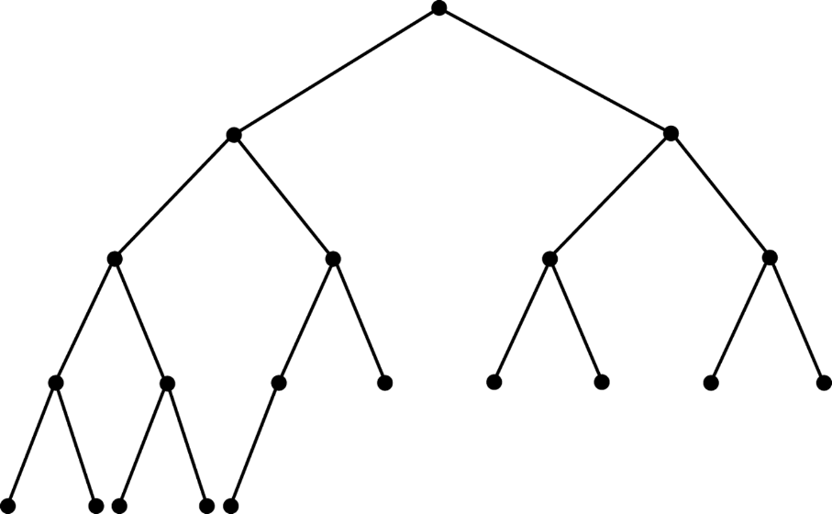
Terminology
Complete binary trees
  A binary tree T of height h is complete if
    All nodes at level h – 2 and above have two children each, and
    When a node at level h – 1 has children, all nodes to its left at the same level have two children each, and
    When a node at level h – 1 has one child, it is a left child
Figure 11-8
A complete binary tree

Slide 9
Terminology
Balanced binary trees
  A binary tree is balanced if the height of any node’s right subtree differs from the height of the node’s left subtree by no more than 1
Full binary trees are complete
Complete binary trees are balanced

Slide 10
Terminology
Summary of tree terminology
  General tree
    A set of one or more nodes, partitioned into a root node and subsets that are general subtrees of the root
  Parent of node n
    The node directly above node n in the tree
  Child of node n
    A node directly below node n in the tree
  Root
    The only node in the tree with no parent

Slide 11
Terminology
Summary of tree terminology (Continued)
  Leaf
    A node with no children
  Siblings
    Nodes with a common parent
  Ancestor of node n
    A node on the path from the root to n
  Descendant of node n
    A node on a path from n to a leaf
  Subtree of node n
    A tree that consists of a child (if any) of n and the child’s descendants

Slide 12
Terminology
Summary of tree terminology (Continued)
  Height
    The number of nodes on the longest path from the root to a leaf
  Binary tree
    A set of nodes that is either empty or partitioned into a root node and one or two subsets that are binary subtrees of the root
    Each node has at most two children, the left child and the right child
  Left (right) child of node n
    A node directly below and to the left (right) of node n in a binary tree

Slide 13
Terminology
Summary of tree terminology (Continued)
  Left (right) subtree of node n
    In a binary tree, the left (right) child (if any) of node n plus its descendants
  Binary search tree
    A binary tree where the value in any node n is greater than the value in every node in n’s left subtree, but less than the value of every node in n’s right subtree
  Empty binary tree
    A binary tree with no nodes

Slide 14
Terminology
Summary of tree terminology (Continued)
  Full binary tree
    A binary tree of height h with no missing nodes
    All leaves are at level h and all other nodes each have two children
  Complete binary tree
    A binary tree of height h that is full to level h – 1 and has level h filled in from left to right
  Balanced binary tree
    A binary tree in which the left and right subtrees of any node have heights that differ by at most 1

Slide 15
The ADT Binary Tree: Basic Operations of the ADT Binary Tree
The operations available for a particular ADT binary tree depend on the type of binary tree being implemented
Basic operations of the ADT binary tree
  createBinaryTree()
  createBinaryTree(rootItem)
  makeEmpty()
  isEmpty()
  getRootItem() throws TreeException

Slide 16
General Operations of the ADT Binary Tree
General operations of the ADT binary tree
  createBinaryTree (rootItem, leftTree, rightTree)
  setRootItem(newItem)
  attachLeft(newItem) throws TreeException
  attachRight(newItem) throws TreeException
  attachLeftSubtree(leftTree) throws TreeException
  attachRightSubtree(rightTree) throws TreeException
  detachLeftSubtree() throws TreeException
  detachRightSubtree() throws TreeException

Slide 17
Traversals of a Binary Tree
A traversal algorithm for a binary tree visits each node in the tree
Recursive traversal algorithms
  Preorder traversal
  Inorder traversal
  Postorder traversal
Traversal is O(n)

Slide 18
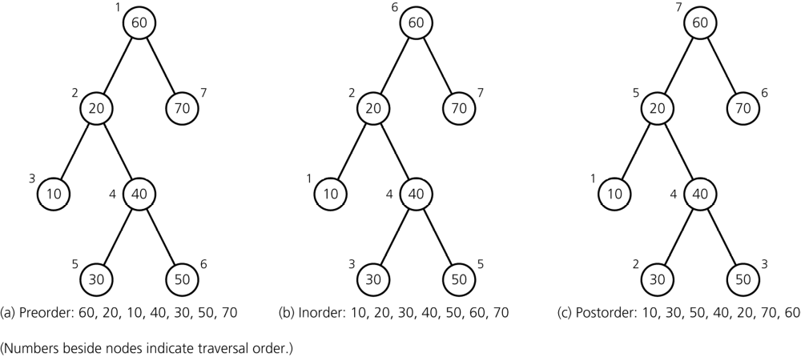
Traversal of a Binary Tree
Figure 11-10
Traversals of a binary tree: a) preorder; b) inorder; c) postorder

Slide 19
Possible Representations of a Binary Tree
An array-based representation
  A Java class is used to define a node in the tree
  A binary tree is represented by using an array of tree nodes
  Each tree node contains a data portion and two indexes (one for each of the node’s children)
  Requires the creation of a free list which keeps track of available nodes

Slide 20
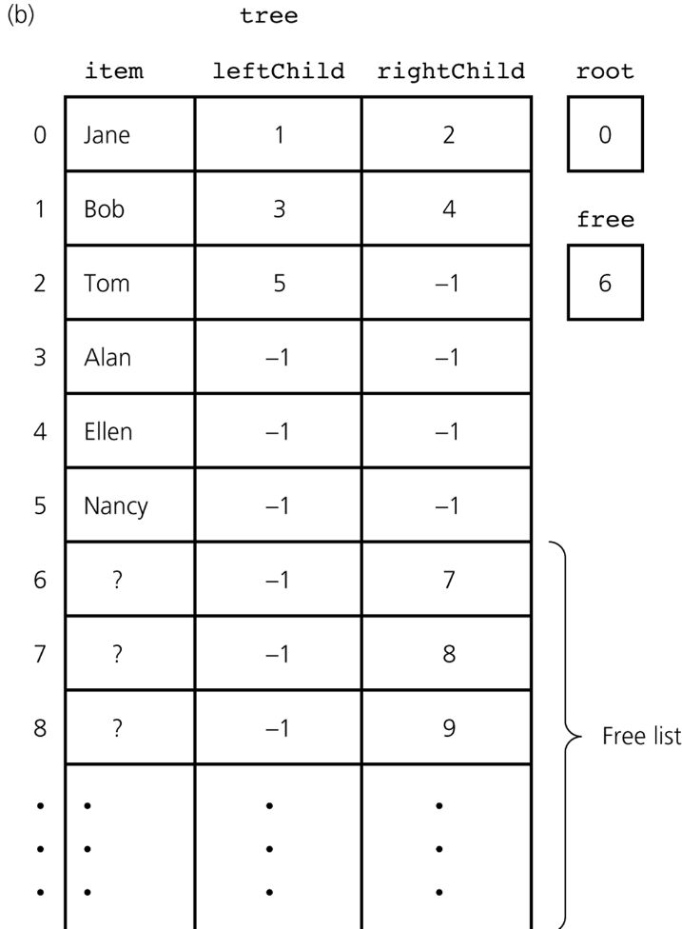
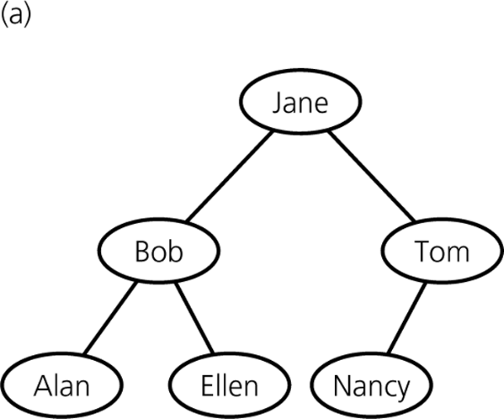
Possible Representations of a Binary Tree
Figure 11-11a
a) A binary tree of names
Figure 11-11b
b) its array-based implementations

Slide 21
Possible Representations of a Binary Tree
An array-based representation of a complete tree
  If the binary tree is complete and remains complete
    A memory-efficient array-based implementation can be used

Slide 22
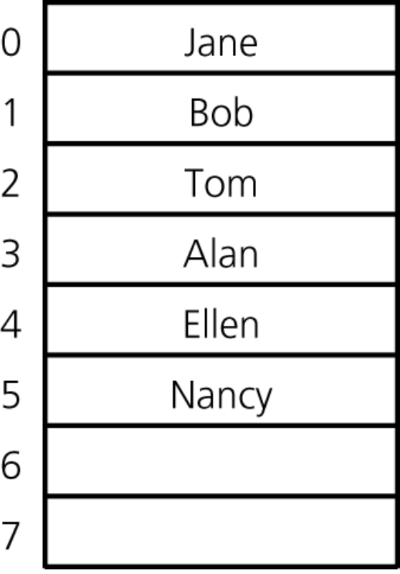
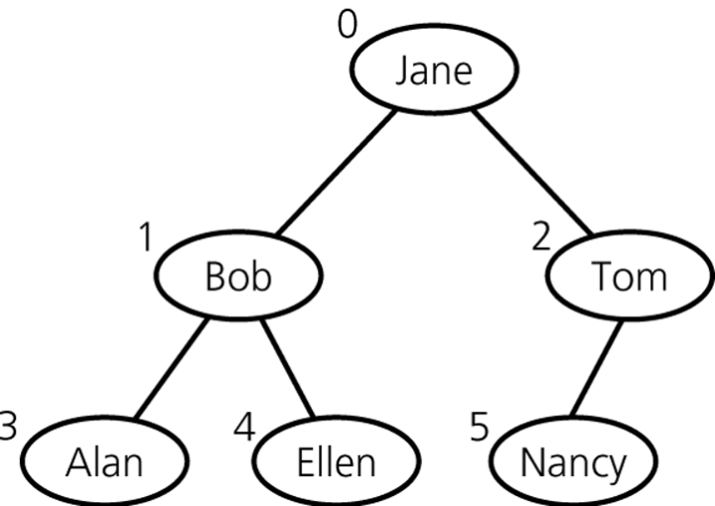
Possible Representations of a Binary Tree
Figure 11-12
Level-by-level numbering of a complete binary tree
Figure 11-13
An array-based implementation of the complete binary tree in Figure 10-12

Slide 23
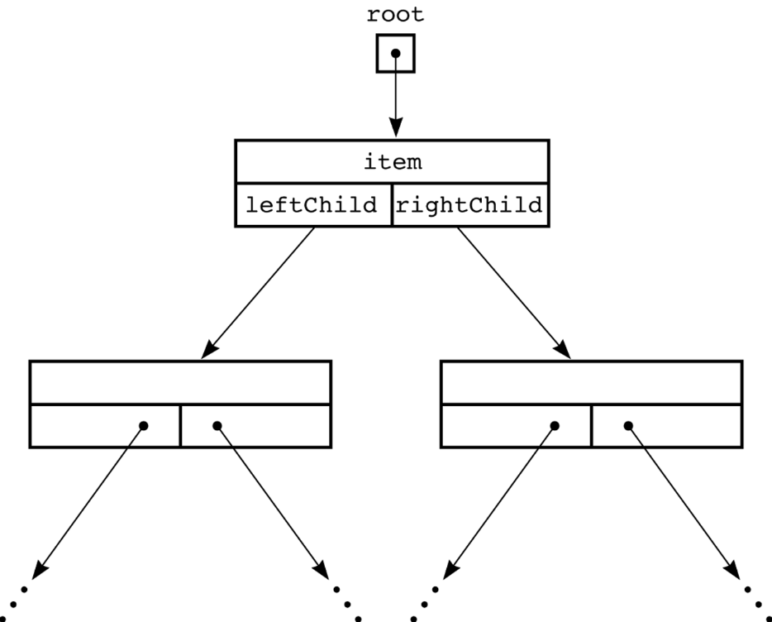
Possible Representations of a Binary Tree
A reference-based representation
  Java references can be used to link the nodes in the tree
Figure 11-14
A reference-based implementation of a binary tree

Slide 24
A Reference-Based Implementation of the ADT Binary Tree
Classes that provide a reference-based implementation for the ADT binary tree
  TreeNode
    Represents a node in a binary tree
  TreeException
    An exception class
  BinaryTreeBasis
    An abstract class of basic tree operation
  BinaryTree
    Provides the general operations of a binary tree
    Extends BinaryTreeBasis

Slide 25
Please open file carrano_ppt11_B.ppt
to continue viewing chapter 11.

