Slide 1


Chapter 11 (continued)
Trees

Slide 2

Tree Traversals Using an Iterator
TreeIterator
  Implements the Java Iterator interface
  Provides methods to set the iterator to the type of traversal desired
  Uses a queue to maintain the current traversal of the nodes in the tree
Nonrecursive traversal (optional)
  An iterative method and an explicit stack can be used to mimic actions at a return from a recursive call to inorder

Slide 3
The ADT Binary Search Tree
A deficiency of the ADT binary tree which is corrected by the ADT binary search tree
  Searching for a particular item
Each node n in a binary search tree satisfies the following properties
  n’s value is greater than all values in its left subtree T_{L}
  n’s value is less than all values in its right subtree T_{R}
  Both T_{L} and T_{R} are binary search trees

Slide 4
The ADT Binary Search Tree
Record
  A group of related items, called fields, that are not necessarily of the same data type
Field
  A data element within a record
A data item in a binary search tree has a specially designated search key
  A search key is the part of a record that identifies it within a collection of records
KeyedItem class
  Contains the search key as a data field and a method for accessing the search key
  Must be extended by classes for items that are in a binary search tree

Slide 5
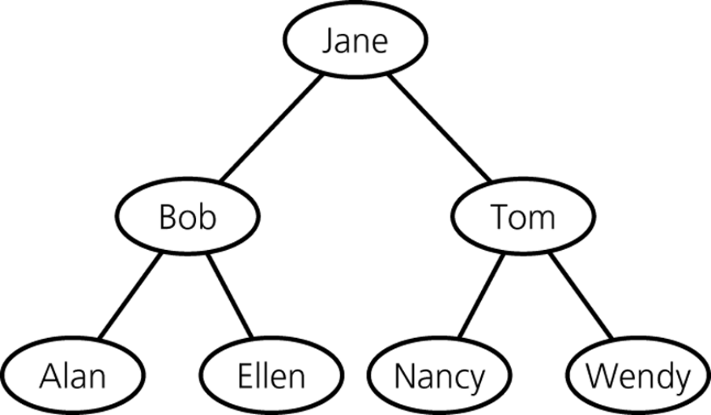
The ADT Binary Search Tree
Operations of the ADT binary search tree
  Insert a new item into a binary search tree
  Delete the item with a given search key from a binary search tree
  Retrieve the item with a given search key from a binary search tree
  Traverse the items in a binary search tree in preorder, inorder, or postorder
Figure 11-19
A binary search tree

Slide 6
Algorithms for the Operations of the ADT Binary Search Tree
Since the binary search tree is recursive in nature, it is natural to formulate recursive algorithms for its operations
A search algorithm
  search(bst, searchKey)
    Searches the binary search tree bst for the item whose search key is searchKey

Slide 7
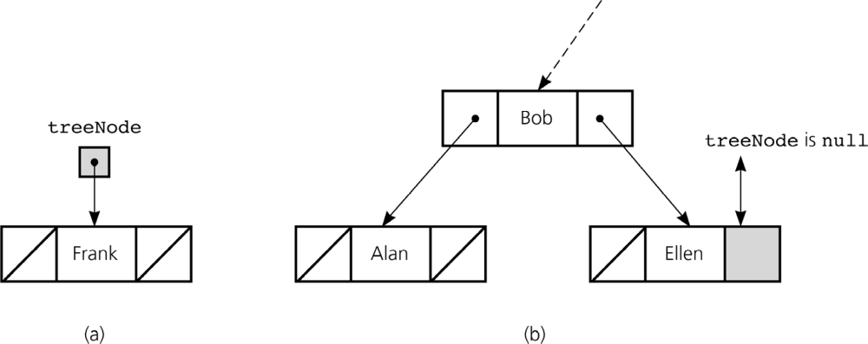
Algorithms for the Operations of the ADT Binary Search Tree: Insertion
insertItem(treeNode, newItem)
  Inserts newItem into the binary search tree of which treeNode is the root
Figure 11-23a and 11-23b
a) Insertion into an empty tree; b) search terminates at a leaf

Slide 8
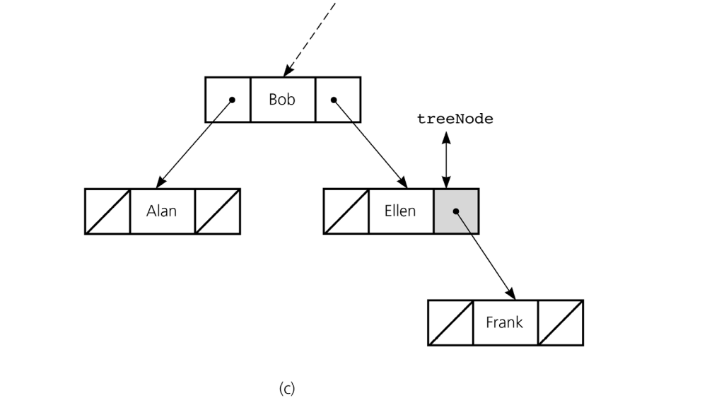
Algorithms for the Operations of the ADT Binary Search Tree: Insertion
Figure 11-23c
c) insertion at a leaf

Slide 9
Algorithms for the Operations of the ADT Binary Search Tree: Deletion
Steps for deletion
  Use the search algorithm to locate the item with the specified key
  If the item is found, remove the item from the tree
Three possible cases for node N containing the item to be deleted
  N is a leaf
  N has only one child
  N has two children

Slide 10
Algorithms for the Operations of the ADT Binary Search Tree: Deletion
Strategies for deleting node N
  If N is a leaf
    Set the reference in N’s parent to null
  If N has only one child
    Let N’s parent adopt N’s child
  If N has two children
    Locate another node M that is easier to remove from the tree than the node N
    Copy the item that is in M to N
    Remove the node M from the tree

Slide 11
Algorithms for the Operations of the ADT Binary Search Tree: Retrieval
Retrieval operation can be implemented by refining the search algorithm
  Return the item with the desired search key if it exists
  Otherwise, return a null reference

Slide 12
Algorithms for the Operations of the ADT Binary Search Tree: Traversal
Traversals for a binary search tree are the same as the traversals for a binary tree
Theorem 11-1
  The inorder traversal of a binary search tree T will visit its nodes in sorted search-key order

Slide 13
A Reference-Based Implementation of the ADT Binary Search Tree
BinarySearchTree
  Extends BinaryTreeBasis
  Inherits the following from BinaryTreeBasis
    isEmpty()
    makeEmpty()
    getRootItem()
    The use of the constructors
TreeIterator
  Can be used with BinarySearchTree

Slide 14
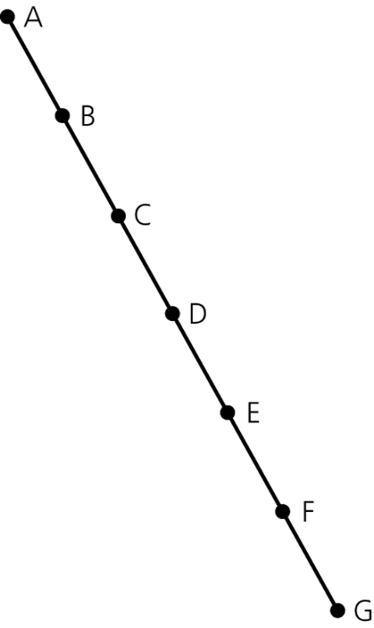
The Efficiency of Binary Search Tree Operations
The maximum number of comparisons for a retrieval, insertion, or deletion is the height of the tree
The maximum and minimum heights of a binary search tree
  n is the maximum height of a binary tree with n nodes
Figure 11-30
A maximum-height binary tree with seven nodes

Slide 15
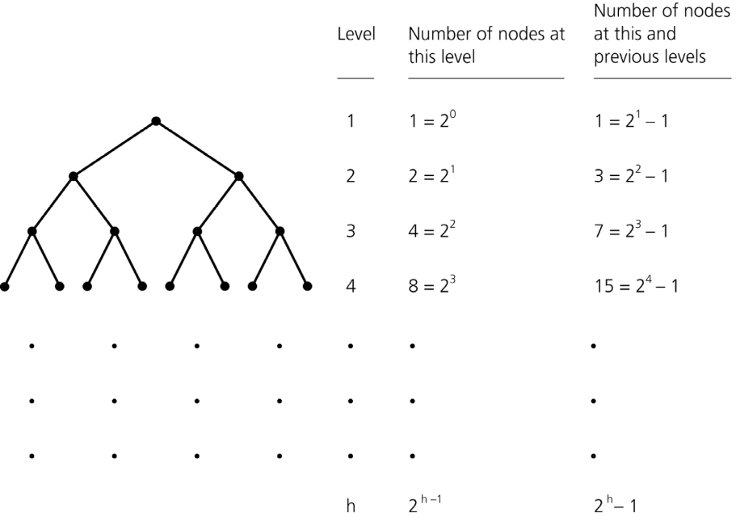
The Efficiency of Binary Search Tree Operations
Theorem 11-2
  A full binary tree of height h ≥ 0 has 2^{h} – 1 nodes
Theorem 11-3
  The maximum number of nodes that a binary tree of height h can have is 2^{h} – 1
Figure 11-32
Counting the nodes in a full binary tree of height h

Slide 16
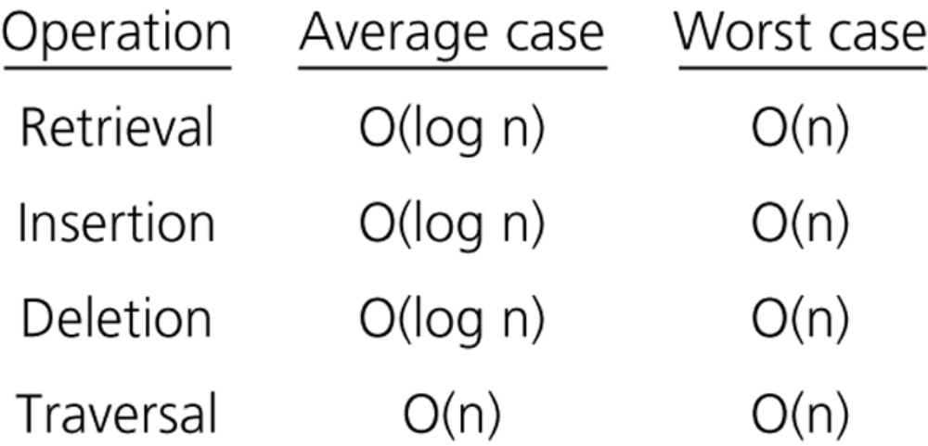
The Efficiency of Binary Search Tree Operations
Theorem 11-4
  The minimum height of a binary tree with n nodes is ⎡log₂(n+1)⎤
The height of a particular binary search tree depends on the order in which insertion and deletion operations are performed
Figure 11-34
The order of the retrieval, insertion, deletion, and traversal operations for the reference-based implementation of the ADT binary search tree

Slide 17
Treesort
Treesort
  Uses the ADT binary search tree to sort an array of records into search-key order
  Efficiency
    Average case: O(n * log n)
    Worst case: O(n²)

Slide 18
Saving a Binary Search Tree in a File
Two algorithms for saving and restoring a binary search tree
  Saving a binary search tree and then restoring it to its original shape
    Uses preorder traversal to save the tree to a file
  Saving a binary tree and then restoring it to a balanced shape
    Uses inorder traversal to save the tree to a file
    Can be accomplished if
      The data is sorted
      The number of nodes in the tree is known

Slide 19
The JCF Binary Search Algorithm
JCF has two binary search methods
  Based on the natural ordering of elements:
  static <T> int
  binarySearch (List<? extends Comparable<? super T>> list, T key)
  Based on a specified Comparator:
  static <T> int binarySearch (List<? extends T> list, T key,
  Comparator<? super T> c)

Slide 20
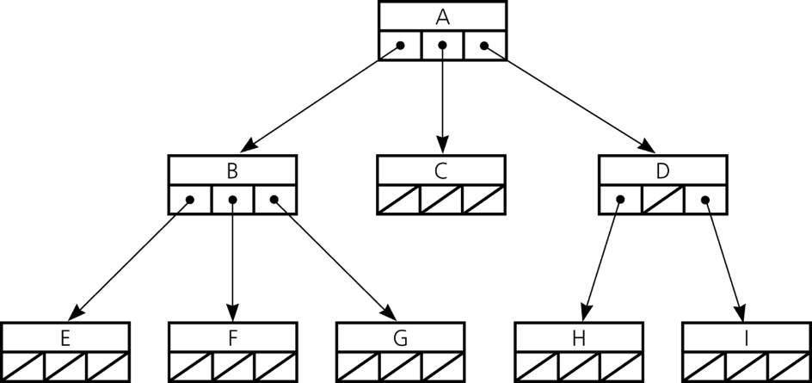
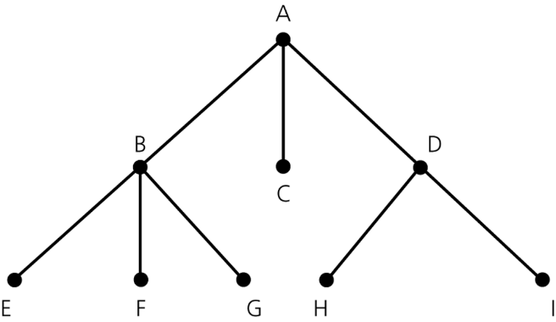
General Trees
An n-ary tree
  A generalization of a binary tree whose nodes each can have no more than n children
Figure 11-38
A general tree
Figure 11-41
An implementation of the n-ary tree in Figure 11-38

Slide 21
Summary
Binary trees provide a hierarchical organization of data
Implementation of binary trees
  The implementation of a binary tree is usually referenced-based
  If the binary tree is complete, an efficient array-based implementation is possible
Traversing a tree is a useful operation
The binary search tree allows you to use a binary search-like algorithm to search for an item with a specified value

Slide 22
Summary
Binary search trees come in many shapes
  The height of a binary search tree with n nodes can range from a minimum of ⎡log₂(n + 1)⎤ to a maximum of n
  The shape of a binary search tree determines the efficiency of its operations
An inorder traversal of a binary search tree visits the tree’s nodes in sorted search-key order
The treesort algorithm efficiently sorts an array by using the binary search tree’s insertion and traversal operations

Slide 23
Summary
Saving a binary search tree to a file
  To restore the tree as a binary search tree of minimum height
    Perform inorder traversal while saving the tree to a file
  To restore the tree to its original form
    Perform preorder traversal while saving the tree to a file

