Slide 1

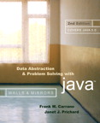
Chapter 12
Tables and Priority Queues

Slide 2

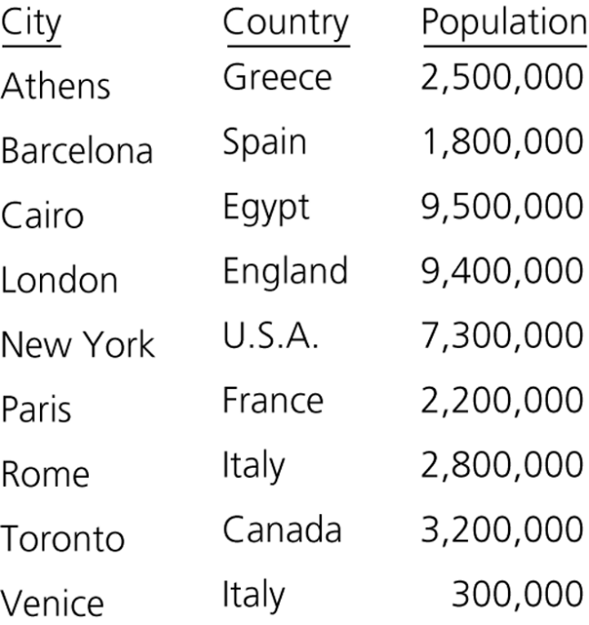
The ADT Table
The ADT table, or dictionary
  Uses a search key to identify its items
  Its items are records that contain several pieces of data
Figure 12-1
An ordinary table of cities

Slide 3
The ADT Table
Operations of the ADT table
  Create an empty table
  Determine whether a table is empty
  Determine the number of items in a table
  Insert a new item into a table
  Delete the item with a given search key from a table
  Retrieve the item with a given search key from a table
  Traverse the items in a table in sorted search-key order

Slide 4
The ADT Table
Pseudocode for the operations of the ADT table
  createTable()
  // Creates an empty table.
  tableIsEmpty()
  // Determines whether a table is empty.
  tableLength()
  // Determines the number of items in a table.
  tableInsert(newItem) throws TableException
  // Inserts newItem into a table whose items have
  // distinct search keys that differ from newItem’s
  // search key. Throws TableException if the
  // insertion is not successful

Slide 5
The ADT Table
Pseudocode for the operations of the ADT table (Continued)
  tableDelete(searchKey)
  // Deletes from a table the item whose search key
  // equals searchKey. Returns false if no such item
  // exists. Returns true if the deletion was
  // successful.
  tableRetrieve(searchKey)
  // Returns the item in a table whose search key
  // equals searchKey. Returns null if no such item
  // exists.
  tableTraverse()
  // Traverses a table in sorted search-key order.

Slide 6
The ADT Table
Value of the search key for an item must remain the same as long as the item is stored in the table
KeyedItem class
  Contains an item’s search key and a method for accessing the search-key data field
  Prevents the search-key value from being modified once an item is created
TableInterface interface
  Defines the table operations

Slide 7
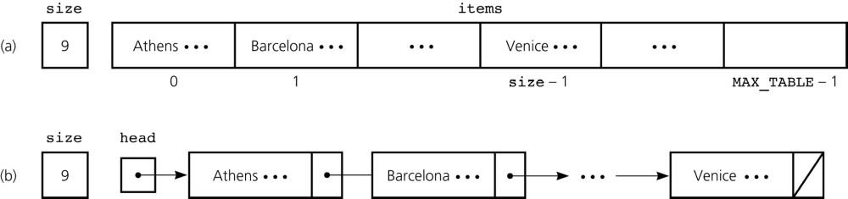
Selecting an Implementation
Categories of linear implementations
  Unsorted, array based
  Unsorted, referenced based
  Sorted (by search key), array based
  Sorted (by search key), reference based
Figure 12-3
The data fields for two sorted linear implementations of the ADT table for the data in Figure 12-1: a) array based; b) reference based

Slide 8
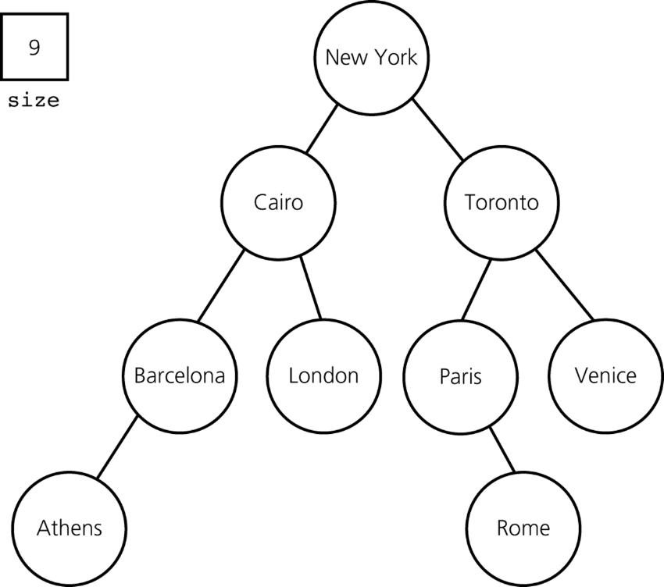
Selecting an Implementation
A binary search implementation
  A nonlinear implementation
Figure 12-4
The data fields for a binary search tree implementation of the ADT table for the data in Figure 12-1

Slide 9
Selecting an Implementation
The binary search tree implementation offers several advantages over linear implementations
The requirements of a particular application influence the selection of an implementation
  Questions to be considered about an application before choosing an implementation
    What operations are needed?
    How often is each operation required?

Slide 10
Scenario A: Insertion and Traversal in No Particular Order
An unsorted order in efficient
  Both array based and reference based tableInsert operation is O(1)
Array based versus reference based
  If a good estimate of the maximum possible size of the table is not available
    Reference based implementation is preferred
  If a good estimate of the maximum possible size of the table is available
    The choice is mostly a matter of style

Slide 11
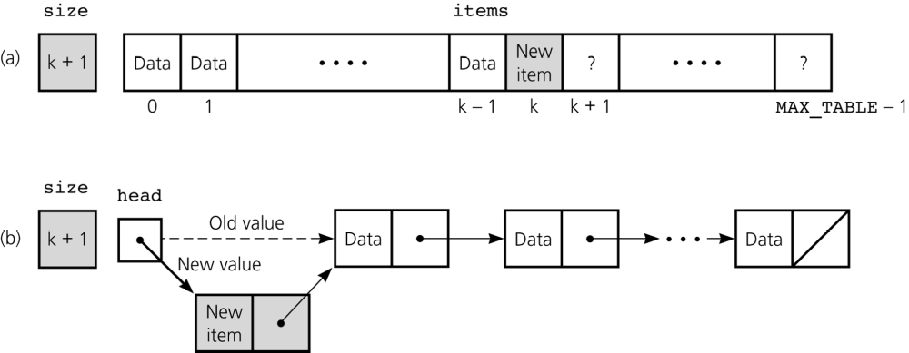
Scenario A: Insertion and Traversal in No Particular Order
Figure 12-5
Insertion for unsorted linear implementations: a) array based; b) reference based

Slide 12
Scenario A: Insertion and Traversal in No Particular Order
A binary search tree implementation is not appropriate
  It does more work than the application requires
    It orders the table items
  The insertion operation is O(log n) in the average case

Slide 13
Scenario B: Retrieval
Binary search
  An array-based implementation
    Binary search can be used if the array is sorted
  A reference-based implementation
    Binary search can be performed, but is too inefficient to be practical
A binary search of an array is more efficient than a sequential search of a linked list
  Binary search of an array
    Worst case: O(log₂n)
  Sequential search of a linked list
    O(n)

Slide 14
Scenario B: Retrieval
For frequent retrievals
  If the table’s maximum size is known
    A sorted array-based implementation is appropriate
  If the table’s maximum size is not known
    A binary search tree implementation is appropriate

Slide 15
Scenario C: Insertion, Deletion, Retrieval, and Traversal in Sorted Order
Steps performed by both insertion and deletion
  Step 1: Find the appropriate position in the table
  Step 2: Insert into (or delete from) this position
Step 1
  An array-based implementation is superior than a reference-based implementation
Step 2
  A reference-based implementation is superior than an array-based implementation
    A sorted array-based implementation shifts data during insertions and deletions

Slide 16
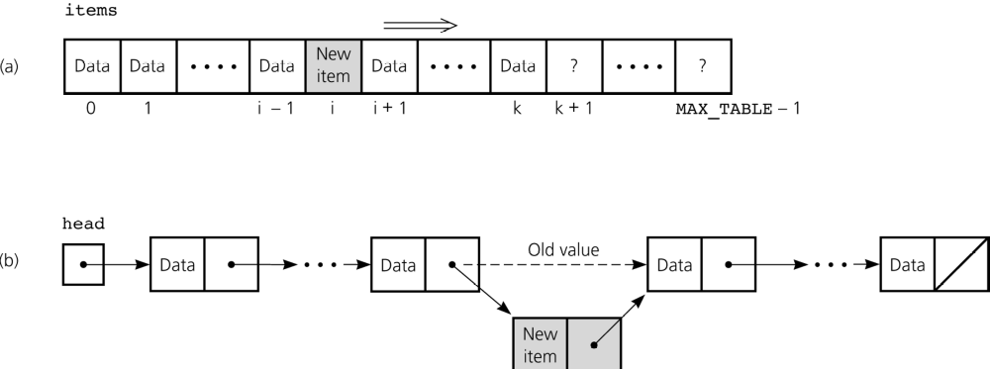
Scenario C: Insertion, Deletion, Retrieval, and Traversal in Sorted Order
Figure 12-6
Insertion for sorted linear implementations: a) array based; b) reference based

Slide 17
Scenario C: Insertion, Deletion, Retrieval, and Traversal in Sorted Order
Insertion and deletion operations
  Both sorted linear implementations are comparable, but neither is suitable
    tableInsert and tableDelete operations
      Sorted array-based implementation is O(n)
      Sorted reference-based implementation is O(n)
  Binary search tree implementation is suitable
    It combines the best features of the two linear implementations

Slide 18
A Sorted Array-Based Implementation of the ADT Table
Linear implementations
  Useful for many applications despite certain difficulties
A binary search tree implementation
  In general, can be a better choice than a linear implementation
A balanced binary search tree implementation
  Increases the efficiency of the ADT table operations

Slide 19
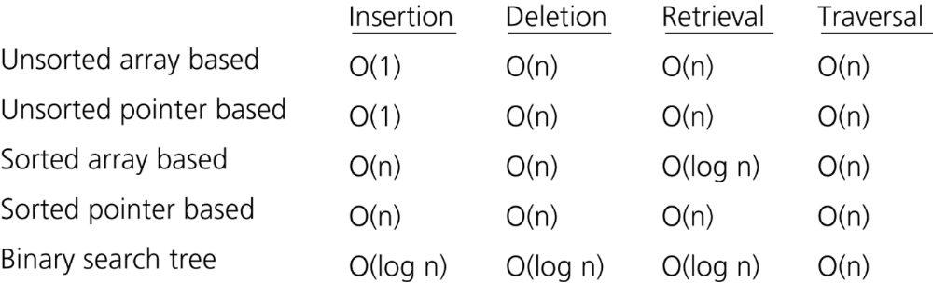
A Sorted Array-Based Implementation of the ADT Table
Figure 12-7
The average-case order of the operations of the ADT table for various implementations

Slide 20
A Sorted Array-Based Implementation of the ADT Table
Reasons for studying linear implementations
  Perspective
  Efficiency
  Motivation
TableArrayBased class
  Provides an array-based implementation of the ADT table
  Implements TableInterface

Slide 21
A Binary Search Tree Implementation of the ADT Table
TableBSTBased class
  Represents a nonlinear reference-based implementation of the ADT table
  Uses a binary search tree to represent the items in the ADT table
    Reuses the class BinarySearchTree

Slide 22
Please open file carrano_ppt12_B.ppt
to continue viewing chapter 12.

