Slide 1

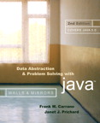
Chapter 12 (continued)
Tables and Priority Queues

Slide 2

The ADT Priority Queue:
A Variation of the ADT Table
The ADT priority queue
  Orders its items by a priority value
  The first item removed is the one having the highest priority value
Operations of the ADT priority queue
  Create an empty priority queue
  Determine whether a priority queue is empty
  Insert a new item into a priority queue
  Retrieve and then delete the item in a priority queue with the highest priority value

Slide 3
The ADT Priority Queue:
A Variation of the ADT Table
Pseudocode for the operations of the ADT priority queue
  createPQueue()
  // Creates an empty priority queue.
  pqIsEmpty()
  // Determines whether a priority queue is
  // empty.

Slide 4
The ADT Priority Queue:
A Variation of the ADT Table
Pseudocode for the operations of the ADT priority queue (Continued)
  pqInsert(newItem) throws PQueueException
  // Inserts newItem into a priority queue.
  // Throws PQueueException if priority queue is
  // full.
  pqDelete()
  // Retrieves and then deletes the item in a
  // priority queue with the highest priority
  // value.

Slide 5
The ADT Priority Queue:
A Variation of the ADT Table
Possible implementations
  Sorted linear implementations
    Appropriate if the number of items in the priority queue is small
    Array-based implementation
      Maintains the items sorted in ascending order of priority value
    Reference-based implementation
      Maintains the items sorted in descending order of priority value

Slide 6
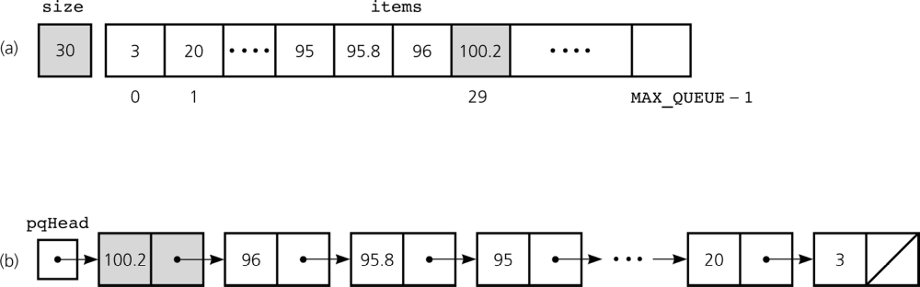
The ADT Priority Queue:
A Variation of the ADT Table
Figure 12-9a and 12-9b
Some implementations of the ADT priority queue: a) array based; b) reference based

Slide 7
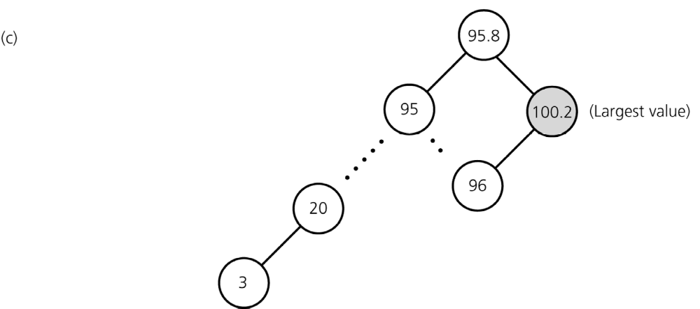
The ADT Priority Queue:
A Variation of the ADT Table
Possible implementations (Continued)
  Binary search tree implementation
    Appropriate for any priority queue
Figure 12-9c
Some implementations of the ADT priority queue: c) binary search tree

Slide 8
Heaps
A heap is a complete binary tree
  That is empty
or
  Whose root contains a search key greater than or equal to the search key in each of its children, and
  Whose root has heaps as its subtrees

Slide 9
Heaps
Maxheap
  A heap in which the root contains the item with the largest search key
Minheap
  A heap in which the root contains the item with the smallest search key

Slide 10
Heaps
Pseudocode for the operations of the ADT heap
  createHeap()
  // Creates an empty heap.
  heapIsEmpty()
  // Determines whether a heap is empty.
  heapInsert(newItem) throws HeapException
  // Inserts newItem into a heap. Throws
  // HeapException if heap is full.
  heapDelete()
  // Retrieves and then deletes a heap’s root
  // item. This item has the largest search key.

Slide 11
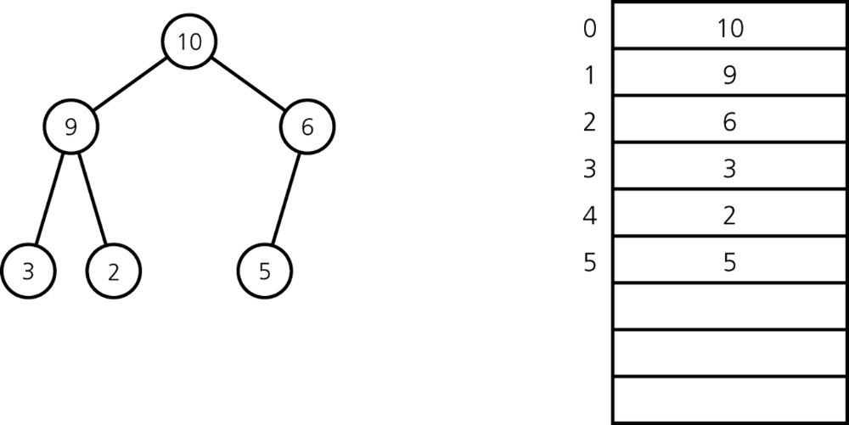
Heaps: An Array-based Implementation of a Heap
Data fields
  items: an array of heap items
  size: an integer equal to the number of items in the heap
Figure 12-11
A heap with its array representation

Slide 12
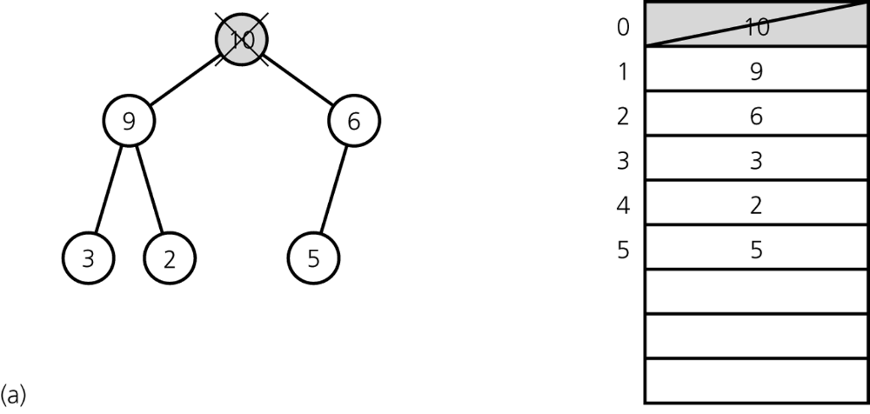
Heaps: heapDelete
Step 1: Return the item in the root
  Results in disjoint heaps
Figure 12-12a
a) Disjoint heaps

Slide 13
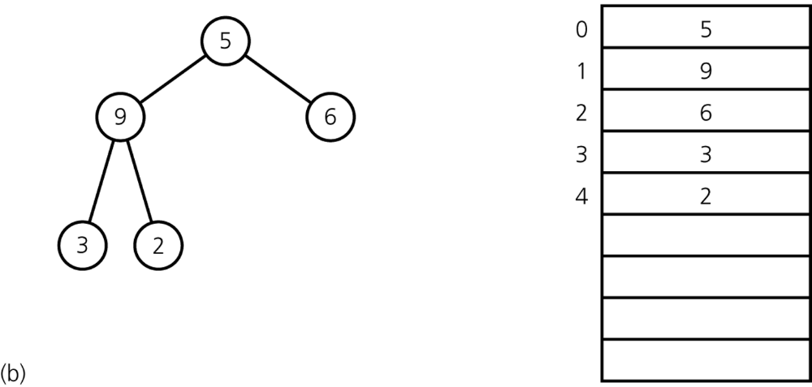
Heaps: heapDelete
Step 2: Copy the item from the last node into the root
  Results in a semiheap
Figure 12-12b
b) a semiheap

Slide 14
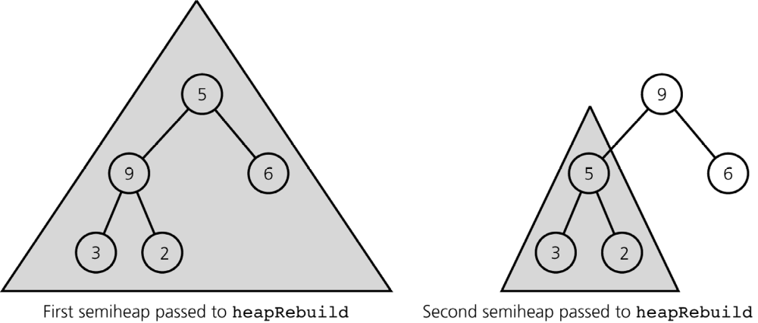
Heaps: heapDelete
Step 3: Transform the semiheap back into a heap
  Performed by the recursive algorithm heapRebuild
Figure 12-14
Recursive calls to heapRebuild

Slide 15
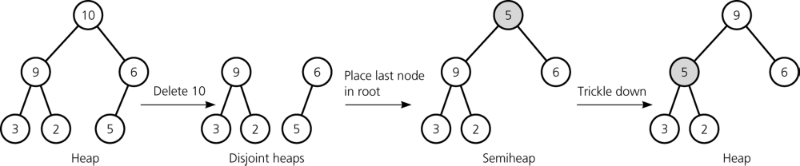
Heaps: heapDelete
Efficiency
  heapDelete is O(log n)
Figure 12-13
Deletion from a heap

Slide 16
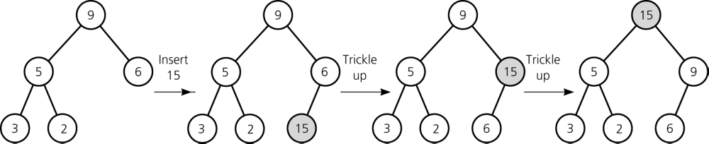
Heaps: heapInsert
Strategy
  Insert newItem into the bottom of the tree
  Trickle new item up to appropriate spot in the tree
Efficiency: O(log n)
Heap class
  Represents an array-based implementation of the ADT heap
Figure 12-15
Insertion into a heap

Slide 17
A Heap Implementation of the ADT Priority Queue
Priority-queue operations and heap operations are analogous
  The priority value in a priority-queue corresponds to a heap item’s search key
PriorityQueue class
  Has an instance of the Heap class as its data field

Slide 18
A Heap Implementation of the ADT Priority Queue
A heap implementation of a priority queue
  Disadvantage
    Requires the knowledge of the priority queue’s maximum size
  Advantage
    A heap is always balanced
Finite, distinct priority values
  A heap of queues
    Useful when a finite number of distinct priority values are used, which can result in many items having the same priority value

Slide 19
Heapsort
Strategy
  Transforms the array into a heap
  Removes the heap's root (the largest element) by exchanging it with the heap’s last element
  Transforms the resulting semiheap back into a heap
Efficiency
  Compared to mergesort
    Both heapsort and mergesort are O(n * log n) in both the worst and average cases
    Advantage over mergesort
      Heapsort does not require a second array
  Compared to quicksort
    Quicksort is the preferred sorting method

Slide 20
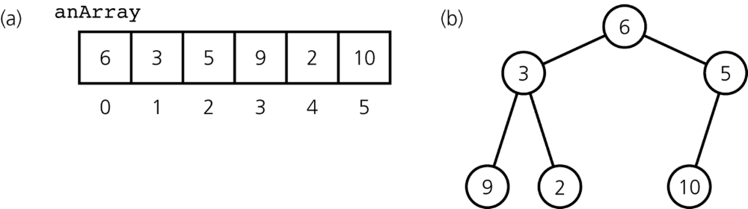
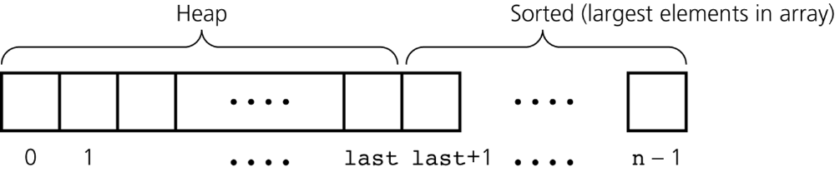
Heapsort
Figure 12-16
a) The initial contents of anArray; b) anArray’s corresponding binary tree
Figure 12-18
Heapsort partitions an array into two regions

Slide 21
Tables and Priority Queues in JFC: The JFC Map Interface
Map interface
  Provides the basis for numerous other implementations of different kinds of maps
public interface Map<K,V> methods
  void clear()
  boolean containsKey(Object key)
  boolean containsValue(Object value)
  Set<Map.Entry<K,V>> entrySet()
  V get(Object key);

Slide 22
Tables and Priority Queues in JFC: The JFC Map Interface
public interface Map<K,V> methods (continued)
  boolean isEmpty()
  Set<K> keySet()
  V put(K key, V value)
  V remove(Object key)
  Collection<V> values()

Slide 23
The JFC Set Interface
Set interface
  Ordered collection
  Stores single value entries
  Does not allow for duplicate elements
public interface Set<T> methods
  boolean add(T o)
  boolean addAll(Collection<? extends T> c)
  void clear()
  boolean contains(Object o)
  boolean isEmpty()

Slide 24
The JFC Set Interface
public interface Set<T> methods (continued)
  Iterator<T> iterator()
  boolean remove(Object o)
  boolean removeAll(Collection<?> c)
  boolean retainAll(Collection<?> c)
  int size()

Slide 25
The JFC PriorityQueue Class
PriorityQueue class
  Has a single data-type parameter with ordered elements
  Relies on the natural ordering of the elements
    As provided by the Comparable interface or a Comparator object
  Elements in queue are ordered in ascending order
public Class PriorityQueue<T> methods
  PriorityQueue(int initialCapacity)
  PriorityQueue(int initialCapacity, Comparator<? super T> comparator)
  boolean add(T o)
  void clear()
  boolean contains(Object o)

Slide 26
The JFC PriorityQueue Class
public Class PriorityQueue<T> methods (continued)
  Comparator<? super T> comparator()
  T element()
  Iterator<T> iterator()
  boolean offer(T o)
  T peek()
  T poll()
  boolean remove(Object o)
  int size()

Slide 27
Summary
The ADT table supports value-oriented operations
The linear implementations (array based and reference based) of a table are adequate only in limited situations or for certain operations
A nonlinear reference-based (binary search tree) implementation of the ADT table provides the best aspects of the two linear implementations
A priority queue, a variation of the ADT table, has operations which allow you to retrieve and remove the item with the largest priority value

Slide 28
Summary
A heap that uses an array-based representation of a complete binary tree is a good implementation of a priority queue when you know the maximum number of items that will be stored at any one time
Efficiency
  Heapsort, like mergesort, has good worst-case and average-case behaviors, but neither algorithms is as good in the average case as quicksort
  Heapsort has an advantage over mergesort in that it does not require a second array

Slide 29
Summary
Tables and priority queues in JFC
  Map interface
  Set interface
  PriorityQueue class

