Slide 1

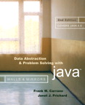
Chapter 8 (continued)
Queues

Slide 2

An Implementation That Uses the ADT List
If the item in position 1 of a list list represents the front of the queue, the following implementations can be used
  dequeue()
    list.remove(1)
  peek()
    list.get(1)

Slide 3
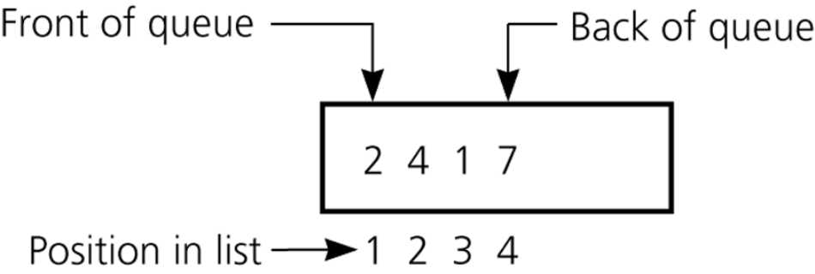
An Implementation That Uses the ADT List
If the item at the end of the list represents the back of the queue, the following implementations can be used
  enqueue(newItem)
    list.add(list.size()+1, newItem)
Figure 8-13
An implementation that uses the ADT list

Slide 4
The Java Collections Framework Interface Queue
JCF has a queue interface called Queue
Derived from interface Collection
Adds methods:
  element: retrieves, but does not remove head
  offer: inserts element into queue
  peek: retrieves, but does not remove head
  poll: retrieves and removes head
  remove: retrieves and removes head

Slide 5
Comparing Implementations
All of the implementations of the ADT queue mentioned are ultimately either
  Array based
  Reference based
Fixed size versus dynamic size
  A statically allocated array
    Prevents the enqueue operation from adding an item to the queue if the array is full
  A resizable array or a reference-based implementation
    Does not impose this restriction on the enqueue operation

Slide 6
Comparing Implementations
Reference-based implementations
  A linked list implementation
    More efficient
  The ADT list implementation
    Simpler to write

Slide 7
A Summary of Position-Oriented ADTs
Position-oriented ADTs
  List
  Stack
  Queue
Stacks and queues
  Only the end positions can be accessed
Lists
  All positions can be accessed

Slide 8
A Summary of Position-Oriented ADTs
Stacks and queues are very similar
  Operations of stacks and queues can be paired off as
    createStack and createQueue
    Stack isEmpty and queue isEmpty
    push and enqueue
    pop and dequeue
    Stack peek and queue peek

Slide 9
A Summary of Position-Oriented ADTs
ADT list operations generalize stack and queue operations
  length
  add
  remove
  get

Slide 10
Application: Simulation
Simulation
  A technique for modeling the behavior of both natural and human-made systems
  Goal
    Generate statistics that summarize the performance of an existing system
    Predict the performance of a proposed system
  Example
    A simulation of the behavior of a bank

Slide 11
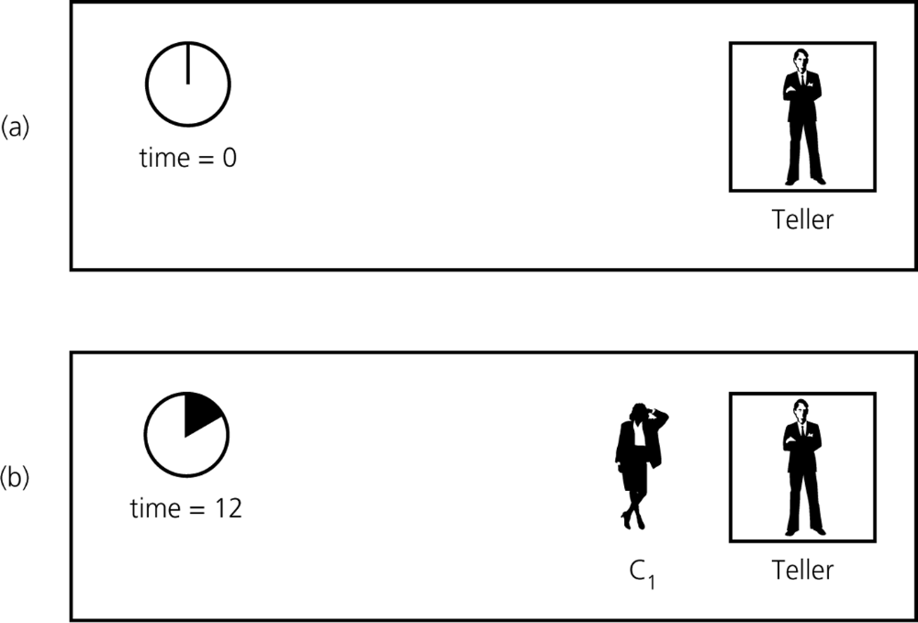
Application: Simulation
Figure 8-14a and 8-14b
A blank line at at time a) 0; b) 12

Slide 12
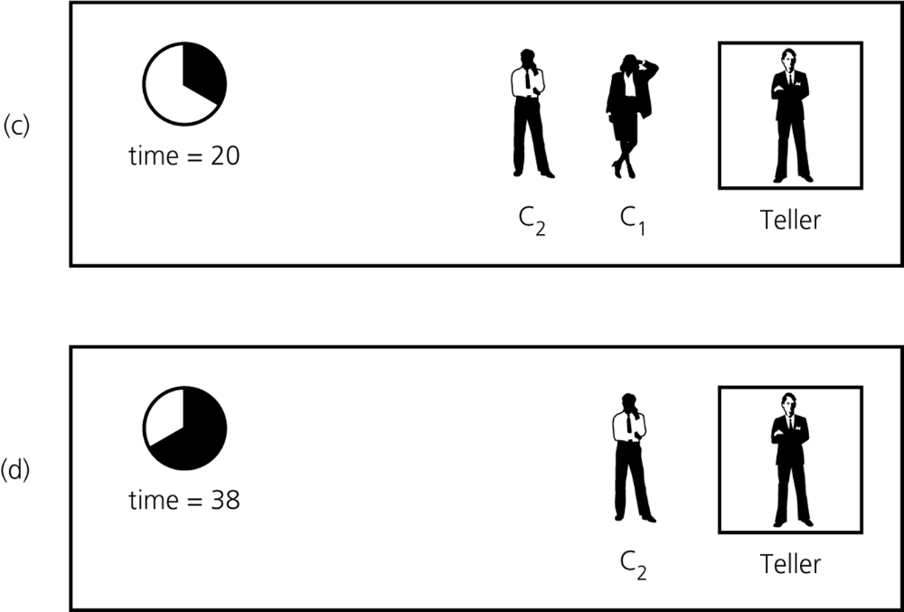
Application: Simulation
Figure 8-14c and 8-14d
A blank line at at time c) 20; d) 38

Slide 13
Application: Simulation
An event-driven simulation
  Simulated time is advanced to the time of the next event
  Events are generated by a mathematical model that is based on statistics and probability
A time-driven simulation
  Simulated time is advanced by a single time unit
  The time of an event, such as an arrival or departure, is determined randomly and compared with a simulated clock

Slide 14
Application: Simulation
The bank simulation is concerned with
  Arrival events
    Indicate the arrival at the bank of a new customer
    External events: the input file specifies the times at which the arrival events occur
  Departure events
    Indicate the departure from the bank of a customer who has completed a transaction
    Internal events: the simulation determines the times at which the departure events occur

Slide 15
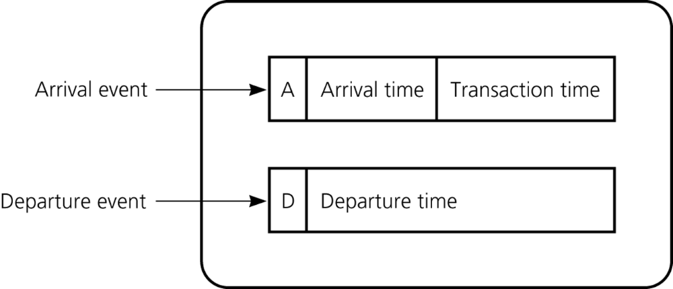
Application: Simulation
An event list is needed to implement an event-driven simulation
  An event list
    Keeps track of arrival and departure events that will occur but have not occurred yet
    Contains at most one arrival event and one departure event
Figure 8-15
A typical instance of the event list

Slide 16
Summary
The definition of the queue operations gives the ADT queue first-in, first-out (FIFO) behavior
A reference-based implementation of a queue uses either
  A circular linked list
  A linear linked list with a head reference and a tail reference
An array-based implementation of a queue is prone to rightward drift
  A circular array eliminates the problem of rightward drift

Slide 17
Summary
To distinguish between the queue-full and queue-empty conditions in a queue implementation that uses a circular array, you can
  Count the number of items in the queue
  Use a full flag
  Leave one array location empty
Models of real-world systems often use queues
  The event-driven simulation in this chapter uses a queue to model a line of customers in a bank

Slide 18
Summary
Simulations
  Central to a simulation is the notion of simulated time
    In a time-driven simulation
      Simulated time is advanced by a single time unit
    In an event-driven simulation
      Simulated time is advanced to the time of the next event
  To implement an event-driven simulation, you maintain an event list that contains events that have not yet occurred

