Slide 1
Capstone Project - The Battle of Neighborhoods -
Presentation Jaime Pilar de Oliveira

Slide 2
1. Introduction
• Background: Safety is a top concern when moving to a new area. If you don’t feel safe in your own home, you’re not going to be able to enjoy living there.
• Problem: This project aims to select the safest borough in London based on the total crimes, explore the neighborhoods of that borough to find the 10 most common venues in each neighborhood and finally cluster the neighborhoods using k-mean clustering.
• Interest: Expats who are considering to relocate to London will be interested to identify the safest borough in London and explore its neighborhoods and common venues around each neighborhood.
Boroughs with the lowest crime rates London Boroughs with the least no of crime |  | Neighborhoods in Kingston upon Thames | mi
-Ml u»5 - BBSs |  | — ........x\
Modelling
• Using th

Slide 3
2. Data Acquisition and Cleaning
Data Acquisition: The data acquired for this project is a combination of data from three sources:
• The first data source of the project uses a London crime data that shows the crime per borough in London.
• The second source of data is scraped from a Wikipedia page that contains the list of London boroughs. This page contains additional information about the boroughs.
• The third data source is the list of Neighborhoods in the Royal Borough of Kingston upon Thames as found on the Wikipedia page.
OMU Cleaning: The data c wring process for each at the three sources o' data are done separately.
• t-rom the London crone data, the dimes during the mod teorrf. year (201C1 ate only selected. The major categoric;. at crime are p voted to get ?tc total crime', per the bcraughs lot each motet cattgo-y
• The second duta is scraped Item a wkipedia page us rig the BeaulHul Scop ibrary r python Usng ths tbrary we can extract the data n the tabula* formal as shown n the website.
3. Methodology
• The two data sets a*e merged or the Borough names to V*m a new data set. The purpose ol
•hr Hrifn rtti Ir viut i ilTai thn irtmn rv«< in twvh hrwMtnh nnd UismiiKi iton htmi t»fn «h*»

Slide 4
mmm
Data Cleaning: The data cleaning process for each of the three sources of data are done separately.
• From the London crime data, the crimes during the most recent year (2016) are only selected. The major categories of crime are pivoted to get the total crimes per the boroughs for each major category.
• The second data is scraped from a Wikipedia page using the Beautiful Soup library in python. Using this library we can extract the data in the tabular format as shown in the website.
• The two data sets are merged on the Borough names to form a new data set. The purpose of this data set is to visualize the crime rates in each borough and identify the borough with the least crimes recorded during the year 2016.
• After visualizing the crime in each borough we can find the borough with the lowest crime rate.The third data set is created, with the names of the neighborhoods and the name of the borough with the latitude and longitude obtained using Google Maps API geocoding. •
• The new data set is used to generate the 10 most common venues for each neighborhood using the Foursquare API, finally using k means clustering algorithm to cluster similar neighborhoods together.
mam

Slide 5
3. Methodology
Exploratory Data Analysis
Statistical summary of crimes
 | Burglary | Criminal Damage | Drugs | Other Notifiable Offences | Robbery | Theft and Handling | Violence Against the Person | Total
count | 33.000000 | 33.000000 | 33.000000 | 33.000000 | 33.000000 | 33.000000 | 33.000000 | 33.000000
mean | 2069.242424 | 1941.545455 | 1179.212121 | 479.060606 | 682.666667 | 8913.121212 | 7041.848485 | 22306.696970
std | 737.448644 | 625.207070 | 586.406416 | 223.298698 | 441.425366 | 4620.565054 | 2513.601551 | 8828.228749
min | 2.000000 | 2.000000 | 10.000000 | 6.000000 | 4.000000 | 129.000000 | 25.000000 | 178.000000
25% | 1531.000000 | 1650.000000 | 743.000000 | 378.000000 | 377.000000 | 5919.000000 | 5936.000000 | 16903.000000
50% | 2071.000000 | 1989.000000 | 1063.000000 | 490.000000 | 599.000000 | 8925.000000 | 7409.000000 | 22730.000000
75% | 2631.000000 | 2351.000000 | 1617.000000 | 551.000000 | 936.000000 | 10789.000000 | 8832.000000 | 27174.000000
max | 3402.000000 | 3219.000000 | 2738.000000 | 1305.000000 | 1822.000000 | 27520.000000 | 10834.000000 | 48330.000000
The count for each of the major categories of crime returns the value 33 which is the number of London boroughs. Theft and Handling’ is the highest reported crime during the year 2016 followed by ‘Violence against the person’, ‘Criminal damage’. The lowest recorded crimes are ’Drugs’, ‘Robbery’ and ‘Other Notifiable offenses’

Slide 6
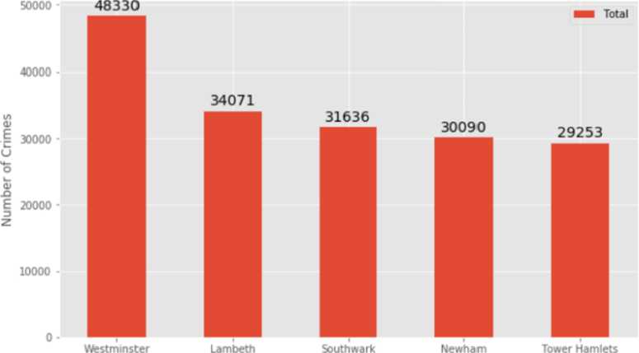
Boroughs with the highest crime rates
London Boroughs with the Highest no. of crime
Borough
Comparing five boroughs with the highest crime rate during the year 2016 it is evident that Westminster has the highest crimes recorded followed by Lambeth, Southwark, Newham and Tower Hamlets. Westminster has a significantly higher crime rate than the other 4 boroughs.

Slide 7
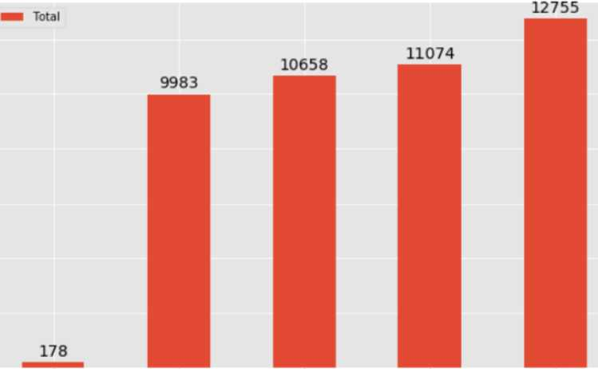
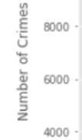
Boroughs with the lowest crime rates
London Boroughs with the least no. of crime
12000 -
10000 -
2000 • 0-
City of London Kingston upon Thames Sutton Richmond upon Thames Merton
Borough
Comparing five boroughs with the lowest crime rate during the year 2016, City of London has the lowest recorded crimes followed by Kingston upon Thames, Sutton, Richmond upon Thames and Merton.
City of London has a significantly lower crime rate because it i is the 33rd principal division of Greater London but it is not a London borough. It has an area of 1.12 square miles and a population of 7000 as of 2013 which suggests that it is a small area.
We will consider the next borough with the lowest crime rate as the safest borough in London which is Kingston upon Thames.

Slide 8
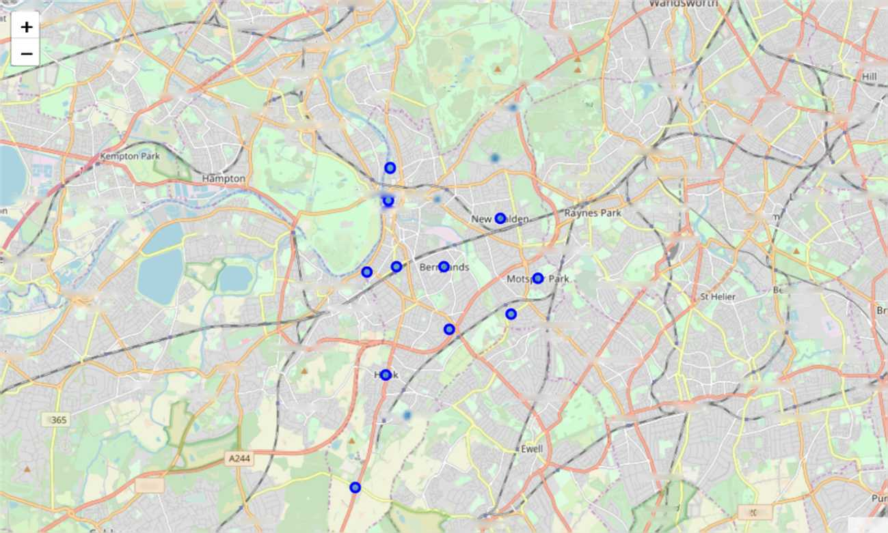
Neighborhoods in Kingston upon Thames
_JT‘
6DFONT
M Mciraarets
onxi
..Whitton
Roehampton
Feltham
Twickenham
Richmond
Park
Southfields /
Balham
Strawberry
trfn
Hanworth
Hamptori'Hill \
j Teddington
Wimbledon Park /
st r eathai
Ham
Putney Vale
Upper Tooting
Kings©! Vale ^ble-j-.r Common
Streatham
Tooting
CoQbe
Wimbledon
Cottenham
Park
South Wimbledon
Streatham
Charlton'
Sunbury-on
Thames
Bushy Park ,,
Kmgstra uponQ Thames
Merton Park
.onesome
Nor bur>
Molesey
Hampton \ Court Pork
Mitchai
West Barnes
Morden
ppertcn
Walton-on-
Thames
Thames Dltton
Lower Morden
“ddmgtOfV
Corner
Long Ditton
Worcester
Park
Hackbndge
ridge
Hinchley Wood
North Cheam
Beddington
Hersham
Esher
tlarshalton
~Wadd
West End
Claygate
ChesQgton
Stoneleigh
Suttorf
3
,Cheam
"Wellington
A307
Belmont
“ Si
y£psom
Bonsieo*
Dovyns
K 02
Leaflet
There are 15 neighborhoods in the royal borough of Kingston upon Thames, they are visualised on a map using folium on python.

Slide 9
Modelling
• Using the final data set containing the neighborhoods in Kingston upon Thames along with the latitude and longitude, we can find all the venues within a 500 meter radius of each neighborhood by connecting to the Foursquare API.
 | Neighborhood | Neighborhood Latitude | Neighborhood Longitude | Venue | Venue Latitude | Venue Longitude | Venue Category
0 | Berrylands | 51.393781 | -0.284802 | Surbiton Racket & Fitness Club | 51.392676 | -0.290224 | Gym / Fitness Center
1 | Berrylands | 51.393781 | -0.284802 | Alexandra Park | 51.394230 | -0.281206 | Park
2 | Berrylands | 51.393781 | -0.284802 | K2 Bus Stop | 51.392302 | -0.281534 | Bus Stop
3 | Berrylands | 51.393781 | -0.284802 | Cafe Rosa | 51.390175 | -0.282490 | Cafe
4 | Canbury | 51.417499 | -0.305553 | The Boater's Inn | 51.418546 | -0.305915 | Pub
One hot encoding is done on the venues data. The Venues data is then grouped by the Neighborhood and the mean of the venues are calculated, finally the 10 common venues are calculated for each of the neighborhoods.
To help people find similar neighborhoods in the safest borough we will be clustering similar neighborhoods using K - means clustering which is a form of unsupervised machine learning algorithm that clusters data based on predefined cluster size.
We will use a cluster size of 5 for this project that will cluster the 15 neighborhoods into 5 clusters. The reason to conduct a K- means clustering is to cluster neighborhoods with similar venues together so that people can shortlist the area of their interests based on the venues/amenities around each neighborhood.
■■
■
■■

Slide 10
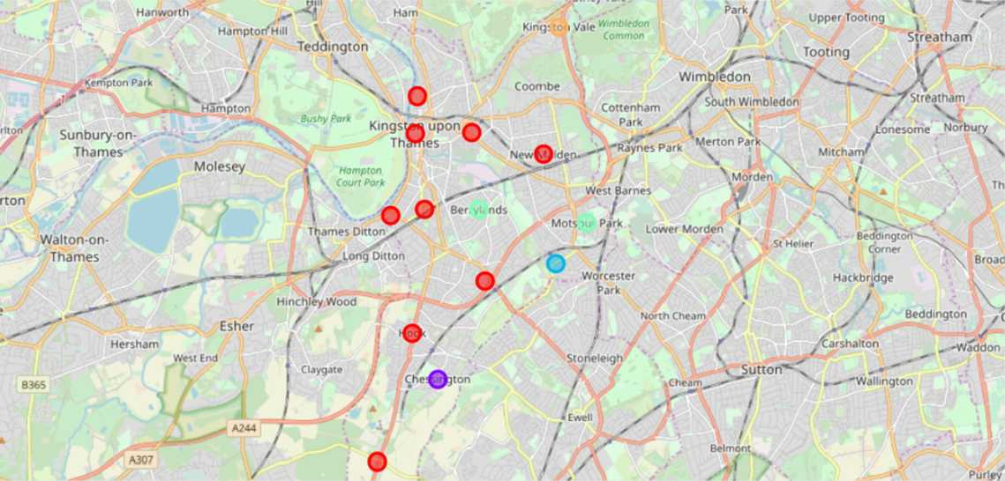
4. Results
After running the K-means clustering we can access each cluster created to see which neighborhoods were assigned to each of the five clusters. Visualizing the clustered neighborhoods on a map using the folium library.
Each cluster is color coded for the ease of presentation, we can see that majority of the neighborhood falls in the red cluster which is the first cluster. Three neighborhoods have their own cluster (Blue, Purple and Yellow), these are clusters two three and five. The green cluster consists of two neighborhoods which is the 4th cluster.

Slide 11
Cluster 1: Looking into the neighborhoods in the first cluster
 | Neighborhood | Borough | Latitude | Longitude | Cluster Labels | 1st Most Common Venue | 2nd Most Common Venue | 3rd Most Common Venue | 4th Most Common Venue | 5th Most Common Venue | 6th Most Common Venue | 7th Most Common Venue | 8th Most Common Venue
1 | Canbury | Kingston upon Thames | 51.417499 | -0.305553 | 0 | Pub | Cafe | Plaza | Fish & Chips Shop | Supermarket | Spa | Shop& Service | Park
4 | Hook | Kingston upon Thames | 51.367898 | -0.307145 | 0 | Bakery | Convenience Store | Indian Restaurant | Fish & Chips Shop | Wine Shop | Food | Electronics Store | Farmers Market
5 | Kingston upon Thames | Kingston upon Thames | 51.409627 | -0.306262 | 0 | Coffee Shop | Cafe | Burger Joint | Sushi Restaurant | Pub | Record Shop | Cosmetics Shop | Market
7 | Malden Rushett | Kingston upon Thames | 51.341052 | -0.319076 | 0 | Convenience Store | Pub | Garden Center | Restaurant | Fast Food Restaurant | Discount Store | Dry Cleaner | Electronics Store
9 | New Malden | Kingston upon Thames | 51.405335 | -0.263407 | 0 | Gastropub | Gym | Sushi Restaurant | Supermarket | Korean Restaurant | Indian Restaurant | Fish & Chips Shop | Dry Cleaner
10 | Norbiton | Kingston upon Thames | 51.409999 | -0.287396 | 0 | Indian Restaurant | Pub | Food | Italian Restaurant | Platform | Grocery Store | Farmers Market | Dry Cleaner
12 | Seething Wells | Kingston upon Thames | 51.392642 | -0.314366 | 0 | Indian Restaurant | Coffee Shop | Italian Restaurant | Pub | Cafe | Wine Shop | Fast Food Restaurant | Chinese Restaurant
13 | Surbiton | Kingston upon Thames | 51.393756 | -0.303310 | 0 | Coffee Shop | Pub | Supermarket | Breakfast Spot | Grocery Store | Gastropub | French Restaurant | Train Station
14 | Tolworth | Kingston upon Thames | 51.378876 | -0.282860 | 0 | Grocery Store | Pharmacy | Furniture / Home Store | Train Station | Pizza Place | Discount Store | Coffee Shop | Bus Stop
The cluster one is the biggest cluster with 9 of the 15 neighborhoods in the borough Kingston upon Thames. Upon closely examining these neighborhoods we can see that the most common venues in these neighborhoods are Restaurants, Pubs, Cafe, Supermarkets, and stores

Slide 12
■
Cluster 2: Looking into the neighborhoods in the second cluster.
 |  |  |  | Cluster Labels | 1st Most | 2nd Most Common Venue | 3rd Most | 4th Most | 5th Most | 6th Most | 7th Most | 8th Most | 9th Most
Neighborhood | Borough | Latitude | Longitude |  | Common |  | Common | Common | Common | Common | Common | Common | Common
 |  |  |  |  | Venue |  | Venue | Venue | Venue | Venue | Venue | Venue | Venue
2 Chessington | Kingston upon Thames | 51.358336 | -0.298622 | 1 | Fast Food Restaurant | Wine Shop | Golf Course | German Restaurant | Gastropub | Garden Center | Furniture / Home Store | Fried Chicken Joint | French Restaurant
The second cluster has one neighborhood which consists of Venues such as Restaurants, Golf courses, and wine shops.
Cluster 3: Looking into the neighborhoods in the third cluster.
Neighborhood | Borough | Latitude | Longitude | Cluster Labels | 1st Most Common Venue | 2nd Most Common Venue | 3rd Most Common Venue | 4th Most Common Venue | 5th Most Common Venue | 6th Most Common Venue | 7th Most Common Venue | 8th Most Common Venue | 9th Most Common Venue
11 Old Malden | Kingston upon Thames | 51.382484 | -0.25909 | 2 | Train Station | Pub | Food | Gastropub | Garden Center | Furniture / Home Store | Fried Chicken Joint | French Restaurant | Deli/ Bodega
The third cluster has one neighborhood which consists of Venues such as Train stations, Restaurants, and Furniture shops.

Slide 13
Cluster 4: Looking into the neighborhoods in the fourth cluster.
 |  |  |  | Cluster Labels | 1st Most | 2nd Most Common Venue | 3rd Most | 4th Most | 5th Most | 6th Most | 7th Most | 8th Most | 9th Most
Neighborhood | Borough | Latitude | Longitude |  | Common |  | Common | Common | Common | Common | Common | Common | Common
 |  |  |  |  | Venue |  | Venue | Venue | Venue | Venue | Venue | Venue | Venue
0 Benrylands | Kingston upon Thames | 51.393781 | -0.284802 | 3 | Gym/ Fitness Center | Park | Cafe | Bus Stop | Wine Shop | Fish & Chips Shop | Electronics Store | Farmers Market | Fast Food Restaurant
8 Motspur Park | Kingston upon Thames | 51.390985 | -0.248898 | 3 | Park | Gym | Restaurant | Soccer Field | Bus Stop | Wine Shop | Fast Food Restaurant | Dry Cleaner | Electronics Store
The fourth cluster has two neighborhoods in it, these neighborhoods have common venues such as Parks, Gym/Fitness centers, Bus Stops, Restaurants, Electronics Stores and Soccer fields etc.
Cluster 5: Looking into the neighborhoods in the fourth cluster.
Neighborhood | Borough | Latitude | Longitude | Cluster Labels | 1st Most Common Venue | 2nd Most Common Venue | 3rd Most Common Venue | 4th Most Common Venue | 5th Most Common Venue | 6th Most Common Venue | 7th Most Common Venue | 8th Most Common Venue | 9th Most Common Venue
6 Kingston Vale | Kingston upon Thames | 51.43185 | -0.258138 | 4 | Grocery Store | Bar | Italian Restaurant | Soccer Field | Garden Center | Furniture / Home Store | Fried Chicken Joint | French Restaurant | Department Store
The fifth cluster has one neighborhood which consists of Venues such as Grocery shops, Bars, Restaurants, Furniture shops, and Department stores.

Slide 14
5. Discussion
• The aim of this project is to help people who want to relocate to the safest borough in London, expats can chose the neighborhoods to which they want to relocate based on the most common venues in it.
• For example if a person is looking for a neighborhood with good connectivity and public transportation we can see that Clusters 3 and 4 have Train stations and Bus stops as the most common venues.
• If a person is looking for a neighborhood with stores and restaurants in a close proximity then the neighborhoods in the first cluster is suitable.
• For a family I feel that the neighborhoods in Cluster 4 are more suitable dues to the common venues in that cluster, these neighborhoods have common venues such as Parks, Gym/Fitness centers, Bus Stops, Restaurants, Electronics Stores and Soccer fields which is ideal for a family.
• The preference of venues may vary from person to person, they can select a neighborhood based on ones priorities.

Slide 15
■
6.Conclusion
This project helps a person get a better understanding of the neighborhoods with respect to the most common venues in that neighborhood. It is always helpful to make use of technology to stay one step ahead i.e. finding out more about places before moving into a neighborhood.
We have just taken safety as a primary concern to shortlist the safest borough of London. The future of this project includes taking other factors such as cost of living in the areas into consideration to shortlist the borough, such as filtering areas based on a predefined budget.

