Slide 1
Week 4

Slide 2
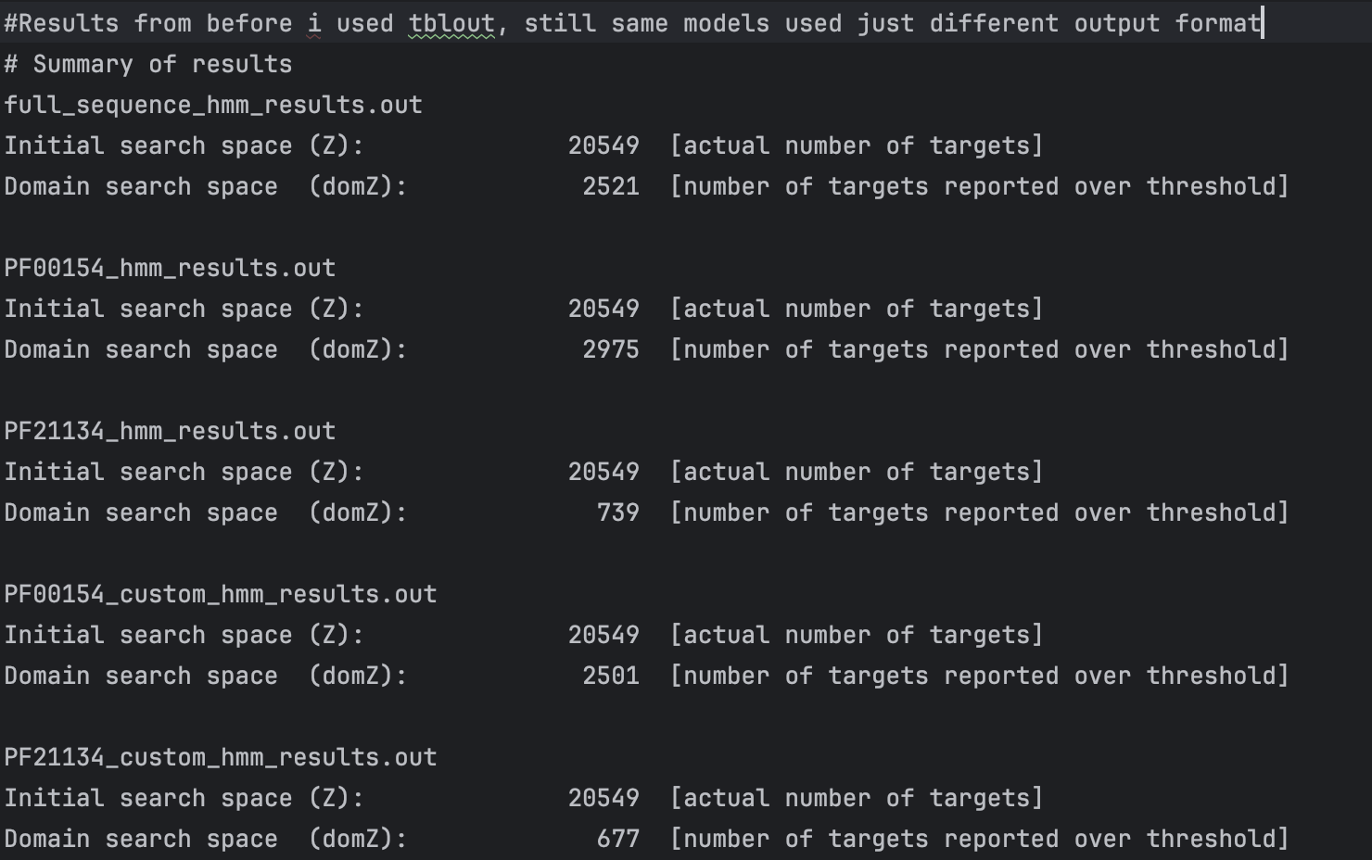
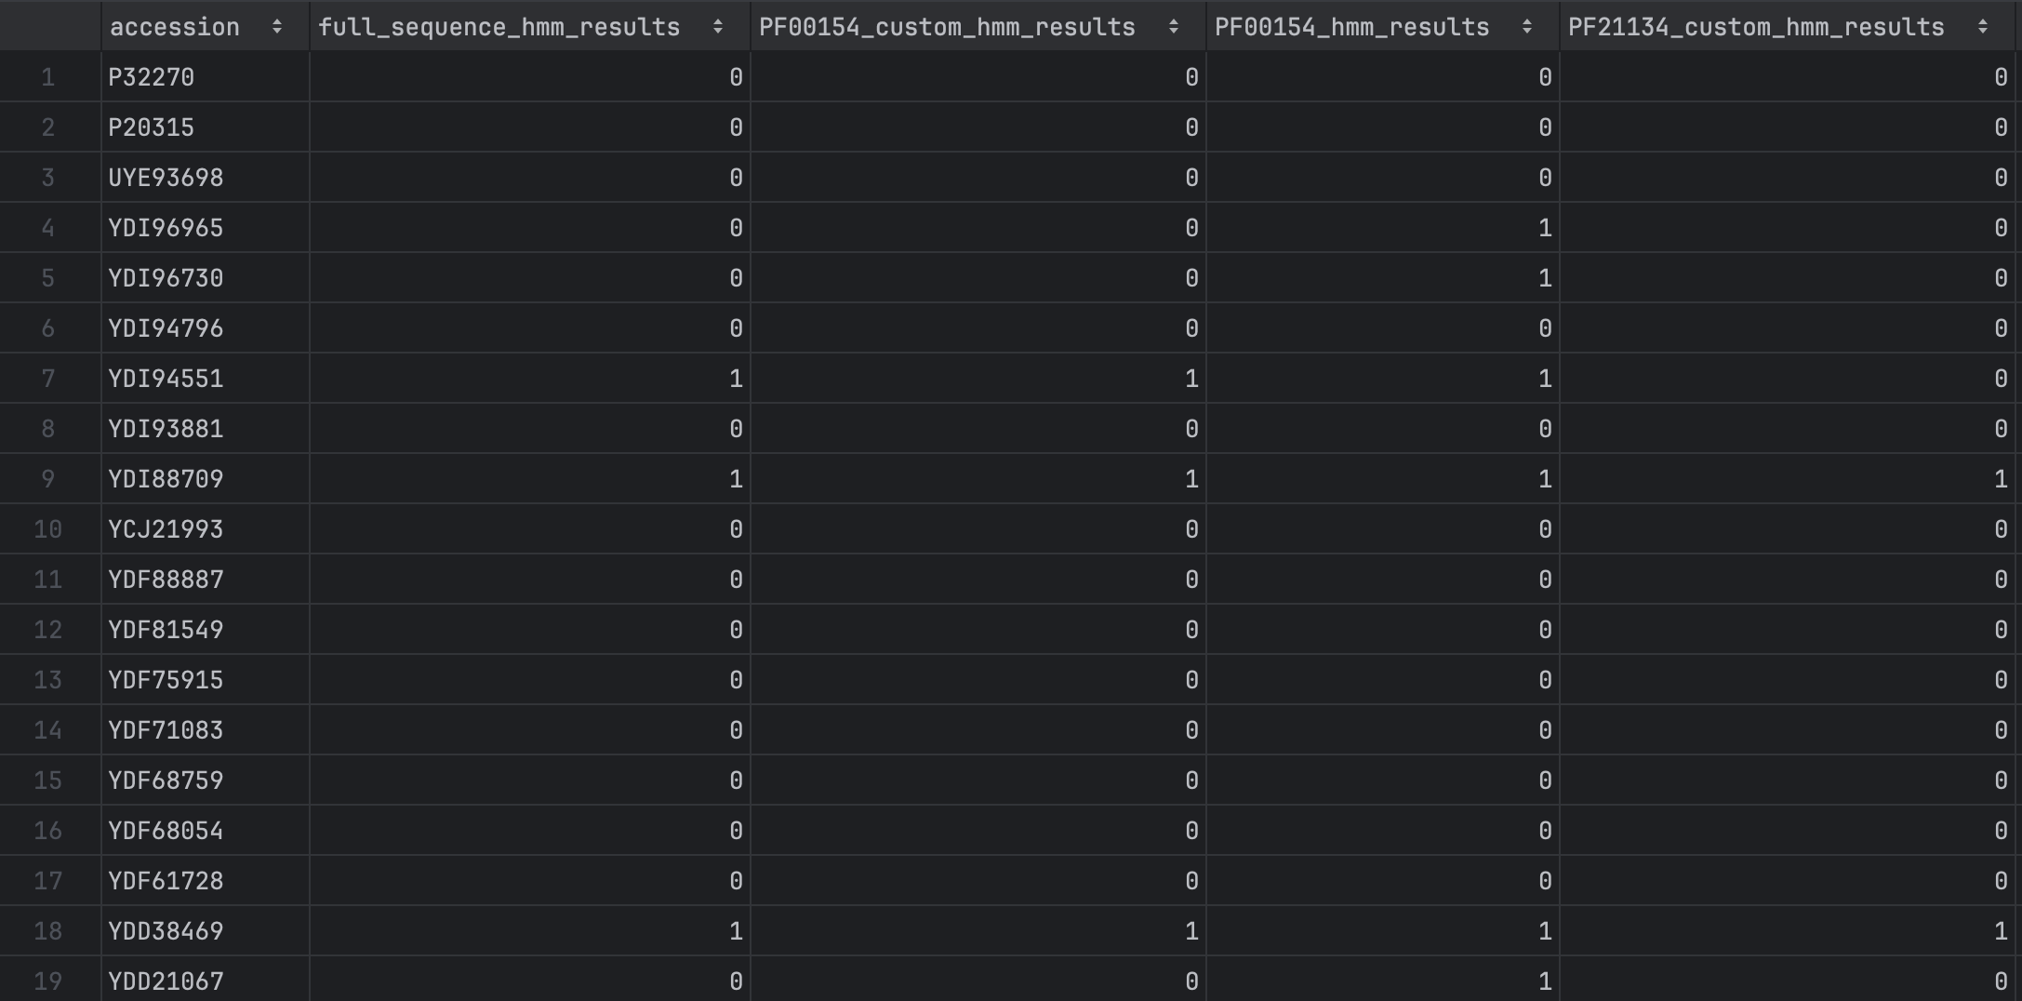
5 HMMs used to search protein database

Slide 3
Phylogenies of seqs ion the database
Constructed full phylogeny.
Phylogeny of seqs identified by each HMMs phylogeny coloured by representation of seqs in the mapped groups

Slide 4
For today and weekend
Look at how to implement seqopt2 and TOMER on identified seqs.
Identify the loops in all the seqs using regex/fuzzy string match. To add to scoring system

