Slide 1
WEEK 5

Slide 2
Thermal prediction
Sandboxed seq2topt. Performs poorly on cold adapted proteins, due to lack of psychrophiles in training data.
Found another potential tool online, however replicating their metholodogy is complicated.
Potentially build my own model, however should look to include data specifically from cold adapted proteins

Slide 3
String matches
Walker A and Walker B added to the scoring system. Regex of the motif used to scan database.
In the process od adding dna binding loops

Slide 4
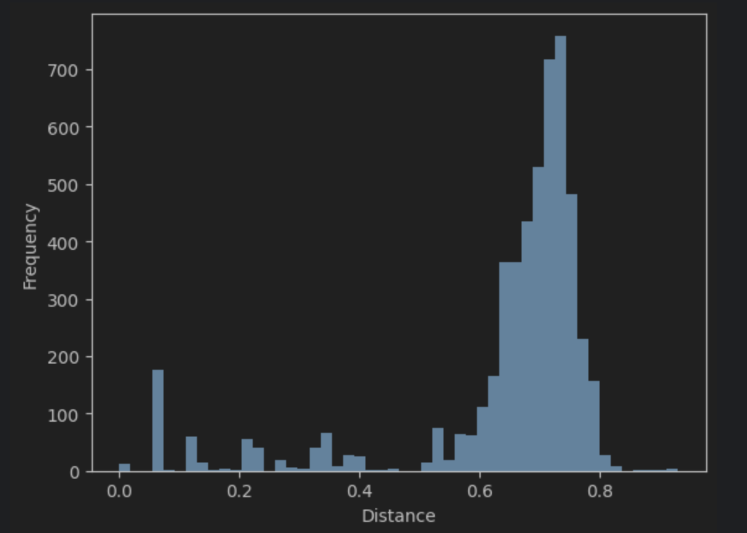
Distance matrix

Slide 5
Next steps
Alignments of best scoring accessions. Plot phylogenies to identify closest seqs to

