Slide 1

Computational discovery of cold-adapted UvsX orthologs for Ambient temperature RPA
JAIME DUARTE-NIEMEN
Matt Higgins
MSc Bioinformatics

Slide 2
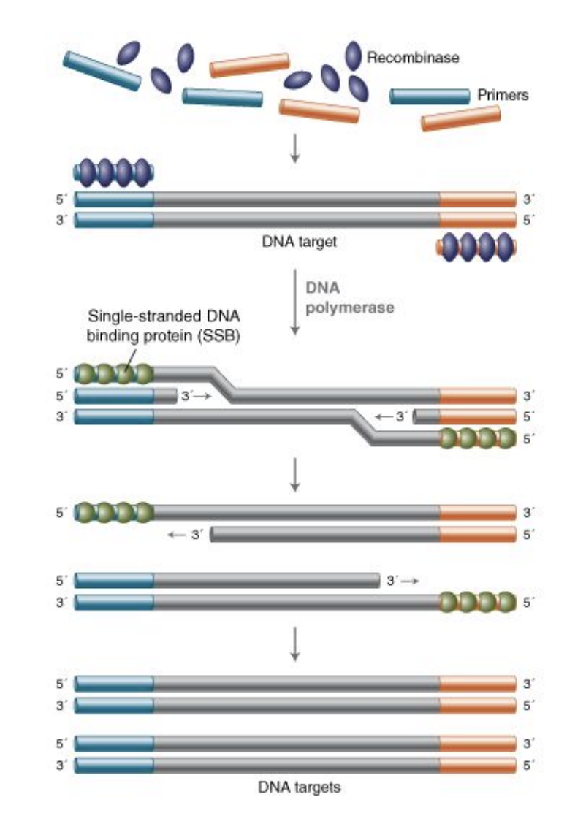
Background
Why RPA? Recombinase Polymerase Amplification (RPA) is a rapid, highly sensitive DNA amplification method that operates at low temperatures (37–42°C), making it a promising platform for point-of-care and field-based molecular diagnostics.
Why UvsX? UvsX is the recombinase that initiates DNA amplification by locating target sequences and enabling primer binding to double-stranded DNA.
Role of UvsX in RPA
UvsX binds primers to form a nucleoprotein filament.
Filament searches for homologous DNA within the target sequence.
UvsX promotes strand invasion, opening the DNA duplex.
Primer anneals to the complementary target strand.
Polymerase extends the primer, initiating DNA amplification.
[1]
Figure 1. RPA diagram
Notes:
RPA could revolutionise DNA diagnostics.
Untrained personnel would be able to use RPA to amplify and detect the presence of DNA in the most remote or populated places in the world. Without the need of expensive equipment or thermocycling.
UvsX comes from a phage. RPA is adapted version of how viruses reproduce. We wanted to look to see if we could identify UvsX ortholog from a psychrophilic phage. Remove the need for heating entirely.

Slide 3
Project Rationale
Project rationale: RPA performance is limited at ambient temperatures
Cold-adapted enzymes may improve low-temperature DNA amplification
Objective:
Identify and characterise cold-adapted UvsX orthologs
Aims:
Identify UvsX orthologs from public databases
In silico screening of candidates (HMMs, Seq2Topt, TMP)
Molecular dynamics evaluation of flexibility and stability
Figure 1. RPA diagram [1]
Notes:
Identifying cold-adapted UvsX orthologs may improve RPA performance at lower temperatures, expanding its use in resource-limited and environmentally challenging settings.
In silico screening, exploring tools available online, developed an agentic tool for literature searching
Molecular dynamics using predicted structure to understand protein behaviour at different temperatures.

Slide 4
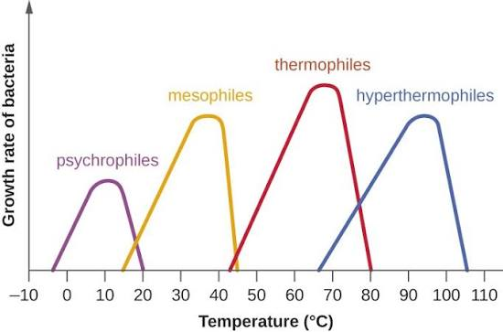
GOLD STANDARDS
Gold-standard UvsX proteins were selected via literature review of wet-lab validated enzymes. Proteins with experimentally confirmed activity, structures and characterised thermal properties.
Why these proteins?
Represent a spectrum of thermal adaptations (cold → moderate → hot).
Provide experimentally characterised reference points for validating computational analyses.
Enable identification of sequence and structural features associated with recombinase activity.
1) T4 UvsX
2) 7Z3M (Thermophilic phage)
3) 9GBG (Psychrophilic phage)
[2]
Figure 2. Thermal adaptation temperature ranges
Notes:
Mention what the temperature ranges are for mesophiles, psychrophiles and thermophiles.
Why RecA wasn’t included as a gold standard. – Could bias results away from phage systems, which are adapted to more rapid replication cycles seen in viruses. ATP kinetics are slightly different and UvsX requires fewer accessory proteins and functions as part of a simpler pathway, making it ideal for biotechnological applications

Slide 5
Database curation
Query search NCBI and UNIPROT for ‘uvsx’ or ‘recA’ or ‘recombinase’ and filtering only results from viruses.
Stringent layers to refine potential candidates.
Query Search
~25,000
Deduplication
20,550
Filtering
5,159
HMMs
2501
Motif
1498

Slide 6
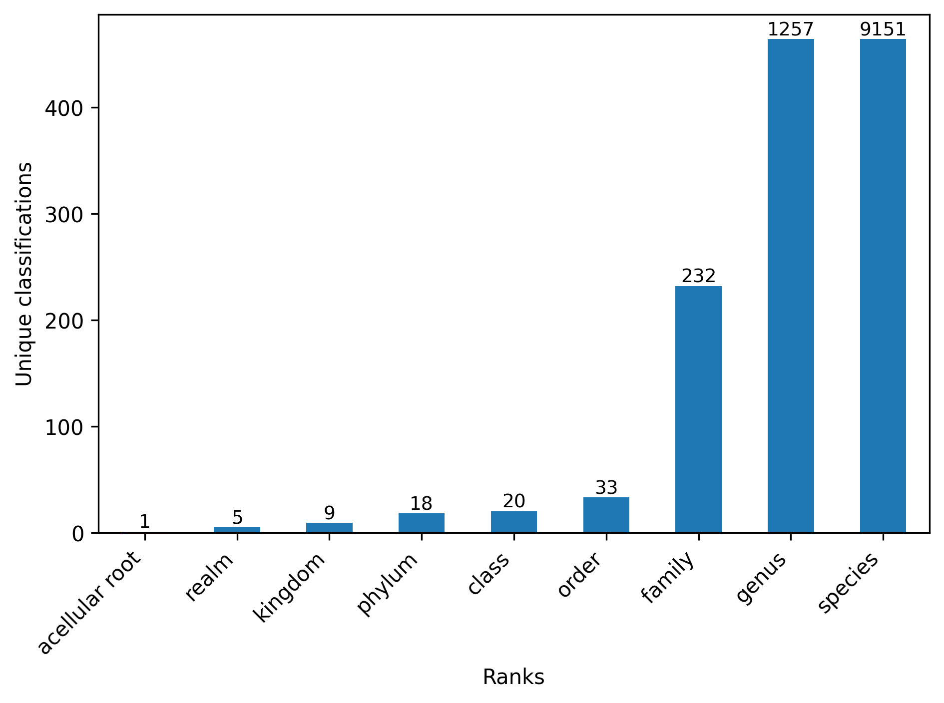
Database curation
There were many duplicates between Uniprot and NCBI. The cleaning step removed any protein sequences that were identical to a different accession, which were of the same species. This left me with 20,550 accessions.
Query Search
~25,000
Deduplication
20,550
Filtering
5,159
HMMs
2501
Motif
1498
Figure 3. The Number of different phylogenetic ranks

Slide 7
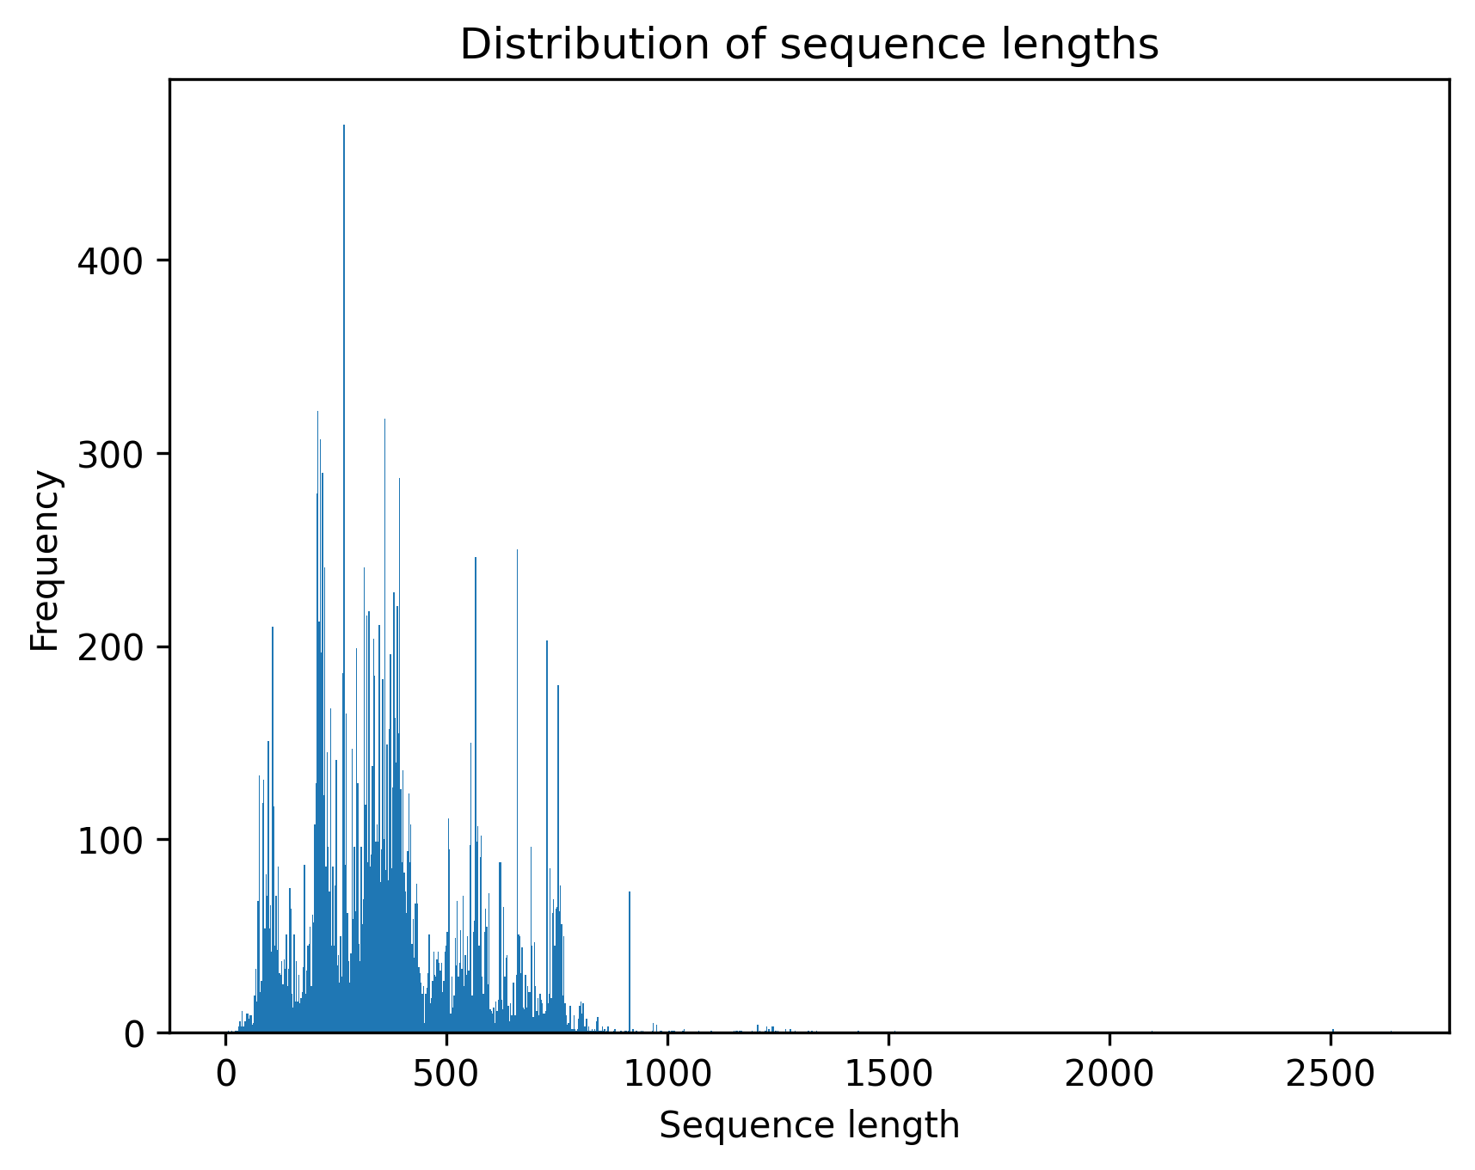
Database curation
Due to some poor annotation there were sequences much shorter or much larger than would be expected of a recombinase protein. These were cut out in the filtering step which produced 5159 sequences.
Sequences were filtered to be longer than 326 and shorter than 426.
Query Search
~25,000
Deduplication
20,550
Filtering
5,159
HMMs
2501
Motif
1498
Figure 4. Distribution of sequence lengths before filtering

Slide 8
Database curation
Hidden Markov models were created from alignments of the gold standards (HMMR3). Aswell as a PFAM hmm profile of N terminal domain which encompasses the ATP binding domains and ssDNA binding site. [3]
Query Search
~25,000
Deduplication
20,550
Filtering
5,159
HMMs
2501
Motif
1498
Notes:
HMMs were used to assess whether candidate sequences fit the overall recombinase family profile based on a probabilistic model derived from multiple sequence alignments. Unlike pairwise alignment methods, HMMs capture position-specific conservation patterns, allowing detection of distant homologs and divergent members of the family.
My HMM profiles tell me how likely the proteins in my database would be produced by the hidden states encoded in the alignment used to create the profile.
Amino acids are observed states and the hidden states are the match, insert, and delete states that generated them (from the alignment).

Slide 9
Database curation
Walker A: [GA]....[GF]K[TS]
Binds ATP
Walker B: hhhhD
h = hydrophobic residue
Enables ATP hydrolysis
Query Search
~25,000
Deduplication
20,550
Filtering
5,159
HMMs
2501
Motif
1498
Figure 5. Alignment of the gold standards
Notes:
Walker a and b are conserved sequence motifs.
This results in a scoring matrix for my filtered database. I went to the downstream analysis that hit for every metric. HMMs and motifs.
Filtered in this way as a purely alignment / distance based method wouldn’t account for convergence.
This method ensures the proteins have the correct domains to behave as a recombinase as well as fitting the statistical profile of my gold standards.

Slide 10
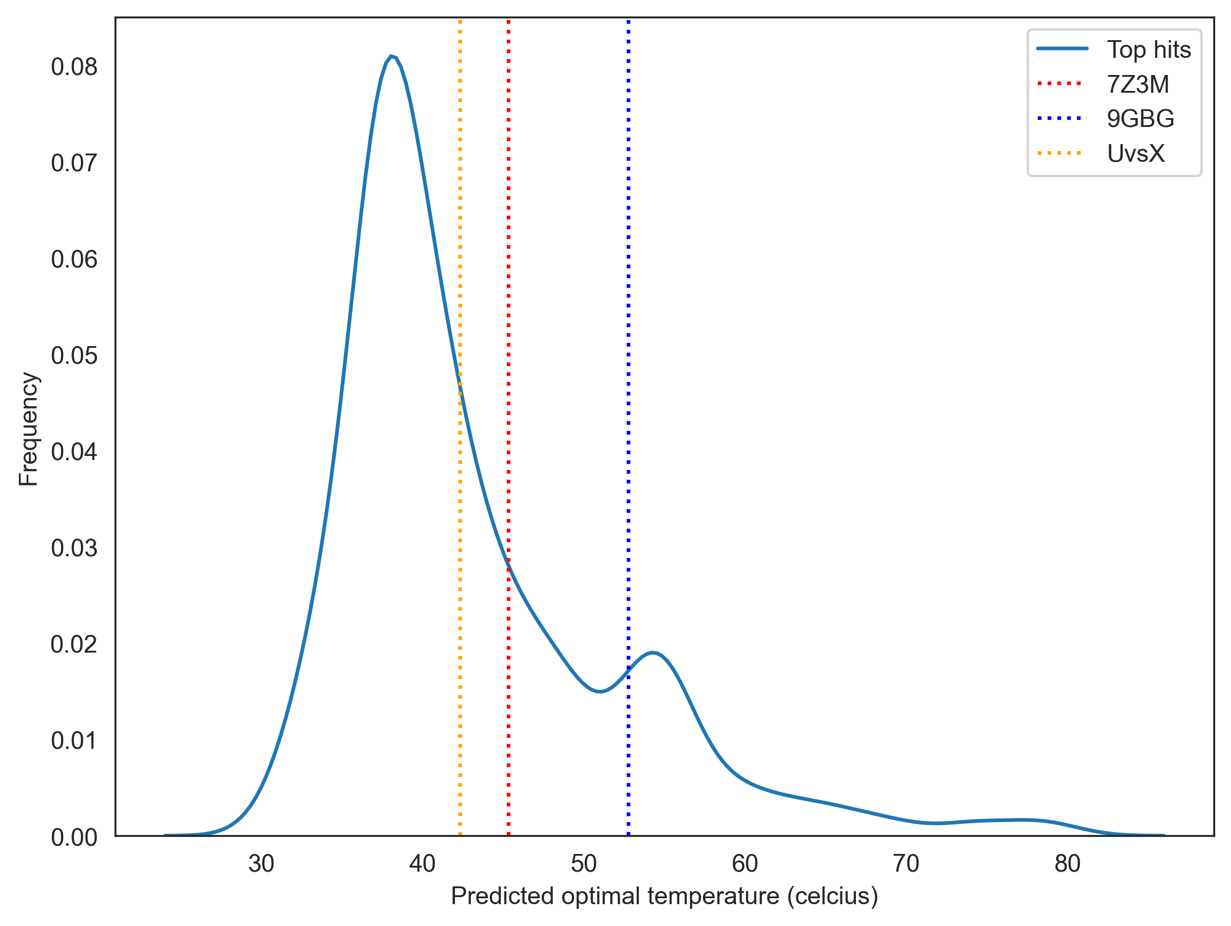
Seq2Topt prediction
Seq2Topt is a deep learning model that predicts enzyme optimal temperature (Topt) ab initio.
Seq2Topt showed variable predictive accuracy and limited biological interpretability. (RMSE= 12.26◦C and R2= 0.57)
Notably, predictions did not consistently align with known ecological data:
Psychrophilic 9GBG predicted at higher Topt (52.7°C) than thermophilic 7Z3M (45.3°C)
This contradicts experimental isolation data for 9GBG from near-freezing deep-sea environments (~0.4°C)
[4]
Figure 6. Distribution of Seq2Topt optimal temperature predictions
Notes:
The model was mostly trained on thermophilic proteins and so may bias results.
Due to poor performance of Seq2topt wanted another method to make predictions of thermal adaptation.

Slide 11
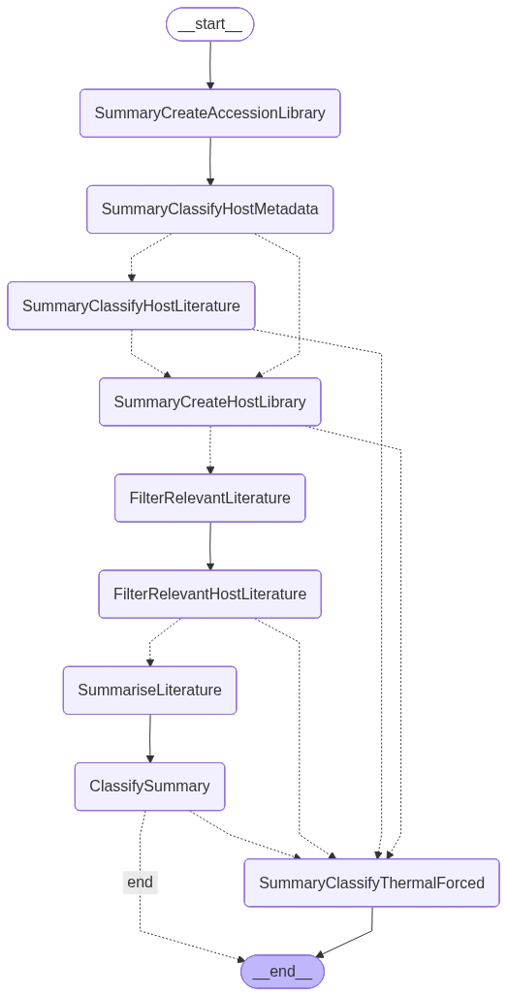
Agentic literature search
Summary Graph
Metadata may contain implicit information about thermal adaptation. (e.g. sampled from hydrothermal vent, deep snow ice etc.)
Literature may contain implicit or explicit information about thermal adaptation. (e.g. studies on an organisms activity at different temperatures)
Can an Agentic LLM system be used to make accurate classifications of thermal adaptation from literature and metadata.
Created a test dataset, and trialled different versions to optimize for classification accuracy.
Seq2opt / TMP boxplot
Figure 9. Decision graph for TMP Summary

Slide 12
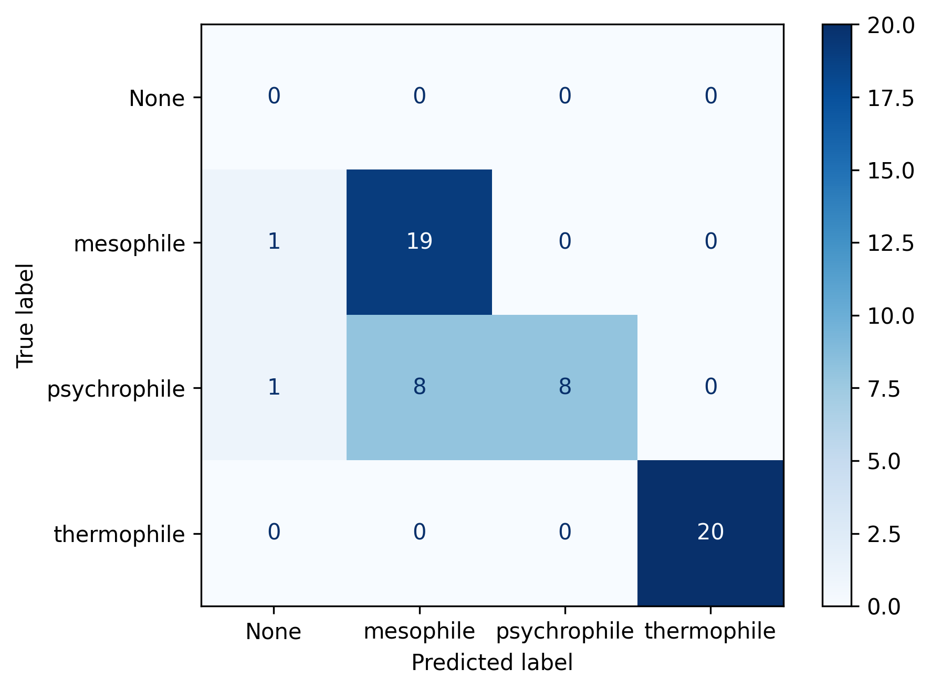
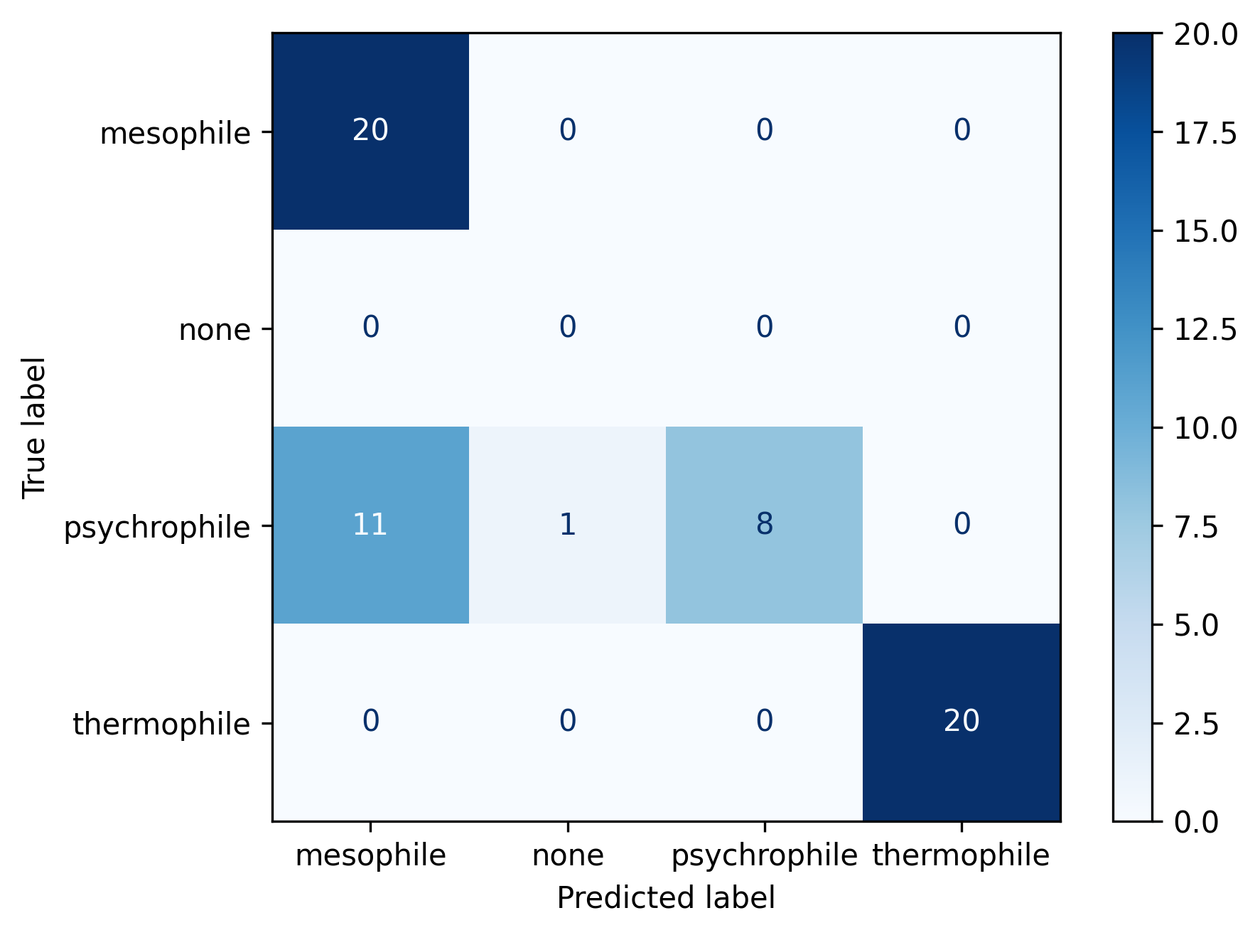
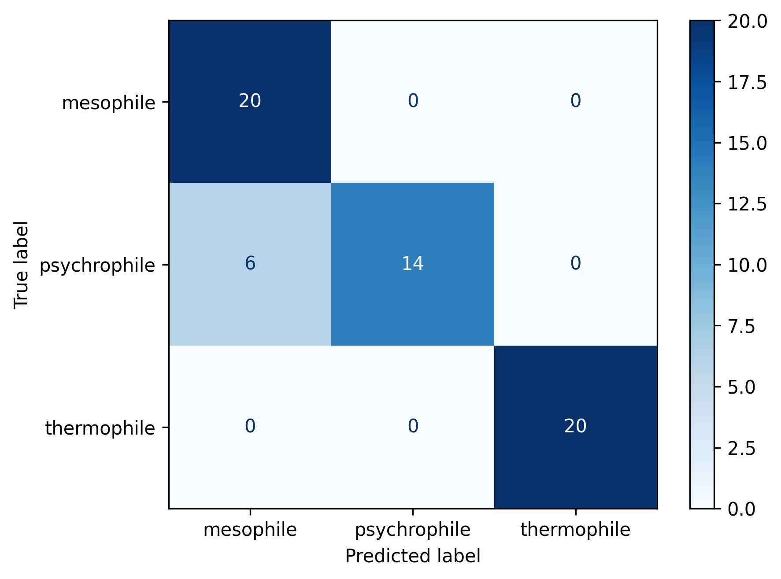
FAST
DEMOCRATIC
SUMMARY
Duration: 74 minutes
Duration: 158 minutes
Duration: 210 minutes
Figure 8. Confusion matrices of the classification results of the test data
Notes:
Fix over lapping labels

Slide 13
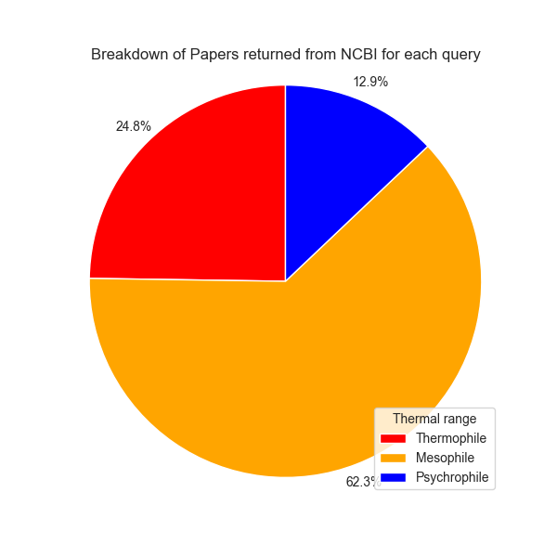
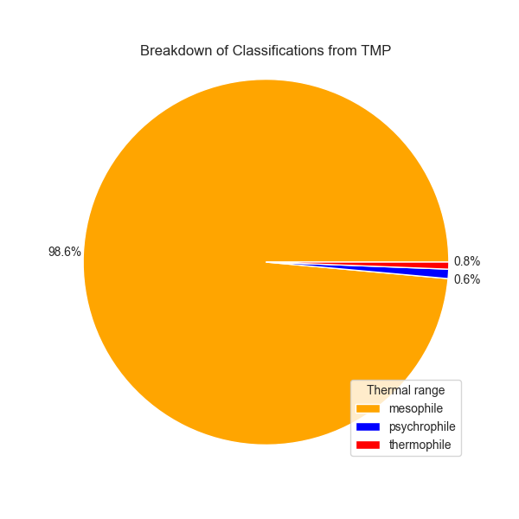
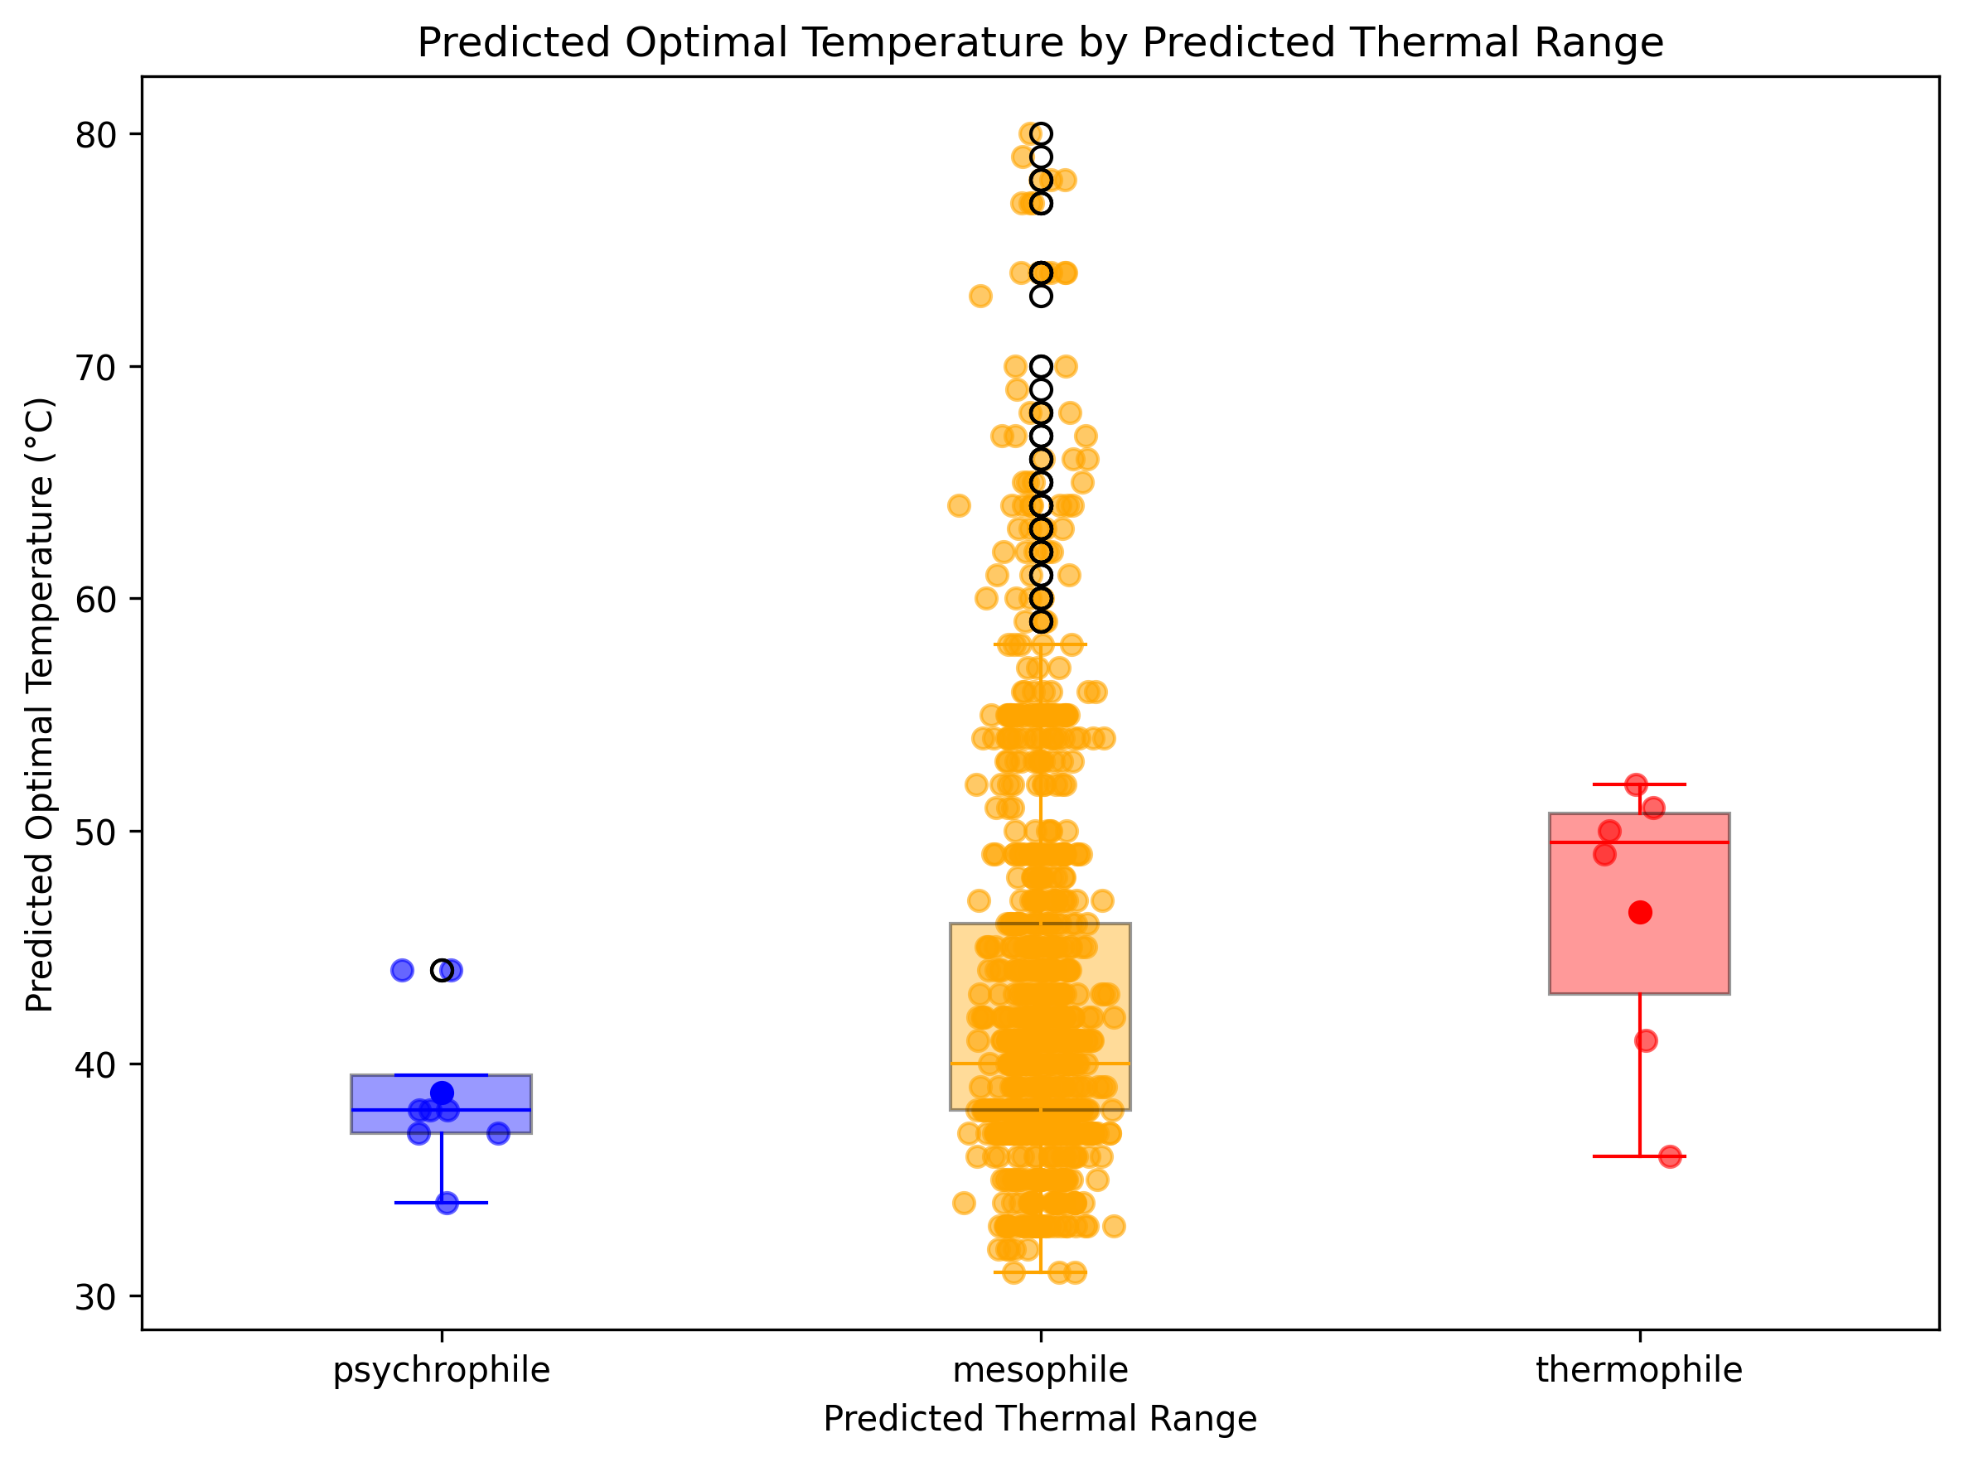
Agentic literature search
Ran TMP for all accessions in my top hits database.
Identified 6 Psychrophiles.
When plotted with the SEQ2TOPT prediction a divergence begins to emerge.
Figure 10. Number of results on NCBI
Figure 11. Sum of each classification from TMP
Seq2opt / TMP boxplot
Figure 12. Seq2Topt predictions for TMP predictions
Notes:
An underlying trend begins to emerge with both tools used in tandem

Slide 14
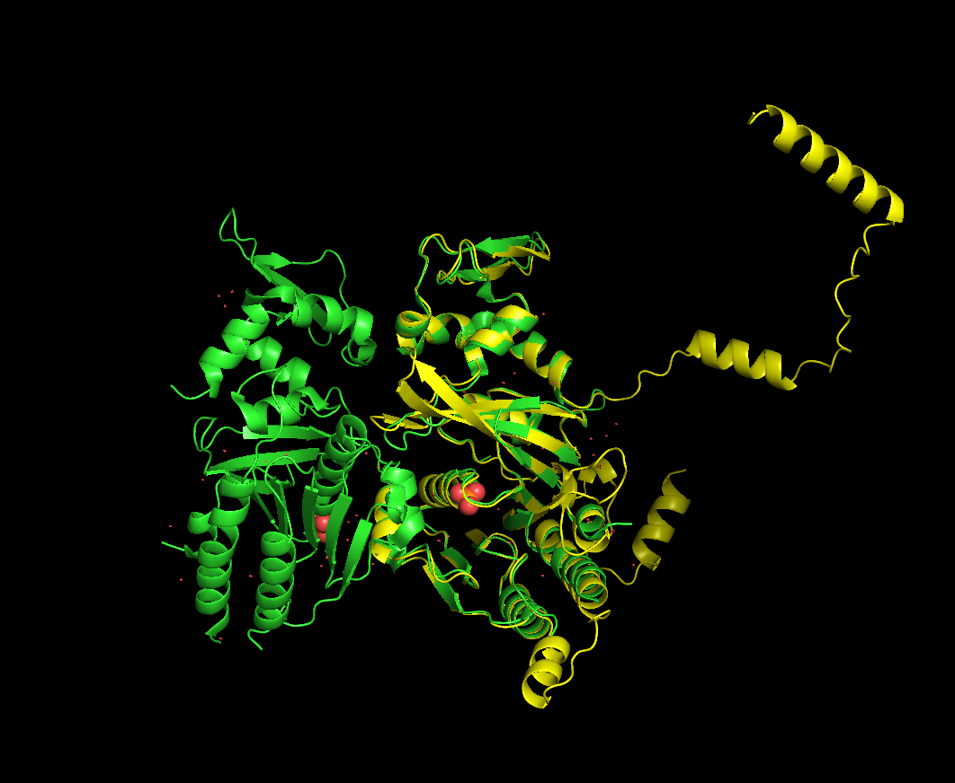
Structural modelling
Molecular Dynamics simulations require a 3D structure.
Evaluated Boltz and Alphafold structures. Compared alignments to crystal structure.
Found that Alphafold had much greater alignment with the lab validated crystal structures.
Used Alphafold structures for Molecular dynamics simulations
[5][6]
UvsX crystal structure (green) aligned with the alphafold UvsX prediction (yellow)
Notes:
Start with Why we are doing structural modelling
Computational method is much cheaper. Can we understand differences in protein structure and temperatures. Developing classifier

Slide 15
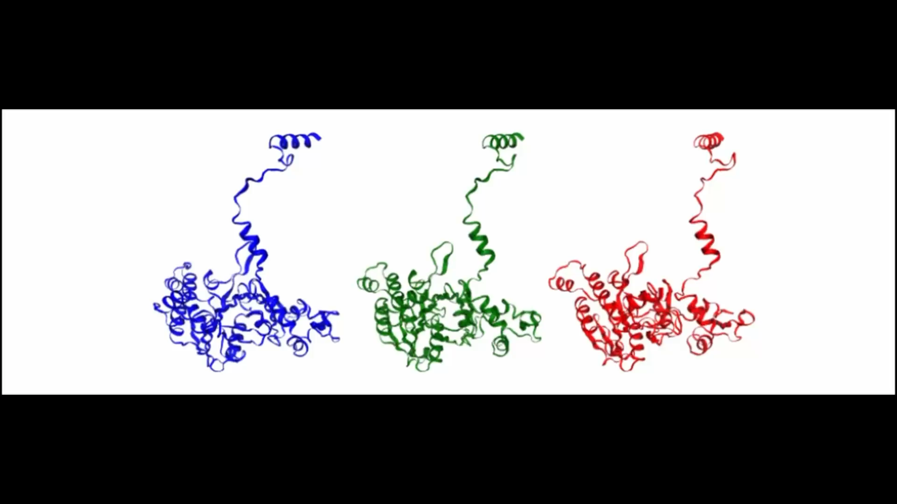
Molecular dynamics
Molecular dynamics simulations performed using GROMACS
Circumvents expensive, labour intensive and timely wet-lab experimentation
Candidate top hits, gold standards (crystal & predicted) simulated across three temperatures:
Cold (288k / 15ºc)
Moderate (310k / 37ºc)
Hot (338k / 65ºc)
Allows direct comparison of:
Structural stability
Flexibility dynamics
Temperature-dependent conformational changes
Still ongoing…
[7]

Slide 16
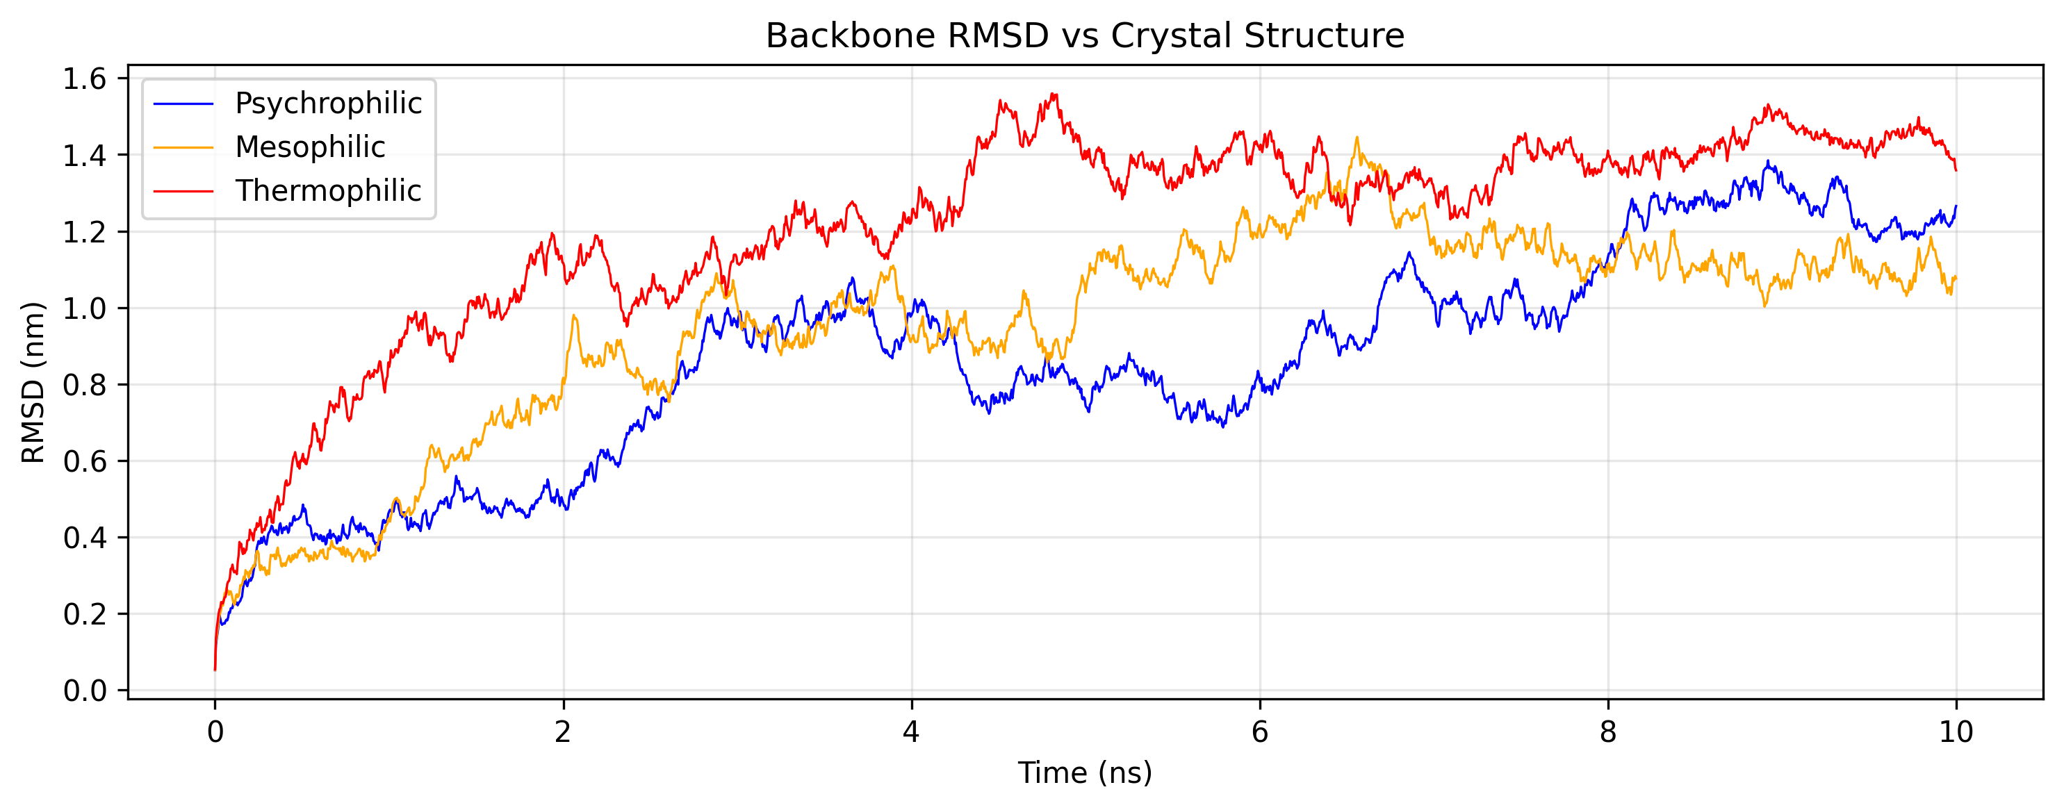
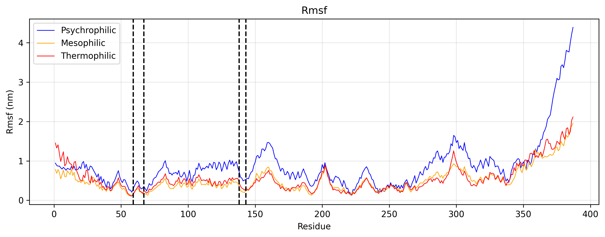
Molecular dynamics Ortholog Results
From the database an ortholog has been identified that demonstrates behavior analogous to what you would expect from a psychrophilic protein.
RMSD is increased under thermophilic conditions (1.218 nm (12.2 Å) compared with psychrophilic conditions (0.864 nm (8.6 Å) (upper). Alluding to dentaturing under increased temperatures
The RMSF plot (lower), key to understanding flexibility of the protein, reflects what you would expect from a psychrophilic protein. Mean of 0.879 nm in the psychrophilic condition.
Notes:
Psychrophilic proteins are more flexible mainly because evolution has tuned them to keep high catalytic activity at low temperatures, where chemical reactions slow down dramatically. Flexibility is one of the most effective ways to compensate for that slowdown—but it comes with trade-offs.

Slide 17
Future work
Run Crystal structures through molecular dynamics pipeline to analyse behavior at different temperatures.
Add API LLM call ability to TMP agentic classifier software
Notes:
Condense bothfuture work slides.

Slide 18
Acknowledgements
Thank you to Matt for being an extremely helpful supervisor for this project
Thanks to Emanuel for going through all of this with me.

Slide 19
References
[1] Li, J. and Macdonald, J., 2015. Advances in isothermal amplification: novel strategies inspired by biological processes. Biosensors and Bioelectronics, 64, pp.196-211.
[2] Tarrant, E., Cormack, I.G., Hunter, C.E., Werbowy, O., Dorawa, S., Wang, L., Steen, I.H., Sandaa, R.A., Guðmundsdóttir, E.E., Ketelsen-Striberny, B. and Kaczorowska, A.K., 2026. Structure, function, and applications of two novel phage recombinases from extreme environments. Nucleic acids research, 54(4), p.gkag069.
[3] Eddy, S.R., 2011. Accelerated profile HMM searches. PLoS computational biology, 7(10), p.e1002195.
[4] Qiu, S., Hu, B., Zhao, J., Xu, W. and Yang, A., 2025. Seq2Topt: a sequence-based deep learning predictor of enzyme optimal temperature. Briefings in Bioinformatics, 26(2), p.bbaf114.
[5] Passaro, S., Corso, G., Wohlwend, J., Reveiz, M., Thaler, S., Somnath, V.R., Getz, N., Portnoi, T., Roy, J., Stark, H. and Kwabi-Addo, D., 2025. Boltz-2: Towards accurate and efficient binding affinity prediction. BioRxiv.
[6] Abramson, J., Adler, J., Dunger, J., Evans, R., Green, T., Pritzel, A., Ronneberger, O., Willmore, L., Ballard, A.J., Bambrick, J. and Bodenstein, S.W., 2024. Accurate structure prediction of biomolecular interactions with AlphaFold 3. Nature, 630(8016), pp.493-500.
[7] Van Der Spoel, D., Lindahl, E., Hess, B., Groenhof, G., Mark, A.E. and Berendsen, H.J., 2005. GROMACS: fast, flexible, and free. Journal of computational chemistry, 26(16), pp.1701-1718.

Slide 20
Thank you for listening
Questions?

