Slide 1
Week 1
Mining Arctic Phages to Build The Next
Generation of NAAT-based Diagnostics

Slide 2
Phases
Phase 1: Literature review
Phase 2: Identify candidate orthologs
Phase 3: Filter candidate orthologs
Phase 4: Classify thermal ranges of orthologs.

Slide 3
Phase 1
A review of the literature is needed to:
Understand the biological system better
Find tried and tested methods of discovery that I can base my methodology on.
Identify potential markers to find orthologs.
Useful databases and tools to make the best use of the search space avaliable

Slide 4
Phase 2
Applicable methodologies applied to databases will provide a large sample of sequences
BLAST, Kmer searching, marker searching, orthofinder and others will be used to get a large initial pool of potential candidates.
Databases such as RefSeq, NCBI, Uniprot and PhageScope.

Slide 5
Phase 3:
Scrutiny of the initial candidate list to filter out low likelihood candidates.
Could potentially skip this step if unfiltered candidates does not prove to be a large burden on computation.

Slide 6
Phase 4:
Classify thermal ranges of candidates to identify most suitable and active candidates at the desired temp range
Computational methods will be used.
Further review of the literature will be done to find the best methods for this. (Molecular dynamics and others)
Structural comparisons, molecular dynamic simulation and ML models are potential methods that could be used.

Slide 7
Market and application importance
NAAT is used in research, clinical diagnostics, agriculture, epidemiology and many other fields.
Isothermal methods have built on traditional pcr. In which heating is not required to amplify large quantities of DNA
Ambient NAAT circumvent the necessity for trained personnel and expensive equipment to perform a wide range of DNA amplification protocols in resource limited settings.

Slide 8
Key developments to achieve
balancing the requirements for improved speed, lower reaction volumes, reduced electricity requirements, and yet exhibiting high sensitivity and robustness
employing higher multiplexed ability by allowing multiple (e.g. more than 5) reactions in one tube
being more amenable to be integrated with other processes, such as sample preparation, purification and detection, which paves the way for a fully automated system for POC application
Notes:
https://www.sciencedirect.com/science/article/pii/S0956566314006654

Slide 9
RPA
A method to amplify targeted section of DNA.
Recombinase proteins form a non specific complex with ssDNA primers to form a complex.
Complex bind to target dsDNA. DNA is stabilised and then a strand displacing polymerase extends the DNA.
uvsX is a recombinase identified, when used in tandem with uvsY and gp32, favourable conditions for RPA can be established.
Incubation temps between 37°C-42°C

Slide 10
Computational discovery of LSRs
Large sample of genomes from NCBI RefSeq database were identified
Clustered at the species level.
Genomes were batched an annotated using prodigal.
Searched for all encoded proteins that contained a Recombinase pfam domain. Genomes with predicted LSR compared to those without.
MGEFinder used to find if MGE boundaries contained an LSR, alluding to Recombinant activity occurring.
These genomes were added to the database.

Slide 11
Adaptations to Durrant et al
UvsX doesn’t work with transposable elements. We wouldn’t be able to use MGEFinder to identify candidates
Specific markers and sequence similarity will be main predictors of potential recombinase activity.
Setting a threshold of similarity will be an important decision.
Alternatively we could first identify promising genomes and allow a larger level of difference.

Slide 12
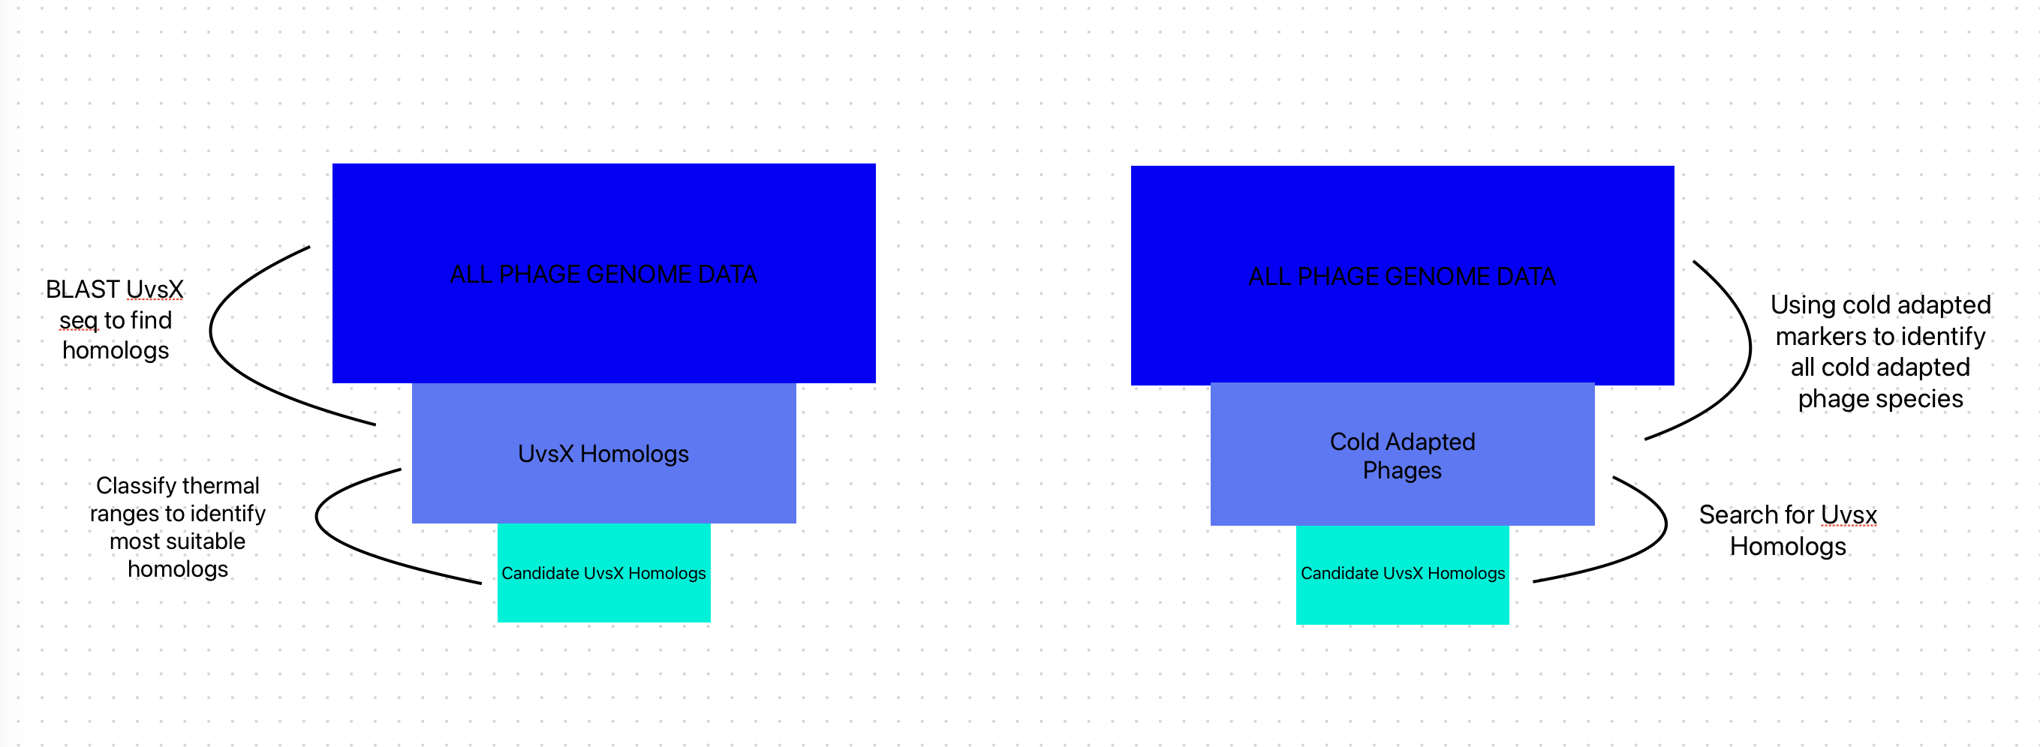
Potential strategies

Slide 13
Cold Enzyme adaptations
Understanding typical adaptions enzymes evolve to withstand activity even in cold temperatures may help identify useful markers we can target during the search phase.
Genome wide markers would help us identify any cold adapted phage.
UvsX specific markers for cold adaptation will reveal potential candidates for high catalytic activity at ambient temperatures

Slide 14
Typical cold adaptations
Enzymes
Orthologs found in mesophiles tend to have high structural and sequence conservation
Main issue is overcoming the exponential decay in chemical reaction rates
Typical markers include; decreased core hydrophobicity, increased surface hydrophobicity and increased surface hydrophilicity.
Appears to be no particular structural or sequence elements that predacity psychrophilicity.
One prevailing hypothesis, is increased flexibility around active sites.
May be more useful to look for genome wide adaptations to identify potential candidate genomes and then look to identify the prescence of recombinases.
In general there is full conservation between cold and warm adapted enzymes.

Slide 15
Justification for a Scandinavia field Trip
Estimated 200 million tonnes of Bacteriophages on the planet. With an estimate of many ten millions of species on the planet.
On the internet there are 30,000 bacteriophage genomes present (being generous) comprising roughly 14,000 unique species.
A trip to collect polar ice and sequence any bacteriophages could return many novel genome sequences which may not be available online, increasing the search space for uvsX and potential identification of more active variants in lower temperature ranges.

Slide 16
Creating pipeline to identify a wide range of industrially useful cold adapted enzymes
Using the knowledge and methodology to identify cold adapted UvsX
Apply this to find all cold adapted orthologs
Review literature to see which processes possess proteins that could be replaced with cold adapted orthologs.
Do more research into these to develop more useful products.

Slide 17
Questions
Kmer searching. What size K. Protein or DNA seq?
Hidden Markov model. What are the state transitions. Do I look between bases? Observable states are Bases or whether
LOGAN contains reads or full assembled genomes? Does it have metadata such as species?
How can this be adapted for a wide variety of different systems, would it be useful?

