Slide 1
Do We Need to Maintain Our Vehicles?
Linghao Yang

Slide 2

Business Objectives
Data Selection
Modeling
Model Comparison
Feature Importance
Conclusion
Contents

Slide 3

Business Objectives

Slide 4

Business Objectives
Maintenance Flag
Determine whether the car needs to be maintained or not
Reduce the loss caused by not timely maintenance

Slide 5
Data Selection

Slide 6
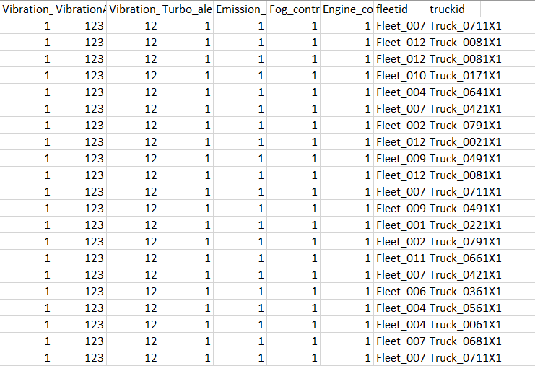
Data Selection
Data Set: fleet_truck.csv
8307 rows and 42 columns
Remove ‘fleetid’ and ‘truckid’
Remove columns with only one value
26 variables left

Slide 7
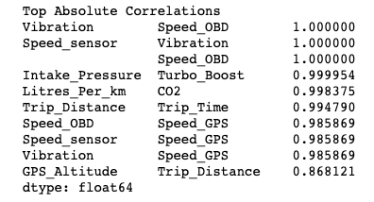
Data Selection
Data Set: fleet_truck.csv
Remove collinear features
threshold = 0.9
Drop 'Vibration', 'Speed_OBD', 'Turbo_Boost', 'CO2', 'Speed_GPS' and 'Trip_Time’
20 variables left

Slide 8
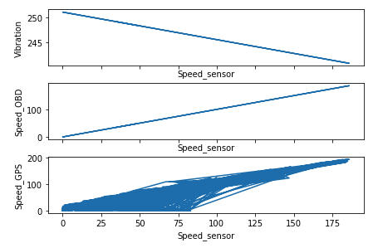
Data Selection
‘Vibration’ , ‘speed_OBD’, ‘speed_sensor’ have perfect linear relationship to each other
‘speed_GPS’ is highly correlated to these three feature..

Slide 9
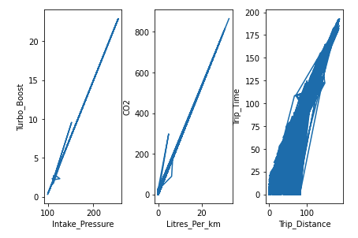
Data Selection
These three pairs of variables are also highly correlated.

Slide 10
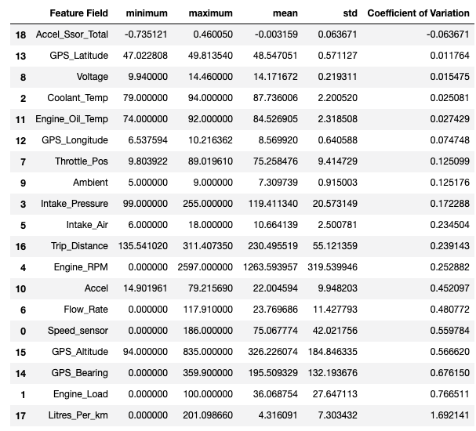
Data Selection
Data Set: fleet_truck.csv
Check coefficient of variation
threshold = 0.1
Drop 'GPS_Latitude', 'Voltage', 'Coolant_Temp', 'Engine_Oil_Temp', 'Accel_Ssor_Total', 'GPS_Longitude’
14 variables left

Slide 11
Data Selection
Data Set: fleet_truck.csv
Remove all rows with missing values
From 8307 rows and 42 columns to 8149 rows and 14 columns
Remaining predictors are: 'Speed_sensor', 'Engine_Load', 'Intake_Pressure', 'Engine_RPM', 'Intake_Air', 'Flow_Rate', 'Throttle_Pos', 'Ambient', 'Accel', 'GPS_Bearing', 'GPS_Altitude', 'Trip_Distance', 'Litres_Per_km'
Response is ‘Maintenance_flag’

Slide 12
Modeling
70% as training data, 30% as testing data

Slide 13
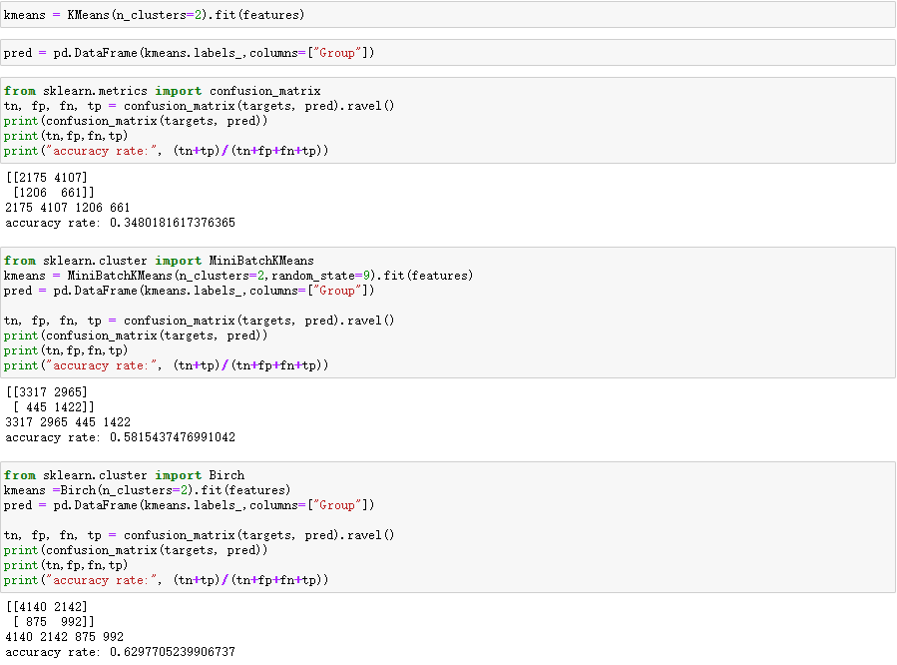
Model 1: Clustering
Three clustering method
cluster into two groups
Low accuracy score
logically not appropriate here

Slide 14
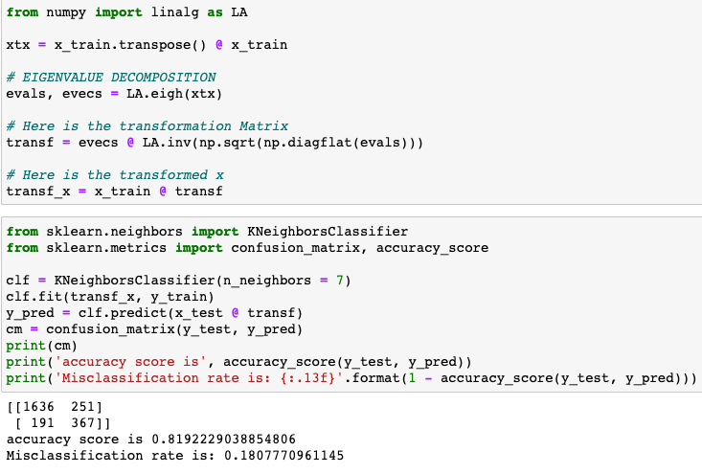
Model 2: Nearest Neighbor
Try number of neighbors from 3 to 10
Choose 7 based on accuracy score

Slide 15
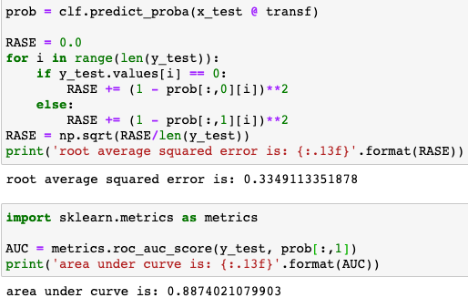
Model 2: Nearest Neighbor
The root average squared error and area under curve are also calculated

Slide 16
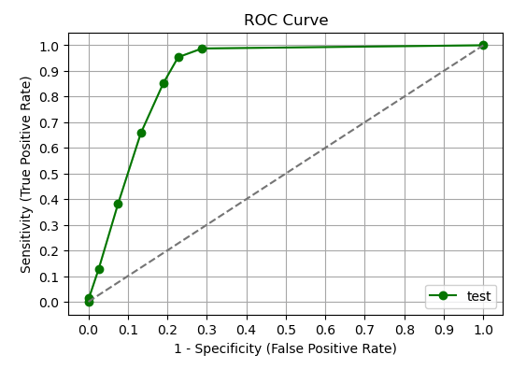
Model 2: Nearest Neighbor

Slide 17
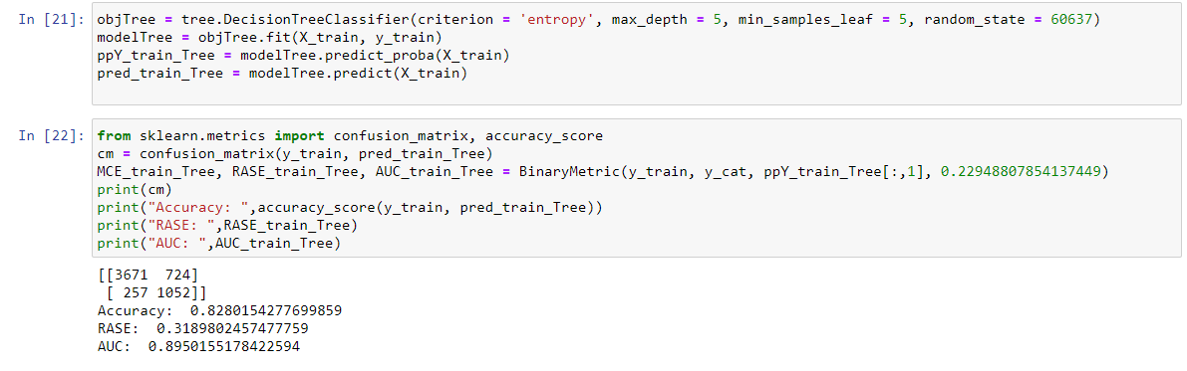
Model 3: Classification
Training

Slide 18
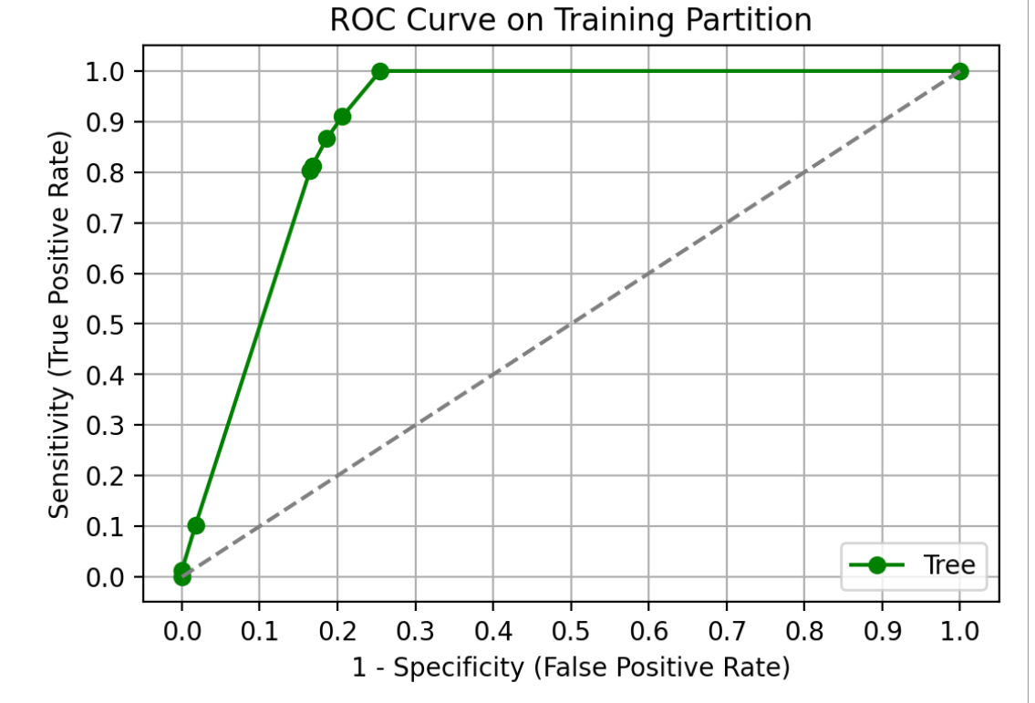
Model 3: Classification
Training

Slide 19
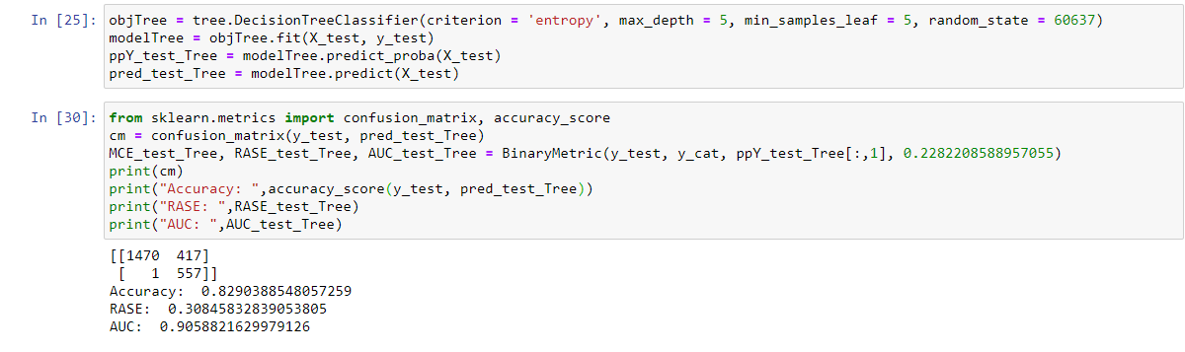
Model 3: Classification
Testing

Slide 20
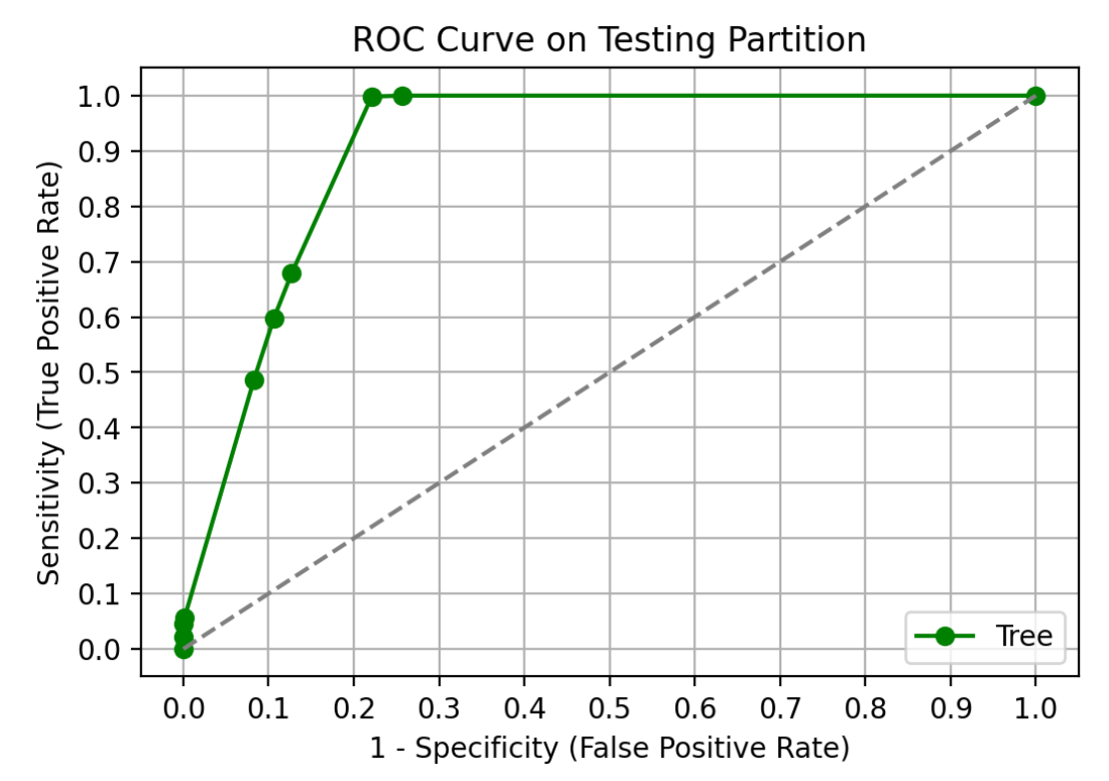
Model 3: Classification
Testing

Slide 21
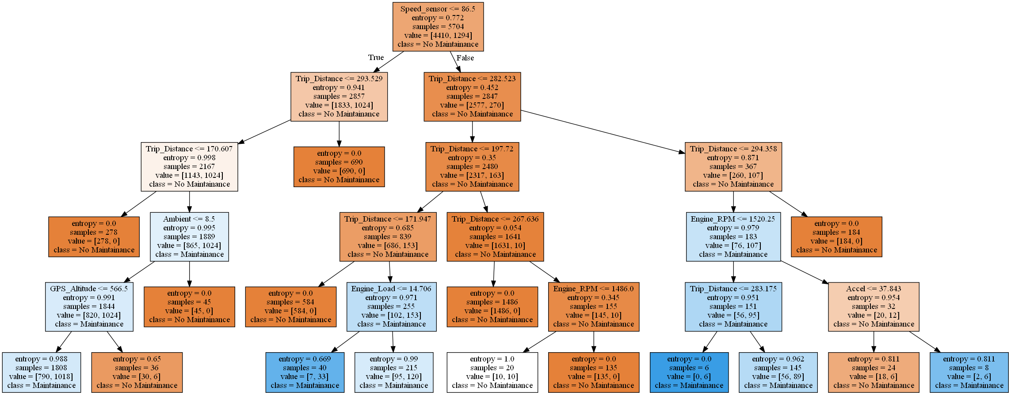
Model 3: Classification

Slide 22
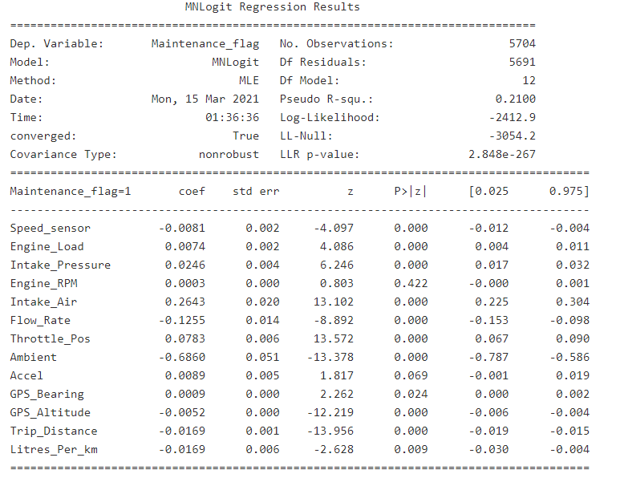
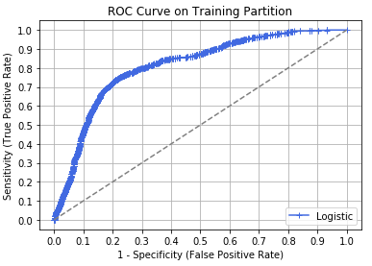
Model 4: Logistic Regression
Metric | Logistic training | Logistic testing
Misclassification Rate | 0.210 | 0.212
Accuracy | 0.790 | 0.788
Root Average Squared Error | 0.371 | 0.370
AUC | 0.810 | 0.820

Slide 23
Feature Importance

Slide 24
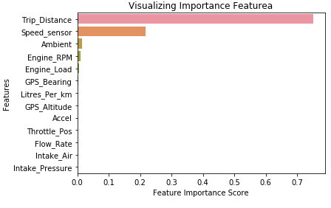
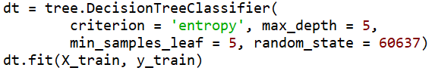
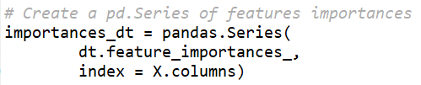
Feature Importance
build the decision tree model and rank the feature importance

Slide 25
Model Comparison

Slide 26
Model Comparison
Metric | Logistic training | Logistic testing | Decision Tree training | Decision tree testing | Nearest Neighbor training | Nearest Neighbor testing
Misclassification Rate | 0.210 | 0.212 | 0.172 | 0.171 | 0.139 | 0.181
Accuracy | 0.790 | 0.788 | 0.828 | 0.829 | 0.861 | 0.819
Root Average Squared Error | 0.371 | 0.370 | 0.319 | 0.308 | 0.297 | 0.335
AUC | 0.810 | 0.820 | 0.895 | 0.906 | 0.931 | 0.887

Slide 27
Conclusion

Slide 28
Conclusion
If it is a single time training exercise, then we should choose the nearest neighbor model
If we will deploy the selected model for future data, then we prefer the Decision Tree model
Maintenance is highly related to Trip distance, speed sensor, and ambient.

Slide 29
THANK YOU!

