Slide 1

Identifying and Resolving Conflicts in Non Functional Requirements specified in Natural Language
Project members: U17CO059 - Jaimin Patel
U18CO112 - Shtakshi Upadhyay
U18CO113 - Shreyash Kadam
U18CO114 - Aditya Kumar
Supervised by Devesh C Jinwala,
Professor, SVNIT, Surat and Adjunct Professor, IIT Jammu, Sardar Vallabhbhai National Institute of Technology Surat
Project Group No. 03

Slide 2
Introduction
In any application, the stakeholders usually focus heavily on Functional Requirements whereas Non-Functional Requirements do not get enough attention. However, for the success of any software application, it is important to have clear and unambiguous Non-Functional Requirements which do not conflict with each other. Non-functional requirements tend to interfere and conflict with each other. The objective of this project is identifying and resolving conflicts among the Non-functional requirements (NFRs).

Slide 3
Motivation
Software Requirements can have a huge impact on success or failure of a system/application.
Conflicting requirements are one of the three main problems in software development in terms of the additional effort or mistakes attributed to them (Curtis, Krasner & Iscoe 1988)[6].
A study conducted by Egyed & Boehm confirm that between 40% and 60% of requirements involved are in conflict, and among them, NFRs involved the greatest conflict [7].
Neglecting NFRs may lead to customer dissatisfaction.
It also increases the time and cost of production.
Case-Study: London Ambulance services(LAS) crisis.

Slide 4
Research Objectives
It is difficult to identify conflicts among NFRs available in natural language
Manual method for conflict identification is tedious, time-consuming and error-prone
Our objective is to create a semi-automated approach for identifying conflicts in NFRs and resolving them
Conflict resolution is mostly an intuitive approach, so our focus is primarily on identifying conflicts
We propose to use word embedding method for conflict identification.

Slide 5
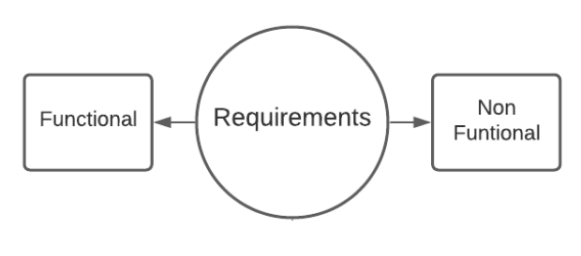
Software Requirements
A functionality or capability required by a user to solve a problem or achieve an objective
The requirements can be obvious or hidden, known or unknown, expected or unexpected from client’s point of view.
Two types of requirements: Functional and Non Functional

Slide 6
Functional Requirements
Functional requirements are features that allow the system to function as it was intended.
Functional requirements are represented in a way where desired output is achieved after the input is operated according to the designed system.
FRs are actually the product features and focuses mainly on the end user.
Specifies what the system should do.
Example of an FR can be - When a user enters OTP while transaction, money should be debited from his/her bank account

Slide 7
Non-functional Requirements
Non-functional requirements specify how the system should perform the required tasks.
They do not interfere with the behavior of an application.
They can be called as quality attributes which focus on user expectation.
Some of the common NFRs which the software developers encounter are:
Security, Usability, Performance, Maintainability, Quality etc.

Slide 8
Conflicts in Non-Functional Requirements
NFRs can be viewed, interpreted, and evaluated differently by different people and different contexts[3]
Different perspectives which are a part of the SDLC intersect and overlap which gives rise to conflicts.[1]
Meaning, achieving one requirement can impact the achievement of another and there can be a negative relationship among two NFRs[2]
Example:
NFR1: A user should be authenticated via OTP before performing any transaction on the database (NFR type: Security)
NFR2: Performing a transaction on the database must be easy for the user and must not involve transition to a different page (NFR Attribute: Usability)

Slide 9
Natural Language Specifications
There exist several methods of writing system requirements, however, natural language specification (NLS) is the most preferred method.
it is intuitive and universally understood by users and stakeholders.
It enlists the requirements using natural language sentences
Requirements may sometimes be written in a manner where distinguishing functional with non-functional requirements is difficult.
Also, the natural language non-functional requirements tend to interfere and conflict with each other, leading to confusion in requirements.

Slide 10
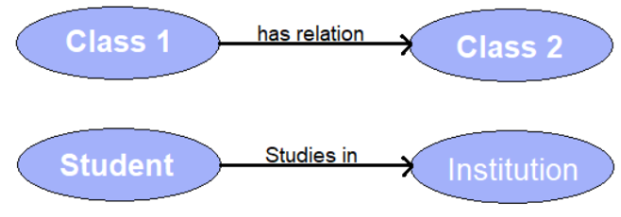
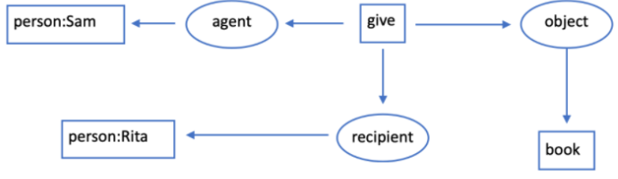
Other Approaches
Ontological approach: In this approach, NFRs are formally specified from available natural language NFRs by means of ontological representation that helps requirements analysts prioritize the NFRs at an early stage of requirements engineering.
Knowledge representation using conceptual graph: Natural language NFRs can be represented in the form of a conceptual graph to have a clear understanding of NFRs, detect ambiguity in NFRs and identify conflicts between two NFRs.

Slide 11
Word Embedding
In natural language processing (NLP), word embedding is a term used for the representation of words for text analysis, typically in the form of a real-valued vector that encodes the meaning of the word such that the words that are closer in the vector space are expected to be similar in meaning.
Conceptually it involves the mathematical embedding from space with many dimensions per word to a continuous vector space with a much lower dimension.

Slide 12
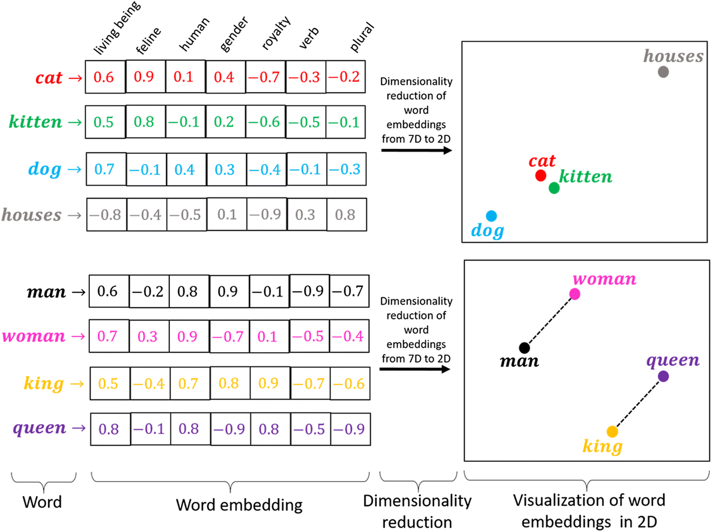

Slide 13
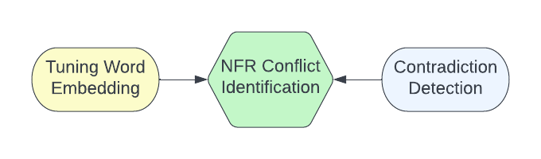
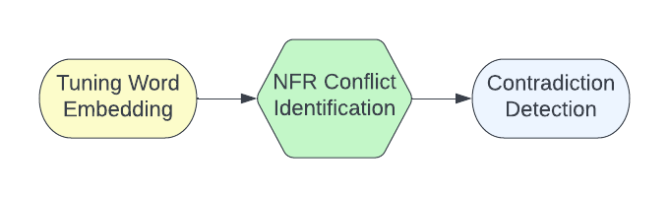
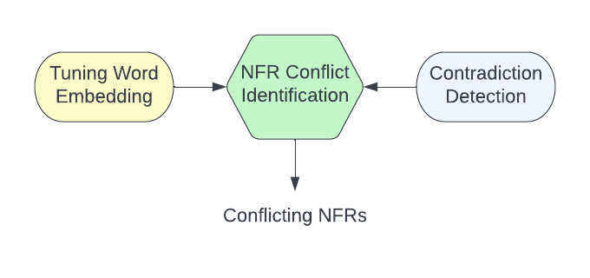
Proposed Framework

Slide 14
Training Word Embedding (Preprocessing)
Dataset
Manually created data from 18 SRS documents of different domains.
Total 626 sentences and 22,220 trigrams were created.
Data preprocessing
Removing stop-words
Removing sentences with length <= 3
Removing special characters and numbers
Convert to lower case
Tri-gram
Example: "the quick red fox jumps over the lazy brown dog"
Here, trigrams are: the quick red, quick red fox, red fox jumps etc.

Slide 15
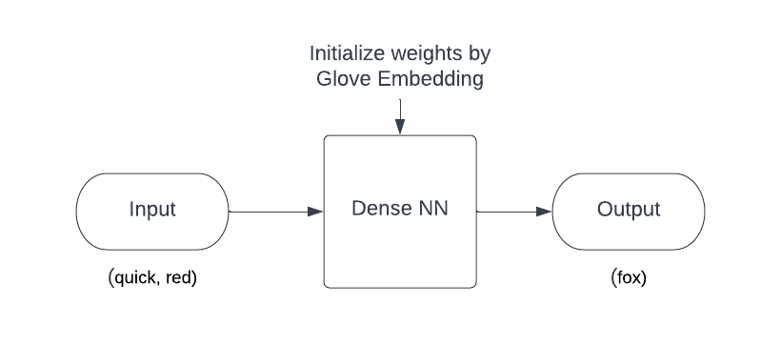
Training Word Embedding (Model)
Its a dummy application created to fine-tune Glove word embeddings.
Input layer has number of neurons equal to the total number of words in Glove Embeddings.
We fetch weights after training the model, which acts as tuned word embedding

Slide 16
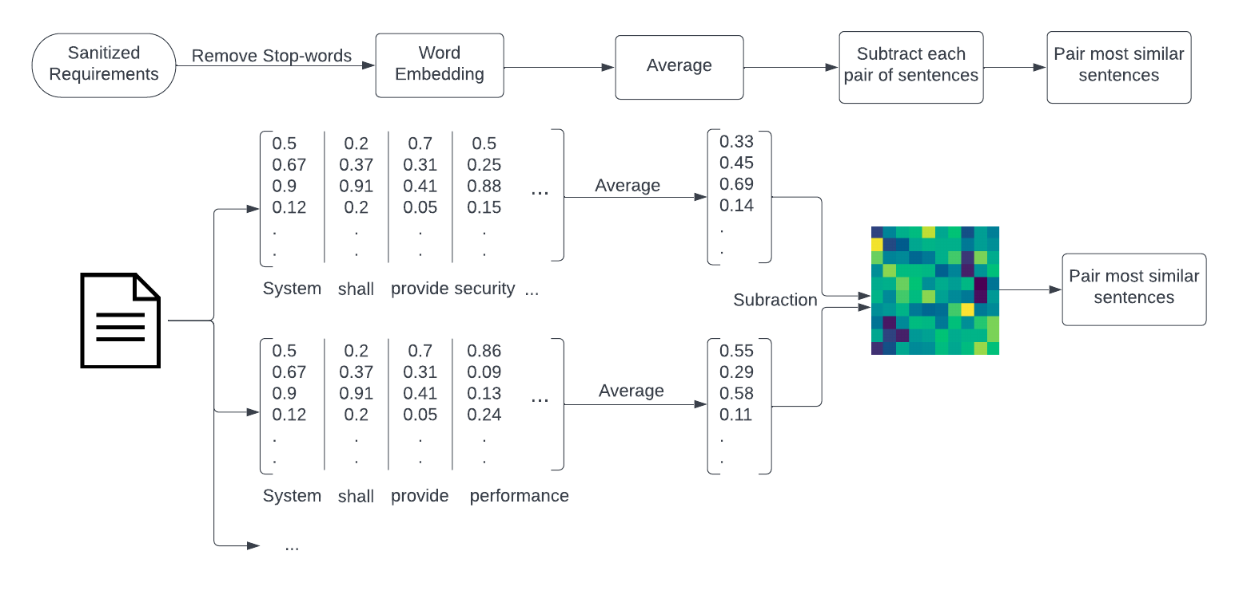
Grouping Similar NFRs

Slide 17
Contradiction Detection
Contradiction detection or conflicting statements detection in text consists of identifying discrepancy, inconsistency in text.
Contradiction can be present due to the presence of:
Negation
Antonyms
Numeric Mismatch
Example: negation in a political debate can be as follows, “I support the new anti-corruption law” and another candidates says that “I do not support the new anti-corruption law”.
Our contradiction detection model is based on [4]
Dataset used for training and testing is SEMEVAL.
Test accuracy = 92.29%

Slide 18
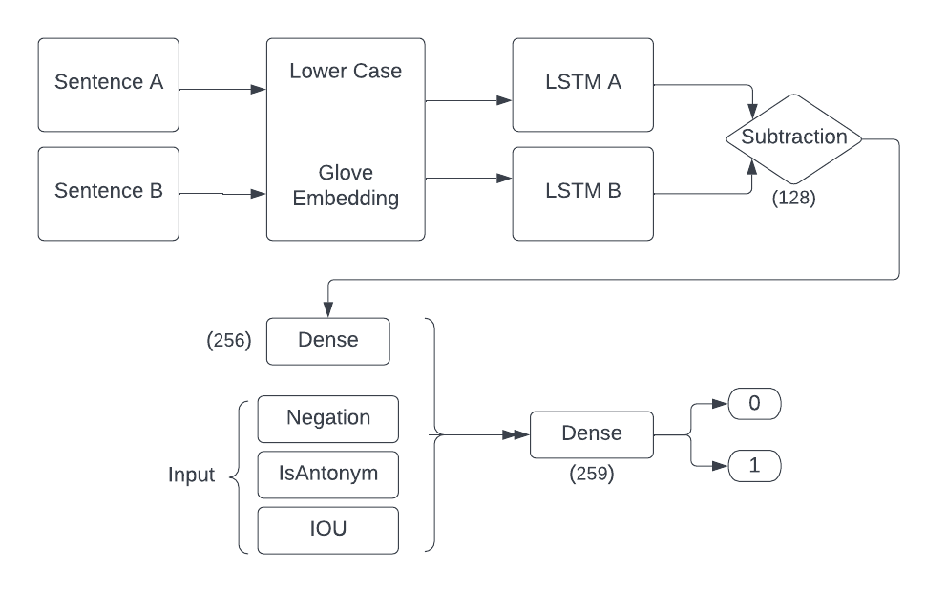
Contradiction Detection

Slide 19
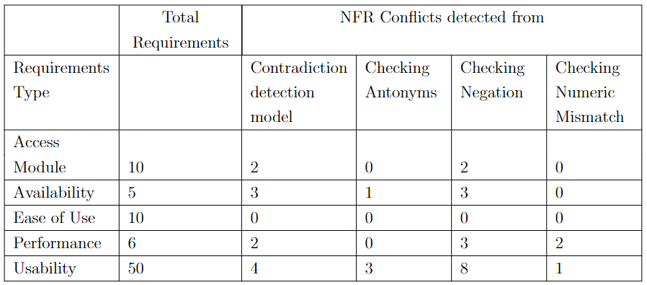
Experiment and Results obtained

Slide 20
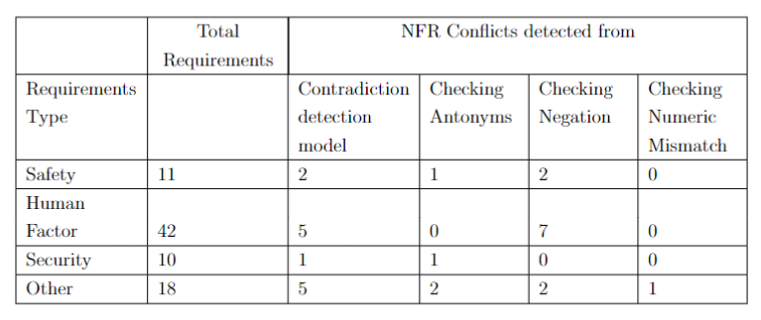
Experiment and Results obtained

Slide 21
Future Work
Precision of this approach can be increased by tuning the word embedding with a larger dataset, by taking content of further more number of SRS documents.
Increased data can provide more contextual information for tuning word embedding which can result in better grouping of similar pair of sentences.
A larger and rich set of antonyms can help to automatically identify conflicts among the similar pair of sentences (once grouped together).
Manual analysis of conflicts is needed to be done by an expert so as to compare our result with the actual conflicts.

Slide 22
References
[1] V. Sadana and X. F. Liu, “Analysis of Conflicts among Non-Functional Requirements Using Integrated Analysis of Functional and Non-Functional Requirements,” in 31st Annual International Computer Software and Applications Conference (COMPSAC 2007), Jul. 2007, vol. 1, pp. 215–218. doi: 10.1109/COMPSAC.2007.73.
[2] R. Maia, “Dealing with Conflicts between Non-Functional Requirements of UbiComp and IoT Applications,” Sep. 2017. doi: 10.1109/RE.2017.51.
[3] D. Mairiza, D. Zowghi, and N. Nurmuliani, “Towards a Catalogue of Conflicts Among Non-functional Requirements,” 2010. doi: 10.5220/0002927900200029.
[4] [1]V. Lingam, S. Bhuria, M. Nair, D. Gurpreetsingh, A. Goyal, and A. Sureka, “Deep learning for conflicting statements detection in text,” PeerJ Preprints, preprint, Mar. 2018. doi: 10.7287/peerj.preprints.26589v1.
[5] L. Li, B. Qin, and T. Liu, “Contradiction Detection with Contradiction-Specific Word Embedding,” Algorithms, vol. 10, p. 59, May 2017, doi: 10.3390/a10020059.
[6] D. Mairiza, D. Zowghi, and N. Nurmuliani, “Towards a Catalogue of Conflicts Among Non-functional Requirements,” 2010. Doi: 10.5220/0002927900200029.
[7] D. Mairiza, D. Zowghi, and N. Nurmuliani, “Managing conflicts among non-functional requirements,” Jan. 2009

Slide 23
THANK YOU!

