Slide 1

Swiggy analyzing
By : Jaimin Koladiya

Slide 2
content
Introduction
Objective
Problem statement
Data transformation
Data loading
Data analysis
conclusion

Slide 3
introduction
The online food ordering market includes foods prepared by restaurants, prepared by independent people, and groceries being ordered online and then picked up or delivered.
The first online food ordering service, World Wide Waiter (now known as Waiter.com), was founded in 1995.
Online food ordering is the process of ordering food from a website or other application. The product can be either ready-to-eat food or food that has not been specially prepared for direction consumption.

Slide 4
Objective
In the world of rising new technology and innovation, Food industry is advancing with the role of Data Science and Analytics. Data analysis can help them to understand their business in a quiet different manner and helps to improve the quality of the service by identifying the weak areas of the business.
Advantages :
Help out to make better business decisions.
Help analyze customer trends and satisfaction, which can lead to new and better products and services.
Gives better insight of customers base.
Helps in easy flow for managing resources.

Slide 5
Problem statement
Food industries are having important reflection of the economy from past few decades. Online food ordering is the process of ordering food from a website or other application. The product can be either ready-to-eat food or food that has not been specially prepared for direction consumption.
In this project, we are analyzing the various aspects with different use cases which covers.
Many aspects of Swiggy Food Delivery Service. It helps in not only understanding the meaningful relationships between attributes, but it also allows us to do our own research and come-up with our findings.

Slide 6
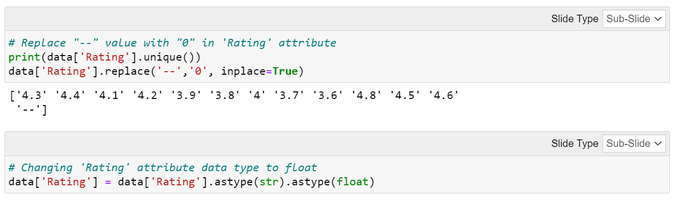
Data transformation

Slide 7
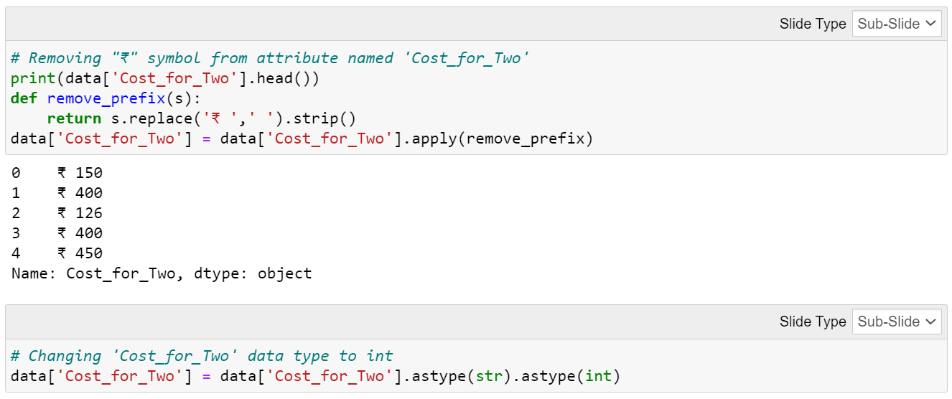
Data transformation

Slide 8
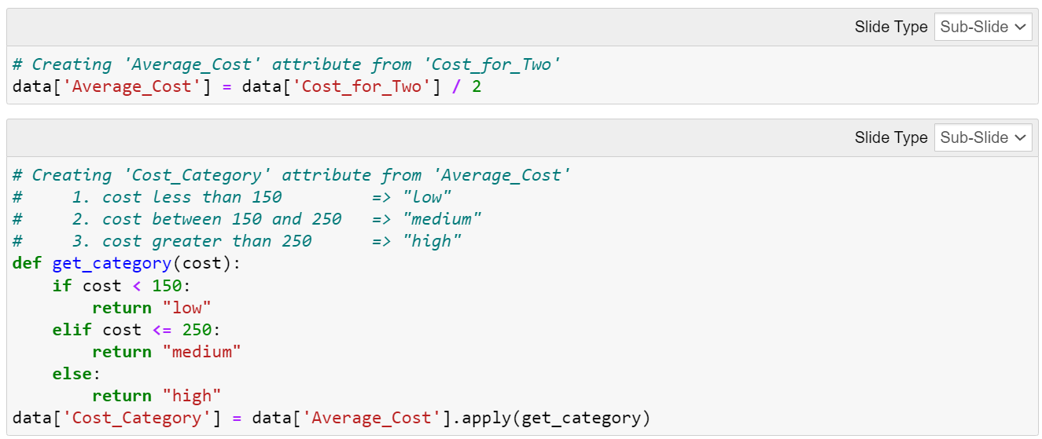
Data transformation

Slide 9
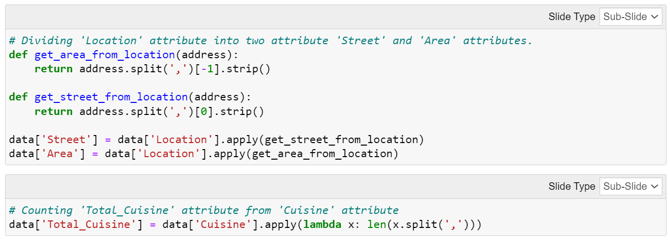
Data transformation

Slide 10
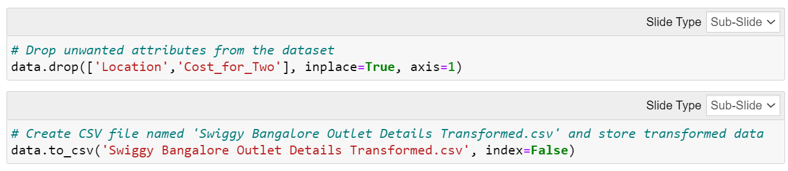
Data transformation

Slide 11
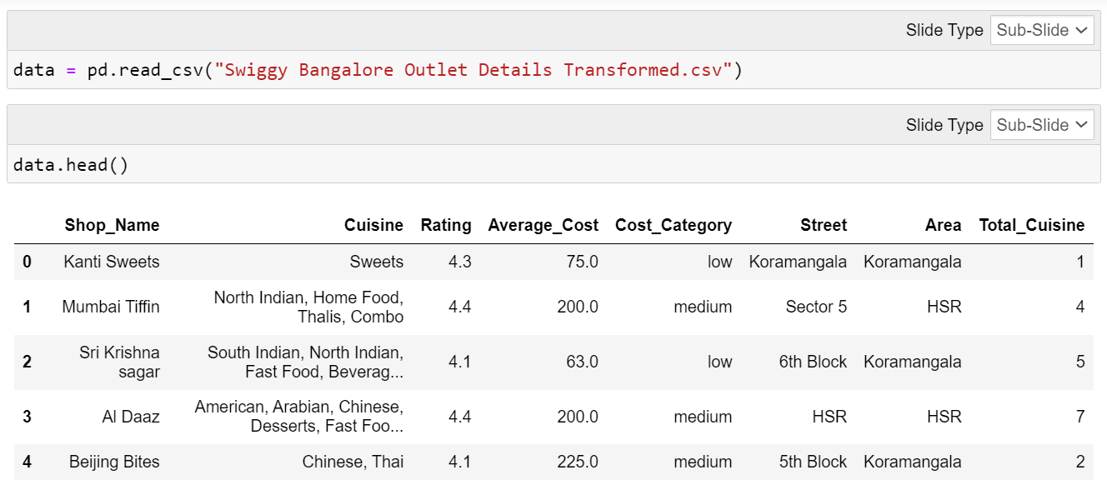
Data loading

Slide 12
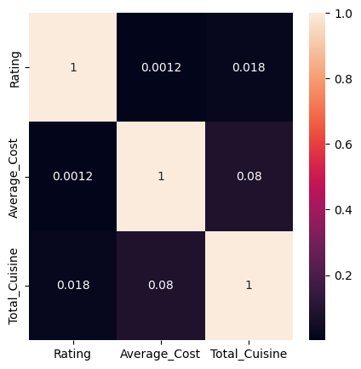
Data analysis
The Heatmap indicates that there isn't exists any linear relationship between two numerical attributes.

Slide 13
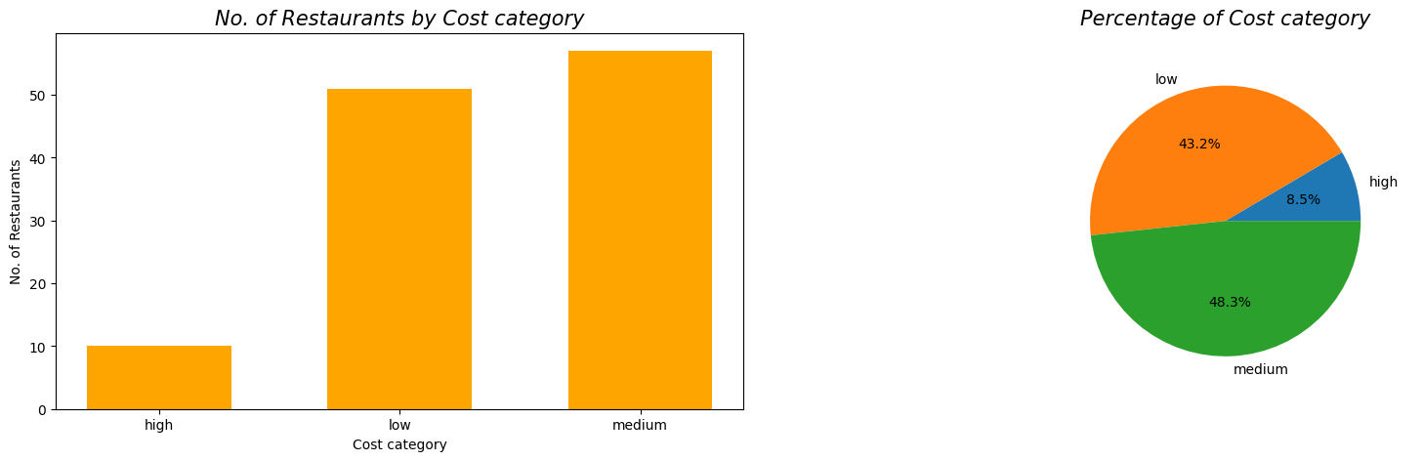
Data analysis
- The graphs shows that there are less restaurants where average cost per person is high.
- More than 90% restaurants have low or medium average cost per person

Slide 14
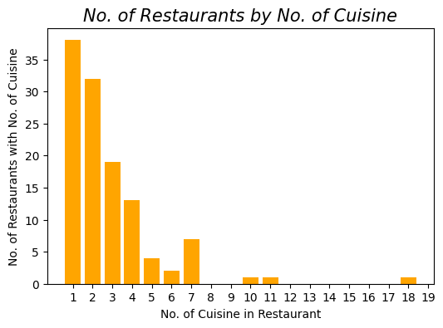
Data analysis
The bar graph indicates that more than 60 restaurants offers only one or two cuisine or dishes.
There is only 3 restaurant which offers more than 7 cuisine or dishes.

Slide 15
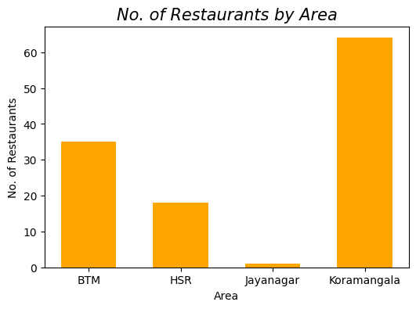
Data analysis
From the graph we can say that most restaurants are located in Koramangala.
There is only one restaurant in Jayanagar so that we must have to collaborate with more restaurants in Jayanagar.

Slide 16
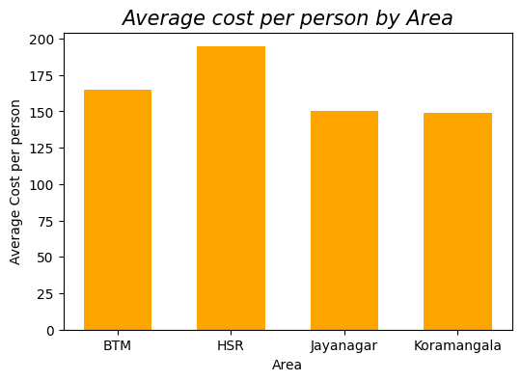
Data analysis
Using the graph we can say that person must have minimum 150 Rupees to buy from swiggy in these areas.
The highest average cost per person in HSR area so that we can say that Per Capita Income is more for that area

Slide 17
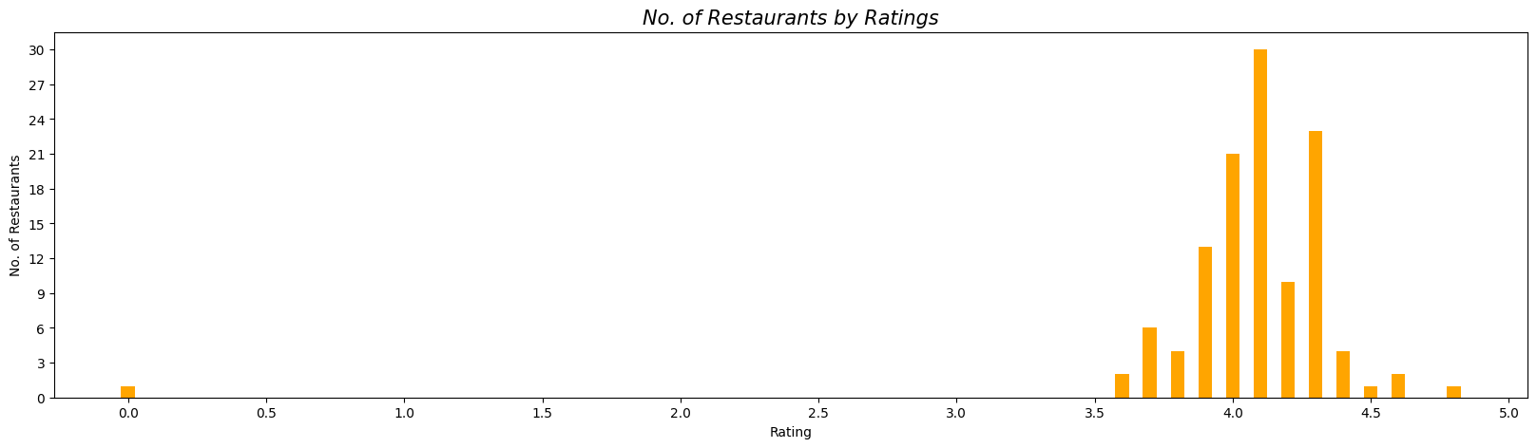
Data analysis
- The graph indicates that 30 restaurants have obtained rating of 4.1.
- Mandya Gowdru Donne Biryani shop has nothing obtained any rating yet.

Slide 18
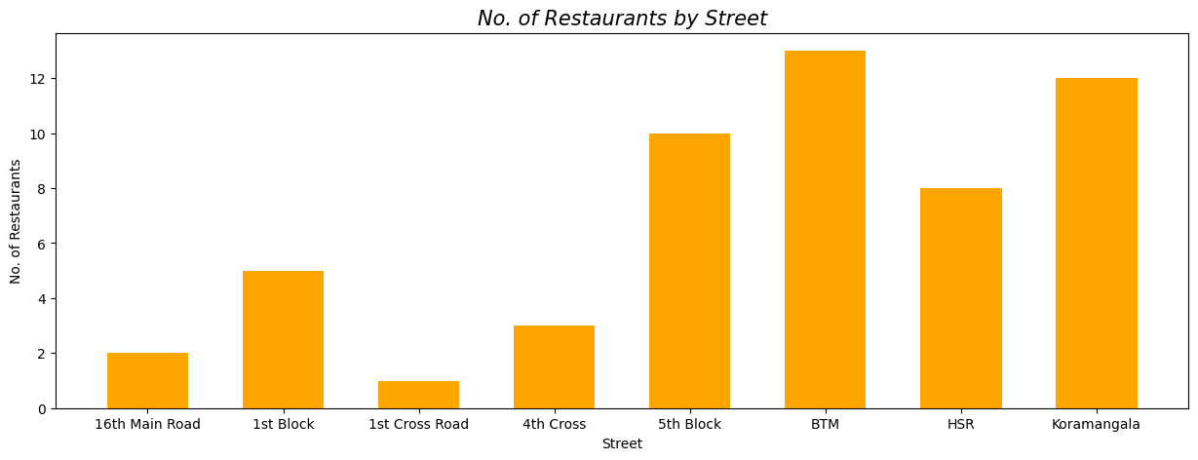
Data analysis
- The graph explains that more restaurants are in 'BTM' and 'Koramangala' Street.
- We have to increment restaurants in '1st Cross Road' so that delivery can be fast in that street and we can improve user experience

Slide 19
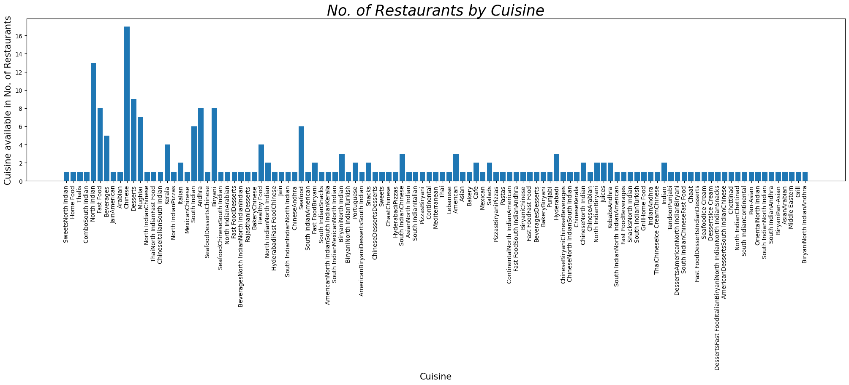
Data analysis

Slide 20
Data analysis
We can say that there are less cuisines that available in most restaurants.
Chinese food available in the most restaurants with 17 restaurants.
There are 9 cuisines which is available in more than 5 restaurants.
More than 80 unique cuisines which is provided by 80 different restaurants.

Slide 21
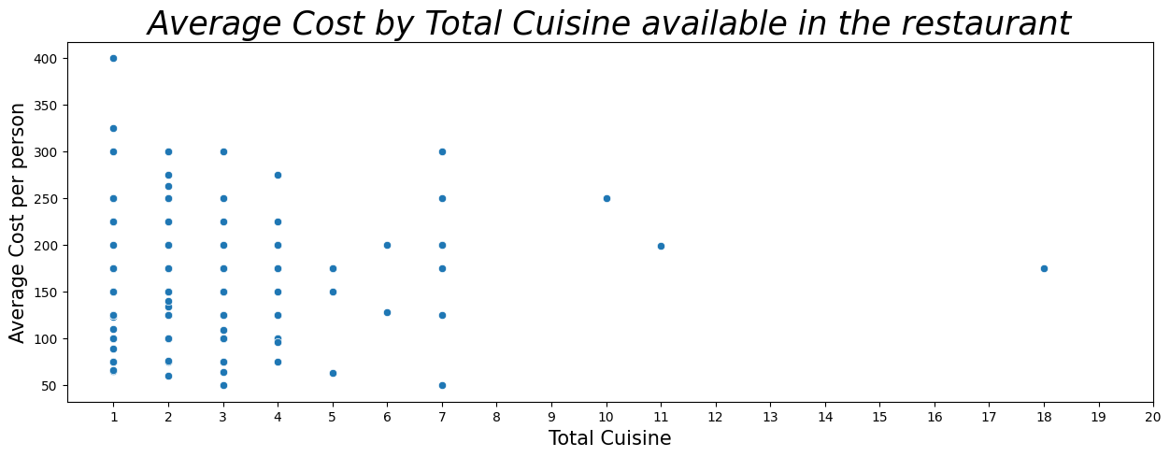
Data analysis
- From the graph we can say that there is no linear relationship between Average cost and Total Cuisine available in restaurant.
- The graph tells that if we increase cuisine of the Restaurants then average cost per person will be less or more.

Slide 22
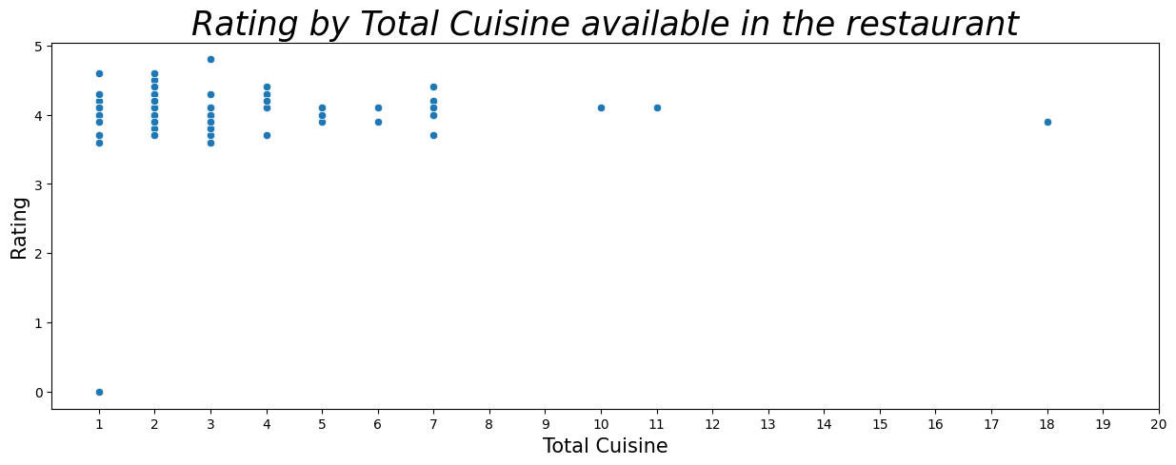
Data analysis
- From the graph we can say that there is no linear relationship between Rating and Total Cuisine available in restaurant.
- The graph tells that if we increase cuisine of the Restaurants then Rating of that Restaurant will be good or bad.

Slide 23
ConclusIOn
We have to identify those restaurants who provides four or more cuisines or dishes so that when customer orders food then delivery can be done fast.
In Jayanagar area there is only one restaurant that can’t tackle all customers of that area and taking orders from other area takes too much time for delivery so there can be more cancelled orders. We can improve our customers in that area by collaborating and joining with restaurants.

Slide 24
Thank you

