Slide 1
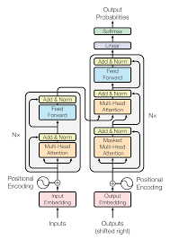
Introduction to BERT
Bidirectional Encoder Representations from Transformers
🔹 Key Features of BERT:
📌 Transformer-based model by Google
📌 Deeply bidirectional for better context understanding
📌 Pre-trained with Masked Language Modeling
📌 State-of-the-art in NLP tasks like QA
📌 Used in search engines, chatbots, AI assistants

