Slide 1
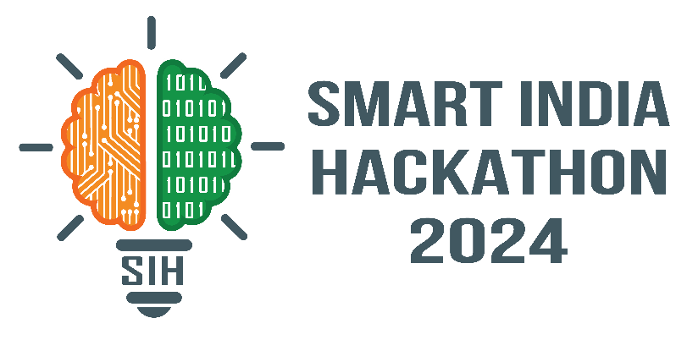
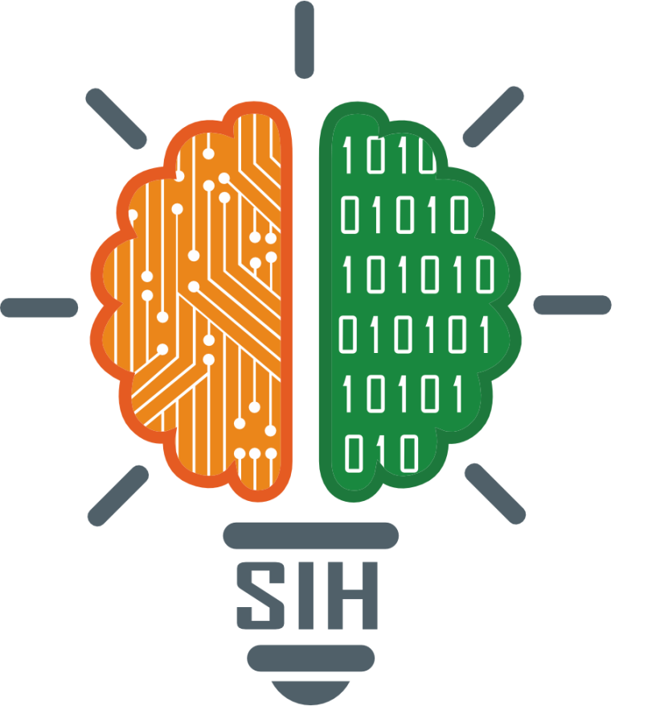
SMART INDIA HACKATHON 2024
Problem Statement ID – 1732
Problem Statement Title- Enhancement of Permanently
Shadowed Regions (PSR) of Lunar Craters Captured by OHRC of
Chandrayaan-2
Theme- Space Technology
PS Category- Software
Team ID- 1732
Team Name (Registered on portal)- Team ChandraKriti

Slide 2
Enhancement of PSR Lunar Imagery
ChandraKriti
IDEA:
Development of a web application that serves to reduce noise from PDS Lunar Images captured by the OHRC of Chandrayaan-2 and generates a 3-Dimensional Image Map of Moon's terrain with enhanced vertices-density.
Intuitive Frontend: Designed with a user-friendly interface that allows seamless input of sample images from the Moon’s Permanently Shadowed Regions (PSR) for 3D visualization.
Image Analysis: Extracts grey values from the input image to generate NumPy arrays, forming the basis for 3D plotting.
Flask Integration: Created a Flask app that utilizes NumPy to generate and plot high-density 3D terrain maps, enhancing the detail and accuracy of the resulting images and meshes.
Machine Learning Integration: Implemented machine learning to detect craters from the input image, predict their depths to determine safer landing zones.
SOLUTION:
Developed a 3D map of the Moon’s Permanently Shadowed Regions (PSR) using enhanced and denoised PDS lunar images, providing detailed and accurate terrain visualization.
Utilized technologies like NumPy to achieve high pixel density in 3D plotting, significantly enhancing the quality and detail of the input images.
UNIQUE VALUE PROPOSITIONS:
High-Resolution 3D Lunar Map: Developed the first of its kind web app delivering optimized, high-resolution outputs with no need for manual adjustments.
Advanced Techniques for Lunar Analysis: Output models can be used to run trajectory simulations, while the 3D development and enhancement of low-light images offer an improved method for studying the Moon's topography.

Slide 3
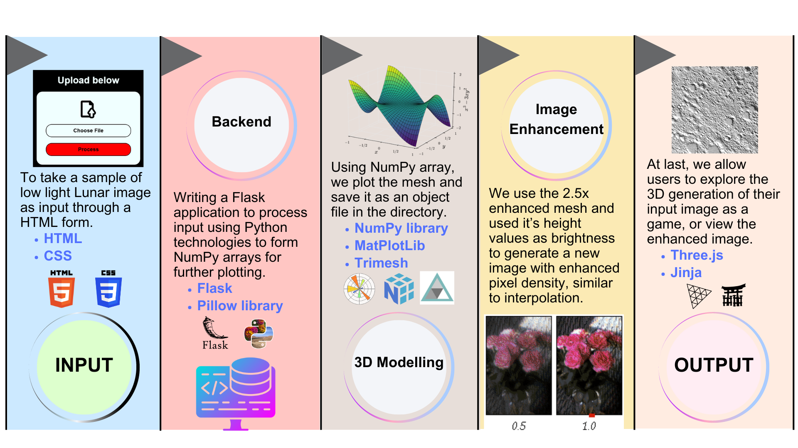
TECHNICAL APPROACH
ChandraKriti

Slide 4
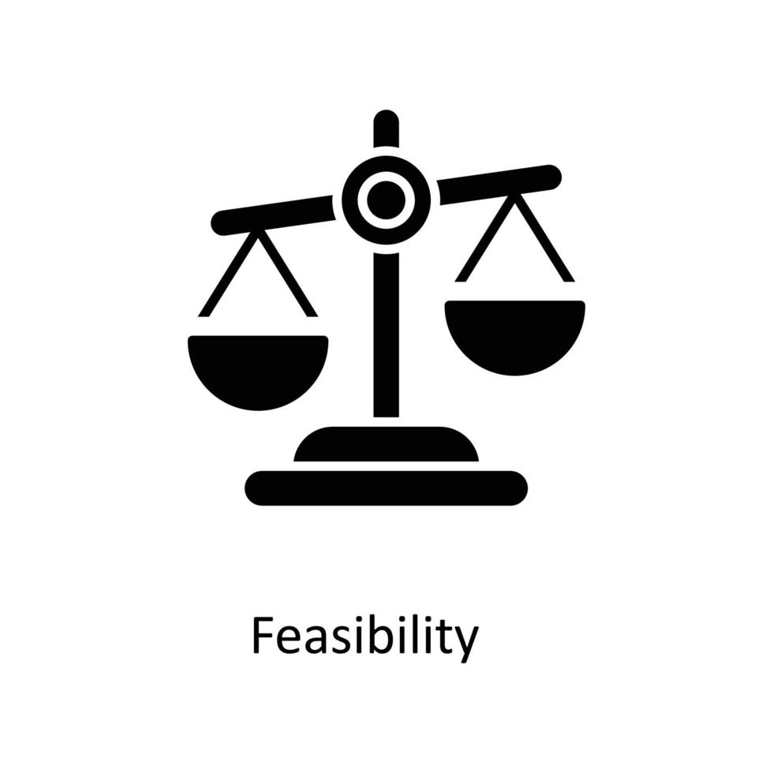




FEASIBILITY AND VIABILITY
ChandraKriti
Analysis of the feasibility
The project is technically and operationally feasible.
Challenges and risks
Noise Reduction from the image captured by OHRC.
Finding the Depth of Lunar Crater for 3D Modelling accurately.
Strategies to overcome
Use advanced noise reduction algorithms and robust machine learning training for accuracy.

Slide 5
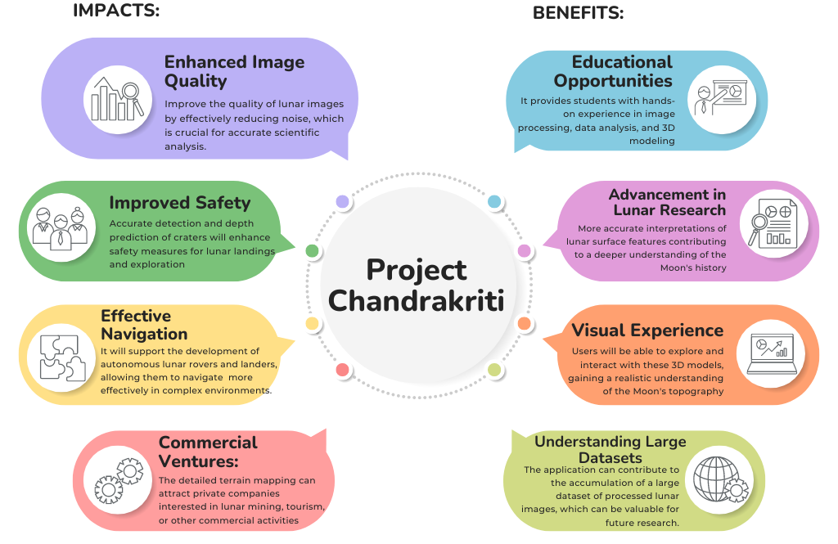
IMPACT AND BENEFITS
ChandraKriti

Slide 6
RESEARCH AND REFERENCES
ChandraKriti
Numpy Documentation
https://numpy.org/doc/stable/user/basics.html
NumPy module is extensively used for the development of 3D Lunar imagery. Documentation makes the necessary knowledge accessible.
Isro Source
https://pradan.issdc.gov.in/ch2/protected/browse.xhtml?id=ohrc
This hyperlink leads to all the public data captured by Chandrayaan-2 containing raw and calibrated data in Tabular, Label and Image form.
FY23 Innovative Spontaneous Concepts Research and Technology Development (ISC)
https://scienceandtechnology.jpl.nasa.gov/sites/default/files/posters/2023/R23225.pdf
A research article that contains details about NASA’s Deep Learning approach to denoising Lunar Imagery.
Studying existing denoising methods discovered like HyMiNoR and HORUS
https://github.com/Anurag-Dutta/Ch-3-Denoise
https://openaccess.thecvf.com/content/CVPR2021/supplemental/Moseley_Extreme_Low-Light_Environment-Driven_CVPR_2021_supplemental.pdf

