Slide 1

Industrial Training on ARTIFICIAL INTELLIGENCE
Presented By:
Name: Arushi Jain
University Roll No: 20EJCCS054
Branch: CSE
Class: VII-Sem(2023-2024)
Section: A
Submitted To:
Ms. Shaina Arora
Associate Professor CSE
Dr. Sanjay Gaur
HOD, CSE

Slide 2
Contents
Introduction
History of AI
Why AI?
How Does AI Work?
Limitations of Human Mind
Applications
Advantages
Disadvantages
Future
Conclusion

Slide 3
INTRODUCTION
Artificial Intelligence is a branch of Science which deals with helping machine finds solutions to complex problems in a more human-like fashion.
This generally involves borrowing characteristics from human intelligence, and applying them as algorithm in a computer friendly way.
Artificial intelligence (AI) refers to the simulation or approximation of human intelligence in machines.
The goals of artificial intelligence include computer-enhanced learning, reasoning, and perception.

Slide 4
Artificial intelligence (AI) refers to the simulation of human intelligence in machines that are programmed to think like humans and mimic their actions.
The ideal characteristic of artificial intelligence is its ability to rationalize and take actions that have the best chance of achieving a specific goal.
AI is being used today across different industries from finance to healthcare.
Some critics fear that the extensive use of advanced AI can have a negative effect on society.

Slide 5
HISTORY OF AI
1956 - John McCarthy coined the term ‘artificial intelligence’ and had the first AI conference.
1969 - Shakey was the first general-purpose mobile robot built. It is now able to do things with a purpose vs. just a list of instructions.
1997 - Supercomputer ‘Deep Blue’ was designed, and it defeated the world champion chess player in a match. It was a massive milestone by IBM to create this large computer.

Slide 6
2002 - The first commercially successful robotic vacuum cleaner was created.
2005 - 2019 - today, we have speech recognition, robotic process automation (rpa), a dancing robot, smart homes, and other innovations make their debut.
2020 - Baidu releases the linear fold ai algorithm to medical and scientific and medical teams developing a vaccine during the early stages of the sars-cov-2 (covid-19) pandemic. The algorithm can predict the RNA sequence of the virus in only 27 seconds, which is 120 times faster than other methods.

Slide 7
WHY AI?
Computers are fundamentally well suited to performing mechanical computations, using fixed programmed rules. This allows artificial machines to perform simple monotonous tasks efficiently and reliably, which humans are ill-suited to.

Slide 8
HOW DOES AI WORK?
AI systems work by merging large with intelligent, iterative processing algorithms. This combination allows AI to learn from patterns and features in the analyzed data. Each time an artificial intelligence system performs a round of data processing, it tests and measures its performance and uses the results to develop additional expertise.

Slide 9
Ways of implementing AI:
Machine learning
It is machine learning that gives AI the ability to learn. This is done by using algorithms to discover patterns and generate insights from the data they are exposed to.
Deep learning
Deep learning
Which is a subcategory of machine learning, provides AI with the ability to mimic a human brain’s neural network. It can make sense of patterns, noise, and sources of confusion in the data.

Slide 10
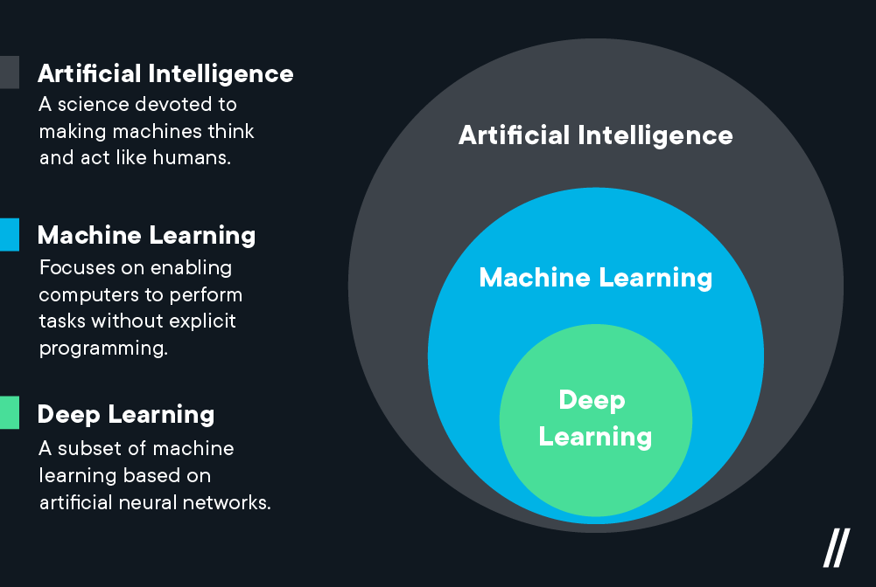

Slide 11
AI programming focuses on three cognitive skills: learning, reasoning and self-correction.
Learning processes- This aspect of AI programming focuses on acquiring data and creating rules for how to turn the data into actionable information. The rules, which are called algorithms provide computing devices with step-by-step instructions for how to complete a specific task.
Reasoning processes-This aspect of AI programming focuses on choosing the right algorithm to reach a desired outcome.

Slide 12
Self-correction processes- This aspect of AI programming is designed to continually fine-tune algorithms and ensure they provide the most accurate results possible.

Slide 13
LIMITATIONS OF HUMAN MIND
Object Recognition. People cannot properly explain how they recognize objects.
Face recognition. Cannot be passed on to another person by explanation.
Naming of colors. Based on learning, not on absolute standards.

Slide 14
APPLICATIONS
AI in healthcare- The biggest bets are on improving patient outcomes and reducing costs. Companies are applying machine learning to make better and faster diagnoses than humans. One of the best-known healthcare technologies is IBM Watson.
AI in business- Machine learning algorithms are being integrated into analytics and customer relationship management (CRM) platforms to uncover information on how to better serve customers.
AI in education- AI can automate grading, giving educators more time. It can assess students and adapt to their needs, helping them work at their own pace.

Slide 15
AI in finance- AI in personal finance applications, such as intuit mint or turbo tax, is disrupting financial institutions. Applications such as these collect personal data and provide financial advice.
Ai in law-The discovery process -- sifting through documents -- in law is often overwhelming for humans. Using AI to help automate the legal industry's labor-intensive processes is saving time and improving client service.
Ai in manufacturing- Manufacturing has been at the forefront of incorporating robots into the workflow.

Slide 16
AI in banking - Banks are successfully employing chatbots to make their customers aware of services and offerings and to handle transactions that don't require human intervention.
Ai in transportation- In addition to ai's fundamental role in operating autonomous vehicles, AI technologies are used in transportation to manage traffic, predict flight delays, and make ocean shipping safer and more efficient.
Security - AI and machine learning are at the top of the buzzword list security vendors use today to differentiate their offerings. Those terms also represent truly viable technologies.

Slide 17
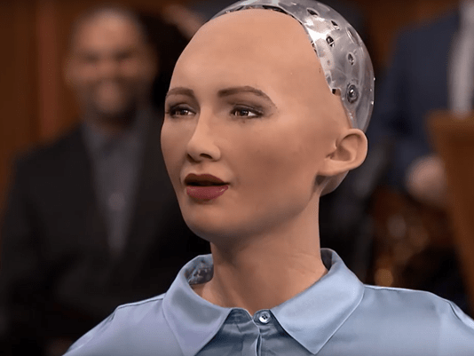
EXAMPLE OF AI:
Sophia – humanoid robot
Sophia is a social humanoid robot developed by Hong Kong based company Hanson robotics.
Sophia was activated on April 19,2015.
She made her first public appearance at south by southwest festival in mid-march 2016 in united states.
She was able to display more than 62 facial expressions.
In October 2017, Sophia became a Saudi
Arabian citizen, the first robot to receive
citizenship in any country.

Slide 18
ADVANTAGES
Reduction in human error- one of the biggest advantages of artificial intelligence is that it can significantly reduce errors and increase accuracy and precision. The decisions taken by AI in every step is decided by information previously gathered and a certain set of algorithms. When programmed properly, these errors can be reduced to null.
Zero risks- another big advantage of ai is that humans can overcome many risks by letting ai robots do them for us. Whether it be defusing a bomb, going to space, exploring the deepest parts of oceans, machines with metal bodies are resistant in nature and can survive unfriendly atmospheres.
24x7 availability- there are many studies that show humans are productive only about 3 to 4 hours in a day. Humans also need breaks and time offs to balance their work life and personal life.

Slide 19
Digital assistance -some of the most technologically advanced companies engage with users using digital assistants, which eliminates the need for human personnel.
New inventions -in practically every field, ai is the driving force behind numerous innovations that will aid humans in resolving the majority of challenging issues.
Unbiased decisions - human beings are driven by emotions, whether we like it or not. AI on the other hand, is devoid of emotions and highly practical and rational in its approach.
Daily applications -today, our everyday lives are entirely dependent on mobile devices and the internet. We utilize a variety of apps, including google maps, Alexa, Siri, Cortana on windows, OK google, taking selfies, making calls, responding to emails, etc. With the use of various ai-based techniques, we can also anticipate today’s weather and the days ahead.

Slide 20
DISADVANTAGES
High costs -the ability to create a machine that can simulate human intelligence is no small feat. It requires plenty of time and resources and can cost a huge deal of money. AI also needs to operate on the latest hardware and software to stay updated and meet the latest requirements, thus making it quite costly.
No creativity -a big disadvantage of ai is that it cannot learn to think outside the box. AI is capable of learning over time with pre-fed data and past experiences, but cannot be creative in its approach.
Unemployment -one application of artificial intelligence is a robot, which is displacing occupations and increasing unemployment (in a few cases).

Slide 21
Make humans lazy -AI application automate the majority of tedious and repetitive tasks. Since we do not have to memorize things or solve puzzles to get the job done, we tend to use our brains less and less. This addiction to AI can cause problems to future generations.
No ethics-Ethics and morality are important human features that can be difficult to incorporate into an AI. The rapid progress of AI has raised a number of concerns that one day, AI will grow uncontrollably, and eventually wipe out humanity. This moment is referred to as the AI singularity.
Emotionless -Since early childhood, we have been taught that neither computers nor other machines have feelings. Humans function as a team, and team management is essential for achieving goals.
No improvement- Humans cannot develop artificial intelligence because it is a technology based on pre-loaded facts and experience.

Slide 22
FUTURE(+)
The day is not far when you will just sit back in your cozy little beds and just command your personal robot's to entirely do your ruts. He will be a perfect companion for you. Just enjoy the technology.

Slide 23
FUTURE(-)
But wait,
It may end in other way too. Some day there will be a knock to your door. As you open it, you see a large number of robots marching into your house destroying everything you own and looting you. This is because ever since there is an advantage in the technology, it attracts anti-social elements. This is true for robots too. Because now they will have full power to think as human, even as of anti-social elements. So think trice before giving them power of cognition.

Slide 24
CONCLUSION
In it's short existence, AI has increased understanding of the nature of intelligence and provided an impressive array of application in a wide range of areas. It has sharpened understanding of human reasoning, and of the nature of intelligence in general. At the same time, it has revealed the complexity of modeling human reasoning providing new areas and rich challenges for the future.

Slide 25
THANK YOU

