Slide 1
DEEP REINFORCEMENT LEARNING
LAKSH JAIN
23110185
BTECH IN ARTIFICIAL INTELLIGENCE, 3RD SEMESTER
CG501: COMPUTATION AND COGNITION

Slide 2

Link to Github Repository
Link to Github Repository: Jain-Laksh/DQN-CartPole

Slide 3
Learning Outcomes
I learnt how to implement Deep Q-learning from scratch, to train an agent to do a task, leveraging deep neural networks along with reinforcement learning. I used virtual environments provided by OpenAI Gymnasium to train and test RL agents. I implemented the DQN in Pytorch to train an agent to balance a pole on a cart. This involved understanding basic RL terminologies such as ‘state’, ‘action’ and ‘reward’, Markov Decision Processes (MDPs), Q-learning and the Deep Q-learning algorithm. I implemented two neural networks: a Q-network and a target network, leveraging a soft update rule for stable learning. Additionally, I used the exploration vs. exploitation trade-off/strategy to optimize the agent’s decision-making process.
This hands-on experience enhanced my grasp of reinforcement learning concepts and different algorithms and their practical application.

Slide 4
Bibliography/Resources Used
1] Reinforcement learning using Q-learning, Q-values and Q-table:
Lecture on Introduction to RL and Q-learning, by Prof. Nipun Batra (link)
UCL Course on RL, slides by David Silver (website)
Youtube Playlist on Reinforcement Learning- Developing Intelligent Agents, by deeplizard (playlist)
2] Deep Q-learning:
Slides on Deep Reinforcement Learning, provided by Alexander Amini, MIT Introduction to Deep Learning (slides)
Reinforcement Learning (DQN) Tutorial, by PyTorch (documentation)
Deep Q-Networks Explained!, youtube video by CodeEmporium (video)

Slide 5
Bibliography/Resources Used
3] Documentations Referred:
PyTorch (documentation)
OpenAI Gymnasium (documentation)
Cart Pole virtual environment by OpenAI Gymnasium (documentation)
4] ChatGPT: Used Chatgpt to learn/clarify concepts/doubts of Reinforcement Learning, debugging and setting up virtual environment, installing required dependencies and setting up OpenAI Gymnasium.
5] Time Invested: Exploring several different project ideas(~1hr), watch and re-watch lecture by prof. Nipun Batra(~1.5hr), watch complete playlist by deeplizard(~5x15 = 1.25hr), go through slides(~30min x 2 = 1hr), understand DQN implementation from youtube videos and documentation(~30min), set up openai gymnasium virtual environment(~30min), coding and training the agent(~2hr) and slides preparation(~2hr). Hence a total aggregate time of ~9-10 hrs.

Slide 6
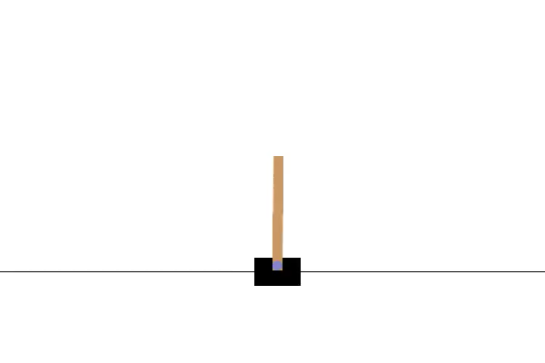
Objective of Project
The objective of this project is to understand and implement a Deep Q-Learning Model to train an agent to be able to balance a pole on a cart using reinforcement learning and neural networks. We also want to tune hyper-parameters for efficiency and use advanced techniques in DQN such as using 2 different neural networks simultaneously and exploration vs exploitation trade-off to increase stability.

Slide 7
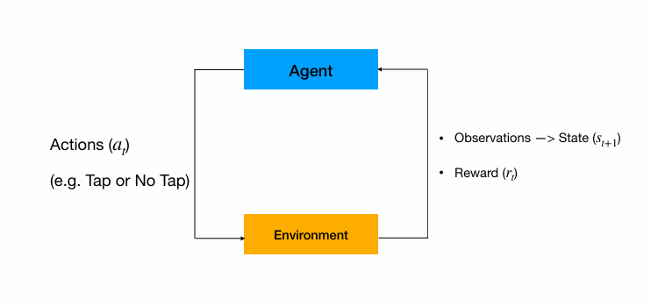
Introduction
Reinforcement Learning: RL is a self-supervised algorithm which trains an agent to perform a particular task by maximising rewards. The agent takes an action such that the predicted reward is maximum. The state changes from state s to s+1. The agent is given some reward. Based on the reward predicted and reward given, the agent learns.

Slide 8
Understanding Terminologies
State: The state of the agent is defined by a set of parameters which explains the situation. For example, in a 4x4 square maze, each state can be defined by coordinates of the box. In Cart and Pole environment, a state is defined by the position of cart, its velocity, angle of pole and its angular velocity. A state can be continuous or discrete.
Action: Any action that the agent can take in a given state. For example, in case of a square maze, the agent can move in 4 directions denoted by 0,1,2 and 3. In Cart and Pole environment, the agent has only 2 actions, ie, move left or move right(0 or 1).
Reward: A reward is a real valued function, which returns the reward for every state. In our case, we want the agent to balance the pole for maximum time. Hence, it is rewarded +1 for every time step until termination.

Slide 9

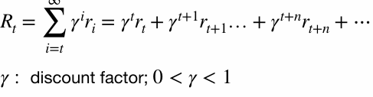
Markov Decision Process
The reward given to the agent depends only on its previous actions. This sequencial decision making is formulated by the Markov Decision Process(MDP).
For every state, the agent has a predicted reward-value for every action. We want to maximize R(t).
Since we want the agent to prioritize the immediate reward, we have a discounting factor gamma.

Slide 10
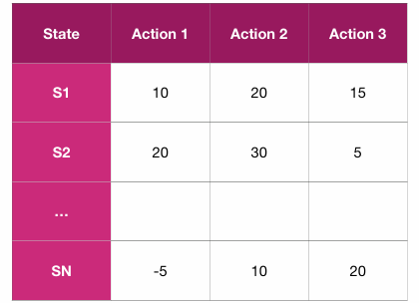
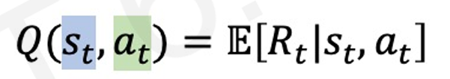
Q-learning and Q-function
In Q-learning algorithm ,the agent learns a Q-function(Q-table).
A Q-function is defined for a state and action value pair. It returns the expected total future reward the agent will receive by taking that action in that state.
These values are stored in a Q-table.

Slide 11


Bellman Equation
The Bellman equation for Q-values is given by:
The update equation is derived by using the Bellman equation:
Ideally, Q(s,a) = reward(s,a) + Q(s’,a’). The equation uses the error in prediction to update the corresponding Q-values for state s and action a in the Q-table.

Slide 12
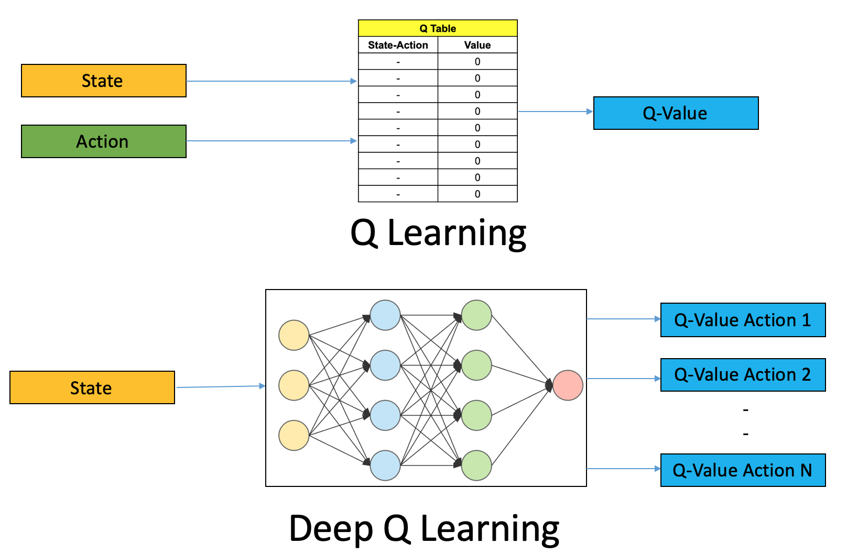
Q-learning Vs Deep Q-learning
In Q-learning the state space and the action space need to be discrete. However as the complexity of the environment increases, we have large continuous state spaces. If we discretize this space, then we get very large Q-tables.
Hence we make use of neural networks. The neural networks can take in continuous values for the state and output the q-values for the actions.

Slide 13
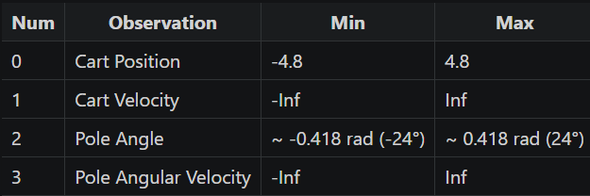
Implementation Details
Description of the Environment (refer to openai gymnasium documentation for the cart-pole-v1 environment):
Action Space: Discrete space with 2 values – 0- Push cart to the left and 1- Push cart to the right
Observation Space/State: the observation space is an ndarray of shape (4,) with values corresponding to following positions and velocities.

Slide 14
Implementation Details
Reward: We need to maximize the time for which the cart can balance the pole. Hence a reward of +1 is given for every step taken, including the termination step.
Starting State: All observations are assigned a uniformly random value in (-0.05,0.05).
Termination Condition: The episode ends if any one of the following occurs:
Termination: Pole Angle is greater than ±12°
Termination: Cart Position is greater than ±2.4 (center of the cart reaches the edge of the display)
Truncation: Episode length is greater than 500

Slide 15
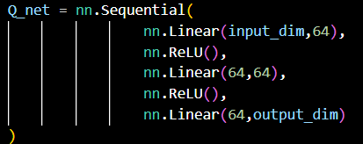

Implementation Details
We create 2 networks: Q- network and a target-network. Below is the architecture:
Initially, we initialize both the networks with same weights and then update the Q network every iteration and soft update the target with parameter tau.

Slide 16
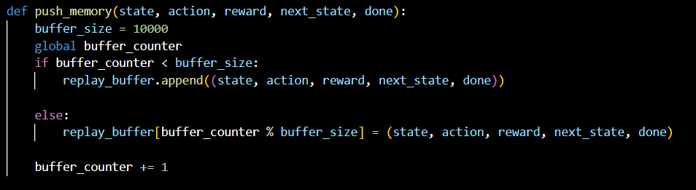

Implementation Details
Buffer Memory: This is a list which stores the past experiences of the agent, ie, state, action, reward and the next state. It can store at most 10000 values. If it is filled, we replace the oldest memories with the new ones. We train out neural networks on a batch (batch size of 64) of these memories sampled randomly.

Slide 17
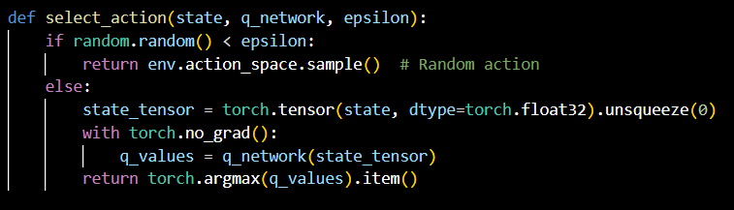
Implementation Details
Exploration vs exploitation strategy: In any state the logic behind choosing an action is to choose the action corresponding to largest value outputted from the Q-network with input as state parameters. This is known as exploitation. In random cases, we choose a random action. This is known as exploration. This may lead to discovery of better paths quickly. With every iteration, we keep decreasing this exploration constant epsilon so that the agent takes best actions in later stages of training.

Slide 18
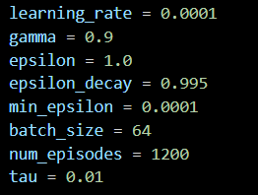
Implementation Details
We define our parameters as follows:

Slide 19
Implementation Details
Update Logic:
We use a batch of memories from past experiences to train out model. We input state parameters to out Q model and get the corresponding Q values for that state.
Then we input the new state parameters into out target model to get Q(s’,a’). Then we use the Bellman’s equation. Out Loss function is Mean squared error.

Slide 20
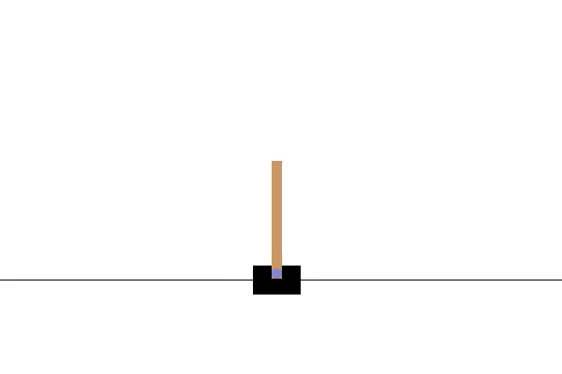
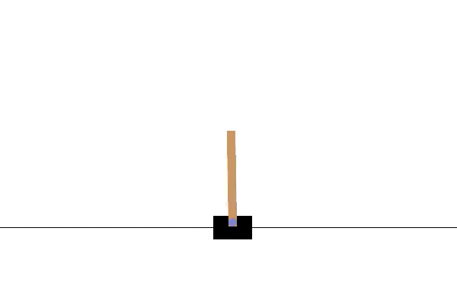
Results
Before Training- episode 0
After Training- episode 1200

Slide 21
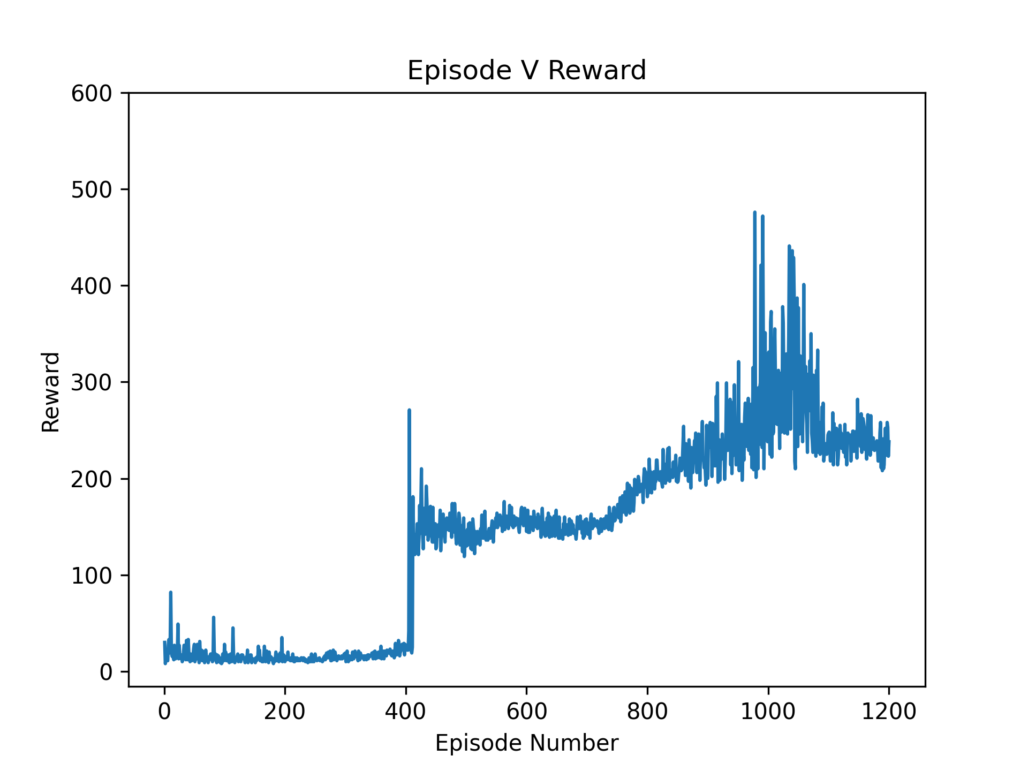
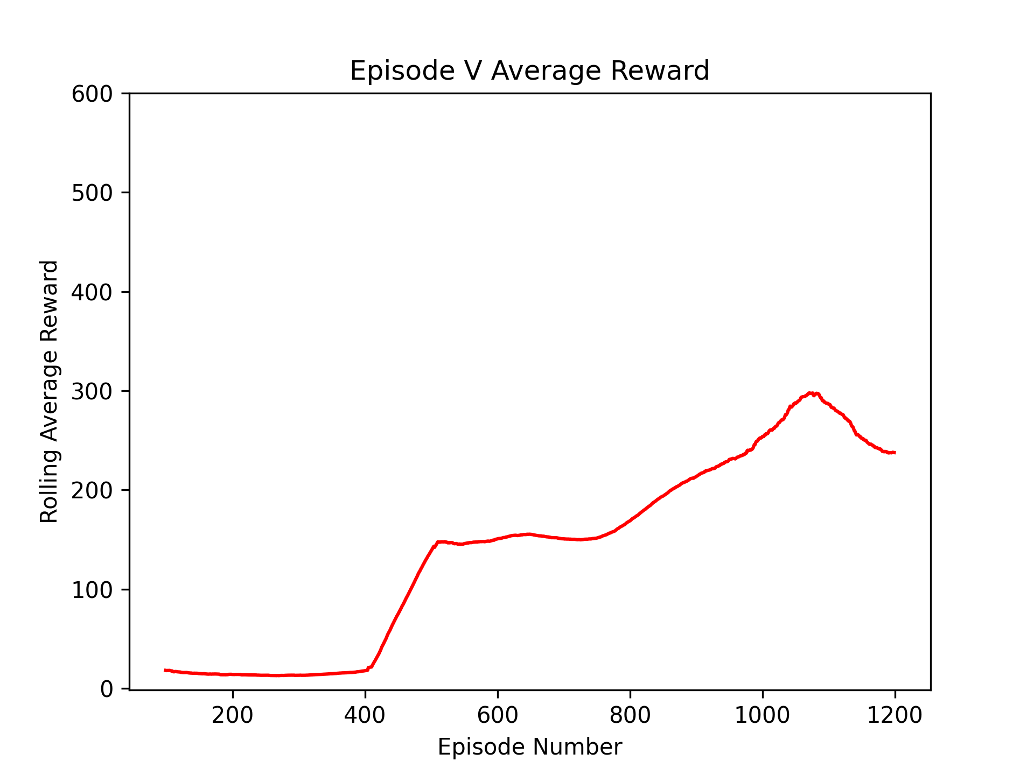
Results
We observe that the reward maximizes with episode and then converges.

Slide 22
Limitations
Deep Q learning can not account for a continuous action space
Requires more compute power

