Slide 1
Single qubit error mitigation by simulating Non-Markovian dynamics
King Lin & Naman Jain
Mirko Rossini, Dominik Maile, Joachim Ankerhold and Brecht I. C Donvil, “Single Qubit Error Mitigation by Simulating Non-Markovian Dynamics”, Phys. Rev. Lett. 131, 110603 – Published 15 September, 2023

Slide 2
General Dynamical Map
General Dynamical Map [1] are
Linear
Trace preserving
Hermiticity preserving
Not necessarily CP
Arise from
Intermediate steps in Non-Markovian dynamics
Correlated system-bath initial states
As time reversed evolution
[1] E. C. G. Sudarshan, P. M. Mathews and Jayaseetha Rau, “Stochastic Dynamics of Quantum-Mechanical Systems”, Phys. Rev. 121, 920 – Published 1 February, 1961

Slide 3
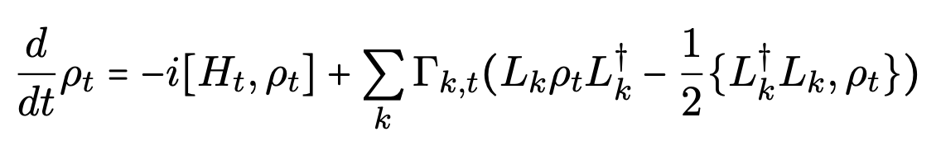

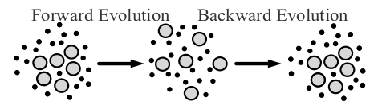
State recovery
Consider the evolution
The time reversed evolution is
Evolving a state for a time t with and then for a time s ≤ t with its time reversed evolution results in the state obtained by just evolving with (6) for a time t − s

Slide 4
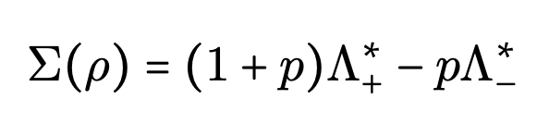
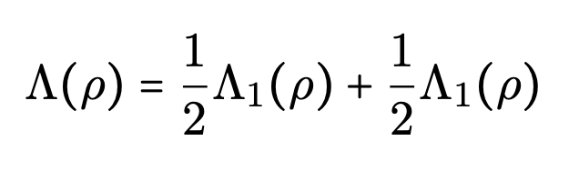
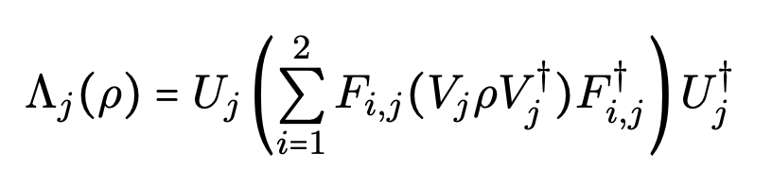
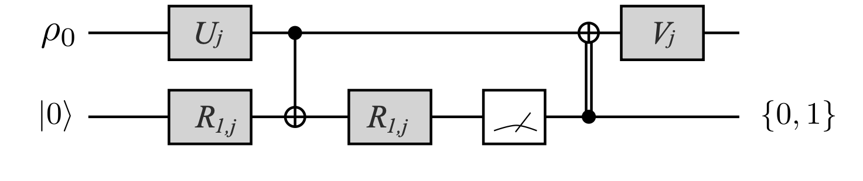
General Dynamical Map
General Dynamical Map as weighted sum of CPTP map:
CPTP map expressed as the sum of two extremal CP maps [1, 2]:
A simple circuit shown in to realise the action of the Λj using just one ancillary qubit and CNOT gates [3]
[1] Mary Beth Ruskai, Stanislaw Szarek and Elisabeth Werner, “An analysis of completely-positive trace-preserving maps on M_2”, Linear Algebra and its Applications, Vol. 347, Issues 1–3, 15 May 2002, Pages 159-187
[2] C. King and M. B. Ruskai, "Minimal entropy of states emerging from noisy quantum channels," in IEEE Transactions on Information Theory, vol. 47, no. 1, pp. 192-209, Jan. 2001, doi: 10.1109/18.904522.
[3] Dong-Sheng Wang, Dominic W. Berry, Marcos C. de Oliveira and Barry C. Sanders, “Solovay-Kitaev Decomposition Strategy for Single-Qubit Channels”, Phys. Rev. Lett. 111, 130504 – Published 25 September, 2013

Slide 5
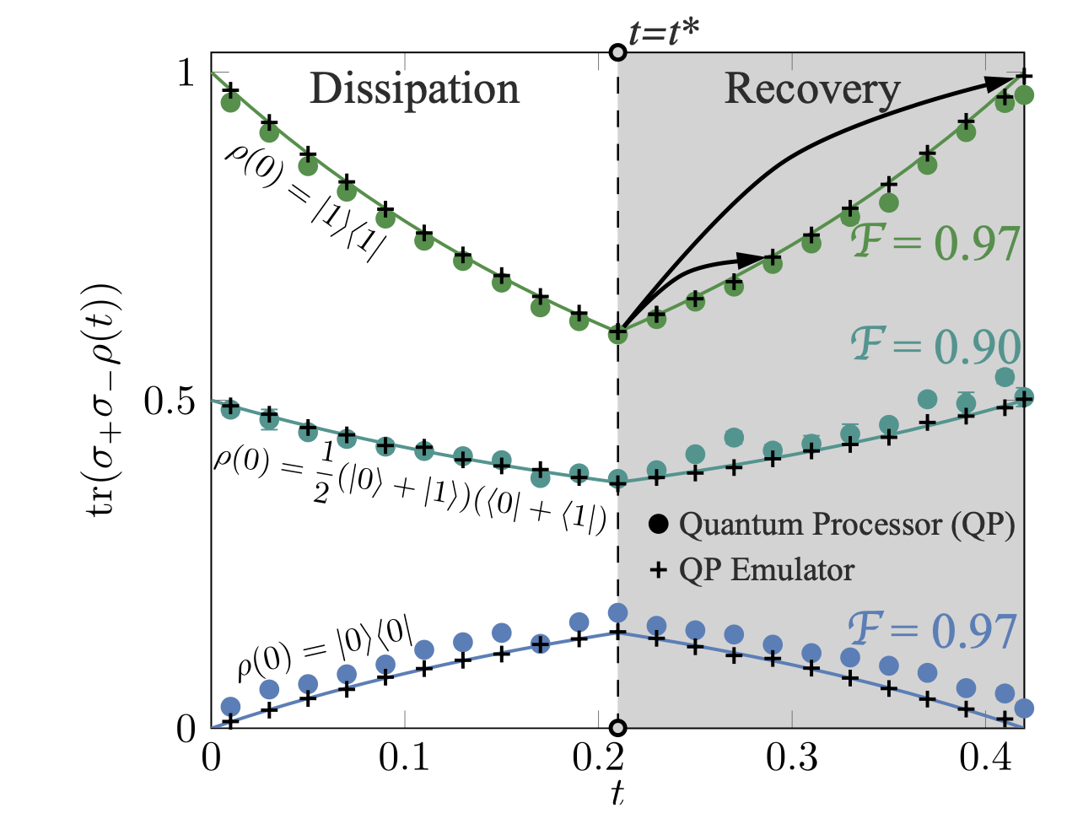
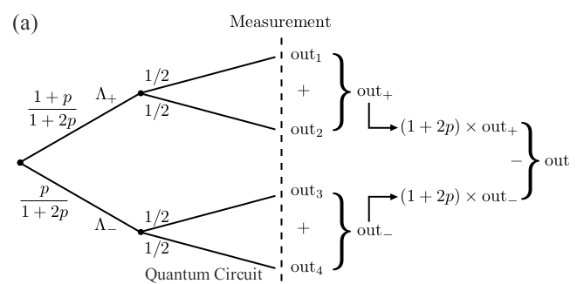
Protocol
Dissipation: 𝛤_{k,t} are positive definite
Recovery: 𝛤_{k,t} are not necessarily positive definite
A qubit weakly coupled to a thermal bath

Slide 6
Extra slides

Slide 7
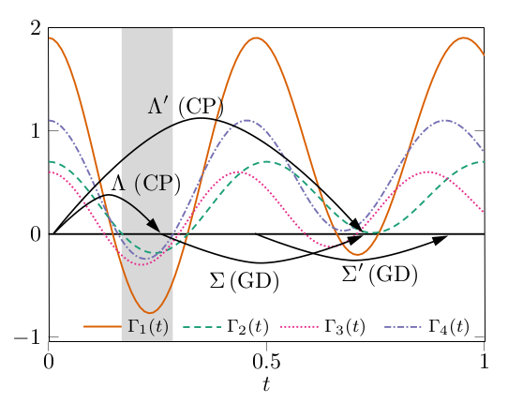
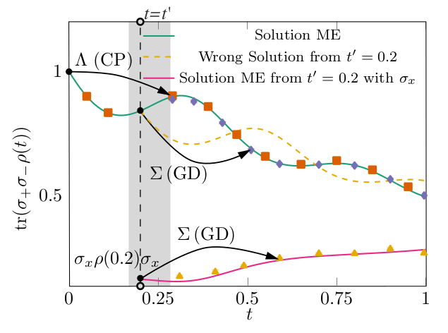
Example GD evolution

