Slide 1
6.Servlet(16 Marks)

Slide 2
Servlets Introduction
Servlets are small programs that execute on the server side of a Web connection.
Servlets dynamically extend the functionality of a Web server
Servlets are the components of java that are used to create dynamic web applications
There was CGI technology also to create dynamic web applications

Slide 3
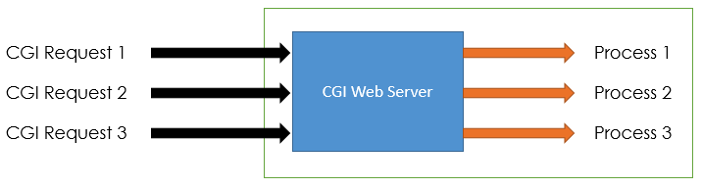
CGI (Commmon Gateway Interface)
is used to provide dynamic content to the user.
is used to execute a program that resides in the server to process data or access databases to produce the relevant dynamic content.
Programs that resides in server can be written in native operating system such as C,C++,Perl.

Slide 4
Disadvantages of CGI :
For each request, It creates new Operating System Process.
If the number of requests from the client increases then more time it will take to respond to the request.
As programs executed by CGI Script are written in the native languages such as C, C++, perl which are platform dependent.

Slide 5
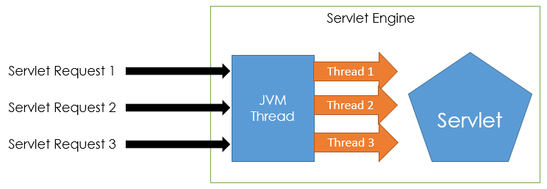
Servlet
Are used to create dynamic web applications
Can run on any java-enabled platform.
Servlet programs are compiled into the Java bytecode which is then run in the Java virtual machine.
All the requests coming from the Client are processed with the threads instead of the OS process.

Slide 6
Advantages of Servlets
Faster than CGI
Platform independent
Portable
Removes overhead of creating new process for each request. There is only a single instance which handles all requests concurrently.
Secured

Slide 7
Servlet Vs CGI
Servlet | CGI (Common Gateway Interface)
Servlets are portable | CGI is not portable.
In Servlets each request is handled by lightweight Java Thread | IN CGI each request is handled by heavy weight OS process
In Servlets, Data sharing is possible | In CGI, data sharing is not available.
Servlets can link directly to the Web server | CGI cannot directly link to Web server.
Session tracking and caching of previous computations can be performed | Session tracking and caching of previous computations cannot be performed
Automatic parsing and decoding of HTML form data can be performed. | Automatic parsing and decoding of HTML form data cannot be performed.
Servlets can read and Set HTTP Headers | CGI cannot read and Set HTTP Headers
Servlets can handle cookies | CGI cannot handle cookies
Servlets can track sessions | CGI cannot track sessions
Servlets is inexpensive than CGI | CGI is more expensive than Servlets

Slide 8
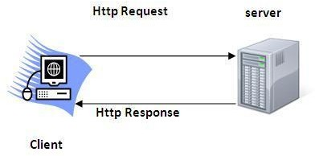
Servlet Terminologies : 1. HTTP
Http is the protocol that allows web servers and browsers to exchange data over the web.
It is a request response protocol.
Http uses reliable TCP connections by default on TCP port 80.
It is stateless means each request is considered as the new request. In other words, server doesn't recognize the user by default.

Slide 9
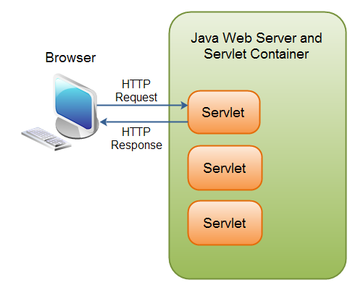
2. Servlet
A Java Servlet is a Java object that responds to HTTP requests. It runs inside a Servlet container.
A Servlet is part of a Java web application.
A Servlet container may run multiple web applications at the same time, each having multiple servlets running inside.
A Java web application can contain other components than servlets.
It can also contain Java Server Pages (JSP), images, text files, documents, Web Services etc.

Slide 10
3. HTTP Request and Response
The browser sends an HTTP request to the Java web server.
The web server checks if the request is for a servlet. If it is, the servlet container is passed the request.
The servlet container will then find out which servlet the request is for, and activate that servlet.
The servlet is activated by calling the Servlet.service()method.
Once the servlet has been activated the servlet processes the request, and generates a response. The response is then sent back to the browser.

Slide 11
4. Servlet Containers
Java servlet containers are usually running inside a Java web
server.
Example: Tomcat, GlasssFish, Jboss etc.
Container:
It provides runtime environment for JavaEE (j2ee) applications.
It performs many operations that are given below:
Life Cycle Management
Multithreaded support
Security etc.

Slide 12
5. Server
It is a running program or software that provides services.
Two types
Web Server:
Web server contains only web or servlet container. It can be used for servlet, jsp, struts, jsf etc. It can't be used for EJB.
Example of Web Servers are: Apache Tomcat and Resin.
Application Server:
Application server contains Web and EJB containers. It can be used for servlet, jsp, struts, jsf, ejb etc.
Ex: Jboss, Glassfish, Weblogic, Websphere

Slide 13
6. Content Type
Content Type:
Content Type is also known as MIME
(Multipurpose internet Mail Extension) Type.
It is a HTTP header that provides the description about what are you sending to the browser.
text/html
text/plain
application/msword
application/vnd.ms-excel
application/jar
application/pdf
application/octet-stream
application/x-zip
images/jpeg

Slide 14
Types Of Servlet
Generic Servlet:
It is in javax.servlet.GenericServlet package
It is protocol independent.
HTTP Servlet
It is in javax.servlet.HTTPServlet package
Built-in HTTP protocol support.

Slide 15
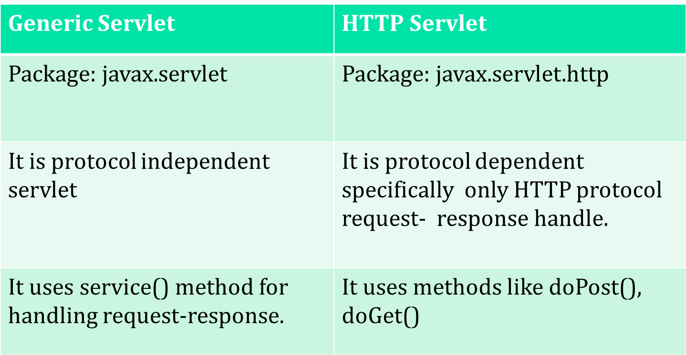
Cont…

Slide 16
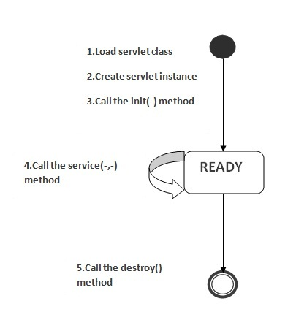
Servlet Life Cycle
The web container maintains the life cycle of a servlet instance
Following are the stages of servlet life cycle
Loading a Servlet
Instantiating a Servlet
Initializing a Servlet
Request Handling
Destroying a Servlet

Slide 17
Cont…………….
there are three states of a servlet: new, ready and end.
The servlet is in new state if servlet instance is created. After invoking the init() method, Servlet comes in the ready state. In the ready state, servlet performs all the tasks.
When the web container invokes the destroy() method, it shifts to the end state.

Slide 18
Cont…………….
1 Servlet class is loaded:- The classloader is responsible to load the servlet class. The servlet class is loaded when the first request for the servlet is received by the web container.
2 Servlet instance is created:- The web container creates the instance of a servlet after loading the servlet class. The servlet instance is created only once in the servlet life cycle.
3 init method is invoked:- The web container calls the init method only once after creating the servlet.The init method is used to initialize the servlet.
Syntax of the init method is given below:
public void init(ServletConfig config) throws ServletException

Slide 19
Cont………..
4 service method is invoked:- The web container calls the service method each time when request for the servlet is received. If servlet is not initialized, it follows the first three steps as described above then calls the service method. If servlet is initialized, it calls the service method.
Syntax:
public void service(ServletRequest request, ServletResponse response) throws ServletException, IOException
5 destroy method is invoked:- The web container calls the destroy method before removing the servlet instance from the service
Syntax:
public void destroy()

Slide 20
Using Tomcat For Servlet Developmnet
To create servlets you need a servlet developement environment.The one recommended by sun is Tomcat.
Tomcat is an open source product maintained by Jakarta project of the Apache Software Foundation.
When installed default location for Tomcat is
C:\Program files\Apache Software Foundation\Tomcat7.0.
Now go to
C:\Program files\Apache Software Foundation\Tomcat7.0\common\lib
And copy servlet-api.jar file and paste it in
C:\program files\java\jre1.7\ext\lib
Folder so that servlet package is available for JVM.
Then Update Environment variable path to the
C:\program files\java\jre1.7\ext\lib\servlet-api.jar

Slide 21
Create Folder Structure
C:\Program files\Apache Software Foundation\Tomcat7.0\webapps
Your own folder
WEB-INF .html files
classes web.xml
.class files

Slide 22
Cont…………..
After compiling Servlet programs put .class files in the folder classes. classes folder of servlet applications is called as private folder which means the client cannot directly access Servlet.
So the user should map some URL pattern for every Servlet class in web.xml
web.xml file is called as deployment discriptor.

Slide 23
Web.xml
<web-app>
<servlet>
<servlet-name>name</servlet-name>
<servlet-class>Servletclassfile</servlet-class>
</servlet>
<servlet-mapping>
<servlet-name>name</servlet-name>
<url-pattern>/url</url-pattern>
</servlet-mapping>
</web-app>
Now when the client wants to access Servlet class file then he has to type in web browser’s address bar
http://localhost:8080/your own folder/url
Sometimes we create .html files also

Slide 24
.html
<html>
<form name=”any-name” method=”method used in servlet class(get/post)” action=”/your own folder/url”>
<input type=typename value=val>
</html>
When we create .html then to access Servlet class file type in web browser’s address bar as
http://localhost:8080/your own folder/file.html

Slide 25
Servlet API
Servlet API consists of two important packages that encapsulates all the important classes and interface, namely :
javax.servlet
javax.servlet.http

Slide 26
Interfaces from javax.servlet package
1. Servlet
Declare life cycle methods for servlet. To implement this interface we have to extends GenericServlet or HttpServlet classes.
2. ServletConfig
Helps servlet to get initialization parameter means startup information, basic information about servlet.
3. ServletContext
Allows servlet to log events and access information about their environment
4. ServletRequest
Used to read data from client
5. ServletResponse
Used to sent data to client

Slide 27
Classes from javax.servlet package
1. GenericServlet
Used to create servlet (Protocol independent)
2. ServletInputStream
Provides an input stream for reading requests from client.
3. ServletOutputStream
This class supports an output stream for writing responses to a client
4. ServletException
For handling exception: Error Occurred
5. UnavailableException
For handling exception: generate when servlet not available

Slide 28
Servlet Interface
All servlets must implement the Servlet interface. It declares the init( ), service( ), and destroy( ) methods that are called by the server during the life cycle of a servlet.
Methods
void destroy( ) -Called when the servlet is unloaded.
ServletConfig getServletConfig( ) -Returns a ServletConfig object that contains any initialization parameters.
String getServletInfo( ) Returns a string describing the servlet.
void init(ServletConfig sc)throws ServletException- Called when the servlet is initialized. Initialization parameters for the servlet can be obtained from sc. An UnavailableException should be thrown if the servlet cannot be initialized.
void service(ServletRequest req,ServletResponse res)throws ServletException,IOException -Called to process a request from a client. The request from the client can be read from req.The response to the client can be written to res. An exception is generated if a servlet or IO problem occurs.

Slide 29
ServletConfig Interface
Object of ServletConfig created by the web container for each servlet.
This object can be used to get configuration information from web.xml file.
Advantage: No need to edit the servlet file if information is modified from the web.xml file.
Methods
ServletContext getServletContext( ) - Returns the context for this servlet.
String getInitParameter(String param) -Returns the value of the initialization parameter named param.
Enumeration getInitParameterNames( )- Returns an enumeration of all initialization parameter names.
String getServletName( ) Returns the name of the invoking servlet.

Slide 30
Init parameters in web.xml
<web-app>
<servlet>
<init-param>
<param-name> name </param-name>
<param-value> value </param-value>
</init-param>
</servlet>
</web-app>

Slide 31
ServletContext Interface
An object of ServletContext is created by the web container at time of deploying the project (web application).
This object can be used to get configuration information from web.xml file.
There is only one ServletContext object per web application.

Slide 32
Cont…
If any information is shared to many servlet, it is better to provide it from the web.xml file using the <context-param> element.
Usage:
The object of ServletContext provides an interface between the container and servlet.
The ServletContext object can be used to get configuration information from the web.xml file.
The ServletContext object can be used to set, get or remove attribute from the web.xml file.
The ServletContext object can be used to provide inter-application communication.

Slide 33
Context parameter in web.xml
<web-app>
......
<context-param>
<param-name>parametername</param-name>
<param-value>parametervalue</param-value>
</context-param>
......
</web-app>

Slide 34
Methods of ServletContext Interface
1. Object getAttribute(String attr) -Returns the value of the server attribute named attr.
2. String getMimeType(String file) Returns the MIME type of file.
3. String getRealPath(String vpath) Returns the real path that corresponds to the virtual path vpath.
4. String getServerInfo( ) Returns information about the server.
5. void log(String s) Writes s to the servlet log.
6. void log(String s, Throwable e) Write s and the stack trace for e to the servlet log.
7. void setAttribute(String attr, Object val) Sets the attribute specified by attr to the value passed in val.

Slide 35
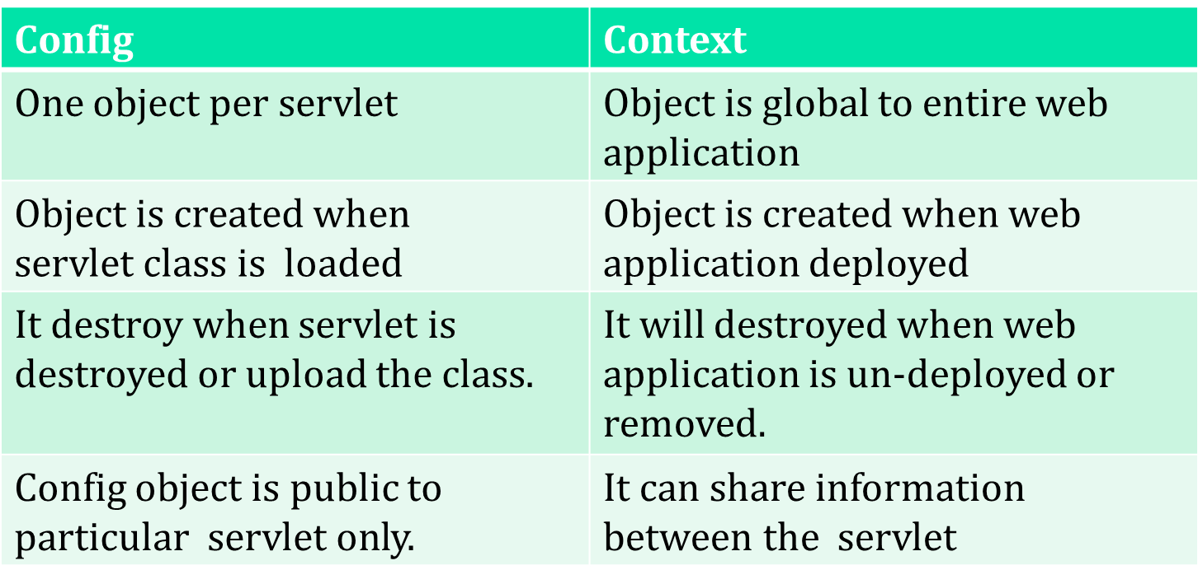
ServletConfig Vs ServletContext

Slide 36
ServletRequest Interface
It enables a servlet to obtain information about a client request.
Methods
Object getAttribute(String attr) -Returns the value of the server attribute named attr.
String getCharacterEncoding( ) Returns the character encoding of the request.
int getContentLength( ) Returns the size of the request. The value –1 is returned if the size is unavailable.
String getContentType( ) Returns the type of the request. A null value is returned if the type cannot be determined.
String getParameter(String pname) Returns the value of the parameter named pname.
Enumeration getParameterNames( ) Returns an enumeration of the parameter names for this request.

Slide 37
Cont…
7. String[ ] getParameterValues(String name ) Returns an array containing values associated with the parameter specified by name.
8. String getProtocol( ) Returns a description of the protocol.
9. String getRemoteAddr( ) Returns the string equivalent of the client IP address.
10. String getRemoteHost( ) Returns the string equivalent of the client host name.
11. String getScheme( ) Returns the transmission scheme of the URL used for the request (for example, “http”, “ftp”).
12. String getServerName( ) Returns the name of the server.
13. int getServerPort( ) Returns the port number.

Slide 38
ServletResponse Interface
It enables a servlet to formulate a response for a client.
Methods
String getCharacterEncoding( ) Returns the character encoding for the response.
ServletOutputStream getOutputStream( ) throws IOException- Returns a ServletOutputStream that can be used to write binary data to the response.
An IllegalStateException is thrown if getWriter( ) has already been invoked for
this request.
3. PrintWriter getWriter( ) throws IOException- Returns a PrintWriter that can be used to write character data to the response.An IllegalStateException is thrown if getOutputStream( ) has already been invoked for this request.
4. void setContentLength(int size) Sets the content length for the response to size.
5. void setContentType(String type) Sets the content type for the response to type.

Slide 39
GenericServlet Class
The GenericServlet class provides implementations of the basic life cycle methods for a servlet and is typically sub classed by servlet developers.
GenericServlet implements the Servlet and ServletConfig interfaces.
Methdos
void log(String s)
void log(String s, Throwable e)
Here, s is the string to be appended to the log, and e is an exception that occurred.

Slide 40
ServletInputStream Class
The ServletInputStream class extends InputStream.
It is implemented by the server and provides an input stream that a servlet developer can use to read the data from a client request. It defines the default constructor.
In addition, a method is provided to read bytes from the stream. Its signature is shown here:
int readLine(byte[ ] buffer, int offset, int size) throws IOException
Here, buffer is the array into which size bytes are placed starting at offset. The method returns the actual number of bytes read or –1 if an end-of-stream condition is encountered.

Slide 41
ServletOutputStream Class
The ServletOutputStream class extends OutputStream.
It is implemented by the server and provides an output stream that a servlet developer can use to write data to a client response.
A default constructor is defined.
It also defines the print( ) and println( ) methods, which output data to the stream.

Slide 42
Servlet Exception Classes
javax.servlet defines two exceptions. The first is ServletException, which indicates that a servlet problem has occurred.
The second is UnavailableException, which extends ServletException. It indicates that a servlet is unavailable.

Slide 43
Working with parameters of Servlet
Parameters may come into our application from the client request, or may be configured through deployment descriptor (web.xml) elements or their corresponding annotations. When you submit a form, form values are sent as request parameters to a web application.
Servlet init parameters and context init parameters are set through the deployment descriptor (web.xml). All parameters are read-only from the application code. We have methods in the Servlet API to retrieve various parameters.
Parameters are String objects.

Slide 44
Working with request parameters
The API methods to retrieve the request parameters are:
1. ServletRequest.getParameterValues(String parmName)
returns a String array with all values present, or null if no value exists for the parameter name.
2. ServletRequest.getParameter(String parmName)
returns the first value for the given parameter.
3. ServletRequest.getParameterNames()
returns an Enumeration of String objects representing the names of all the parameters in the request. If there are no parameters Enumeration will be empty.

Slide 45
Cont....
Input type in html are treated as parameters.
Different input types
<input type=“text”>- defines textbox
<input type=“password”>-defines password field
<input type=“submit”>-defines a button for submitting form data to a form-handler
<input type=“radio”>- defines radio button
<input type=“checkbox”>-defines checkbox

Slide 46
Cont..
6. <input type=“button”>- defines button
For providing choice control in html use <select> tag as shown in ex.
<select name="cars" id="cars"> <option value="volvo">Volvo</option> <option value="saab">Saab</option> <option value="mercedes">Mercedes</option> <option value="audi">Audi</option> </select>
To create list just provide multiple in select tag as
<select multiple ...>

Slide 47
Example of Reading request parameters
ReadingData.html
<html>
<form name="readdata" method="post" action="/servletpgm/readdatafromform">
<br>
<select multiple size="5" name="Browsers">
<option value="Internet Explorer">Internet Explorer</option>
<option value="Google Chrome">Google Chrome</option>
<option value="Firefox">Firefox</option>
<option value="Opera Mini">Opera Mini</option>
<option value="Safari">Safari</option>
</select>
<br>
Are you sure?:
<input type="radio" name="option" value="yes">Yes
<input type="radio" name="option" value="no">No
<br>
<input type="submit" value="Ok">
</html>

Slide 48
Cont....
web.xml
<web-app>
<servlet>
<servlet-name>second</servlet-name>
<servlet-class>ReadData</servlet-class>
</servlet>
<servlet-mapping>
<servlet-name>second</servlet-name>
<url-pattern>/readdatafromform</url-pattern>
</servlet-mapping>
</web-app>

Slide 49
Cont...
ReadData.java
import java.io.*;
import javax.servlet.*;
public class ReadData extends GenericServlet
{
public void service(ServletRequest req,ServletResponse res)throws IOException,ServletException
{
res.setContentType("text/html");
PrintWriter w=res.getWriter();
String p[]=req.getParameterValues("Browsers");
if(p!=null)
{
w.println("browsers selected are");
for(String b:p)
{
w.println(b);
}
}
String o=req.getParameter("option");
w.println("Browser selection correct:"+o);;
w.close();
}
}

Slide 50
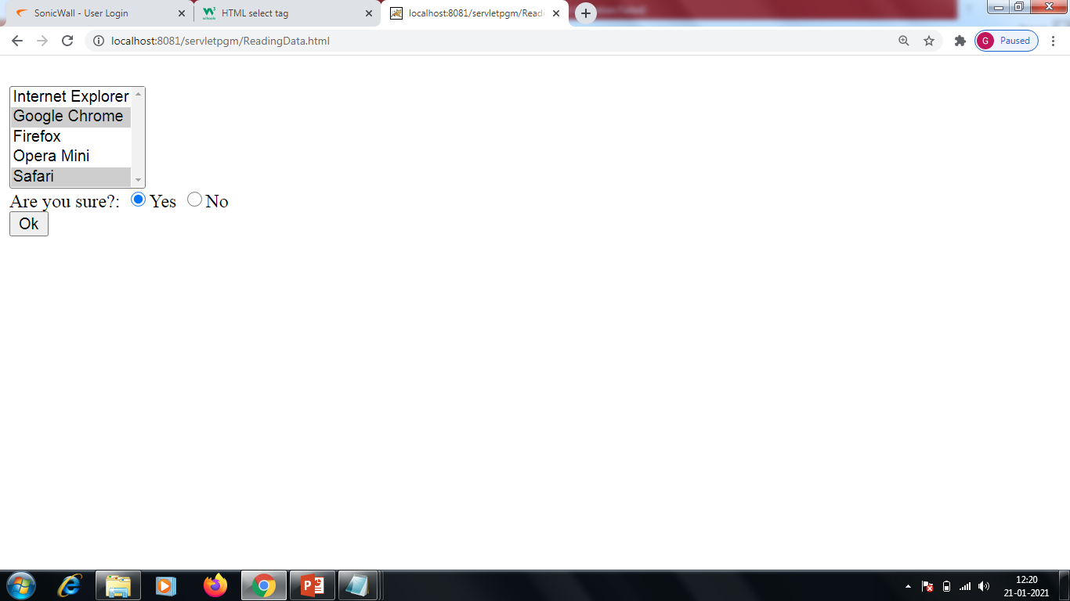
Example output

Slide 51
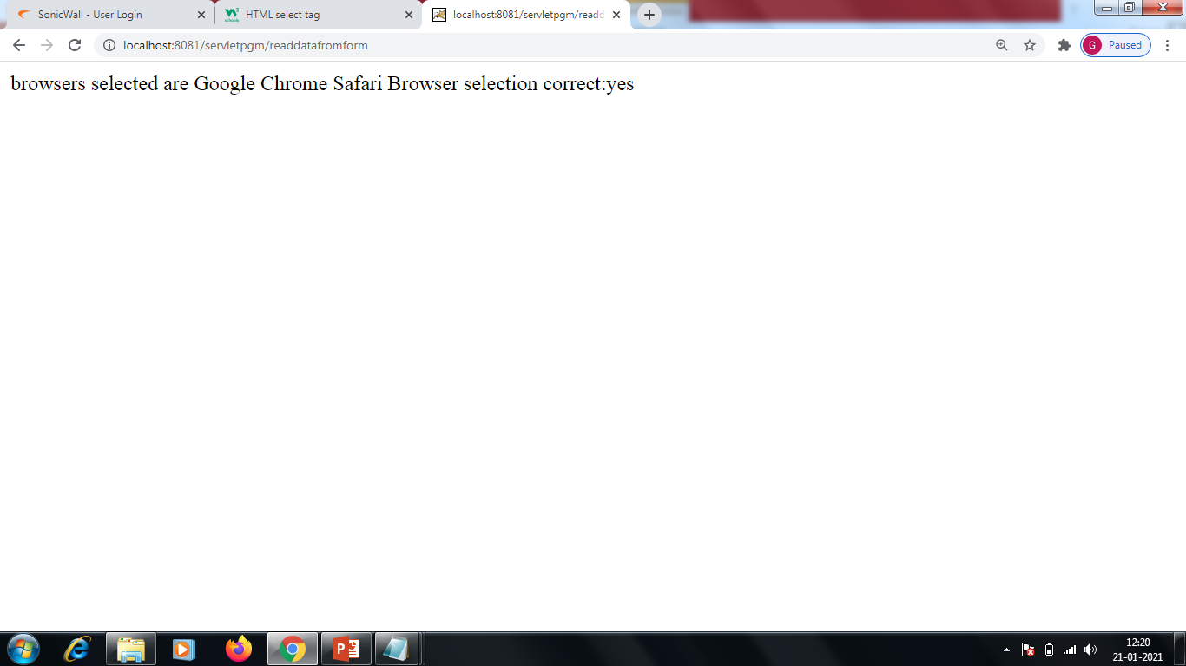
Cont...

Slide 52
Working with intilization parameters
The API methods to retrieve the ServletContext initialization parameters from a ServletContext object are:
ServletContext.getInitParameterNames()
will always return an enumeration of names.
ServletContext.getInitParameter(String paramName)
will return a String or null.
The API methods to retrieve the ServletConfig initialization parametersfrom a ServletConfig object are:
ServletConfig.getInitParameterNames()
returns an enumeration of all the parameter names available to the servlet.
ServletConfig.getInitParameter(String paramName)
return a parameter value.

Slide 53
Example
web.xml
<web-app>
<servlet>
<servlet-name>third</servlet-name>
<servlet-class>ReadInitParameter</servlet-class>
<init-param>
<param-name>Country</param-name>
<param-value>India</param-value>
</init-param>
<init-param>
<param-name>State</param-name>
<param-value>Maharashtra</param-value>
</init-param>
</servlet>
<servlet-mapping>
<servlet-name>third</servlet-name>
<url-pattern>/initparam</url-pattern>
</servlet-mapping>
</web-app>

Slide 54
Cont..
ReadInitParameter.java
import java.io.*;
import javax.servlet.*;
public class ReadInitParameter extends GenericServlet
{
public void service(ServletRequest req,ServletResponse res)throws ServletException,IOException
{
res.setContentType("text/html");
PrintWriter w=res.getWriter();
ServletConfig sc=getServletConfig();
w.println("Initilization parameters with their values");
String country=sc.getInitParameter("Country");
String state=sc.getInitParameter("State");
w.println("<br>"+"Country is "+country+"</br>");
w.println("<br>"+"State is "+state+"</br>");
w.close();
}
}

Slide 55
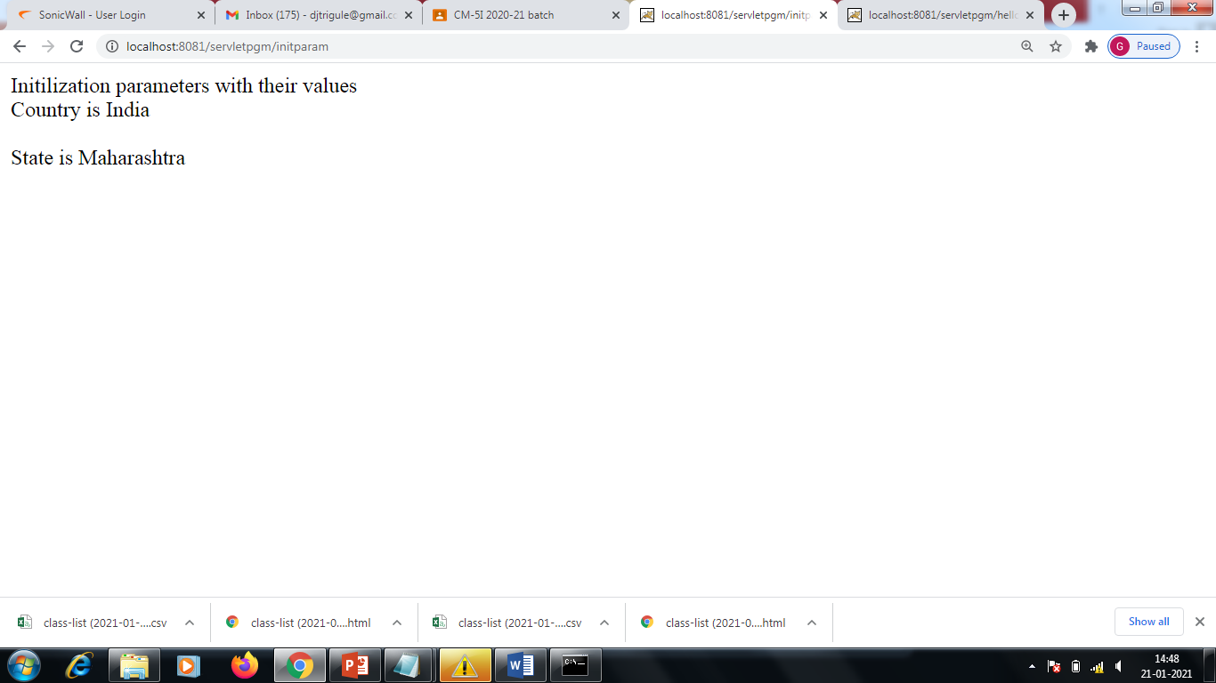
http://localhost:8081/servletpgm/initparam
Output:

Slide 56
javax.servlet.http Package
The javax.servlet.http package contains several interfaces and classes that are commonly used by servlet developers.
Its functionality makes it easy to build servlets that work with HTTP requests and responses.

Slide 57
Interfaces of javax.servlet.http package
HttpServletRequest-
Enables servlets to read data from an HTTP request.
HttpServletResponse-
Enables servlets to write data to an HTTP response.
HttpSession-
Allows session data to be read and written.
HttpSessionBindingListener-
Informs an object that it is bound to or unbound from a session.

Slide 58
Classes of javax.servlet.http package
Cookie-
Allows state information to be stored on a client machine.
HttpServlet-
Provides methods to handle HTTP requests and responses.
HttpSessionBindingEvent-
Indicates when a listener is bound to or unbound from a session value.

Slide 59
HttpServletRequest Interface
The HttpServletRequest interface is implemented by the server. It enables a servlet to obtain information about a client request.
Methods
String getAuthType( )
Returns authentication scheme.
Cookie[ ] getCookies( )
Returns an array of the cookies in this request.
long getDateHeader(String field)
Returns the value of the date header field named field
String getHeader(String field)
Returns the value of the header field named field
Enumeration getHeaderNames( )
Returns an enumeration of the header names.
int getIntHeader(String field)
Returns the int equivalent of the header field named field.
String getMethod( )
Returns the HTTP method for this request.
String getPathInfo( )
Returns any path information that is located after the servlet path and before a query string of the URI.

Slide 60
Cont...
String getPathTranslated( )
Returns any path information that is located after the servlet path and before a query string of the URI, after translating it to a real path.
String getQueryString( )
Returns any query string in the URI.
String getRemoteUser( )
Returns the name of the user who issued this request.
String getRequestedSessionId( )
Returns the ID of the session.
String getRequestURI( )
Returns that part of the URI to the left of any query string.
String getServletPath( )
Returns the part of the URI that identifies the servlet.
HttpSession getSession(boolean new)
If newis true, creates and returns a session for this request. Otherwise, returns the existing session for this request.
boolean isRequestedSessionIdFromCookie()
Returns true if a cookie contains the session ID. Otherwise, returns false.
boolean isRequestedSessionIdFromUrl( )
Returns true if the URL contains the session ID. Otherwise, returns false.
boolean isRequestedSessionIdValid( )
Returns true if the requested session ID is valid in the current session context

Slide 61
HttpServletResponse Interface
The HttpServletResponse interface is implemented by the server. It enables a servlet to formulate an HTTP response to a client.
Methods
void addCookie(Cookie cookie)
Adds cookie to the HTTP response.
boolean containsHeader(String field)
Returns true if the HTTP response header contains a field named field.
String encodeURL(String url)
Determines whether the session ID must be encoded in the URL identified as url. If so, returns the modified version of url. Otherwise, returns url. All URLs generated by a servlet should be processed by this method.
String encodeRedirectUrl(String url)
Determines whether the session ID must be encoded in the URL identified as url. If so, returns the modified version of url. Otherwise, returns url. All URLs passed to sendRedirect( ) should be processed by this method.
void sendError(int c) throws IOException
Sends the error code c to the client.

Slide 62
Cont..
void sendError(int c, String s) throws IOException
Sends the error code c and message s to the client.
void sendRedirect(String url) throws IOException Redirects the client to url.
void setDateHeader(String field, long msec)
Adds field to the header with date value equal to msec (milliseconds since midnight, January 1, 1970, GMT).
void setHeader(String field, String value)
Adds field to the header with value equal to value.
void setIntHeader(String field, int value)
Adds field to the header with value equal to value.
void setStatus(int code)
Sets the status code for this response to code.
void setStatus(int code, String s)
Sets the status code and message for this response to code and s.

Slide 63
HttpSession Interface
The HttpSession interface is implemented by the server. It enables a servlet to read and write the state information that is associated with an HTTP session.
All methods throw an IllegalStateException if the session has already been invalidated.
Methods
long getCreationTime( )
Returns the time (in milliseconds since midnight, January 1, 1970, GMT) when this session was created.
String getId( )
Returns the session ID.
long getLastAccessedTime( )
Returns the time (in milliseconds since midnight, January 1, 1970, GMT) when the client last made a request for this session.
HttpSessionContext getSessionContext( )
Returns the context associated with this session.

Slide 64
HttpSessionBindingListener Interface
The HttpSessionBindingListener interface is implemented by objects that need to be notified when they are bound to or unbound from an HTTP session.
The methods that are invoked when an object is bound or unbound are the following:
void valueBound(HttpSessionBindingEvent e)
void valueUnbound(HttpSessionBindingEvent e)
Here, e is the event object that describes the binding.

Slide 65
HttpServlet Class
The HttpServlet class extends GenericServlet. It is commonly used when developing servlets that receive and process HTTP requests.
Methods
void doDelete(HttpServletRequest req, HttpServletResponse res) throws IOException, ServletException
Performs an HTTP DELETE.
void doGet(HttpServletRequest req, HttpServletResponse res) throws IOException, ServletException Performs an HTTP GET.
void doOptions(HttpServletRequest req, HttpServletResponse res) throws IOException, ServletException
Performs an HTTP OPTIONS.

Slide 66
Cont....
void doPost(HttpServletRequest req, HttpServletResponse res) throws IOException, ServletException
Performs an HTTP POST.
void doPut(HttpServletRequest req, HttpServletResponse res) throws IOException, ServletException
Performs an HTTP PUT.
void doTrace(HttpServletRequest req, HttpServletResponse res) throws IOException, ServletException
Performs an HTTP TRACE.
long getLastModified(HttpServletRequest req)
Returns the time (in milliseconds since midnight, January 1, 1970, UTC) when the requested resource was last modified.
void service(HttpServletRequest req, HttpServletResponse res) throws IOException, ServletException
Called by the server when an HTTP request arrives for this servlet. The arguments provide access to the HTTP request and response, respectively.

Slide 67
Handling HTTP Requests and Responses
The HttpServlet class provides specialized methods that handle the various types of HTTP requests.
A servlet developer typically overrides one of these methods. These methods are doDelete( ), doGet( ), doOptions( ),doPost( ),doPut( ), and doTrace( ).
The GET and POST methods are commonly used when handling form input.
GET- It requests the data from a specified resource
POST- It submits the processed data to a specified resource
The query string (name/value pairs) is sent inside the URL of a GET request:
GET /RegisterDao.jsp?name1=value1&name2=value2

Slide 68
Difference between GET and POST
GET | POST
1) In case of Get request, only limited amount of data can be sent because data is sent in header. | In case of post request, large amount of data can be sent because data is sent in body.
2) Get request is not secured because data is exposed in URL bar. | Post request is secured because data is not exposed in URL bar.
3) Get request can be bookmarked. | Post request cannot be bookmarked.
4) Get request is idempotent . It means second request will be ignored until response of first request is delivered | Post request is non-idempotent.
5) Get request is more efficient and used more than Post. | Post request is less efficient and used less than get.

Slide 69
GET Example
getrequest.html
<html>
<form name="SampleGet" method="get" action="/servletpgm/getRequest">
<h1>Enter Welcome Message</h1>
<br>
<input type="text" name="WelcomeMsg" value="">
<input type="submit" value="Ok">
</html>
web.xml
<web-app>
<servlet>
<servlet-name>sixth</servlet-name>
<servlet-class>GetData</servlet-class>
</servlet>
<servlet-mapping>
<servlet-name>sixth</servlet-name>
<url-pattern>/getRequest</url-pattern>
</servlet-mapping>
</web-app>

Slide 70
Cont..
GetData.java
import java.io.*;
import javax.servlet.*;
import javax.servlet.http.*;
public class GetData extends HttpServlet
{
public void doGet(HttpServletRequest req,HttpServletResponse res)throws ServletException,IOException
{
res.setContentType("text/html");
PrintWriter w=res.getWriter();
String msg=req.getParameter("WelcomeMsg");
w.println(msg);
w.close();
}
}

Slide 71
POST Example
postrequest.html
<html>
<form name="SampleGet" method=“post" action="/servletpgm/postRequest">
<h1>Enter Welcome Message</h1>
<br>
<input type="text" name="WelcomeMsg" value="">
<input type="submit" value="Ok">
</html>
web.xml
<web-app>
<servlet>
<servlet-name>seventh</servlet-name>
<servlet-class>PostData</servlet-class>
</servlet>
<servlet-mapping>
<servlet-name>seventh</servlet-name>
<url-pattern>/postRequest</url-pattern>
</servlet-mapping>
</web-app>

Slide 72
Cont..
PostData.java
import java.io.*;
import javax.servlet.*;
import javax.servlet.http.*;
public class PostData extends HttpServlet
{
public void doPost(HttpServletRequest req,HttpServletResponse res)throws ServletException,IOException
{
res.setContentType("text/html");
PrintWriter w=res.getWriter();
String msg=req.getParameter("WelcomeMsg");
w.println(msg);
w.close();
}
}

Slide 73
Cookie class
Cookies are Small files that store information on client's computer.
Cookies are valuable for tracking user activities.
Servlet can check previous cookies for information.
A servlet can write a cookie to a user's machine via the addCookie( ) method of the HttpServletResponse interface.
The data for that cookie is then included in the header of the HTTP response that is sent to the browser.
The names and values of cookies are stored on the user's machine.
Some of the information that is saved includes the cookie's:
name
value
expiration date- determines when this cookie is deleted from the user's machine
domain and path- determine when it is included in the header of an HTTP request. If the user enters a URL whose domain and path match these values, the cookie is then supplied to the Web server. Otherwise, it is not.

Slide 74
Cont...
Constructor for Cookie is
Cookie(String name, String value)
Here, the name and value of the cookie are supplied as arguments to the constructor.
To retrieve cookies use getCookies() method of HttpServletRequest interface

Slide 75
Methods of Cookie class
Object clone( )-Returns a copy of this object.
String getComment( )-Returns the comment.
String getDomain( )-Returns the domain.
int getMaxAge( )-Returns the age (in seconds).
String getName( )-Returns the name.
String getPath( )-Returns the path.
boolean getSecure( )-Returns true if the cookie is secure. Otherwise, returns false.
String getValue( )-Returns the value.
int getVersion( )-Returns the version.
void setComment(String c)-Sets the comment to c.
void setDomain(String d) -Sets the domain to d.
void setMaxAge(int secs)-Sets the maximum age of the cookie to secs. This is the number of seconds after which the cookie is deleted.
void setPath(String p)-Sets the path to p.
void setSecure(boolean secure)-Sets the security flag to secure.
void setValue(String v)-Sets the value to v.
void setVersion(int v)-Sets the version to v

Slide 76
Example
Demonstrate cookies
Servlet handles both POST and GET requests
User set Cookie data
POST - Add cookie to client machine.
GET - Browser sends cookies to servlet.
Two separate HTML files
One invokes POST, the other GET
Same ACTION - invoke same servlet

Slide 77
addCookie.html
<html>
<form name="addcookie" method="post" action="/servletpgm/cookie">
Enter Value for MyCookie
<input type=textbox name="data">
</form>
</html>

Slide 78
getCookie.html
<html>
<form name="getcookie" method="get" action="/servletpgm/cookie">
Press GetCookie button
<input type=submit name="GetCookie">
</form>
</html>

Slide 79
CookieExample.java
import java.io.*;
import javax.servlet.*;
import javax.servlet.http.*;
public class CookieExample extends
HttpServlet
{
public void doPost(HttpServletRequest
req,HttpServletResponse res)throws
ServletException,IOException
{
res.setContentType("text/html");
PrintWriter w=res.getWriter();
String cVal=req.getParameter("data");
Cookie c=new Cookie("CookieData",cVal);
res.addCookie(c);
w.println("<br>"+"Cookie has been set
to"+cVal);
w.close();
}
public void doGet(HttpServletRequest
req,HttpServletResponse res)throws
ServletException,IOException
{
res.setContentType("text/html");
PrintWriter w=res.getWriter();
Cookie c[]=req.getCookies();
for(int i=0;i<c.length;i++)
{
String name=c[i].getName();
String val=c[i].getValue();
c[i].setComment("This is a demo of cookie");
int j=c[i].getMaxAge();
w.println("<br>"+"Name"+name);
w.println("<br>"+"Value"+val);
w.println("<br>"+"Age is"+j);
}
w.close();
}
}

Slide 80
web.xml
<web-app>
<servlet>
<servlet-name>Eighth</servlet-name>
<servlet-class>CookieExample</servlet-class>
</servlet>
<servlet-mapping>
<servlet-name>Eighth</servlet-name>
<url-pattern>/cookie</url-pattern>
</servlet-mapping>
</web-app>

Slide 81
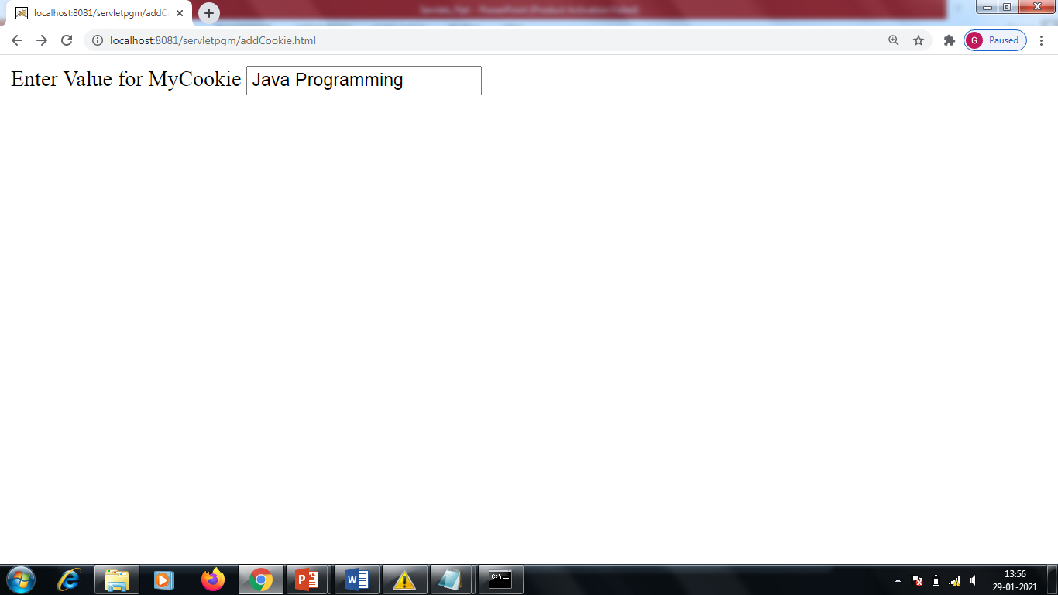
Output

Slide 82
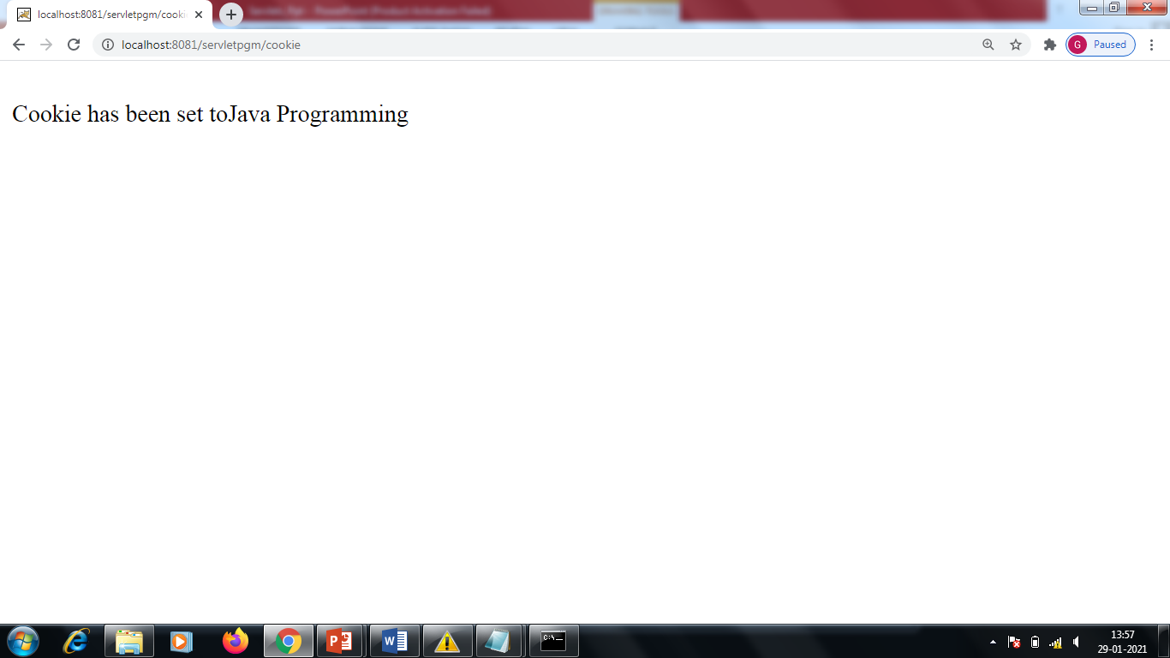
Output cont...

Slide 83
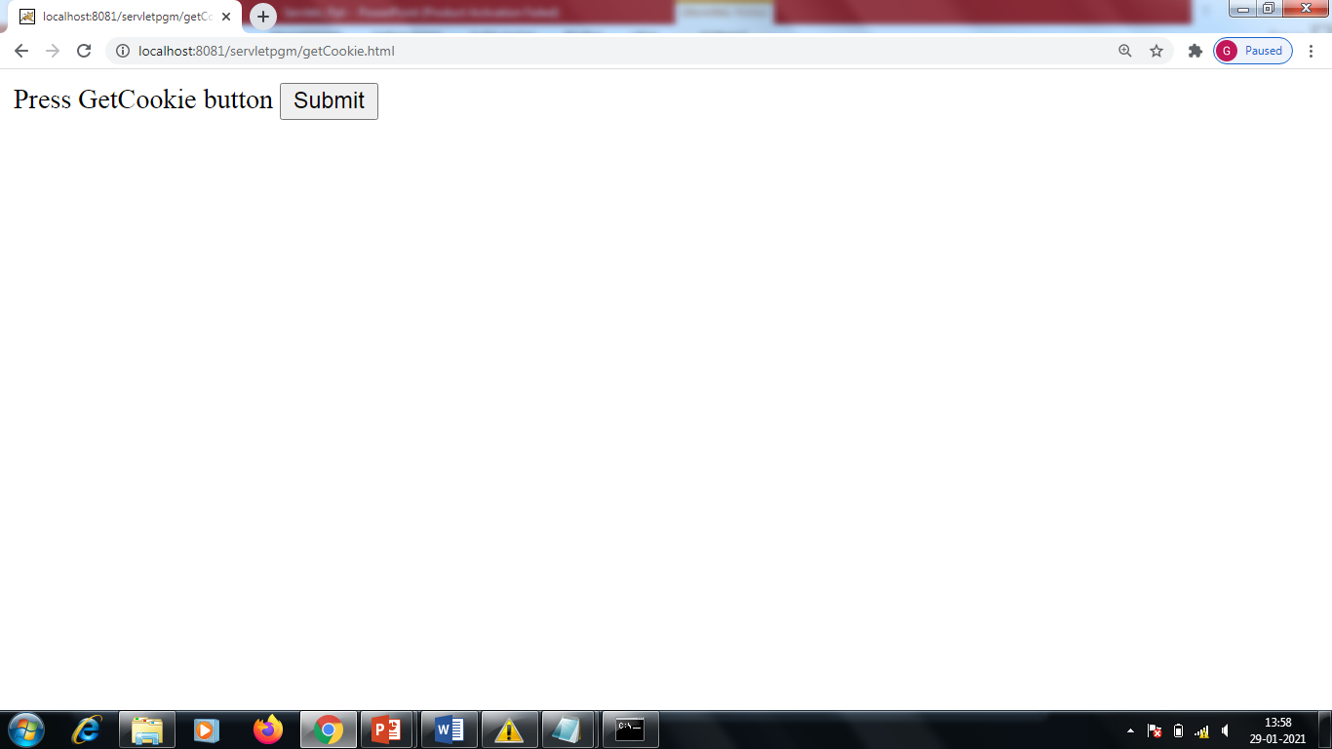
Output cont..

Slide 84
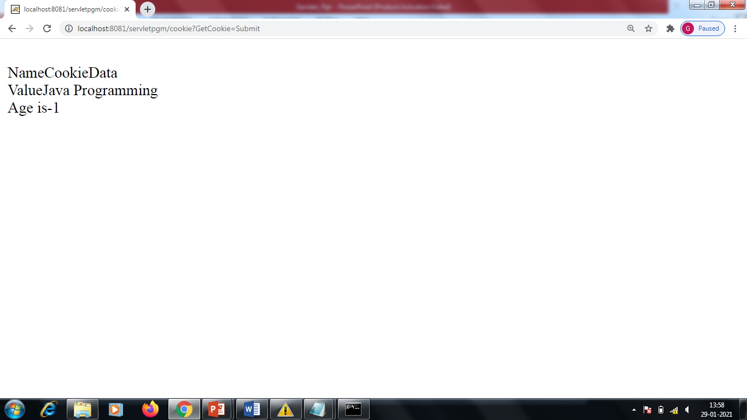
Output cont..

