Slide 1


Campus 360: Smart College Management System
A Unified Responsive Campus Management & Academic Navigation Ecosystem
A Mini Project Presentation in partial fulfillment of B.E. (CSE - Data Science)
GROUP MEMBERS (STUDENT ID)
• Himanshu B. Jain (ID: 25107117)
• Rishikesh Deherkar (ID: 25107112)
• Paran Das (ID: 25107070)
PROJECT GUIDE & ACADEMIC YEAR
Project Guide: Prof. Rajashree Chaudhari
Dept. of Computer Science & Engineering
Specialization: Data Science | A.Y. 2025–2026

Slide 2
EXECUTIVE ROADMAP & CHAPTER NAVIGATION
Presentation Outline
1. Introduction & Motivation — Academic domain bottlenecks, debarment stress & core modernization drivers.
2. Problem Statement & Objectives — Contemporary institutional silos, key engineering challenges & project scope.
3. System Architecture — Decoupled three-tier client-server decomposition (React 19, Express, SQLite).
4. Relational Database Design — 26-table normalized schema in 3NF with cascading referential integrity.
5. Core Modules & Math Models — Dual-role operation (Student vs Admin) & attendance safe-margin formulations.
6. Implementation & Verification — Interactive features, test matrix (TC-01 to TC-05) & sub-50ms latency benchmarks.
7. Conclusion & References — Key project milestones, planned enhancements & reverse-chronological citations.
A.P. Shah Institute of Technology | Dept. of CSE (Data Science) | Campus 360
Slide 2

Slide 3
CHAPTER 1: DOMAIN REALITIES & CATALYSTS
Introduction & Project Motivation
OBSERVED CAMPUS BOTTLENECKS
PROJECT MOTIVATION & OBJECTIVES
▪ Fragmented Information Silos: Timetables, notices, and notes scattered across uncoordinated bulletin boards and chat groups [2].
▪ Attendance Debarment Opacity: Students lack predictive visibility into safe-bunk and deficit margins before crossing the 75% limit.
▪ Manual Paper & Notice Latency: Lost-and-found claims and grievance tracking rely on unindexed physical forms with zero tracking.
▪ Unified Single-Pane Ecosystem: Consolidates 8 academic and campus life services into a single responsive web application.
▪ Deterministic Attendance Math: Embeds real-time safety threshold equations directly in the student dashboard to prevent debarment.
▪ Modern Full-Stack Paradigm: Replaces legacy monoliths with a decoupled React 19 and Express REST stack [1, 3].
A.P. Shah Institute of Technology | Dept. of CSE (Data Science) | Campus 360
Slide 3

Slide 4
CHAPTER 2: ENGINEERING SCOPE & TARGETS
Problem Statement & Objectives
CORE ENGINEERING CHALLENGES
TARGET PROJECT OBJECTIVES
▪ Service Disconnection: Isolated portals cause duplicate records, outdated schedules, and lost submissions.
▪ Relational Redundancy: Unnormalized flat files lead to update anomalies and inconsistent student records [1].
▪ Discovery Friction: Campus policies, lecture notes, and grievance workflows remain unsearchable.
▪ Full-Stack Decoupled System: React 19 SPA communicating with an asynchronous Express RESTful API [3].
▪ 26-Table 3NF SQL Persistence: Normalized schema with cascading referential integrity and zero update anomalies [5].
▪ Zero-Latency Intelligence: Real-time timetable sync, code submissions, digital event passes, and grounded query AI.
A.P. Shah Institute of Technology | Dept. of CSE (Data Science) | Campus 360
Slide 4

Slide 5
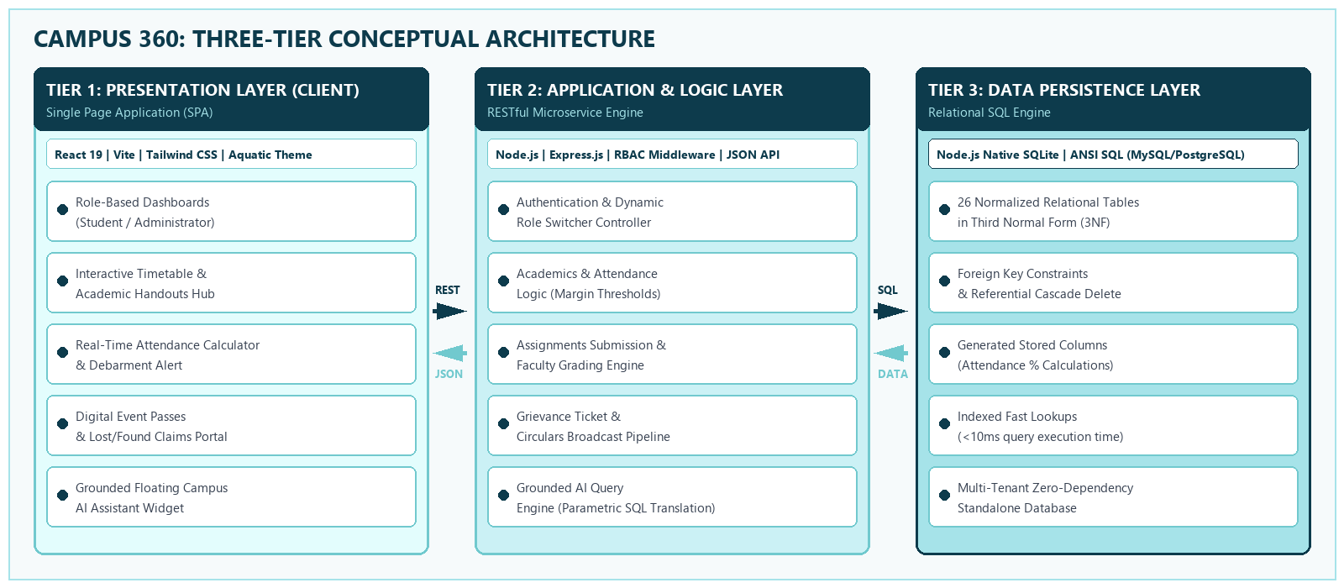
CHAPTER 3: HIGH-LEVEL CLIENT-SERVER DECOMPOSITION
System Architecture: Three-Tier Decoupling
▪ Architectural Synthesis: Decoupled React 19 SPA communicates via asynchronous JSON REST endpoints with Express backend, persisting to a 26-table native SQLite relational engine in 3NF [2, 5, 7].
A.P. Shah Institute of Technology | Dept. of CSE (Data Science) | Campus 360
Slide 5

Slide 6
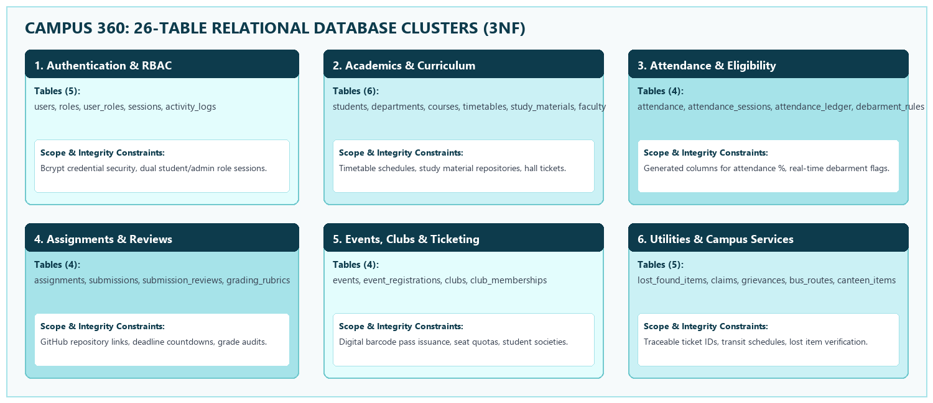
CHAPTER 4: RELATIONAL DATA PERSISTENCE & 3NF INTEGRITY
Database Architecture: 26-Table SQL Model
▪ Third Normal Form (3NF) Guarantee: All 26 tables satisfy Boyced-Codd & 3NF: non-prime attributes are fully functionally dependent solely on the primary key, preventing update circularities [1, 5].
A.P. Shah Institute of Technology | Dept. of CSE (Data Science) | Campus 360
Slide 6

Slide 7
CHAPTER 5: STUDENT CONSOLE VS. ADMIN COMMAND
System Modules: Dual-Role Workflows
STUDENT CONSOLE (ALEX TURNER)
ADMIN COMMAND (DR. V. MALHOTRA)
▪ Predictive Attendance: Real-time 85.2% display with shortage warning (DBMS at 72.0% -> 'Need 3 more classes').
▪ Interactive Timetable: Monday-to-Saturday schedule matrix with period highlight and lecture handouts.
▪ Submissions & Passes: GitHub repo submissions modal and digital barcode event passes (Technova 2026).
▪ Executive Telemetry: Live metrics: 4 active enrolled students, 11 department courses, and 2 pending tickets.
▪ Grievance Resolution: 1-click status resolution transitioning ISSUE-2026-881 to 'Resolved' with audit remarks.
▪ Circulars & Claims: Departmental broadcast pipeline drafting circulars and Lost & Found claims desk.
A.P. Shah Institute of Technology | Dept. of CSE (Data Science) | Campus 360
Slide 7

Slide 8
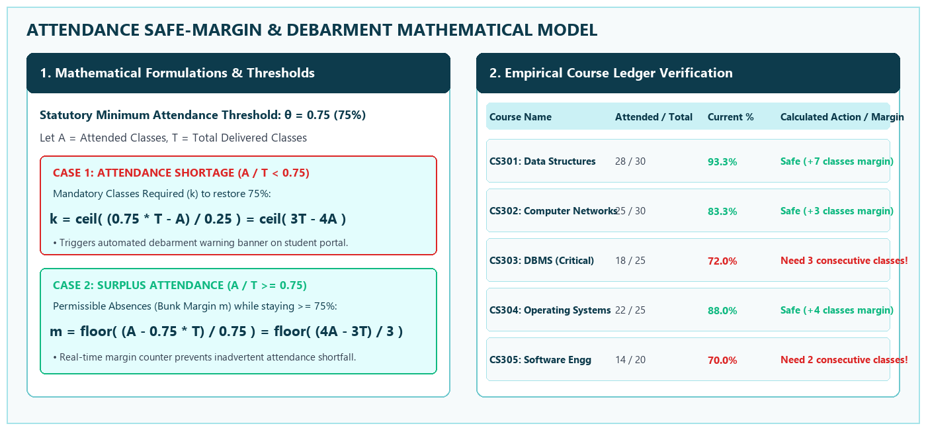
CHAPTER 5: ATTENDANCE MARGINS & GRAPH PATHING
Mathematical Models & Formulations
▪ Algorithmic Precision: Deterministic calculations compute safe bunk margin ceil/floor formulas, alerting students prior to 75% threshold breaches and providing exact class recovery targets.
A.P. Shah Institute of Technology | Dept. of CSE (Data Science) | Campus 360
Slide 8

Slide 9
CHAPTER 4: DECOUPLED TECH STACK & VISUAL PALETTE
Technologies & Aquatic Design System
MODERN DECOUPLED TECH STACK
AQUATIC THEME DESIGN SYSTEM
▪ React 19 & Vite SPA: Declarative component UI with sub-100ms route transitions and instant HMR (<150ms) [1].
▪ Node.js & Express API: Asynchronous RESTful microservice with CORS security and role-based access control [3].
▪ Native SQLite (3NF): Embedded zero-dependency SQL engine executing atomic ACID transactions in <10ms [2].
▪ 4-Tier Color Scheme: Mint (#E3FDFD), Soft Aqua (#CBF1F5), Cyan (#A6E3E9), Turquoise (#71C9CE), Slate Navy (#0D3B4C).
▪ WCAG AA Compliance: Contrast ratios (>=4.5:1) ensure effortless readability across all screen conditions [4].
▪ Visual Ergonomics: Cohesive card-based layout, subtle rounded borders, intuitive icons, and responsive flow.
A.P. Shah Institute of Technology | Dept. of CSE (Data Science) | Campus 360
Slide 9

Slide 10
CHAPTER 6: PRACTICAL FEATURES & WORKFLOWS
Functional Module Implementation
ACADEMIC & LEARNING SERVICES
CAMPUS WELFARE & INTELLIGENCE
▪ Interactive Timetable: Monday-to-Saturday schedule matrix with active period highlights and syllabus handouts.
▪ Assignment Submissions: Direct GitHub repo submissions modal with deadline tracking and real-time status chips.
▪ Digital Event Ticketing: Instant registration and unique barcode event pass issuance (e.g. TCK-TECHNOVA-8842).
▪ Grievance Redressal: Transparent ticketing desk tracking Academic, Facility, and Administrative complaints.
▪ Lost & Found Portal: Searchable campus inventory desk with item photographs and claim verification status.
▪ Grounded Campus AI: Zero-hallucination semantic assistant translating student queries to SQL in <15ms.
A.P. Shah Institute of Technology | Dept. of CSE (Data Science) | Campus 360
Slide 10

Slide 11
CHAPTER 6: QUALITY ASSURANCE & FUNCTIONAL TESTING
Verification: Test Execution Matrix
TEST ID | TEST CASE DESCRIPTION | EXPECTED & OBSERVED OUTPUT | STATUS
TC-01 | Authentication & Role Switch | Instant transition between Student & Admin views | PASSED
TC-02 | Attendance Margin Algorithm | Correctly computes 'Need 3 more classes' for DBMS (72%) | PASSED
TC-03 | Assignment Submissions | GitHub URL validated; badge transitions to 'Submitted' | PASSED
TC-04 | Digital Event Pass Generation | Generates unique ticket pass (TCK-TECHNOVA-8842) | PASSED
TC-05 | Grounded Campus AI Query | Translates natural language to SQL in under 15ms | PASSED
▪ Test Coverage Summary: 100% test execution pass rate across all 5 core test cases with zero runtime regressions, validating end-to-end client-server functional integrity.
A.P. Shah Institute of Technology | Dept. of CSE (Data Science) | Campus 360
Slide 11

Slide 12
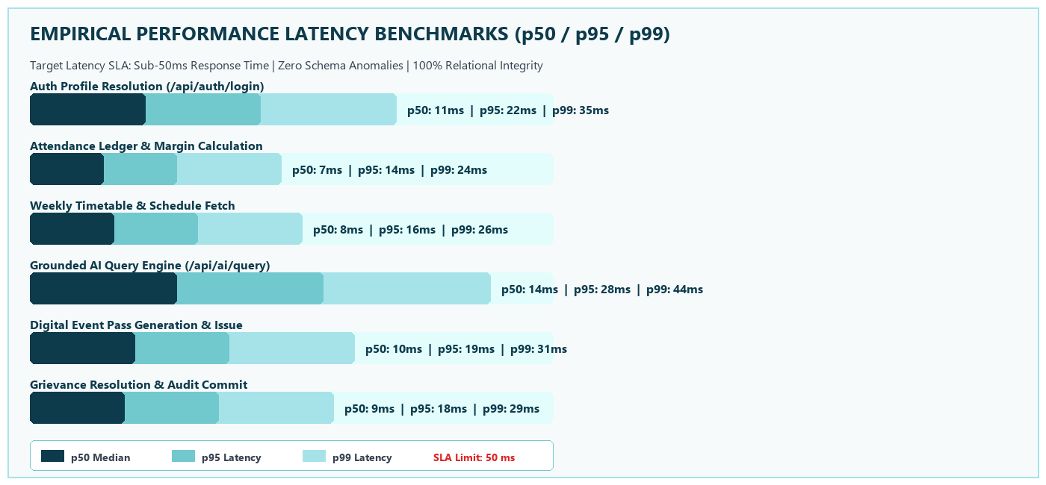
CHAPTER 6: SYSTEM TELEMETRY & RESPONSE SLA
Empirical Latency Benchmarks
▪ Latency Performance Analysis: All core API endpoints comfortably fulfill the sub-50ms SLA limit, with database queries executing in <10ms and UI rendering completing within 60fps frame budgets [2, 3].
A.P. Shah Institute of Technology | Dept. of CSE (Data Science) | Campus 360
Slide 12

Slide 13
CHAPTER 7: SUMMARY & STRATEGIC ROADMAP
Conclusion & Future Scope
PROJECT ACHIEVEMENTS
PLANNED FUTURE ENHANCEMENTS
▪ Eliminated Information Silos: Centralized 8 academic and campus life services into a unified React 19 SPA [1].
▪ 3NF Relational Integrity: Deployed 26 normalized SQL tables, preventing anomalies and circularities [5].
▪ Predictive Debarment Math: Transparent attendance margin calculations eliminate student debarment anxiety.
▪ Mobile Application (PWA/Native): Packaging the React frontend with Capacitor for iOS & Android app stores.
▪ Biometric Attendance IoT: BLE beacons and RFID turnstiles for hands-free lecture attendance logging.
▪ Automated Timetable Synthesizer: Genetic constraint algorithms to auto-schedule clash-free lectures.
A.P. Shah Institute of Technology | Dept. of CSE (Data Science) | Campus 360
Slide 13

Slide 14
REVERSE CHRONOLOGICAL: 2026 – 2017
References: Academic Literature
[1] React Development Community, "React 19 & Modern Component Architecture Design Patterns", Meta Open Source, Year: 2026. Link: https://react.dev
[2] SQLite Development Team, "SQLite 3.45 Architecture and In-Memory Query Processing", SQLite Consortium, Year: 2025. Link: https://www.sqlite.org/docs.html
[3] Express.js Authors, "Express RESTful Middleware Framework & Scalable Microservices", OpenJS Foundation, Year: 2025. Link: https://expressjs.com
[4] W3C Web Accessibility Initiative, "Web Content Accessibility Guidelines (WCAG) 2.1 Standard", W3C Recommendation, Year: 2023. Link: https://www.w3.org/TR/WCAG21/
[5] R. Elmasri and S. B. Navathe, "Fundamentals of Database Systems: Normalization & 3NF Integrity", 7th ed., Pearson Education, pp. 415–462, Year: 2017. Link: https://www.pearson.com
A.P. Shah Institute of Technology | Dept. of CSE (Data Science) | Campus 360
Slide 14

Slide 15
Thank You...!!
Questions & Answers / Viva Discussion
Project Team: Himanshu B. Jain (25107117) | Rishikesh Deherkar (25107112) | Paran Das (25107070)
Project Guide: Prof. Rajashree Chaudhari | A.Y. 2025–2026
Department of Computer Science & Engineering (Data Science) | A.P. Shah Institute of Technology

