Slide 1
Technical Seminar
Image Processing with Open CV
Submitted by :
Jai Jain
1BM18CS040

Slide 2
Overview
OpenCV (Open Source Computer Vision Library) is a library of programming functions mainly aimed at real-time computer vision.
Originally developed by Intel
Open CV has wide range of applications in programming and technology.
Using a combination of trending technology and a 13,000 member workforce, Bridged intends to save you from the burden of creating data, while you focus on its involvement in your operation.
Bridged also has an AI-Based online learning platform offering students a holistic learning experience, help them become Industry ready .

Slide 3
Project – Image recognition and Template Matching
Image recognition, in the context of machine vision, is the ability of software to identify objects and actions in images.
Image recognition is used to perform many machine-based visual tasks, such as labeling the content of images with meta-tags, performing image content search and guiding autonomous robots, self-driving cars and accident-avoidance systems
Google, Facebook, Microsoft, Apple and Pinterest are among the many companies that are investing significant resources and research into image recognition and related applications.Privacy concerns over image recognition and similar technologies are controversial as these companies can pull a large volume of data from user photos uploaded to their social media platforms.

Slide 4
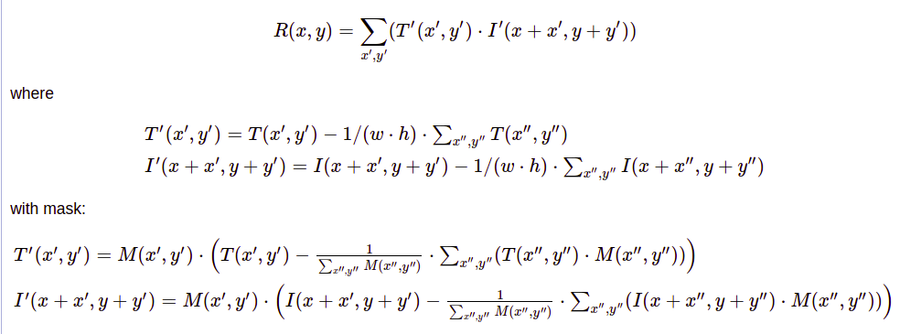
Algorithms and Research Papers
TM_CCOEFF
A research paper “ C++ with the OpenCV Library “ By Adrian Kaehler,.
TM_CCOEFF method is simply used to a) make the template and image zero mean and b) make the dark parts of the image negative values and the bright parts of the image positive values.

Slide 5

Algorithms and Research Papers
TM_CCORR
A research paper “OpenCV 3: Computer Vision“ By Gary Bradski.
TM_CCORR is the direct ("simplest") correlation between template and image:
result pixel is the sum of the dot product of between the template pixel and and image pixel for each pixel in the template.

Slide 6

Algorithms and Research Papers
TM_SQDIFF
A research paper “OpenCV 3: Computer Vision“ By Adrian Rosebrock.
The SQDIFF or Square difference method uses squared distance between template and the image.

Slide 7
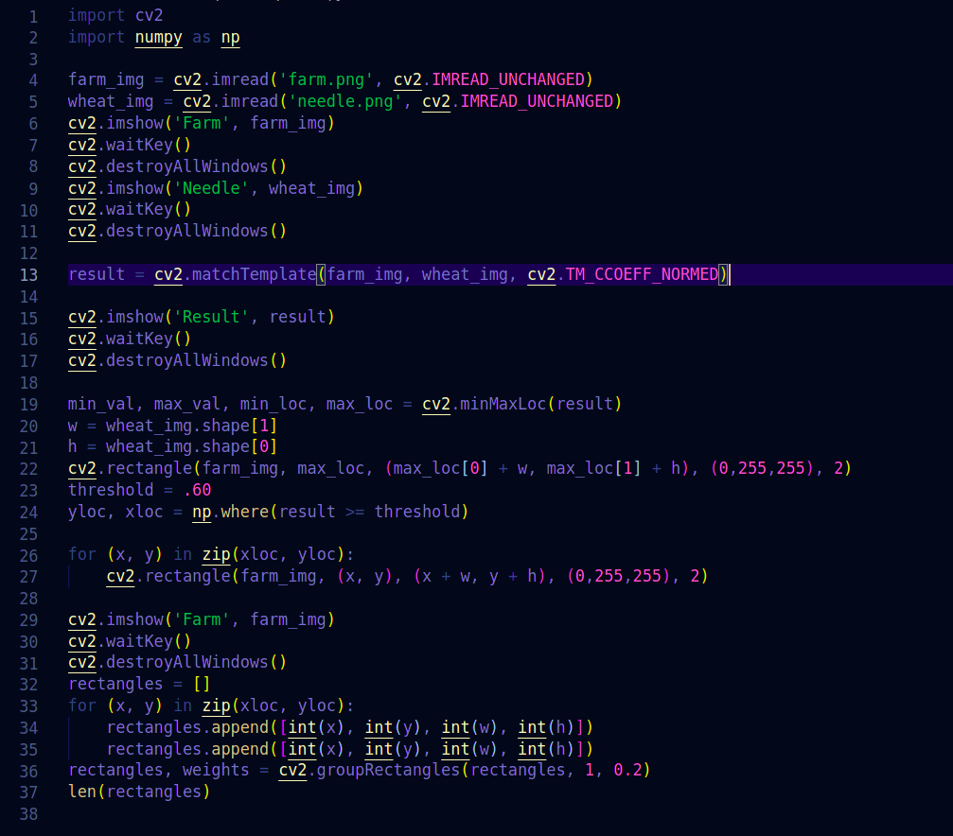
Code

Slide 8
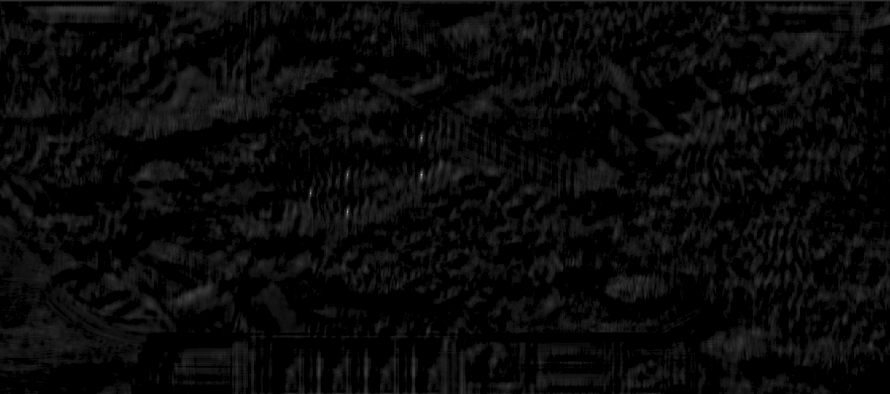

Result
cv2.TM_CCOEFF_NORMED gave the best result

