Slide 1




SMART INDIA HACKATHON 2026
TITLE PAGE
Problem Statement ID – 26005
Problem Statement Title – Solar Powered Smart Mini Cold Storage System for Fresh Vegetables in North Eastern Region (NER)
Theme - Agriculture, Food Tech & Rural Development
PS Category- Hardware
Team ID-
Team Name (Registered on portal) – Dhoop Tech

Slide 2
IDEA TITLE
Dhoop Tech
IDEA AND SOLUTION :
A compact refrigerator that uses *Solar Energy and Peltier Technology* to provide cooling without relying completely on grid electricity.
Off-grid cooling — Enables cooling with solar-charged battery power.
Renewable energy — Uses solar energy for battery charging.
Compressor-free cooling — Uses Peltier thermoelectric technology.
Better heat management — Heat sinks and fans effectively remove hot-side heat.
Temperature monitoring — Real-time temperature can be monitored without opening the chamber.
Thermal insulation — Thermocol reduces unwanted heat transfer and helps maintain the cold environment.
Backup operation — Rechargeable battery and manual charging provide flexibility when sunlight is unavailable.
Compact & practical — Suitable for small-scale cooling and academic/field demonstrations.
Multi-domain learning — Integrates electrical, thermal, mechanical and renewable-energy concepts.
Problem Resolution - Small and remote locations may face *limited access to reliable electricity*, making conventional refrigeration difficult.
Works using solar energy
Battery provides backup when sunlight is unavailable
Insulation helps maintain the cooling inside
Compact and suitable for small-scale cooling needs
Unique Value Proposition - *Solar + Battery + Peltier* in one system
*Compressor-free cooling*
Active heat management using *3 cooling fans*
Real-time temperature display
Designed for *off-grid and low-connectivity areas*
@SIH Idea submission- Template
2
Notes:
2

Slide 3
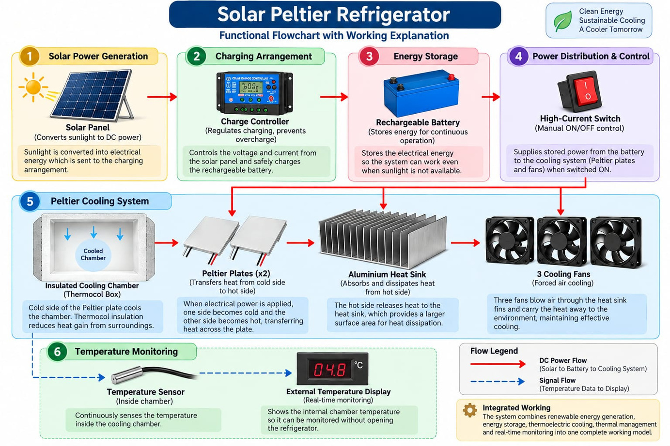
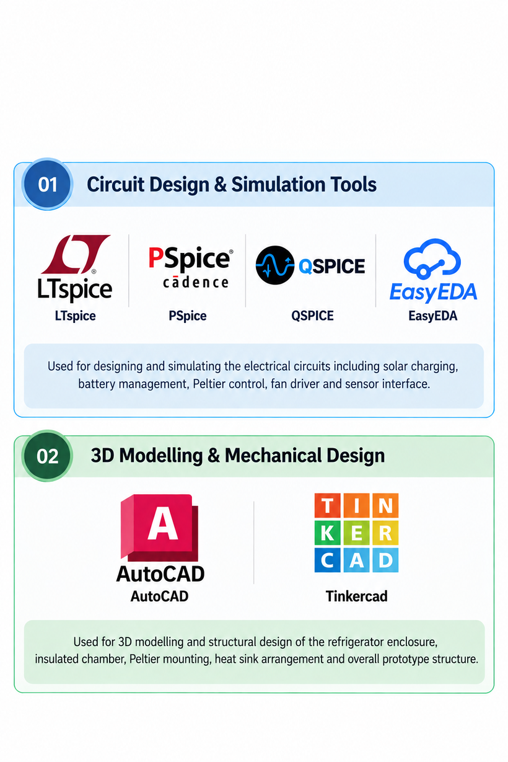
TECHNICAL APPROACH
Dhoop Tech
Tools/Tech used
@SIH Idea submission- Template
3
Notes:
3

Slide 4
FEASIBILITY AND VIABILITY
Dhoop Tech
Feasibility of the idea
Technical Feasibility:
Uses readily available components such as Peltier modules, DC fans, solar panels, batteries, temperature sensors and microcontrollers.
➢ Operational Feasibility:
Can be operated with a simple interface and requires little mechanical maintenance.
➢ Energy Feasibility:
Solar generation combined with battery storage can provide power during sunlight hours as well as periods of low sunlight.
➢ Economic Feasibility:
Prototype can be constructed using commercially available components, allowing the design to be tested and scaled according to storage requirements.
Potential Challenges, Risks and their Overcoming:
Low cooling efficiency of Peltier modules
Solution: Use of effective insulation, adequate heat-sink area and high-airflow fans minimizing cooling losses.
Heat accumulation on the hot side
Solution: Constant ventilation for the heat sink and hot-side temperature monitoring
Limited battery backup
Solution: Optimized cooling cycles and insulation to reduce unnecessary energy consumption.
Temperature variation inside the chamber
Solution: Strategically and maintain proper airflow inside the storage chamber.
Outdoor operating conditions
Solution: Use weather-resistant housing and protect the electronic components from moisture and dust.
@SIH Idea submission- Template
4
Notes:
4

Slide 5
IMPACT AND BENEFITS
Dhoop Tech
Reduced Post-Harvest Losses
Provides temporary controlled cooling after harvesting.
Helps slow deterioration and gives farmers additional time before transportation or sale.
Improved Farmer Flexibility
Creates a local storage point between harvesting and transportation.
Farmers are less dependent on immediate sale of highly perishable vegetables.
Affordable Local Cold Storage
Compact construction allows deployment at smaller collection points.
Makes cooling infrastructure more accessible to small farmers and farmer groups.
Scalability
Modular cooling and power components can be increased according to the required storage capacity.
The same basic design can be adapted for different farms, collection centres and local markets.
@SIH Idea submission- Template
5
Notes:
5

Slide 6
RESEARCH AND REFERENCES
Dhoop Tech
• Technology Research:
Solar Peltier Plate Refrigerator — Project Tutorial
https://circuitsbazaar.com/solar-peltier-plate-refrigerator-project-tutorial/
ICAR — Solid State / Peltier Cooling Module
https://epubs.icar.org.in/index.php/IJDS/article/view/114858
ICAR — Solar Powered Cold Storage
https://epubs.icar.org.in/index.php/IJAgS/article/view/110904
Solar Peltier Plate Refrigerator — Project Reference
https://circuitsbazaar.com/shop/solar-peltier-plate-refrigerator-project/
Chat gpt
@SIH Idea submission- Template
6
Notes:
6

