Slide 1

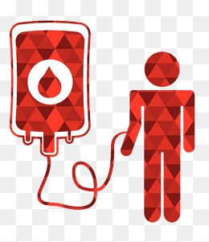
Red Cross Blood Management System

Slide 2
Aim
The high-tech era we live in makes us look up to technology for solutions to anything and everything.
Blood cannot be manufactured, and has a short shelf life too, which makes it impossible to predict the availability of a particular blood group.
This makes everyone highly vulnerable to the shortage of blood.
We aim to simplify and automate the process of searching for blood in emergency situations.

Slide 3
Problem Statement
Our application mainly deals with following major problems of current scenario:
•Manual approach
Currently, majority of blood banks follow the manual approach for processing blood. With the manual approach, there are a number of problems such as managing bloodstock, blood donor details, and request details.
•The communication gap between donor and recipient
Due to the lack of communication between blood donors/blood banks and the blood recipients, most of the patients do not get blood on time. So, synchronization is a must between blood donors, recipients, and blood banks. This improper management of blood leads to wastage of the available blood inventory and black marketing.

Slide 4
Key functionalities of project
Functionalities provided by the application are as follows:
The application provides login functionality for the Blood Bank and User – Donor or Recipient – to search, view, or request blood info.
Provides accurate search results based on blood group, and geographic location of the donor and recipient.
Provides appointment scheduling facility for donors as well as blood recipients.

Slide 5
Additional features
Notification will be sent through email to relevant donors in an emergency situation, when a patient requests for an unavailable blood group.
In the case of an emergency, a patient also gets the details of the nearest blood bank which has an availability of the required blood type.
Blood bank can view their scheduled appointment for blood donation.
Donor can also schedule an appointment with blood bank to donate blood.

Slide 6
Entities involved in project
Blood Bank: The Blood Bank can manage and store details of donor.
User: Application can store the details of the user. A user can be of two types.
  Donor: Application will store the information of the user such that in case of requirement of blood, blood bank or recipient can directly contact them.
  Recipient: Through the application, a recipient can directly contact to the blood bank if bloodstock is available or with the donor of the required blood group.

Slide 7
Libraries
Styling: @Angular, Bootstrap
NodeJS framework: Express
UI Components: Angular Material
Calendar API: Angular 6+ calendar
Email: nodemailer

Slide 8
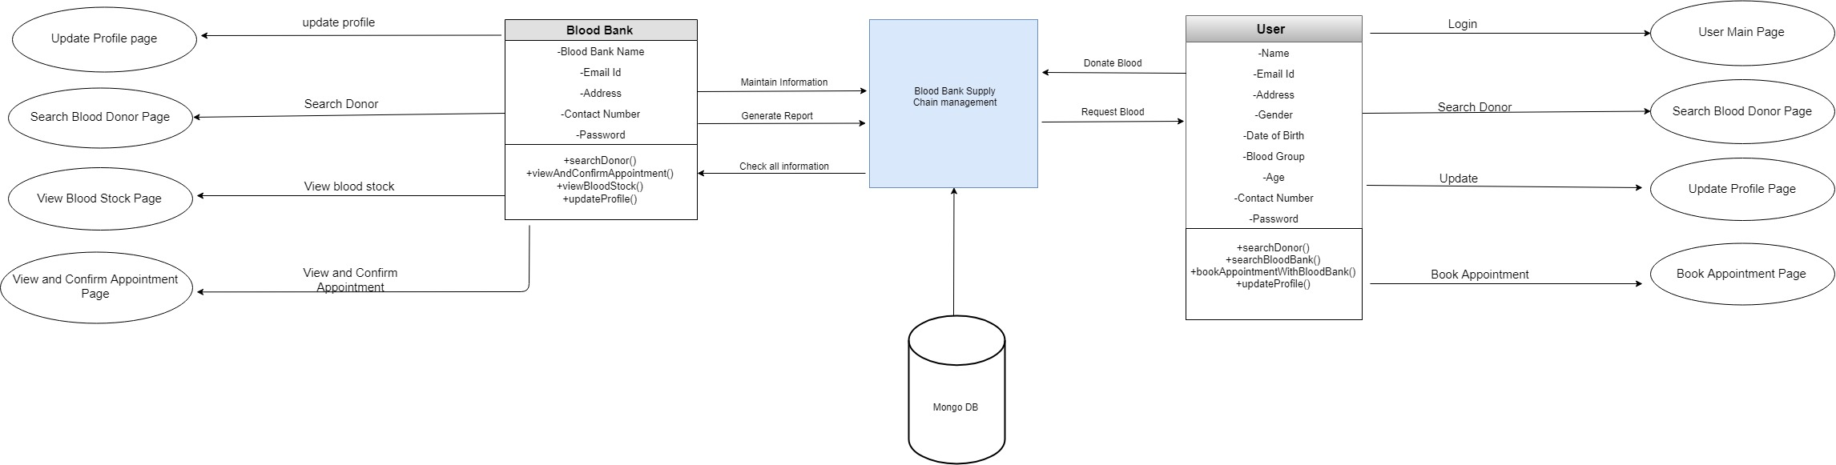
User Flow Diagram

Slide 9
Thankyou…!!

