Slide 1
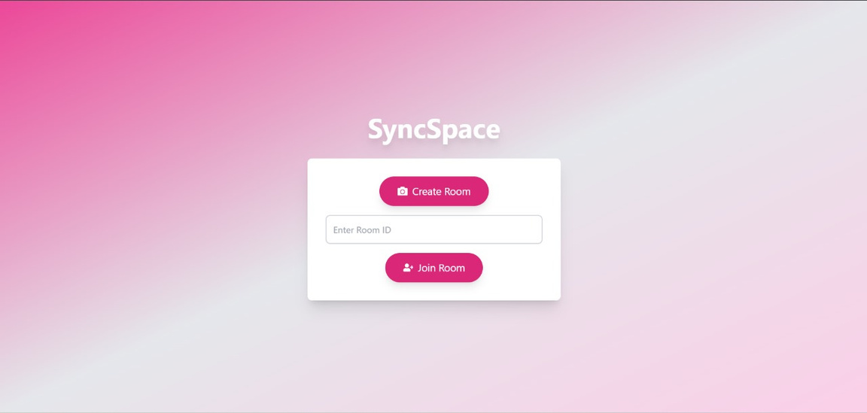

Department of Computer Engineering
Vishwakarma Institute of Technology, Pune
SYNC-SPACE
DIVISION: TY-CS-D
GROUP-76
44 - Shrey Chougule
46 - Siddhartha Chakrabarty
50 - Sneha Jain
54 - Somrath Bisen

Slide 2

Overview
Introduction
Methodology
Tech - Stack
Video Calling
White Board
Chats / Messages
Result
Conclusion

Slide 3
Introduction
SyncSpace is an online collaboration platform designed to bring remote teams together with an all-in-one suite of tools. It offers real-time video calling, chat messaging with support for emojis and GIFs, and an interactive whiteboard for drawing and sharing ideas. Built using WebRTC and Socket.IO, SyncSpace enables smooth, low-latency communication, making it ideal for virtual meetings, brainstorming sessions, and online classrooms. This platform aims to simplify remote collaboration by merging essential features into one seamless experience.

Slide 4
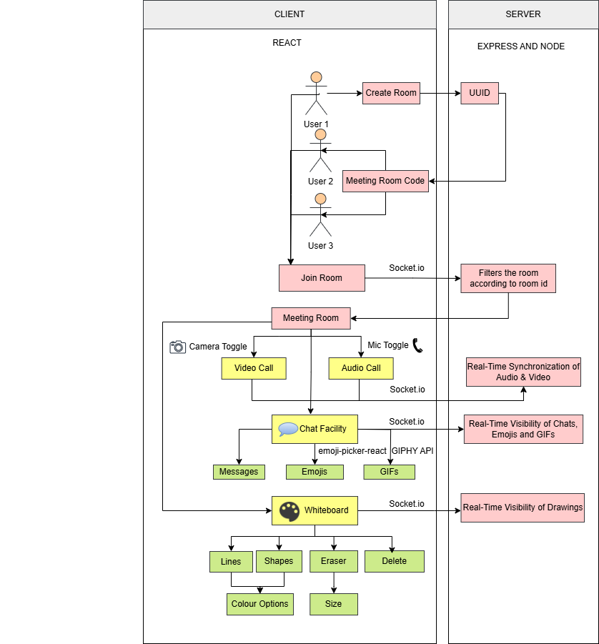
Methodology

Slide 5
React: A JavaScript library for building user interfaces with reusable components.
Socket.io: A library for real-time, bidirectional communication between web clients and servers.
TECH STACK
Axios: A promise-based HTTP client for making requests to APIs from the browser or Node.js.
Node.js: A JavaScript runtime built on Chrome's V8 engine for building scalable server-side applications.
Express.js: A minimal and flexible Node.js web application framework for building APIs and web servers.

Slide 6
Simple-Peer: A lightweight library for building WebRTC peer-to-peer data and video connections in the browser.
React-Icons: A library that provides popular icons as React components.
Framer Motion: A library for creating smooth and customizable animations in React applications.
Extra Libraries
React-Color: A collection of customizable color pickers as React components, ideal for color selection in web applications.
Emoji-Picker-React: A React component library that provides a user-friendly emoji picker for adding emojis to inputs and text areas.
GIPHY API: An API that provides access to GIPHY's vast library of GIFs for easy integration into apps.
CORS: A mechanism that allows controlled access to resources on a web page from a different domain..

Slide 7
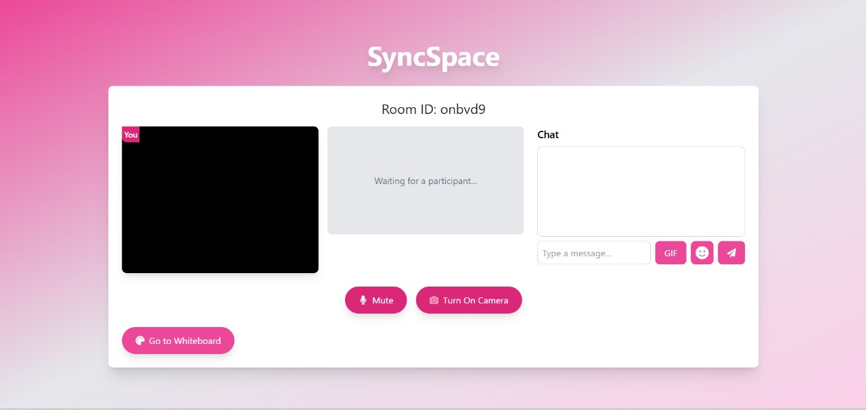
Video Calling
Video calling in SyncSpace allows real-time, face-to-face communication for a seamless virtual meeting experience.
Built with WebRTC, it enables peer-to-peer audio and video streaming, reducing latency and maintaining high quality.
Socket.IO handles the WebRTC signaling, managing the exchange of connection data.
Once connected, media flows directly between users, ensuring smooth performance and less server load.

Slide 8
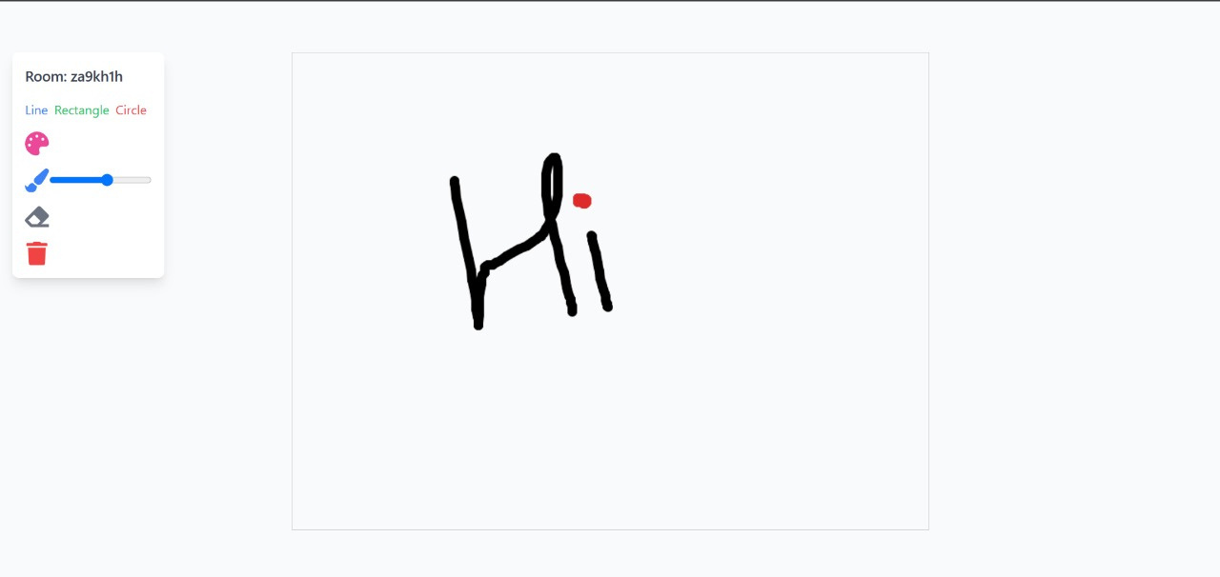
White Board
The whiteboard in SyncSpace provides an interactive, real-time drawing experience.
Users can draw freely, create shapes, and clear the board with ease.
Built with Socket.IO, it instantly shares updates across all participants in the same room.
This ensures everyone sees changes in real time, enhancing collaboration.

Slide 9
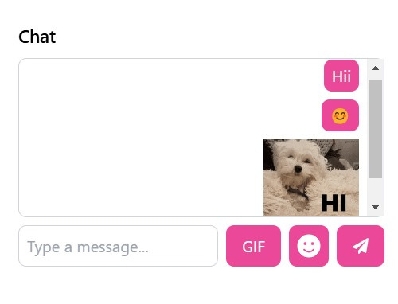
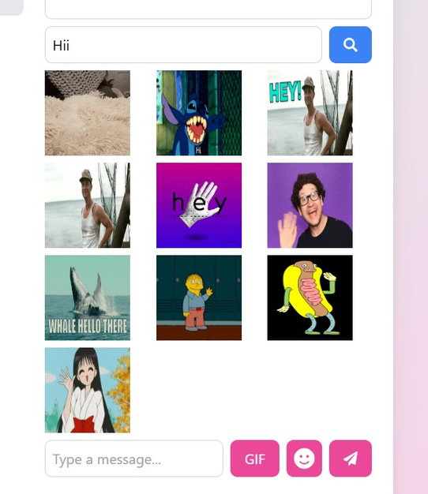
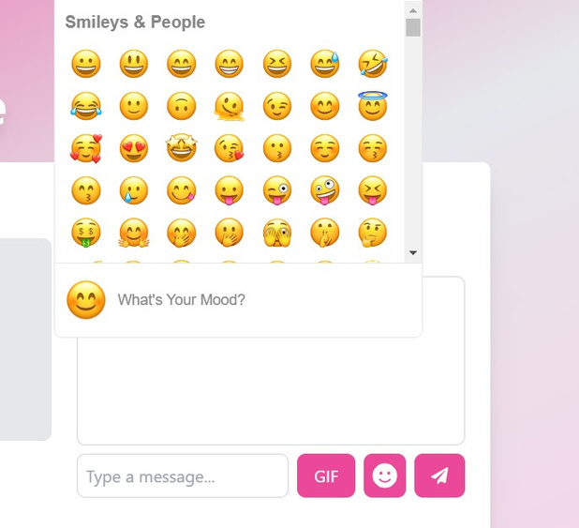
Chats / Messages
The Chats and Messages feature in SyncSpace enables real-time communication during meetings.
Powered by Socket.IO, messages are instantly shared with all room participants.
To make chats more engaging, it supports emojis and GIFs.
Third-party APIs allow users to choose emojis and search for GIFs, enhancing interaction.

Slide 10
Result
The results of the SyncSpace project demonstrate its effectiveness as an all-in-one collaboration platform, achieving seamless integration of video calling, chat, and a shared whiteboard.
Testing showed that video and audio quality remained stable with minimal latency, thanks to WebRTC, while the real-time chat and whiteboard features synced instantly across all users in a room via Socket.IO.
The platform also handled multiple participants smoothly, supporting collaborative sessions without disruptions.
Overall, SyncSpace effectively meets the needs for a remote collaboration tool, providing a robust foundation for potential future enhancements.

Slide 11
Conclusion
Successfully developed a unified platform for video calling, chat, and whiteboard collaboration, enhancing remote teamwork.
Achieved smooth, low-latency interactions using WebRTC and Socket.IO, ensuring real-time communication and responsiveness.
User feedback highlights an intuitive interface and engaging chat features like emojis and GIFs.
Future enhancements could include AI-powered tools, session persistence, and optimized media quality for improved user experience.

Slide 12


THANK YOU

