Slide 1
How much did it rain?
Presentation by :
Dhaval Sanghavi, Sheetal Singh and Tanisha Jain

Slide 2
Contents
Overview
Domain – IOT (Internet of things) Analytics
Dataset Used
Data Pre-Processing and Cleaning
Models created – Regression and Classification
Web Services & Hosting
Final Project proposal

Slide 3
OVERVIEW
The project is based on predicting the rainfall by using readings from polarimetric radars
The rainfall prediction will allow:
Wholesalers and retailers of production input
To better forecast production and quality of grains and fibres
To better perform water resource management

Slide 4
IOT Analytics and Rainfall Prediction
IOT Analytics enable organizations to collect and analyse data from sensors on equipments, meters, guages, radars etc.
The rain gauges does not provide a very accurate measurement of rainfall.
But Polarimetric radars are very accurate and are least affected by weather.
The readings from Polarimeter Radar distance sensor is sent to the machine of the meteorologist thereby establishing communication between devices.
This IOT Analytics will help meteorologists to make rainfall predictions!

Slide 5
Dataset Used
Dataset is taken from Kaggle website
The data has 24 variables and over 130 million rows, these rows have readings from the radar observations at gauges
Data Pre-Processing and Cleaning
Remove all the rows where the value of Ref column was 0
Replaced all NA’s with 0 so that there is no missing data
Took out the outliers based on the values of ‘expected’ column of gauge values

Slide 6
Models Used
Following models were decided based on the accuracy after model comparisons-
Regression
Neural Network Model
Classification
Two-Class Boosted Decision Tree

Slide 7
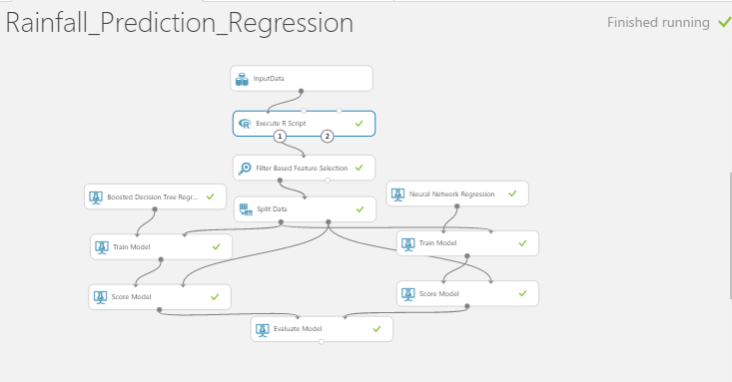

Slide 8
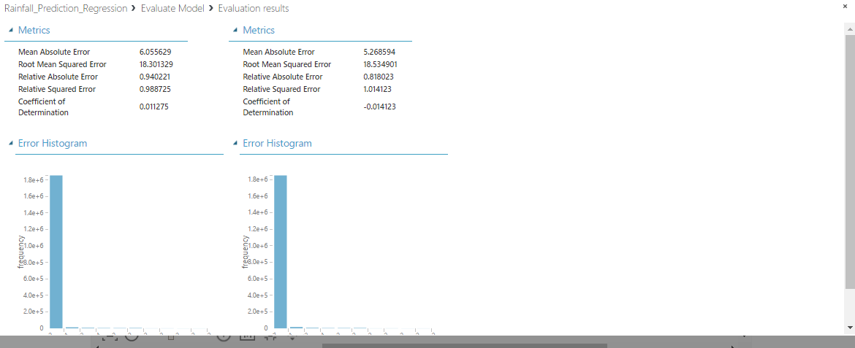

Slide 9
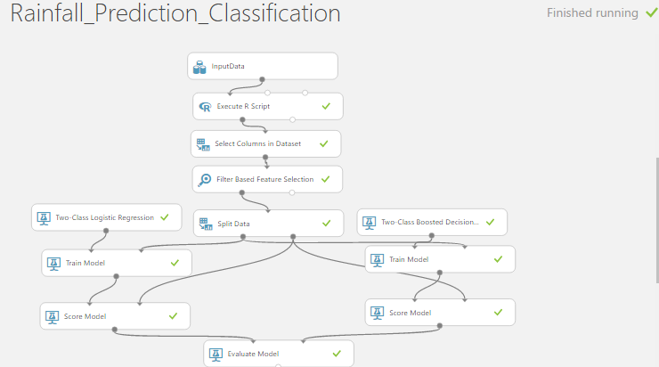

Slide 10
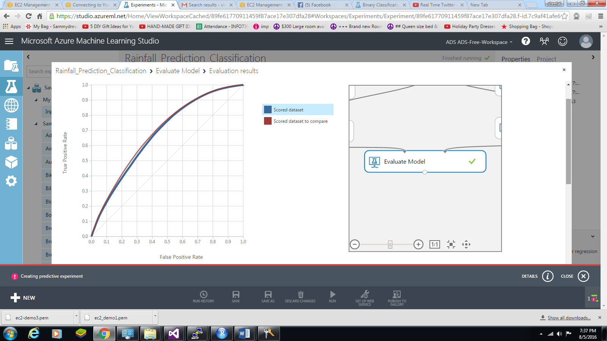

Slide 11
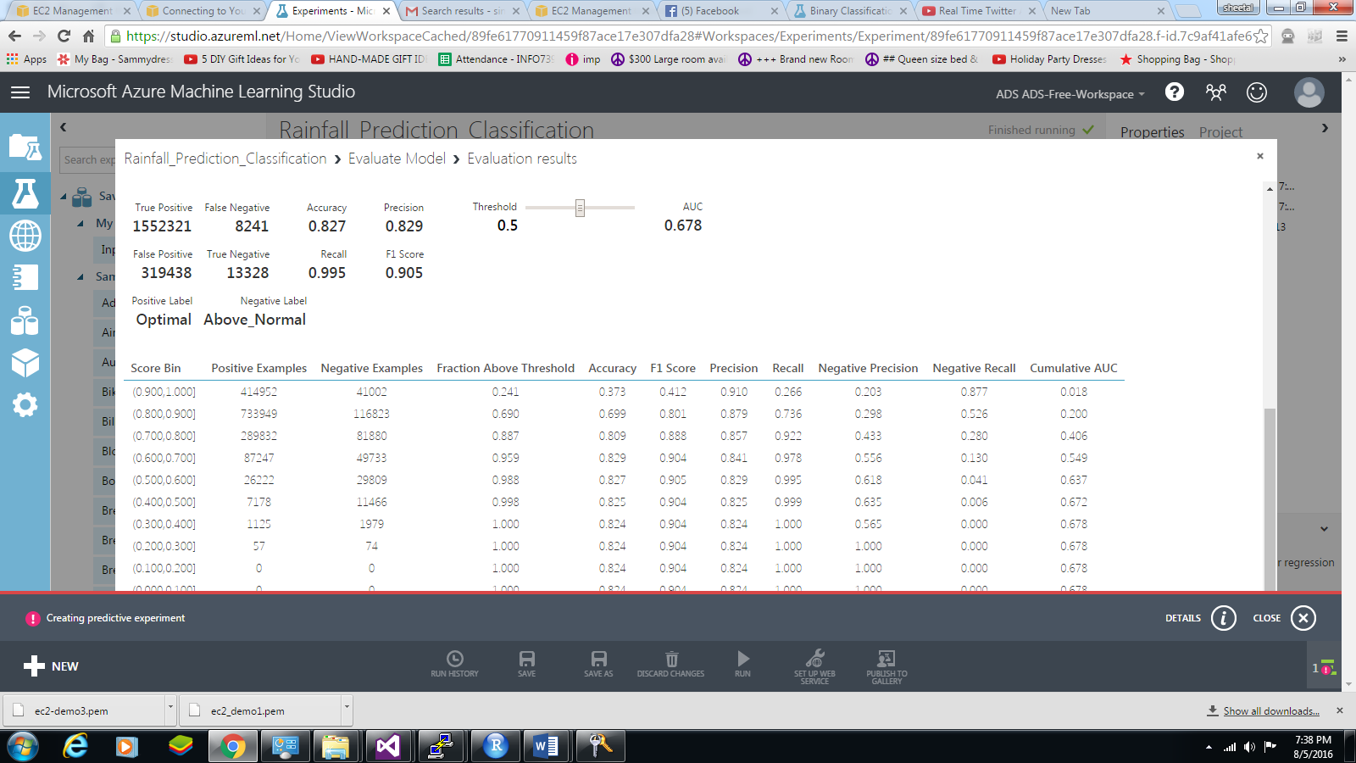

Slide 12
Web Services & Hosting
Deployed web services using Microsoft Azure Machine Learning Studio
Back End programming language is asp.net coded in Visual Studio 2015
Finally, hosted website by publishing the Visual Studio project onto Azure Web Application Service.

Slide 13
Final Project Idea
Diagnose schizophrenia using multimodal features from MRI scans
Training file have Ids, diagnosis etc.
Dataset have ‘source based morphometry’(patterns of brain structure) and ‘functional network connectivity’ (physical synchronicity) data to be tested on
Need to predict if the person is normal (0) or schizophrenic (1).

Slide 14
The End

