Slide 1
ADS MIDTERM ASSIGNMENT
Team 8
Dhaval Sanghavi
Sheetal Singh
Tanisha Jain

Slide 2
Problem 1 :
Credit Card Default

Slide 3
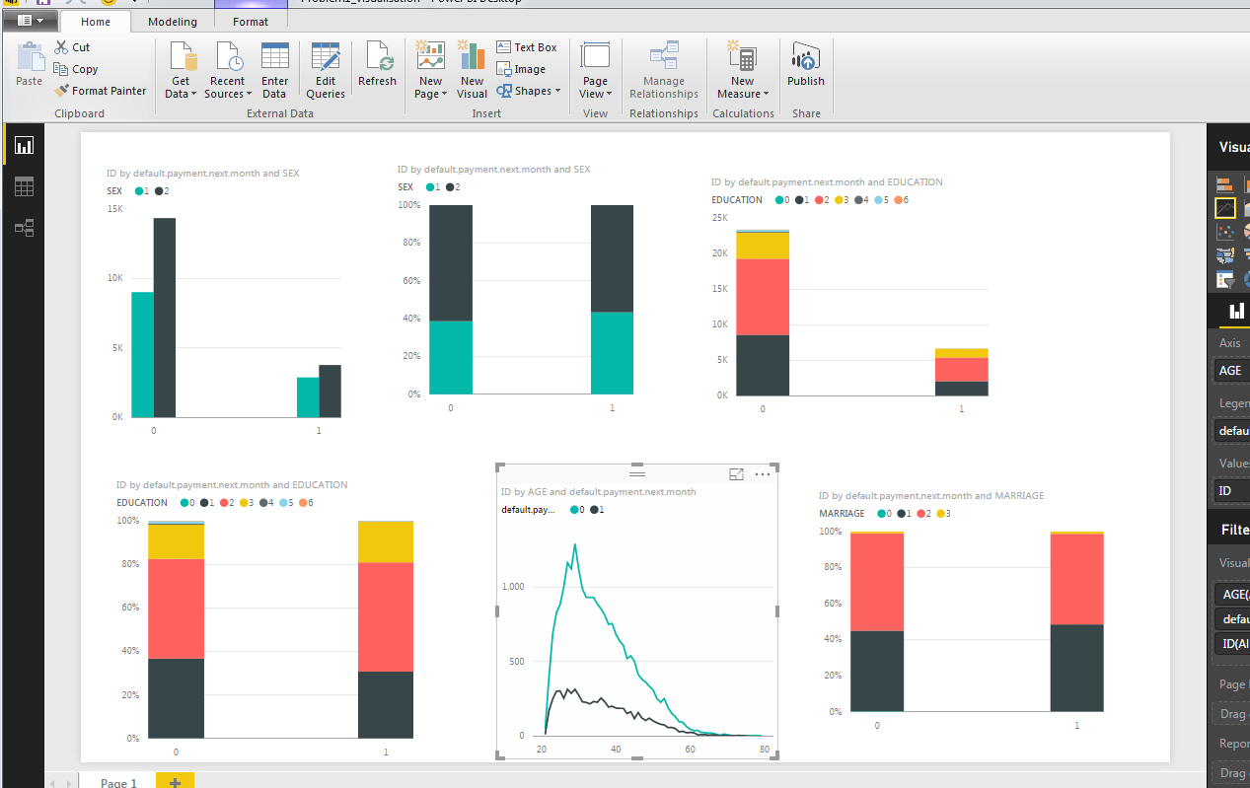
VISUALISATION BEFORE CLEANING THE DATA

Slide 4
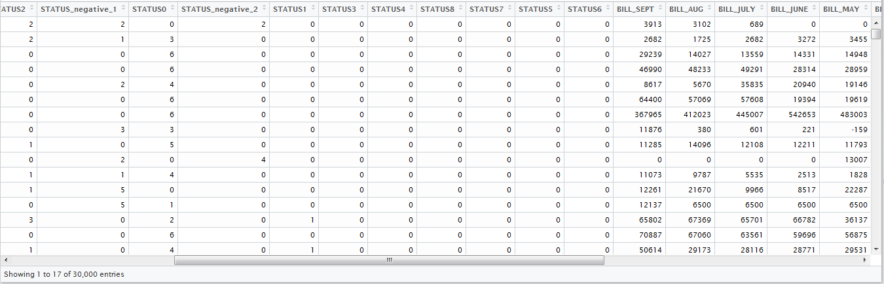
Step 1 : Clean the Data
First add New columns with the count of occurrence of particular payment status for every customer

Slide 5
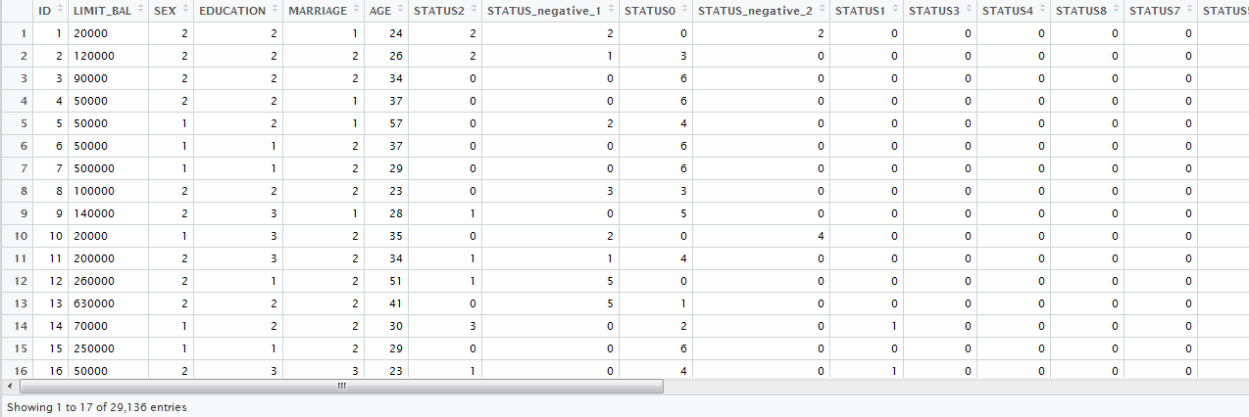
Continue…
Remove all the rows with zero values of bill and payment column

Slide 6
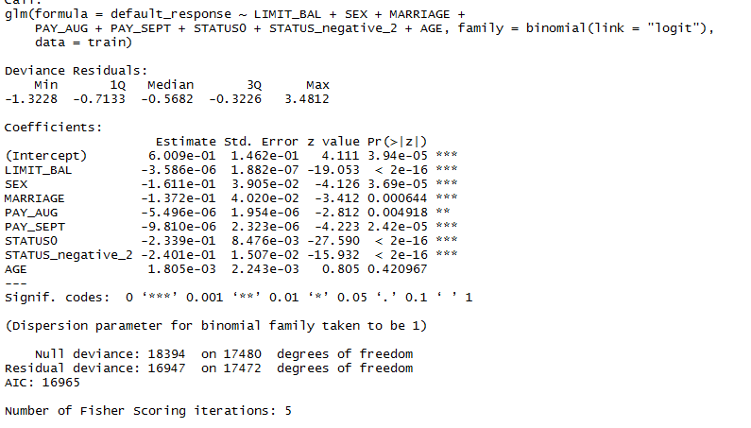
Step 2 :Construct the Logistic Regression Model
Use the glm function to build the model

Slide 7
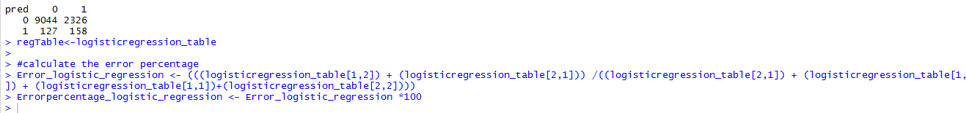
Predict and create the error table
Error Percentage: 21.04%

Slide 8
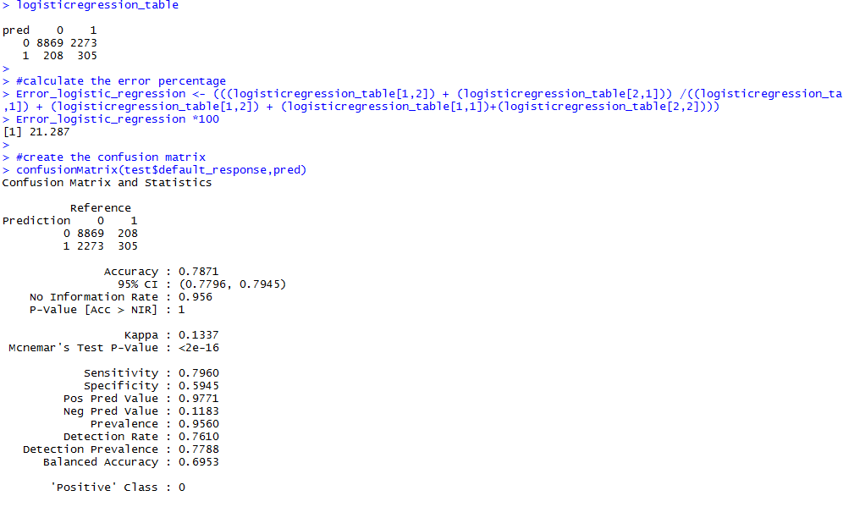
Confusion Matrix

Slide 9
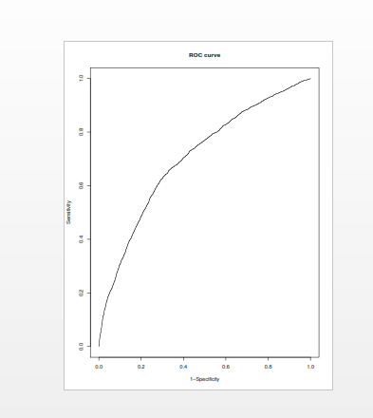
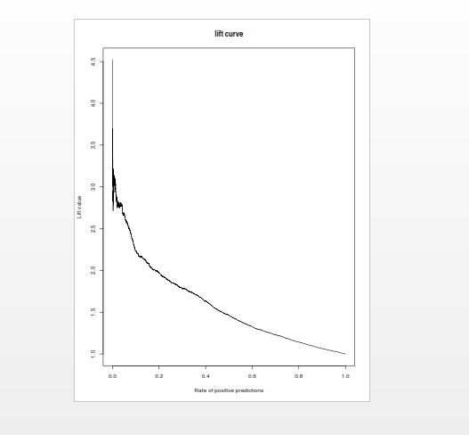
ROC Curve and Lift Chart

Slide 10
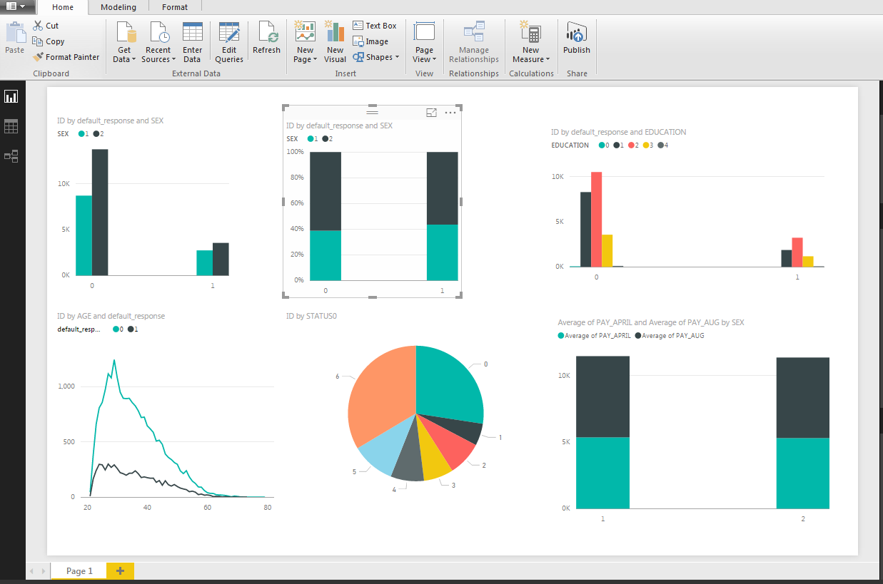
Analysis after cleaning the data

Slide 11
Step 2:Contruct the Classification Tree Model

Slide 12

Predict and create the error table
Error Percentage: 19.65%

Slide 13
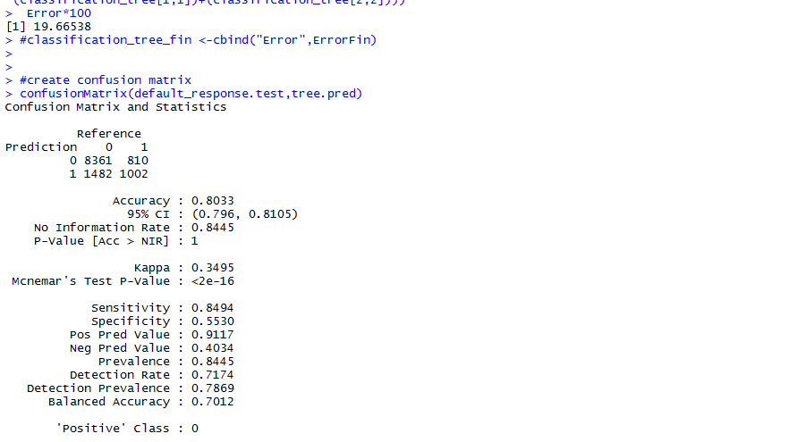
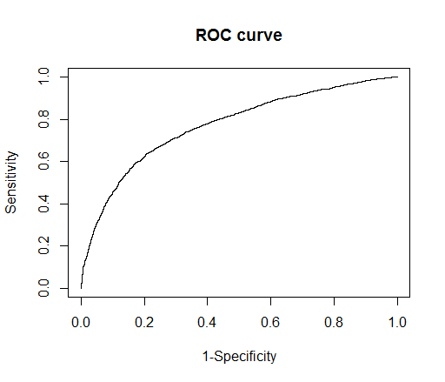
Confusion Matrix

Slide 14
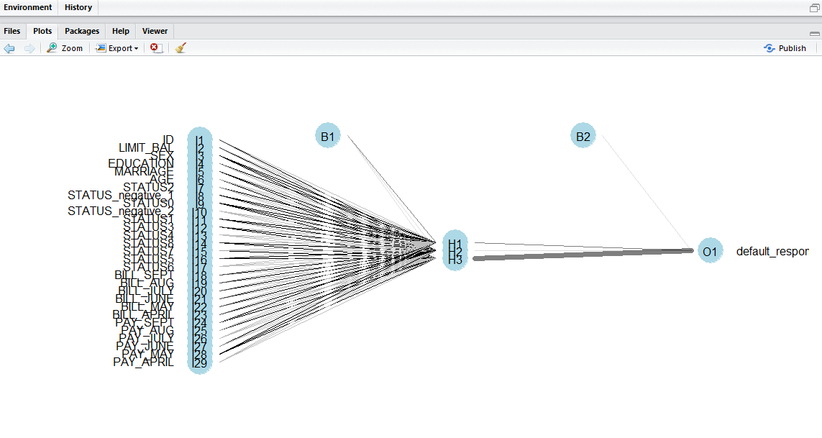
Step 3:Contruct the Neural Network Model
Use the nnet function and build the model

Slide 15

Predict and create the error table

Slide 16
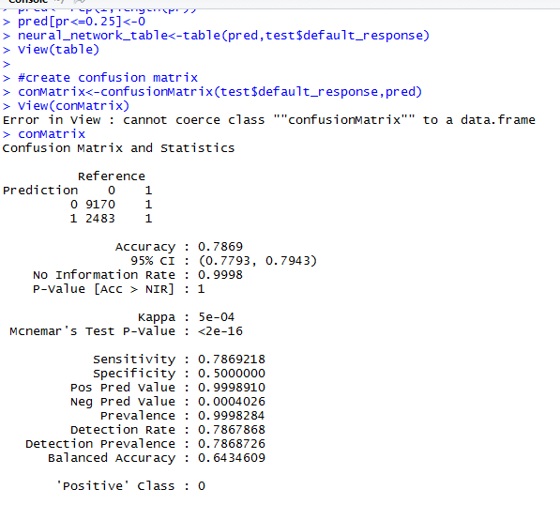
Confusion Matrix
Error Percentage: 21.01%

Slide 17
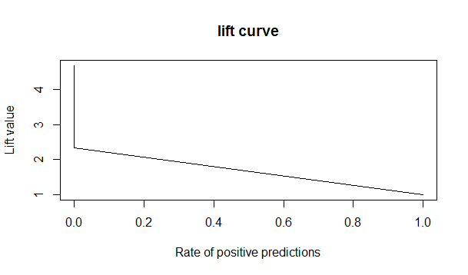
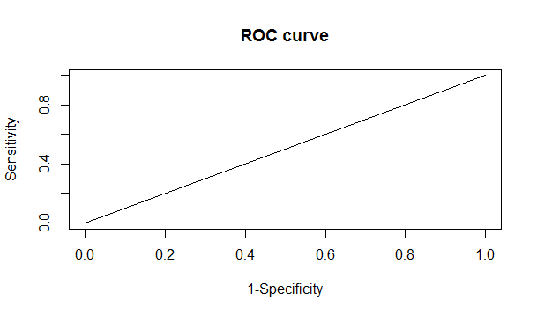
ROC Curve and Lift Chart

Slide 18
Best Model
Classification Model is the best model for this problem.
Because Accuracy is high as compared to others.
Also sensitivity is also high and low error as compared to others

Slide 19
Problem 2:
Advertisement on Internet Pages

Slide 20
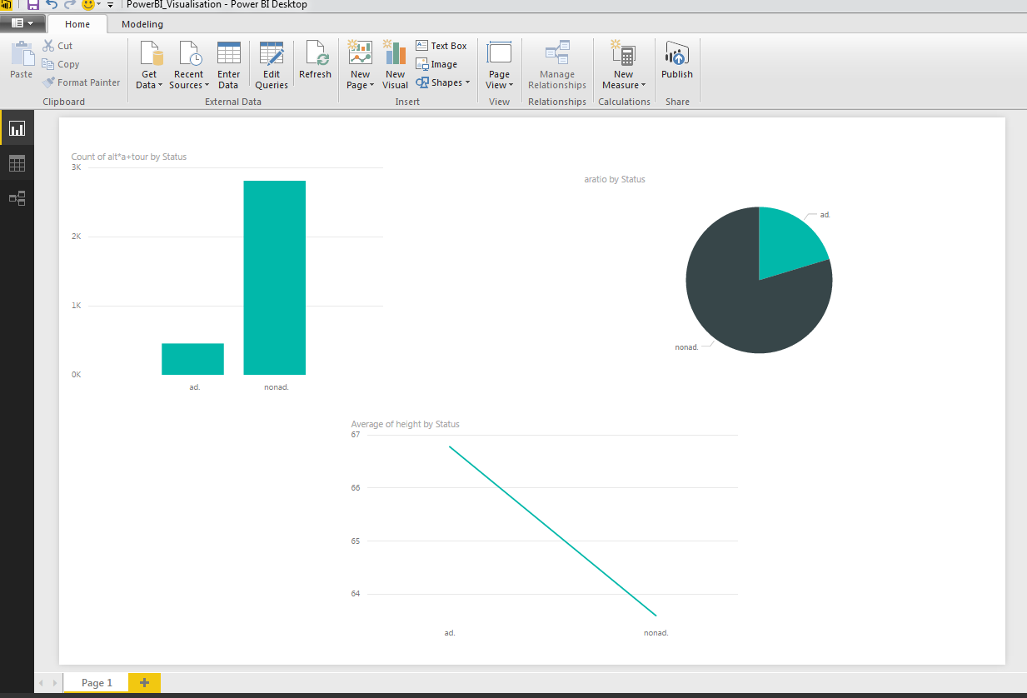
Visualization using Power BI

Slide 21
Step 1 : Clean the Data
Removing the first row ad/non-ad classes
Removing the additional rows with no binary values (pipeline)
Binding the three rows in the beginning - height, width, ratio
Changing the name of the column by removing substrings - colons and zeroes in the end

Slide 22
Continue…
Transpose with column name as the first rows
Changing transpose_names matrix to dataframe
Replacing "?" with the NA and changing the table.data to a data frame
Removing the last column ad from df2 dataset
Changing the 473rd, 534th and 956th column name because of multibyte error due to some absurd characters
Replacing the NA values in height,width with mean of the height and width column
Finding out the third column's NA values by dividing height by width
Adding the status column that would tell id the advertisement is ad or nonad
Remove the rows with NA values in "local" column

Slide 23
Step 2: Construct the Logistic Regression Model and Predict the error Percentage

Slide 24
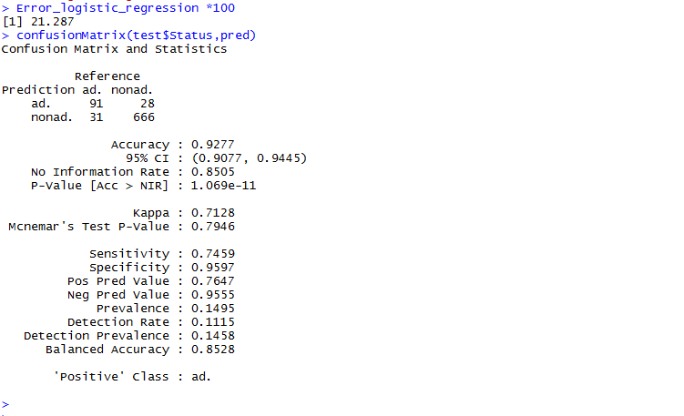
Confusion Matrix
Error Percentage: 7.23

Slide 25
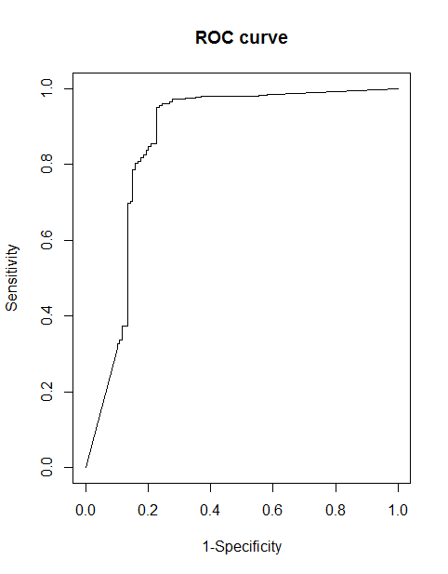
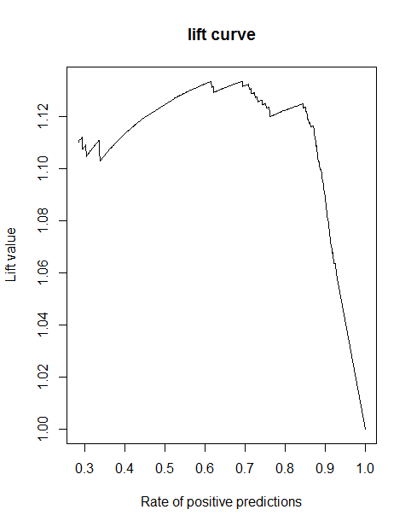
ROC Curve and Lift Chart

Slide 26
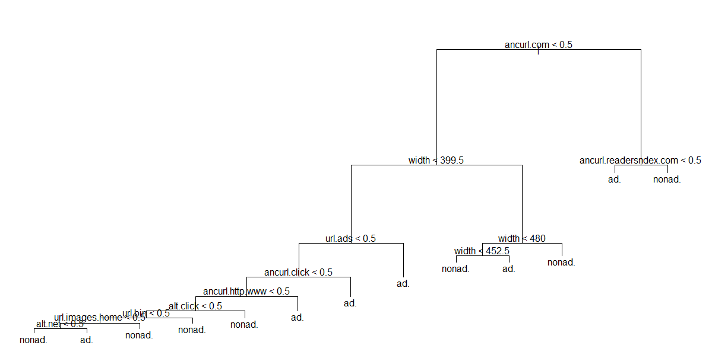
Step 2 : Construct Classification Tree Model
Use the tree function and build the model

Slide 27

Predict and create the error table

Slide 28
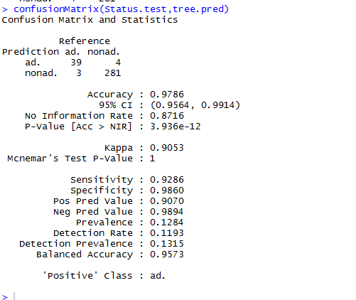
Confusion Matrix
Error Percentage:1.76

Slide 29
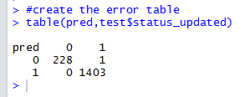
Step 3 : Construct the neural network model and determine the error table

Slide 30
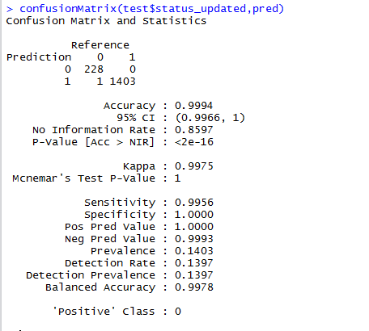
Confusion Matrix
Error Percentage : 0.67

Slide 31
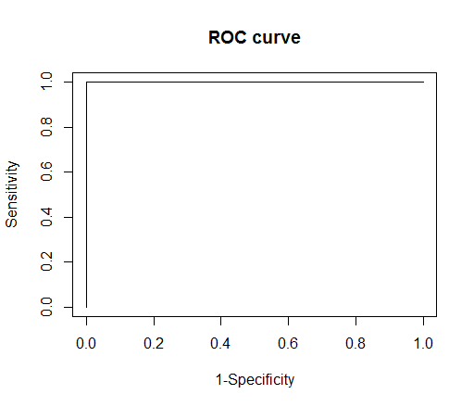
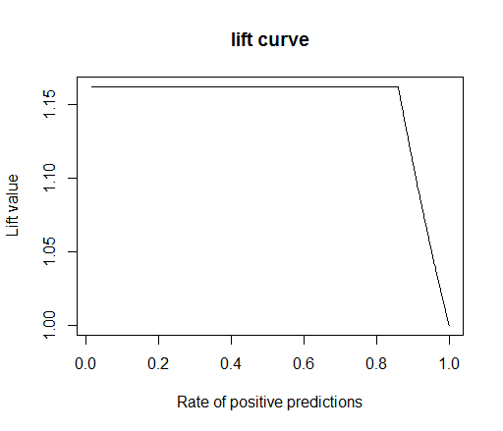
ROC Curve and Lift Curve

Slide 32
Best Model
Neural Network is the Best Model
Because accuracy is high (99.9) as compared to other model.
And low error and better roc curve

Slide 33
Problem 3
Wind forecasting (48 hours prediction after interval of every 12 hours)

Slide 34
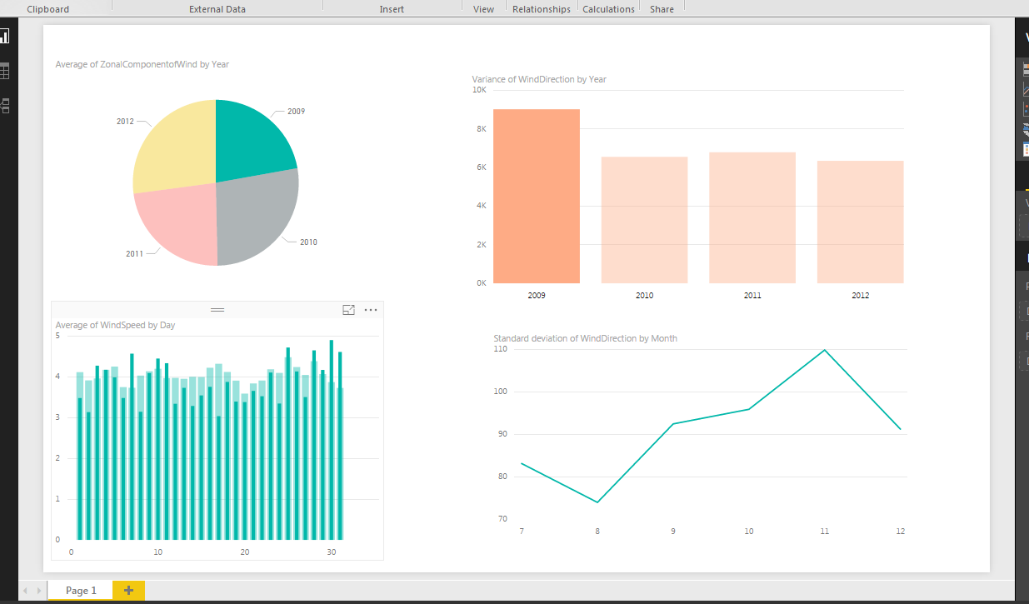
VISUALISATION

Slide 35
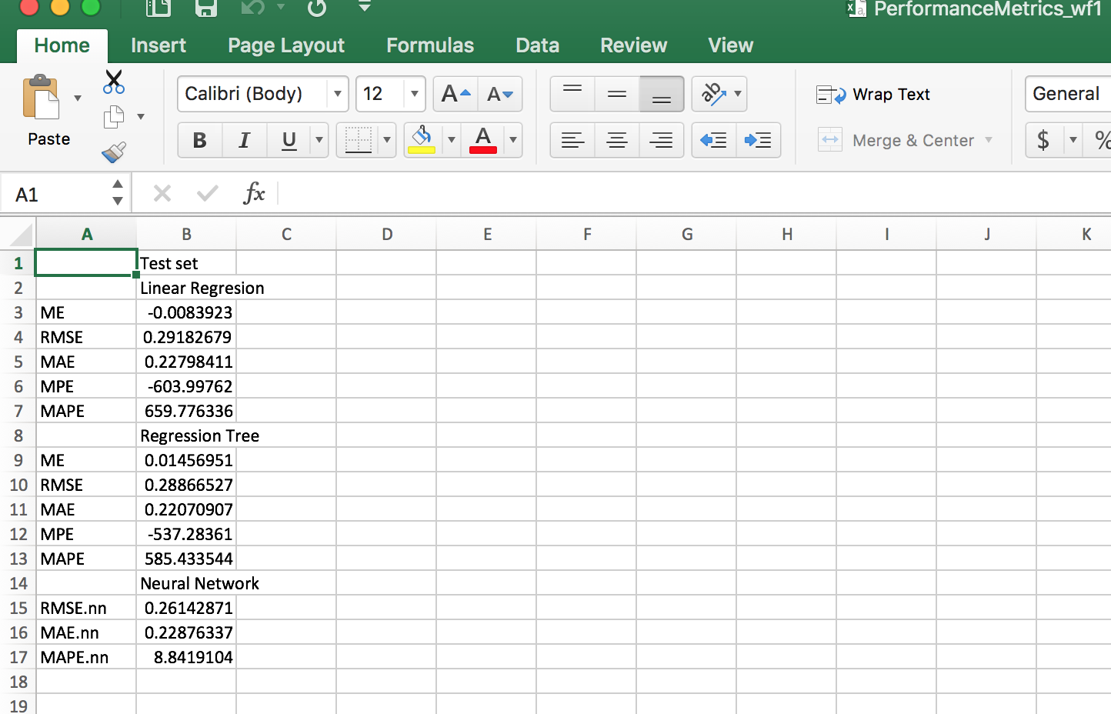
Performance Metrics for wf1

Slide 36
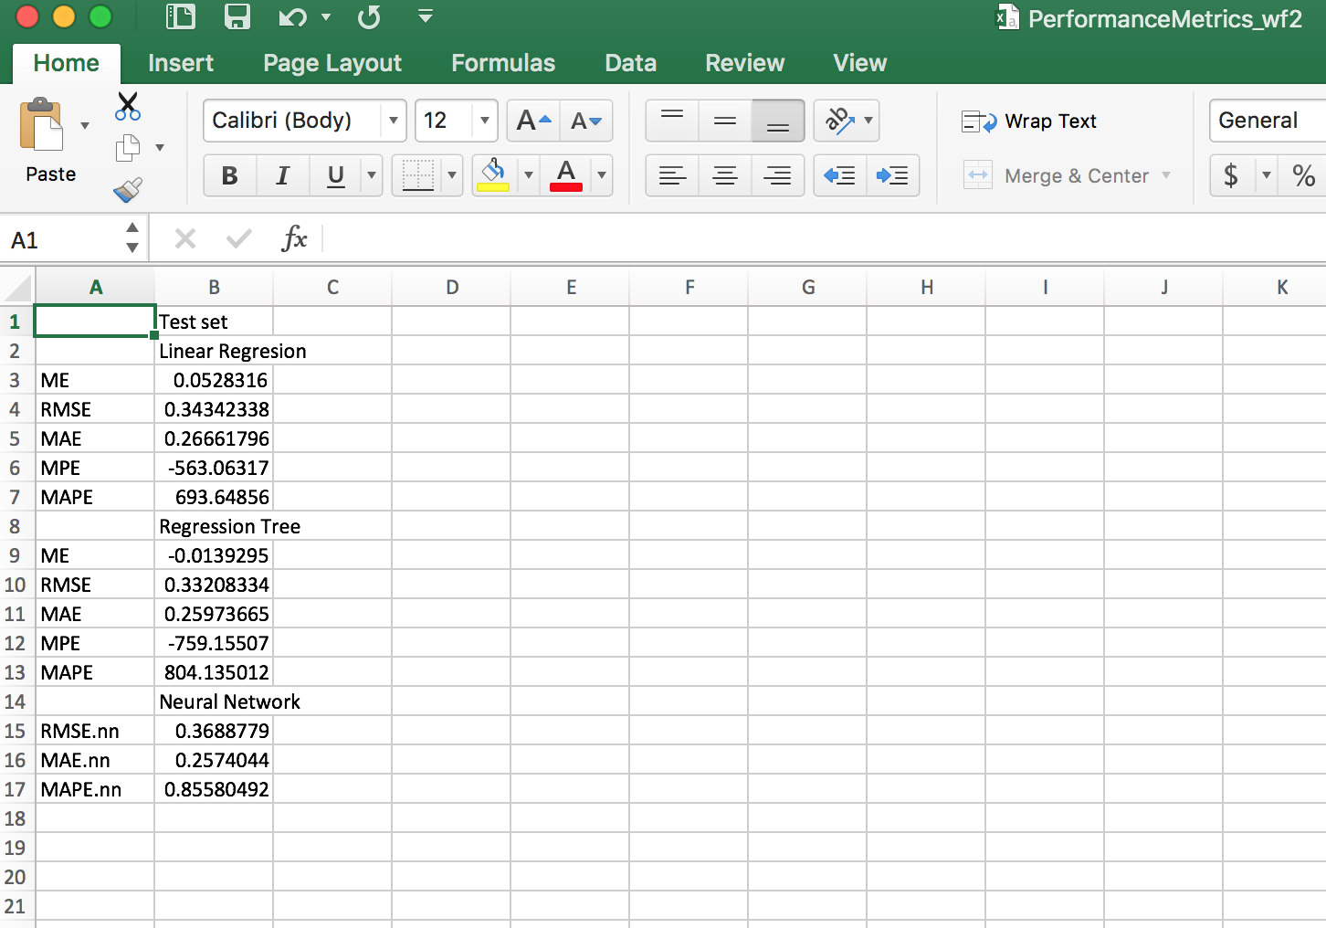
Performance Metrics for wf2

Slide 37
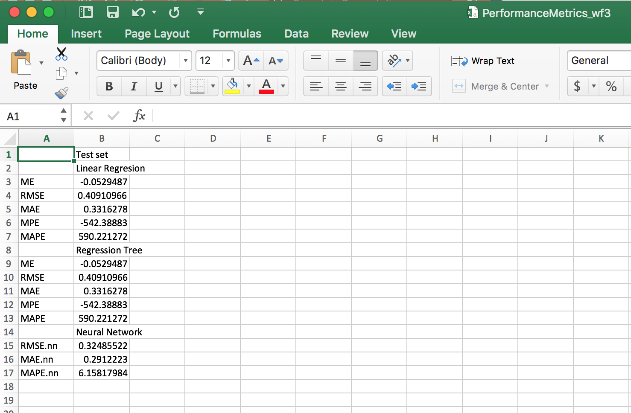
Performance Metrics for wf3

Slide 38
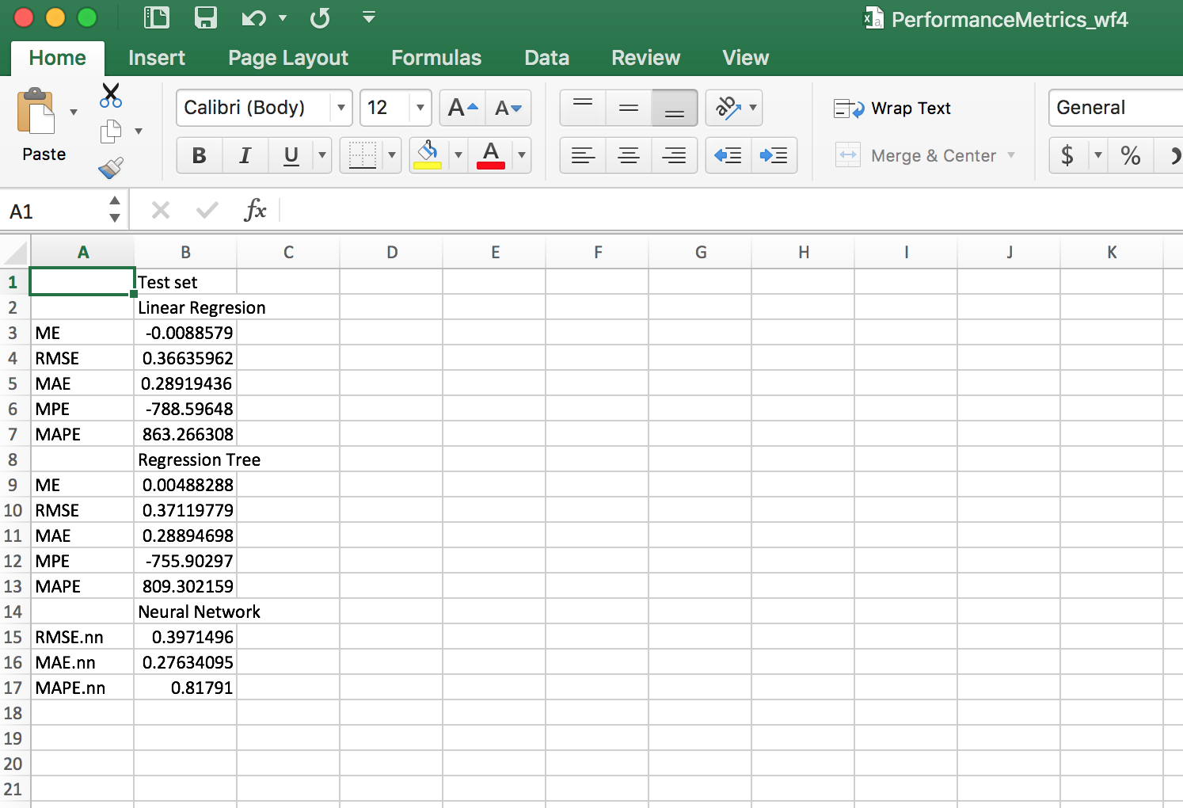
Performance Metrics for wf4

Slide 39
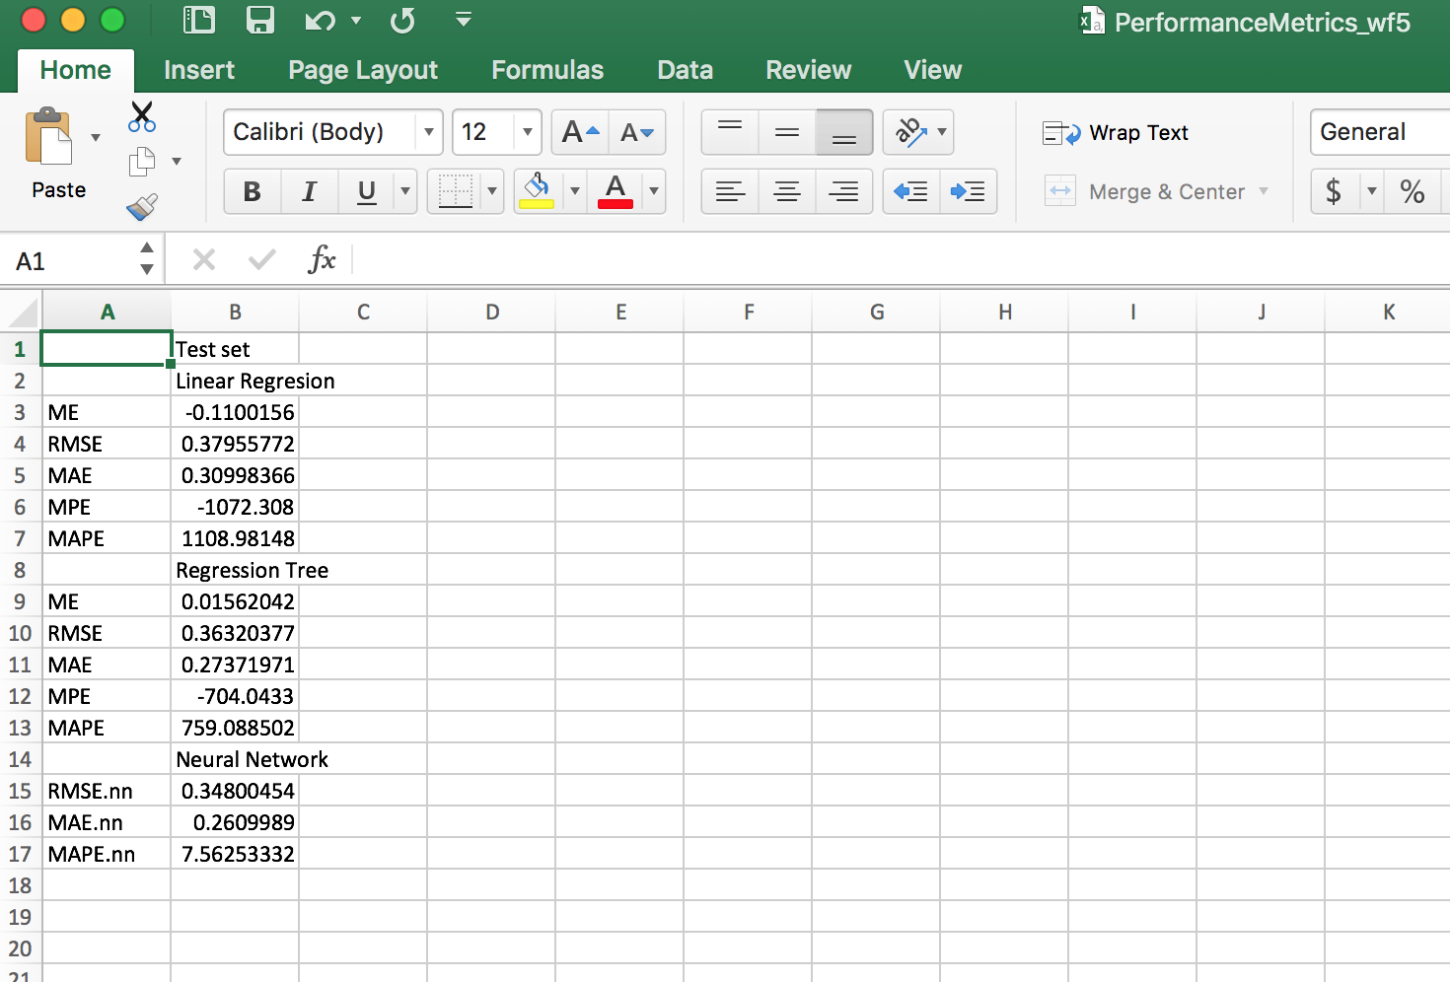
Performance Metrics for wf5

Slide 40
Performance Metrics for wf5

Slide 41
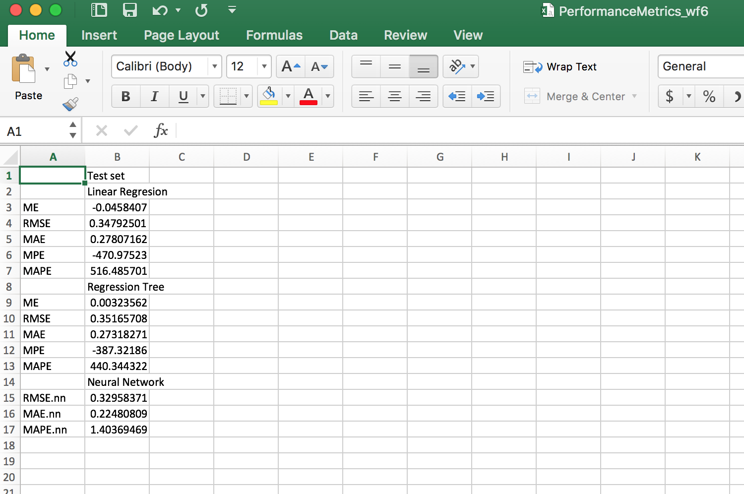
Performance Metrics for wf6

Slide 42
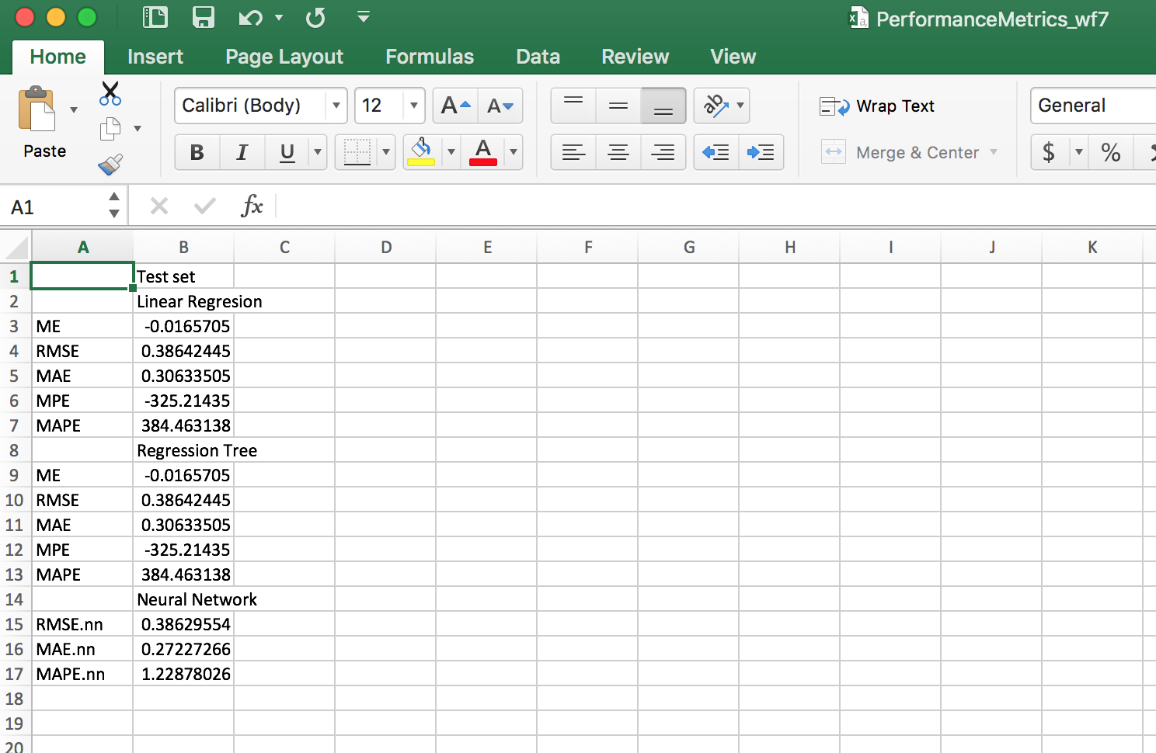
Performance Metrics for wf7

Slide 43
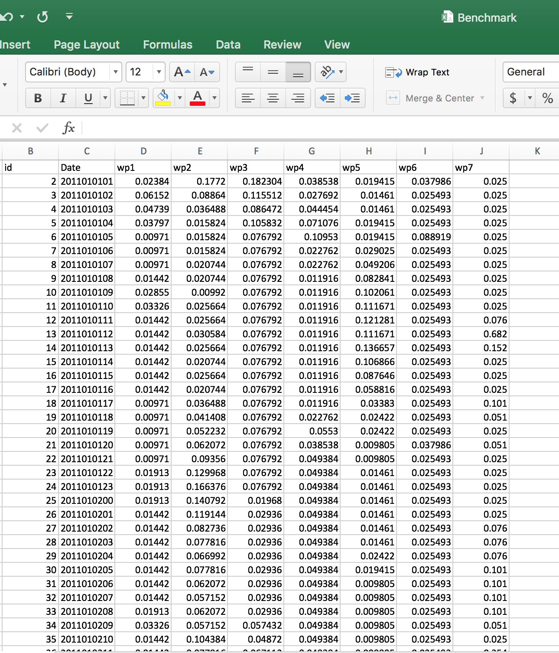
Final Benchmark.csv (7488 rows)

Slide 44
Best Model
Neural Network is the best model
It has the lowest MAPE error as compared to other models

Slide 45
Thank You

