Slide 1
ROSSMANN STORE SALES (Kaggle- Competition) INFO 7390 : Advances in Data Science/Architecture
TEAM 8
DHAVAL SANGHAVI
SHEETAL SINGH
TANISHA JAIN

Slide 2

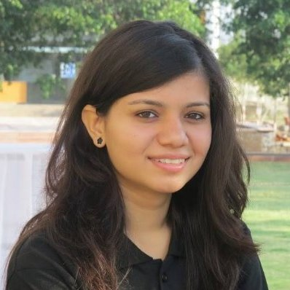
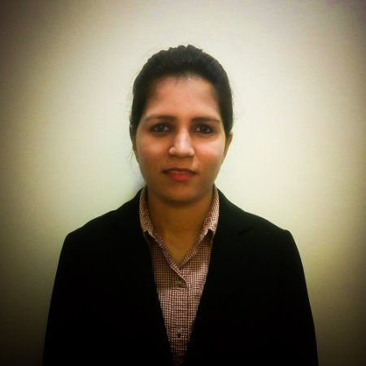
TEAM MEMBERS
Dhaval Sanghavi
Tanisha Jain
Sheetal Singh

Slide 3
PROBLEM STATEMENT
To Forecast the daily sale of individual 1115 Rossmann stores located across Germany.
Historical data upto 2 year 7 month is provided(Jan 2013 to July 2015)

Slide 4
TOOLS & TECHNOLOGY
ML ALGORITHM
Two Class Classification Models
Regression Models
K-Means Clustering
Arima Models (Time Series)
TOOLS
Visual Studio
R Studio
Power BI
Microsoft Azure Machine Learning Studio
TECHNOLOGY
Front End :- Bootstrap, HTML, CSS
ASP.NET
AZURE SERVICES

Slide 5
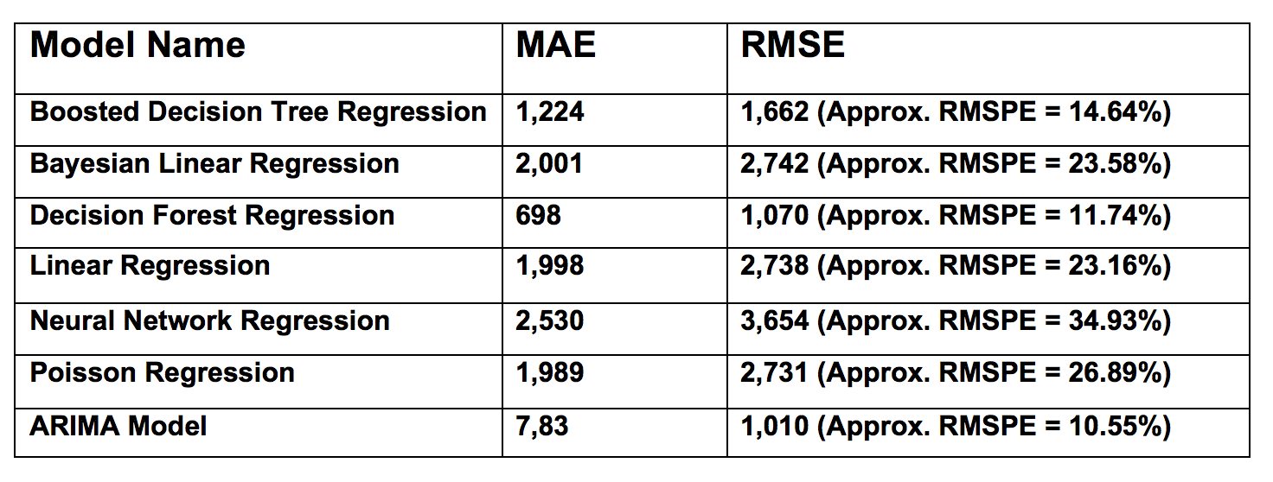
MODEL SELECTION FOR REGRESSION

Slide 6
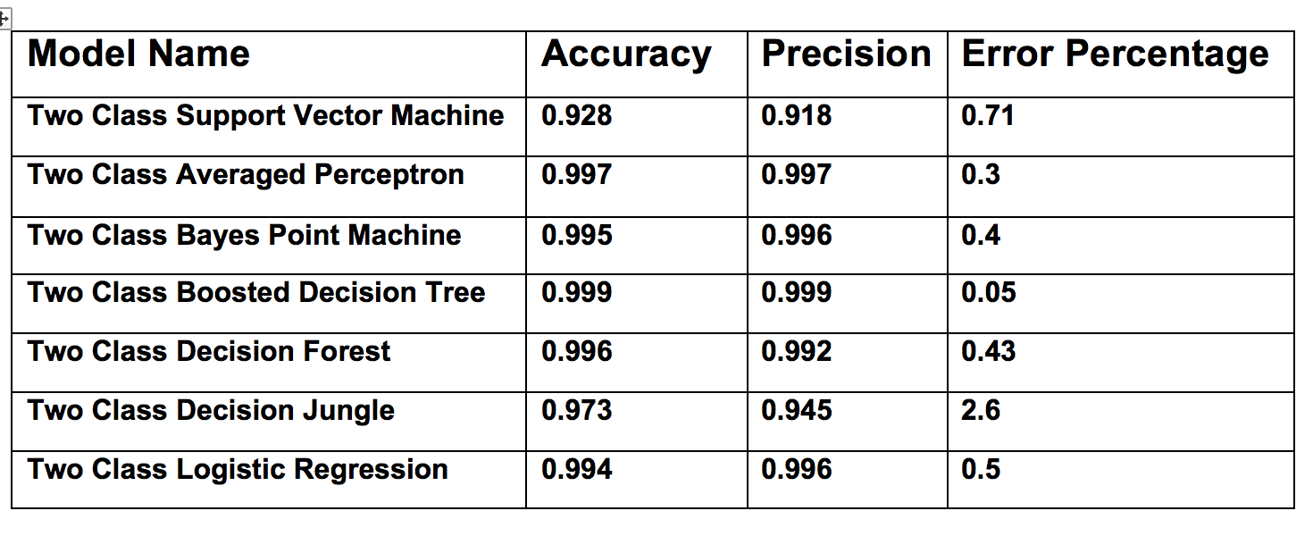
MODEL SELECTION FOR CLASSIFICATION

Slide 7
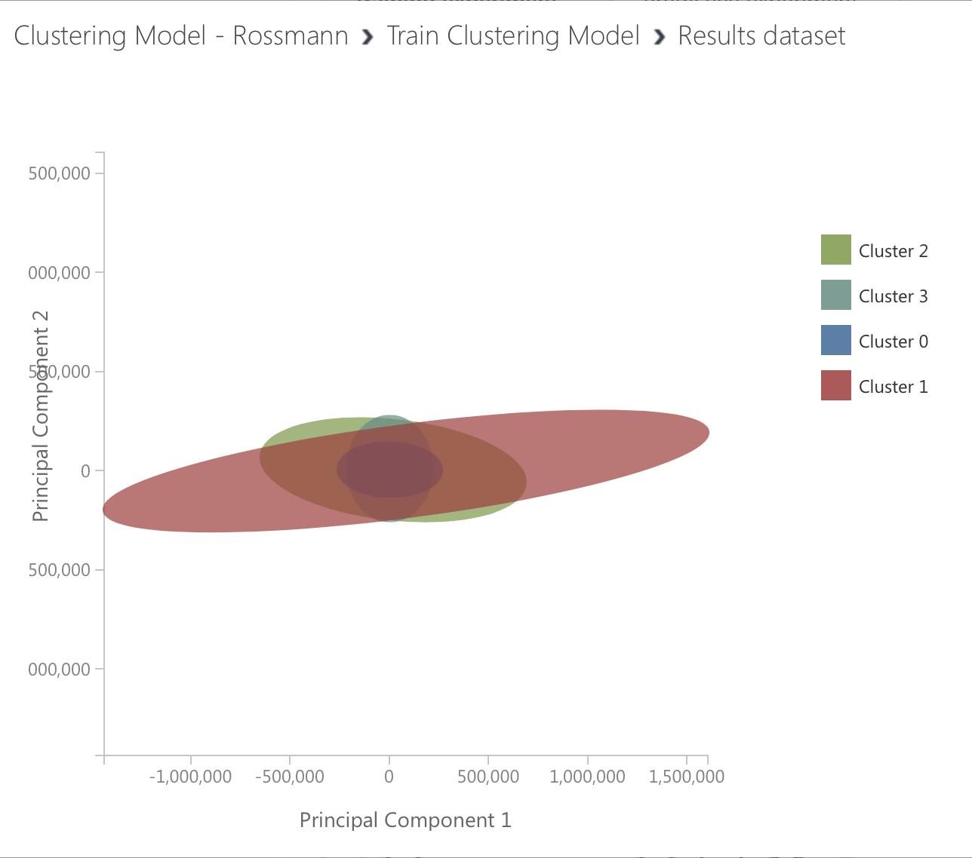
K-MEANS CLUSTERING

Slide 8
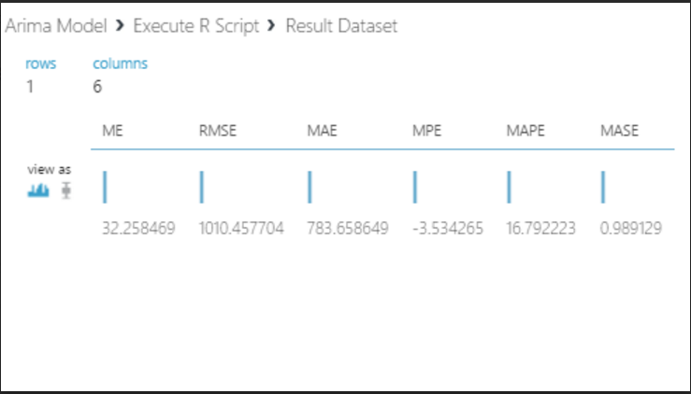
ARIMA MODEL

Slide 9
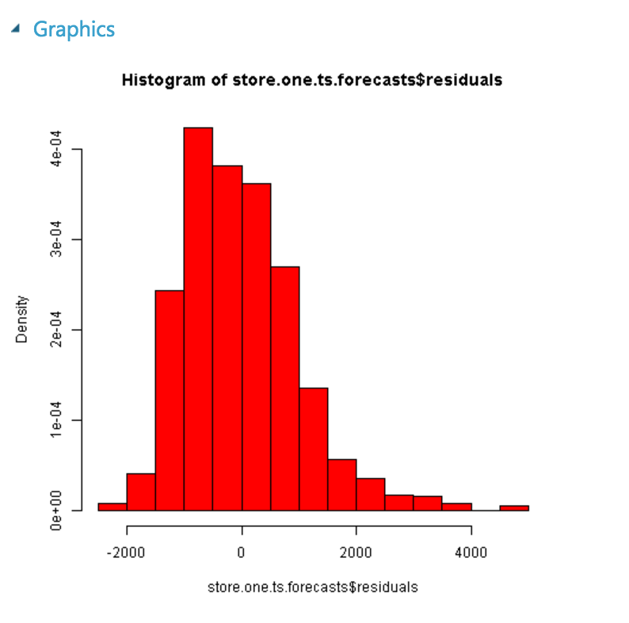
ARIMA VISUALIZATION

Slide 10
BUSINESS CASE
Better management of staff schedules
Provide enough time to store managers to focus on customers and their teams
Increase efficiency of employees.

Slide 11
THANK YOU

