Slide 1
E-Prescription And E-Lab Tanisha Jain 001617268

Slide 2
Traditional Way
Traditionally, people have to see doctor and take the hand written prescription and show it to chemists, who would after some time, provide patients with drugs.
These drugs can be erroneous if the chemist misread drug’s name.
Also, when doctor would suggest tests, people will have to make all new appointment by filling details for the tests.

Slide 3
Problem Statement
When it comes to healthcare, technology has to be implemented in a way that it lessens the patient’s time, energy .
Old-aged people, children or independent beings, all can gather information related to their diseases online.
Once, they see a doctor, all the drug and lab tests information will be in their hand so that there won’t be any hassle in their selection.

Slide 4
The Project
E-prescription is beneficial to healthcare providers and pharmacies serving all care settings – ambulatory, acute, chronic and specialty.
Electronic exchange of prescription information between prescribers(Doctors) and pharmacists(Chemists) improves prescription accuracy and saves time which will ultimately improve patient safety.
Pharmacists will realize a reduction in phone calls and faxes related to prescription renewal authorizations, as well as a reduced need for pharmacy staff to enter prescription data manually.
E-labs can attach results to doctor’s profile of the patient he treated and also to patient’s chart so that patient can view his report analysis through login. This will reduce time and conveyance costs for patients as reports will be received online through E-labs.

Slide 5
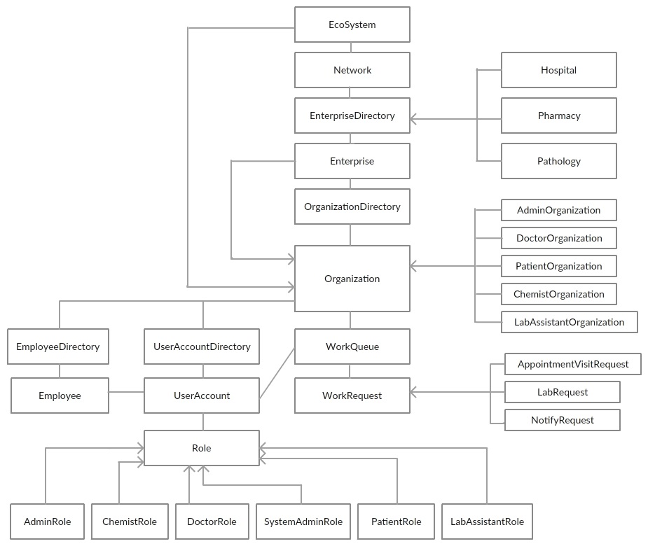
Object Model

Slide 6
FLOW
There will be separate logins for receptionists, doctors, chemists, pathology lab assistants and patients.
Account will be created for patients at the time of registration. Patients will log-in to book appointments with the doctor of particular specialization.
As per the schedule, patient goes to see the doctor and doctor prescribes drugs and tests that is required by the diagnosis he made on patient’s illness. Doctor will send the e-prescription to the pharmacy (of patient’s choice) and also will send one to the pathology lab (of patient’s choice) for referencing patient.

Slide 7
FLOW (CONT..)
The drugs will be collected by patient once they are ready to pick up from the store. For the tests, patient will log into his account and see the lab schedule for different tests. He will select a time and go to lab.
The test result from lab, updated by the lab assistant, will be electronically sent to the doctor and an alert will be sent to the patient that doctor has received his reports. He may call doctor and doctor will let him know if patient needs to visit him for follow up and test results.
Again, patient will schedule appointment with doctor for follow up through their log-in. Any further changes in the profile of patient can be made like updating what tests has been done and what was the result.

Slide 8
Key Entites/Roles
Patients
Hospital Receptionist (Hospital)
Doctors (Hospital)
Chemists/Pharmacists (Pharmacy)
Pathology Receptionist (Pathology)
Pathology lab Assistants (Pathology)

Slide 9
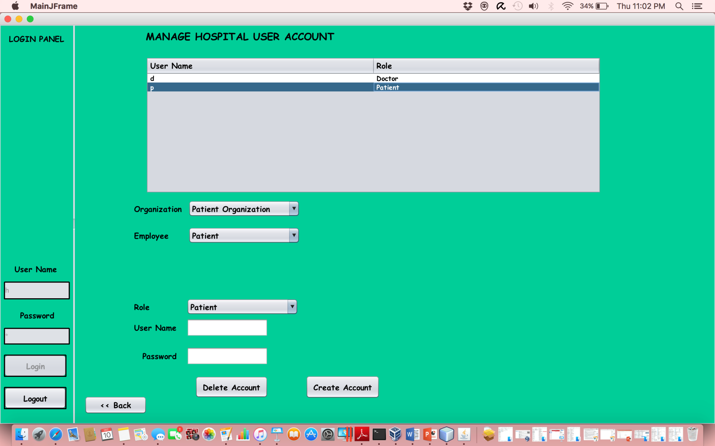
Screenshot

Slide 10
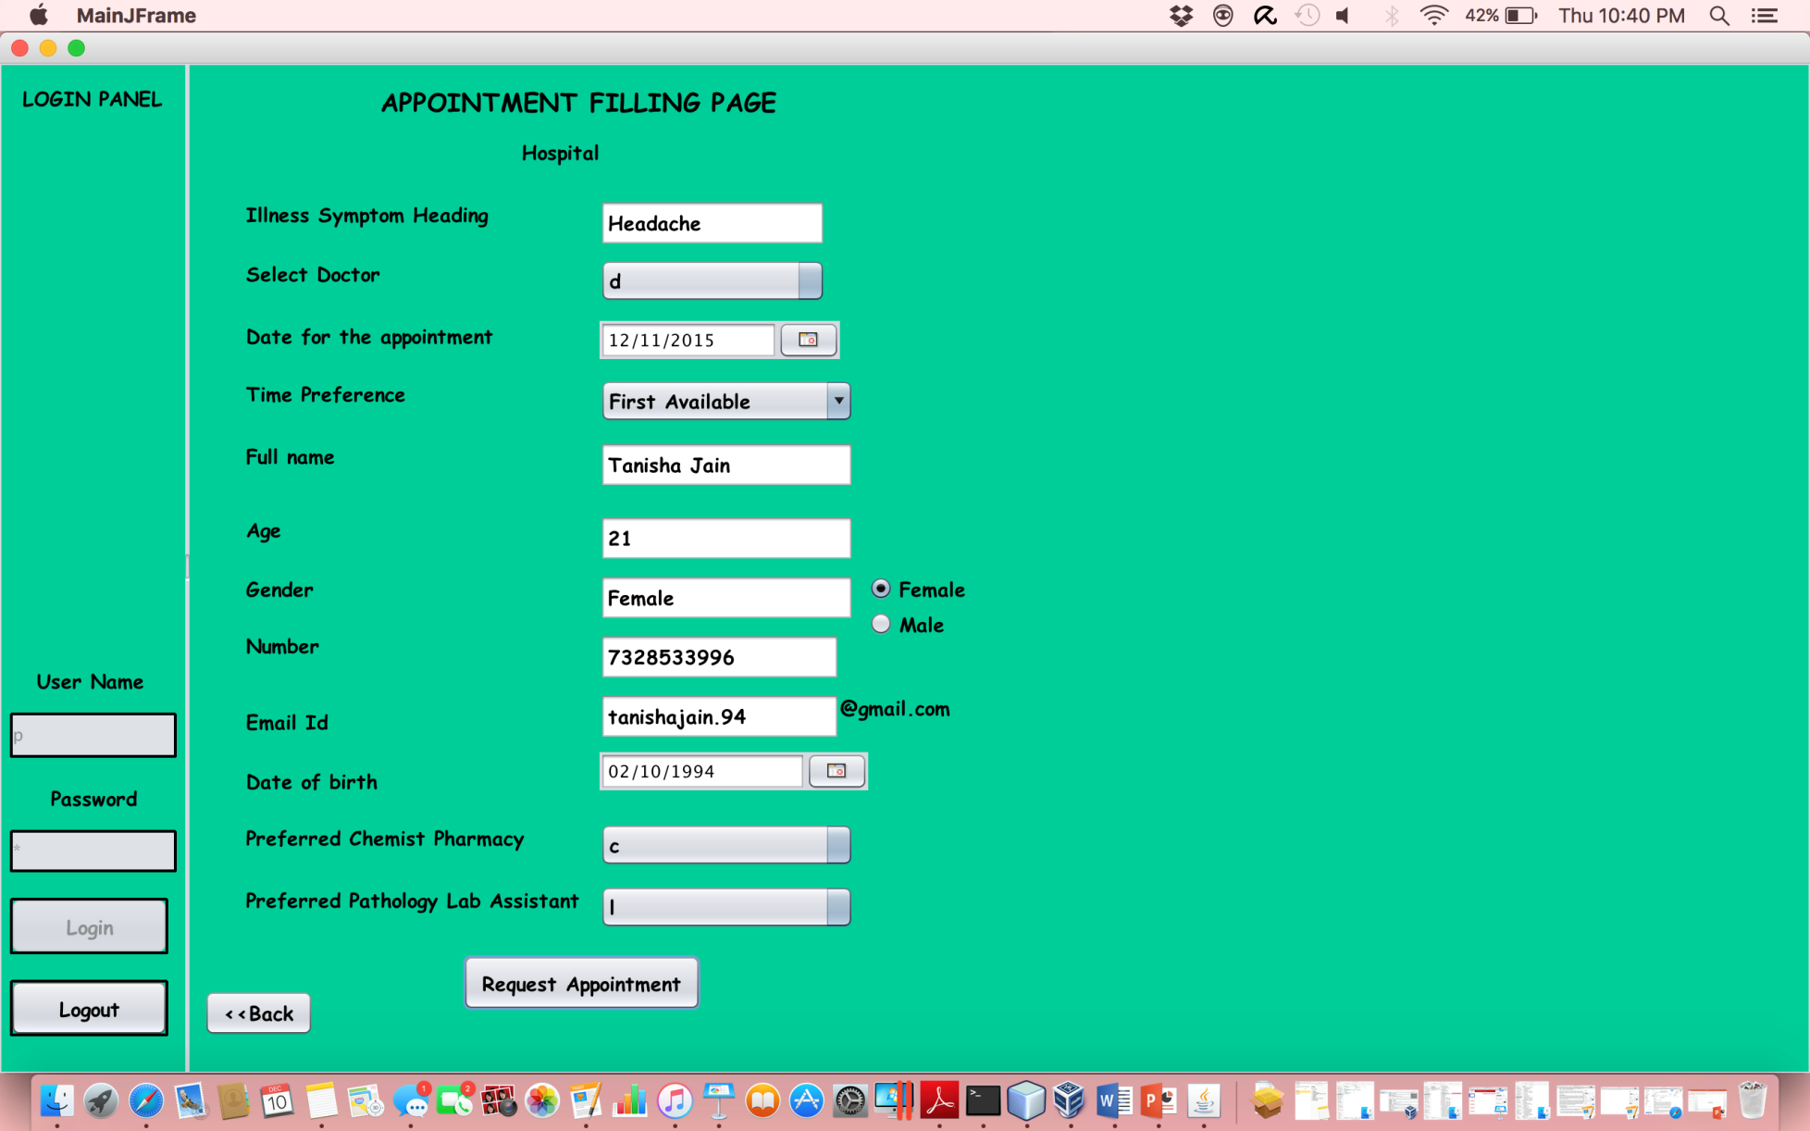
Screenshots

Slide 11
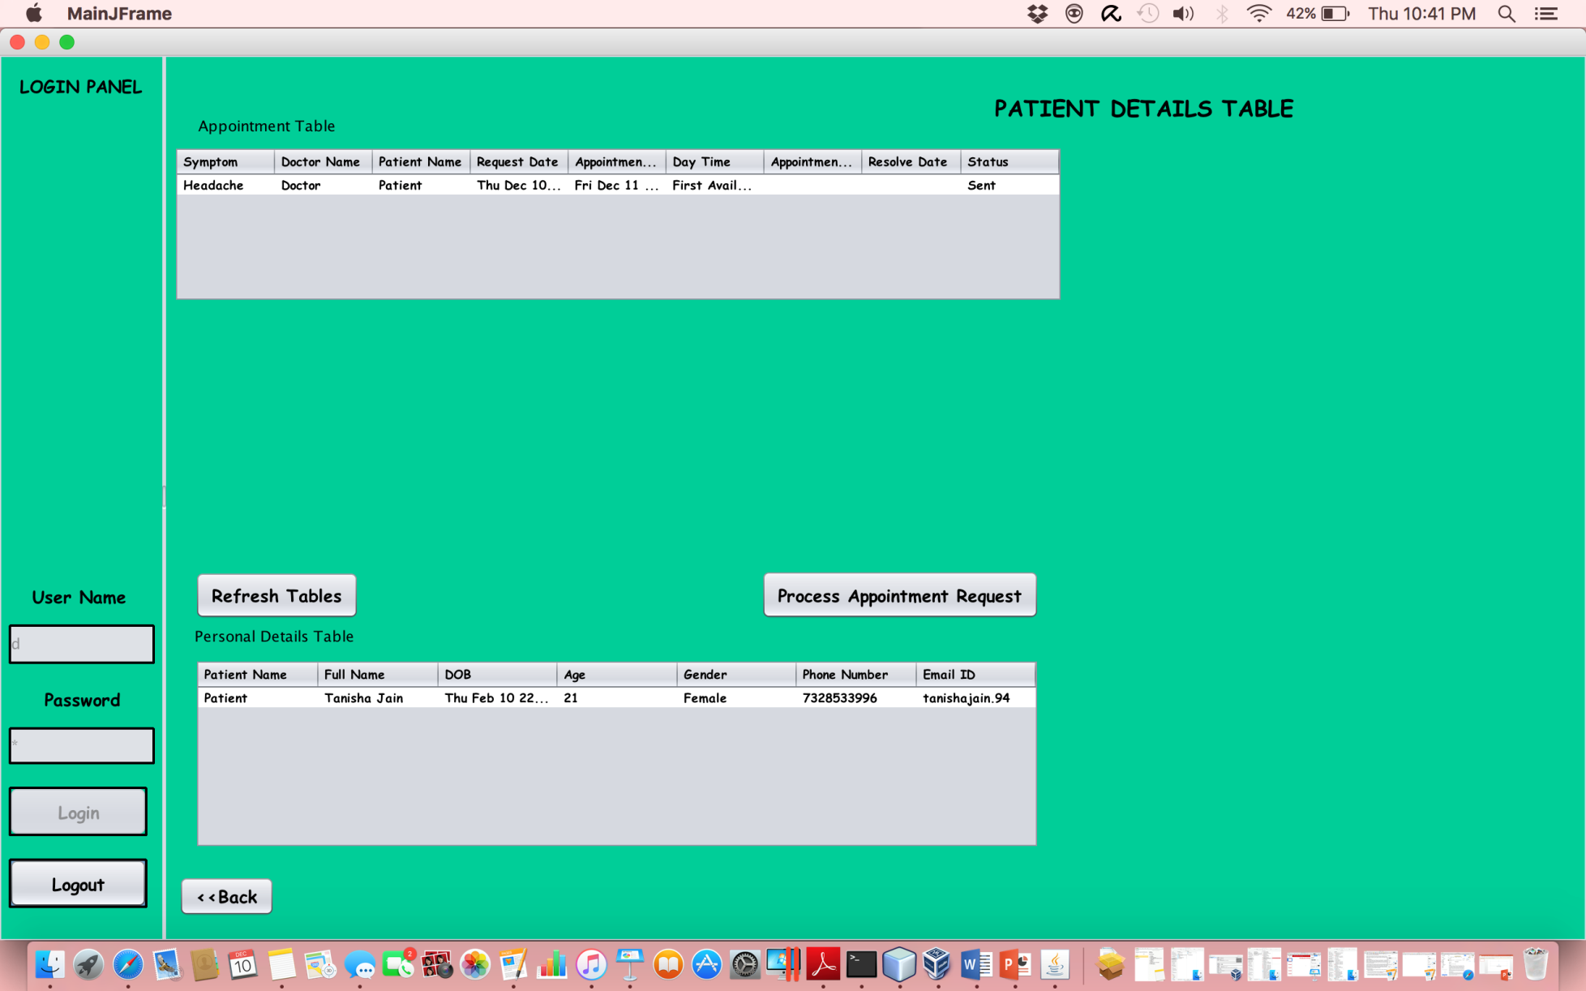
Screenshot

Slide 12
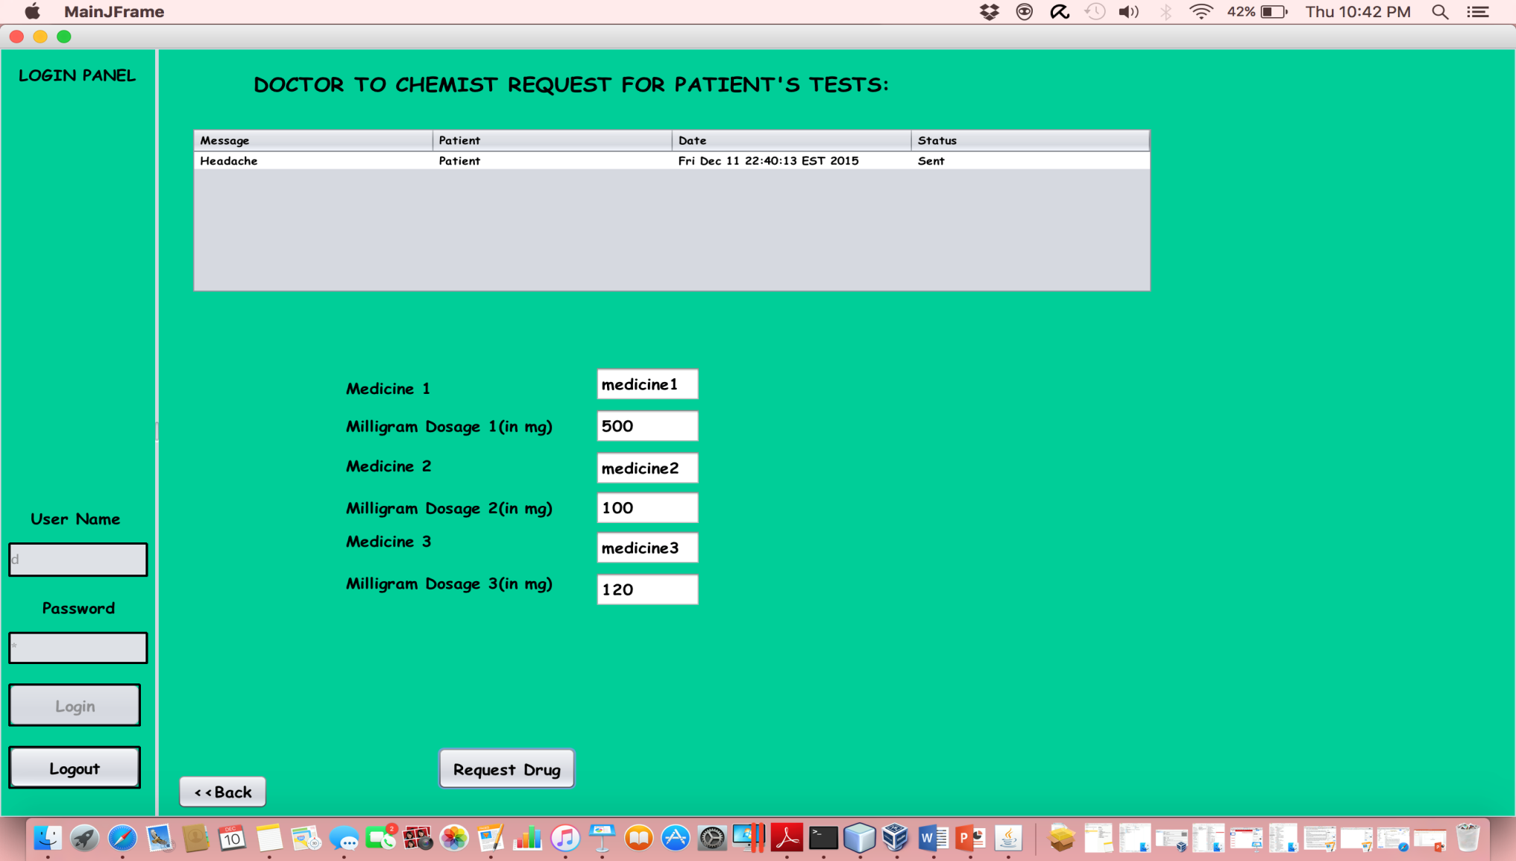
Screenshot

Slide 13
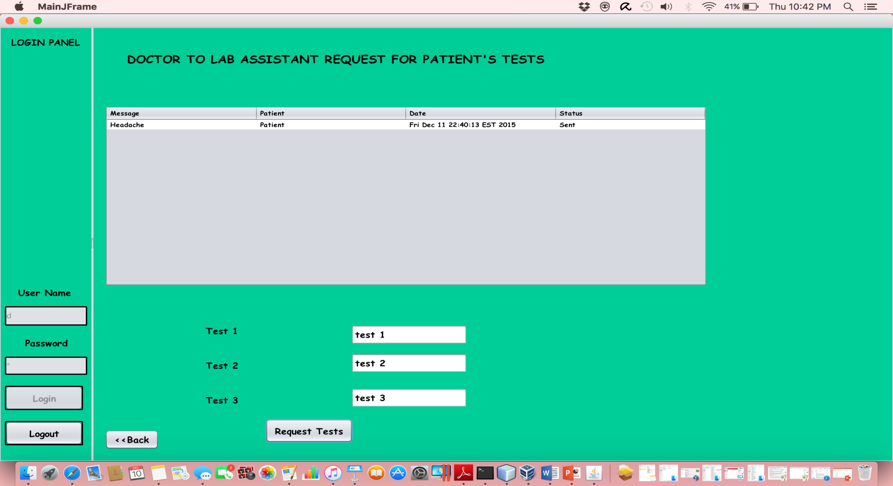
Screenshot

Slide 14
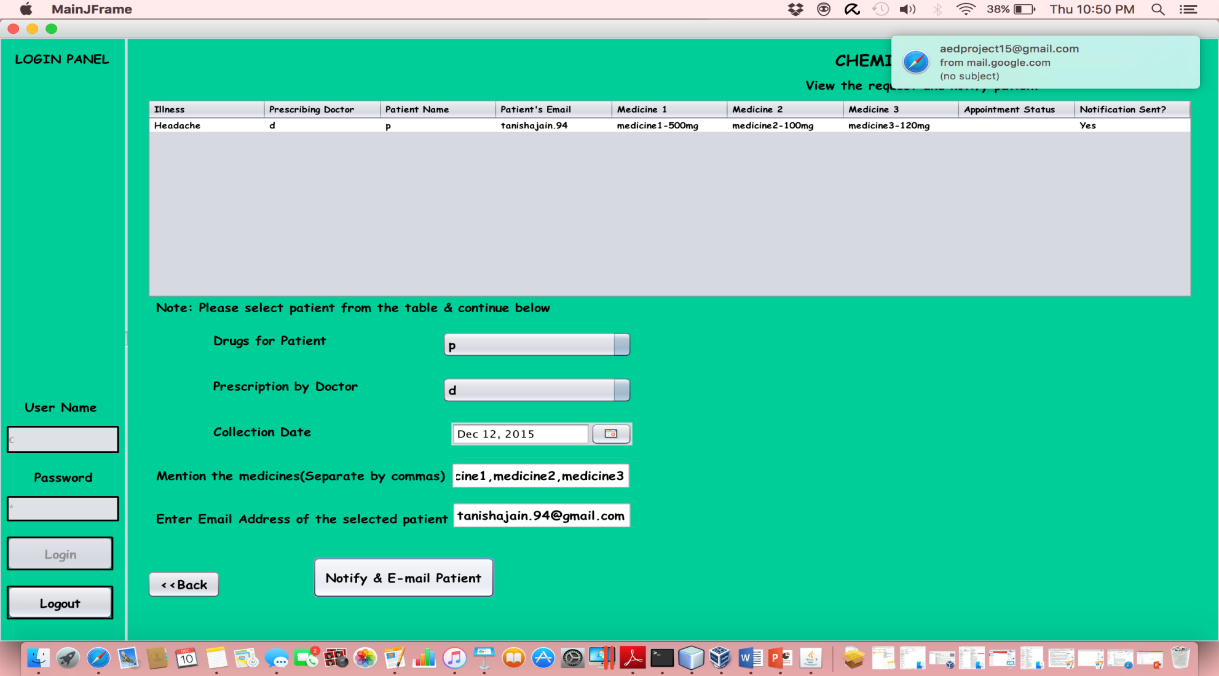
Screenshot

Slide 15
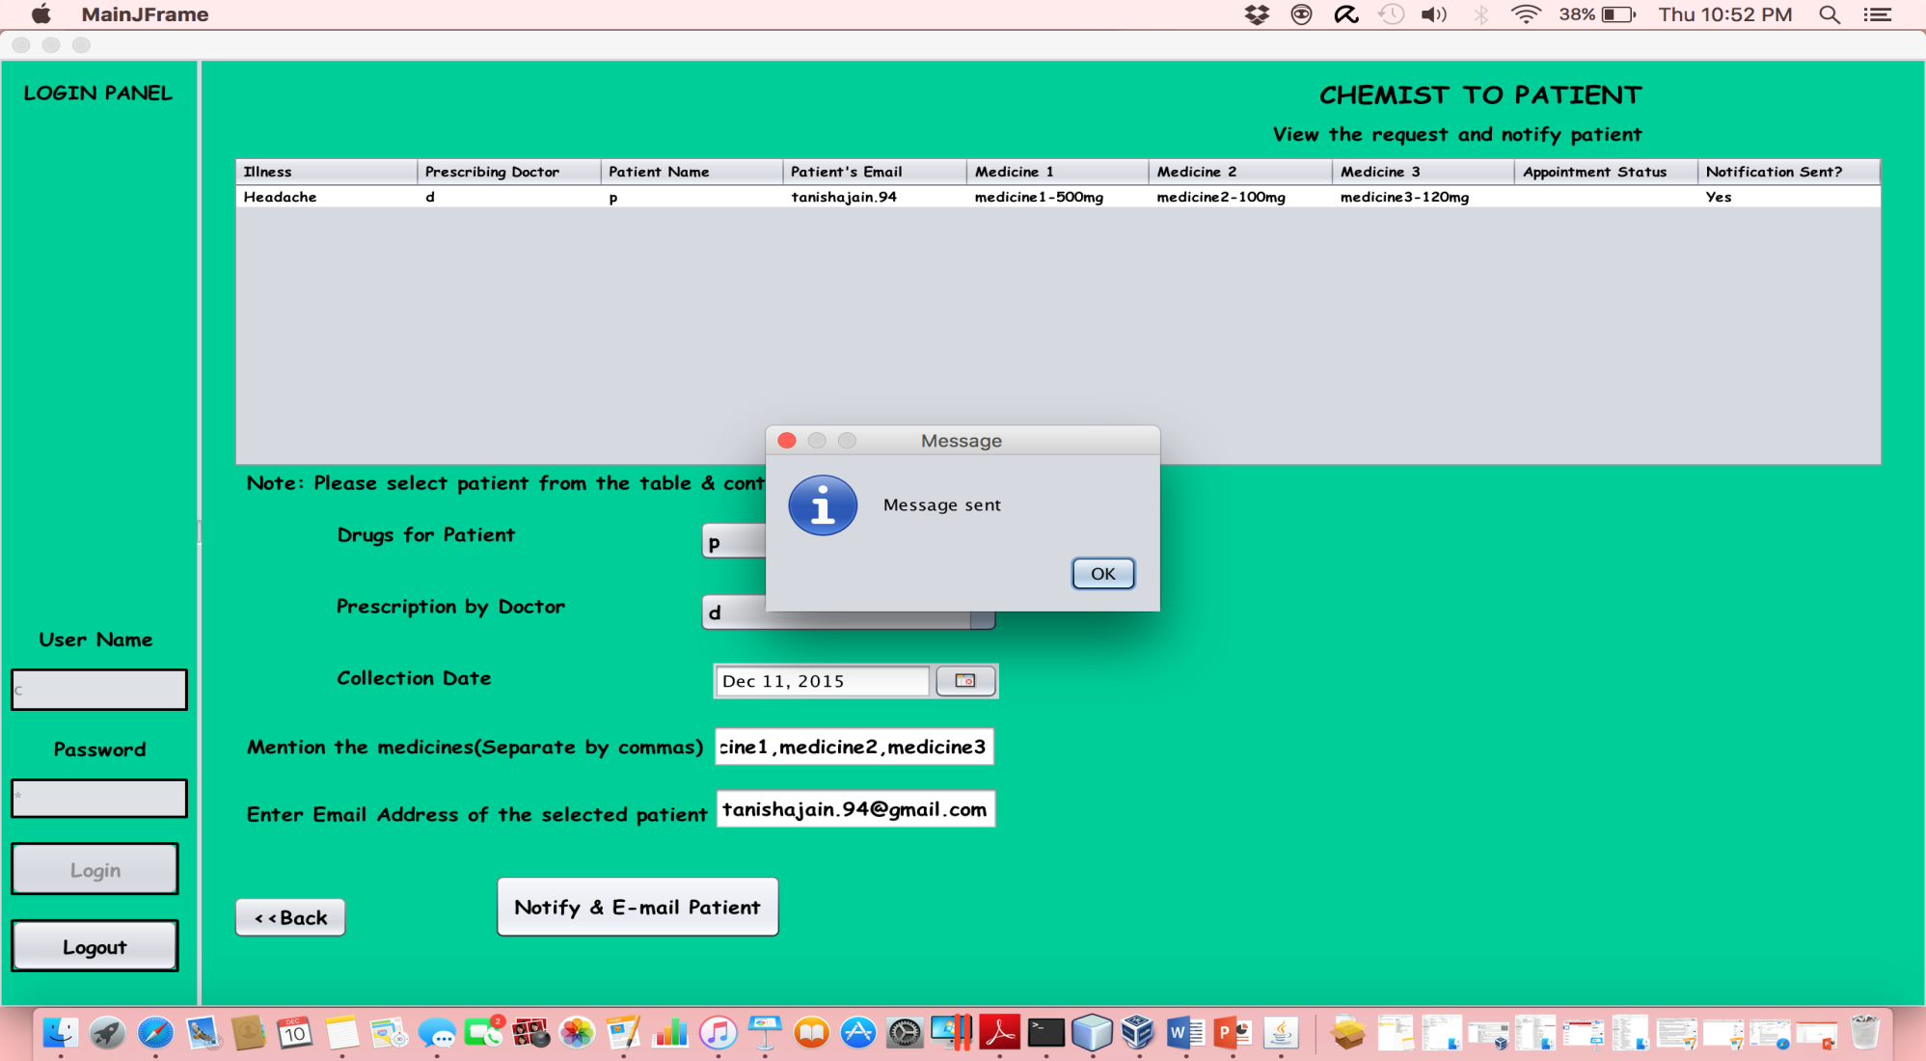
Screenshot

Slide 16
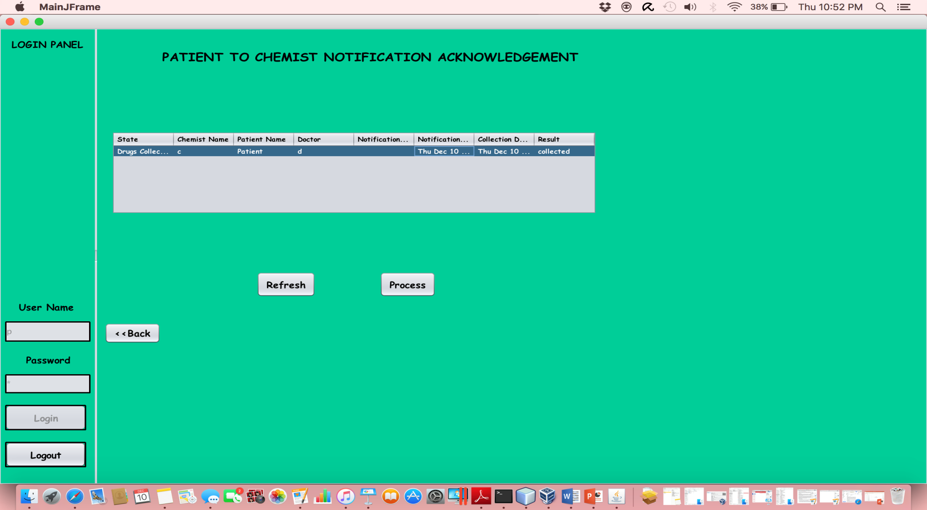
Screenshot

Slide 17
Thank You

Slide 18

Questions

