Slide 1

DEPARTMENT OF COMPUTER ENGINEERING
GRE-AT
Student name:Komal Mahesh Chitnis Roll no:26 Division:A
Student name:Jainam Kirtikumar Gala Roll no:42 Division:A
Student name:Dhruvil Gandhi Roll no:43 Division:A

Slide 2
Problem statement
In modern times, Education is on an ever expanding scale, which is why for many education doesn’t stop at graduation they tend to go for further studies i.e Post Graduation. In order to get admission in foreign universities for post graduation, students need to appear for competitive examinations such as GRE (Graduate Record Examinations) The results of these competitive examinations play a crucial role for getting admission in such universities, which is why students need help inorder to get prepared for the exam and figure out which university is the best for them according to their results.
Nowadays, students find it difficult to find sample papers or mock exams online. Also after solving these sample papers or mock tests students find it difficult to figure out their weak subjects and strong subjects and prepare accordingly. It is also difficult for students to figure out the best university which they can get an admission in according to their scores. Our application will provide user with a sample mock test based on GRE and they will get their score and they can figure out their weak subjects according to the result graphs which will be made by plotly library, If the user has already appeared for the examination they can also input their results and these scores will be inputted in our ML model which will use linear regression algorithm to show output in the form of a linear progression graph which will show the chances in percentage of the user to get an admission into the Universities which will be ranked as Rank 1, Rank 2, etc.
GRE-AT

Slide 3
Objective
To Help Users to get an idea about the Top Rank Universities and their chances of getting admission according to their Quiz Scores.
To create a quiz application where users can solve gre questions which will generate scores at the end
To Help Students to Analyze their Quiz Results so that they can figure out their weak skills and work on them accordingly.
To deploy this project on cloud using its various services.
GRE-AT

Slide 4
Scope
The Scope of this project can be very wide as there are other entrance examinations which can be included for taking admission for post-graduation in universities worldwide
We can integrate different language proficiency tests like IELTS, TOEFL, etc. in our quiz module and allow students to prepare for the quiz by creating a Learning module where we can provide video Lectures and PDF’s for the particular test.
We can also provide a module which can allow students to analyze their results through graphs and various other analysis algorithms
Features
Result Analysis
Quiz
List out colleges with their respective rankings
GRE-AT

Slide 5
GRE-QUIZ basic idea
You receive one point for each question you answer correctly in Verbal or Quant. These points will be added up to get your raw score (0-40) for each section. Your raw scores will then be converted to scaled scores (130-170) which take into account both adaptive testing and equating.
So, if you answered 30 Verbal questions correctly, you may, for example, get a final Verbal score of 157 if you had an easier exam and/or you scored low enough on the first Verbal measure to get easier questions in the second measure. Or, you could answer 30 Verbal questions correctly and get a score of, say, 162 if your GRE was harder and/or your second measure was adapted to have more challenging questions. On your GRE score report, you’ll only see your final scaled scores, so you won’t know how equating or adaptive testing affected your final GRE score breakdown.

Slide 6
List of Modules
Collecting and Cleaning the dataset
Choosing appropriate algorithm
Implementing the machine learning model
Serving the model on a website
Creating a quiz website
Linking quiz website and prediction

Slide 7
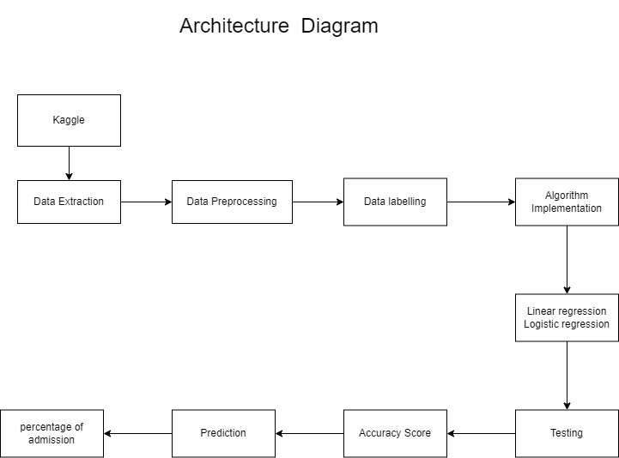

Slide 8
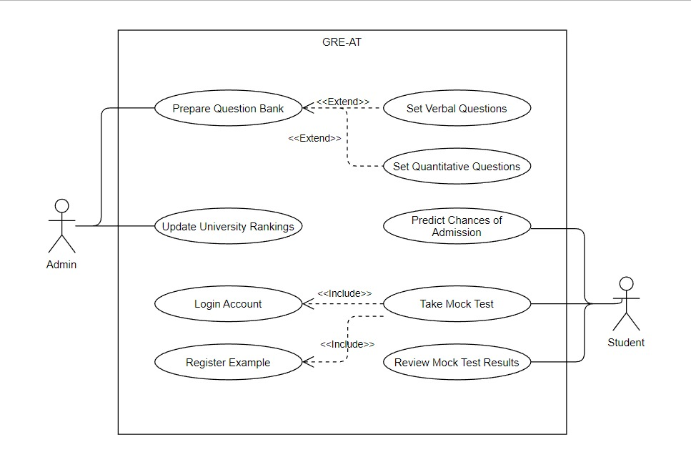
USE CASE DIAGRAM

Slide 9
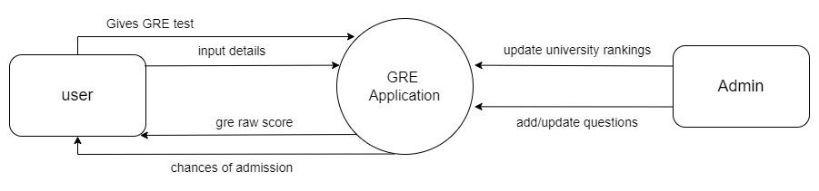
DFD level 0

Slide 10
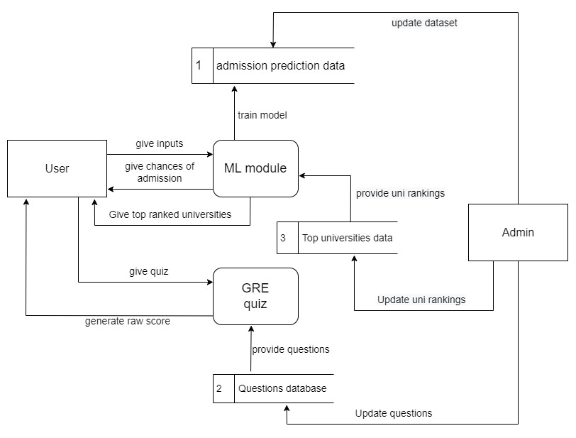
DFD level 1

Slide 11
Implemetation Technology
Technology Stack-
React-Js
Python/Flask
Css3/HTML5
Numpy/pandas
ScikitLearn
Plotly
Use AWS cloud services and intuitive user interface with a focus on user-centered design
GRE-AT

Slide 12
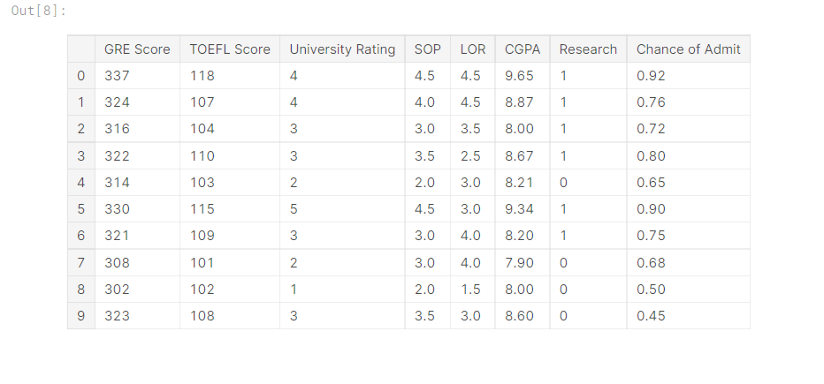
Modules Completed
Collecting and Cleaning the dataset
The dataset was found on Kaggle which is having 400 entries and 8 columns. This dataset is created for prediction of graduate admissions and the dataset is shown below
Chance of admit is the target column and the rest are attributes.

Slide 13
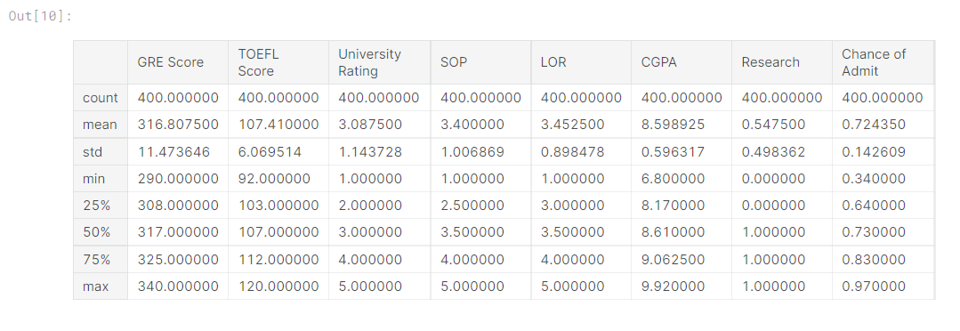
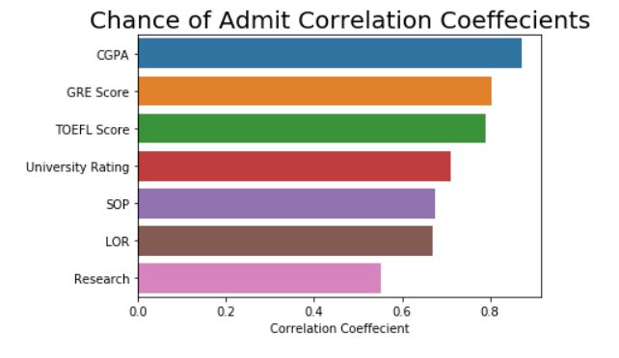
Modules Completed
These are some statistics of the data. Corelation coefficients of all the columns with respect to the target column were studied

Slide 14
Modules Completed
Choosing appropriate algorithm and implementing the ML model
Linear regression was used to train the ML model. CGPA, GRE Score and TOEFL score are the 3 top attributes which have the most impact on the chance of admission positively. This algorithm is giving 80 percent accuracy currently with 80 20 train test split

Slide 15
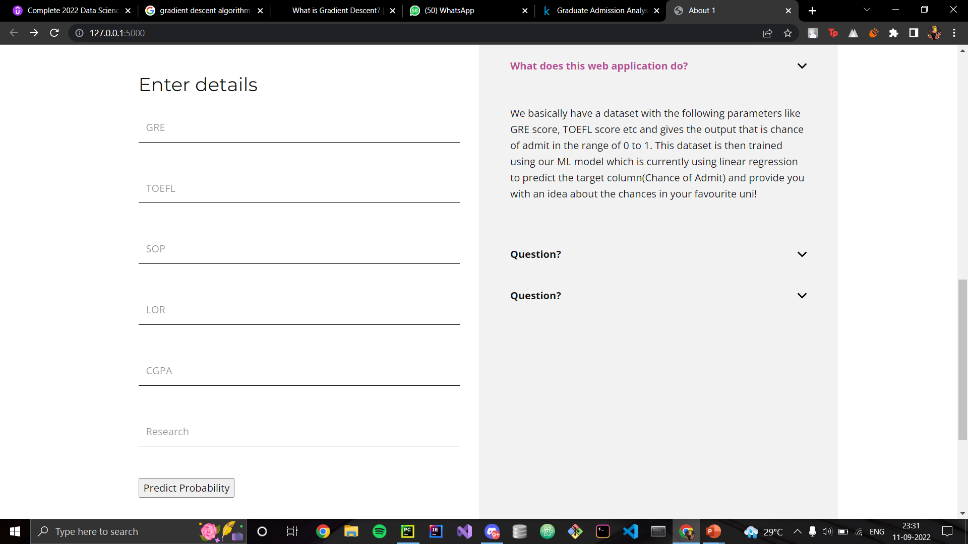
Modules Completed
Serving the model on a website
The trained model is stored in a .pkl file to reduce website load times and the model doesn’t have to rerun each time an user requests for prediction.

Slide 16
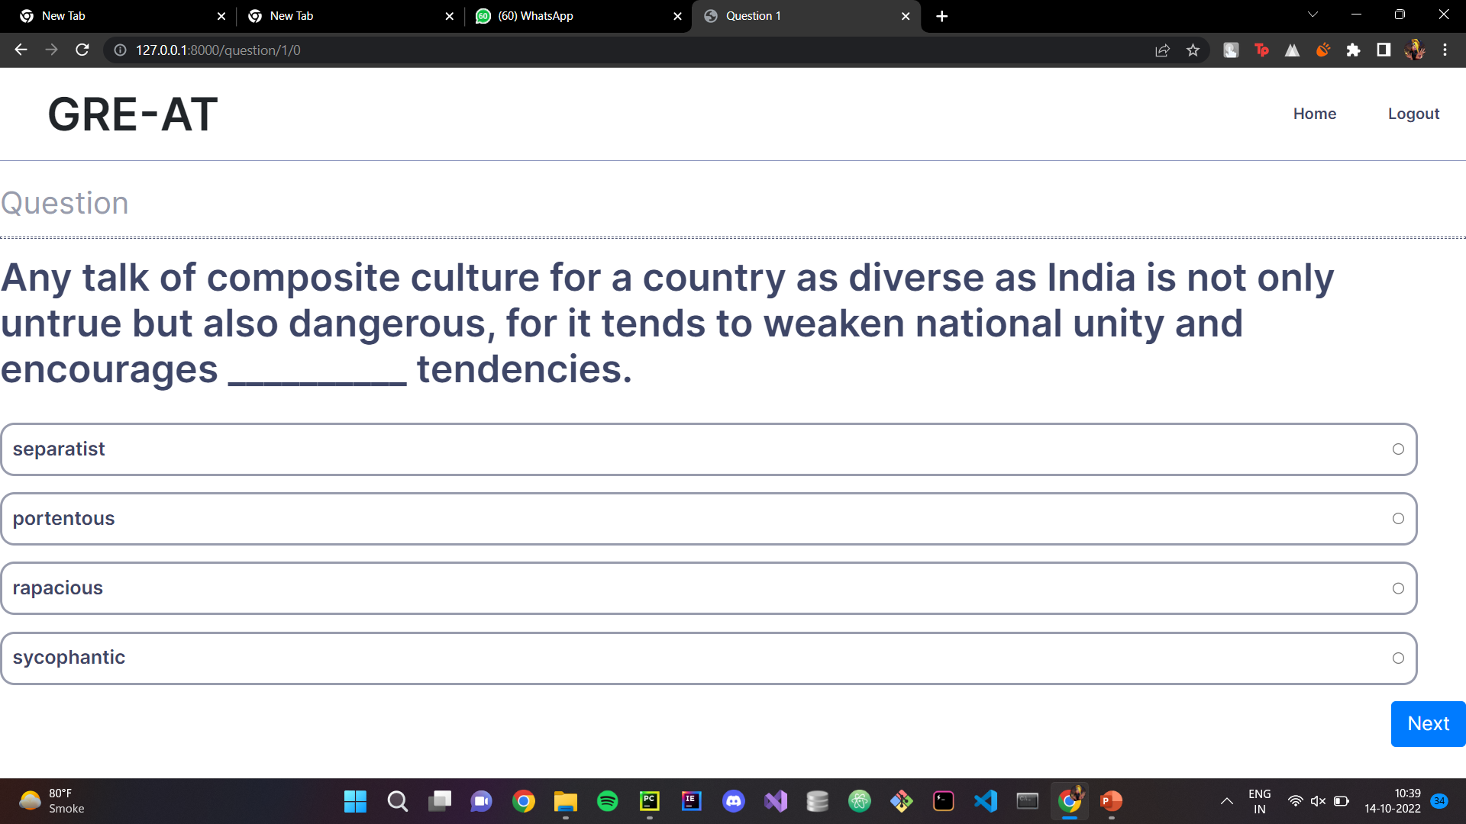
Modules Completed
Quiz module

Slide 17
References 1
Ghadge Vrushali, Koli Jyoti D, Koli Namrata A, Koli Shital S “Student Progress Report, Result Analysis& Time Table Generation” International Research Journal of Engineering and Technology (IRJET), Volume: 03 Issue: 02, February2016
https://www.irjet.net/archives/V3/i2/IRJET-V3I2141.pdf
GRE-AT

Slide 18
References 2
Nakul Sharma, Sonali Dake, Riddhi Panchale, K. S. Charumathi,"Student Result Analysis System ", International Research Journal of Engineering and Technology (IRJET),Volume 09 Issue 4 Apr 2022
https://www.irjet.net/archives/V9/i4/IRJET-V9I4458.pdf
GRE-AT

Slide 19
References 3
Prof. Sanjay Kadam, Bhavana Jadhav, Saylee Molawade, Saloni Patil ,"Student Performance Analysis System for Higher Secondary Education ",IRJET, Volume: 06 Issue: 04, April 2019
https://www.irjet.net/archives/V6/i4/IRJET-V6I4704.pdf
GRE-AT

Slide 20
References 4
Anurag Sharma, Nikhil Gupta, Anamika Tripathi, Monica Sehrawa “Student Result Analysis and Performance Report Generator”, International Research Journal of Engineering and Technology (IRJET), Volume: 06 Issue: 04, April 2019
https://www.irjet.net/archives/V8/i4/IRJET-V8I4700.pdf
GRE-AT

